Slide 1
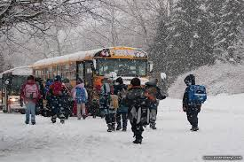
Snow Storm Table Top Exercise for Schools
https://www.mtwp.net/wp-content/uploads/2016/09/Emergency-closing.jpg

Slide 2
Agenda
Introductions
Today’s Tabletop Scenario
Discussions
Hot Wash (Debrief)
Action Planning
Closure

Slide 3
Rules of the Road
Creativity/Group Problem Solving
Use the knowledge and information available in the room.
Active Thinking
Active Listening
Active Participation
Respect – challenge ideas, not people
Reality Check – make the exercise real for you.
https://opimedia.azureedge.net/-/media/images/men/editorial/blogs/natural-health/new-years-revolution-throw-out-your-rule-book/fotolia42640553subscriptionxxl.jpg

Slide 4
Guidelines (continued)
The facilitator will serve as the exercise referee and provide any official interpretation of the exercise rules.
From time to time, there will be injections into the scenario. These are intended to further assess response to the exercise scenario.
This is designed to be a learning experience for all.
https://mgrush.com/blog/wp-content/uploads/2015/08/support-for-arguments.png

Slide 5
Objectives
To evaluate policies and procedures… your plan.
To evaluate command and control including communications procedures.
To identify resources needed vs. available.
To identify training needs.
To identify needed improvements and create an action plan to address those needs.
https://www.smartsheet.com/sites/default/files/styles/media_thumbnail/public/ic-og-PoliciesandProcedures-FacebookLinkedIn.jpg

Slide 6
https://media.giphy.com/media/bhFMbDZpU1Cuc/giphy.gif
So lets get started………………………….

Slide 7
Late Monday evening, the media issue this warning: "An ice storm warning has been issued for your area this means severe winter weather conditions are imminent or occurring. Significant amounts of ice accumulations will make travel dangerous or impossible. Travel is strongly discouraged. If you must travel keep an extra flashlight, food and water in your vehicle in case of an emergency. Ice accumulations may lead to snapped power lines and falling tree branches that add to the danger."
Scenario
The Day Before

Slide 8
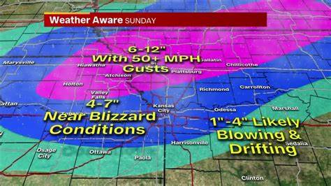
Scenario The Start
The night and early morning are quiet, but cold. Your Tuesday school day begins normally.
Around 9:30-9:45 a.m. on Tuesday morning, snow flurries begin. The students are excited! They love snow.
You hear from the National Weather Service that this is a fast moving storm coming quickly down from the north.
https://th.bing.com/th/id/OIP.1V6k3kFSXyPhysfEw-NbKwHaEK?pid=Api&rs=1

Slide 9
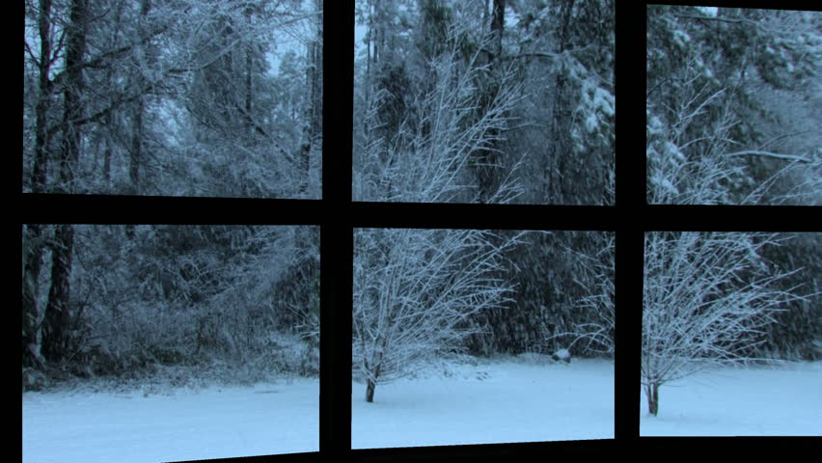
Questions………
Based on this much information,
What are your immediate concerns?
What initial actions should you take?
What have you done to this point?
What should you do next?
Who do you contact?
http://il2.picdn.net/shutterstock/videos/1679167/thumb/1.jpg?i10c=img.resize(height:72)

Slide 10
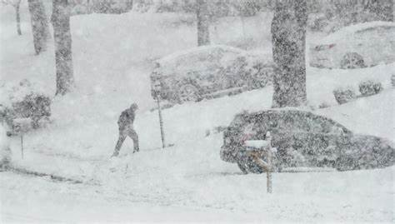
Inject #1 1:00 p.m.
By now, this has become a major wind and freezing rain storm.
Winds are reaching 75-80mph.
The snow continues to fall; temperatures drop to 20 degrees.
The snow is turning into freezing rain and has made travel treacherous in most areas.
Your power fluctuates. You hear that there are already some places without power.
https://th.bing.com/th/id/OIP.qqvVlODJO1MrPb-xOiBztwHaEN?pid=Api&rs=1

Slide 11
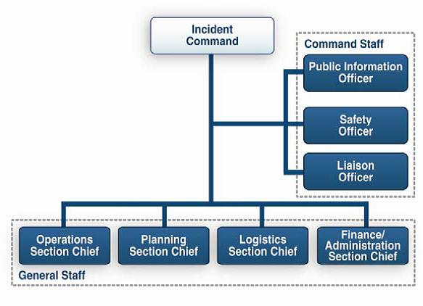
Questions……………
What does your EOP/Crisis Plan call for?
What are you going to do?
What actions will you take?
Do you need to activate your school incident command at this point? (Do you have one in place?)
https://aneskey.com/wp-content/uploads/2016/06/c28f002.gif

Slide 12
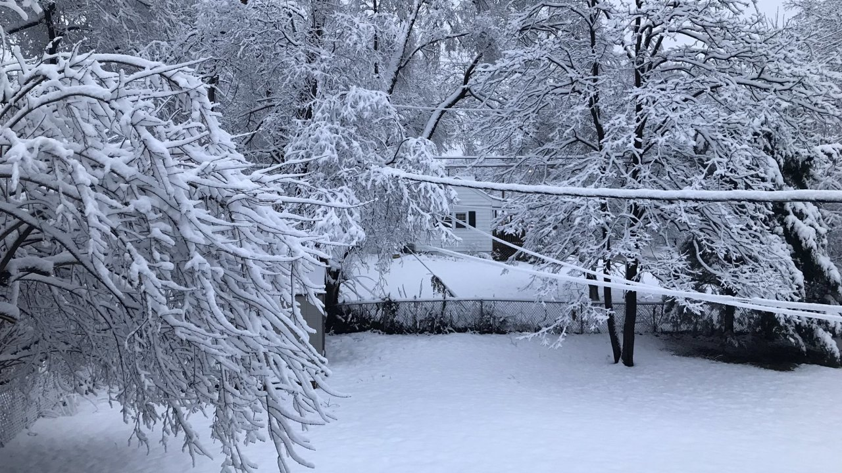
Inject #2 2:30 P.M.
By now, there are 3-4 inches of snow and ice in most places.
The snow and freezing rain continue.
With the weight of the snow and ice, trees and branches are already breaking and falling around campus.
You can see accumulation of Ice and snow across power lines and roads. You know that it is all but impossible for your buses to run.
The news reports that trees and limbs continue to break and damaging power lines, resulting in power outages.
You still have power, but you are not sure how much longer it will be on.
Due to power outages and downed cables, internet service is seriously degraded and intermittent at best.
https://ewscripps.brightspotcdn.com/dims4/default/0aa581f/2147483647/strip/true/crop/2048x1152+0+237/resize/1280x720!/quality/90/?url=https%3A%2F%2Fewscripps.brightspotcdn.com%2F83%2F46%2Fbb8834ab42c798acbdcdb8f065e6%2Fdwtwj7quwaaugpu.jpg

Slide 13
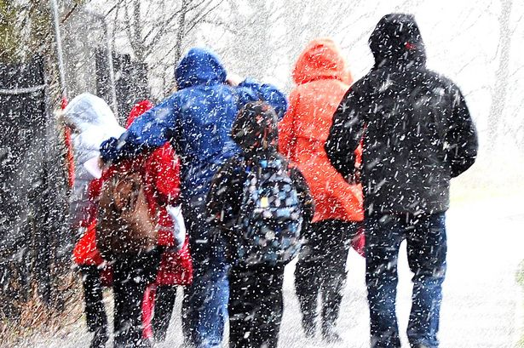
Inject #2 (Continued)
Cell service is still functional but spotty.
You have gotten frantic calls from a few families which were able to get through.
Some parents have managed to get to school to pick up their children.
The only way that they can leave is to walk through the storm.
You realize that your remaining students and staff are very likely going to have to stay at school for the duration of the storm.
https://i2-prod.mirror.co.uk/incoming/article7080978.ece/ALTERNATES/s1200/People-walking-in-the-snow-in-Stirling.jpg

Slide 14
Questions……………
What actions should you take based on this realization?
How will you tell those parents who came to school?
How will you notify others?
What will you tell them?
Does your safety plan have contingencies for such a situation?
http://cdn.xl.thumbs.canstockphoto.com/canstock21611884.jpg

Slide 15
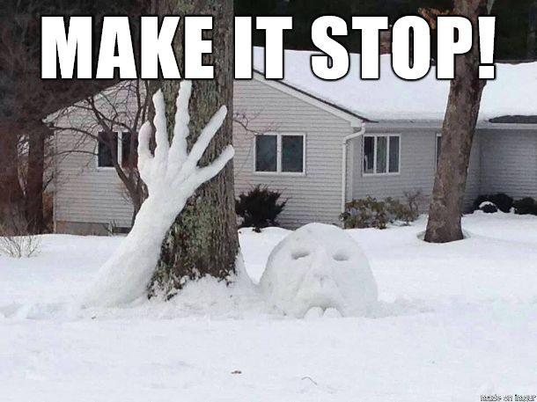
Questions……
What actions should school personnel take based on the information from the NWS?
Knowing that you will have students, staff and potentially parents, what is your back-up plan?
What do you do about staff who want to leave to be with their own families?
https://i.pinimg.com/736x/56/0f/2c/560f2ca6496fa01ae2650a3fd059c29e--john-collins-snow-sculptures.jpg

Slide 16
Questions………………..
When possible, how will you ensure that everyone (including students, parents, and staff) is accounted for?
What is your reunification plan?
What further actions will you take?
What additional contingencies must you now prepare for?
Will you need to address long-term recovery?
https://grid.gograph.com/family-silhouette-stock-illustration_gg55942698.jpg

Slide 17
Hot Wash
How well did your EOP/Crisis Plan operate and what actions will you take toward improvement?
If you did have an Incident Command Team in place what actions will you take toward improvement?
If you have no IC Team, would you consider having one in place, and if yes how do we train them.
How well did your Communications Plan operate and what actions will you take toward improvement?
http://keystosaferschools.net/images/products/759.png

Slide 18
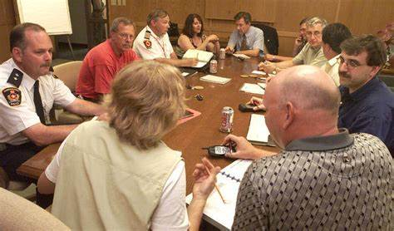
Hot Wash (Cont.)
What can be done to improve school safety & security operations?
What internal district-level offices were required to work together in this scenario?
What external agencies did find out you needed to work with in this scenario?
Are all necessary agreements in place to facilitate cooperation among agencies?
https://th.bing.com/th/id/OIP.46TDLbN4AqM2LlfHBXD2HAHaEW?pid=Api&rs=1

Slide 19
After Action Plan
Lessons Learned:
For an improved action plan, consider what
you will:
Keep Doing ______
Stop Doing ______
Do Differently _________
Start Doing ______
http://blog.cayenneapps.com/wp-content/uploads/2015/01/Lesson-learned-from-the-MVP-building.png

Slide 20
Conclusion
What is your biggest take away today ?
https://www.westernseminary.edu/transformedblog/wp-content/uploads/2012/04/bridging-the-gap.jpg

