Slide 1


Severe Weather Tabletop Exercise For Schools
https://www.fema.gov

Slide 2
Severe Weather
Severe weather can happen anytime, in any part of the country. It can include hazardous conditions produced by thunderstorms, including damaging winds, tornadoes, large hail, flooding and flash flooding, and winter storms associated with freezing rain, sleet, snow and strong winds.
Understand the type of hazardous weather that affects you and your school based on where you live.
This tabletop exercise will help you and your school develop, review, and improve your safety/preparedness plan.
So lets get started!………..

Slide 3
Objectives:
This tabletop exercise will help your organization also identify strengths and weaknesses in the following areas:
FACILITIES: Structural maintenance considerations; safe rooms/designated shelter areas; back-up power supplies; supplies for staying on-site; accessibility considerations; and emergency repairs.
HUMAN RESOURCES POLICIES: Employee notification and alerts; early release/telework policies; flexible work schedules; payroll and insurance policies; employee insurance policies; employee/family reunification procedures; employees trained in first-aid with access to medical supplies; and capacity to ensure accessibility for individuals with disabilities or access and functional needs.

Slide 4
Objectives cont.
CONTINUITY OF OPERATIONS PLANS: Plans to operate at an alternate location; access to important data; roles and responsibilities; insurance policies; supplier and customer relationship management; and plans and processes to resume operations.
EMERGENCY OPERATIONS PLANS: Ability to provide critical information and updates during the emergency through multiple notification systems; guidance on how to protect critical assets; plans to provide first aid; and protocols for communicating with local first responders and critical infrastructure providers.

Slide 5
Tornado Exercise: Scenario
Monday, 12:23 p.m.: The National Weather Service (NWS) has issued a Tornado Watch for your area. A large line of powerful thunderstorms is approaching your area and conditions are favorable for tornadoes to develop.

Slide 6
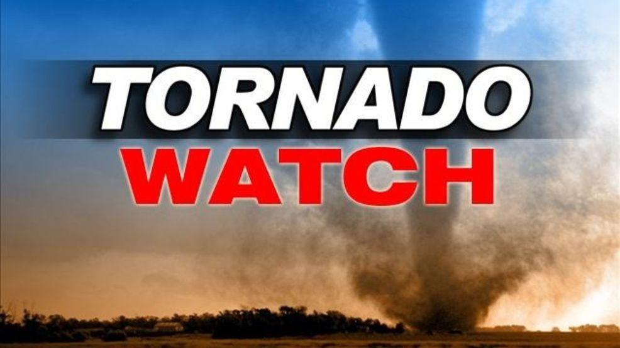
Questions…..(Scenario)
Who in the school is responsible for monitoring or would likely hear or receive a bulletin or alert from the NWS or other alerting authority? How would they receive this information?
What information are you sharing with your staff/students/volunteers at this time?
What are the current process and communications platform(s) used to notify staff of potential threats or hazards, including those who are out of the building?
When you hear that a Tornado Watch has been issued, what are your immediate concerns?
What, if any, decisions should be made at this time? Who can make those decisions (name, position/role)?
https://bloximages.chicago2.vip.townnews.com/jacksonvilleprogress.com/content/tncms/assets/v3/editorial/c/dc/cdcc1b48-098b-11e9-b7e7-e77e56ad1783/5c244e58b2733.image.jpg?resize=986%2C555

Slide 7
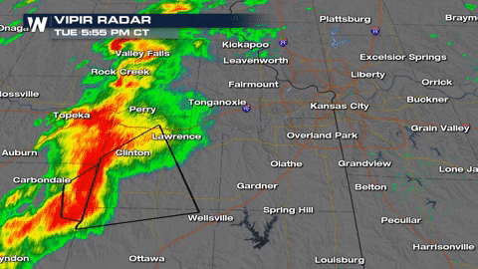
Tornado Exercise…..Inject #1
1:05 p.m.: A large tornado, initially thought to be an Enhanced Fujita (EF) scale EF3, has touched down approximately 10 miles south of your community.
The NWS reports that the storm system responsible for this tornado is headed directly toward your area and has issued an immediate Tornado Warning for your community and the surrounding area.

Slide 8
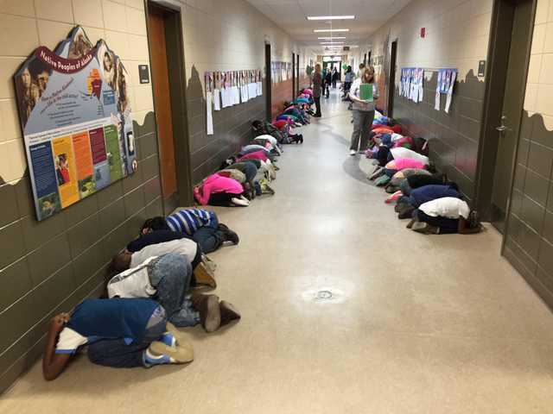
Questions…..(Inject #1)
Based on this updated information, how have your concerns changed? Do you have any new concerns?
What and how is your school communicating about the Tornado Warning staff/parents/students/volunteers at this time?
Are there identified locations where people should go in the event of a tornado?
Does all staff/volunteers know where they are and what to do?
https://statesboroherald.cdn-anvilcms.net/media/images/2018/09/18/images/Tornado_Drill_1.max-1200x675.jpg

Slide 9
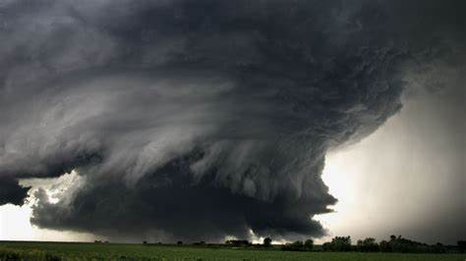
Tornado Exercise….Inject #2
1:18 p.m.: A large tornado touches down in the outskirts of your community near a highly populated neighborhood. You hear a loud rumbling noise, the power goes out, and the building begins to vibrate. You hear the sound of breaking glass and flying debris. The sound intensifies and then gradually fades

Slide 10
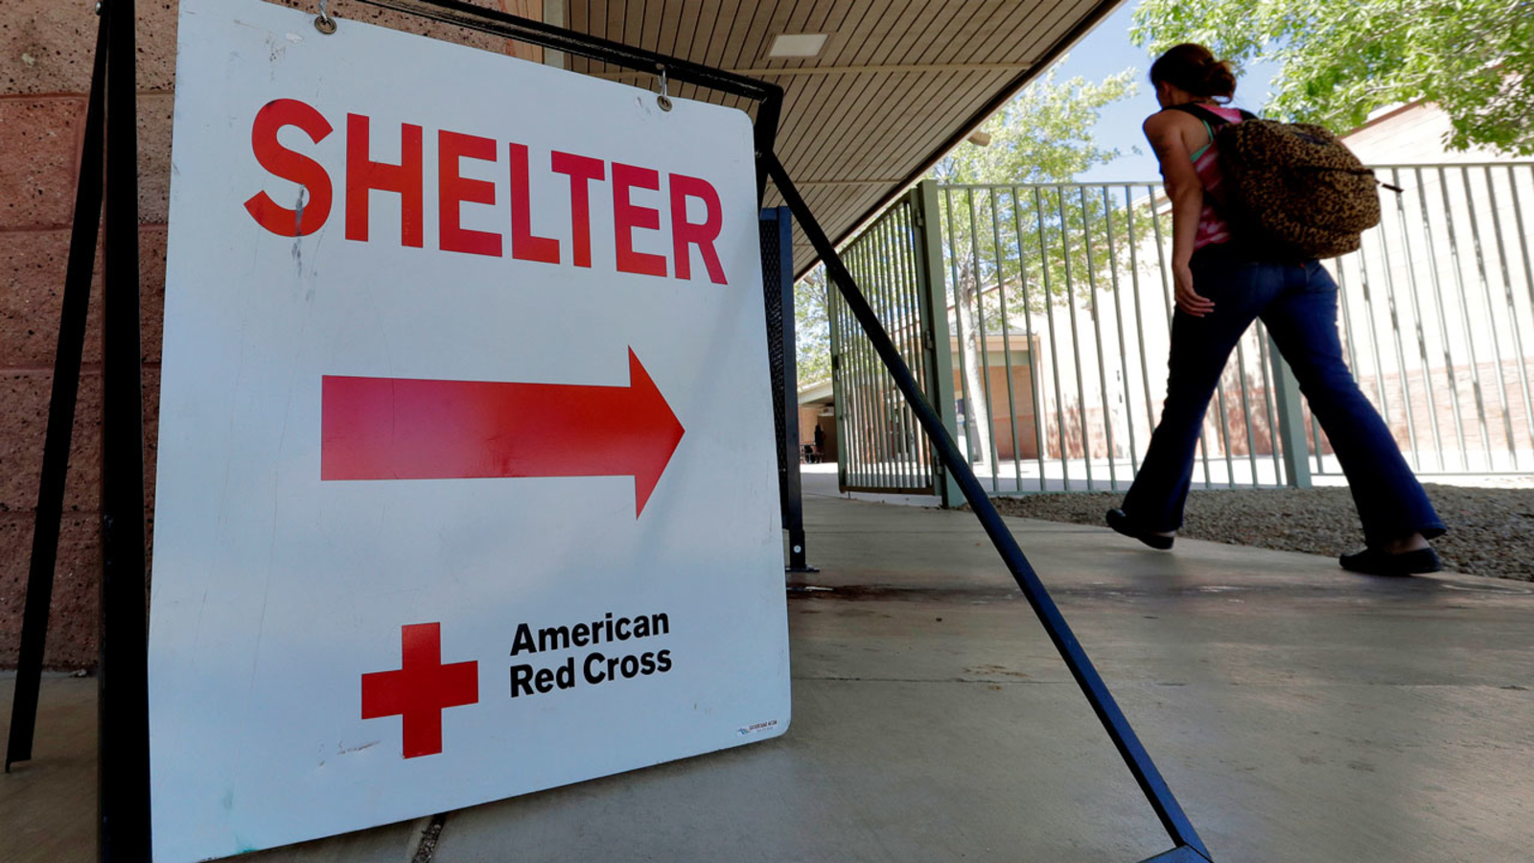
Questions…….(Inject #2)
What are your immediate actions and priorities in the first 10–15 minutes?
What information are you sharing with staff/parents/students/volunteers How are you communicating about the status of your operations?
Do you have an identified place to evacuate to in the immediate aftermath of a disaster like a tornado? How do you communicate this evacuation plan to your staff/students/volunteers?
https://cdn.abcotvs.com/dip/images/2341070_082517-ktrk-ap-red-cross-shelter-generic-img.jpg?w=

Slide 11

Questions Cont.……
If safe to do so, what critical operations/functions must be shut down before you leave the facility? Who knows how to do this?
Is there adequate staff with first aid skills to help with injuries? Do you have medical supplies on hand?
Do you have a process in place to account for all your employees and visitors? If people cannot be located or contacted, what—if any—processes do you have to account for them?
http://i.ebayimg.com/images/i/221375290502-0-1/s-l1000.jpg

Slide 12
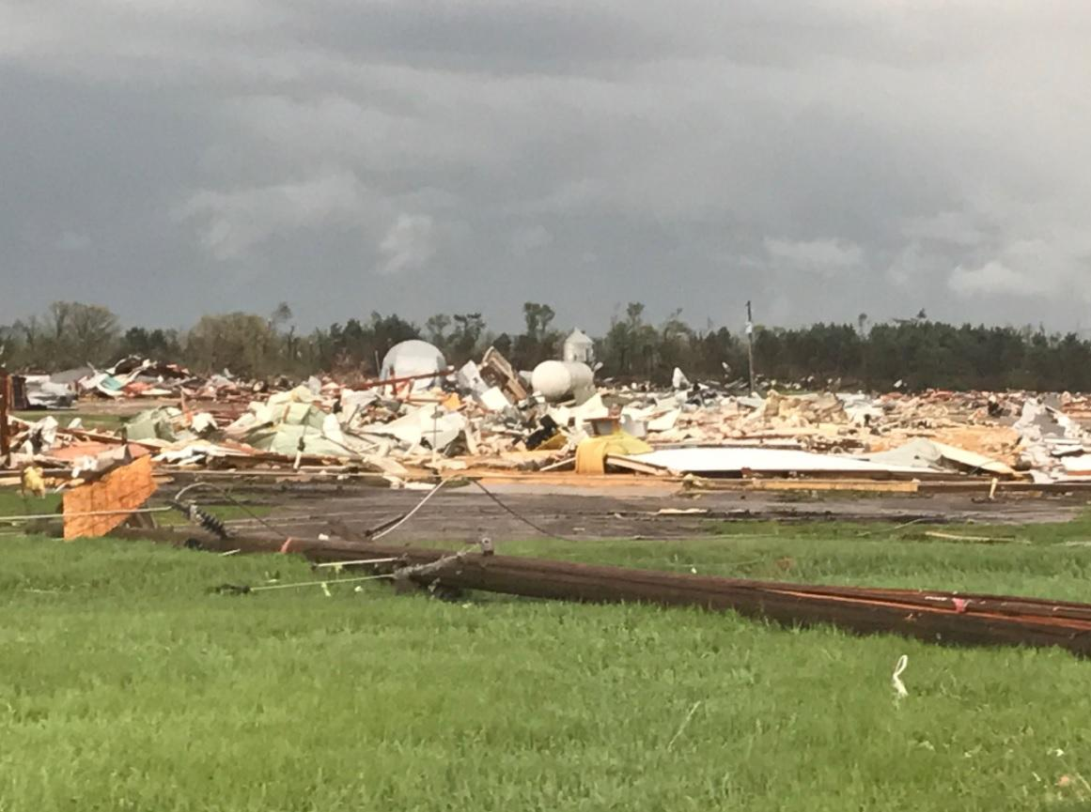
Tornado Exercise…….Inject #3
1:38 p.m.: The tornado, determined to be an EF3, has damaged approximately 300 homes and businesses in your community. At least 50 people have various injuries, and an unknown number of people are missing.
Your facility has suffered extensive damage and at least five employees are injured and two are missing. Search and rescue efforts are ongoing. The mayor and fire chief are asking people to leave the affected areas and not return until the area has been declared safe.
http://cbsnews1.cbsistatic.com/hub/i/2017/05/17/23d9dbd3-3a2a-4caa-b400-ea5d6465215e/170516-wcco-tornado-damage-01.jpg

Slide 13
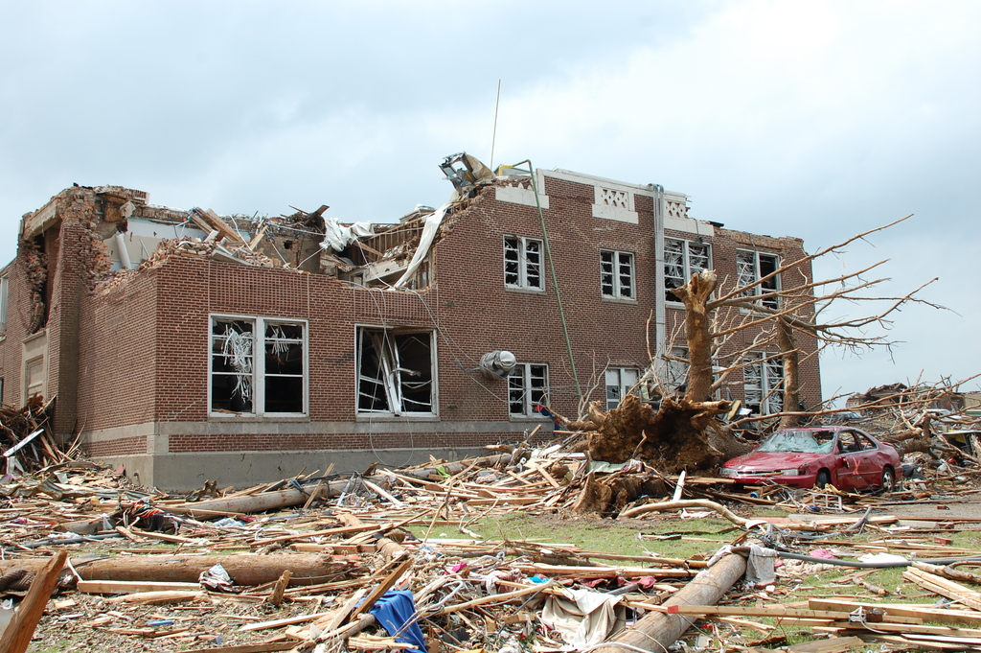
Questions……………(Inject #3)
Now that you know the extent of the damage, do you have options that allow you to continue operations?
How long can you continue to operate without access to your primary facility? Are your staff/volunteers prepared to telework for an extended period of time?
What are the critical services your employees rely upon to be at work (e.g., power, transit, schools/day care)?
http://media2.govtech.com/images/EM_FEMA_Joplin+elementary.jpg

Slide 14

Questions cont.……..(Inject #3)
Who is responsible for identifying and notifying family members about injured employees and potential fatalities?
Can you access copies of your vital documents such as insurance papers, financial information, and key business documents?
How are you communicating with staff/volunteers regarding their work status? What are your expectations for staff/volunteers who cannot work, either because your business is not operational or because they have suffered personal losses?
How are you communicating with parents and students regarding the status of classes? What are your expectations for students who cannot attend classes because your school(s) is/are closed?
http://clipart-library.com/images/kc8koz8ji.jpg

Slide 15

More Questions……(Inject #3)
Experiencing disasters can be upsetting, so it is important to pay attention to the emotional reactions of your staff/volunteers/students. How is your organization prepared to support individuals who express anxiety or stress?
What can you do to support the community as it recovers? How can you improve your network and relationships to be better connected to the community to prepare for future events?
http://images.clipartpanda.com/grief-clipart-microsoft-free-clip-art-486898.jpg

Slide 16
Tornado Exercise…..”Hot Wash”
What weaknesses in your organization’s emergency plans did this exercise expose?
What unanticipated issues arose during the exercise?
What gaps were identified?
What are the high-priority issues that should be addressed?
What are new ideas and recommendations for improvement?
Were the exercise objectives met?
https://www.fema.gov

