Slide 1


https://images.tmcnet.com/tmc/misc/articles/image/2018-may/power-utility-electicity-electric-outage-supersize.jpg
Power Outage Tabletop Exercise for Schools

Slide 2
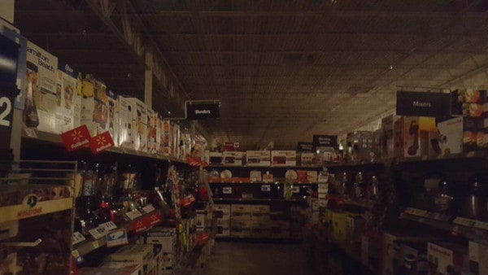
Power Outages
Extended power outages may impact the whole community and the economy. A power outage may:
Disrupt communications, water, and transportation.
Close retail businesses, grocery stores, gas stations, ATMs, banks, and other services.
Cause food spoilage and water contamination.
Prevent use of medical devices
And disrupt schools………

Slide 3
Power Outage Tabletop Exercise for Schools
Scenario
It is 9:30 a.m. in late March and your classes are in session. The weather is sunny with warm temperatures in the low 70s. Without warning, the power throughout the school goes out.
The power also appears out in the whole community. The school’s emergency generator, which powers critical building systems, turns on automatically.

Slide 4
Inject #1.
The school’s administrator decides to convene your school’s response team, which you are a member of, to decide the next steps. As the weather is warm and there is enough daylight, the team decides to continue classes, with some adjustments to the schedule.

Slide 5

Questions……
What is the team’s first steps? Do you have existing protocols for what to do in this type of situation, such as in the Power Outage Annex to your school or school district emergency operations plan (EOP)?
What steps do you need to take to help prevent any additional emergencies, damage, or injuries from occurring when the power is restored, such as turning off electrical or science equipment? How would your actions be different if you have, or do not have, a working emergency generator?
https://tothereal.files.wordpress.com

Slide 6

More Questions…………..
With whom will you need to communicate, such as your district office or a liaison with the power company? How will you do that? Do you have established protocols in the Communications and Warning Annex?
How will instruction be adjusted for classes that require power (e.g., science classes, industrial arts)? Where would classes be held on the school’s grounds if existing classrooms do not have enough light to continue instruction? Will there be enough light to complete the entire school day? What about afternoon/extracurricular activities, such as sports?
https://www.quickanddirtytips.com

Slide 7
Inject #2
About 30 minutes later, the power is still out. The students are calm and seem to be actually enjoying the novelty of being at school without power. The school administrator speaks to a liaison at the local power company who says they are still trying to identify why the power went out and the extent of the outage. The person says that at the moment they are not able to determine the extent of the outage or predict when power will be restored. The response team reconvenes.

Slide 8

Questions……………
Would you need to update anyone about what is happening at the school? If so, to whom and how often? Again, are those actions described in the Communications and Warning Annex?
How will the outage impact services the school provides, such as food programs? Do you have established protocols for what to do in that situation? Where would you find them, such as in the Continuity of Operations (COOP) Annex?
How will the power outage impact specific populations, such as those with disabilities or access and functional needs or students who need medicine regularly? How will you identify and address their needs?

Slide 9
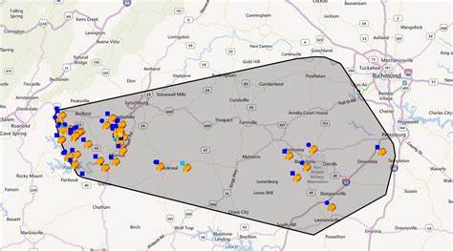
Inject # 3
While you are still meeting with the team, you receive word from the power company liaison that the outage was caused by human error at a nearby facility. In addition to your school, the outage has affected approximately 5,000 homes and two other nearby schools. The power will likely be restored in the early evening.

Slide 10

Questions…………..

Slide 11
Exercise Conclusion / “ Hot Wash”
What did the exercise demonstrate about how the school or school district would respond to
this type of emergency event?
2. What went well in the exercise?
3. What lessons were learned?
4. What gaps in the school’s or school district’s EOP, including annexes, were identified?
5. How will the EOP and annexes be revised, if needed?
6. Who will be responsible for making these revisions?
7. By when will these revisions be made?

