Slide 1
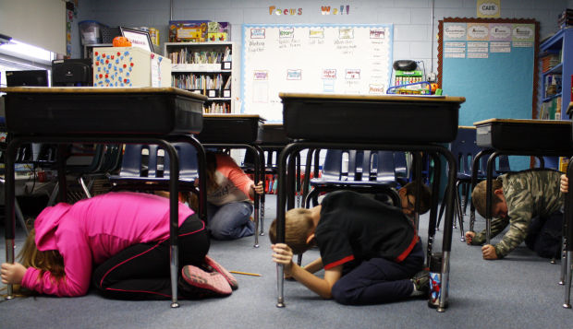
Earthquake
https://bloximages.chicago2.vip.townnews.com/thesouthern.com/content/tncms/assets/v3/editorial/f/03/f031a7b6-3772-11e3-a254-001a4bcf887a/52605646ab4ee.image.jpg
Tabletop Exercise for Schools

Slide 2
Earthquakes
An earthquake is a sudden, rapid shaking of the ground caused by the shifting of rocks deep underneath the earth’s surface. Earthquakes can happen without warning and can result in injuries and damage to property and roads. Earthquakes can cause fires, tsunamis, landslides or avalanches. Earthquakes can happen any where even here in Kansas, they happen daily but most are to small to notice.
That is why it is important to have a plan when a strong one does occur, this tabletop exercise will help you prepare or improve that plan.
Keep an open mind while planning and don’t worry to step outside the box and be creative, because remember emergencies /disasters have no boundaries so neither should you while planning when it come to safety and preparedness.
So here we go : “DROP, COVER, and HOLD ON”……………….
http://clipart-library.com/img1/890756.jpg

Slide 3
EXERCISE OBJECTIVES
FACILITIES: Structural maintenance considerations; earthquake resistant construction; non-structural mitigation; back-up power supplies; supplies for staying on-site; accessibility considerations; and emergency repairs.
HUMAN RESOURCES POLICIES: Employee notification and alerts; early release/telework policies; flexible work schedules; payroll and insurance policies; employee insurance policies; employee/family reunification procedures; employees trained in first-aid with access to medical supplies; and capacity to ensure accessibility for individuals with disabilities or access and functional needs.
CONTINUITY OF OPERATIONS PLANS: Plans to operate at an alternate location; access to important data; roles and responsibilities; insurance policies; supplier and customer relationship management; and plans and processes to resume operations.
EMERGENCY OPERATIONS PLANS: Ability to provide critical information and updates during the emergency through multiple notification systems; guidance on how to protect critical assets; plans to provide first aid; and protocols for communicating with local first responders and critical infrastructure providers.

Slide 4
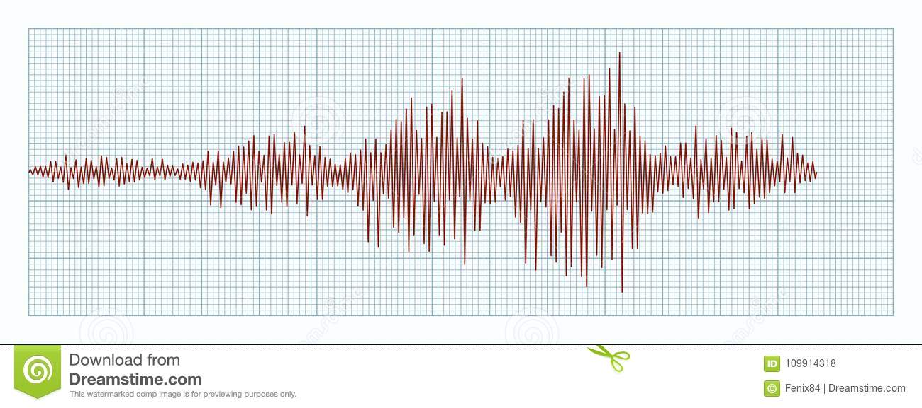
https://thumbs.dreamstime.com/z/diagram-earthquakes-concept-seismic-activity-seismogram-graph-earthquake-paper-tape-vector-record-seismograph-shows-109914318.jpg
Exercise Scenario
Tuesday, 10:30 a.m.: Residents in our county and the surrounding area experience a magnitude 6.5 earthquake along a fault line that runs underneath our community.
Initial reports estimate the quake to have been felt for a 60-mile radius around the epicenter. The quake causes several ruptures of major highways and numerous bridges, and overpasses suffer damage.
The strong shaking also severely damages roads and highways stranding motorists. Upwards of 60 percent of local residents are without power, and a water main break near the center of town causes localized flooding.
Several residents report serious injuries, mostly from car accidents, and crush or puncture wounds from falling debris. Homes, schools, hospitals, and other buildings sustain structural damage across the area with some people trapped in the debris.
At 11:28 am, an aftershock occurs 7 miles north of the city limits causing additional transportation infrastructure damage and panic among residents.
Your school appears to have suffered structural damage and at least five students are reported missing.

Slide 5
Questions.....(Scenario)
Who is responsible for identifying and notifying family members about injured students and potential fatalities?
What information are you sharing with students
How are you communicating about the status of your operations?
If safe to do so, what critical operations/functions must be shut down before you leave the facility(ies)? Who knows how to do this?
http://www.teacherfiles.com/clipart/clip_words/folder_parent_information.jpg

Slide 6
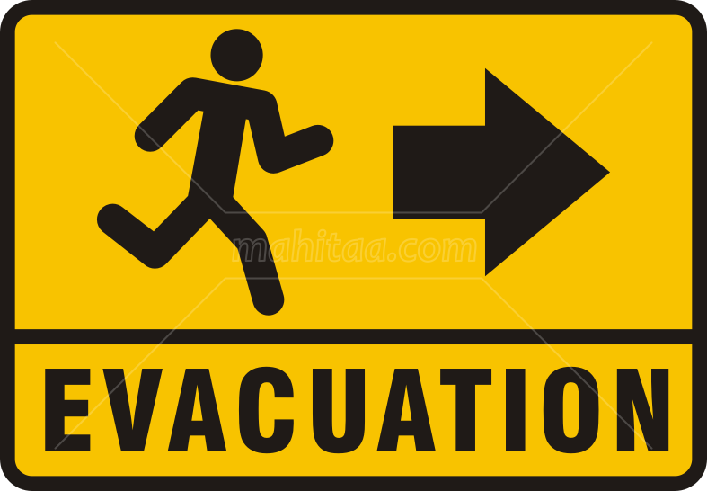
Questions Cont.….(Scenario)
What are your immediate actions and priorities in the first 10-15 minutes?
Do you have an identified place to evacuate to in the immediate aftermath of a disaster like an earthquake? How do you communicate this evacuation plan to your students
Do you have a process in place to account for all of your students? If people cannot be located or contacted, what—if any—processes do you have to account for them?
http://1.bp.blogspot.com/-P_qNqaMDJIY/T_Uj51yoqgI/AAAAAAAAAN8/pvUK3NX63Ks/s1600/Evacuation+sign.png

Slide 7
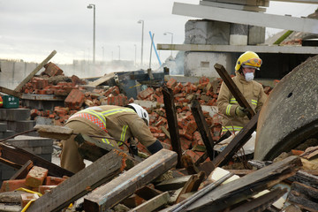
Inject #1
Wednesday, 8:00 a.m.: Search and rescue efforts are ongoing as reports of people trapped in the debris continue. Utility companies are working around the clock to restore services, but most people lack electricity, natural gas, and water. American Red Cross shelters open at public schools and undamaged recreation centers, where food, water, and personal items are available. The Department of Public Works is clearing main roadways.
Law enforcement is managing checkpoints at the most heavily damaged areas. The fire chief is asking people to leave heavily affected areas and stay out of all buildings within a 5-mile radius of the epicenter until structural engineers can assess the damage and clear the buildings for occupancy. 12
https://t4.ftcdn.net/jpg/00/87/66/13/240_F_87661318_RtKRLBsdZGaByxDlj2dysX0BTDoKBpWS.jpg

Slide 8
Questions....(Inject #1)
What are your organization’s priorities over the next 12 to 24 hours?
Is your organization continuing to operate in any capacity?
Is your organization prepared to manage extensive earthquake damage? What steps would you take at this time to address the damage?
https://thumbs.dreamstime.com/z/d-man-thinking-question-marks-illustration-red-above-his-head

Slide 9
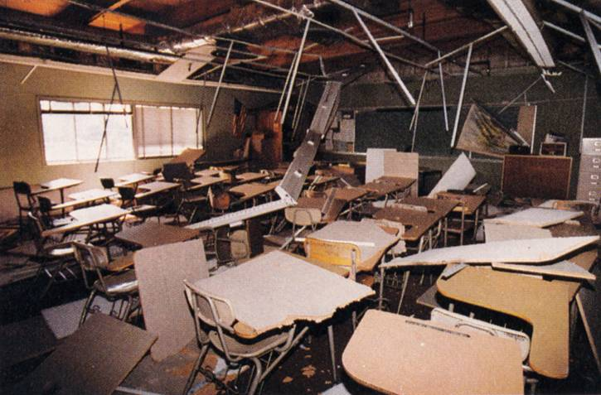
Inject #2
https://seismo.berkeley.edu/~rallen/seishaz/prepare/classroom.jpg
Monday, 8:00 a.m.: More than 6,500 homes and businesses suffered moderate to major damage. Parts of major highways and roadways, and dozens of bridges and overpasses require major repairs and debris removal. Many households are still without potable water and power.
Approximately 5,000 families are displaced from households and shelter. Most schools and public buildings remain closed at this time. You are able to access your facility(ies) for an initial damage assessment.
There is significant damage to the structure of the building(s) and based on the initial inspection, your facility will not be operational in any capacity for at least 3 months.

Slide 10
Questions....(Inject #2)
Now that you know the extent of the damage to your facility(ies), do you have options that allow you to continue operations?
Can you access copies of your vital documents, such as insurance papers, financial information, and key business documents and records?
How are you communicating with employees/volunteers regarding their work status? What are your expectations for employees/volunteers who cannot work, either because your organization is not operational or because they have suffered personal losses?
What critical services do your employees/volunteers rely upon to be at work (e.g., power, transit, schools/day care)?
https://thumbs.dreamstime.com/z/d-man-standing-having-no-idea-red-question-marks-above-his-head-over-white-background-38751032.jpg

Slide 11
Questions Cont...(Inject #2)
Experiencing disasters can be upsetting, so it is important to pay attention to the emotional reactions of your employees/volunteers/ students How is your organization prepared to support individuals who express anxiety or stress?
What is the long-term impact of this earthquake on your facility? Are there any steps you can take now that may lessen the impact of any event like this in the future?
What can you do to support the community as it recovers? How can you improve your network and relationships to be better connected to the community to prepare for future events?
http://cliparts.co/cliparts/8c6/5B5/8c65B5bzi.jpg

Slide 12
Exercise Conclusion “ Hot Wash”
What weaknesses in your organization’s emergency plans did this exercise expose?
What unanticipated issues arose during the exercise?
What gaps were identified?
What are the high-priority issues that should be addressed?
What are new ideas and recommendations for improvement?
Were the exercise objectives met?

