Slide 1
TIP- Targeted Improvement Plan Application Entry
June 18, 2024

Slide 2
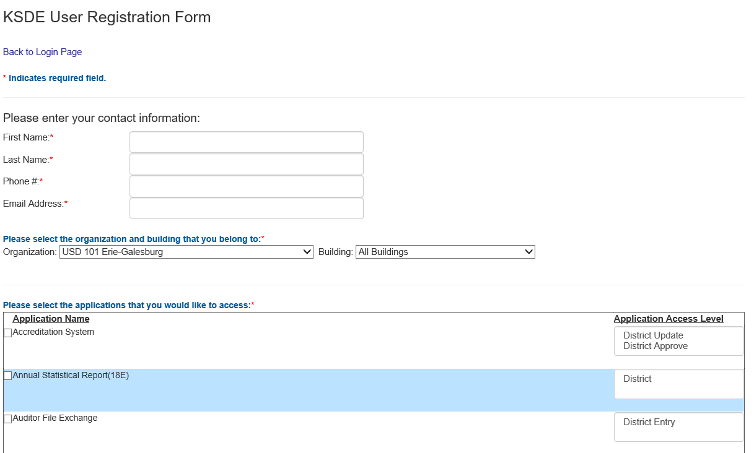
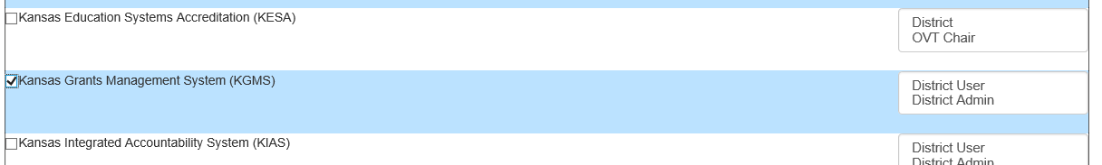
Register in Common
Authentication
  Register for the Targeted Improvement Plan (TIP) Application within Common Authentication
  To register for the TIP Application use the following web address: https://apps.ksde.org/authentication/login.aspx. Complete requested information, then scroll thought the list of available programs and select Kansas Grants Management System (KGMS).
  At least one individual will need to be registered as the District Admin access level in order to set security access for other users.

Slide 3
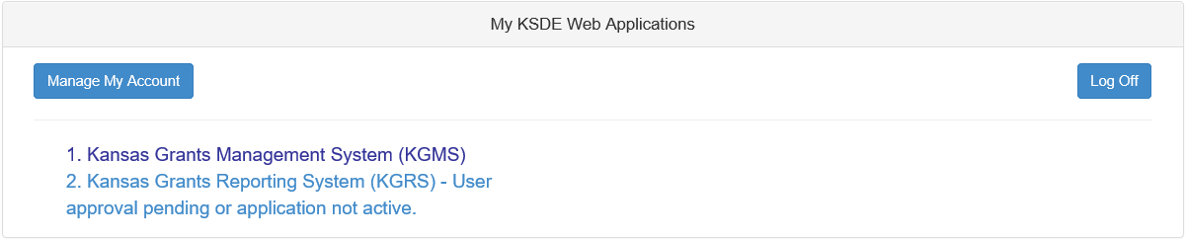
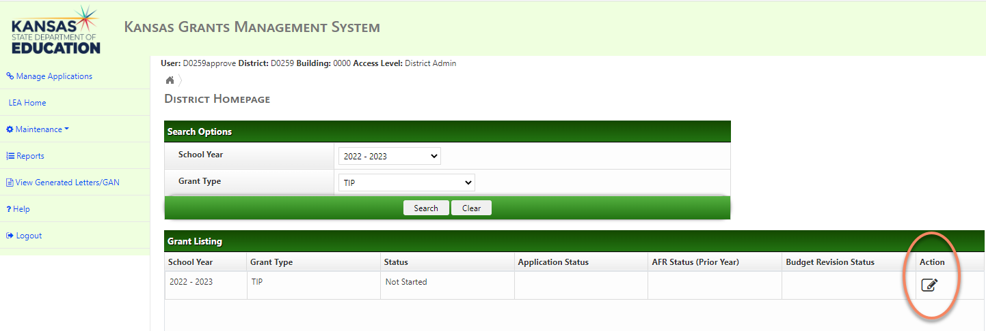
Welcome to the (TIP)-Targeted Improvement Plan Application
  When the registration request for the TIP is completed, click on the submit button.
  All registrations and changes are reviewed and approved by the superintendent. Users will receive an email when access is granted.
  Once approved you may enter the TIP Application.
  Select the School Year and Grant Type, then click search and Action.

Slide 4
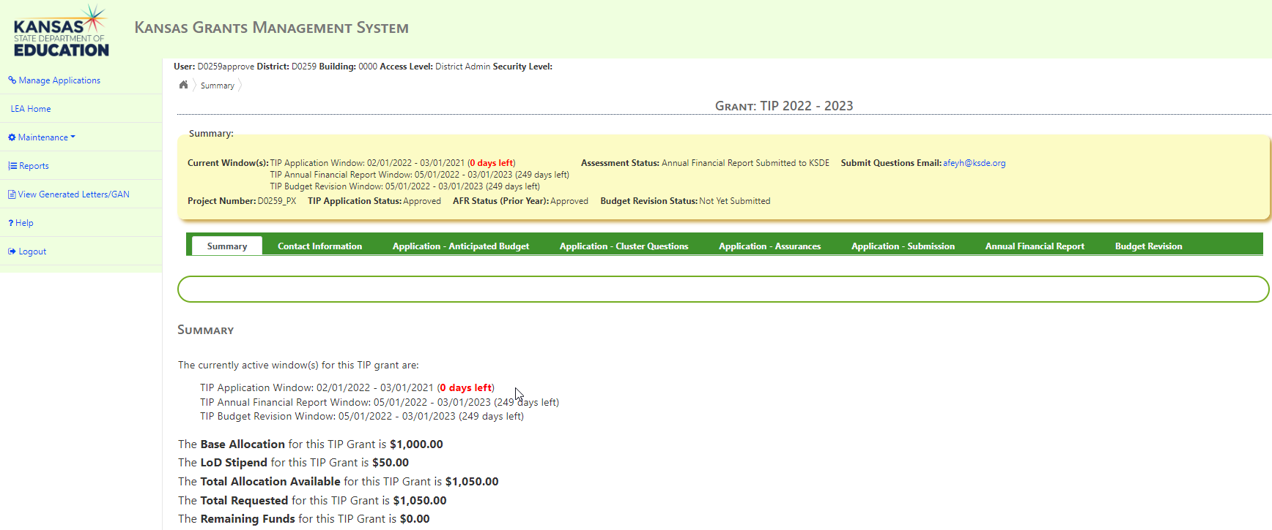
TIP Summary Page
The Summary page displays:
  due dates for TIP related documents
  provides a quick reference to the base allocation, LoD stipend, and total allocation available

Slide 5

Use Menu to Navigate
These are located in the top left corner of the screen and will assist the user in navigating throughout the application.
“Manage Applications”- returns the user to KSDE Web Applications listing.
“LEA Home”- returns the user to the District Homepage to select another year or Grant Type.
“Maintenance”- allows the district admin user to set the User Security for other users logging into the application.
“Reports”- displays a list of Reports accessible to the user for both current and previous years submissions
“View Generated Letters/Gan”- allows the district easy access to both current and previous years Award Letters and Grant Award Notifications
“?Help”- displays a list of phone numbers and hours of operation for assistance, in addition to a list of links to other resources available for assistance.
“Logout”- logs the user out of the application.

Slide 6
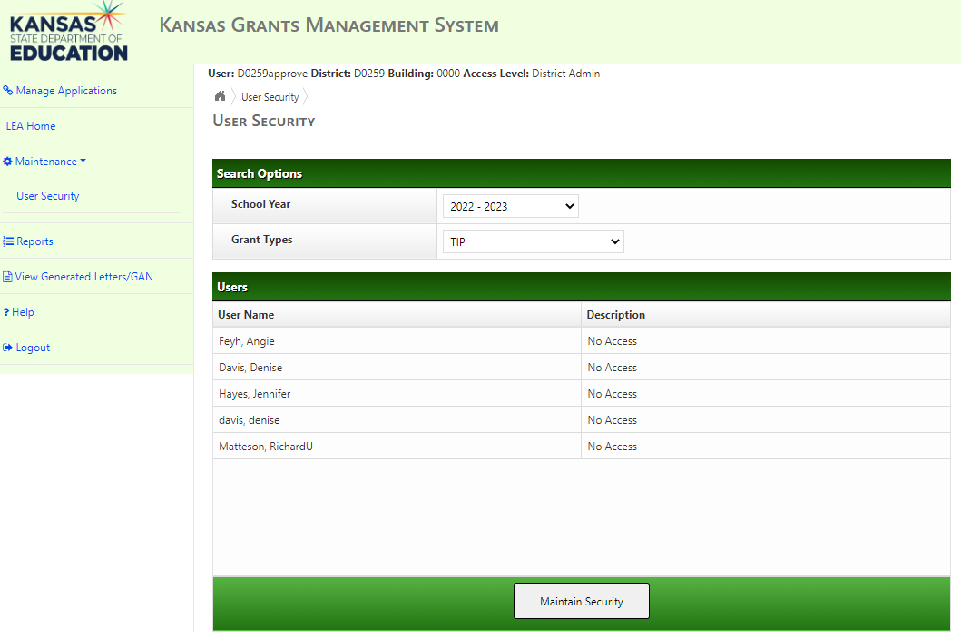
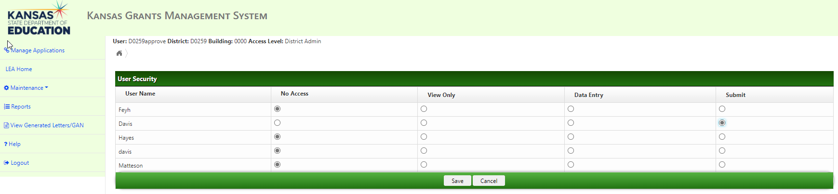
Grant Access Levels
The District Admin user will have the ability to “set” the access level for the other users by clicking the option next to the User Name.
The options are:
  No Access- will not be able to view the application
  View Only- will only be able to view and not enter/edit information
  Update- will be able to enter and edit information but not Submit
  Submit-will be able to enter, edit, and Submit information
When finished setting the User Security click on the LEA Home on menu options to return to the TIP Application

Slide 7
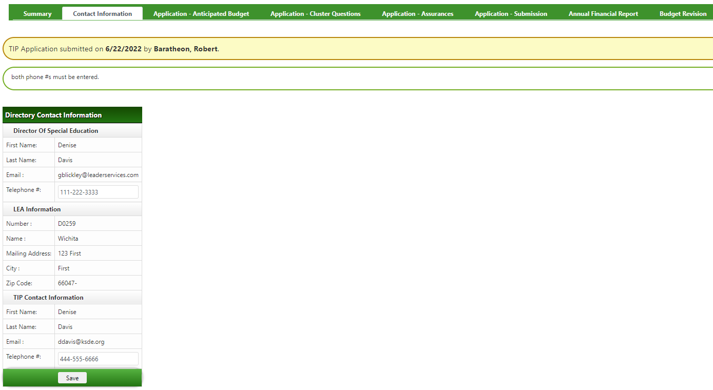
Contact Information & Phone Entry
Auto populated using data from main KSDE LEA Directory
User must enter phone number for Director of Special Education and TIP Contact before application can be submitted.

Slide 8
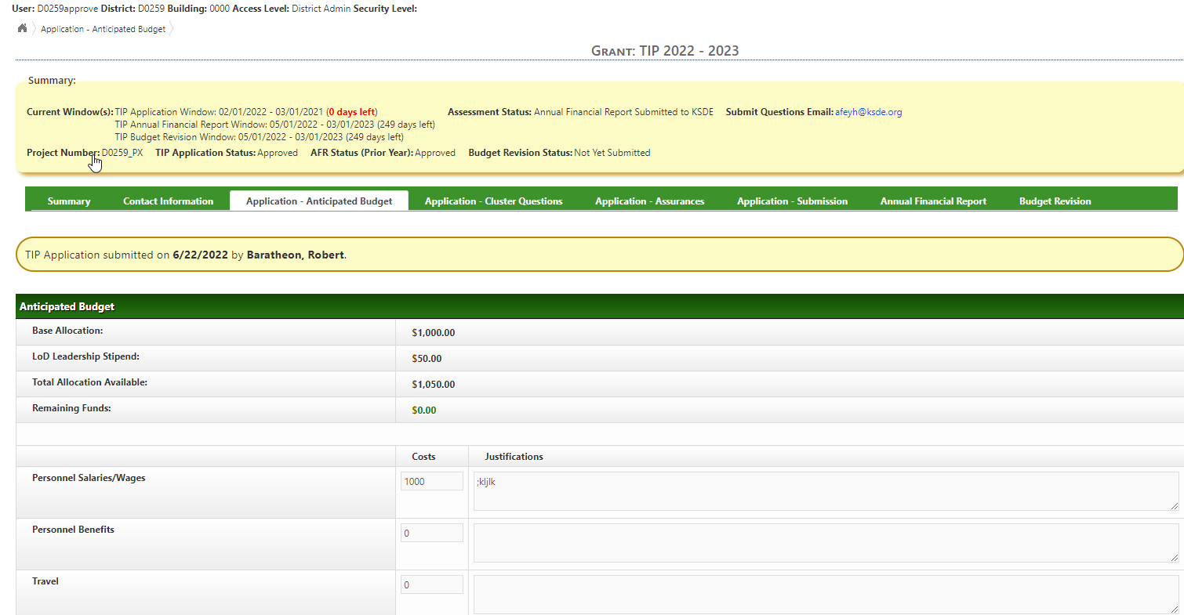
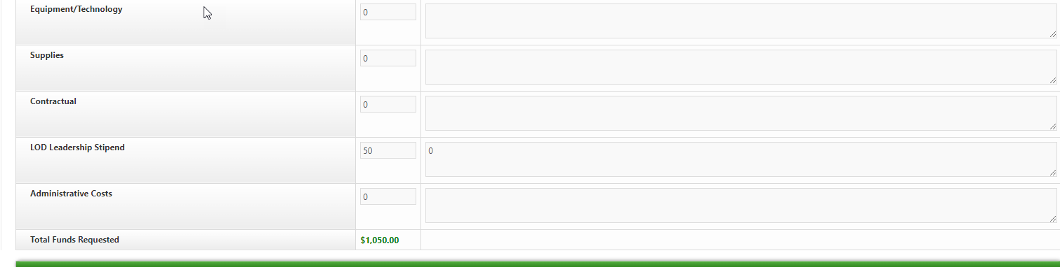
Application – Anticipated Budget
Only include figures for the IDEA Title VIB funding in the application.
Budget justification describes how expenditures are related to the applicant’s SPP plan.
LoD Leadership Stipends amount cannot be combined with another line item and must be explained separately.
Administrative Costs capped at the indirect cost rate the district has on file with KSDE.
Costs –
  Enter numeric data for each direct cost line item
Justifications –
  field is text only and will not calculate numeric entries
  include expenditure type and how amounts were calculated

Slide 9
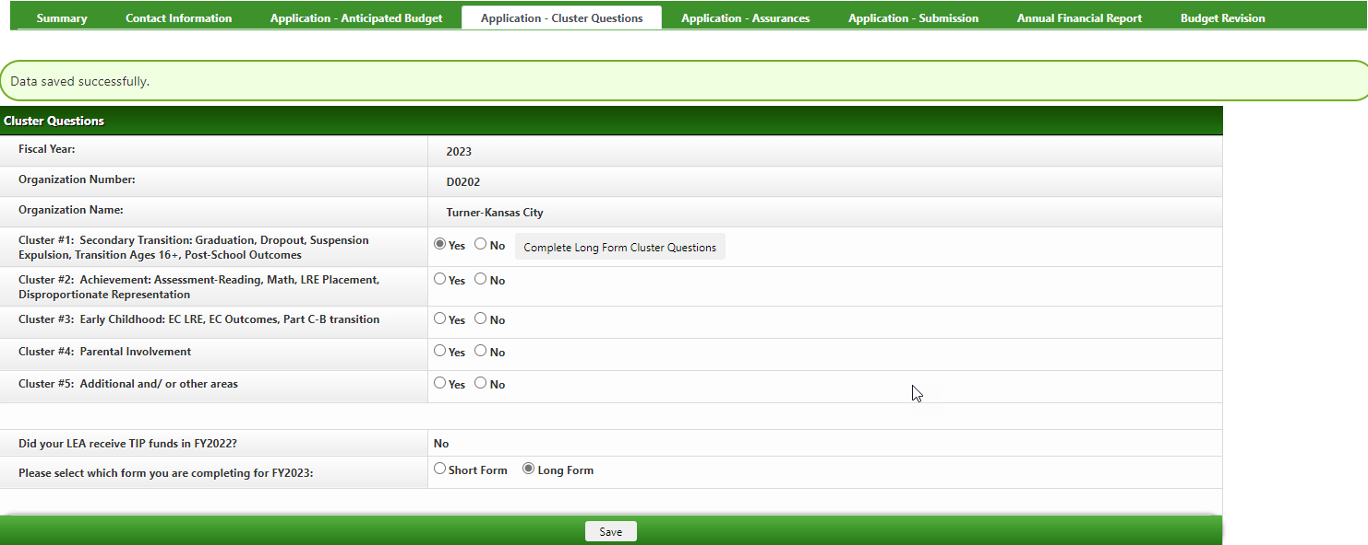
Cluster Questions
Aligned with IDEA SPP District Level Indicators. Select most relevant.
Each cluster must be checked Yes or No. At least one cluster must be answered Yes.
Everyone completes same form. No option for short or long.

Slide 10
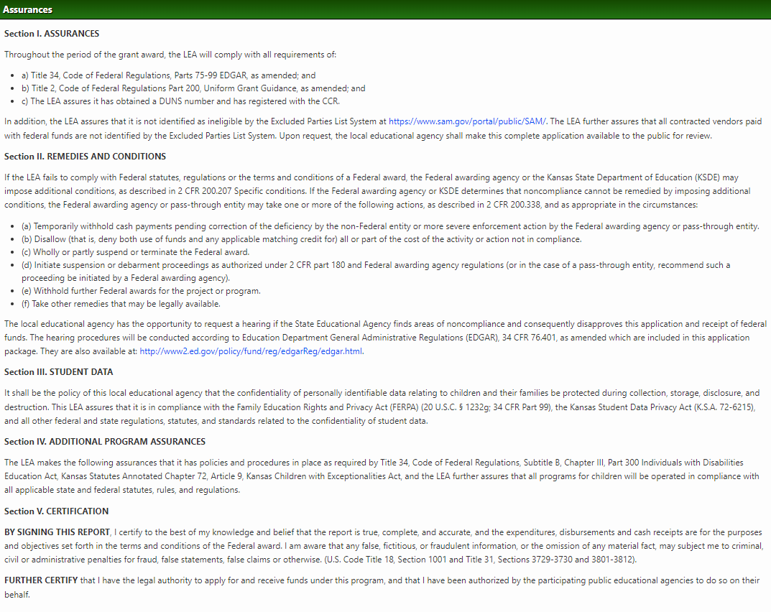
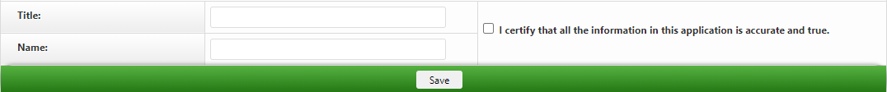
Assurances
Assurances must be agreed to prior to submitting the Application. The user must enter the following for certification purposes:
  Title
  Name
  Check the box to certify the information is accurate and true
After entering select Save.

Slide 11
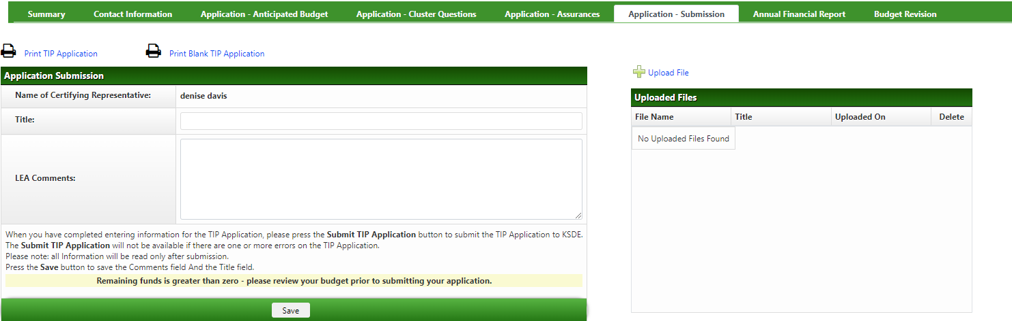
Application - Submission
The Name of Certifying Representative will be populated from the user id of the person submitting.
The Title of the person certifying needs to be entered and is required for submission.
LEA Comments are optional.
The user can choose to ‘Upload File” to provide any additional documentation for the application.
When required data fields have been entered and errors resolved the Submit button will be displayed.
Done? Click Submit.

Slide 12
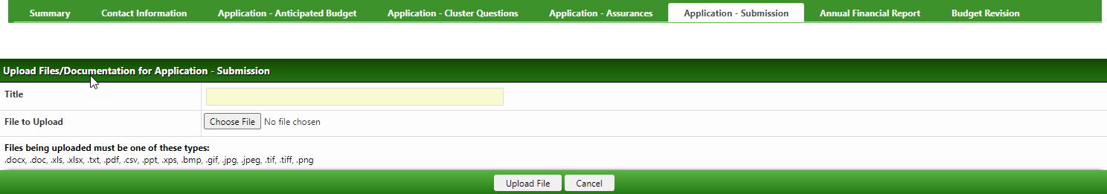
How to Upload Optional Files
The Upload File option will be available on the following pages:
  Application Submission
  Annual Financial Report
  Budget Revision
File Title will be required for the file uploaded.
Each file uploaded to a page will be displayed and available to click on and view as needed.

Slide 13
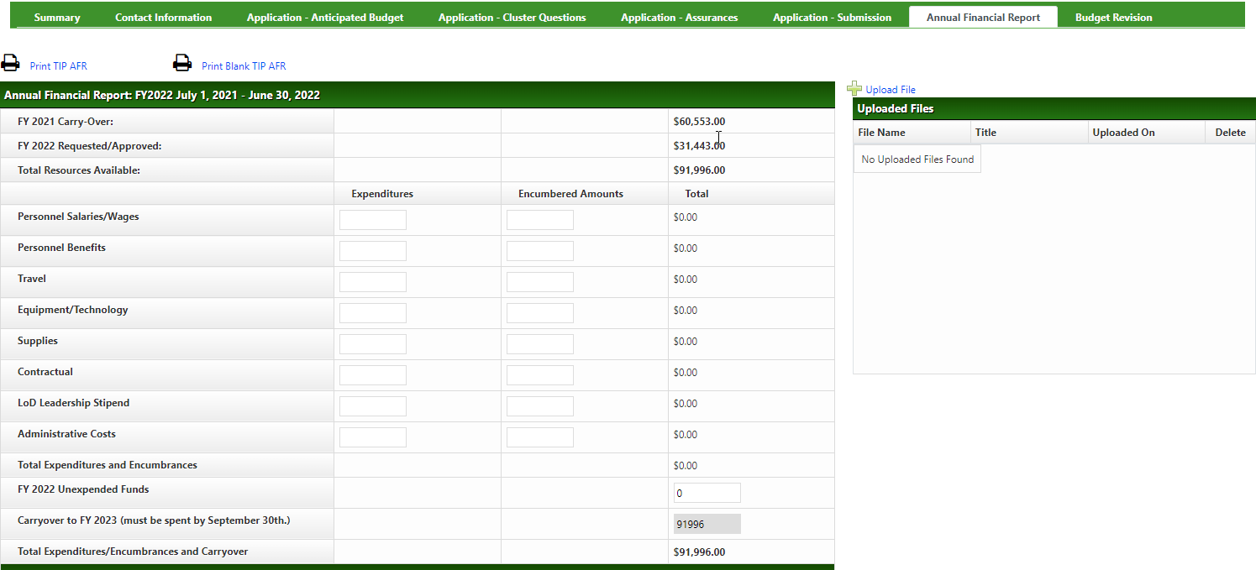
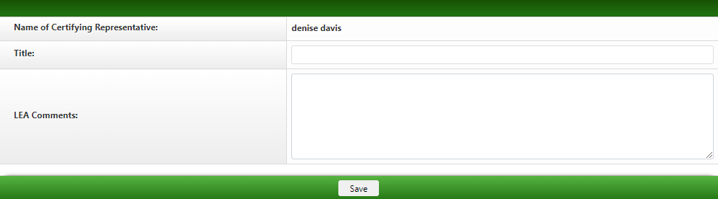
AFR - Submission
AFR must be completed, submitted, and approved before the system will generate annual award.
The amounts for encumbered, unexpended funds and carryover, if requested, will need to be locally calculated and entered by the district business manager and /or business office.
NOTE: Unexpended funds are the fiscal year amount not expended, not drawn down, not encumbered and /or not obligated prior to the end of the fiscal year.
User may choose to ‘Upload File” to provide any additional documentation if needed.
LEA Comments will be required when Carryover is >0.
When required data fields have been entered and errors have been resolved the Submit button will be displayed.

Slide 14
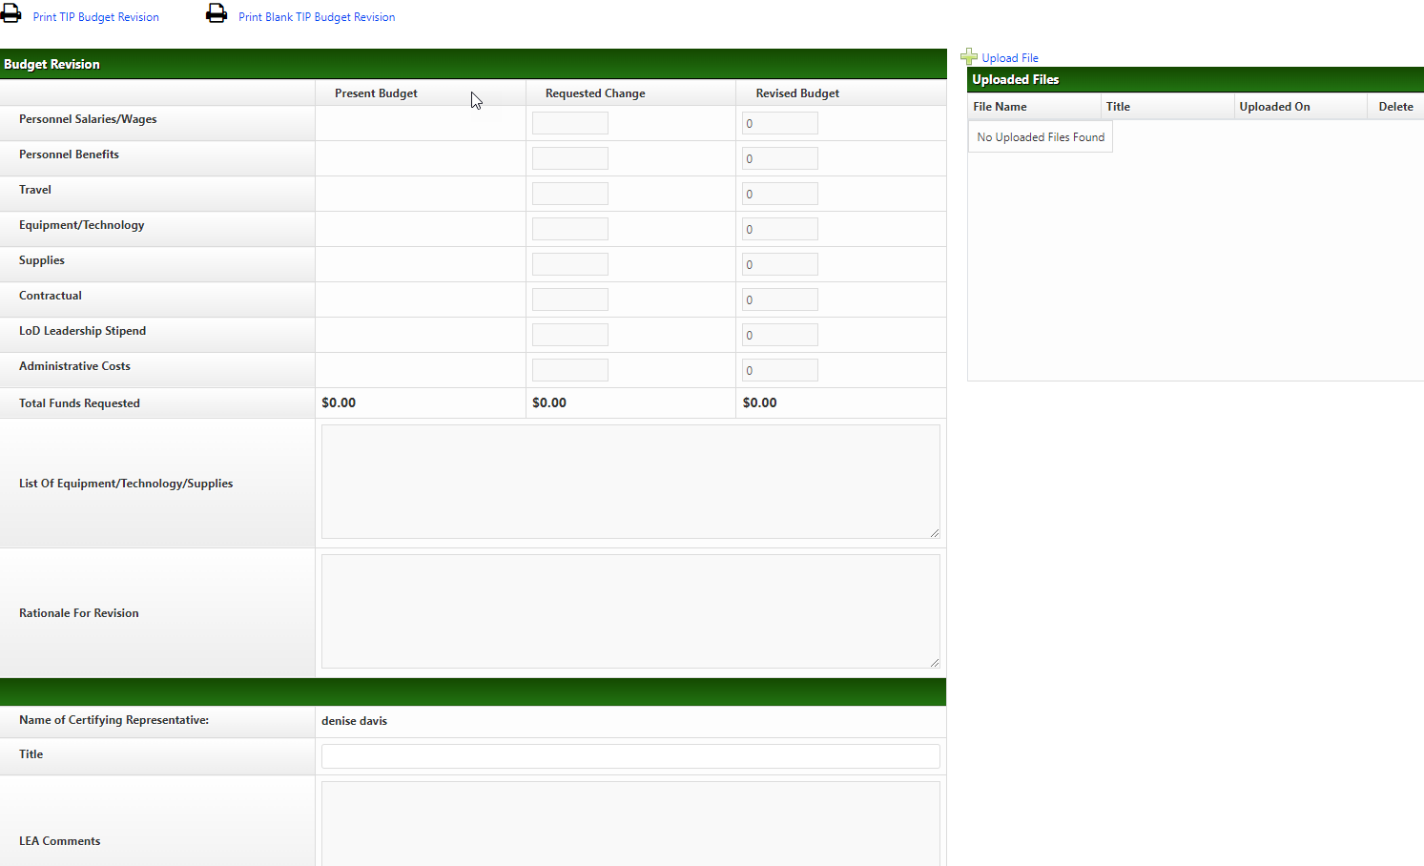
Budget Revision Submission
This form needs to be submitted when the direct cost line item transfers exceed 10% of the grant total or an additional cost/new activity within line item expenditure is needed.
Use a minus (-) sign when reducing a line item amount
The user may choose to ‘Upload File” if additional documentation is needed.
When required data fields have been entered and errors have been resolved the Submit button will be displayed.

Slide 15
Contact information for
TIP - Targeted Improvement Plan:
Application help/status: Sami Reed, Public Service Administrator at TIPHelp@ksde.org at 785-296-2134
Level of Determination Rewards and Sanction Questions go to: Stacie Martin at smartin@ksde.org
Program questions: Kerry Haag, Assistant Director khaag@ksde.org
The Kansas State Department of Education does not discriminate on the basis of race, color, national origin, sex, disability, or age in its programs and activities and provides equal access to the Boy Scouts and other designated youth groups. The following person has been designated to handle inquiries regarding the non-discrimination policies: KSDE General Counsel, KSDE, Landon State Office Building, 900 SW Jackson, Suite 102, Topeka, KS 66612, (785) 296-3201.

Slide 16
Technical assistance questions with navigating, data entry, and editing in KGMS System:
Leader Services
Phone Toll-Free: (877) 456-8777
OR
helpdesk@leaderservices.com
Hours (excluding Holidays): Monday- Friday 7AM – 5PM (CST)
The Kansas State Department of Education does not discriminate on the basis of race, color, national origin, sex, disability, or age in its programs and activities and provides equal access to the Boy Scouts and other designated youth groups. The following person has been designated to handle inquiries regarding the non-discrimination policies: KSDE General Counsel, KSDE, Landon State Office Building, 900 SW Jackson, Suite 102, Topeka, KS 66612, (785) 296-3201.

