Slide 1
Welcome to the Special Education Advisory Council Meeting
Please be sure your microphone is muted until you wish to participate in an open discussion with the council.
The meeting will start promptly at 9:00 a.m.

Slide 2
How to pin the Interpreters Video
At the top of your meeting window, hover over the video of the participant you want to pin and click ...
From the menu, click Pin.
Optional: If you want to pin additional videos (up to 9 total), follow steps 1 & 2 again as needed.
Optional: If you have at least 3 participants in the meeting and dual monitor enabled, you will have the option to pin to your first screen or your second screen.

Slide 3
Special Education Advisory Council
April 22, 2025

Slide 4
Call to Order
Call to Order Lindsay Graf
Roll Call Joyce Broils

Slide 5
Approvals
Agenda for April 22, 2025. Lindsay Graf
Minutes (January 14 & 15, 2025)
Notes:
Poll I and 2

Slide 6
Discussion topic
Discussion to add a position of Virtual Schools to the SEAC Council.
Bert Moore
Notes:
Poll I and 2

Slide 7
Public Comment
Guidelines for Testimony
Prior to start of the SEAC meeting, be sure to email Joyce Broils, jbroils@ksde.org expressing desire to speak during public comment.
All comments will be taken under advisement by the council.
Any response from the Council to public comments will come at a later date.
Verbal Public Comment
Verbal comments are limited to three minutes.
Cue will be given one minute before time expires.
Written Testimony
Written input must include the name, address and county of residence of the person submitting comment.
Written comments can be submitted via email, mail, or fax to the secretary of the SEAC.

Slide 8
ESI follow up
Trish Backman
School Mental Health Coordinator
Notes:
Amanda

Slide 9
91-42-1 (b). Definitions
(b) "Area of purposeful isolation" means any separate space, regardless of any other use of that space, other than an open hallway or similarly open environment.

Slide 10
91-42-1 (p). Definitions
(p) "Purposefully isolate," when used regarding a student, means that school personnel are not meaningfully engaging with the student to provide instruction and any one of the following occurs: (1) Removal of the student from the learning environment by school personnel; (2) separation of the student from all or most peers and adults in the learning environment by school personnel; or (3) placement of the student within an area of purposeful isolation by school personnel.

Slide 11
91-42-1(r). Definitions
(r) "Seclusion" means placement of a student for any reason other than for in-school suspension or detention or any other appropriate disciplinary measure in a location where both of the following conditions are met: (1) School personnel purposefully isolate the student. (2) The student is prevented from leaving, or the student has reason to believe, that the student will be prevented from leaving, the area of purposeful isolation.
Notes:
PowerPoints

Slide 12
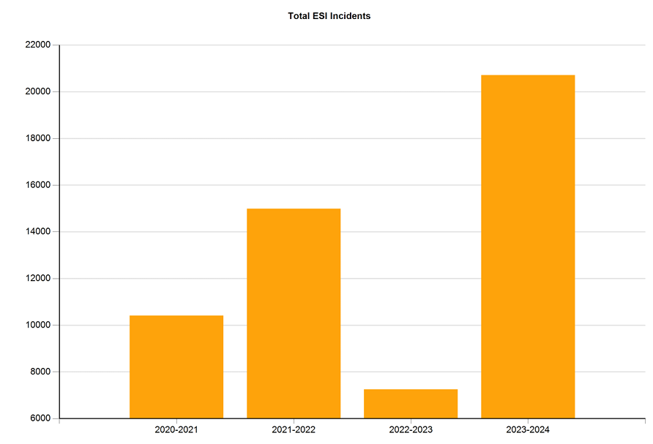
Year-to-Year totals
Notes:
Describe business rules for using each – what are the non-negotiables in terms of design, etc.?
Describe logo usage – when to use KSDE, when to use Kansans Can, using dual logos, etc.

Slide 13
Restraints vs. Seclusion Y2Y
20-21 data was during Covid lockdown
21-22 data some schools had not returned
22-23 buildings were given guidance that anytime a student is sent home due to behavior, it counts as 1 day OSS
23-24 baseline year with new definition

Slide 14
ESI Incidents
Still need better reporting on non-identified students

Slide 15
Average Age

Slide 16
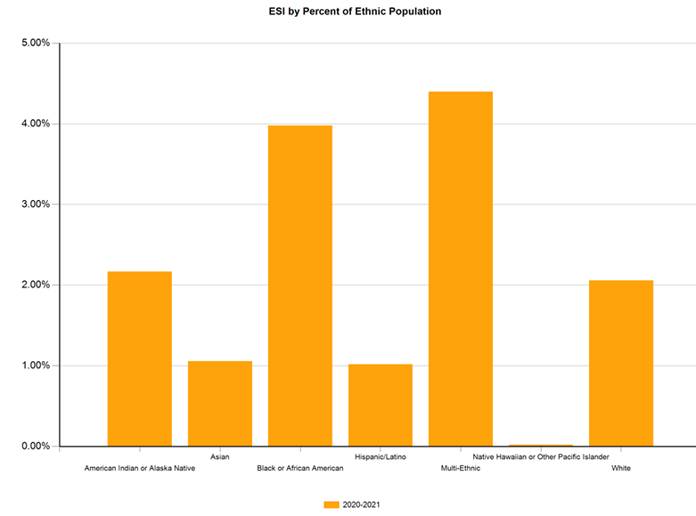
ESI by Ethnic Population

Slide 17
ESI by Gender

Slide 18
Fall 2024
Restraint Totals : 2808
Average Duration of Restraint: 1.0 minutes
Average age of student receiving restraint: 8.0

Slide 19
Fall 2024
Seclusion totals: 4910
Average Duration of Seclusion: 4.0 minutes
Average age of student receiving seclusion: 8.0

Slide 20
Seclusion and Restraint

Slide 21
Fall 2024
The number of students physically restrained= 863
The number of students placed in seclusion= 793

Slide 22
Legislative Discussion
Frank Harwood
Notes:
Laurie will share her screen

Slide 23
KSDE Director Updates
Bert Moore
Notes:
Laurie will share her screen

Slide 24
Transition
Dean Zajic
Stacie Martin
Notes:
Laurie will share her screen

Slide 25
Youth Outcomes Driven Accountability - YODA
Brian Dempsey
Notes:
Laurie will share her screen

Slide 26
Lunch
Notes:
Laurie will share her screen

Slide 27
Virtual Schools
Brian Dempsey
Crista Grimwood

Slide 28
FAPE in Virtual Settings
Meeting the Needs of Exceptional Students in Online Learning Environments
Dr. Crista Grimwood, KSDE Dispute Resolution Coordinator

Slide 29
Learning Objectives
At the end of the presentation, the learner will be able to:
Define and apply virtual learning terminology.
Define a Free Appropriate Public Education within the context of a virtual setting.
Identify potential “legally problematic” issues within the virtual setting placement as it relates to special education.
Mitigation strategies and solution ideas when contemplating a virtual education placement for students with disabilities.

Slide 30
Key Terms
Notes:
Amanda

Slide 31
Key Terms
Virtual school:
A public school that offers only virtual classes.
Virtual classes:
A class wherein the student and teacher are separated by time zones and/or locations.
Virtual classrooms:
The online space wherein a student and teacher virtually interact.
Online learning:
Broad term for education wherein instruction, content, knowledge, and skill acquisition are conducted primarily over the internet.
Digital learning:
An instructional practice that leverages technology to enhance the student’s learning. Uses learning types as tools of practice.
Blended learning:
A formal educational program that leverages both technology and in-person instruction. It must have both (1) supervised learning time and (2) student-led learning time.
Remote learning:
Receiving FAPE outside of the physical school building. This may include online learning, blended learning, or non-technologically based learning.
Virtual learning environment:
The online learning interface providing virtual instruction, exams, assignments, and classes.

Slide 32
FAPE
FAPE means special education and related services that are provided at public expense, under public supervision and direction, and without charge; meet the standards of the SEA, including the requirements of this part; include an appropriate preschool, elementary school, or secondary school education in the State involved; and are provided in conformity with an individualized education program (IEP) that meets the requirements of §§ 300.320 through 300.324.
34 C.F.R. § 300.17
This Photo by Unknown Author is licensed under CC BY
Notes:
PowerPoints

Slide 33
FAPE in Virtual Schools
Notes:
Amanda

Slide 34
Application of the ADA, IDEA, & Sec. 504
“The IDEA, including its provisions concerning child find, monitoring, and compliance, applies with equal force to virtual schools.”
See Dear Colleague Letter, 68 IDELR 108 (OSERS/OSEP, August 5, 2016).
504 and Title II: Schools may not directly, or through contractual (or other) arrangements, discriminate against students on the basis of their disability. 34 CFR § 104.4.
Enrollment and attendance policies must be nondiscriminatory.
Restricting how special education services are provisioned will almost always be discriminatory unless the restriction is necessary for the school to achieve its goals or mission.
Appropriate restriction example: We will not provide a paraprofessional because the evaluation data does not indicate your child needs access to a paraprofessional to benefit from his curriculum.
Inappropriate restriction example: We will not provide a paraprofessional because our school cannot provide paraeducators to virtual students.
There may be differences in service model or delivery, but the FAPE obligation remains the same!

Slide 35
Special Considerations
Child Find
Is the virtual setting capable of identifying eligible children?
Appropriateness
Is a virtual setting appropriate for this child?
Accessibility
Is a virtual setting accessible to this child?
Least Restrictive Environment
Would a virtual setting integrate the child with their neurotypical peers to the maximum amount appropriate?
Adapting the IEP
Can this IEP be appropriately adapted to a virtual setting without materially impacting educational benefit?

Slide 36
Child Find
Above and beyond ordinary child find obligations, virtual settings present unique challenges as it relates to identifying IDEA eligible children.
Owing to this, in a 2016 joint Dear Colleague Letter, OSEP and OSERS recommended that districts containing virtual schools should empower their staff members to identify potentially IDEA eligible children through additional methods such as:
Additional screenings
Distributing questionnaires to staff
Distributing surveys to parents
Reliance upon parental referral should never be the primary vehicle for satisfying the IDEA’s child find obligation.

Slide 37
Appropriateness
The IEP team must make an individualized determination of the virtual school setting’s appropriateness for the child.
Even if the family is unilaterally demanding virtual education, the team must meet & make its own determination.
In Downington Area School District v. K.D., 69 IDELR 162 (Pa. Commw. Ct. 2017, unpublished), an ADHD fifth grader’s IEP team violated the IDEA by proposing to place the child in an accelerated online math class. The online setting was inappropriate given the child’s known propensity to play games and seek out peers when presented with online instruction.
In J.D. v. Pennsylvania Virtual Charter School, 77 IDELR 287 (E.D. Pa. 2020), a virtual school proposed to place an Autistic student in a private special education school. The parent filed for due process, arguing the proposed placement was inappropriate and her child required their virtual placement. The Pennsylvania Department of Education determined that, because this child needed to learn in a classroom setting around same-aged peers to receive FAPE, the virtual school’s proposal to place the child in a private school was appropriate.
In S.P. v. Fairview School District, 64 IDELR 99 (W.D. Pa. 2014), a Pennsylvania school district recommended a virtual placement to a student with refractory migraine headaches. The District Court held that the proposal was appropriate given the child’s frequent absences and documented need to remain in a dark, quiet room for 12-to-16-hour intervals.

Slide 38
Accessibility
Virtual schools must provide children with disabilities with an equal opportunity to participate in and benefit from their virtual education. See Dear Colleague Letter, 43 NDLR 75 (OCR 2011).
NEW REQUIREMENTS:
The Office for Civil Rights has recently released new accessibility rules amending Title II. The LEA is responsible for ensuring the following are readily accessible to students with disabilities:
Web content and Mobile Apps:
All web content and mobile apps provided directly by you – whether or not you developed it or maintain it.
All web content and mobile apps provided by a third party through contract, license, or another arrangement – whether or not you’re hosting it on your own server.

Slide 39
Least Restrictive Environment
Continuum of Placements: Transferring a student from a traditional physical public-school building to an online learning environment is usually a change in placement.
LRE Video: https://youtu.be/nUtR75sMBOc
This is because online settings generally offer a substantially different education with substantially different opportunities for peer interaction.
Ensure students with disabilities attending virtual schools are given the same or substantially similar opportunities to interact with their general education peers within virtual settings.

Slide 40
Adapting the IEP
Upon completed enrollment of an IDEA ID’d child, immediately convene an IEP team meeting. Use this meeting to engage the family, ensure the child has access to the internet and appropriate hardware, and adapt the IEP for an online curriculum.
Collaborate with the IEP team and the child’s district of residence to provide for services if necessary. Consider the use of telehealth and other online tools for remote service delivery.
Ensure, when appropriate, the child’s IEP articulates a path to eventual in-person reintegration with their general curriculum peers (or a reason why this would not be appropriate to include).

Slide 41
Virtual FAPE: Challenges & Opportunities
Challenges:
Access to Technology: Ensuring every student is provided equitable access to technology and internet connectivity.
Specializing the Instruction: Adapting IEPs to an online format without degradation of service.
Maintaining Engagement: Creating engaging, interactive environments for students with a range of disabilities who may struggle with attention and/or focus.
Social/Emotional Isolation: Maintaining social/emotional health and individualized support without making physical contact.
Opportunities:
Flexibility: Flexible learning environments can be tailored to the individual student.
Equity: Enables children to continue attending school after events that would ordinarily remove them from the curriculum, e.g. expulsion, LEO removal, and acute health crises.

Slide 42
Virtual Challenges & Virtual Solutions
ADHD
Possible Challenges:
Maintaining focus.
Managing time.
Minimizing distractions.
Potential Solutions:
Use of timers, reminders, visual aides, checklists, and/or check-ins.
Incorporation of movement breaks, gamified learning activities.
Clear, structured daily schedules and tasks.
Flexible deadlines.
Autism (ASD)
Possible Challenges:
Adapting to online interactions.
Managing sensory sensitivities.
Increasing social isolation.
Potential Solutions:
Predictable routines and visual supports.
Clear, structured communication with minimal distraction.
Virtual social groups, social skills training, and peer interaction opportunities.
Notes:
Fact Sheet

Slide 43
Virtual Challenges & Virtual Solutions
Visual Impairments
Possible Challenges:
Accessing digital content.
Navigating online platforms.
Potential Solutions:
Use of screen-readers, braille displays, and text-to-speech technology.
High-contrast visuals, large fonts, and audio descriptions.
Customizable learning tools that adjust for the reader’s vision.
Specific Learning Disabilities
Possible Challenges:
Difficult processing, organizing, or retaining information.
Potential Solutions:
Assistive technology such as speech-to-text software.
Chunked lessons, modified pacing, and/or frequent assessments.
Flexible assessment formatting.
Notes:
Fact Sheet

Slide 44
Turn and Talk
What do you see as challenges or opportunities within your own district’s virtual learning as it relates to special education?
2-Minutes
Share Out
Notes:
Fact Sheet

Slide 45
Bottom Line:
What does the IEP team recommend so that this student can:
1. access the general education curriculum at their grade level
2. participate with same aged peers in the least restrictive environment to the maximum extent possible
3. be provided FAPE as required by IDEA. (What would the district’s offer of FAPE be if the child were not in the virtual setting?)

Slide 46
Feedback & Questions From the Field……..
Notes:
PowerPoints

Slide 47
Dr. Crista Grimwood
#SETS Dispute Resolution Coordinator
Crista.Grimwood@ksde.gov
(785) 296- 7262

Slide 48
Ex-Officio Member Reports

Slide 49
Ex-Officio Member Reports
Families Together
Kansas Association of Special Education Administrators (KASEA) – Ashley Enz
Disability Rights Center
Kansas State Board of Education
KSSB
KSSD
KNEA
Others

Slide 50
KASEA
SEAC Update - April 2025
Resources
KASEA Monthly Updates from Dr. Lena Kisner
KSDE Fiscal File Review
Self-Assessment Supplement
What Schools Can Do to Prepare Students with Disabilities for College
Mission
Special Education Leaders united in advocacy and committed to success of all children.
Vision
To be the voice of special education, to actively provide mentoring and support for leaders, and to advance the profession through policy and practice.
Awards: The KASEA General Education Administrator Award acknowledges a general education colleague at the building, district, or organizational level who exemplifies leadership, continuous improvement, and advocacy in the provision of special education programs in the context of general education settings.
Nominations must come from a KASEA member. The deadline to submit nominations is April 28, 2025. The winner will be announced and celebrated during the USA conference in Wichita this summer (May 28-30).
KASEA & Friends Calendar:
Promoting Independence and Reducing the Reliance on 1:1 Paraprofessionals
4/9/25 12:00-11:00 (Free for CASE members)
Connecting with KASEA
4/16/25 12:00-1:00
USA-KS Uniting Leaders Conference
5/28-30/25 Wichita
FY 2026 MIS Workshop
6/24/25 1:00-4:00 Wichita
SETS Leadership Conference
6/25-26/25 Wichita
CASE Conference 2025 November 5-7, 2025 Oklahoma City, OK
Tri-State Law Conference 2025
November 13-14, 2025 Omaha, NE

Slide 51
Next Meeting Date
June 24, 2025 – 9:00 a.m. to 12:00 p.m.
Wichita Hyatt Regency
400 W Waterman Street
Wichita, KS
At the June Leadership Conference. If you wish to attend the SEAC meeting only, no need to register. If you plan on attending the MIS at 1:00 pm on the 24th or any of the conference you must register. Please go to this website to register, 2025 KSDE SETS Leadership Conference Webpage.
I can reimburse hotel up to $137.50 plus tax for hotel expense. I can reimburse the cost of registration and mileage from your home address to the conference location round trip per google maps and for per diem I need the time you leave home, arrive at the conference, and the same for your return trip home. You are not reimbursed per diem if meals and provided and you choose not to partake. If you have any questions, please reach out to Joyce Broils at joyce.broils@ksde.gov or 785-291-3097.

Slide 52
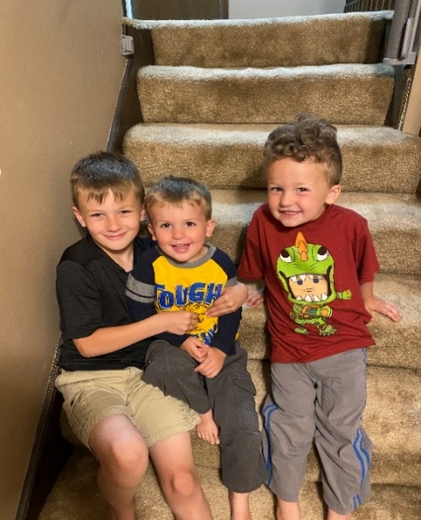
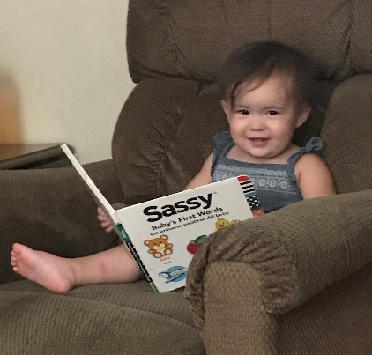
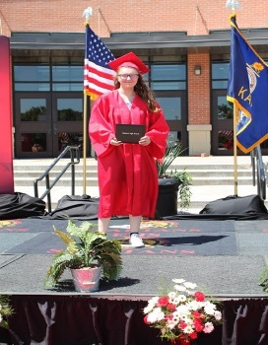
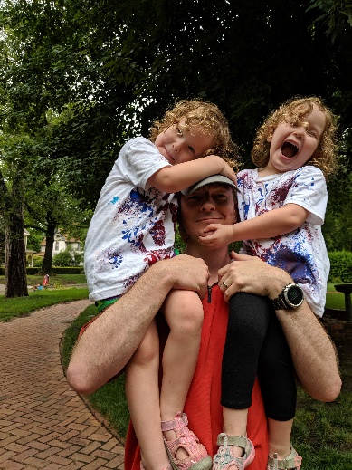
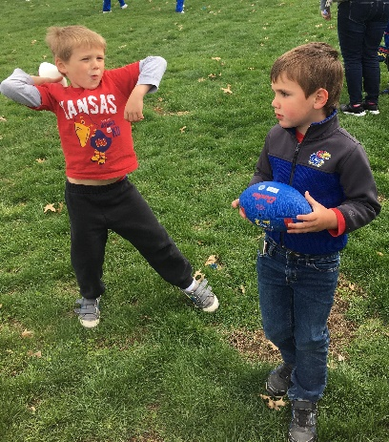
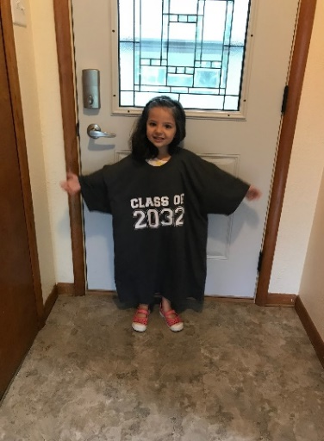
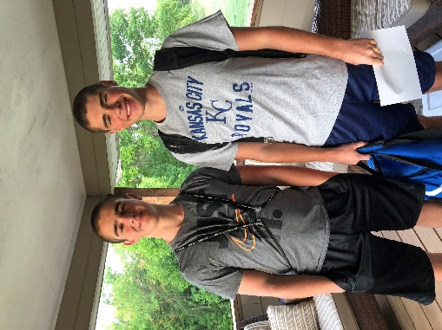
Keep The Main Thing The Main Thing

Slide 53
Closing Comments/Adjournment
Motion to adjourn

Slide 54
SETS Contacts
Bert Moore Director Special Education & Title Services (785) 291-3097 bmoore@ksde.org
Joyce Broils Administrative Specialist Special Education & Title Services (785) 291-3097 jbroils@ksde.org

Slide 55
KSDE Address

