Slide 1
Welcome to the Special Education Advisory Council Meeting
Please be sure your microphone is muted until you wish to participate in an open discussion with the council.
The meeting will start promptly at 9:00 a.m.

Slide 2
How to pin the Interpreters Video
At the top of your meeting window, hover over the video of the participant you want to pin and click ...
From the menu, click Pin.
Optional: If you want to pin additional videos (up to 9 total), follow steps 1 & 2 again as needed.
Optional: If you have at least 3 participants in the meeting and dual monitor enabled, you will have the option to pin to your first screen or your second screen.

Slide 3
Special Education Advisory Council
January 15, 2025

Slide 4
Call to Order
Call to Order Lindsay Graf
Roll Call Joyce Broils

Slide 5
Approvals
Agenda for January 15, 2025. Lindsay Graf
Notes:
Poll I and 2

Slide 6
Public Comment
Guidelines for Testimony
Prior to start of the SEAC meeting, be sure to email Joyce Broils, jbroils@ksde.org expressing desire to speak during public comment.
All comments will be taken under advisement by the council.
Any response from the Council to public comments will come at a later date.
Verbal Public Comment
Verbal comments are limited to three minutes.
Cue will be given one minute before time expires.
Written Testimony
Written input must include the name, address and county of residence of the person submitting comment.
Written comments can be submitted via email, mail, or fax to the secretary of the SEAC.

Slide 7
Stronger Connections Grant
Bonnie Houk
Kristin Heuer
Notes:
Laurie will share her screen

Slide 8
Transitions Grant
Dean Zajic

Slide 9
Break
Notes:
Laurie will share her screen

Slide 10
Fiscal Forum Information
Dean Zajic
Notes:
Laurie will share her screen

Slide 11
Virtual Graduation
Brian Dempsey
Bert Moore
Notes:
Laurie will share her screen

Slide 12
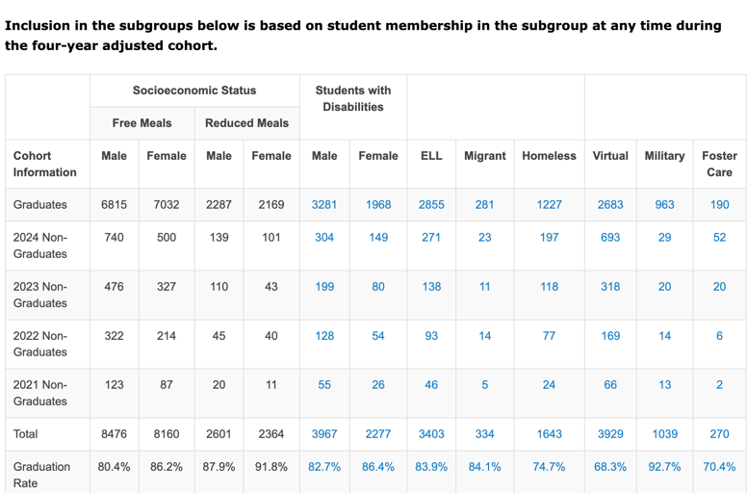
Inclusion in subgroup

Slide 13
Dyslexia Data
Bert Moore
Notes:
Laurie will share her screen

Slide 14
ESI
Trish Backman

Slide 15
Lunch
Notes:
Laurie will share her screen

Slide 16
Indicator 8
Josie McClendon
Brian Dempsey
Notes:
Laurie will share her screen

Slide 17
Indicator 8 Current Survey Question
“Did the school district facilitate involvement as a means for improving services and results for your child?”

Slide 18
Possible Additional Questions
Communication- How well did the district communicate with the parents? Was feedback on communication styles/methods taken into consideration?
Collaboration- How well did the district facilitate a collaborative environment? What was the application of parental feedback/information like during IEP meetings?
Feedback- How well did the district take feedback? Did parents notice changes based on the feedback they provided?

Slide 19
SETS contacts
Bert Moore Director Special Education & Title Services (785) 291-3097 bmoore@ksde.org
Brian Dempsey Assistant Director Special Education & Title Services (785) 296-5522 bmoore@ksde.org

Slide 20
Ex-Officio Member Reports

Slide 21
Ex-Officio Member Reports
Families Together
Kansas Association of Special Education Administrators (KASEA) – Ashley Enz
Disability Rights Center
Kansas State Board of Education
KSSB
KSSD
KNEA
Others

Slide 22
Next Meeting Date
April 22, 2025 – 9:00 a.m. to 3:30 p.m.
Landon State Office Building
900 SE Jackson, Room 509
Topeka, KS 66612

Slide 23
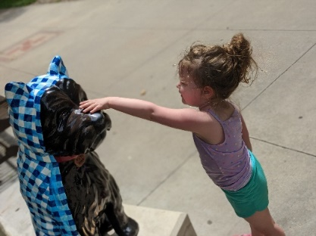
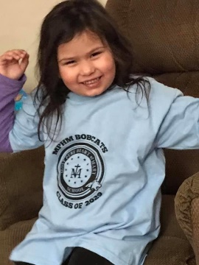
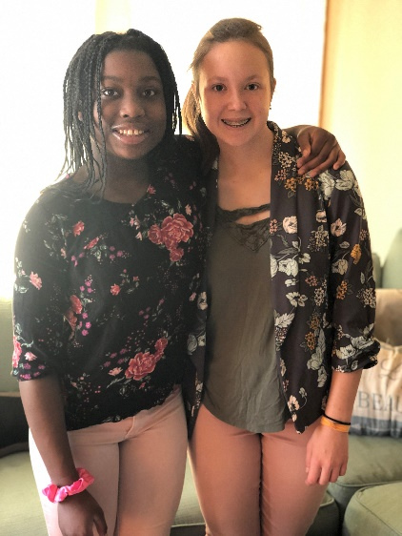
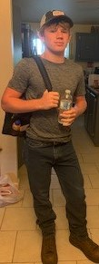
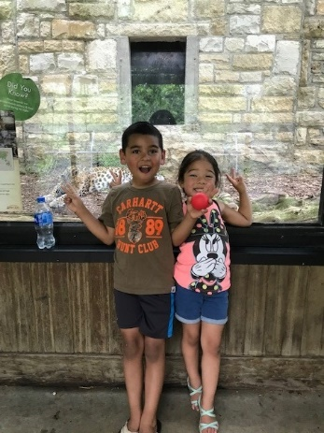
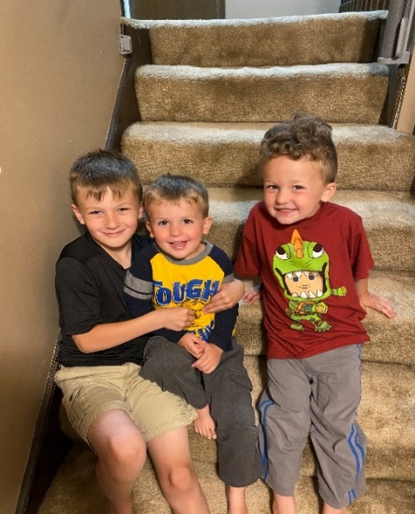
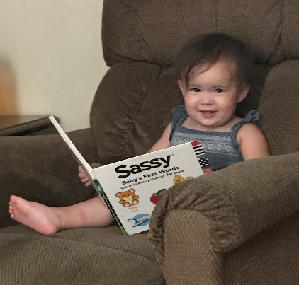
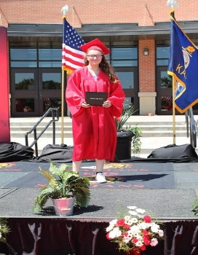
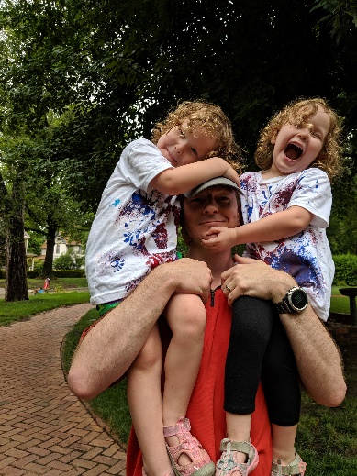
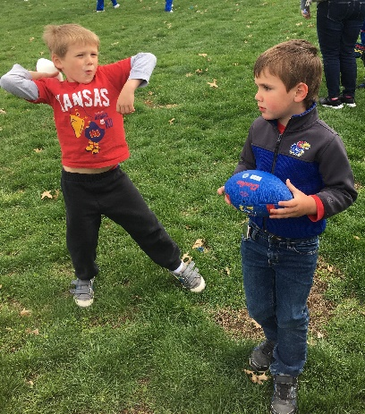
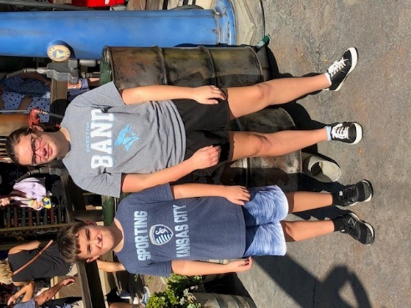
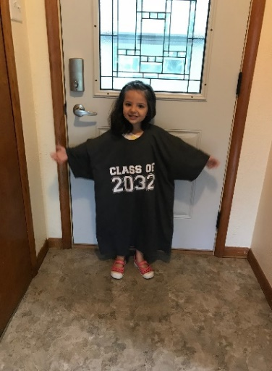
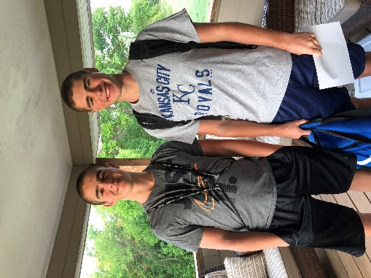
Keep The Main Thing The Main Thing

Slide 24
Closing Comments/Adjournment
Motion to adjourn

Slide 25
SETS contact
Bert Moore Director Special Education & Title Services (785) 291-3097 bmoore@ksde.org
Joyce Broils Administrative Specialist Special Education & Title Services (785) 291-3097 jbroils@ksde.org

Slide 26
Contact-black

