Slide 1
Welcome to the Special Education Advisory Council Meeting
Please be sure your microphone is muted until you wish to participate in an open discussion with the council.
The meeting will start promptly at 9:00 a.m.

Slide 2
How to pin the Interpreters Video
At the top of your meeting window, hover over the video of the participant you want to pin and click ...
From the menu, click Pin.
Optional: If you want to pin additional videos (up to 9 total), follow steps 1 & 2 again as needed.
Optional: If you have at least 3 participants in the meeting and dual monitor enabled, you will have the option to pin to your first screen or your second screen.

Slide 3
Special Education Advisory Council
January 14, 2025

Slide 4
Call to Order
Call to Order Lindsay Graf
Roll Call Joyce Broils

Slide 5
Approvals
Agenda for January 14, 2025. Lindsay Graf
Minutes (November 20, 2024.)
Notes:
Poll I and 2

Slide 6
Public Comment
Guidelines for Testimony
Prior to start of the SEAC meeting, be sure to email Joyce Broils, jbroils@ksde.org expressing desire to speak during public comment.
All comments will be taken under advisement by the council.
Any response from the Council to public comments will come at a later date.
Verbal Public Comment
Verbal comments are limited to three minutes.
Cue will be given one minute before time expires.
Written Testimony
Written input must include the name, address and county of residence of the person submitting comment.
Written comments can be submitted via email, mail, or fax to the secretary of the SEAC.

Slide 7
Introductions of all SICC and SEAC Members
SICC and SEAC Membership
Notes:
Laurie will share her screen

Slide 8
SPP/APR FFY2023
Tricia Waggoner | 1/14/25

Slide 9
FFY2023
FFY 2023
State Performance Plan/Annual Performance Report
July 1, 2023 – June 30, 2024
FFY2023

Slide 10
INTRODUCTION
Kansas Early Childhood Developmental Services (KECDS) Served 11,610 Children in the reporting period (July 1, 2023-June 30, 2024).
KECDS Updated its baseline year to FFY 2021, new targets are in effect for FFY2023 (July 1, 2023-June 30, 2024). This is the first year reporting with these new targets.
KECDS’ General Supervision System includes Determinations, Semi-Annual Reports, Random IFSP Reviews, and Fiscal Audit Reviews
The Kansas Inservice Training System provides Technical Assistance to KECDS.
KECDS makes information available to the public on its website: https://www.kdhe.ks.gov/677

Slide 11
INDICATOR 1
Indicator 1: Timely Provision of Services
Monitoring Priority: Early Intervention Services In Natural Environments
Compliance indicator: Percent of infants and toddlers with Individual Family Service Plans (IFSPs) who receive the early intervention services on their IFSPs in a timely manner. (20 U.S.C. 1416(a)(3)(A) and 1442)
Compliance Indicators are required to be set at 100%
The Kansas’ definition of timely receipt of services is that services will be provided within 30 days from the parent consent to IFSP services.

Slide 12
INDICATOR 1
Indicator 1: Timely Provision of Services
5583 Children with IFSPs all with timely Provision of Services
The definition of slippage is a worsening from the previous data AND a failure to meet the target. The worsening also needs to meet certain thresholds to be considered slippage:
For "large" percentages (10% or above), it is considered slippage if the worsening is more than 1.0 percentage point. For example: It is not slippage if the FFY2023 data for Indicator X are 32% and the FFY2022 data were 32.9% (32% is below target). It is slippage if the FFY2023 data for Indicator X are 32% and the FFY2022 data were 33.1%.
For "small" percentages (less than 10%), it is considered slippage if the worsening is more than 0.1 percentage point. For example: It is not slippage if the FFY2023 data for Indicator Y are 5% and the FFY2022 data were 5.1% (5% is below target). It is slippage if the FFY2023 data for Indicator Y are 4.9% and the FFY2022 data were 5.1%.
FFY2023 TARGET | FFY2023 DATA | STATUS | SLIPPAGE
100% | 100% | MET TARGET | NO SLIPPAGE

Slide 13
INDICATOR 2
Indicator 2: Services in Natural Environments
Monitoring Priority: Early Intervention Services In Natural Environments
Results indicator: Percent of infants and toddlers with IFSPs who primarily receive early intervention services in the home or community-based settings. (20 U.S.C. 1416(a)(3)(A) and 1442)
FFY2023 TARGET | FFY2023 DATA | STATUS | SLIPPAGE
95.00% | 99.86% | MET TARGET | NO SLIPPAGE

Slide 14
INDICATOR 3
Indicator 3: Early Childhood Outcomes
Monitoring Priority: Early Intervention Services In Natural Environments
Results indicator: Percent of infants and toddlers with IFSPs who demonstrate improved:
Positive social-emotional skills (including social relationships);
Acquisition and use of knowledge and skills (including early language/ communication); and
Use of appropriate behaviors to meet their needs.
(20 U.S.C. 1416(a)(3)(A) and 1442)

Slide 15
INDICATOR 3A
Indicator 3A. Percent of infants and toddlers with IFSPs who demonstrate improved positive social-emotional skills (including social relationships)
 | FFY2023 TARGET | FFY2023 DATA | STATUS | SLIPPAGE
A1. Of those children who entered or exited the program below age expectations in Outcome A, the percent who substantially increased their rate of growth by the time they turned 3 years of age or exited the program | 64.63% | 68.28% | MET TARGET | NO SLIPPAGE
A2. The percent of infants and toddlers who were functioning within age expectations in Outcome A by the time they turned 3 years of age or exited the program | 54.97% | 56.09% | MET TARGET | NO SLIPPAGE

Slide 16
INDICATOR 3B
Indicator 3B. Acquisition and use of knowledge and skills (including early language/ communication); and
 | FFY2023 TARGET | FFY2023 DATA | STATUS | SLIPPAGE
B1. Of those children who entered or exited the program below age expectations in Outcome B, the percent who substantially increased their rate of growth by the time they turned 3 years of age or exited the program | 69.19% | 69.82% | MET TARGET | NO SLIPPAGE
B2. The percent of infants and toddlers who were functioning within age expectations in Outcome B by the time they turned 3 years of age or exited the program | 53.50% | 53.56% | MET TARGET | NO SLIPPAGE

Slide 17
INDICATOR 3C
Indicator 3C. Percent of infants and toddlers with IFSPs who demonstrate se of appropriate behaviors to meet their needs
 | FFY2023 TARGET | FFY2023 DATA | STATUS | SLIPPAGE
C1. Of those children who entered or exited the program below age expectations in Outcome C, the percent who substantially increased their rate of growth by the time they turned 3 years of age or exited the program | 72.21% | 74.60% | MET TARGET | NO SLIPPAGE
C2. The percent of infants and toddlers who were functioning within age expectations in Outcome C by the time they turned 3 years of age or exited the program | 58.12% | 57.41% | DID NOT MEET TARGET | NO SLIPPAGE

Slide 18
INDICATOR 3C2
Indicator 3C2. Percent of infants and toddlers with IFSPs who demonstrate use of appropriate behaviors to meet their needs within age expectations
The definition of slippage is a worsening from the previous data AND a failure to meet the target. The worsening also needs to meet certain thresholds to be considered slippage:
For "large" percentages (10% or above), it is considered slippage if the worsening is more than 1.0 percentage point. For example: It is not slippage if the FFY2023 data for Indicator X are 32% and the FFY2022 data were 32.9% (32% is below target). It is slippage if the FFY2023 data for Indicator X are 32% and the FFY2022 data were 33.1%.
For "small" percentages (less than 10%), it is considered slippage if the worsening is more than 0.1 percentage point. For example: It is not slippage if the FFY2023 data for Indicator Y are 5% and the FFY2022 data were 5.1% (5% is below target). It is slippage if the FFY2023 data for Indicator Y are 4.9% and the FFY2022 data were 5.1%.
FFY2022 DATA | FFY2023 DATA | STATUS | SLIPPAGE
56.79% | 57.41% | DID NOT MEET TARGET | NO SLIPPAGE

Slide 19
INDICATOR 4
 | FFY2023 TARGET | FFY2023 DATA | STATUS | SLIPPAGE
A. Percent of families participating in Part C who report that early intervention services have helped the family know their rights | 93.74% | 94.54% | MET TARGET | NO SLIPPAGE
B. Percent of families participating in Part C who report that early intervention services have helped the family effectively communicate their children's needs | 95.00% | 96.06% | MET TARGET | NO SLIPPAGE
C. Percent of families participating in Part C who report that early intervention services have helped the family help their children develop and learn | 94.25% | 95.30% | MET TARGET | NO SLIPPAGE

Slide 20
INDICATOR 4
Indicator 4: Family Involvement
Monitoring Priority: Early Intervention Services In Natural Environments
Results indicator: Percent of families participating in Part C who report that early intervention services have helped the family:
A. Know their rights;
B. Effectively communicate their children's needs; and
C. Help their children develop and learn.
(20 U.S.C. 1416(a)(3)(A) and 1442)
Based on Family Outcome Survey. KECDS increased survey returns from 11.01% in FFY2021 to 19.80% in FFY2023.

Slide 21
INDICATOR 5
Indicator 5: Child Find (Birth to One)
Monitoring Priority: Effective General Supervision Part C / Child Find
Results indicator: Percent of infants and toddlers, birth to 1 with IFSPs. (20 U.S.C. 1416(a)(3)(B) and 1442)
Kansas consistently ranks above average in the nation on our Child Find Indicators (Indicators 5 and 6).
FFY203 TARGET | FFY2023 DATA | STATUS | SLIPPAGE
2.20% | 2.02% | DID NOT MEET TARGET | NO SLIPPAGE

Slide 22
INDICATOR 6
Indicator 6: Child Find (Birth to Three)
Monitoring Priority: Effective General Supervision Part C / Child Find
Results indicator: Percent of infants and toddlers, birth to 3 with IFSPs. (20 U.S.C. 1416(a)(3)(B) and 1442)
Kansas consistently ranks above average in the nation on our Child Find Indicators (Indicators 5 and 6).
FFY2022 TARGET | FFY2022 DATA | STATUS | SLIPPAGE
5.18% | 5.38% | MET TARGET | NO SLIPPAGE

Slide 23
INDICATOR 7
Indicator 7: 45-Day Timeline
Monitoring Priority: Effective General Supervision Part C / Child Find
Compliance indicator: Percent of eligible infants and toddlers with IFSPs for whom an initial evaluation and initial assessment and an initial IFSP meeting were conducted within Part C’s 45-day timeline. (20 U.S.C. 1416(a)(3)(B) and 1442)
Compliance Indicators are required to be set at 100%
FFY2023 TARGET | FFY 2023 DATA | STATUS | SLIPPAGE
100% | 99.82% | DID NOT MEET TARGET | NO SLIPPAGE

Slide 24
INDICATOR 8A
Indicator 8A: Early Childhood Transition
Monitoring Priority: Effective General Supervision Part C / Effective Transition
Compliance indicator: The percentage of toddlers with disabilities exiting Part C with timely transition planning for whom the Lead Agency has:
Developed an IFSP with transition steps and services at least 90 days, and at the discretion of all parties, not more than nine months, prior to the toddler’s third birthday;
Compliance Indicators are required to be set at 100%
FFY2023 TARGET | FFY 2023 DATA | STATUS | SLIPPAGE
100% | 99.87% | DID NOT MEET TARGET | NO SLIPPAGE

Slide 25
INDICATOR 8B
Indicator 8B: Early Childhood Transition
Monitoring Priority: Effective General Supervision Part C / Effective Transition
Compliance indicator: The percentage of toddlers with disabilities exiting Part C with timely transition planning for whom the Lead Agency has:
B. Notified (consistent with any opt-out policy adopted by the State) the SEA and the LEA where the toddler resides at least 90 days prior to the toddler’s third birthday for toddlers potentially eligible for Part B preschool services;
Compliance Indicators are required to be set at 100%
FFY2023 TARGET | FFY 2023 DATA | STATUS | SLIPPAGE
100% | 99.31% | DID NOT MEET TARGET | NO SLIPPAGE

Slide 26
INDICATOR 8C
Indicator 8C: Early Childhood Transition
Monitoring Priority: Effective General Supervision Part C / Effective Transition
Compliance indicator: The percentage of toddlers with disabilities exiting Part C with timely transition planning for whom the Lead Agency has:
C. Conducted the transition conference held with the approval of the family at least 90 days, and at the discretion of all parties, not more than nine months, prior to the toddler’s third birthday for toddlers potentially eligible for Part B preschool services.
Compliance Indicators are required to be set at 100%
FFY2023 TARGET | FFY 2023 DATA | STATUS | SLIPPAGE
100% | 99.80% | DID NOT MEET TARGET | NO SLIPPAGE

Slide 27
INDICATOR 8
INDICATOR 8 | FFY2020 DATA | FFY2021 DATA | FFY2022 DATA | FFY2023 DATA
A. Developed an IFSP with transition steps and services | 98.27% | 99.76% | 99.85% | 99.87%
B. Notified the SEA and the LEA | 98.73% | 99.18% | 99.31% | 99.31%
C. Conducted the transition conference | 99.24% | 99.32% | 99.62% | 99.80%

Slide 28
INDICATOR 9 & 10
Indicator 9: Resolution Sessions
Monitoring Priority: Effective General Supervision Part C / General Supervision
Results indicator: Percent of hearing requests that went to resolution sessions that were resolved through resolution session settlement agreements (applicable if Part B due process procedures are adopted). (20 U.S.C. 1416(a)(3)(B) and 1442)
This indicator is not applicable to a State that has adopted Part C due process procedures under section 639 of the IDEA
Indicator 10: Mediation
Monitoring Priority: Effective General Supervision Part C / General Supervision
Results indicator: Percent of mediations held that resulted in mediation agreements. (20 U.S.C. 1416(a)(3)(B) and 1442)
States are not required to establish baseline or targets if the number of mediations is less than 10. In a reporting period when the number of mediations reaches 10 or greater, the State must develop baseline and targets and report them in the corresponding SPP/APR.

Slide 29
INDICATOR 11
Indicator 11. Percent of Medicaid eligible infants and toddlers with IFSPs who demonstrate positive social emotional skills within age expectations
The definition of slippage is a worsening from the previous data AND a failure to meet the target. The worsening also needs to meet certain thresholds to be considered slippage:
For "large" percentages (10% or above), it is considered slippage if the worsening is more than 1.0 percentage point. For example: It is not slippage if the FFY2023 data for Indicator X are 32% and the FFY2022 data were 32.9% (32% is below target). It is slippage if the FFY2023 data for Indicator X are 32% and the FFY2022 data were 33.1%.
For "small" percentages (less than 10%), it is considered slippage if the worsening is more than 0.1 percentage point. For example: It is not slippage if the FFY2023 data for Indicator Y are 5% and the FFY2022 data were 5.1% (5% is below target). It is slippage if the FFY2023 data for Indicator Y are 4.9% and the FFY2022 data were 5.1%.
FFY2023 TARGET | FFY2023 DATA | STATUS | SLIPPAGE
45.20% | 45.80% | MET TARGET | NO SLIPPAGE

Slide 30
INDICATOR 12
Indicator 12: General Supervision
Monitoring Priority: Effective General Supervision Part C
Compliance indicator: This SPP/APR indicator focuses on the State lead agency’s exercise of its general supervision responsibility to monitor its Early Intervention Service (EIS) Providers and EIS Programs for requirements under Part C of the Individuals with Disabilities Act (IDEA) through the State’s reporting on timely correction of noncompliance.
Compliance Indicators are required to be set at 100%
FFY2023 TARGET | FFY 2023 DATA | STATUS | SLIPPAGE
100% | 100% | MET TARGET | NO SLIPPAGE

Slide 31
Thank you/Questions
SPP/APR FFY2023

Slide 32
Break
Notes:
Laurie will share her screen

Slide 33
SEAC SPP/APR
Brian Dempsey
Notes:
Laurie will share her screen

Slide 34
SICC ESIDS
Trevor Huffman
Notes:
Laurie will share her screen

Slide 35
FY23 SLDS Grant Early Childhood Integrated Data System

Slide 36
What is an SLDS?
Statewide Longitudinal Data System
A data system that combines data from multiple agencies to help answer questions about student learning and outcomes. SLDS can include data from early childhood education, K-12 schools, community colleges, four-year colleges and universities, workforce programs, and services.
An SLDS can:
Help educators identify students' academic strengths and weaknesses
Increase student achievement
Close achievement gaps
Identify and address potential recurring impediments to student learning

Slide 37
What is an Early Childhood Integrated Data System?
An Early Childhood Integrated Data System (ECIDS):
Collects, integrates, maintains, stores, and reports information from early childhood programs across multiple agencies within a state that serve children and families from birth to age eight

Slide 38
Why ECIDS?
Data Integration is a high priority for those seeking to make data-informed decisions
Facilitates the technical and organizational collaboration that leads to data-informed cross-program planning and decision-making
Integrating data supports both child and family outcomes
Allows decisions to be made to improve services
Public Health Issues span multiple sectors
Childhood illness not only falls on healthcare providers, but it also falls on educators, schools, families, and communities

Slide 39
Expected Outcomes of the Grant
Connecting early childhood data from multiple systems, programs, and state agencies to affect positive outcomes and policy for children to thrive.
A robust data governance system that ensures the ECIDS provides data that is secure, valid, reliable, actionable and provides useful insights for informed decision-making.
The ability to calculate a distinct count by assigning every child participating in early childhood programs a unique identifier that is consistent across early childhood platforms and remains constant throughout PK-12.

Slide 40
Expected Outcomes of the Grant
Architect a centralized ECIDS infrastructure that is flexible enough to stand alone, is scalable, and integrates with the P20W SLDS.
Produce customizable data analytics dashboards to provide reliable, high-quality, actionable data to early childhood and education stakeholders.

Slide 41
Contact Us
Kyle Lord
Assistant Director
Information Technology
klord@ksde.org
Trevor Huffman
Data Coordinator
Early Childhood
thuffman@ksde.org
Mike Jordan
Information Systems Manager
Information Technology
mjordan@ksde.org
Tammy Blaess
Developer
Information Technology
tblaess@ksde.org
Eric Dehner
Requirements Analyst
Information Technology
edehner@ksde.org

Slide 42
SICC & SEAC C to B
Brian Dempsey
Stacy Clarke
Notes:
Laurie will share her screen

Slide 43
Lunch
Notes:
Laurie will share her screen

Slide 44
Medicaid Billing
Heather Gould

Slide 45
Legislative Discussion
Frank Harwood
Notes:
Laurie will share her screen

Slide 46
Ex-Officio Member Reports

Slide 47
Ex-Officio Member Reports
Families Together
Kansas Association of Special Education Administrators (KASEA) – Ashley Enz
Disability Rights Center
Kansas State Board of Education
KSSB
KSSD
KNEA
Others

Slide 48
Items for April SEAC Agenda
SEAC Members

Slide 49
Next Meeting Date
January 15, 2025 – 8:00 a.m. to 9:00 a.m. Breakfast with the Board and 9:00 a.m. to 1:15 p.m.
Meeting.
Breakfast with the Board
900 SE Jackson, Room 509
Topeka, KS 66612

Slide 50
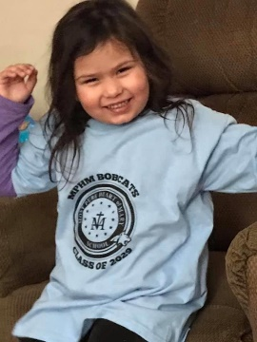
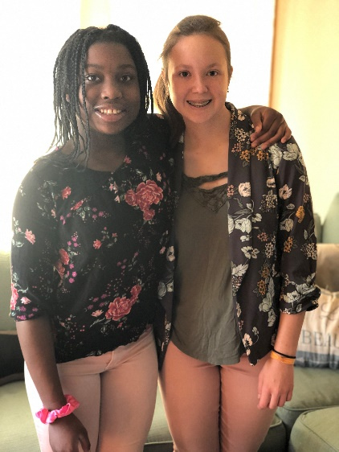
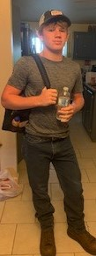
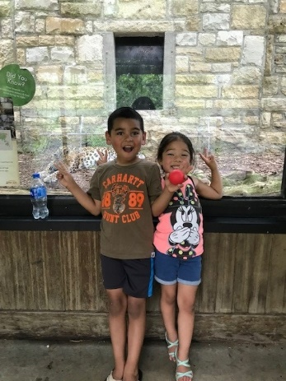
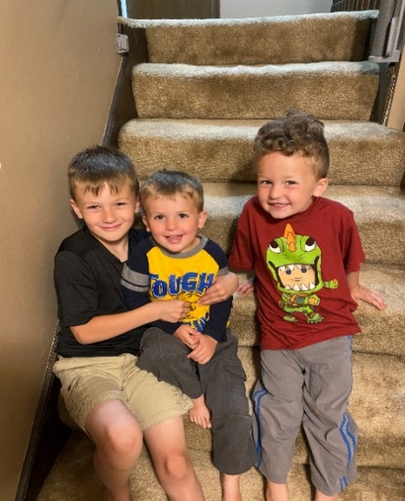
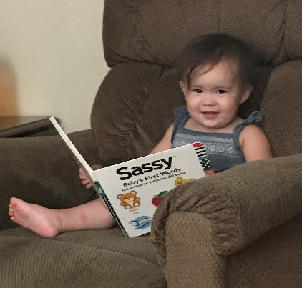
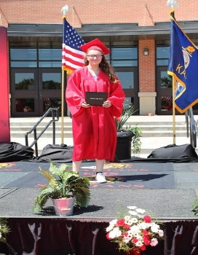
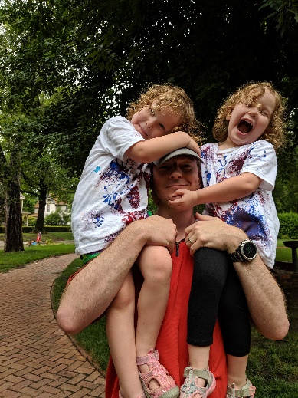
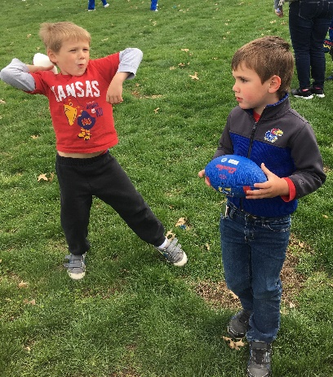
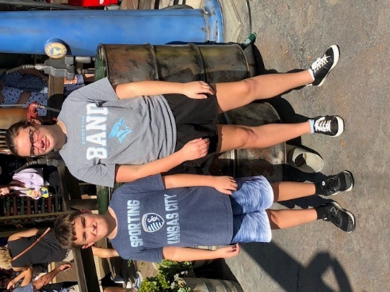
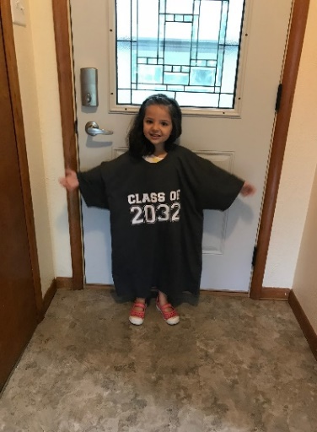
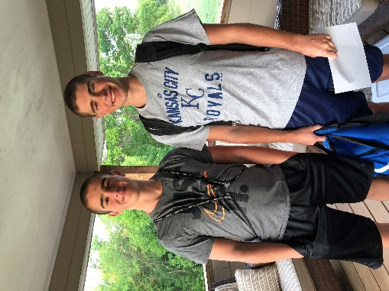
Keep The Main Thing The Main Thing

Slide 51
Closing Comments/Adjournment
Motion to adjourn

Slide 52
SETS contact
Bert Moore Director Special Education & Title Services (785) 291-3097 bmoore@ksde.org
Joyce Broils Administrative Specialist Special Education & Title Services (785) 291-3097 jbroils@ksde.org

Slide 53
KSDE address

