Slide 1
Welcome to the Special Education Advisory Council Meeting
Please be sure your microphone is muted until you wish to participate in an open discussion with the council.
The meeting will start promptly at 9:00 a.m.

Slide 2
How to pin the Interpreters Video
At the top of your meeting window, hover over the video of the participant you want to pin and click ...
From the menu, click Pin.
Optional: If you want to pin additional videos (up to 9 total), follow steps 1 & 2 again as needed.
Optional: If you have at least 3 participants in the meeting and dual monitor enabled, you will have the option to pin to your first screen or your second screen.

Slide 3
Special Education Advisory Council
November 20, 2024

Slide 4
Call to Order
Call to Order Lindsay Graf
Roll Call Joyce Broils

Slide 5
Approvals
Agenda for September 24, 2024 Lindsay Graf
Minutes (July 24, 2024, and September 25, 2024.)
Notes:
Poll I and 2

Slide 6
Public Comment
Guidelines for Testimony
Prior to start of the SEAC meeting, be sure to email Joyce Broils, jbroils@ksde.org expressing desire to speak during public comment.
All comments will be taken under advisement by the council.
Any response from the Council to public comments will come at a later date.
Verbal Public Comment
Verbal comments are limited to three minutes.
Cue will be given one minute before time expires.
Written Testimony
Written input must include the name, address and county of residence of the person submitting comment.
Written comments can be submitted via email, mail, or fax to the secretary of the SEAC.

Slide 7
Part C to B Transitions
Brian Dempsey
Bert Moore
Notes:
Laurie will share her screen

Slide 8
Part C to B Transitions
Bert Moore
Brian Dempsey

Slide 9
Part C to B Transitions
Refers to the coordination of public awareness, child find, screening, referral, evaluation to ensure the smooth and effective transition of children as they move from early intervention services under Part C into Part B early childhood special education programs and services for the benefit of children and families.
Part C lead agency: KDHE
Part B lead agency: KSDE

Slide 10
Contact part c to b
Bert Moore Director Special Education & Title Services (785) 291-3097 bmoore@ksde.org
Brian Dempsey Assistant Director Special Education & Title Services (785) 296-5522 bmoore@ksde.org

Slide 11
OSEP Items of Concern
Brian Dempsey
Bert Moore

Slide 12
Identification and Correction of NonCompliance
Data Collection
Representativeness
Self-Assessment File Reviews
Ensuring Correction-sufficiency of data review
Part 619 Monitoring-beyond Indicator 12
Monitoring of LEAs-KSDE monitors all districts through cyclical monitoring

Slide 13
Data
Ensure public reporting at LEA level, when required, i.e. Indicator 4
Include Levels of Determination at LEA level

Slide 14
Dispute Resolution
Mediation Agreement-Confidentiality and Staying of a Formal Complaint
Tracking-Due Process
Hearing Officer and Complaint Investigator Training
Procedure/Process Documents
Expedited Due Process-Resolution Session and extension of timeline.

Slide 15
Child Find
Discussion regarding ensuring GEI, MTSS or RTI do not delay child find obligations.

Slide 16
Next Steps
KSDE will continue working with TA Centers
OSEP DMS Monitoring Report: Due 120 days from closure of onsite.

Slide 17
contacts
Bert Moore Director Special Education & Title Services (785) 291-3097 bmoore@ksde.org
Brian Dempsey Assistant Director Special Education & Title Services (785) 296-5522 bmoore@ksde.org

Slide 18
Break
Notes:
Laurie will share her screen

Slide 19
Answer Questions on Virtual Programs
Brian Dempsey
Melissa Valenza
Kelly Steele
Notes:
Laurie will share her screen

Slide 20
Lunch
Notes:
Laurie will share her screen

Slide 21
KIAS Stakeholders
Lindsay Graf

Slide 22
KIAS Stakeholder Meeting Review
Indicator 18
Brian will review today (next agenda item)
Statewide IEP Update
IT says they can do it
Next Step is sending out for RFI’s
RFI stands for Request for Information, a formal document that companies use to gather information from vendors or suppliers
District Level of Determination
Reviewing the rewards and sanctions to see if still working to incentivize
APR guide being updated
Monitoring
Virtual Schools are being monitored, specifically ensuring that files are pulled that are students enrolled in the virtual school
Discussed IDEA and Gifted File review process and procedures
Discussed the Adult Jails Monitoring

Slide 23
KIAS Stakeholder Meeting Review
Transition
Discussed various transition initiatives and programs throughout the state
Some pilot programs are starting transition at age 12 (not a requirement)
Professional Development
Overview of PD opportunities for directors and staff
Discussed PD opportunities for GEN. Ed administrators especially at the building level
Next Meeting
April 24th

Slide 24
SPP/APR 2023, Ind 1-17 & Ind 18
Brian Dempsey
Notes:
Laurie will share her screen

Slide 25
SPP/APR
Bert Moore
Brian Dempsey

Slide 26
FFY 2023 SPP/APR

Slide 27
SPP/APR Indicators
Indicator 1: Graduation
Indicator 2: Drop Out
Indicator 3A: Participation for Students with IEPS
Indicator 3B: Proficiency for Students with IEPs (Grade Level Academic Achievement Standards)
Indicator 3C: Proficiency for Students with IEPs (Alternate Academic Achievement Standards)
Indicator 3D: Gap in Proficiency Rates (Grade Level Academic Achievement Standards)
Indicator 4A: Suspension/Expulsion
Indicator 4B: Suspension/Expulsion by Race/Ethnicity
Indicator 5: Education Environments (5-year-old kindergarteners–21)
Indicator 6: Preschool Environments
Indicator 7: Preschool Outcomes
Indicator 8: Parent Involvement
Indicator 9: Disproportionate Representation
Indicator 10: Disproportionate Representation in Specific Disability Categories
Indicator 11: Child Find
Indicator 12: Early Childhood Transition
Indicator 13: Secondary Transition
Indicator 14: Post-School Outcomes
Indicator 15: Resolution Sessions
Indicator 16: Mediation
Indicator 17: State Systemic Improvement Plan
Indicator 18: General Supervision

Slide 28
Kansas Performance on the FFY 2023 SPP/APR
Indicator | Did Kansas Meet the Target? | Did Kansas have Slippage?
1: Graduation | Baseline Year: FFY 20 Met Target | No Slippage
2: Drop Out | Baseline Year: FFY 21 Met Target | No Slippage
3A: Participation for Students with IEPs | Baseline Year: FFY 20 | Data Upload January 2025
3B: Proficiency for Students with IEPs (Grade Level Academic Achievement Standards) | Baseline Year: FFY 20 | Data Upload January 2025
3C: Proficiency for Students with IEPs (Alternate Academic Achievement Standards) | Baseline Year: FFY 20 | Data Upload January 2025
3D: Gap in Proficiency Rates (Grade Level Academic Achievement Standards) | Baseline Year: FFY 20 | Data Upload January 2025
4A: Suspension/Expulsion | Baseline Year: FFY 22 | Data Finalized January
4B: Suspension/Expulsion by Race/Ethnicity | Baseline Year: FFY 22 Compliance | Data Finalized January
5: Education Environments (5-year-old kindergarteners-21) | Baseline Year: FFY 19 Met Target for 5A, 5B, and 5C | No Slippage for 5A, 5B, and 5C

Slide 29
Kansas Performance on the FFY 2023 SPP/APR
Indicator | Did Kansas Meet the Target? | Did Kansas have Slippage?
6: Preschool Environments | Baseline Year: FFY 19 for 6A and 6B, and FFY 20 for 6C Met all targets | No Slippage
7: Preschool Outcomes | Baseline Year: FFY 08 Met Target for 7B2 and Did Not Meet Target for 7A, 7B1, and 7C | Slippage for 7A, 7B1 and 7C
8: Parent Involvement | Baseline Year: FFY 21 | Data Finalized December
9: Disproportionate Representation | Baseline Year: FFY 20 (Compliance) | Data Finalized December
10: Disproportionate Representation in Specific Disability Categories | Baseline Year: FFY 20 (Compliance) | Data Finalized December
11: Child Find | Baseline Year: FFY 05 Did Not Meet Target (Compliance) | No Slippage

Slide 30
Kansas Performance on the FFY 2022 SPP/APR
Indicator | Did Kansas Meet the Target? | Did Kansas have Slippage?
12: Early Childhood Transition | Baseline Year: FFY 05 (Compliance) | Data Finalized December
13: Secondary Transition | Baseline Year: FFY 09 Did Not Meet Target (Compliance) | No Slippage
14: Post-School Outcomes | Baseline Year: FFY 09 Met Target for 14A and 14B and Did Not Meet Target for 14C | No Slippage
15: Resolution Sessions | Baseline Year: FFY 05 | Data Finalized December
16: Mediation | Baseline Year: FFY 13 | Data Finalized December
17: State Systemic Improvement Plan | Baseline Year: FFY 21 Did Not Meet Target | Data Finalized December
18: General Supervision | Baseline Year: FFY 23 | Data Finalized December

Slide 31
OSEP Required Actions: Compliance Indicators
Because the State reported less than 100% compliance (greater than 0% actual target data for this indicator) for FFY 2022, the State must report on the status of correction of noncompliance identified in FFY 2022 for this indicator. The State must demonstrate, in the FFY 2023 SPP/APR, that the districts identified with noncompliance in FFY 2022 have corrected the noncompliance, including that the State verified that each district with noncompliance: (1) is correctly implementing the specific regulatory requirement(s) (i.e., achieved 100% compliance) based on a review of updated data, such as data subsequently collected through on-site monitoring or a State data system; and (2) has corrected each individual case of noncompliance, unless the child is no longer within the jurisdiction of the district, consistent with OSEP QA 23-01.
In the FFY 2023 SPP/APR, the State must describe the specific actions that were taken to verify the correction. If the State did not identify any findings of noncompliance in FFY 2022, although its FFY 2022 data reflect less than 100% compliance (greater than 0% actual target data for this indicator), provide an explanation of why the State did not identify any findings of noncompliance in FFY 2022.

Slide 32
OSEP Required Actions: Indicator 10
Because the State reported less than 100% compliance for FFY 2022 (greater than 0% actual target data for this indicator), the State must report on the status of correction of noncompliance identified in FFY 2022 for this indicator. The State must demonstrate, in the FFY 2023 SPP/APR, that the two districts identified in FFY 2022 with disproportionate representation of racial and ethnic groups in specific disability categories that was the result of inappropriate identification are in compliance with the requirements in 34 C.F.R. §§ 300.111, 300.201, and 300.301 through 300.311.
If the State did not identify any findings of noncompliance in FFY 2022, although its FFY 2022 data reflect less than 100% compliance (greater than 0% actual target data for this indicator), provide an explanation of why the State did not identify any findings of noncompliance in FFY 2022.
Further, the State must demonstrate, in the FFY 2023 SPP/APR, that the remaining district identified in FFY 2021 with disproportionate representation of racial and ethnic groups in specific disability categories that was the result of inappropriate identification, are in compliance with the requirements in 34 C.F.R. §§ 300.111, 300.201, and 300.301 through 300.311. In demonstrating the correction of the noncompliance identified in FFY 2021, the State must report, in the FFY 2023 SPP/APR, that the State verified that each district with noncompliance identified in FFY 2022 and the one district with remaining noncompliance identified in FFY 2021: (1) is correctly implementing the specific regulatory requirement(s) (i.e., achieved 100% compliance) based on a review of updated data such as data subsequently collected through on-site monitoring or a State data system; and (2) has corrected each individual case of noncompliance, unless the child is no longer within the jurisdiction of the district, consistent with OSEP QA 23-01. In the FFY 2023 SPP/APR, the State must describe the specific actions that were taken to verify the correction.

Slide 33
OSEP Required Actions: Indicator 8
In the FFY 2023 SPP/APR, the State must report whether the FFY 2023 data are from a response group that is representative of the demographics of children receiving special education services, and, if not, the actions the State is taking to address this issue. The State must also include its analysis of the extent to which the response data are representative of the demographics of children receiving special education services.

Slide 34
OSEP Required Actions: Indicator 14
In the FFY 2023 SPP/APR, the State must report whether the FFY 2023 data are representative of the demographics of youth who are no longer in secondary school and had IEPs in effect at the time they left school, and, if not, the actions the State is taking to address this issue. The State must also include its analysis of the extent to which the response data are representative of the demographics of youth who are no longer in secondary school and had IEPs in effect at the time they left school.

Slide 35
Contacts 2
Bert Moore Director Special Education & Title Services (785) 291-3097 bmoore@ksde.org
Brian Dempsey Assistant Director Special Education & Title Services (785) 296-5522 bmoore@ksde.org

Slide 36
Break
Notes:
Laurie will share her screen

Slide 37
Kansas State Assessments Results
SY 2023-2024
SEAC Presentation November 2024

Slide 38
Testing Window 2023-2024
General Assessments: ELA, Math, & Science
March 18 - April 19 (In-person Testing)
April 22- May 3 (Remote testing for virtual students)
Dynamic Learning Maps (DLM): ELA, Math, & Science*
Fall Window- 9/11/2023 to 12/26/2023
Spring Window*- 2/05/2024 to 4/26/2024

Slide 39
General Summative Assessments
Subject | Grades | Estimated Time to Complete (untimed)
Mathematics | 3 - 8, and 10 | Two Sessions, 45-60 minutes each
ELA | 3 - 8, and 10 | Two Sessions, 45-60 minutes each
Science | 5, 8, and 11 | Two Sessions, 45-60 minutes each

Slide 40
Current Performance Level Descriptors
Level 1: A student at Level 1 shows a limited ability to understand and use the skills and knowledge needed for postsecondary readiness.
Level 2: A student at Level 2 shows a basic ability to understand and use the skills and knowledge needed for postsecondary readiness.
Level 3: A student at Level 3 shows an effective ability to understand and use the skills and knowledge needed for postsecondary readiness.
Level 4: A student at Level 4 shows an excellent ability to understand and use the skills and knowledge needed for postsecondary readiness.
Notes:
Fact Sheet

Slide 41
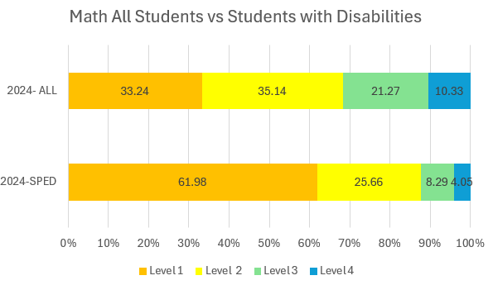
Math

Slide 42
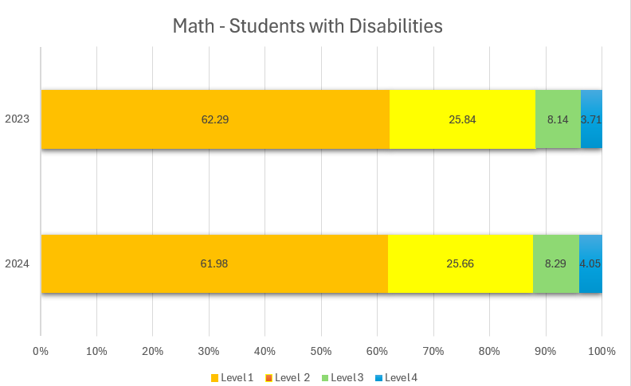
Math students w/disabilites

Slide 43
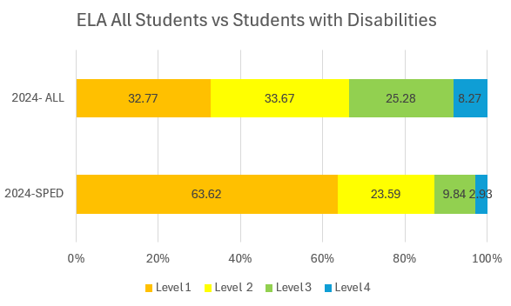
ELA all vs

Slide 44
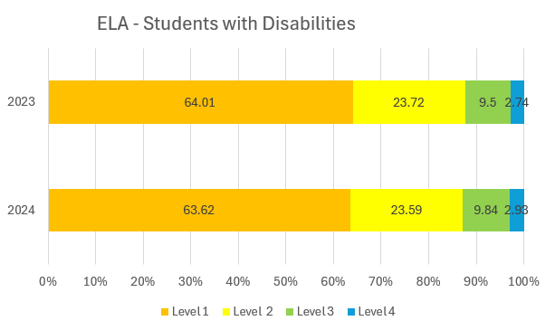
ELA students with disabilities

Slide 45
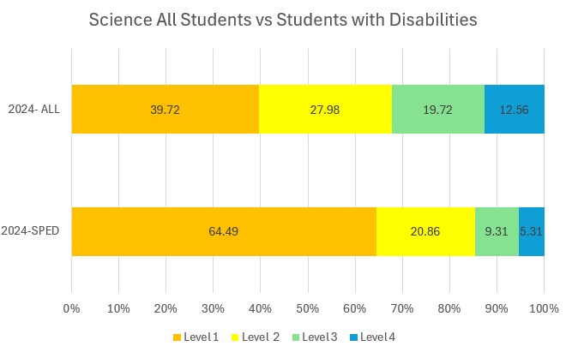
Science all vs

Slide 46
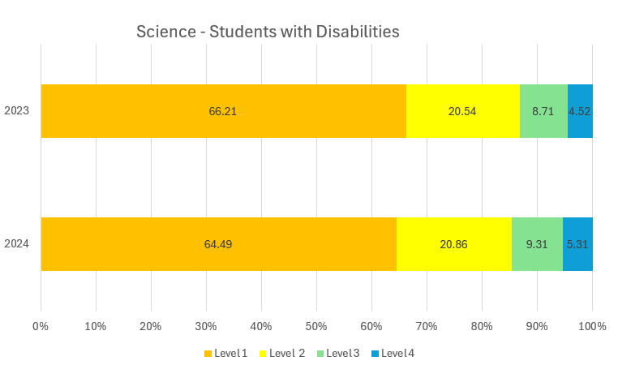
Science students w

Slide 47
Contact testing
Julie Ewing
Assistant Director
Career, Standards and Assessment Services
785-296-2325
jewing@ksde.org
www.ksde.org

Slide 48
Indicator 8 – Get parents more involved. Stakeholders Feedback
Brian Dempsey

Slide 49
Indicator 8 Current Survey Question
“Did the school district facilitate involvement as a means for improving services and results for your child?”

Slide 50
Possible Topic Areas
Parent Rights/Procedural Safeguards
Parent Involvement and Participation
Training and Information
Communication

Slide 51
Contacts 3
Bert Moore Director Special Education & Title Services (785) 291-3097 bmoore@ksde.org
Brian Dempsey Assistant Director Special Education & Title Services (785) 296-5522 bmoore@ksde.org

Slide 52
Discuss September Site Visit to KSD and KSSB
Membership

Slide 53
Ex-Officio Member Reports

Slide 54
Ex-Officio Member Reports
Families Together
Kansas Association of Special Education Administrators (KASEA) – Ashley Enz
Disability Rights Center
Kansas State Board of Education
KSSB
KSSD
KNEA
Others

Slide 55
Items for January SEAC Agenda
SEAC Members

Slide 56
Next Meeting Date
January 14, 2025 – 9:00 a.m. to 3:30 p.m.
Bishop Professional Development Center
3601 SW 31st St
Topeka, KS 66614
January 15, 2025 – 8:00 a.m. to 9:00 a.m. Breakfast with the Board and 9:00 a.m. to 3:30 p.m.
Meeting.
Breakfast with the Board
900 SE Jackson, Room 509
Topeka, KS 66612

Slide 57
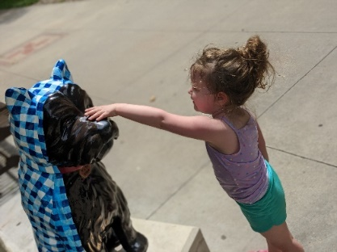
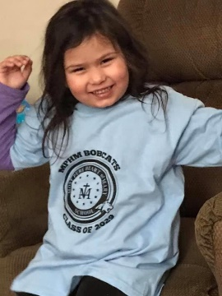
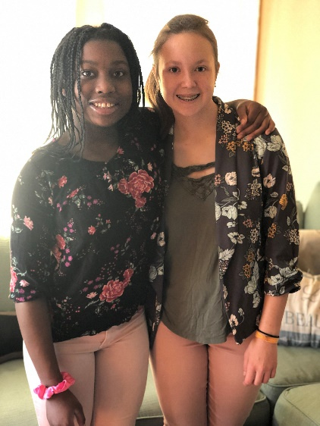
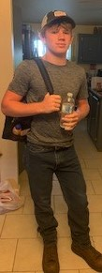
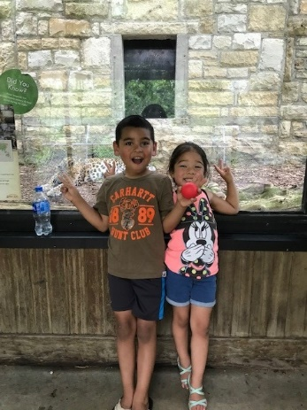
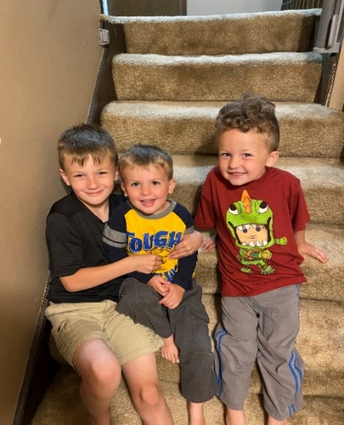
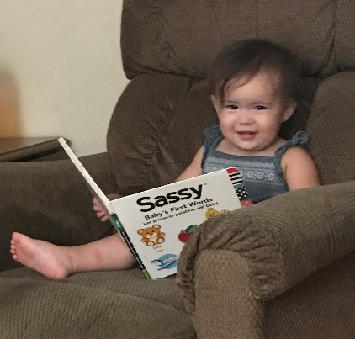
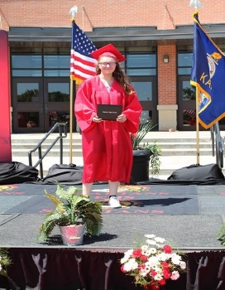
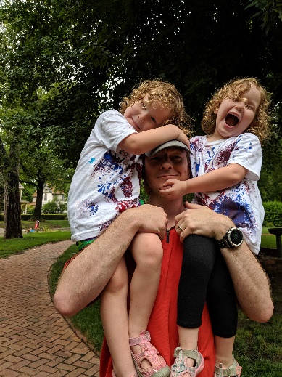
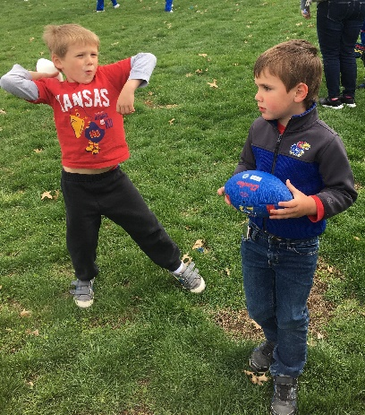
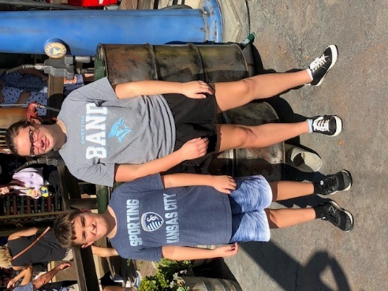
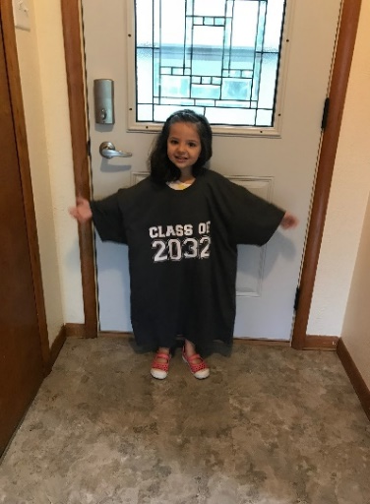
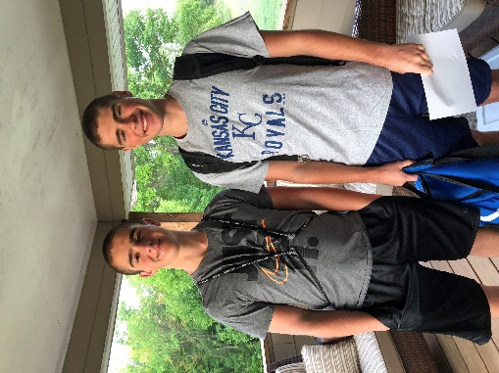
Keep The Main Thing The Main Thing

Slide 58
Closing Comments/Adjournment
Motion to adjourn

Slide 59
Contacts overall
Bert Moore Director Special Education & Title Services (785) 291-3097 bmoore@ksde.org
Joyce Broils Administrative Specialist Special Education & Title Services (785) 291-3097 jbroils@ksde.org

Slide 60
eeoc

