Slide 1
Welcome to the Special Education Advisory Council Meeting
Please be sure your microphone is muted until you wish to participate in an open discussion with the council.
The meeting will start promptly at 9:00 a.m.

Slide 2
How to pin the Interpreters Video
At the top of your meeting window, hover over the video of the participant you want to pin and click ...
From the menu, click Pin.
Optional: If you want to pin additional videos (up to 9 total), follow steps 1 & 2 again as needed.
Optional: If you have at least 3 participants in the meeting and dual monitor enabled, you will have the option to pin to your first screen or your second screen.

Slide 3
Special Education Advisory Council
July 24, 2024

Slide 4
Call to Order
Welcome – Introductions:
Autumn Biltz - individual with disability,
Jennifer Florez – Teacher Special Education,
Bradley Miller – Representative from the State Juvenile Corrections agency, Effective 7/1/2024.
Sydney Dringman – Representative from State Agency Responsible for Foster Care of Children
Roll Call

Slide 5
Approvals
Agenda for today, July 24, 2024
Minutes (April 11, 2024)
Notes:
Poll I and 2

Slide 6
Public Comment
Guidelines for Testimony
  Prior to start of the SEAC meeting, be sure to email Joyce Broils, jbroils@ksde.org expressing desire to speak during public comment.
  All comments will be taken under advisement by the council.
  Any response from the Council to public comments will come at a later date.
Verbal Public Comment
  Verbal comments are limited to three minutes.
  Cue will be given one minute before time expires.
Written Testimony
  Written input must include the name, address and county of residence of the person submitting comment.
  Written comments can be submitted via email, mail, or fax to the secretary of the SEAC.

Slide 7
Discuss OSEP Questions
Membership
Notes:
Laurie will share her screen

Slide 8
OSEP Questions
Describe the State Advisory Panel (SAP) role in advising the State on unmet needs of infants, toddlers, children, and you with disabilities?
Describe the SAP role in advising the state on rules or regulations related to the Individual with Disabilities Education Act (IDEA)?
Describe the SAP role in the development of evaluations and reporting data?
Describe the State’s process on developing and implementing policies related to the coordination of services for children with disabilities?
Describe the SAP involvement in assisting the State Educational Agency (SEA) in achieving the full participation, coordination, and cooperation of all appropriate public agencies in the State?
Describe the SAP involvement in assisting the SEA in effective implementation of the State’s Systemic Improvement Plan?
Describe the SAP role to the extent appropriate in developing dispute resolution policies and procedures?
Describe the frequency and method of meeting with the SEA?
Describe the SAP role in advising the State on its general supervision system?
Describe the biggest challenges facing the State in meeting the needs of infants, toddlers, children and youth with disabilities, and their families?
Describe the most important accomplishments of the State in meeting the needs of infants, toddlers, children and youth with disabilities, and their families?

Slide 9
Executive Session

Slide 10
Break
Notes:
Laurie will share her screen

Slide 11
Lunch
Notes:
Laurie will share her screen

Slide 12
Orientation
Wayne Ball
Notes:
Laurie will share her screen

Slide 13

SEAC Orientation –

Slide 14
Council Membership Demographics
Members are representatives of the State population demographics and composed of individuals involved in, or concerned with, the education of children and youth with disabilities.
NOTE: Kansas includes Giftedness
SEAC membership reflects this.

Slide 15
Kansas SEAC Membership
Related Services
Private Schools
Local Education Officials
Homeless
Corrections- Juvenile
Corrections- Adult
Parents
General Education
Students
Other agencies
Vocational, Community or business
State Official
Foster Care
Institutions of Higher Education
Gifted*
Administrator of Exceptional Programs
Charter Schools

Slide 16
Kansas SEAC Ex-Officio Members
Parent Training and Information Center
Disability Rights Center
Kansas Senate Education Committee – Designee
Kansas House Education Committee Designee

Slide 17

Special Rule 51%
The majority of the members of the panel must be individuals with disabilities and/or parents/guardians of children with disabilities.
34 CFR 300.168 (b)

Slide 18
Representation
One of the most significant contributions each council member makes is that of representing their stakeholder group. The federal regulations require that the specific stakeholders be represented by membership on the State Special Education Advisory Council. This requires that the council consider methods that can facilitate ongoing communication between council members and their stakeholder group.

Slide 19

Guests
It is important to have a separate seating section for guests and non-council individuals.

Slide 20
Advisory Council – Primary Role
Serves as advisory to the State Office of Education, Special Education Unit and/or directly to the State Commissioner or State Board of Education.

Slide 21

Advisory
A COUNCIL ROLE
To give advice
To inform
To counsel
To recommend
To suggest
To guide

Slide 22
Exercising Advisory Responsibilities
Issue/Priority
Member Perspective/Experience
Stakeholder Input
Member Discussion
Resource/Information
Objective Advice
Change
Improved services for
children and youth with disabilities

Slide 23
Advocacy
There is a place for advocacy at council meetings. During discussions you might take sides, favor a position or support a position. However, in the final analysis, hopefully the council can come to consensus and provide meaningful advice that leads to change for children and youth with disabilities.

Slide 24

Special Interest Advocacy
There are special groups in the State that are advocacy in nature
Protection and Advocacy
Disability Organizations
Professional Organizations

Slide 25
Advisory Council Procedures
Adhere to State Open Meeting laws. All advisory council meetings and agenda items must be announced far enough in advance of the meeting to afford interested parties a reasonable opportunity to attend. Meetings must be open to the public.
If possible, provide meals or refreshments
at council meetings.

Slide 26
Recommendations for Advisory Council
Close working relationship with the State Director
Membership orientation
Understand council functions
Advisory, not advocacy in nature
Discuss current issues and trends in the field of special education

Slide 27
Recommendations for Advisory Council
Priorities determined by data from State Performance Plan/Annual Performance Reports as well as,
State Level of Determination or Technical Assistance as determined by OSEP
Part C connection
Support SEA’s Improvement efforts
Use the established by-laws for the council operation and update as needed

Slide 28
The Big Picture
U.S. Department of Education
Office of Special Education and Rehabilitation Services (OSERS)
Office of Special Education Programs (OSEP)
Technical Assistance Projects
State Education Agency (SEA)
Lead Education Agency (LA)
Special Education
Advisory Panel
(SEAP)
Advice to SEA
Interagency
Coordinating
Council (ICC)
Advice to LA
Part B
(3–21 years)
Part C
(Birth–2 years)
Keep the Main Thing the Main Thing.
Infants, Toddlers, Children, and Youth with Disabilities

Slide 29
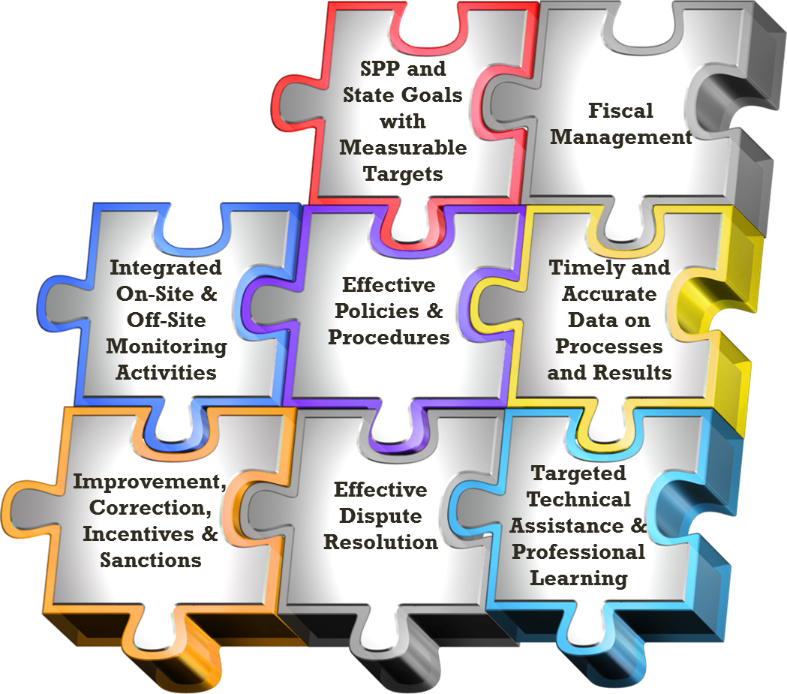
General Supervision – SEA Oversight
Components of
General Supervision:
Kansas Integrated
Accountability
System
(KIAS)

Slide 30
SPP Indicators:
Graduation
Dropout
Assessments
Suspension/Expulsion
LRE
Preschool LRE
Preschool Outcomes
Parent Involvement
Disproportionate Representation
Disproportionate Representation – disability category
Evaluation Timelines
Preschool Transition
Secondary Transition
Post-school Outcomes
Resolution Sessions
Mediation
State Systemic Improvement Plan (SSIP)
General Supervision

Slide 31
State Advisory Panels SAP & SICC
The IDEA State Advisory Panels (SAP) and State Interagency Coordinating Councils (SICC) address the needs of students with disabilities in K-12 special education programs, early intervention programs, and preschool.
This website is intended to address the information and communication needs of:
SAP members and State Education Agency (SEA) staff
SICC members and Lead Agency (LA) staff
Individuals interested in learning about the functions of the SAPs and SICCs
https://osepideasthatwork.org/resources-grantees/sap-sicc

Slide 32
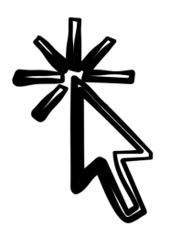
National SEAC/ICC Website
https://osepideasthatwork.org/resources-grantees/sap-sicc
Access to State SEAP and ICC websites
Information/Resources
Announcements
National Quarterly Webinars
osepideasthatwork.org

Slide 33
SPP/APR AND
DMS UPDATE
Brian Dempsey

Slide 34
Data Source and Measurement
Data Source: The State must include findings from data collected through all components of the State’s general supervision system that are used to identify noncompliance. This includes, but is not limited to, information collected through State monitoring, State database/data system, dispute resolution, and fiscal management systems as well as other mechanisms through which noncompliance is identified by the State. Provide the actual numbers used in the calculation. Include all findings of noncompliance regardless of the specific type and extent of noncompliance.

Slide 35
Data Source and Measurement
Measurement: This SPP/APR indicator requires the reporting on the percent of findings of noncompliance corrected within one year of identification: a. # of findings of noncompliance issued the prior Federal fiscal year (FFY) (e.g., for the FFY 2023 submission, use FFY 2022, July 1, 2022 – June 30, 2023) b. # of findings of noncompliance the State verified were corrected no later than one year after the State’s written notification of findings of noncompliance Percent = [(b) divided by (a)] times 100

Slide 36
Instructions for Indicator Measurement
This SPP/APR indicator focuses on the State’s exercise of its general supervision responsibility to monitor its local educational agencies (LEAs) for requirements under Part B of the Individuals with Disabilities Education Act (IDEA) through the State’s reporting on timely correction of noncompliance (20 U.S.C. 1412(a)(11) and 1416(a); and 34 C.F.R. §§ 300.149, 300.600). The State must provide baseline data expressed as a percentage. OSEP assumes that the State’s FFY 2023 data for this indicator is the State’s baseline data unless the State provides an explanation for using other baseline data.
Targets must be 100%.

Slide 37
Instructions for Indicator Measurement
Report in Column A the total number of findings of noncompliance made in FFY 2022 (July 1, 2022 – June 30, 2023) and report in Column B the number of those findings which were timely corrected, as soon as possible and in no case later than one year after the State’s written notification of noncompliance.

Slide 38
Instructions for Indicator Measurement
Starting with the FFY 2023 SPP/APR, States will be required to report on the correction of noncompliance related to compliance indicators 4B, 9, 10, 11, 12, and 13 based on findings issued in FFY 2022. Under each compliance indicator, States report on the correction of noncompliance for that specific indicator. However, in this general supervision Indicator 18, States report on both those findings as well as any additional findings that the State issued related to that compliance indicator.

Slide 39
Instructions for Indicator Measurement
In the last row of this General Supervision Data Table, States may also provide additional information related to other findings of noncompliance that are not specific to the compliance indicators. This row would include reporting on all other findings of noncompliance that were not reported by the State under the compliance indicators (e.g., Results indicators, including related requirements, Fiscal, Dispute Resolution, etc.). In future years (e.g., with the FFY 2026 SPP/APR), States may be required to further disaggregate findings by results indicators (1, 2, 3, 4A, 5, 6, 7, 8, 14, 15, 16, and 17), fiscal and other areas.

Slide 40
Instructions for Indicator Measurement
If the State did not ensure timely correction of previous findings of noncompliance, provide information on the nature of any continuing noncompliance and the actions that have been taken, or will be taken, to ensure the subsequent correction of the outstanding noncompliance, to address areas in need of improvement, and any sanctions or enforcement actions used, as necessary and consistent with IDEA’s enforcement provisions, the OMB Uniform Administrative Requirements, Cost Principles, and Audit Requirements for Federal Awards (Uniform Guidance), and State rules.

Slide 41
contacts
Bert Moore
Director
Special Education & Title Services
(785) 291-3097
bmoore@ksde.org
Brian Dempsey
Assistant Director
Special Education & Title Services
(785) 296-5522
bmoore@ksde.org

Slide 42
SEAC Licensure Request
Marvin Miller
Shane Carter
Notes:
Laurie will share her screen

Slide 43
Indicator 4: Suspension/Expulsion
Methodology for Determining Significant Discrepancy

Slide 44
Indicator 4A and 4B
Rates of suspension and expulsion:
A. Percent of local educational agencies (LEA) that have a significant discrepancy, as defined by the State, in the rate of suspensions and expulsions of greater than 10 days in a school year for children with IEPs; and
B. Percent of LEAs that have: (a) a significant discrepancy, as defined by the State, by race or ethnicity, in the rate of suspensions and expulsions of greater than 10 days in a school year for children with IEPs; and (b) policies, procedures or practices that contribute to the significant discrepancy, as defined by the State, and do not comply with requirements relating to the development and implementation of IEPs, the use of positive behavioral interventions and supports, and procedural safeguards.

Slide 45
Methodology for Determining Significant Discrepancy
KSDE performs an analysis of aggregated data to determine if significant discrepancies are occurring in the rate of long-term suspensions and expulsions of all children with disabilities among Local Education Agencies (LEAs) in the state.

Slide 46
Methodology for Determining Significant Discrepancy
For each LEA that meets the minimum n-size and cell size thresholds, the KSDE compares the long-term suspension and expulsion of students with disabilities of the LEA to the mean of the state’s rate of long-term suspensions and expulsions for children with disabilities to set the suspension/expulsion-rate bar.
  Minimum Cell Size: 0
  Minimum N-Size: 30

Slide 47
Methodology for Determining Significant Discrepancy
Annually, the KSDE shall determine a significant discrepancy threshold by multiplying the average of the state’s rate of long-term suspensions and expulsions for children with disabilities by 3.0. Any LEA that exceeds the annually calculated threshold shall be identified as significantly discrepant.

Slide 48
SY22-23 Update - Timeline
February 16, 2024 | Indicator 4 Notices for districts to conduct a Policy, Procedure and Practice (PPP) self-assessment for SY22-23 PPPs Provide selected student documentation to KSDE if indicated in the notification letter.
Data Collection, self-assessment, and May 17, 2024 | District PPP Self-Assessment due to KSDE
Data Verification June 28, 2024 | KSDE will review district submitted documentation, which may include additional documentation requested by KSDE from the district.
Compliance Notification July 5, 2024 | KSDE notifies districts of compliance or non-compliance

Slide 49
SY22-23 Update – Timeline
DCAP August 30, 2024 | KSDE approve District Corrective Action Plan (DCAP) for districts identified as noncompliant
ICA due September 16, 2024 | KSDE approve Individual Corrective Action (ICA) for district student files identified as noncompliant
Updated Data December 20, 2024 | KSDE will review updated data
Determination of compliance or continued non-compliance December 31, 2024 | District notified of compliance or continued non-compliance.

Slide 50
Sig dis contact
  Brian Dempsey
  Assistant Director
  Special Education and Title Services
  (785) 296-5522
  bdempsey@ksde.org

Slide 51
Open Borders/Enrollment
Bert Moore

Slide 52
Legislative Summary
Frank Harwood (if available)

Slide 53
Virtual Programs and SWD’s
Lena Kisner
Brian Dempsey

Slide 54
SEAC 2nd Terms (Whitney George, Lena Kisner, Rebecca Schultz) motion and vote.

Slide 55
Chair-Elect: Need motion and vote (earlier discussion to nominate Lena Kisner).

Slide 56
SEAC Member Reports
SEAC Members

Slide 57
Ex-Officio Member Reports

Slide 58
Ex-Officio Member Reports
Families Together
Kansas Association of Special Education Administrators (KASEA) – Ashley Enz
Disability Rights Center
Kansas State Board of Education
KSSB
KSSD
KNEA
Others

Slide 59
Items for July SEAC Agenda
SEAC Members

Slide 60
Next Meeting Date
July 24, 2024

Slide 61

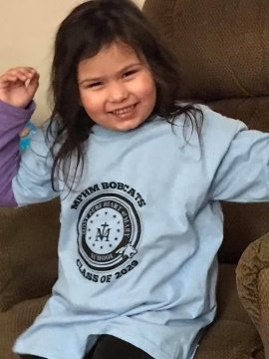

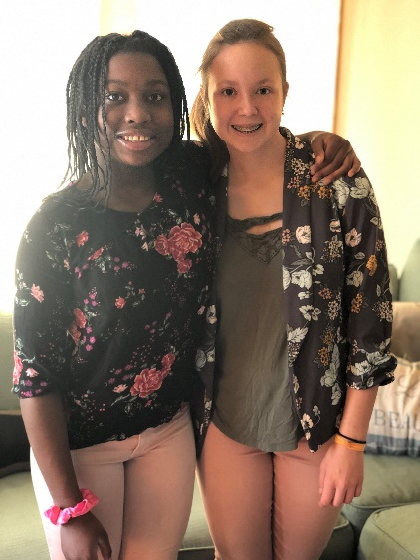
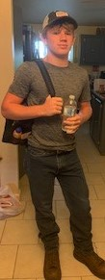
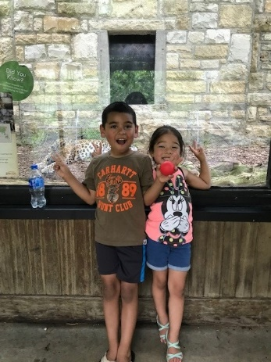
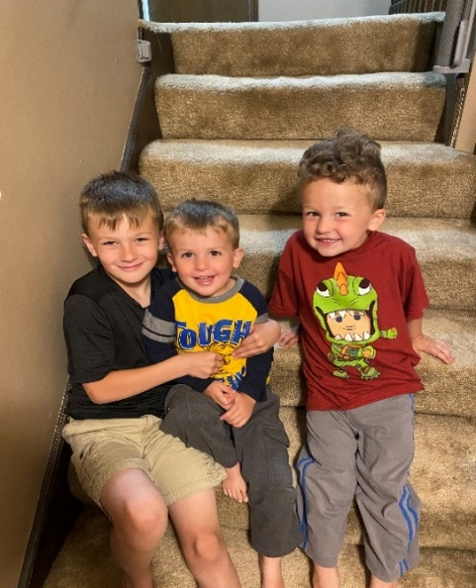
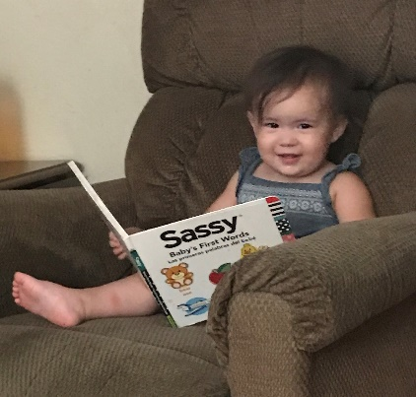
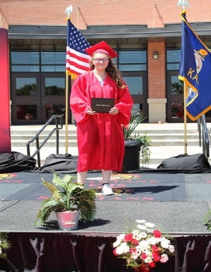

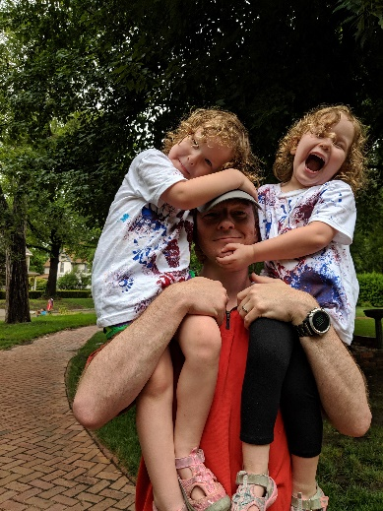
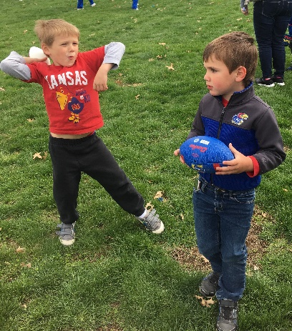
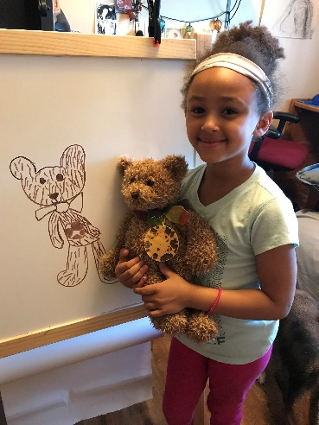
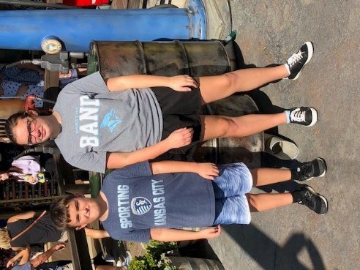
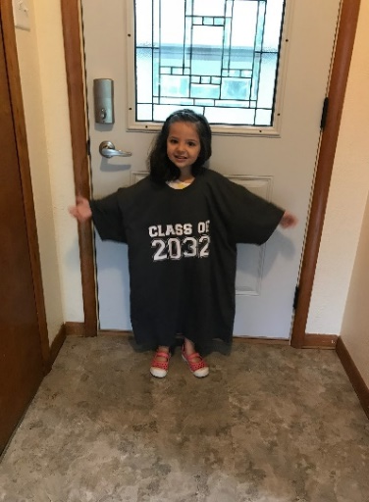
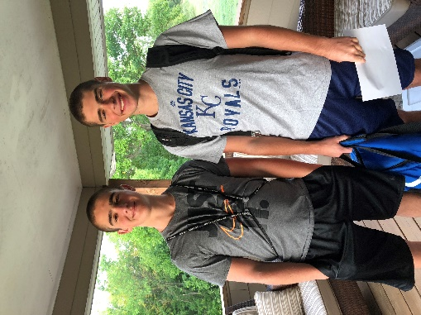
Keep The Main Thing The Main Thing

Slide 62
Closing Comments/Adjournment
Motion to adjourn

Slide 63
Overall contact
  Bert Moore
  Director
  Special Education & Title Services
  (785) 291-3097
  bmoore@ksde.org
Joyce Broils
Administrative Specialist
Special Education & Title Services
(785) 291-3097
jbroils@ksde.org

Slide 64

eeoc

