Slide 1
Welcome to the Special Education Advisory Council Meeting
Please be sure your microphone is muted until you wish to participate in an open discussion with the council.
The meeting will start promptly at 9:00 a.m.

Slide 2
How to pin the Interpreters Video
At the top of your meeting window, hover over the video of the participant you want to pin and click ...
From the menu, click Pin.
Optional: If you want to pin additional videos (up to 9 total), follow steps 1 & 2 again as needed.
Optional: If you have at least 3 participants in the meeting and dual monitor enabled, you will have the option to pin to your first screen or your second screen.

Slide 3
Special Education Advisory Council
July 24, 2024

Slide 4
Call to Order
Welcome
Roll Call

Slide 5
Approvals
Agenda for today, July 24, 2024
Minutes (April 11, 2024)
Notes:
Poll I and 2

Slide 6
Public Comment
Guidelines for Testimony
Prior to start of the SEAC meeting, be sure to email Joyce Broils, jbroils@ksde.org expressing desire to speak during public comment.
All comments will be taken under advisement by the council.
Any response from the Council to public comments will come at a later date.
Verbal Public Comment
Verbal comments are limited to three minutes.
Cue will be given one minute before time expires.
Written Testimony
Written input must include the name, address and county of residence of the person submitting comment.
Written comments can be submitted via email, mail, or fax to the secretary of the SEAC.

Slide 7
FFY 2022 SPP/APR
Bert Moore
Brian Dempsey
Notes:
Laurie will share her screen

Slide 8
SPP/APR Indicators
Indicator 1: Graduation
Indicator 2: Drop Out
Indicator 3A: Participation for Students with IEPS
Indicator 3B: Proficiency for Students with IEPs (Grade Level Academic Achievement Standards)
Indicator 3C: Proficiency for Students with IEPs (Alternate Academic Achievement Standards)
Indicator 3D: Gap in Proficiency Rates (Grade Level Academic Achievement Standards)
Indicator 4A: Suspension/Expulsion
Indicator 4B: Suspension/Expulsion by Race/Ethnicity
Indicator 5: Education Environments (5-year-old kindergarteners–21)
Indicator 6: Preschool Environments
Indicator 7: Preschool Outcomes
Indicator 8: Parent Involvement
Indicator 9: Disproportionate Representation
Indicator 10: Disproportionate Representation in Specific Disability Categories
Indicator 11: Child Find
Indicator 12: Early Childhood Transition
Indicator 13: Secondary Transition
Indicator 14: Post-School Outcomes
Indicator 15: Resolution Sessions
Indicator 16: Mediation
Indicator 17: State Systemic Improvement Plan

Slide 9
Bert Moore Director Special Education & Title Services (785) 291-3097 bmoore@ksde.org
Brian Dempsey Assistant Director Special Education & Title Services (785) 296-5522 bmoore@ksde.org

Slide 10
Break
Notes:
Laurie will share her screen

Slide 11
Differentiated Monitoring and Support (DMS 2.0)

Slide 12
Lunch
Notes:
Laurie will share her screen

Slide 13
Indicator 18
Brian Dempsey
Notes:
Laurie will share her screen

Slide 14
Indicator 18 – General Supervision
Bert Moore
Brian Dempsey

Slide 15
Data Source and Measurement
Data Source: The State must include findings from data collected through all components of the State’s general supervision system that are used to identify noncompliance. This includes, but is not limited to, information collected through State monitoring, State database/data system, dispute resolution, and fiscal management systems as well as other mechanisms through which noncompliance is identified by the State. Provide the actual numbers used in the calculation. Include all findings of noncompliance regardless of the specific type and extent of noncompliance.

Slide 16
Data Source and Measurement
Measurement: This SPP/APR indicator requires the reporting on the percent of findings of noncompliance corrected within one year of identification: a. # of findings of noncompliance issued the prior Federal fiscal year (FFY) (e.g., for the FFY 2023 submission, use FFY 2022, July 1, 2022 – June 30, 2023) b. # of findings of noncompliance the State verified were corrected no later than one year after the State’s written notification of findings of noncompliance Percent = [(b) divided by (a)] times 100

Slide 17
Instructions for Indicator Measurement
This SPP/APR indicator focuses on the State’s exercise of its general supervision responsibility to monitor its local educational agencies (LEAs) for requirements under Part B of the Individuals with Disabilities Education Act (IDEA) through the State’s reporting on timely correction of noncompliance (20 U.S.C. 1412(a)(11) and 1416(a); and 34 C.F.R. §§ 300.149, 300.600). The State must provide baseline data expressed as a percentage. OSEP assumes that the State’s FFY 2023 data for this indicator is the State’s baseline data unless the State provides an explanation for using other baseline data.
Targets must be 100%.

Slide 18
Instructions for Indicator Measurement
Report in Column A the total number of findings of noncompliance made in FFY 2022 (July 1, 2022 – June 30, 2023) and report in Column B the number of those findings which were timely corrected, as soon as possible and in no case later than one year after the State’s written notification of noncompliance.

Slide 19
Instructions for Indicator Measurement
Starting with the FFY 2023 SPP/APR, States will be required to report on the correction of noncompliance related to compliance indicators 4B, 9, 10, 11, 12, and 13 based on findings issued in FFY 2022. Under each compliance indicator, States report on the correction of noncompliance for that specific indicator. However, in this general supervision Indicator 18, States report on both those findings as well as any additional findings that the State issued related to that compliance indicator.

Slide 20
Instructions for Indicator Measurement
In the last row of this General Supervision Data Table, States may also provide additional information related to other findings of noncompliance that are not specific to the compliance indicators. This row would include reporting on all other findings of noncompliance that were not reported by the State under the compliance indicators (e.g., Results indicators, including related requirements, Fiscal, Dispute Resolution, etc.). In future years (e.g., with the FFY 2026 SPP/APR), States may be required to further disaggregate findings by results indicators (1, 2, 3, 4A, 5, 6, 7, 8, 14, 15, 16, and 17), fiscal and other areas.

Slide 21
Instructions for Indicator Measurement
If the State did not ensure timely correction of previous findings of noncompliance, provide information on the nature of any continuing noncompliance and the actions that have been taken, or will be taken, to ensure the subsequent correction of the outstanding noncompliance, to address areas in need of improvement, and any sanctions or enforcement actions used, as necessary and consistent with IDEA’s enforcement provisions, the OMB Uniform Administrative Requirements, Cost Principles, and Audit Requirements for Federal Awards (Uniform Guidance), and State rules.

Slide 22
Bert Moore Director Special Education & Title Services (785) 291-3097 bmoore@ksde.org
Brian Dempsey Assistant Director Special Education & Title Services (785) 296-5522 bmoore@ksde.org

Slide 23
SEAC Licensure Request
Marvin Miller
Shane Carter
Notes:
Laurie will share her screen

Slide 24
Indicator 4: Suspension/Expulsion
Methodology for Determining Significant Discrepancy

Slide 25
Indicator 4A and 4B
Rates of suspension and expulsion:
A. Percent of local educational agencies (LEA) that have a significant discrepancy, as defined by the State, in the rate of suspensions and expulsions of greater than 10 days in a school year for children with IEPs; and
B. Percent of LEAs that have: (a) a significant discrepancy, as defined by the State, by race or ethnicity, in the rate of suspensions and expulsions of greater than 10 days in a school year for children with IEPs; and (b) policies, procedures or practices that contribute to the significant discrepancy, as defined by the State, and do not comply with requirements relating to the development and implementation of IEPs, the use of positive behavioral interventions and supports, and procedural safeguards.

Slide 26
Methodology for Determining Significant Discrepancy
KSDE performs an analysis of aggregated data to determine if significant discrepancies are occurring in the rate of long-term suspensions and expulsions of all children with disabilities among Local Education Agencies (LEAs) in the state.

Slide 27
Methodology for Determining Significant Discrepancy
For each LEA that meets the minimum n-size and cell size thresholds, the KSDE compares the long-term suspension and expulsion of students with disabilities of the LEA to the mean of the state’s rate of long-term suspensions and expulsions for children with disabilities to set the suspension/expulsion-rate bar.
Minimum Cell Size: 0
Minimum N-Size: 30

Slide 28
Methodology for Determining Significant Discrepancy
Annually, the KSDE shall determine a significant discrepancy threshold by multiplying the average of the state’s rate of long-term suspensions and expulsions for children with disabilities by 3.0. Any LEA that exceeds the annually calculated threshold shall be identified as significantly discrepant.

Slide 29
SY22-23 Update - Timeline
February 16, 2024 | Indicator 4 Notices for districts to conduct a Policy, Procedure and Practice (PPP) self-assessment for SY22-23 PPPs Provide selected student documentation to KSDE if indicated in the notification letter.
Data Collection, self-assessment, and May 17, 2024 | District PPP Self-Assessment due to KSDE
Data Verification June 28, 2024 | KSDE will review district submitted documentation, which may include additional documentation requested by KSDE from the district.
Compliance Notification July 5, 2024 | KSDE notifies districts of compliance or non-compliance

Slide 30
SY22-23 Update - Timeline
DCAP August 30, 2024 | KSDE approve District Corrective Action Plan (DCAP) for districts identified as noncompliant
ICA due September 16, 2024 | KSDE approve Individual Corrective Action (ICA) for district student files identified as noncompliant
Updated Data December 20, 2024 | KSDE will review updated data
Determination of compliance or continued non-compliance December 31, 2024 | District notified of compliance or continued non-compliance.

Slide 31
Brian Dempsey Assistant Director Special Education and Title Services (785) 296-5522 bdempsey@ksde.org

Slide 32
Open Borders/Enrollment
Bert Moore

Slide 33
Legislative Summary
lissarrice@gmail.com,
lissarrice@gmail.com,
Frank Harwood (if available)

Slide 34
Virtual Programs and SWD’s
lissarrice@gmail.com,
lissarrice@gmail.com,
Lena Kisner
Brian Dempsey

Slide 35
SEAC Member Reports
SEAC Members

Slide 36
Ex-Officio Member Reports

Slide 37
Ex-Officio Member Reports
Families Together
Kansas Association of Special Education Administrators (KASEA) – Ashley Enz
Disability Rights Center
Kansas State Board of Education
KSSB
KSSD
KNEA
Others

Slide 38
Items for September SEAC Agenda
SEAC Members

Slide 39
Upcoming Meeting Dates
All meetings will be held in the Landon State Office Building (LSOB), 900 SW Jackson, Topeka, KS. In Room 509.
Wednesday, Sept. 25, 2024
Thursday, Nov. 20, 2024
Tuesday, Jan. 14, 2025
Wednesday, Jan. 15, 2025
Wednesday, April 9, 2025

Slide 40
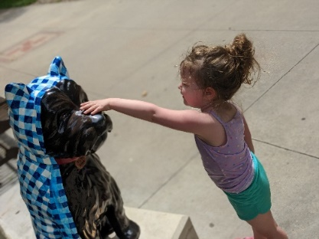
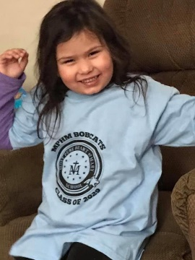
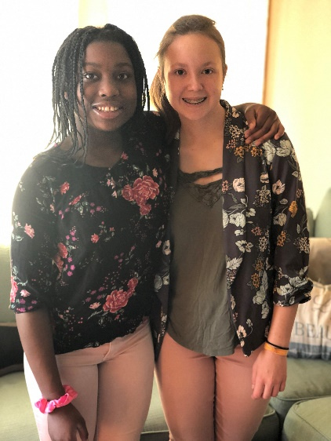
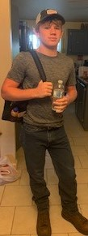
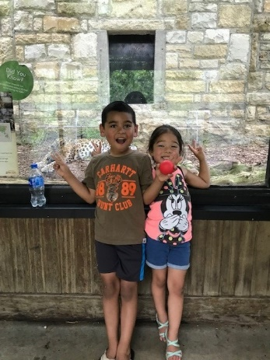
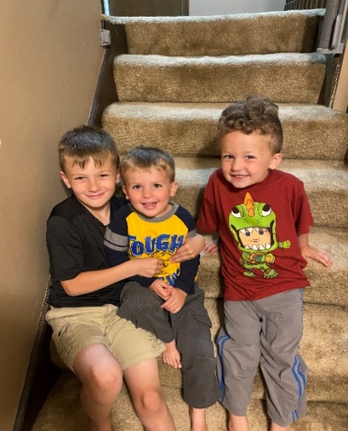
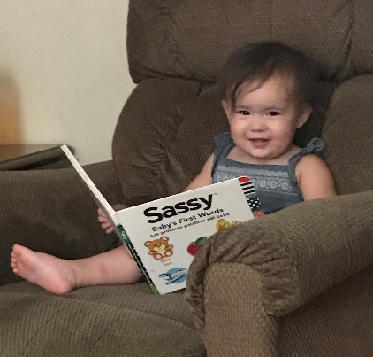
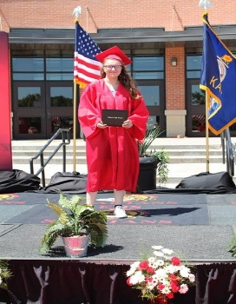
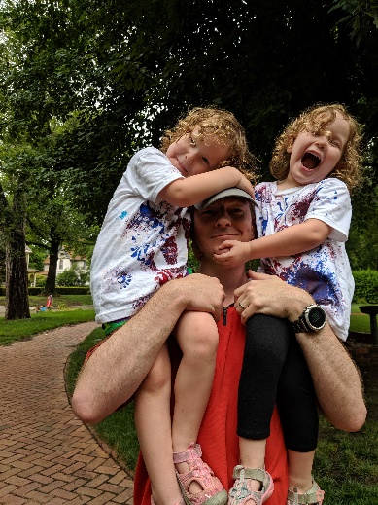
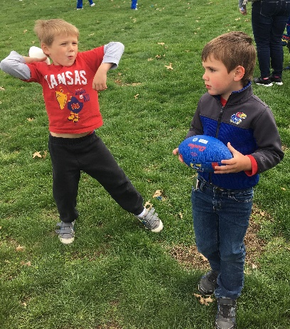
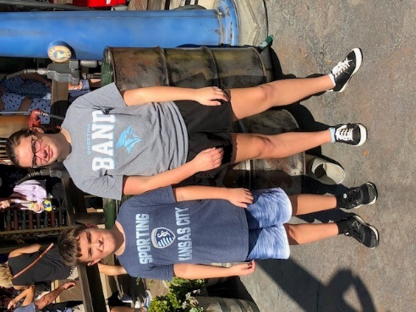
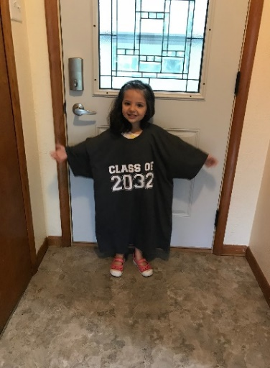
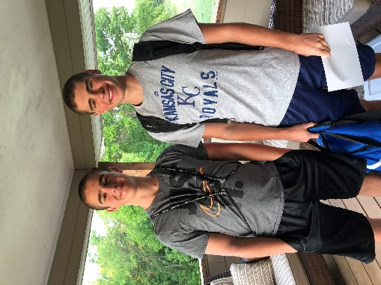
Keep The Main Thing The Main Thing

Slide 41
Closing Comments/Adjournment
Motion to adjourn

Slide 42
Bert Moore Director Special Education & Title Services (785) 291-3097 bmoore@ksde.org
Joyce Broils Administrative Specialist Special Education & Title Services (785) 291-3097 jbroils@ksde.org

