Slide 1
Welcome to the Special Education Advisory Council Meeting
Please be sure your microphone is muted until you wish to participate in an open discussion with the council.
The meeting will start promptly at 9:00 a.m.

Slide 2
How to pin the Interpreters Video
At the top of your meeting window, hover over the video of the participant you want to pin and click ...
From the menu, click Pin.
Optional: If you want to pin additional videos (up to 9 total), follow steps 1 & 2 again as needed.
Optional: If you have at least 3 participants in the meeting and dual monitor enabled, you will have the option to pin to your first screen or your second screen.

Slide 3
Special Education Advisory Council
January 24, 2024

Slide 4
Call to Order
Welcome
Roll Call

Slide 5
Approvals
Agenda for today, January 24, 2024
Minutes (November 30, 2023)
Notes:
Poll I and 2

Slide 6
Public Comment
Guidelines for Testimony
Prior to start of the SEAC meeting, be sure to email Joyce Broils, jbroils@ksde.org expressing desire to speak during public comment.
All comments will be taken under advisement by the council.
Any response from the Council to public comments will come at a later date.
Verbal Public Comment
Verbal comments are limited to three minutes.
Cue will be given one minute before time expires.
Written Testimony
Written input must include the name, address and county of residence of the person submitting comment.
Written comments can be submitted via email, mail, or fax to the secretary of the SEAC.

Slide 7
SICC/SEAC Collaboration Recap
Marvin Miller
Bert Moore
Notes:
Laurie will share her screen

Slide 8
SPP/APR
Brian Dempsey
Notes:
Laurie will share her screen

Slide 9
Open Borders
Brian Dempsey
Bert Moore
Notes:
Laurie will share her screen

Slide 10
Lunch
Notes:
Laurie will share her screen

Slide 11
Special Education and Virtual Schools
Lena Kisner
Marvin Miller
Notes:
Laurie will share her screen

Slide 12
Statewide IEP
Dean Zajic
Brian Dempsey
Notes:
Laurie will share her screen

Slide 13
SEAC Annual Report for 2022-2023
Bert Moore
Notes:
Laurie will share her screen

Slide 14
Emergency Safety Interventions Report
Trish Backman

Slide 15
SEAC School Year 2022-23 ESI Data
Trish Backman
KSDE School Mental Health Coordinator
SETS team

Slide 16
Most recent update- May 2023
Notes:
PowerPoints

Slide 17
Define ESI

Slide 18
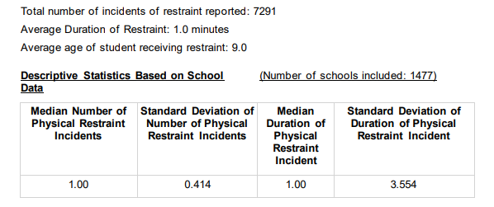
Restraint data

Slide 19
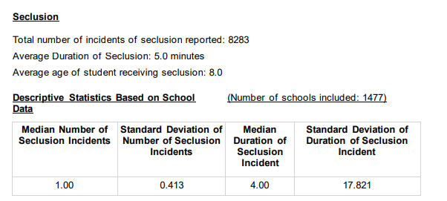
Seclusion Data
Notes:
Amanda

Slide 20
Seclusion and Restraint Reports- with an IEP or 504

Slide 21
Seclusion and Restraints- Non-Identified and total overall

Slide 22
Students who had a Behavior Intervention Plan
The number of students physically restrained= 1673
The number of students placed in seclusion= 1189

Slide 23
Maximums
Maximum Number of Physical Restraint Incidents with a Student= 186
Maximum Number of Seclusion Incidents with a Student= 225
Maximum Number of Emergency Safety Intervention Incidents with a Student= 225

Slide 24
By Ethnicity

Slide 25
By Ethnicity

Slide 26
By Ethnicity

Slide 27
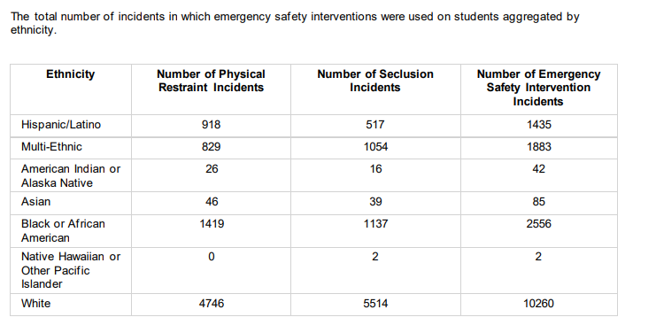
By Ethnicity

Slide 28
By Gender with an IEP

Slide 29
By Gender with 504

Slide 30
Gender with out IEP or 504

Slide 31
Totals Overall by Gender

Slide 32
Based on Free/Reduced lunch and IEP

Slide 33
Free/Reduced lunch and 504

Slide 34
Free/Reduced lunch without IEP or 504

Slide 35
Totals for Free/Reduced

Slide 36
By Age

Slide 37
Let’s explore the updated documents https://www.ksde.org/Agency/Division-of-Learning-Services/Special-Education-and-Title-Services/KIAS-Kansas-Integrated-Accountability-System/Emergency-Safety-Interventions-ESI

Slide 38
Additional Resources https://www.ksde.org/Agency/Division-of-Learning-Services/Special-Education-and-Title-Services/KIAS-Kansas-Integrated-Accountability-System/Emergency-Safety-Interventions-ESI
https://ksdetasn.org/universal_search?search_term=esi

Slide 39
Trish Backman School Mental Health Coordinator SETS Team (785) 296-6937 tbackman@ksde.org

Slide 40
Break
Notes:
Laurie will share her screen

Slide 41
SEAC Member Reports
SEAC Members

Slide 42
Ex-Officio Member Reports

Slide 43
Ex-Officio Member Reports
Families Together
Kansas Association of Special Education Administrators (KASEA) – Ashley Enz
Disability Rights Center
Kansas State Board of Education
KSSB
KSSD
KNEA
Others

Slide 44
Items for April SEAC Agenda
SEAC Members

Slide 45
Last Meeting of 2023-2024
April

Slide 46
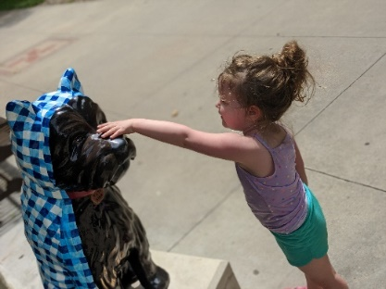
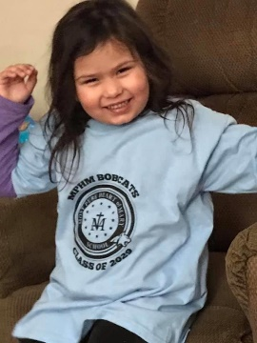
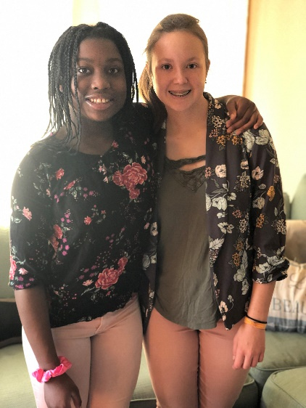
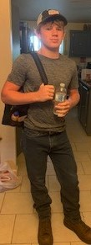
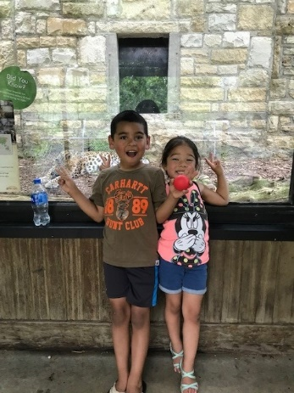
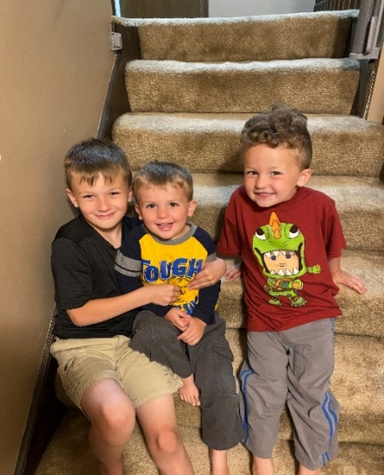
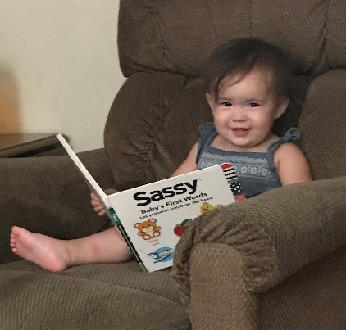
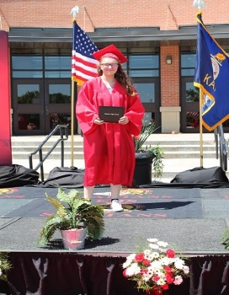
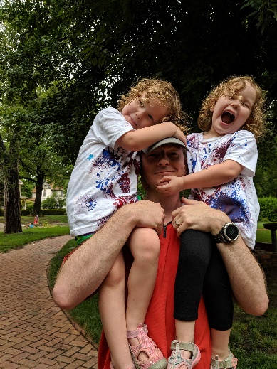
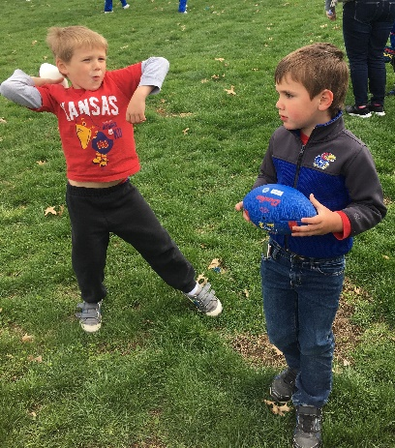
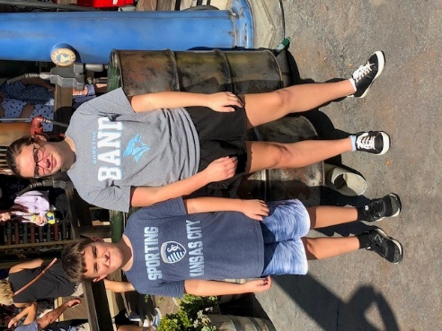
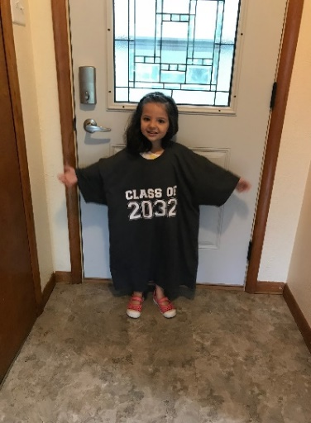
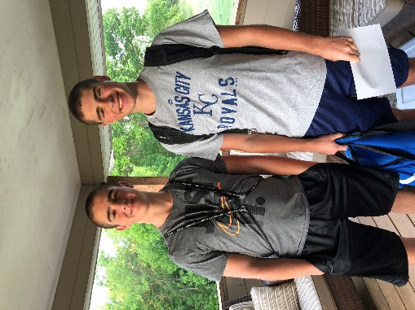
Keep The Main Thing The Main Thing

Slide 47
Closing Comments/Adjournment
Motion to adjourn

Slide 48
Bert Moore Director Special Education & Title Services (785) 291-3097 bmoore@ksde.org
Joyce Broils Administrative Specialist Special Education & Title Services (785) 29 jbroils@ksde.org

