Slide 1
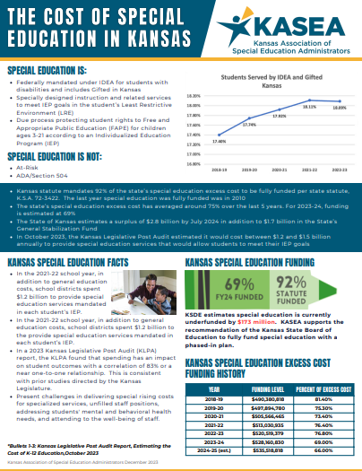
January 2024 KASEA Report
____________________________
Special Education
Advisory Council
Resources
Handout: The Cost of Special Education in Kansas
The Special Education and Related Services Funding Task Force met on Friday, January 5th at the Capitol. Amy Haussler, Kathy KO and Monica Ross did an amazing job representing KASEA and special education on the task force. Several KASEA members braved the weather to show their support as well. Those unable to attend or view the live stream of the meeting can access a recording here: link to recording.
Recommendations of the Task Force:
With a majority of the vote affirmative, the task force recommends full funding of special education with a phased plan over 4 years to attain 92% of state level excess costs. This plan aligns to the Kansas State Board of Education's recent unanimous recommendation.
With a unanimous vote affirmative, the task force recommends that KDHE open additional Medicaid codes similar to what other states are doing so Kansas districts and Infant Toddler programs can access additional funding for the provision of eligible services to eligible students.
Connecting with KASEA is continuing to provide valuable professional resources and information to KASEA members across the state. January 17’s meeting featured Brian Dempsey speaking on how to propose resolutions to formal complaints. The next Connecting with KASEA will be April 17th on Zoom.
Upcoming Events
Membership Meeting
February 19, 2024
Winter Conference
February 20 & 21, 2024 (Wichita)
Connecting with KASEA
April 17, 2024

Slide 2
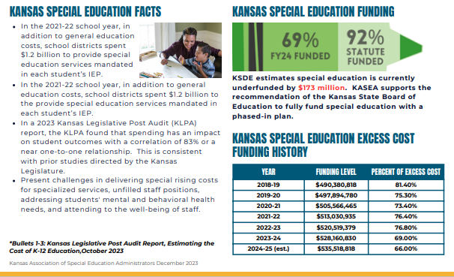
Cost of Special Education Flyer

