Slide 1
Welcome to the Special Education Advisory Council Meeting
Please be sure your microphone is muted until you wish to participate in an open discussion with the council.
The meeting will start promptly at 9:00 a.m.

Slide 2
How to pin the Interpreters Video
At the top of your meeting window, hover over the video of the participant you want to pin and click ...
From the menu, click Pin.
Optional: If you want to pin additional videos (up to 9 total), follow steps 1 & 2 again as needed.
Optional: If you have at least 3 participants in the meeting and dual monitor enabled, you will have the option to pin to your first screen or your second screen.

Slide 3
Special Education Advisory Council
January 24, 2024

Slide 4
Call to Order
Welcome
Roll Call

Slide 5
Approvals
Agenda for today, January 24, 2024
Minutes (November 30, 2023)
Notes:
Poll I and 2

Slide 6
Public Comment
Guidelines for Testimony
Prior to start of the SEAC meeting, be sure to email Joyce Broils, jbroils@ksde.org expressing desire to speak during public comment.
All comments will be taken under advisement by the council.
Any response from the Council to public comments will come at a later date.
Verbal Public Comment
Verbal comments are limited to three minutes.
Cue will be given one minute before time expires.
Written Testimony
Written input must include the name, address and county of residence of the person submitting comment.
Written comments can be submitted via email, mail, or fax to the secretary of the SEAC.

Slide 7
SICC/SEAC Collaboration Recap
Marvin Miller
Bert Moore
Notes:
Laurie will share her screen

Slide 8
SPP/APR
Brian Dempsey
Notes:
Laurie will share her screen

Slide 9
SPP/APR Indicators
Indicator 1: Graduation
Indicator 2: Drop Out
Indicator 3A: Participation for Students with IEPS
Indicator 3B: Proficiency for Students with IEPs (Grade Level Academic Achievement Standards)
Indicator 3C: Proficiency for Students with IEPs (Alternate Academic Achievement Standards)
Indicator 3D: Gap in Proficiency Rates (Grade Level Academic Achievement Standards)
Indicator 4A: Suspension/Expulsion
Indicator 4B: Suspension/Expulsion by Race/Ethnicity
Indicator 5: Education Environments (5-year-old kindergarteners–21)
Indicator 6: Preschool Environments
Indicator 7: Preschool Outcomes
Indicator 8: Parent Involvement
Indicator 9: Disproportionate Representation
Indicator 10: Disproportionate Representation in Specific Disability Categories
Indicator 11: Child Find
Indicator 12: Early Childhood Transition
Indicator 13: Secondary Transition
Indicator 14: Post-School Outcomes
Indicator 15: Resolution Sessions
Indicator 16: Mediation
Indicator 17: State Systemic Improvement Plan

Slide 10
Kansas Performance on the FFY 2022 SPP/APR
Indicator | Did Kansas Meet the Target? | Did Kansas have Slippage?
1: Graduation | Baseline Year: FFY 20 Met Target | No Slippage
2: Drop Out | Baseline Year: FFY 21 Met Target | No Slippage
3A: Participation for Students with IEPs | Baseline Year: FFY 20 | Data Upload January 25, 2024
3B: Proficiency for Students with IEPs (Grade Level Academic Achievement Standards) | Baseline Year: FFY 20 | Data Upload January 25, 2024
3C: Proficiency for Students with IEPs (Alternate Academic Achievement Standards) | Baseline Year: FFY 20 | Data Upload January 25, 2024
3D: Gap in Proficiency Rates (Grade Level Academic Achievement Standards) | Baseline Year: FFY 20 | Data Upload January 25, 2024
4A: Suspension/Expulsion | Baseline Year: FFY 22 | NA
4B: Suspension/Expulsion by Race/Ethnicity | Baseline Year: FFY 22 Compliance | NA
5: Education Environments (5-year-old kindergarteners-21) | Baseline Year: FFY 19 Met Target for 5A and 5B, and did not meet target for 5C | No Slippage for 5A and 5B, and slippage for 5C

Slide 11
Kansas Performance on the FFY 2022 SPP/APR
Indicator | Did Kansas Meet the Target? | Did Kansas have Slippage?
6: Preschool Environments | Baseline Year: FFY 19 for 6A and 6B, and FFY 20 for 6C Met all targets | No Slippage
7: Preschool Outcomes | Baseline Year: FFY 08 Met Target for 7B1 and Did Not Meet Target for 7A, 7B2, and 7C | No Slippage
8: Parent Involvement | Baseline Year: FFY 21 Met Target | No Slippage
9: Disproportionate Representation | Baseline Year: FFY 20 Met Target (Compliance) | No Slippage
10: Disproportionate Representation in Specific Disability Categories | Baseline Year: FFY 20 Did Not Meet Target (Compliance) | No Slippage
11: Child Find | Baseline Year: FFY 05 Did Not Meet Target (Compliance) | No Slippage

Slide 12
Kansas Performance on the FFY 2022 SPP/APR
Indicator | Did Kansas Meet the Target? | Did Kansas have Slippage?
12: Early Childhood Transition | Baseline Year: FFY 05 Did Not Meet Target (Compliance) | No Slippage
13: Secondary Transition | Baseline Year: FFY 09 Did Not Meet Target (Compliance) | No Slippage
14: Post-School Outcomes | Baseline Year: FFY 09 Did Not Meet Target | No Slippage for 14B, and Slippage for 14A and 14C
15: Resolution Sessions | Baseline Year: FFY 05 Did Not Meet Target | No Slippage
16: Mediation | Baseline Year: FFY 13 Did Not Meet Target | Slippage
17: State Systemic Improvement Plan | Baseline Year: FFY 21 Did Not Meet Target | No Slippage

Slide 13
Slippage Statements
Indicator 5C: Education Environments (In separate schools, residential facilities, or homebound/hospital placements)
FFY 21 Data: 2.10%
FFY 22 Target: 2.18%
FFY 22 Data: 2.21%
Slippage statement: An examination of state-level data for Indicator 5C identified 1,603 students served in separate schools, residential facilities, or homebound hospital placements. This is an increase of 121 students, or 0.11%, above the FFY 2021 data and 0.03% above the state’s FFY 2022 target. Slippage is attributable to an increase of 156 students being served in separate schools. One district, the largest LEA in the state, accounts for 98 of the net increase of 156 students in this category. The remainder of the net increase is spread across all other LEA’s.

Slide 14
Slippage Statements
Indicator 14A: Postschool Outcomes (Enrolled in higher education within one year of leaving high school)
FFY21 Data: 26.84%
FFY22 Target: 45.00%
FFY22 Data: 22.71%
Slippage Statement: An examination of state-level data suggests that slippage may be attributed to an increase of nearly 5% in response rate and an increase of more than 252% in the targeted universe due to a change in methodology from a sample to a census. Additionally, based on National Clearinghouse data for all students in Kansas, all cohorts are demonstrating declining participation rates in postsecondary education.

Slide 15
Slippage Statements
Indicator 14C: Postschool Outcomes (Enrolled in higher education or in some other postsecondary education or training program; or competitively employed or in some other employment within one year of leaving high school.)
FFY21 Data: 69.62%
FFY22 Target: 81.09%
FFY22 Data: 67.75%
Slippage statement: An examination of state-level data suggests that slippage may be attributed to an increase of nearly 5% in response rate and an increase of more than 252% in the targeted universe due to a change in methodology from a sample to a census. Additionally, based on National Clearinghouse data for all students in Kansas, all cohorts are demonstrating declining participation rates in postsecondary education.

Slide 16
Slippage Statements
Indicator 16: Mediation
FFY21 Data: 57.14%
FFY22 Target: 77.00-80.00%
FFY22 Data: 54.55% (6 mediation agreements from 11 mediations held)
Slippage Statement: The state attributes slippage to annual changes in mediations held.

Slide 17
OSEP Required Actions: Compliance Indicators
Because the State reported less than 100% compliance for FFY 2021, the State must report on the status of correction of noncompliance identified in FFY 2021 for this indicator. When reporting on the correction of noncompliance, the State must report, in the FFY 2022 SPP/APR, that it has verified that each LEA with noncompliance identified in FFY 2021 for this indicator: (1) is correctly implementing the specific regulatory requirements (i.e., achieved 100% compliance) based on a review of updated data such as data subsequently collected through on-site monitoring or a State data system; and (2) has corrected each individual case of noncompliance, unless the child is no longer within the jurisdiction of the LEA, consistent with OSEP Memo 09-02. In the FFY 2022 SPP/APR, the State must describe the specific actions that were taken to verify the correction. If the State did not identify any findings of noncompliance in FFY 2021, although its FFY 2021 data reflect less than 100% compliance, provide an explanation of why the State did not identify any findings of noncompliance in FFY 2021.

Slide 18
KSDE Response to Required Actions: Compliance Indicators
KSDE has verified that each district with noncompliance identified in FFY 2021 is correctly implementing the regulatory requirements through the correction of noncompliance process of conducting a root cause analysis, correction of each individual case of identified noncompliance and subsequent review of updated student file data. Data are collected through the State data system and each district has achieved 100% compliance as per OSEP QA 23-01.

Slide 19
OSEP Required Action: Indicator 4
Indicator 4A: The State did not provide valid and reliable data for FFY 2021. The State must provide valid and reliable data for FFY 2022 in the FFY 2022 SPP/APR using a methodology that meets one of the two comparison methods as required by 34 C.F.R. § 300.170(a) and the Measurement Table.
Indicator 4B: In the FFY 2022 SPP/APR, the State must provide data for this indicator for FFY 2022 using a methodology that meets one of the two comparison methods as required by 34 C.F.R. § 300.170(a) and the Measurement Table.

Slide 20
KSDE Response to OSEP Required Action: Indicator 4
Indicator 4A: OSEP could not determine if the state’s FFY2021 indicator 4a data were valid and reliable. In response, the KSDE has provided valid and reliable data in this FFY 2022 SPP/APR using a methodology that meets one of the two comparison methods as required by 34 C.F.R. § 300.170(a) and the Measurement Table. Specifically, the chosen methodology is calculated using the rates of suspensions and expulsions for children with IEPs among LEAs within the State.
Indicator 4B: In FFY2021 OSEP determined the state’s chosen methodology for indicator 4b calculation was unclear . In response, the KSDE has provided valid and reliable data in this FFY 2022 SPP/APR using a methodology that meets one of the two comparison methods as required by 34 C.F.R. § 300.170(a) and the Measurement Table. Specifically, the chosen 4a methodology is calculated using the rates of suspensions and expulsions for children with IEPs among LEAs within the State. As such, the data reported under Indicator 4b are valid and reliable.

Slide 21
Indicator 4A Proposed Targets
As a result of the change of methodology, the state may set a new baseline and targets.
Baseline year is FFY 22, and baseline data is 4.51%
Ensure FFY 25 target is an improvement over the baseline.
Proposed Targets for the remainder of the FFY 20-25 package:
FFY | 2022 | 2023 | 2024 | 2025
Target <= | 4.51% | 4.51% | 4.51% | 4.14%

Slide 22
Open Borders
Brian Dempsey
Bert Moore
Notes:
Laurie will share her screen

Slide 23
Lunch
Notes:
Laurie will share her screen

Slide 24
Special Education and Virtual Schools
Lena Kisner
Marvin Miller
Notes:
Laurie will share her screen

Slide 25
Statewide IEP
Dean Zajic
Brian Dempsey
Notes:
Laurie will share her screen

Slide 26
Survey Results

Slide 27
Survey Results

Slide 28
SEAC Annual Report for 2022-2023
Bert Moore
Notes:
Laurie will share her screen

Slide 29
Emergency Safety Interventions Report
Trish Backman

Slide 30
SEAC School Year 2022-23 ESI Data
Trish Backman
KSDE School Mental Health Coordinator
SETS team

Slide 31
Most recent update- May 2023
Notes:
PowerPoints

Slide 32
Define ESI

Slide 33
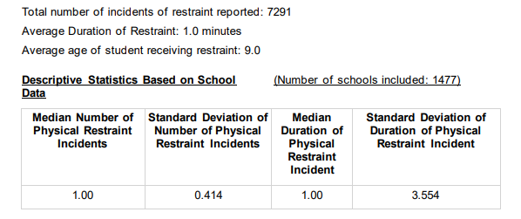
Restraint data

Slide 34
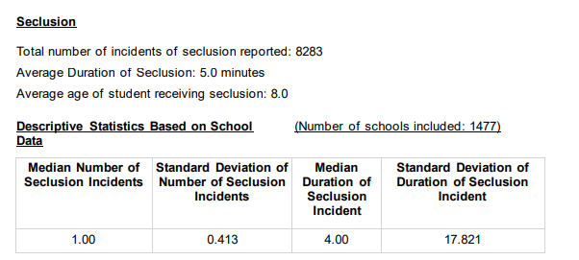
Seclusion Data
Notes:
Amanda

Slide 35
Seclusion and Restraint Reports- with an IEP or 504

Slide 36
Seclusion and Restraints- Non-Identified and total overall

Slide 37
Students who had a Behavior Intervention Plan
The number of students physically restrained= 1673
The number of students placed in seclusion= 1189

Slide 38
Maximums
Maximum Number of Physical Restraint Incidents with a Student= 186
Maximum Number of Seclusion Incidents with a Student= 225
Maximum Number of Emergency Safety Intervention Incidents with a Student= 225

Slide 39
By Ethnicity

Slide 40
By Ethnicity

Slide 41
By Ethnicity

Slide 42
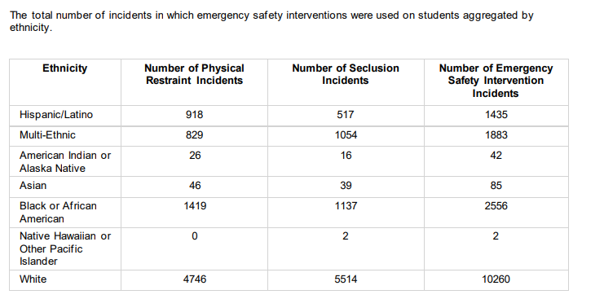
By Ethnicity

Slide 43
By Gender with an IEP

Slide 44
By Gender with 504

Slide 45
Gender with out IEP or 504

Slide 46
Totals Overall by Gender

Slide 47
Based on Free/Reduced lunch and IEP

Slide 48
Free/Reduced lunch and 504

Slide 49
Free/Reduced lunch without IEP or 504

Slide 50
Totals for Free/Reduced

Slide 51
By Age

Slide 52
Let’s explore the updated documents https://www.ksde.org/Agency/Division-of-Learning-Services/Special-Education-and-Title-Services/KIAS-Kansas-Integrated-Accountability-System/Emergency-Safety-Interventions-ESI

Slide 53
Additional Resources https://www.ksde.org/Agency/Division-of-Learning-Services/Special-Education-and-Title-Services/KIAS-Kansas-Integrated-Accountability-System/Emergency-Safety-Interventions-ESI
https://ksdetasn.org/universal_search?search_term=esi

Slide 54
Trish Backman School Mental Health Coordinator SETS Team (785) 296-6937 tbackman@ksde.org

Slide 55
Break
Notes:
Laurie will share her screen

Slide 56
SEAC Member Reports
SEAC Members

Slide 57
Ex-Officio Member Reports

Slide 58
Ex-Officio Member Reports
Families Together
Kansas Association of Special Education Administrators (KASEA) – Ashley Enz
Disability Rights Center
Kansas State Board of Education
KSSB
KSSD
KNEA
Others

Slide 59
Items for April SEAC Agenda
SEAC Members

Slide 60
Last Meeting of 2023-2024
April

Slide 61
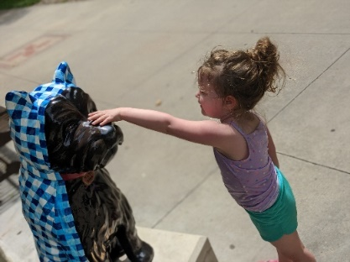
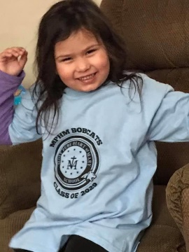
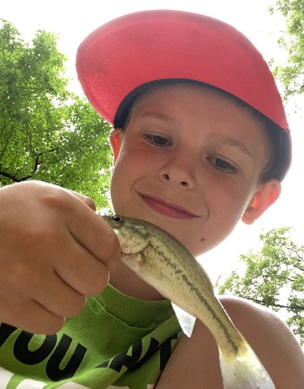
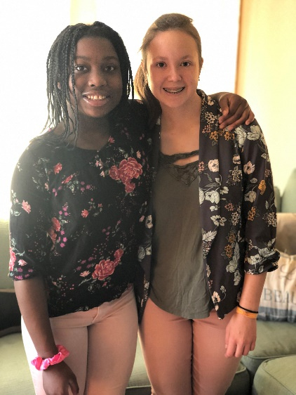
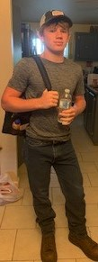
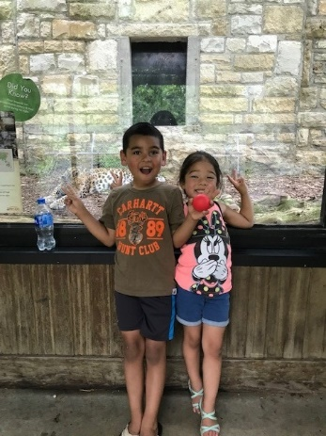
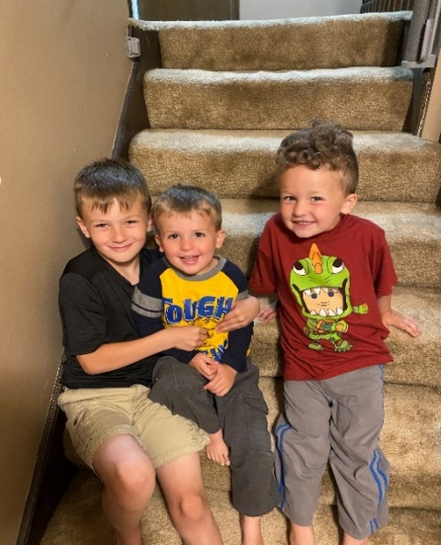
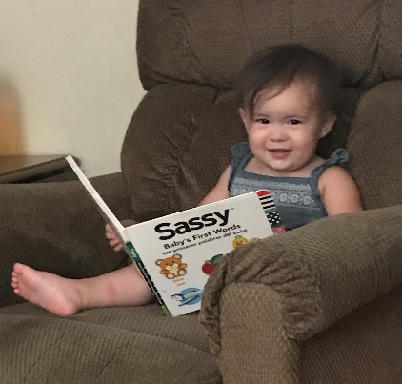
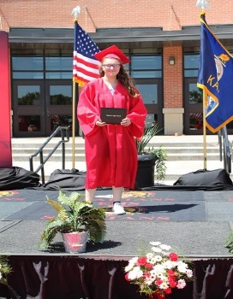
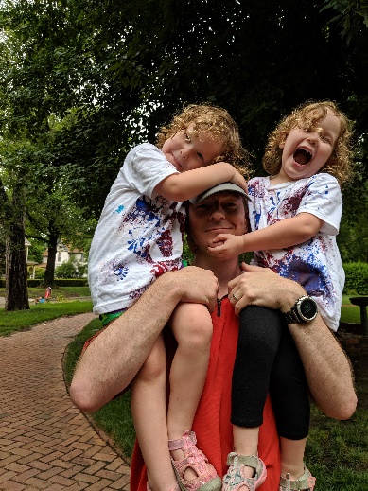
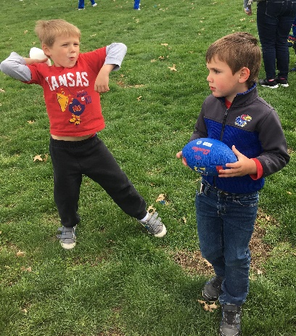
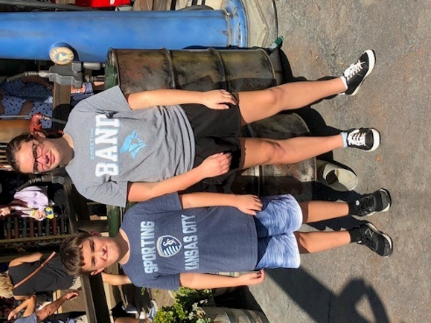
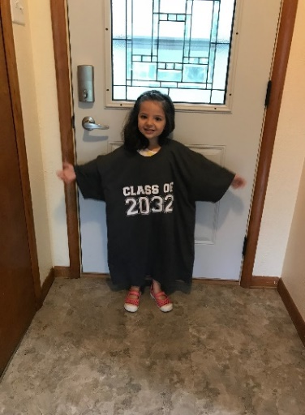
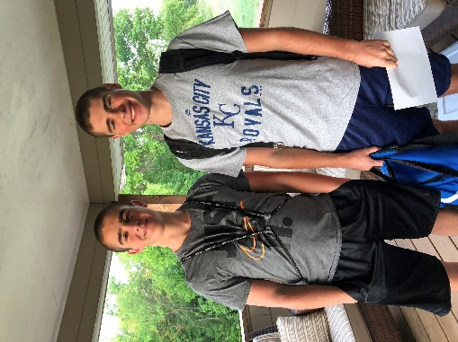
Keep The Main Thing The Main Thing

Slide 62
Closing Comments/Adjournment
Motion to adjourn

Slide 63
Bert Moore Director Special Education & Title Services (785) 291-3097 bmoore@ksde.org
Joyce Broils Administrative Specialist Special Education & Title Services (785) 29 jbroils@ksde.org

