Slide 1
School Year 2022-23 ESI and Discipline Data
Trish Backman
KSDE School Mental Health Coordinator
SETS team

Slide 2
Most recent update- May 2023
Notes:
PowerPoints

Slide 3
Define ESI

Slide 4
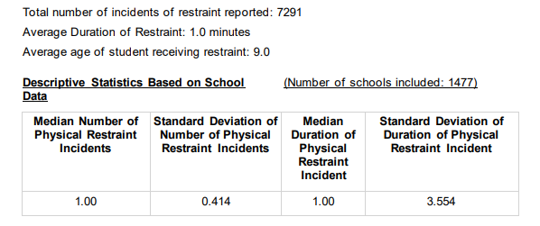
Restraint data
Notes:
Total Number of restraints 7,291
Average duration 1.0 min.
Average age of restraints is 9 y.o.

Slide 5
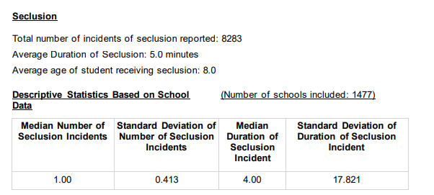
Seclusion Data
Notes:
Total number of seclusions 8,283
Avg Duration 5.0 minutes
Avg age 8 y.o.

Slide 6
Seclusion and Restraint Reports- with an IEP or 504
Notes:
Total Number of restraints 7,291 Total number of seclusions 8,283 total= 15,574
Kiddos with IEP 7143 w/ IEP 7883
W/ 504 61 w/504 100

Slide 7
Seclusion and Restraints- Non-Identified and total overall

Slide 8
Students who had a Behavior Intervention Plan
The number of students physically restrained= 1673
The number of students placed in seclusion= 1189

Slide 9
Maximums
Maximum Number of Physical Restraint Incidents with a Student= 186
Maximum Number of Seclusion Incidents with a Student= 225
Maximum Number of Emergency Safety Intervention Incidents with a Student= 225

Slide 10
By Ethnicity

Slide 11
By Ethnicity

Slide 12
By Ethnicity

Slide 13
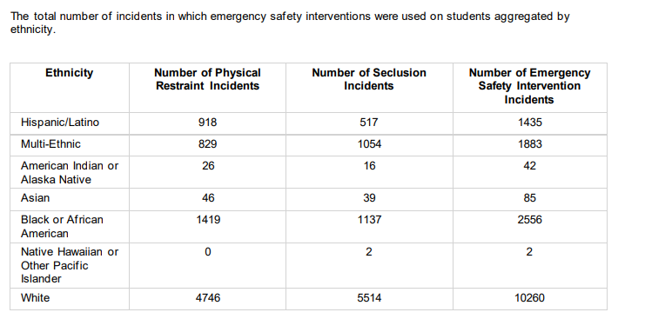
By Ethnicity

Slide 14
By Gender with an IEP

Slide 15
By Gender with 504

Slide 16
Gender with out IEP or 504

Slide 17
Totals Overall by Gender

Slide 18
Based on Free/Reduced lunch and IEP

Slide 19
Free/Reduced lunch and 504

Slide 20
Free/Reduced lunch without IEP or 504

Slide 21
Totals for Free/Reduced

Slide 22
By Age

Slide 23
Kansas School Safety and Security Act, K.S.A. §§ 72-6141 to -6145
Local boards of education must annually compile and report to the Kansas State Board of Education certain information related to school safety and security. This includes the types and frequency of acts that involve conduct that constitutes the commission of a felony or misdemeanor. This information must be disaggregated by occurrences at school, on school property, and at school-supervised activities.
K.S.A. § 72-6143(g) requires the Kansas State Board of Education to transmit this information to the Kansas Governor, Kansas Senate, Kansas House of Representatives, Attorney General, and Secretaries of KDHE, KDCF, and DOC

Slide 24
Aggregated by level

Slide 25
By Ethnicity

Slide 26
By Gender

Slide 27
Trish Backman School Mental Health Coordinator SETS Team (785) 296-6937 tbackman@ksde.org

