Slide 1
Welcome to the Special Education Advisory Council Meeting
Please be sure your microphone is muted until you wish to participate in an open discussion with the council.
The meeting will start promptly at 9:00 a.m.

Slide 2
How to pin the Interpreters Video
At the top of your meeting window, hover over the video of the participant you want to pin and click ...
From the menu, click Pin.
Optional: If you want to pin additional videos (up to 9 total), follow steps 1 & 2 again as needed.
Optional: If you have at least 3 participants in the meeting and dual monitor enabled, you will have the option to pin to your first screen or your second screen.

Slide 3
Special Education Advisory Council
November 30, 2023

Slide 4
Call to Order
Welcome
Roll Call

Slide 5
Approvals
Agenda for today, November 30, 2023
Minutes for last meeting September 28, 2023
Notes:
Poll I and 2

Slide 6
Public Comment
Guidelines for Testimony
Prior to start of the SEAC meeting, be sure to email Alysha Nichols, anichols@ksde.org expressing desire to speak during public comment.
All comments will be taken under advisement by the council.
Any response from the Council to public comments will come at a later date.
Verbal Public Comment
Verbal comments are limited to three minutes.
Cue will be given one minute before time expires.
Written Testimony
Written input must include the name, address and county of residence of the person submitting comment.
Written comments can be submitted via email, mail, or fax to the secretary of the SEAC.

Slide 7
Indicator 4B
Brian Dempsey
Notes:
Laurie will share her screen

Slide 8
Transition Grant
Dean Zajic
Notes:
Laurie will share her screen

Slide 9
DMS
Brian Dempsey
Notes:
Laurie will share her screen

Slide 10
TriState Update
Bert Moore
Brian Dempsey
Notes:
Laurie will share her screen

Slide 11
Break
Notes:
Laurie will share her screen

Slide 12
Virtual Schools
Lena Kisner
Notes:
Laurie will share her screen

Slide 13
Special Education Legislative Committee
Bert Moore
Notes:
Laurie will share her screen

Slide 14
Open SEAC positions
Bert Moore
Notes:
Laurie will share her screen

Slide 15
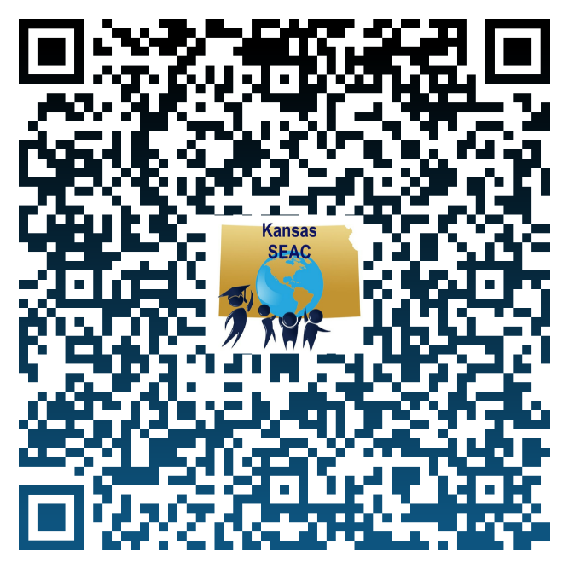
Positions to be filled
Representative from the state juvenile corrections agency
Representative from the state agency responsible for foster care of children
Parent of a child with a disability, ages birth through 26 years
Individual with a disability
Can apply through this link: https://forms.gle/ThFovGLUB9Rci1rPA

Slide 16
Lunch
Notes:
Laurie will share her screen

Slide 17
Licensure Update
November 30, 2023

Slide 18
Nontraditional Routes to the Classroom
Limited Residency License (LRL).
For high incidence and low incidence.
Must hold bachelor's degree.
Must serve as a special education para for one-year at a minimum.
High Incidence program offered: Baker, FHSU, Friends, PSU, Washburn, and WSU.
Low Incidence program offered: FHSU (approved November 2023; cohort will start August 2024).
Teacher Apprentice License (TAP).
Only at WSU.
Early childhood Unified, Birth to grade 3.
Elementary.
Limited Elementary Residency License (LERP).
Elementary.
Must hold bachelor’s degree.
Benedictine, FHSU, KSU, and Newman.
Notes:
LAL:
Friends
FHSU
WSU
PSU
Baker
Washburn
LEAP:
FHSU
K-State
Newman
Benedictine
LTAP: WSU
Restricted:
Benedictine
ESU
FHSU
K-State
MNU
Pitt St
WSU

Slide 19
Special Education Waivers and Provisional Licenses
Contingent on enrollment in an approved program appropriate to the special education teaching assignment, the school district can apply for a waiver.
An educator can receive up to three waivers for three school years.
It is HIGHLY RECOMMENDED that an educator not spend three years on a waiver and instead apply for a provisional license once eligible.

Slide 20
Special Education Waivers and Provisional Licenses
Provisional licenses are available up to four years.
First provisional license requires completion of 50% of the approved program (exception high/low incidence).
Renewing a provisional license requires completion of 50% of the remaining plan of study.
Neither a waiver or a provisional license is available if all an educator has left is the PRAXIS content exam.
A lot of educators make the mistake of staying on a waiver for three years, complete the coursework, and never apply for a provisional license—this can affect upgrade of an initial license.

Slide 21
Limited License Waivers
Limited Licenses do not require waivers.
Limited Licenses are pre-standard licenses that authorize the individual to serve in a position for which she/he is endorsed.

Slide 22
Accreditation Waivers
KESA regulations 91-31-34 Governing Body Requirements
Specifies limitation to substitute licenses.
Issue 38 - 09-23-2021 | Department of Education | Permanent Administrative Regulations - 49460 (ks.gov)
Limitation for licenses
Standard Substitute License
90 days in same assignment
Emergency Substitute w/Bachelor’s Degree
45 days in same assignment
Emergency Substitute w at least (60) college credit hours no Bachelor’s degree
25 days in same assignment, no more than 75 in a semester.
Modified Emergency Substitute License (formerly known as TEAL).
25 days in the same assignment, no more than 75 days in the same assignment.
License will specify it is valid for a specific district.
NOT ELIGIBLE FOR A WAIVER.

Slide 23
Approved Test Changes by the SBOE
Remove the Principles of Learning and Teaching pedagogy exam as a requirement for licensure.
Establish a process through the Licensure Review Committee to address educators who completed Kansas approved teacher preparation programs but have not passed the required content exam after two attempts to qualify for a standard Kansas teaching license.
The instructions and form should be completed NLT December 1, 2023.
Instructions and forms will be submitted via KSDE Weekly updates.

Slide 24
Content Test Rubric

Slide 25
Out of State Licensure
Statute 48-3406.
Valid out of state license.
Experience within the last year.
Complete application.
Complete background check.
Will receive an equivalent Kansas license.
Teacher Mobility Compact.
Bachelor’s degree.
Valid unencumbered out of state license.
Application and fee.
Pass background check.
Will receive equivalent Kansas license.

Slide 26
Teacher Mobility Compact

Slide 27
Teacher Mobility Compact
Member States
Member States
Alabama
Colorado
Florida
Kentucky
Kansas
Nebraska
Nevada
Oklahoma
Oregon
Utah

Slide 28
Registered Teacher Apprenticeship

Slide 29
What is a Registered Teacher Apprenticeship
Apprentice On-The-Job Learning (OJL):
Full-time employment in a preK-6 classroom (assisting a teacher of record).
Is not the teacher of record during the apprenticeship.
Learning and mastering teaching competencies.
Receives wage progression as progress is made in the program.
Receives National Recognized Apprenticeship Certificate on completion.
Apprentice Related Technical Instruction (RTI):
Pursuing a bachelor’s degree at an accredited college/university within teacher preparation program.
Qualifies for Kansas Initial Teaching License.

Slide 30
Roles
Role of KSDE
Apprenticeship Intermediary (not the W-2 employer).
Track and report apprentice progress to Kansas Office of Apprenticeship.
Manage program funding.
Maintain apprenticeship reporting records and enter it into RAPIDS (USDOL tracking system).
Issue initial teaching license.
Role of districts
Apprenticeship Sponsor (W-2 employer).
On-the-Job Learning Provider (OJL).
Recruiting/identifying apprentice candidates.
Hire and train apprentice using competency-based learning.
Track and report apprenticeship progress to KSDE.
Maintain apprenticeship progress records.
Role of universities/community colleges
Related Technical Instruction Provider (RTI).
Deliver online instruction that is conducive to a full-time work schedule.
Confer bachelor’s degree within a teacher preparation program.

Slide 31
Funding and Reporting
Funding:
Up to $2,500 a year for tuition from KSDE (MeadowLARK Grant).
$2,750 a year for tuition from the Kansas Department of Commerce (HB 2292).
KBOR and university/community college scholarships.
District pays wages. Minimum hourly wage $14 per hour.
$1,500 for mentor teachers from KSDE (MeadowLARK Grant / KNEA Grant).
KSDE will cover Praxis and PLT Tests (MeadowLARK Grant).
KSDE will cover initial teaching license fee (MeadowLARK Grant)
All money will be reimbursed to districts.
Summer Apprenticeship Conference with Kansas Teachers of the Year

Slide 32
Timeline
O/A January 15, 2024 -Instructions and Application submitted to districts.
April 1, 2024 – Application deadline to participate in Fall 2024 cohort.
O/A May 1, 2024 – Fall 2024 Cohort established.
May – July 2024 – Apprentices enroll in courses.

Slide 33
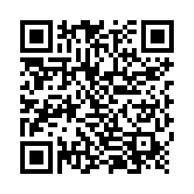
Survey for districts
If your district is interested in participating, please scan the QR code and complete the survey

Slide 34
Questions

Slide 35
Statewide IEP
Brian Dempsey
Dean Zajic
Notes:
Laurie will share her screen

Slide 36
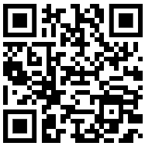
We want to hear from you
Scan the QR code or visit the link below to complete a short survey.
https://forms.gle/9kzrWY7a43A23v7QA

Slide 37
Due Process Reports
Brian Dempsey
Notes:
Laurie will share her screen

Slide 38
Break
Notes:
Laurie will share her screen

Slide 39
SEAC Member Reports
SEAC Members

Slide 40
Ex-Officio Member Reports

Slide 41
Ex-Officio Member Reports
Families Together
Kansas Association of Special Education Administrators (KASEA) – Ashley Enz
Disability Rights Center
Kansas State Board of Education
KSSB
KSSD
KNEA
Others

Slide 42
Items for January SEAC Agenda
SEAC Members

Slide 43
January 9th and 10th
January 9, 2024 – Landon State Office Building or Zoom
Meet from 1pm to 3pm with the State Interagency Coordinating Council
January 10, 2024- Landon State Office Building or Zoom
Breakfast with the State Board of Education starts at 7:30am
Meeting is from 7:30am – 3 pm

Slide 44
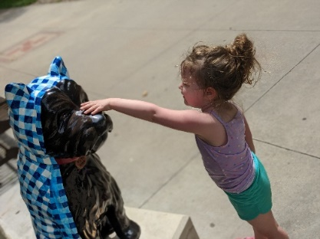
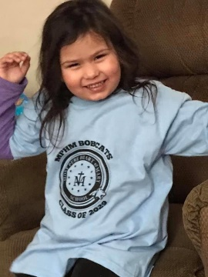
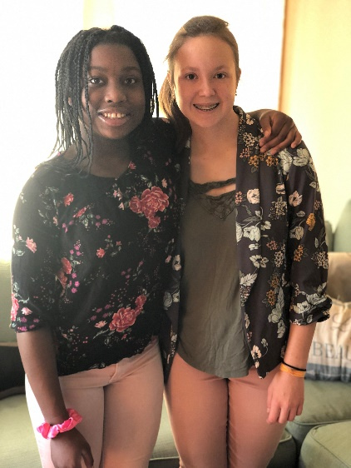
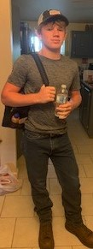
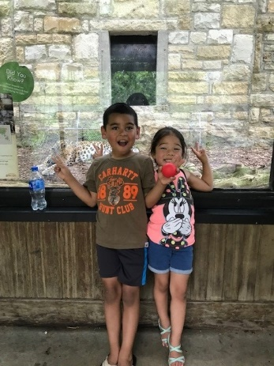
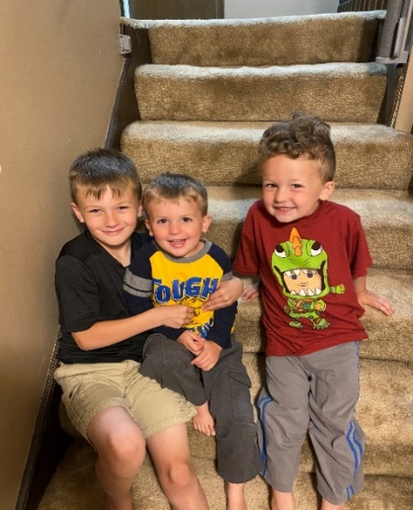
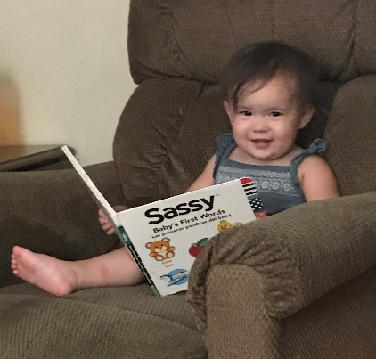
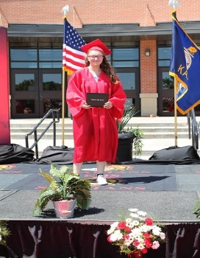
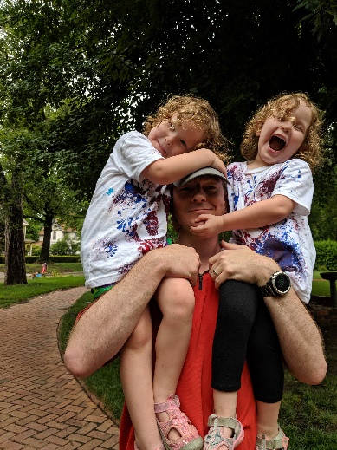
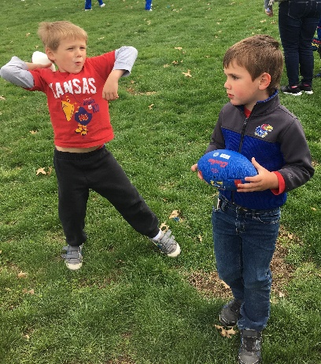
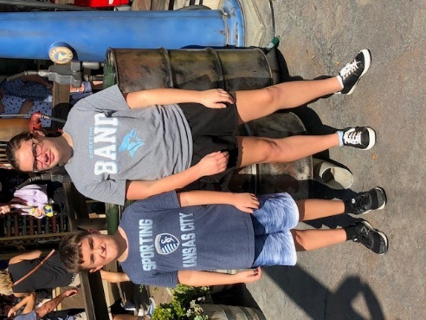
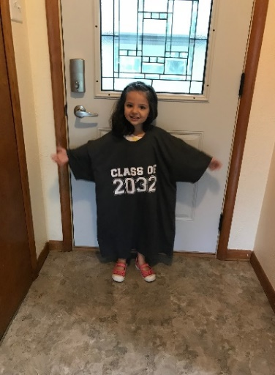
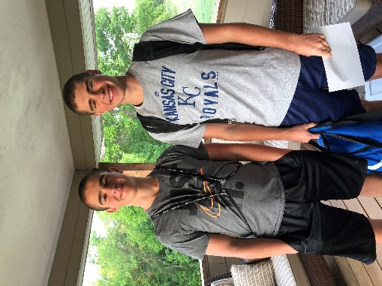
Keep The Main Thing The Main Thing

Slide 45
Closing Comments/Adjournment
Motion to adjourn

Slide 46
Bert Moore Director Special Education & Title Services (785) 291-3097 bmoore@ksde.org
Alysha Nichols Administrative Assistant Special Education & Title Services (785) 296-6066 anichols@ksde.org

