Slide 1
Pieces of the Puzzle
Introduction to Special Education data reporting - MIS
By: Mason Vosburgh

Slide 2
Modules
1
Module One – Introduction to MIS reporting
log in, access
Module Two – Getting started
Navigation, Calendar, Building information, Directory - Building association, Class minutes, settings, Providers
2
3
Module Three – Student data
Entering and exiting student records
4
Module Four – Verifications and reports
5
Module Five – State Funding
6
Module Six – Closing the school year
7
Module Seven – Other related topics

Slide 3
Module 7
  Other related topics.
Module 6 objectives
Provide clarification on related subject matter.
K Time
Address Timely and Accurate reporting
Identify sources of MIS support documents & guidance materials
General Tips and recommendations

Slide 4
K Time
What is K Time?
A portion of the day a child participates in a regular early childhood program without IEP support.
What is a regular early childhood program?
A non-special education preschool program / classroom
*At risk classroom
*Headstart classroom
*Community based / private preschool programs
*Group child development / childcare centers
*All other preschool classes offered to pre-K students by the public school system. “General / Universal” preschool
What do these programs have in common?
Attended by 50% or more non-identified children.

Slide 5
K Time
What does K time do?
K time factors in the December 1 OSEP Environment calculation.
Indicator 6
How does K time factor in the calculation?
OSEP categorizes preschool environments in 2 tiers
Does the child attend a regular early childhood program?
Yes or No
If yes, For how many hours per week?
At least 10 hours / Less than 10 hours
Is there K time in Integrated or Reverse mainstream classrooms?
No, these are special education programs.
R minutes + G minutes = classroom session minutes
W minutes + G minutes = classroom session minutes

Slide 6
K Time
What are the Indicator 6 ramifications? Example
Child attends a regular early childhood for 3 hours, 4 days a week. Receives 20 minutes of pull-out support only.
Org. A – reports only 20 minutes of pull-out. The child is categorized as in a separate class (Code SP), Included in Indicator 6b.
Org. B – reports 20 minutes of pull-out and 160 minutes of K time. The child is categorized as in regular early childhood 10 or more hours, services in other location (Code TL), excluded from Indicator 6.

Slide 7
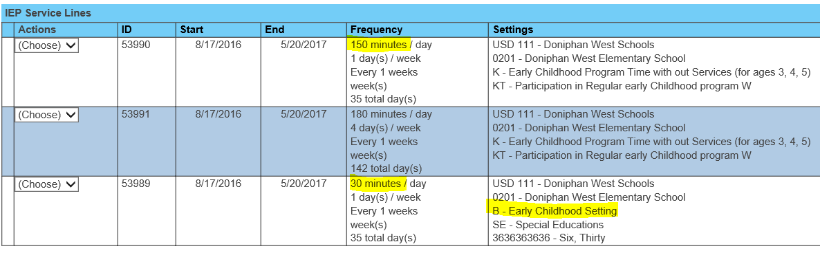
K Time
What does K time look like?
A student attends a 3 hour At Risk class with 30 minutes of pull-out support.
Only B (regular early childhood) programs qualify as K time when no IEP support is provided.
Settings - “B” & “K” are companions and apply to the same classroom session.
Minutes calculation - “B” minutes + “G” minutes + “K” minutes = the class session minutes.

Slide 8
Annual Status
Student’s First Active Status of the school year.
Students must be first reported as Active status to begin a school year.
Children who begin IEP services at age 3 must be have an active status of New Referral (N) or C to B transition (B)
A Student’s status must be promoted to current year status before initial entry into the MIS each school year
All active status from the prior school year change to Continuing on July 1 of the current school year.
Failure to report an accurate initial active status may result in verification 0215. Changing the student’s Annual Status can only be done at the KSDE level

Slide 9
Catchment Area
The domain of your LEA / organization within its boundaries
Coops and Interlocals
  The boundaries of all member districts inclusively compose the catchment area
USD
  All buildings and programs within the USD boundaries compose the catchment area.
Private / Parochial Schools
Accredited / non-accredited
  Calendars, providers and building settings are updated for Private / Parochial Schools by the LEA in the Private school’s catchment area
  Catchment permissions are established in the state building Directory
Exiting considerations
  Students who move within the catchment area do not qualify and are not considered exits

Slide 10
Timely and Accurate reporting
Accurate submission – December 1
Area of Disability, responsible school and OSEP environment are accurate
Accurate submission – End of year data -
Complete data is reported for all students
Discipline incidences are accurate
Exiting data is accurate
Provider data in KGRS is accurate
Verifications flags are cleared
Data Quality reports are resolved
Exit status report
    Unresolved Exits
    Omitted Discipline Incident report
  Internal controls -
Participation in annual training
Presence of a local MIS procedural guide
Following reporting standard and instruction
  Timely and Accurate is tracked by USD on a score sheet. A score of 90% + is compliant

Slide 11
Timely and Accurate Tips
  Grade level
      Do not change final December 1 Kindergarten grade to Preschool grade
    Do not change final December 1 Preschool grade to Kindergarten grade
  Neighborhood School
    Do not change final December 1 Public school to Private school
    Do not change final December 1 Private school to Public school
  Stop data entry a week before a data collection is finalized
    April 22, (Dec. 1) - November 7, (End of Year)
    Limit updates to resolving high priority verifications
    Resume data entry the day following finalization.
  Maintain a Timely and Accurate results template
    Record individual points awarded and lost by category and district
    Point losses should not be a mystery when levels of determination are released each March. A 30-day review period follows the release.

Slide 12
Timely and Accurate FAQ
  Do all unresolved Verifications result in a point deduction?
      No, only unresolved verifications that directly effect the reported OSEP data categories. See the Verification section of the MIS Data Dictionary.
  Can the issue causing the point deduction be corrected?
    In many cases the issue can be resolved before the report finalization. The ability to correct the issue would be determined on an individual basis.
  Do point deductions apply to the Coop or Interlocal.
    a. No, the Timely and Accurate measurement is made at the USD and state school level. The organization is determined by the student’s responsible school.

Slide 13
Timely and Accurate FAQ
  Where do I find the deadlines for Timely reporting?
      For SPEDPro reporting, - The MIS Data Dictionary, Pages 1-2.
      For Discipline, Indicators 11, 12, 13 data – The KIAS Calendar
  Can a single student record result in multiple point losses?
    If a single error triggers different flags in the same area of measurement, only a single point loss occurs
      For example – an invalid responsible school could trigger 0176 and 0224.
      In this case both verifications apply to category 12 thus only 1-point loss.
    If the student record triggers different flags in different areas of measurement, then multiple point loss can occur
      For example – student record has an invalid responsible school, Graduation status was not reported, and service lines do not reflect services location under expulsion.
      In this case the verifications apply to category 12, 14 & 17 thus a 3-point loss.

Slide 14
Timely and Accurate FAQ
  Where do I find the specific 23 points of measurement?
      a. They are posted at www.ksde.org.
      See - Kansas Integrated Accountability System (KIAS) page
      See – MIS and Student data page.
      How do I keep track of T & A points?
        a. Use the Tamely and Accurate results template posted at www.ksde.org
        b. The conditions for awarding points and a T & A Results template are posted on the MIS and Student data page. Points are tracked locally.
  What if a T & A point was deducted by KSDE in error?
    a. A district’s Level of Determination (the USD performance on OSEP Indicators and Timely and Accurate reporting) from the prior school year are released for review in March. During the 30-day review window challenges can be made based on evidence presented. KSDE will reinstate points when evidence shows a point was deducted in error.

Slide 15
MIS support documents & guidance materials
What guidance material is used for MIS reporting?
Local MIS procedural manual
  Process and procedures used to manage MIS collection and reporting
  Local data sources identified, data connections and crosswalks
  Data entry methods described, updated when methods change.
  Common problematic areas, troubleshooting and quality control techniques are documented.
  Local timelines and deadlines
  “How to” guidebook
  Day to Day instruction for data entry, management,
  process and procedures specific to your agency
  This manual is updated throughout the school year.
  Where is the Local MIS procedural manual found?
    At the desk of the LEA’s MIS clerk

Slide 16
MIS support documents & guidance materials
What additional support is available for MIS reporting?
The Report Preparation and Data Dictionary
  MIS business rules and reporting standard
  Submission schedule, and timelines
  Data elements collected, definitions, and acronym descriptions
  File Import specifications
SPEDPro User guide
  Instruction for data entry and file import
Timely and Accurate Results Template
  For recording point awards and losses for T & A reporting
  Where are these support documents found?
  The MIS and student data page at www.ksde.org

Slide 17
MIS support documents & guidance materials
What additional support is available for MIS reporting?
The Index of MIS Support Documents
An alphabetical directory of instructional guidance by subject matter. References are sited to past MIS presentation workbooks, Monthly FAQ reminders, and other posted support documents.
Monthly FAQ – overview of monthly tasks
Other support documents for specific tasks
Resources page at https://ksdetasn.org/gstad
MIS presentation workbooks by year
Directory of local MIS clerks state-wide

Slide 18
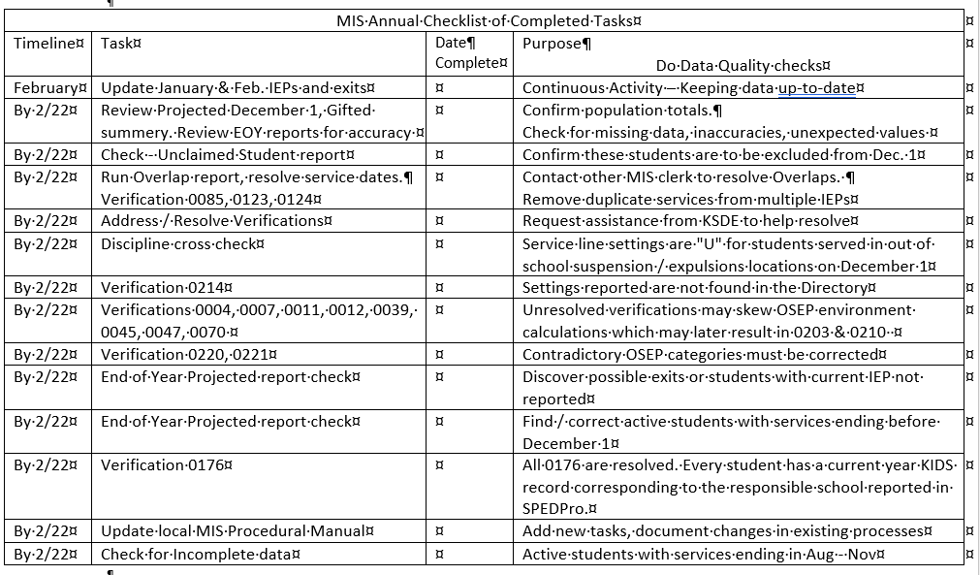
MIS support documents & guidance materials
List of tasks
Timelines
A recommended task list for the school year is found in the Data Dictionary.
Reminders of important MIS activities is sent monthly as a FAQ.
Timeline – target completion date prior to the end of the month
Purpose – why the task needs to be completed
Date completed – when the task has been finished
Monthly reminders / FAQ is emailed from KSDE

Slide 19
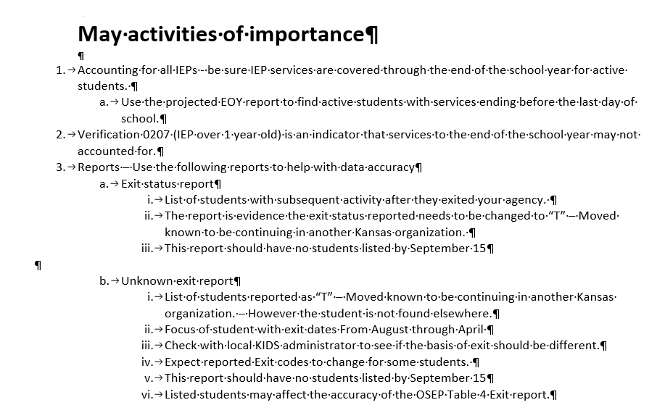
MIS support documents & guidance materials
Monthly reminders / FAQ
Monthly focus
Important reminders of MIS activities to be completed during the month
Activates focus forthcoming OSEP data report.
Reminders focus on high priority activities, reports and data analysis.

Slide 20
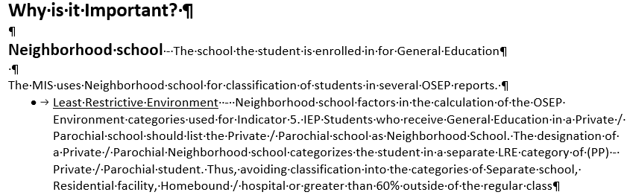
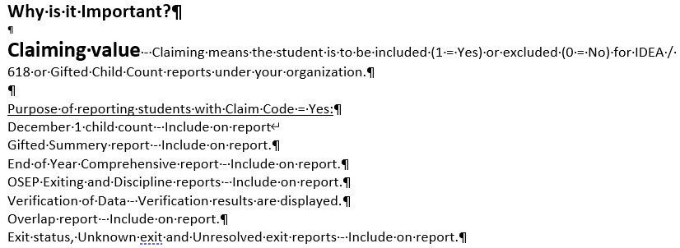
MIS support documents & guidance materials
Monthly reminders / FAQ
Why is it important?
A detailed explanation of a data element and how the values reported effect the student standing on Federal reports.

Slide 21
Last Tips
Do not attach or embed confidential student data to e-mails.
  Upload files for troubleshooting to the MIS collection system which is a secure site.
Do not title import files with student names or initials
Do not skip the begin year Discovery process
Lunch time services are always reported on individual service lines
Resolve verification and data quality reports as the data is submitted
Do not import individual records or batch files into SPEDPro the days before the OSEP reports are scheduled to be finalized.
Delete original records out of SPEDPro before importing new records for the same student
Regularly update the local MIS procedural guide keeping it up-to-date with processes as they are completed.

Slide 22
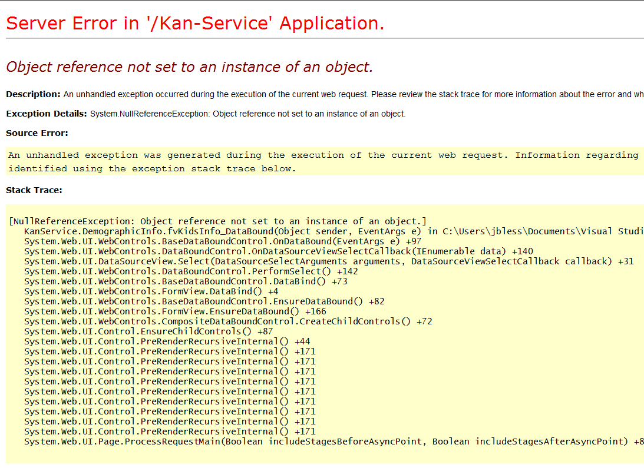
Help Desk contacts
Crash – Let someone know
If the application crashes, there is some helpful information to remember when reporting a crash.
You may be asked a series of questions to trouble shoot.
Your log in access?
D0701
Your permissions?
District user
What were you doing specifically?
selecting a frequency on a
service line
What student did this occur?
4587896541
SPEDPro Help – Mason, 785-296-4945, Mvosburgh@KSDE.Org
Directory Updates - Mason, 785-296-4945, Mvosburgh@KSDE.Org
State-wide Data Clerk contact info - TASN, http://ksdetasn.org/gstad
MIS Workshop Presentations - TASN, http://ksdetasn.org/gstad
Indicator 11 – temporarily vacant
Indicator 12 – Natalie McClane, NMcclane@KSDE.Org
KIAS System, navigation, data entry, or editing – Leader Services,(toll free) 877-456-8777
The SETS Help Desk by content area (file reviews, indicators, ESI, etc,) 785-296-3743
KSDE IT Help Desk, KIDS Data, Access to Authenticated applications - 785-296-7935

Slide 23

The End

