Slide 1
Pieces of the Puzzle
Introduction to Special Education data reporting - MIS
By: Mason Vosburgh

Slide 2
Modules
1
Module One – Introduction to MIS reporting
log in, access
Module Two – Getting started
Navigation, Calendar, Building information, Directory - Building association, Class minutes, settings, Providers
2
3
Module Three – Student data Entering and exiting student records
4
Module Four – Verifications and reports
5
Module Five – State Funding
6
Module Six – Closing the school year
7
Module Seven – Other related topics

Slide 3
Closing the school year
Module 6 objective
How to use SPEDPro data quality reports to find unresolved issues prior to the finalization and closure of current year data collection.
Module 5 corresponds with the “Closing the school year” webinar posted on the MIS and student data page at www.KSDE.org
Watch the “Closing the school year” webinar for more details.

Slide 4
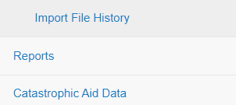
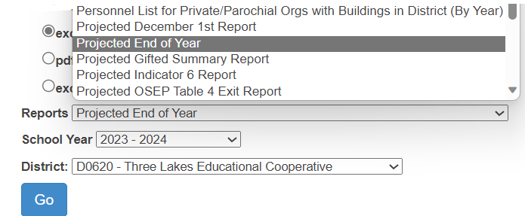
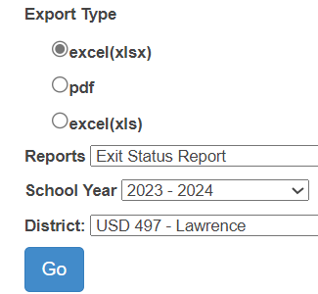
Closing the school year
How to choose and run a report
Navigate to the reports page
Select the target school
Select the Organization
Select the report format
Select the report
needed from the drop
down menu and file
type.
Click Go to generate the
report.

Slide 5
Closing the school year
Overlap report
Overlaps are caused when service date ranges between the start and end are reported on different IEPs for the same student.
An Overlap can occur on the same student record when more than 1 IEP lists the same service dates
An Overlap can occur for the same student when the same service dates are reported by multiple agencies.
The Overlap report will identify the Overlap source (ACC column), single agency or multiple agencies.
Overlaps must be resolved prior to the finalization of current year collection and the final End of Year report.

Slide 6
Closing the school year
Projected End of Year Report
The Projected End of Year report is very important for managing the quality of the data submitted throughout the school year.
Projected EOY Report can find
Duplicate records
Incomplete data
Missing services, invalid “Z” settings
Grade level and age disparities
Inaccurate Assign child count organizations
DD Students older than age 9
Missing and inaccurate data values
Total student population
All exits
Review in great detail the contents of the Projected End of Year report. Make all corrections to all discrepancies found before the finalization of the End of Year report.

Slide 7
Closing the school year
Projected End of Year Report
Duplicates and Overlaps
Federal reporting specifications require unduplicated counts of students in each categorical data set.
Duplicates are determined by the presence of multiple records for the same student from the same organization. Duplicates can be found in the projected End of Year report.
Overlaps are determined by the presence of services from multiple organizations or multiple IEPs within the same service line start and end dates. Overlaps can be found in the Overlap report.
Tip – check for duplicates and overlaps throughout the school year. The December 1 final report requires and unduplicated count of students.

Slide 8
Closing the school year
Projected End of Year Report
Check for Duplicate records
A
B
C
A
Solution
Exit record from D0397 is not valid. The student did not exit the Coop / Interlocal.
Combine all services from both USD into a single record. Delete the record with the exit date and exit status.
A - Use the Excel Conditional Formatting tool to find duplicate ID numbers
B – Duplicate records found from the same organization
C - Multiple USD from the same organization
The presence of duplicate data will result in a point loss for accurate reporting.

Slide 9
Closing the school year
Projected End of Year Report
Check for Incomplete Data
A
B
A
A
Example of Incomplete data
A. Active students
B. Services ceasing before the end of the school year
Solution
A. The current status is correct. Service dates to the end of the school year are missing
B. The service end date is correct. An exit date and inactive status needs to be added
The presence of Incomplete data will result in a point loss for accurate reporting.

Slide 10
Closing the school year
Projected End of Year Report
Check for students age 21 without inactive status and exit date
Age 21 is the last year of eligibility.
Inactive status must be;
Maximum Age or Graduate with Diploma
Solution
If the student received a regular high school diploma, change current status to Graduation
If the student did not receive a regular high school diploma, change current status to Reach Maximum age

Slide 11
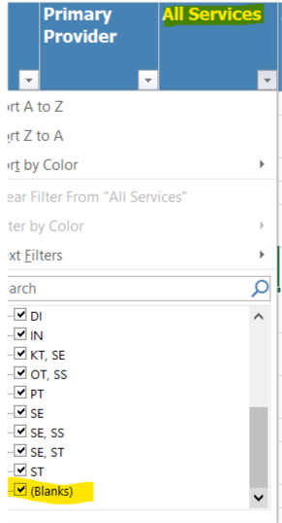
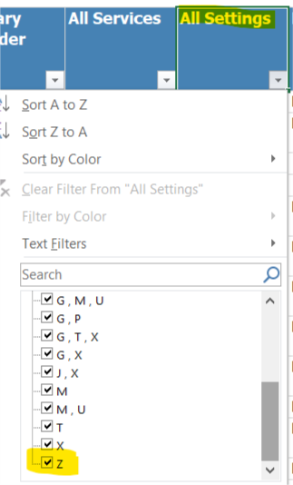
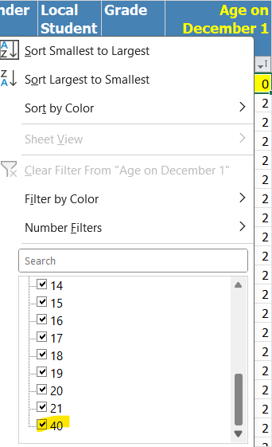
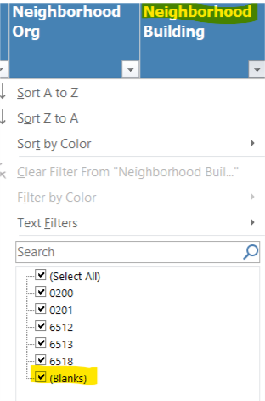
Closing the school year
Projected End of Year Report
Check for Missing / incorrect values
Use the filter tool to check each column for accuracy
Solution: Change the value in the current student record and save.
A
MIS Tip - A good practice is to run this same check throughout the school year.

Slide 12
Closing the school year
Unclaimed Student Report
List of students to be excluded from federal reports and child counts
Note: High Priority report
Objective: To include all students who received IEP support during the school year.
Confirm these students meet the condition for not claiming. Data Dictionary, page 10.
Changes to the claiming value is made on the student profile.

Slide 13
Closing the school year
Overlap Report
2 Organization listed Overlap is in your data and a different agency. Service line dates overlap
Overlap of a single organization indicates the overlap is in your data alone.
Multiple profiles, same service dates on multiple IEPs

Slide 14
Closing the school year
Discipline Reports
Discipline data is reported in the Kansas Integrated Accountability System – KIAS. Some organizations enter the incidences by building, other do a batch submission for all buildings. Discover how your districts report discipline data.
Discipline data review – in addition to the Discipline Incident and summery reports in SPEDPro, the basis of removal and total days removed can be confirmed using manifestation documents, notice of change of placement and in rare cases, IEP amendments.
Discipline data review – some students may be incorrectly identified as IEP students on the discipline incident date. These student would be listed on the Incident omitted report in SPEDPro. The Incident omitted report is used for measuring accurate data reporting. This report would be cleared by the EOY finalization.
Note: – Discipline data would be investigated prior to the December 1 finalization to confirm students with 10 or more days of Out of school suspension, expulsion or removal to Interim Alternative setting intersecting the December 1 date, should have corresponding service lines with the “U” setting for the December 1 services.

Slide 15
Closing the school year
Discipline Reports
Discipline Incident report
List of students subject to disciplinary removals by date, removal type and total days of removal. Check for duplicate entries, inaccurate days of removal or incorrect students listed. Alert the KIAS user for corrections
Examples
Student Klink has duplicate entries.
Same incident (by date) listed twice
OSS, Expulsion & IAES all list the same number of days of removal. Unlikely scenario.
Note: – Students with 10 or more days of Out of school suspension, expulsion or removal to Interim Alternative setting should have corresponding service lines with the “U” setting for the duration of the disciplinary removal.

Slide 16
Closing the school year
Discipline Reports
Incident Omitted report
List of students subject to disciplinary removals by date, removal type and total days of removal. Check for duplicate entries, inaccurate days of removal or incorrect students listed. Notify the KIAS user for corrections and removal of the IDEA indicator in KIAS.
Examples
Smith | No Disability match | Incident dates are before the student was on an IEP
Aikman | No service line | SPEDPro record incomplete. Next IEP is missing
Pugh | No Disability match | student is Gifted only
Landry | No service line | wrong student entered in KIAS. Cousin Bob was suspended.
White | No Disability match | Incident date is after the student exited special ed
Note: – Students with 10 or more days of Out of school suspension, expulsion or removal to Interim Alternative setting should have corresponding service lines with the “U” setting for the duration of the disciplinary removal.

Slide 17
Closing the school year
Exit Reports
Table 4 Exit report
The official count of students ages 14-21 with OSEP qualified exit status.
In Special Education at the beginning of the school year (July 1)
December 1 Age = 14 -21
Last exit of the school year (from the agency providing the last services) counts.
Use the Projected Table 4 Exit to confirm the population of each exit category.
The Exiting reports provide evidence that subsequent student activity has changed reported basis of exit to different OSEP exiting category.
For example
A reported Dropout should be reported as a moved student
A reported in-state transfer should be reported as out of state transfer
An in-state transfer should be reported as an Action initiated withdrawal
Exit reports are used to measure accurate reporting

Slide 18
Closing the school year
Exit Reports
Exit status report
List of students with subsequent activity after exiting, that changes the reported basis of exit / OSEP exit category.
Examples
Student reported as a dropout, but subsequently enrolled elsewhere
Student reported as left the state, but subsequently enrolled elsewhere in Kansas
Student reported as revoked services, but subsequently resumed special education
Solution
Change the current status to moved, known to be continuing and the student is removed from the report.

Slide 19
Closing the school year
Exit Reports
Unknown Exit report
List of students submitted as on-state transfers, but the student is not found in another Kansas USD or state school after the exit date.
Possible solutions
Student moved out of state – change current status to “left state”
Student went to home school without revocation of services - change current status to “action-initiated withdrawal”
Student dropped out - change current status to “dropout”
Student went into GED program - change current status to “enrolled in GED”
Ask KSDE for assistance determining students listed if whereabouts are unknown.

Slide 20
Closing the school year
Exit Reports
Unresolved Exit report
The last data quality report of the prior school year. Current year school year data must be submitted to run the Unresolved exit report.
The report logic selects all active students from the prior school year and looks for a current year record associated to the same organization.
Those active students not found in the current year are considered Unresolved Exits.
Solution
A. Determine if the exit information from the prior year is missing. If so, update the record with and exit date and inactive status. This will clear the student from the report.
B. If the student is active in the current school year, enter the active record in the current school year to clear the student from the report.
The presence of Unresolved Exits will result in a point loss for accurate reporting.

Slide 21
Closing the school year
Exit Reports
Unresolved Exit report
List of students with active status (non-exit) in the prior school year, not found in the MIS for the subsequent school year.
Examples
D0001 – Student’s birthdate indicates the student reached Maximum age
D0002 – The service end date indicates services ended earlier in the year, an Exiter?
D0003 – No service end date. The MIS record may have been entered by mistake.
D0004 - Student’s birthdate indicates the student is of Graduation age
Tip – Contact local KIDS administrators to see if the student has been reported as an exit in other student information systems

Slide 22
Verifications and reports
Dates and Deadlines
November 15
Prior year data finalization deadline
The following data sets will be finalized on November 15.
Verifications and reports related Exiting and Discipline data.
Data Quality reports related to Exiting and Discipline data.
See verification section of the Data Dictionary for a list of verifications related to OSEP data categories
KSDE will measure this deadline for determination of timely and accurate reporting

