Slide 1
Pieces of the Puzzle
Introduction to Special Education data reporting - MIS
By: Mason Vosburgh

Slide 2
Modules
1
Module One – Introduction to MIS reporting
log in, access
Module Two – Getting started
Navigation, Calendar, Building information, Directory - Building association, Class minutes, settings, Providers
2
3
Module Three – Student data Entering and exiting student records
4
Module Four – Verifications and reports
5
Module Five – State Funding
6
Module Six – Closing the school year
7
Module Seven – Other related topics

Slide 3
Module Five
State Funding
Module 5 Objective
Introduce the how a student can qualify for additional state funding and how an organization can claim these funds through MIS data reporting.
Non-Public Equivalency (NPE) funding
Catestrophic Aid funding
Module five corresponds to Parts XI – XII in the SPEDPro User guide
See the NPE and Catestrophic Aid sections of the Data Dictionary for business rules and reporting requirements.
See the SPEDPro User guide for data entry instruction.

Slide 4
State Funding
Non-Public Equivalency
A student may qualify for NPE reimbursement under two conditions
1. The student receives IEP services under contract from a private nonprofit corporation, public or private institution. Service providers at the NPE program do not receive categorial aid reimbursement.
Example – The student is placed in a program outside of any public school system. Qualified NPE programs include, but are not limited to:
Heartspring, Summit Behavioral Services ,
Prairie View, Cornerstone of Care – Ozanam, Gillis Center, Niles Prep
Milestones Academy, Children's Center For Visual Impairments (CCVI)

Slide 5
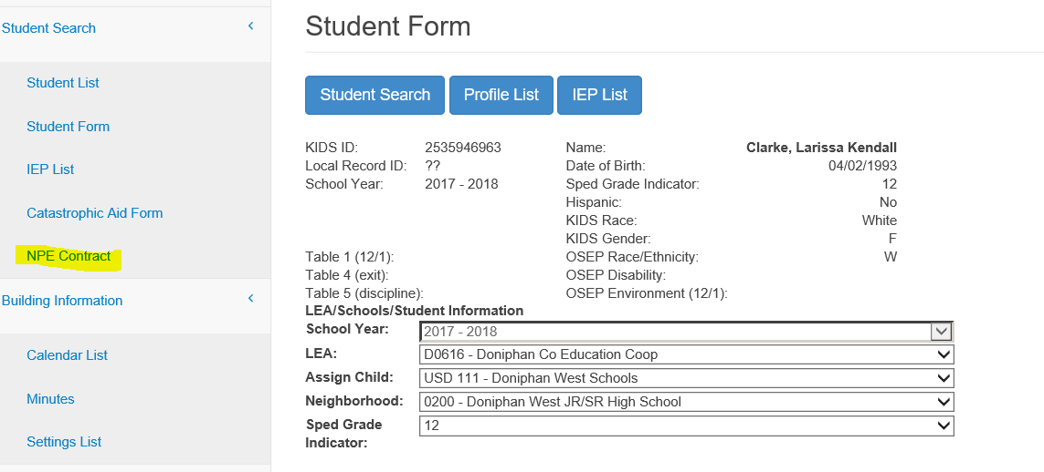
State Funding
Non-Public Equivalency
A student may qualify for NPE reimbursement under two conditions
2. The Kansas School for the Blind or Kansas School for the Deaf summer session only.
NPE data entry is accessed from the student record by clicking the NPE Contract link on the Navigation pane.

Slide 6
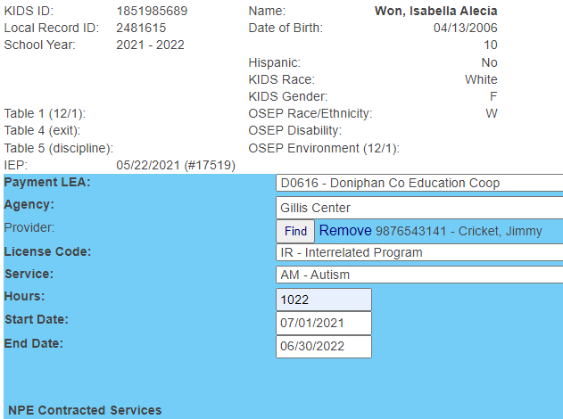
State Funding
Non-Public Equivalency
Click the New button, the form appears on screen, click new for each contracted service and enter each contracted service individually and save
Enter the Payment LEA, contracted agency, provider & license code, service code
Enter the hours of service for the school year and the service start and end dates. Repeat for each service provided.
Save the completed form

Slide 7
State Funding
Non-Public Equivalency
Additional guidance:
NPE services can be reported for the entire school year. July 1 – June 30. The service location and providers would be the same as the MIS service lines. The MIS service lines would only list regular term services.
The Payment LEA is the special education organization paying the contracted services. Coops and Interlocals are typically billed rather than the “Home” district.
Contact KSDE for guidance for entering NPE providers into SPEDPro

Slide 8
State Funding
Non-Public Equivalency
Special requirements for KSSB & KSSD summer session.
A KIDS record is required to create a student profile at the LEA level. Request a KIDS record from KSSB or KSSD listing a USD school or central office as the funding school.
Only report the KSSB & KSSD summer session on the NPE form. Services provided during the regular term will not be accepted
Do not enter an IEP or service lines in the MIS record. Create a student profile and NPE claim only.

Slide 9
State Funding
Non-Public Equivalency
Are there forms that assist with data entry?.
Yes, Non-Public Equivalency contracts are posted on the special education fiscal resources > Categorical aid page at KSDE.org
The contracts are designed to align with the SPEDPro entry form.
Non-Public Equivalency claims are made in terms of Hours of service.
When converting minutes of service on an IEP to hours of service of NPE claims, round any fractional hours up to the next whole hour.

Slide 10
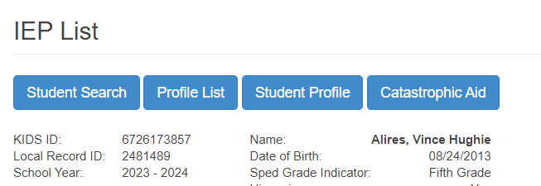
State Funding
Catestrophic Aid
A student qualifies for catastrophic aid reimbursement if the cost of providing special education services exceeds twice the per teacher entitlement for categorical aid from the prior school year. Typically, around $60,000.
The Catestrophic aid claim form can be accessed from the student’s IEP list page

Slide 11
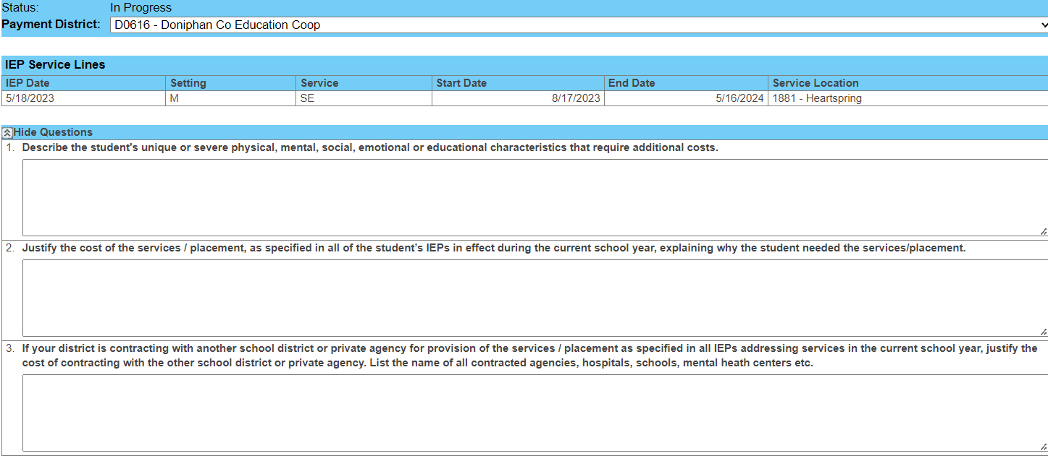
State Funding
Catestrophic Aid
The Catestrophic Aid claim form is designed to replicate the claim form posted at www.KSDE.org. Data from the hard copy must be typed into the form in SPEDPro.
The first section are 3 questions justifying why the additional cost are needed.

Slide 12
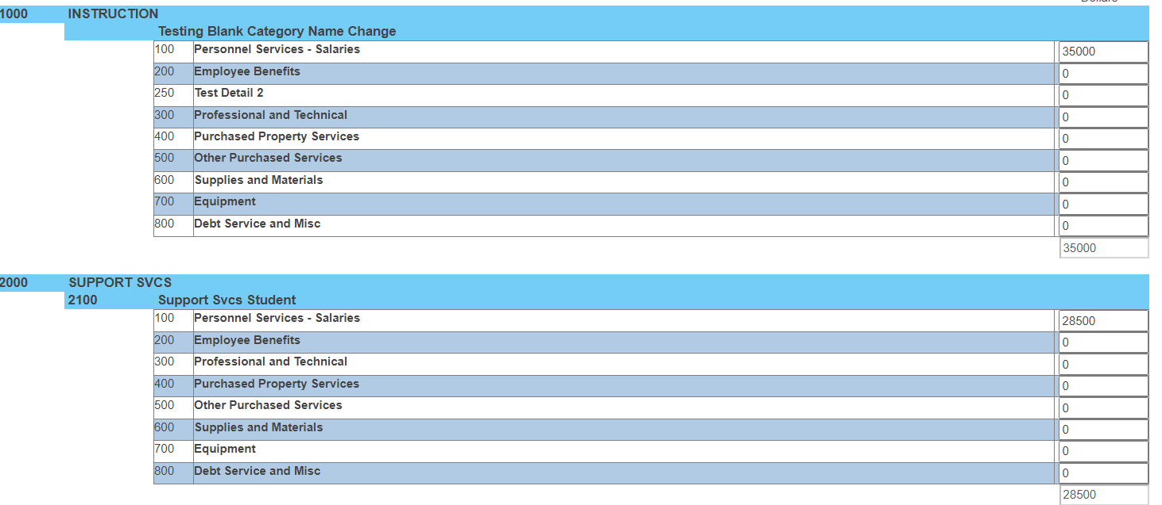
State Funding
Catestrophic Aid
The second section itemizes the total cost accrued over the school year by category. Round all cents up to the next highest dollar.

Slide 13
State Funding
Catestrophic Aid
The third section itemizes other funding sources the student generated during the school year. These are reported as Deduction. Round all cents up to the next highest dollar.
The net cost is the total amount claimed for reimbursement.

Slide 14
State Funding
Catestrophic Aid
Are there any forms for data entry?
Yes, Catestrophic Aid are posted on the special education fiscal resources > Categorical aid page at KSDE.org
What is the last step of the process after claims have been submitted?
KSDE reviews the Catastrophic Aid claims for approval.
Invoices, NPE contracts and copies of provider’s license are kept locally in preparation for the KSDE fiscal auditors.

Slide 15
State Funding
NPE & Catestrophic Aid
Dates and Deadlines
NPE and Catestrophic aid claims are submitted during the month of April. The collection closes on April 30.
In early May, school finance processes each claim. Reimbursement is made on the final Categorical aid voucher in June.

Slide 16
State Funding
NPE & Catestrophic Aid
Notes:
Many catastrophic students participate in a qualified NPE program. Claiming both NPE and Catestrophic aid will result in a higher reimbursement even with the NPE deduction.
KSDE will review all catastrophic claims. Those claims which do not match to the MIS data reported will not be approved until the catastrophic claims and MIS align.
Claims with a net cost less than the minimum will not be approved.
Contact the SPEDPro help desk with any questions

