Slide 1
Pieces of the Puzzle
Introduction to Special Education data reporting - MIS
By: Mason Vosburgh

Slide 2
Modules
1
Module One – Introduction to MIS reporting
log in, access
Module Two – Getting started
Navigation, Calendar, Building information, Directory - Building association, Class minutes, settings, Providers
2
3
Module Three – Student data Entering and exiting student records
4
Module Four – Verifications and reports
5
Module Five – State Funding
6
Module Six – Closing the school year
7
Module Seven – Other related topics

Slide 3
Module 4 – Verifications and reports
Module 4 objective
Provide an understanding of the process of checking for the information submitted for data anomalies, outliers and errors.
Verification search criteria
Data quality reports.
Sorting reports to confirm populations and finding anomalies
How to crosscheck discipline report data to service lines
Module 4 corresponds to Parts IX, XIII & XIV in the SPEDPro User guide
See the SPEDPro User guide for more details

Slide 4
Verifications
Verifying the accuracy of data submitted is an essential component of the MIS process
SPEDPro utilizes two partnering tools for validating information submitted to the application
1. Data Quality reports
2. Verification process
The verification process analysis individual data fields and applies formulated logic to the values contained in each data field. If the data reported is missing, invalid, or illogical a verification flag is triggered. This process is completed on the Verification list page in SPEDPro
The Verification process does not catch all discrepancies. The SPEDPro data quality reports must be used as a companion to the verification process. The details in each data field are reviewed in the Projected reports to confirm the values listed are correct.
Verifications should be prioritized.
High priority verifications relate to OSEP reported categories. These include area of student age, disability, educational environment, exit date and basis of exit, discipline removals, duplicate records, overlaps and responsible school

Slide 5
Verifications
Verification page
Querying for individual verification checks is completed on the verification page in SPEDPro.
Checks can be run using different search criteria or by all verifications collectively.
Using the verification search criteria, verifications can be run by
Individual student
Responsible School – keep on “all buildings”
Single verification flag
Service line provider
Open / Unresolved status
Closed / resolved status.
When the desired search criteria is selected,
click the search button to display the results

Slide 6
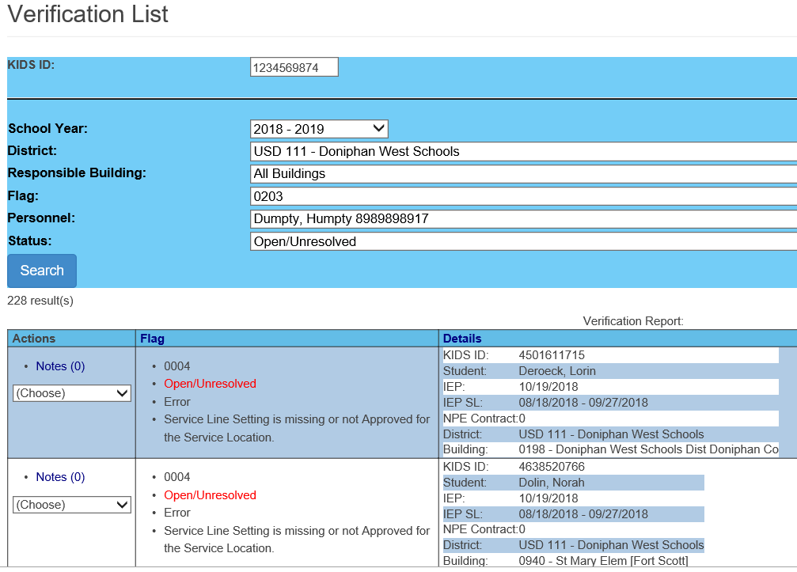
Verifications
Default to all students with verification
Verifications can be filtered by;
Agency / Building
Student or ID #
Flag / type
Open / unresolved
Search
Print verification report

Slide 7
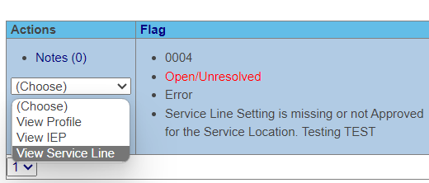
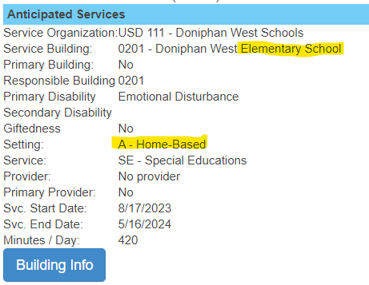
Verifications
Verification Tip -
For quick analysis, use the Actions drop down to jump and view the service line triggering the specific verification

Slide 8
Verification report
Report lists Profile ID, IEP ID, Service line ID or NPE ID
Use ID number as reference to find data triggering verification.
Uses of the verification report
Check list of students needing correction
Present data issues to providers.
Content source for documenting point dedications on the Timely and Accurate template

Slide 9
Verification Assistance
If assistance is needed resolving verifications or data quality reports, follow these steps
Call or email the KSDE MIS data manager for assistance
Identify the issue of concern
Verification by code number
Data quality report by report name
Import alert – provide the name of the import file
and date imported
Identify students by ID number only
Identify school districts by number not name
Specify the area of concern
Provide any clarifying details related to the issue

Slide 10
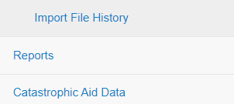
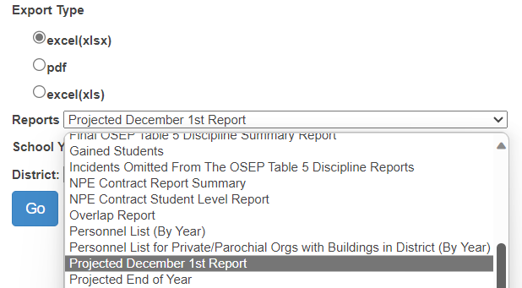
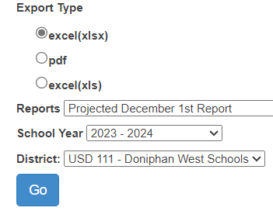
Reports
How to choose and run a report
Navigate to the reports page
Select the target school
Select the Organization
Select the report format
Select the report
needed from the drop
down menu and file
type.
Click Go to generate the
report.

Slide 11
Reports
Projected Child Count Reports
Projected reports – the status of child count reports as of the time they are run. Used for quality checks before the Federal data is finalized.
Projected Reports
Projected December 1 report
Projected Gifted Summery report
Projected End of Year
Projected Table 5 Discipline report
Projected Table 4 Exit report.
Review these reports in detail to assure all information is accurate

Slide 12
Reports
Final Child Count Reports
Final reports – the official child counts reported federally to OSEP. Finalized reports populate OSEP indicators and are used for year-to-year measurements.
Final Reports
Final December 1 report
Final Gifted Summery report
Final End of Year
Final Table 5 Discipline report
Final Table 4 Exit report.
Save these reports as the official child counts

Slide 13
Report Tools – Use to Verify Data
Projected reports can be used to verify data during the collection
Use the column filters to find missing or inaccurate information
Missing Neighborhood / responsible schools
Missing Demographics like race / ethnicity can mean no KIDS records
Exit dates and exit codes not aligning
Age and grade levels not representative.
Missing Grade levels
KG – 12 students with Preschool settings
Verify total number of students

Slide 14
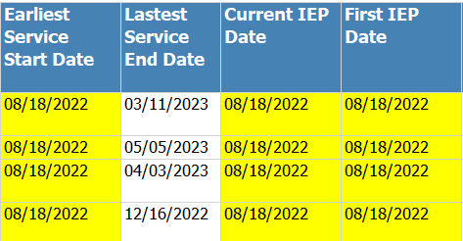
Reports
Projected Reports
Cross check the data fields to look for data outliers
Look for erroneous dates
Earliest Start date equals first day of school
Current IEP equals first day of school
First IEP equal first day of school
A B C
Continuing students should have an IEP from the prior school year
Entering students should have an IEP date from the prior organization
If the IEP date is the first day of school, this can be a red flag.

Slide 15
Reports
Projected End of Year Report
Projected EOY has all students listed.
Use Projected EOY for detailed data analysis
A
B
A
A
Projected EOY Report can find
Duplicate records
Incomplete data
Missing services, invalid “Z” settings
Grade level to age disparities
Inaccurate Assign child count organizations
DD Students older than age 9
Example of Incomplete data
A. Active students
B. Services ceasing before the end of the school year

Slide 16
Reports
Verification Reports
Several reports are for quality analysis, comparing student level data state wide. These reports flag inaccuracies in the current data that may need to be corrected locally.
Verification Reports
Overlap Report
Unresolved Exit Report
Exit Status Report
Unknown Exit report
Discipline Incident Report
These reports provide evidence that current information needs to be corrected.

Slide 17
Report Tips
Do not ignore data quality reports
Data Quality reports are a High Priority and factor
in Timely and Accurate measurements
Unclaimed student report
List of students not counting on OSEP reports
Overlap report
List of students with the same service dates in more than 1 IEP or organization
Unresolved exit report
Exit data is not reported for students not active in current school year
Discipline IDEA Data Validation report
KIAS Discipline data is in question
Exit status report
Evidence that the reported basis of exit must be changed
Unknown Exit report
Basis of exit reported is questionable, student not found elsewhere

Slide 18
Data Quality Reports
Unclaimed Student Report
List of students to be excluded from federal reports and child counts
Note: High Priority report
Claiming means claiming in SPEDPro.
SPEDPro claiming is unrelated to KIDS records.
Not claiming a qualified IDEA student would impact Timely and Accurate reporting
When to run the report – continually through the school year.

Slide 19
Data Quality Reports
Overlap Report
List of students – with service dates overlapping other SPEDPro records.
2 Organization listed Overlap is in your data and a different agency. Service line dates overlap
Overlap of a single organization indicates the overlap is in your data alone.
Multiple profiles or same service dates on multiple IEPs
When to run the report - continually through the school year.

Slide 20
Data Quality Reports
Unresolved Exit report
List of Active students from the prior school year not found in the current school year.
Note: High Priority report
When to run the report -
August - September after initial population of current year students have been submitted.
Why are these students listed?
Did services end in the prior school year?
Was the student omitted from the current year?
No students should be listed on this report.

Slide 21
Data Quality Reports
Discipline IDEA Data Validation report
List of Discipline students not aligning with SPEDPro data
Note: High Priority report – report needs to be clear by EOY finalization.
Why is the student listed? - Student is marked as IDEA on the incident date. But there is no corresponding SPEDPro data
Solution – Student not IDEA, contact local KIAS users to remove the IDEA from the Incident.
Solution – Student is IDEA, update SPEDPro service lines.

Slide 22
Data Quality Reports
Unknow Exit report
List of students – reported as in-state transfer, not found elsewhere in Kansas
Note: High Priority report
Why is the student listed?
Basis of exit is in question.
Is the student reported with a different basis of exit in the local Student information system?
Move out of state, drop out??
When to run the report, May - August

Slide 23
Data Quality Reports
Exit status report
List of students with activity after the exit date, with evidence of a different basis of exit
Note: High Priority report
The Exit status is SPEDPro needs to change.
Listing the student as an in-state transfer “T”, clears the student from the report.
This report should be clear when the End of Year report is finalized in November.

Slide 24
Discipline Data
Verify student, basis of removal, type of removal and length (days) of removal
Go to Projected Discipline summery report
Review the basis of removal, type of removal and days of removal
If discrepancies are found, alert your local KIAS administrator at the building or district level for corrections.
Revisit page for monthly updates to assure corrections have been made in KIAS.

Slide 25
Discipline Data
Cross check Incident date to total days of removal to find intersection with December 1 date for out of school suspension / expulsion
Confirm service line setting = “U” for days served while under suspension / expulsion

Slide 26
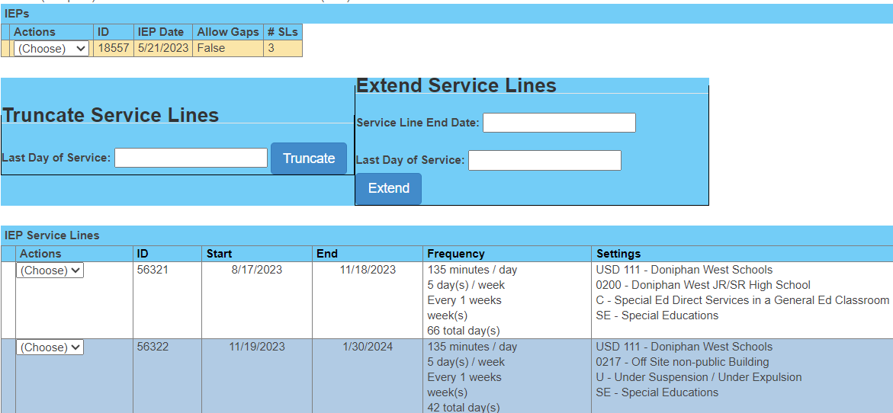
Student Data – Service line data
Do service lines align with Disciplinary removal?
If no, then contact building staff who enter KIAS data
If service location is in question, contact IEP case manager

Slide 27
Informational reports
Verification 0224 report
Report of students with different OSEP categories that have changed since the December 1 report was finalized.
Responsible school, Area of Disability, OSEP Environment.
Displays the original December 1 OSEP value and the current December 1 value. Records triggering both 0210 and 0224 are listed with an explanation of why verification 0210 is present.
See the Verification 0224 comparison report for line-by-line details of differences

Slide 28
Informational reports
Gained student report
List of move in IEP students who are newly associated to your organization
The number of Gifted students in service on December.
Report includes Gifted only student (GI) and IDEA students identified as Gifted (GI+)
Personnel List report
List of current year providers, organization associations, roles and when entered.

Slide 29
Verifications and reports
Dates and Deadlines
April 30
Current year data finalization deadline
The following data sets will be finalized on April 30.
Verifications and reports related December 1 child count and environments
See verification section of the Data Dictionary for a list of verifications related to OSEP data categories
KSDE will measure this deadline for determination of timely and accurate reporting

Slide 30
Verifications and reports
Dates and Deadlines
November 15
Prior year data finalization deadline
The following data sets will be finalized on November 15.
Verifications and reports related Exiting and Discipline data
See verification section of the Data Dictionary for a list of verifications related to OSEP data categories
KSDE will measure this deadline for determination of timely and accurate reporting

