Slide 1
Pieces of the Puzzle
Introduction to Special Education data reporting - MIS
By: Mason Vosburgh

Slide 2
Modules
1
Module One – Introduction to MIS reporting
log in, access
Module Two – Getting started
Navigation, Calendar, Building information, Directory - Building association, Class minutes, settings, Providers
2
3
Module Three – Student data Entering and exiting student records
4
Module Four – Verifications and reports
5
Module Five – State Funding
6
Module Six – Closing the school year
7
Module Seven – Other related topics

Slide 3
Student Data
Module 3 objectives
Managing student level data in SPEDPro
Identifying data element sources
Finding a student in SPEDPro or in the KIDS System
Creating a student profile
Creating an IEP and service lines
The process of Importing student records, import alerts and using the Import template to investigate causes of Import alerts
Student ID numbers
Exiting a student when services cease.
Module 3 corresponds to Parts VIII & X in the SPEDPro User guide
See the SPEDPro User guide for more details

Slide 4
Student Data
What student level data is reported in SPEDPro?
IEP Data – for the school year.
All IEP services provided to the student from the responsible LEA
Initial IEP, Move – In IEP, Annual IEP, Amended IEP, active IEP over 365 days old.
Area of disability
Frequency, duration and location of services.
Change of placement data
Off campus locations for students subjected Out-of-school to Suspension / expulsion
School association
Neighborhood school and service location building
Claiming indicator for state and federal reporting purposes.
Exiting information – why service ceased in the responsible LEA
Basis of Exit code, Date services ceased (exit date)

Slide 5
Student Data
Field Sources – where does MIS data come from?
Student demographics – KIDS Collection
Name – spelling of first and last name |  | Gender
Race / ethnicity | English Language learner status | Responsible school
Student Language | Date of birth
The KIDS Collection values above are displayed in SPEDPro. Importing a student record with different values from the local IEP program may trigger an import alert as notification the values are different.
Special education data – Local IEP program
District association | School Year | Grade level | Student status | Placed by indicator
Claiming indicator | Residence County | Exit date | Basis of exit | Neighborhood school
IEP date | Service code | Setting | Minutes | Days per week
Disability/ Gifted category | Service provider | Service date range | Frequency of service | Service location

Slide 6
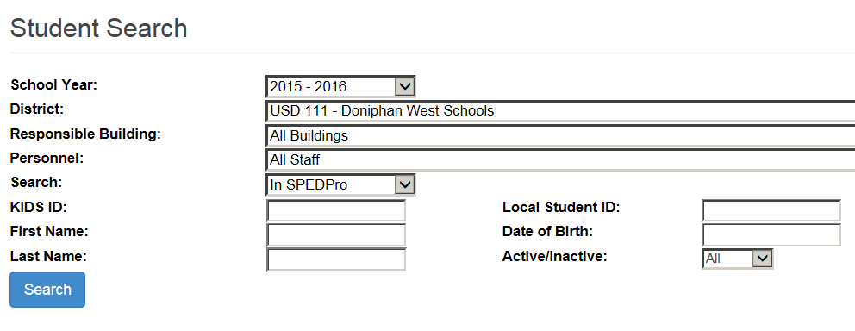
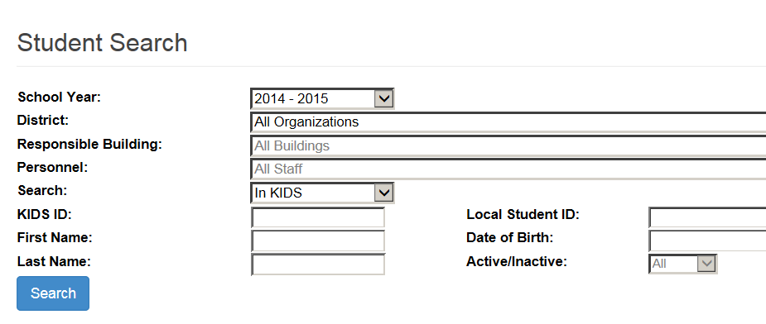
Student Data
Student Search
Finding a student in the application
1. Select database – where to find the student
a. In SPEDPro
Student has been entered into SPEDPro in the target school year
b. In the KIDS system
USD data is populating in the target school year. Students found may be selected and a student profile can be created
2. Search

Slide 7
Student Data
2 methods for student data entry
Method 1 - Keyboard entry – Student found though KIDS Collection search
Select found student record
Confirm demographic data pulling from the KIDS record is intended student
Student Name
Birthday
Race / ethnicity
Gender
Create Student profile - Click the New button for new profile

Slide 8
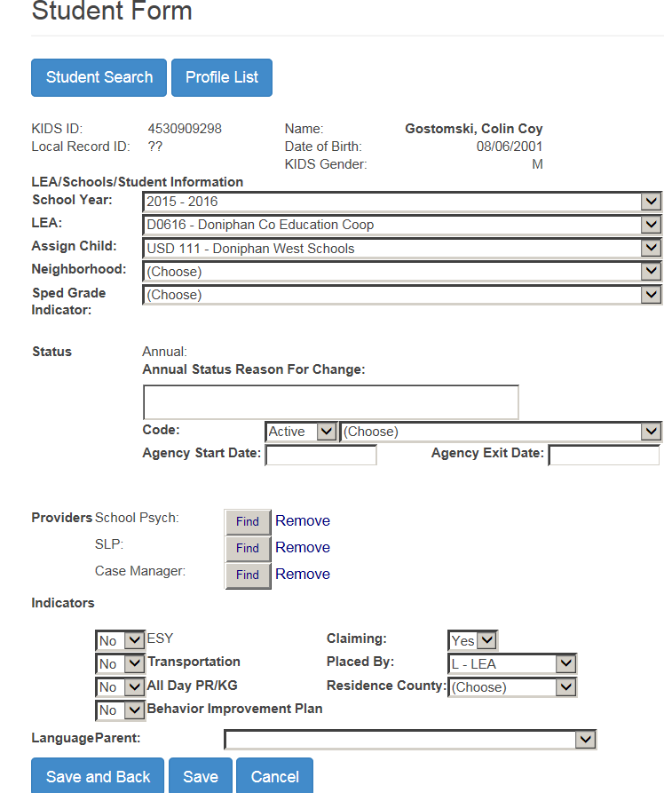
Student Data
2 methods for student data entry
Keyboard entry. Profile
Drop Down Menus for the selection of data elements
Optional fields are selected
Conditional fields are selected when applicable
Note: A student has 1 profile per school year. Multiple profiles for the same student will generate verification errors

Slide 9
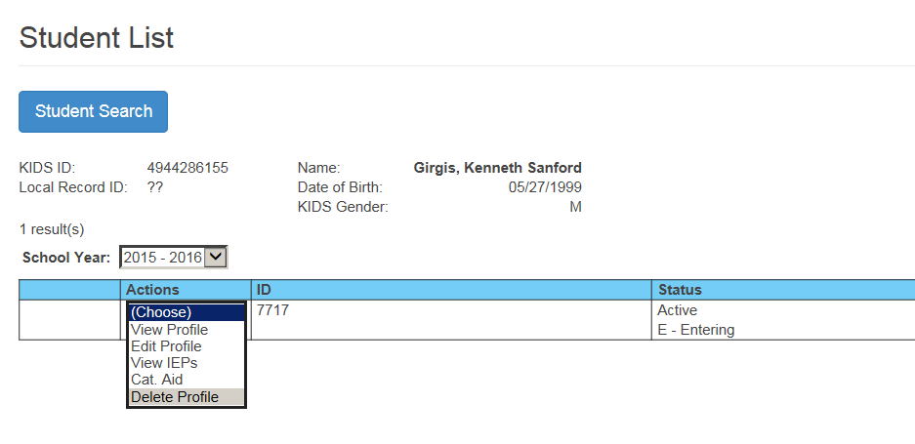
Student Data
2 methods for student data entry
Keyboard entry.
From the Actions Menu
Profiles can be edited, view only or deleted
Go to the IEP page
Go to catastrophic Aid page

Slide 10
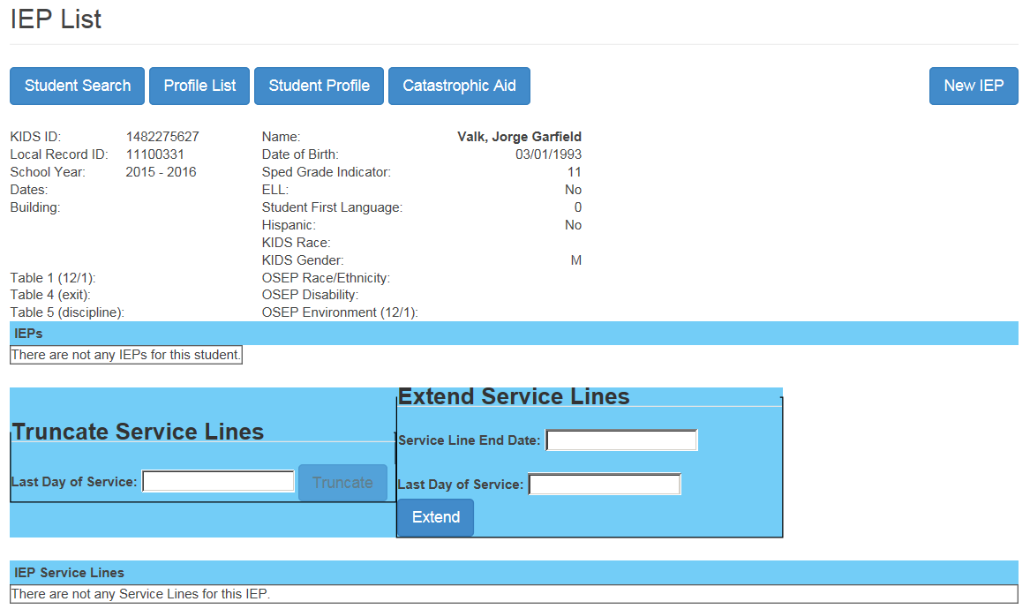
Student Data
Keyboard entry.
Student has no IEP entered
Because data entry is incomplete, OSEP data is not calculated
New IEP is selected
Page shows no IEP present in the student record.
2 methods for student data entry

Slide 11
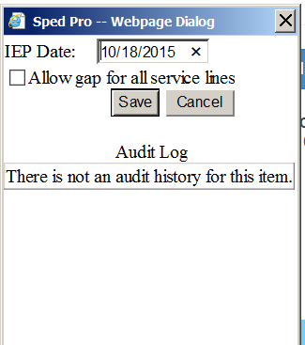
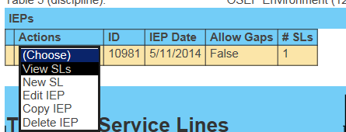
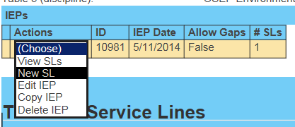
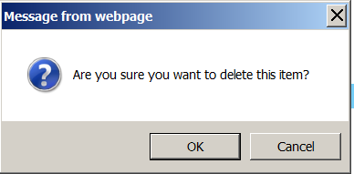
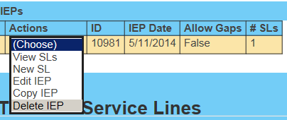
Student Data
Keyboard entry.
Enter IEP date
Do not tab
Save the Date
IEP is listed with alert of no service lines
Action – View Service line
Action – New Service line
Action – Delete Service line
Action – Copy Service line
Edit IEP to mark Allow Gap for students who move out and back in
2 methods for student data entry

Slide 12
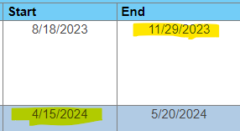
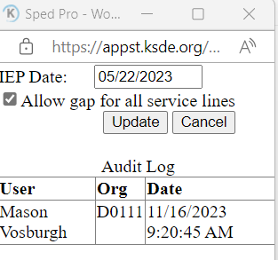
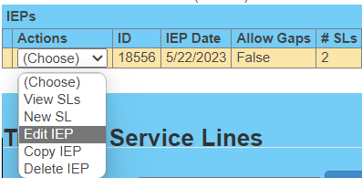
Student Data
Gap in Service
A gap in service occurs under this condition
A student receives IEP services during the current school year, then exits.
As a result of exiting, all IEP services cease.
Later in the same school year, the student resumes IEP services. This creates a Gap in services. Verification 0146 & 0169
To resolve the verification, edit the IEP, mark the “Allow Gap” indicator and update
Confirming the exit and resumption of services reads as True.

Slide 13
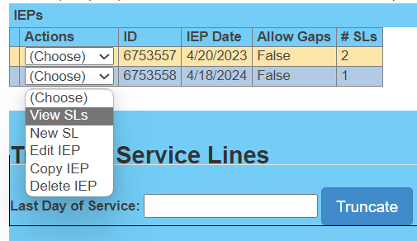
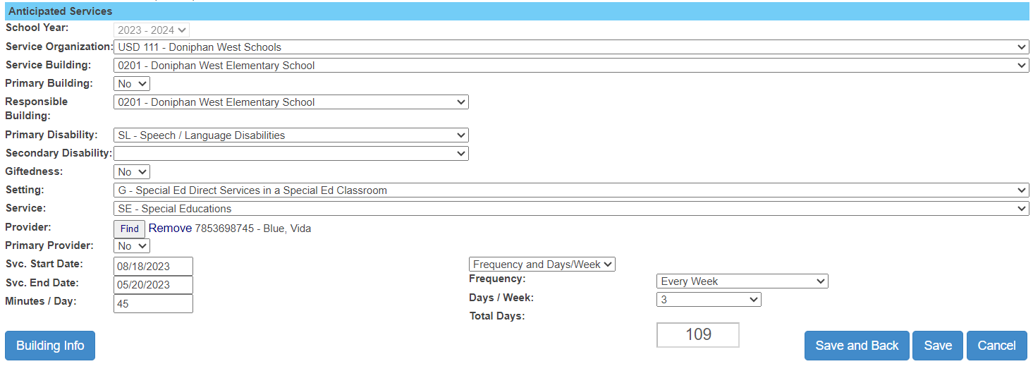
Student Data
Keyboard entry.
Select service line data for each of the service line fields
Service Organization
Attendance building
Responsible school
Disability and Gifted
Provider
Start and end dates, minutes
Frequency or total days

Slide 14
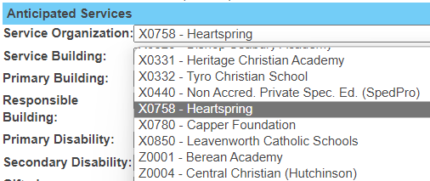
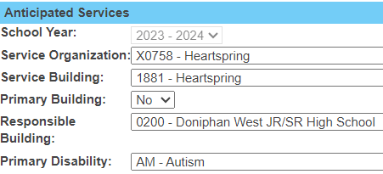
Student Data
How to report students who attend out of district.
Student Profile reflects the general education school of choice.
Service lines report the attendance location
Use the service organization drop down to select the out-of-district service location
The student’s Accountability school remains the Responsible building regardless of the service location

Slide 15
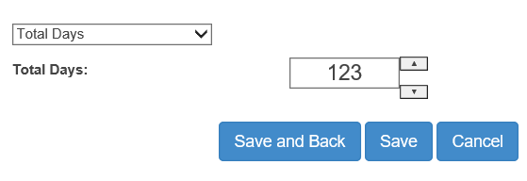
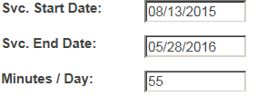
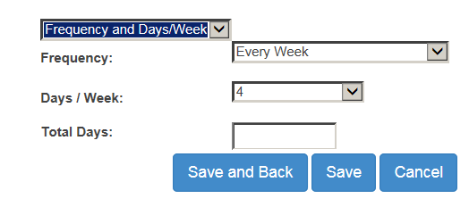
Student Data
Duration is determined by total days. There are 2
options, the user would select 1 option consistently
Total Days between Start and End dates
Just enter the total days
Days per week and frequency
Uses the calendar to determine total days between start and end date
2
123
Tip - Selecting a service line in Edit mode will recalculate the total days when Frequency and total days is selected. Possible solution to verification 011.

Slide 16
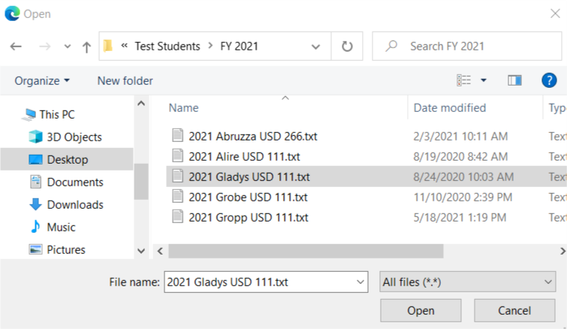
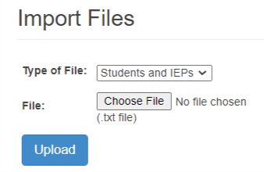
Student Data
Method -2 Importing.
Go to Import Files from navigation pane
Select - Import type – student & IEP
Select “Choose File” to find the record
Navigate to file location
Select / Highlight the file, click Open.
Upload to Import
2 methods for student data entry
Note:
Always import complete data for school year. All IEPs and All Service for each import, original and subsequent. Subsequent imports erase all prior data for the student.
4
5
2
3
5
6

Slide 17
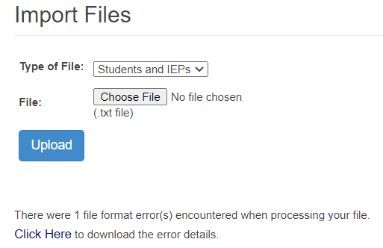
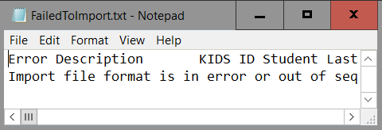
Student Data
Import alerts.
Upon Import completion, check results
Note any Import alerts
Click the alert number for details
Text file opens with alert description and file contents
3
2

Slide 18
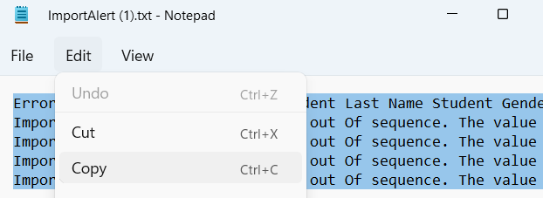
Student Data
Use Import Template to find missing or invalid data in Import file
Import alerts
1. Select All and Copy the text in the alert.
2. Paste alert content into Excel. Column A (alert description) Column B begins the file content
3. Find the problematic data using the alert description and the data field header.
4. Correct in data source and resubmit
2
Invalid building
Missing Exit date
Bad DOB
Paste Alert details
3
3
3

Slide 19
Student Data
Importing records
Batch Importing schedule
Records failing to import
Records will fail to imported under these conditions
Student ID does not exist
No permissions – Assign child count of the student is a not member of the submitting organization
Service dates are not in the same school year as the default school year selected > GO
The imported file does not meet the specifications. Too long or too short.
The field format is incorrect. For example, a date field = 98/HQ/20!*, grade field is not valid, Name field is not alpha – Sm!t8
September 1 – Initial batch submission of current school year records
Continuous submissions
April 22 – stop batch imports until Dec 1 report is finalized
Manual updates
November 1 – Stop batch imports of prior year data
Never Import records on the day the Dec 1 or EOY reports are finalized.
Resume data entry when KSDE gives the OK
Importing near the data finalization data may generate new errors, reintroduce resolved verifications, create duplicate records, etc. with little or no time to correct before finalization

Slide 20
Student Data
Student ID numbers
To resolve multiple ID numbers or incorrect number assignment, the KIDS Help desk must be contacted.
General Help
helpdesk@ksde.org
(785) 296-7935
Explain the situation. The Help Desk will let you know which ID to use, and which ID will be retired.
Be sure to remove the retired ID from your IEP program.
Student ID numbers are maintained in the KIDS assignment system, a KSDE web application.
Occasionally a student will be assigned more than 1 ID number.
Occasionally the same number is assigned to multiple (different) students.
These issues may become prevalent as verifications trigger, or a student is unexpectedly listed on SPEDPro reports.

Slide 21
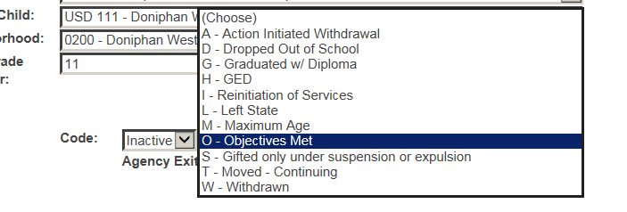
Exiting
How to exit a student
Steps 1 - 3
Exit data is listed on the student profile.
1. Change current status inactive
2. Select Basis of exit
3. Enter Exit Date
4. Save
Note: Students who move within Coop / Interlocal member districts do not qualify as exits.
2
3

Slide 22
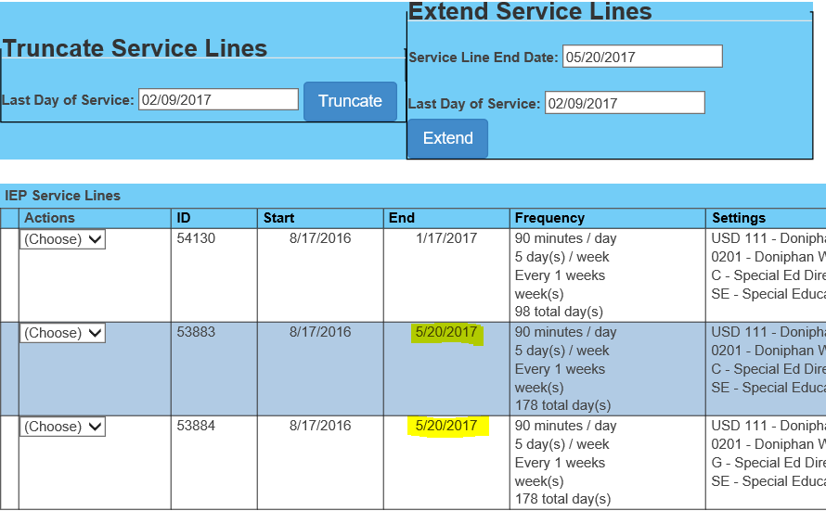
Exiting
How to exit a student
Step 4
End all services – use Truncate button to end every service on the same date
1. Go to the IEP list
2. Select the current IEP
3. Enter the exit date as last day of services
4. Click Truncate - Save
Change targeted end date
Use Extend service lines tool
1. Enter target end date
2. Enter new last day of service
3. Click Extend - Save
Ending Services – How to Truncate end dates

Slide 23
Exiting Tips
Inactivity
If the student does not receive IEP support for two consecutive weeks / 10 school days, the student is considered inactive and Exit data is reported in SPEDPro.
Exit date
The exit date is determined by the last day the student received IEP service. The exit date and the latest service end date are the same day. Verification 0144 checks to confirm these dates are equal.
Basis of Exit
Drop Out status is the default basis of exit, unless there is evidence the student exited one of the other 9 exiting categories.
Request for records, revocation document, received diploma, reached maximum age, no longer has a disability

Slide 24
Student records
Dates and Deadlines
April 30
Current year data finalization deadline
The following data sets will be finalized on April 30.
December 1 child count and environments
KSDE will measure this deadline for determination of timely and accurate reporting

Slide 25
Exiting and Discipline
Dates and Deadlines
November 15
Prior year data finalization deadline
The following data sets will be finalized on November 15.
Exiting data. Students who exited special education in the prior school year
Discipline data. Students subject to disciplinary removals in the prior school year
KSDE will measure this deadline for determination of timely and accurate reporting

