Slide 1
Pieces of the Puzzle
Introduction to Special Education data reporting - MIS
By: Mason Vosburgh

Slide 2
Modules
1
Module One – Introduction to MIS reporting
log in, access
Module Two – Getting started
Navigation, Calendar, Building information, Directory - Building association, Class minutes, settings, Providers
2
3
Module Three – Student data Entering and exiting student records
4
Module Four – Verifications and reports
5
Module Five – State Funding
6
Module Six – Closing the school year
7
Module Seven – Other related topics

Slide 3
Getting Started
Module 2 Objectives
Understanding of the beginning of the school year Discovery process and the tasks of setting up the application for the current year data collection. Understanding the Directory to building association. Knowing timelines for specific tasks.
Building Attributes
Begin Year discovery tasks needed prior to submission of student records
Calendars – current year
Review of Directory information, current year class minutes and program types
Settings – alignment of program types to corresponding setting codes
Providers – current year providers
Module two corresponds to Parts VI - VII in the SPEDPro User guide
See the SPEDPro User guide for more details

Slide 4
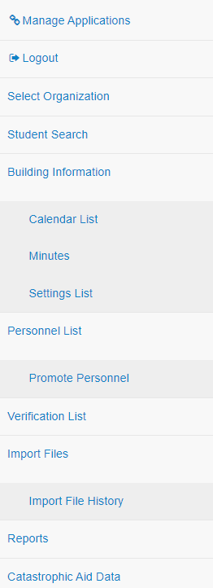
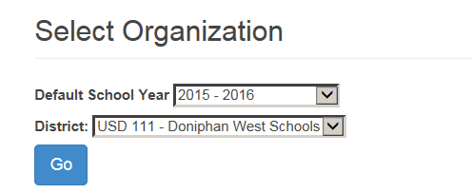
Getting Started
Select desired organization level and target school year–
Note: the application defaults to current school year
Logging In
Click “Go”
Navigation Pane
Select the destination in the application where the desired task is completed.
Student search
Buildings Information, Calendars, settings
Personnel
Verifications
Import records
Reports

Slide 5
Getting Started
Begin Year Discovery Process
Before initial data is submitted to KSDE for the current year, a local Discovery process must be completed. The Discovery process has several parts
Calendars - Discover the district level calendars for all buildings
Providers – Discover inactive providers and remove them from the current school year provider list. Update provider service organizations to only assign a provider to the organization where they serve students.
Buildings – Discover what programs are offered in each building
Buildings – Discover current year session times and days per week in session
Directory – Provide current year building information with local Board clerk for Directory updates.
Crosscheck – Review Building Information Page for accuracy and alignment with Directory.
Students - Discover current year responsible / Accountability school reported in KIDS
Do not forgo the Discovery process. Do not copy data from last school year into current school year !!

Slide 6
Getting Started
Building Attributes
Characteristics specific to individual buildings
Buildings – A unique 4-digit number that represents a service location. The actual place where the student receives IEP services.
Types of buildings include:
School buildings
Special education programs
Off site locations in the community
Building data is managed in the Directory updates application.
Building name and number
Building level, elementary, middle or high school
Classroom schedule / session minutes / days per week
Preschool program type

Slide 7
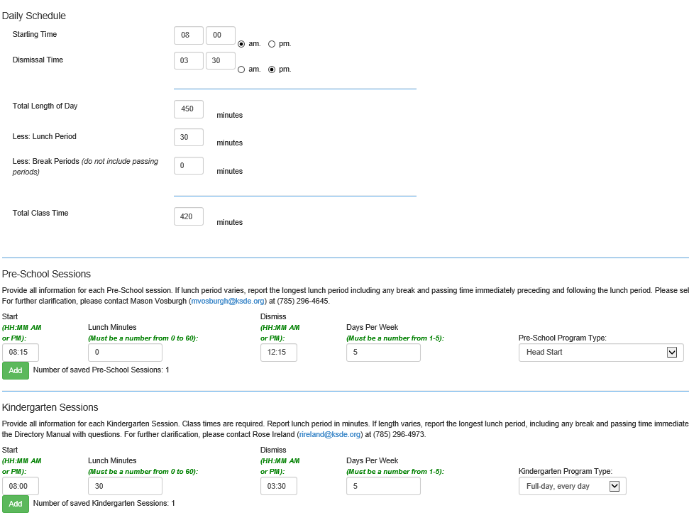
Getting Started
Directory Updates
The Directory is A KSDE Web application which is the source of building session minutes and preschool program types.
Changes to class minutes, program types and days In session, must be updated in the Directory
Section A, Daily Schedule = Grade 1- 12 Schedule
Section B, Preschool Sessions schedules only
Section C, Kindergarten sessions schedules only

Slide 8
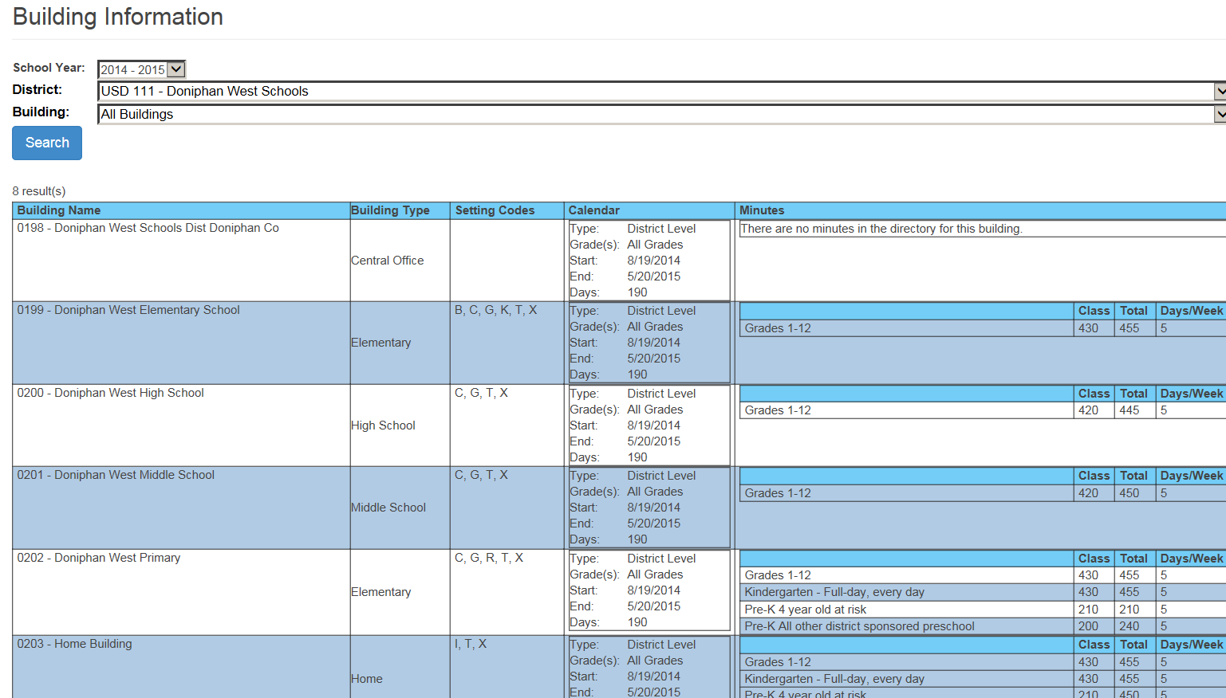
Getting Started
Building Discovery Process
Discover what programs are offered in what buildings
Use the Building information page in SPEDPro.
Check for inaccurate / illogical minutes and days per week
Minutes greater than 500 or less than 150
Days per week of 3 or less
Unequal class and total minutes for a half day preschool session.
Corrections are made in the Directory.

Slide 9
Getting Started
Fixing the Directory
Building Discovery Process
What are the next steps when the Directory information is incorrect?
A. Contact the local board clerk or the KSDE MIS Data manager with the correct information.
What Information will they need?
Starting bell and Dismissal bell time
Days per week the class is in session
Preschool program type
Lunch minutes – to add or remove.

Slide 10
Getting Started
Know your buildings
Neighborhood School – Where the Parent chooses to enroll their child for General Education.
Public school or Private / Parochial school
Elementary, middle or high school
Attendance building – Where special education services are provided
School, Program, home or off campus / community location
Calendars, settings, Directory sessions apply
Responsible school – Accountability or funding school
as designated by the USD or state school in the KEDS data collection
Public elementary, middle or high school
State School
Note: These buildings are determined independently of each other. Service location does not determine neighborhood or responsible school.

Slide 11
Getting Started
Calendars
Building Attributes
Characteristics specific to individual buildings
Calendar – the designated days the school is in session and not in session during the regular school year term. Extended school year / summer sessions are not included in SPEDPro calendars.
District / organization calendars for all buildings and all grades is set as the default calendar for the school year.
A building that does not follow the District calendar (USD 123 Day school) or program that does not follow the District calendar (USD 123 preschool) must have separate calendar created.
Calendars apply to the service location / attendance building only
Calendars are used to determine the total number of service days between the service start and end dates

Slide 12
Getting Started
Calendars
New Calendars
Select Calendar List from Navigation Pane
Click New button to open a new calendar form
Select the target school year for which the calendar applies

Slide 13
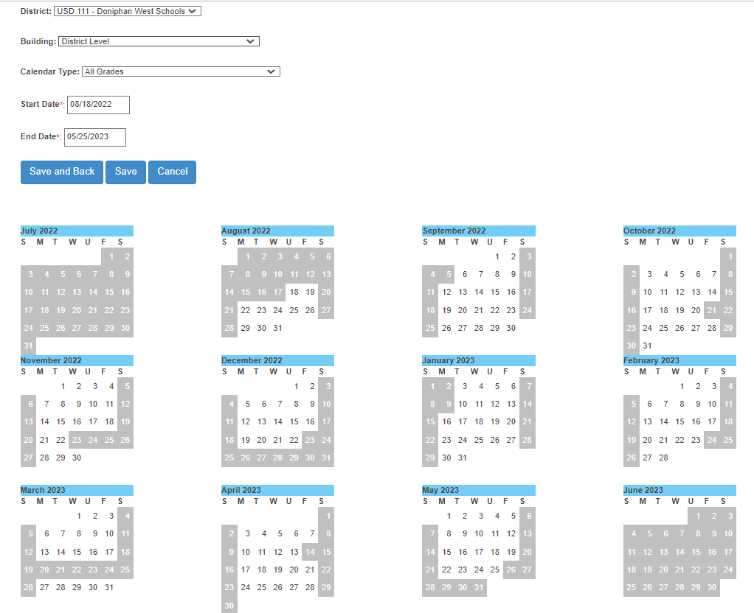
Getting Started
New Calendars
Calendars
Set default master district level calendar for all grades, all buildings.
Enter earliest first and latest last day of school.
Mark days not in session
Save
Only create a new calendar for any programs / buildings that does not follow the master calendar

Slide 14
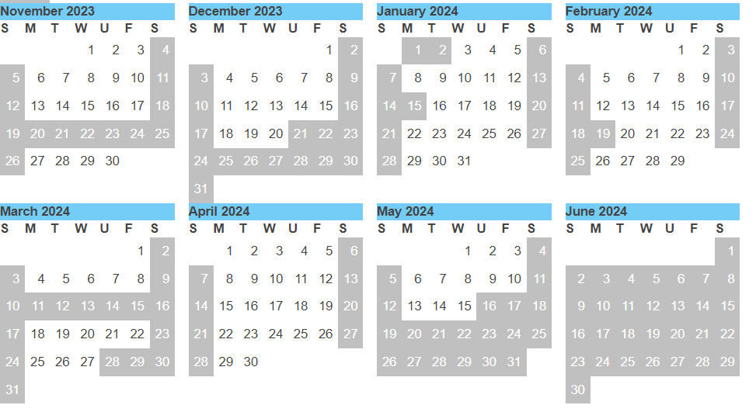
Getting Started
Calendars Tips
Late start days count as a day in session.
Early dismissal days count as a day in session.
Snow days - Modifying calendars for snow days is predicated on how snow days are addressed on the student’s IEP. If the IEP service start and end dates are adjusted for snow days, then the SPEDPro calendar is adjusted accordingly. If snow days are ignored in the student’s IEP, then the MIS calendar is not modified.

Slide 15
Getting Started
Calendars Tips
Discipline data reported in KIAS requires a District level calendar for all grades to be entered into SPEDPro. The calendars are used verify the number of days of removal and to identify removals for the remainder of the school year or longer.
The District level, all grades calendar is required for all D0 and S0 organizations
A building level, all grades calendar is required for X0 and Z0 organizations. You may have to enter a calendar for a school which is not attended by IEP students.

Slide 16
Getting Started
Settings
Building Attributes
Characteristics specific to individual buildings
Settings – Letter codes representing a specific type of classroom, program or service location.
Settings are not copied from one school year to the next.
Setting are entered only after the Discovery process is completed.
Settings are specific to individual building. Not all settings exist in all buildings.
School buildings have settings unique to school buildings.
Service locations outside of school building have their own unique settings.
Preschool settings are unique to the preschool program type listed in the Directory
Special education program buildings have unique default settings as defined in the MIS Data Dictionary.

Slide 17
Getting Started
Matching Preschool Programs and settings
Program Type | Setting Code |  | Program Type | Setting Code
Headstart | B, K |  | SPED Reverse Mainstream | W
Preschool age At-Risk | B, K |  | All other Reg / Gen Ed Preschool | B, K
Integrated SPED | R |  | Itinerant Services – All other | G
Example of non-matching program & settings. Directory lists Reverse Mainstream, setting list is Integrated, service line is Integrated. Setting list and Directory do not match. Settings list will not be approved

Slide 18
Getting Started
Building Settings
July – August, Meet with administrators. Discover what programs are offered in each building for the current year
Use the Directory chart to document session times and program types.
Share Directory chart with local board clerk(s) to enter correct Directory programs
For initial list of settings, Click the new button
Select each building and click search to bring up the settings list form
Click New button to open a new settings form
Select the target school year for which the setting applies

Slide 19
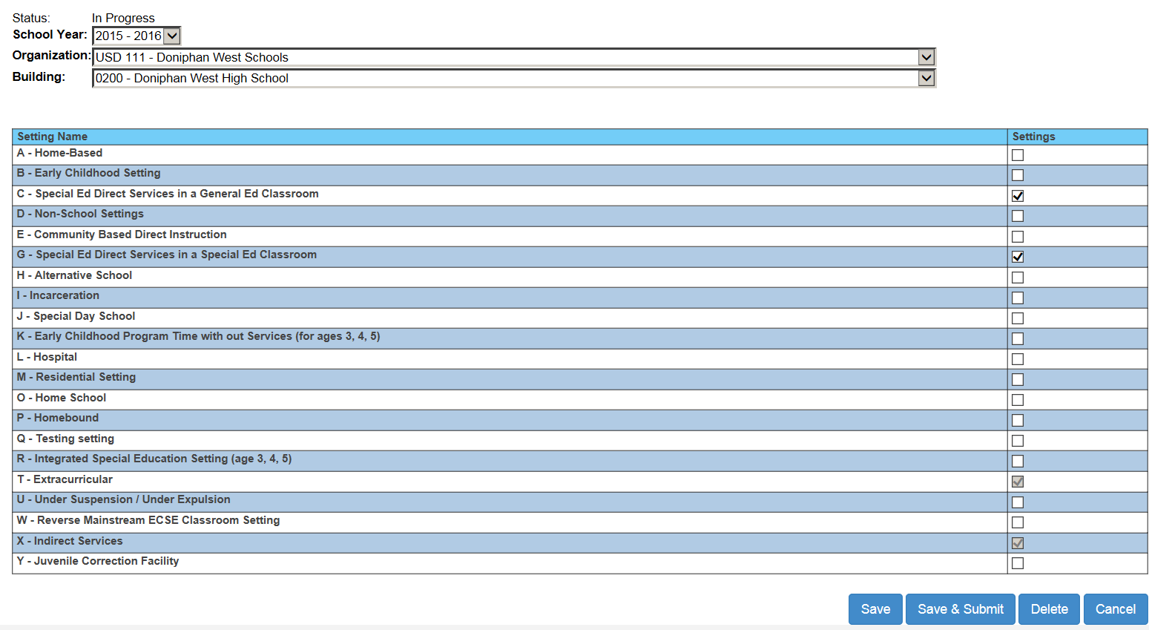
Getting Started Coding building and Program Settings
Mark all applicable setting codes that represent the programs offered in the building
As you work on settings, the building status “In progress”. Clicking Save keeps the data in progress
The save and submit button is selected to send to KSDE for approval.
KSDE will deny invalid settings
If an error is made, you can un-submit or delete and start over and resubmit.

Slide 20
Getting Started
Building Information Page and Directory sessions
Summery page of Building Attributes
Note: Preschool Program types reported in the Directory
Confirm settings match
Preschool type
Special education program default
Off site location
School classrooms
Submit settings for approval
Mis-matching settings will not be approved.

Slide 21
Getting Started
Building Discovery Process
Create a Chart of building session that can be shared with board clerk who completes the Directory Updates. Provide the local board clerk with building attributes in early August.
Directory Chart templated can be found on the MIS and student data page at www.ksde.org

Slide 22
Getting Started
Directory Chart tips
The default classroom types for the special education program buildings are found in the Data Dictionary.
Do not reference MIS codes when presenting or discussing classroom types with local board clerks. The board clerk would not know what a “B / R / W” is. Address the classroom types by name.
The Chart is customizable. Add or remove details that may or may not be applicable.

Slide 23
Getting Started Coding building and Program Settings
Tips
Note the difference between “School” building and “Program” buildings
Settings for special education programs are addressed in the Data Dictionary
Preschool session types in the Directory must align with preschool settings prior to approval
All settings are defined in the Data Dictionary with examples
Do not enter settings for building not used for attendance buildings or service locations.
Do not copy last year’s setting without Discovery

Slide 24
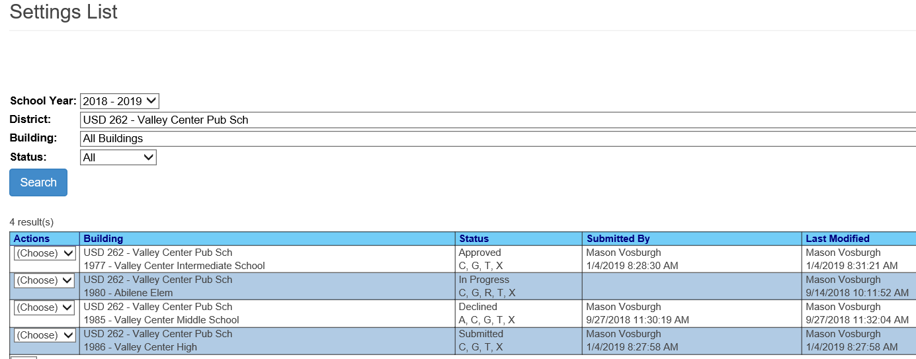
Getting Started Settings List page
Settings list page shows the status of each building
In Progress – settings list is not completed. Additional work needed before submission
Submitted – Settings list is completed, submitted and awaiting approval
Approved – Settings align with the Directory and are available for selection on service lines
Declined – Settings do not exist in the building or do not align with Directory. Settings must be created anew and resubmitted for approval

Slide 25
Getting Started
Providers
Providers – Special education and related service teachers responsible for the provision of IEP services.
Providers are entered in SPEDPro by creating an individual provider profile. Provider profile establishes the organization they work in and the role they serve in the organization buildings.
Providers are associated to the service location / attendance building only. The role of service line provider is required.
Profile requirements.
Organizations listed – only list the organizations which the provider works in. Do not list arbitrary districts.
Roles – only list the role the provider serves.
Listing Case manager, School Psych, Speech language pathologist roles and the primary provider designations are not required and may be left blank.
Only list the role of NPE Contract provider for those providers in qualified out of district programs.
Paraeducators are not reported in SPEDPro. Only supervising professional are listed on Service lines

Slide 26
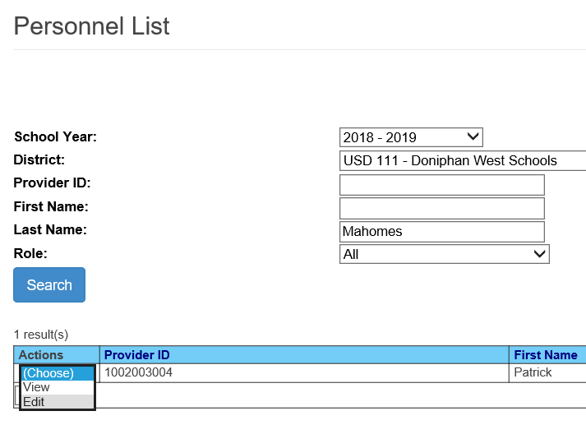
Getting Started
Personnel List
Provider Search
Enter Search Criteria
ID
Name
Role
Click Search
Selection Action

Slide 27
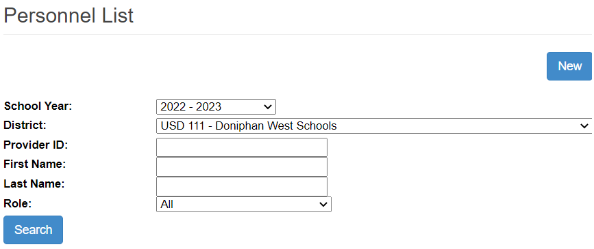
Getting Started
Current Year Providers
Entering Providers
Method 1 – Keyboard Entry Select Personnel List from Navigation Pane
Step 1 – Click the New button to create a new Provider Profile
Click New button to open a new provider profile

Slide 28
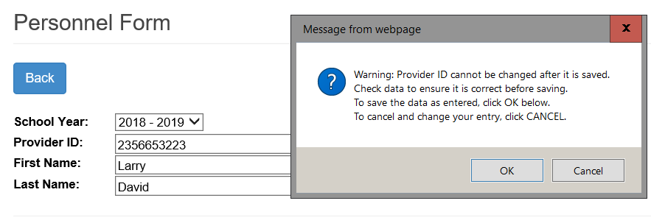
Getting Started
New Providers
Provider ID Alert
Method 1, Step 2 – Provider name and ID number
Enter Provider name and ID number
Once the Name and Number are saved, the Name and Number can not be changed.
An alert is displayed.

Slide 29
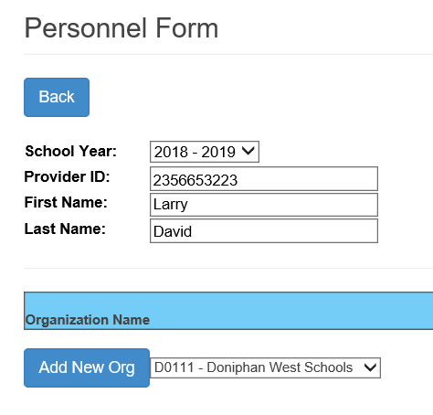
Getting Started
Current Year Providers
Method 1 - Step 3
Organizations of Assignment
Click the “Add New Org / Organization” button
The Organization of assignment will match to the service line provider listed by attendance building / service location
Only list Organizations of Assignment based on buildings the provider actually works in.

Slide 30
Getting Started
Method 1 - Step 3
Note:
Only report roles the provider fills.
Only report organization where the provider works
Do not report all member districts by default.
Current Year Providers
Assigning & removing roles
At least 1 role is required
For each organization the provider travels to, assign a role. Click Add New Org.
When all roles are marked, Save
If a provider was entered in error, removal all roles

Slide 31
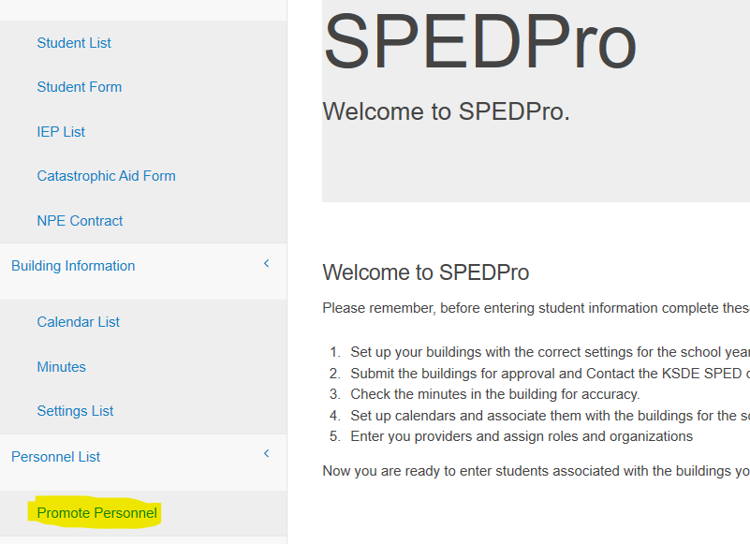
Getting Started
Current Year Providers
Entering Providers
Method 2 – Promote Providers
Select Promote Personnel
from Navigation Pane
Promote Providers
Moving last year’s providers to this year

Slide 32
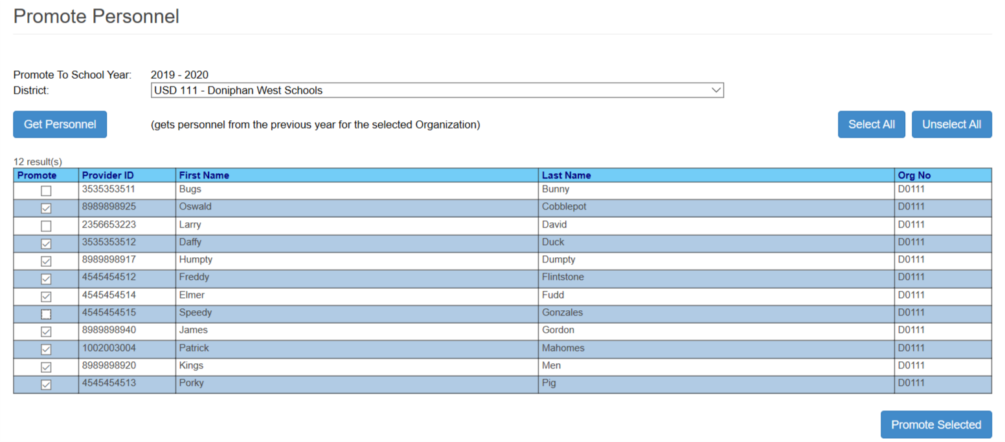
Getting Started
Method 2 – Steps 1 - 3
Get Personnel – pull from last year
Mark this years’ providers
Promote selected into current school year. Copies last data to this year
Promote Providers
Moving last year’s providers to this year
2
3

Slide 33
Getting Started
Current Year Providers
Entering Providers
Method 3 – Import Providers
Select Import files
from Navigation Pane

Slide 34
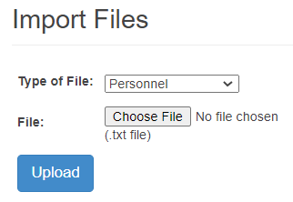
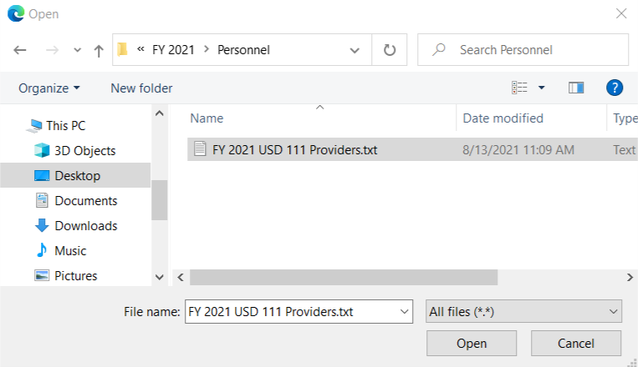
Importing.
Go to Import Files
Select - Import type – Personnel
Select “Choose File” to find the record
Navigate to file location
Select / Highlight the file, click Open.
Upload to Import
Current Year Providers
Method 3 - Steps 1-6
4
2
3
5
6
5

Slide 35
Dates and Deadlines
September 15
Current year data entry deadline
The following data sets must be entered by September 15.
Calendars
Providers
Settings
Student records
KSDE will measure this deadline for determination of time reporting

