Slide 1
Pieces of the Puzzle
Introduction to Special Education data reporting - MIS
By: Mason Vosburgh

Slide 2
Modules
1
Module One – Introduction to MIS reporting
log in, access
Module Two – Getting started
Navigation, Calendar, Building information, Directory - Building association, Class minutes, settings, Providers
2
3
Module Three – Student data Entering and exiting student records
4
Module Four – Verifications and reports
5
Module Five – State Funding
6
Module Six – Closing the school year
7
Module Seven – Other related topics

Slide 3
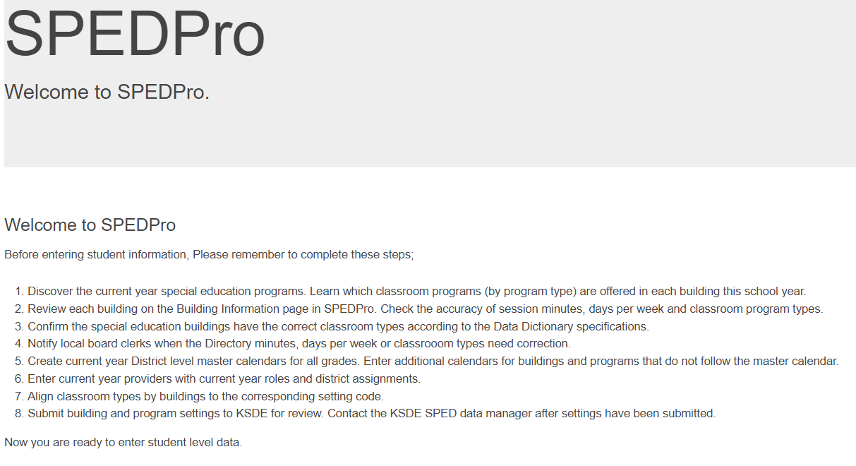
SPEDPro Application
The following series of training modules will show how to navigate the application, data entry process and report functionality

Slide 4
Module One
Introduction to MIS
Module 1 Objective
Introduce the general concept of the data collection
Federal data reporting requirements.
The KSDE web application used to collect student level data.
What data is measured (Indicators)
and what data is reported out (OSEP reports).
Connection of data collected and funding
Acronyms
Module one corresponds to Parts IV – V in the SPEDPro User guide
See the SPEDPro User guide for more details

Slide 5
Introduction to MIS
Big Picture – Why do we collect and report this data?
Federal Law named – Individuals with Disabilities Education Act – IDEA 2004, Pt. B Section 618 – “618 Data” requirements
All states and territories must collect and report the status of special education annually. This includes the number of special education students classified under specific data categories.
Kansas Process
Individual student information originates in local
IEP databases, submitted and compiled at the state
Level, then submitted to the US Department of Education

Slide 6
Introduction to MIS
Big Picture – What happens to the data submitted?
All data is published in an annual report to Congress
State level data is analyzed. The percentage of students in specific categories are measured and determinations are made to the state’s performance in providing special education. These data categories are known as Indicators
Indicators 1 & 2 - Graduation and Drop Out rates – End of year data
Indicator 4 - Suspension Expulsion data – End of year data
Indicators 5 & 6 - Educational Environments – December 1, data
Indicators 9 & 10 - Disproportionate Representation
by Exceptionality / Ethnicity – December 1, data
Timely and accurate data – 23-point measurement of timely and
accurate reporting

Slide 7
Introduction to MIS
Big Picture – How does funding come into play?
Federal funds are awarded to states who meet the reporting requirements. 90% of funds flow through to local education agencies
What MIS data sets are required for federal funding?
December 1 report – Child Count and Educational Environments
End of year report – Exiting and (KIAS) Discipline
KGRS – Teacher and Para data
Is the MIS used for State level funding?
Yes,
Catastrophic aid and Non-public equivalency
Reimbursement claims are submitted through the MIS. These are separate data entry pages of associated to each student profile.

Slide 8
OSEP Categories – Federally Reported Data
IEP reported data
OSEP Disability – the student’s area of disability
Child count – the number of IEP students
Educational environment – where the IEP services are delivered
Exiting – Basis of exit (inactive code), reason services ceased. Exit date
Demographics – from KIDS Collection
Age –December 1 age
Race / ethnicity
Gender
English language learner status
Responsible school
Personnel data – from KGRS Categorical Aid
Teacher FTE by endorsement area
Para FTE
KIAS reported data
Discipline – Incident date, when the removal occurred
Basis of removal – Drug, weapon, violation of school code of conduct
Duration of removal – number of days removed
Type of removal - in-school / out-of-school suspension, expulsion

Slide 9
Introduction to MIS
Big Picture flow chart
1
LEA implements IEP requirements
IDEA data housed in local IEP systems
2
Individuals with Disabilities Education Act
3
SPEDPro data collection
OSEP 618 data reporting requirements
6
Federal VI-B funds
5
Catastrophic Aid & NPE funds
4
6
Local 618 and Indicator reports
KSDE data reporting requirements
OSEP data submission

Slide 10
Introduction to MIS
I see a lot of acronyms, what do all these acronyms mean?
A table of the most frequently used acronyms is found in the Appendix section of the Data Dictionary.
The most common acronyms in the MIS are:
MIS – Management Information System. The KSDE application used to collect student level special education data. – SPEDPro
OSEP – Office of Special Education Programs. An arm of the USD Dept of Education which oversees the special education data collection.
KIAS – Kansas Integrated Accountability system. KSDE web application which collection discipline / suspension / expulsion data.
KGRS – Kansas Grants Reporting System. KSDE web application which houses the Personnel categorial aid database for provider ID numbers

Slide 11
Business Rules, standards and Timelines
The Data reporting elements, specifications, business rules, standards and timelines are established in the MIS Data Dictionary document posted at www.ksde.org.
Rules and Deadlines are consistent set dates that do not change from year to year, unless otherwise announced as such.
Timelines for MIS tasks are also addressed in the Data Dictionary.
Timelines for MIS tasks have target dates prior to deadline dates. The intent is to have tasks completed before the deadline.
The Data Dictionary lists a timeline table for general tasks to be completed through the school year.
Monthly FAQ from KSDE lists a timeline table specific to tasks to be completed that month.

Slide 12
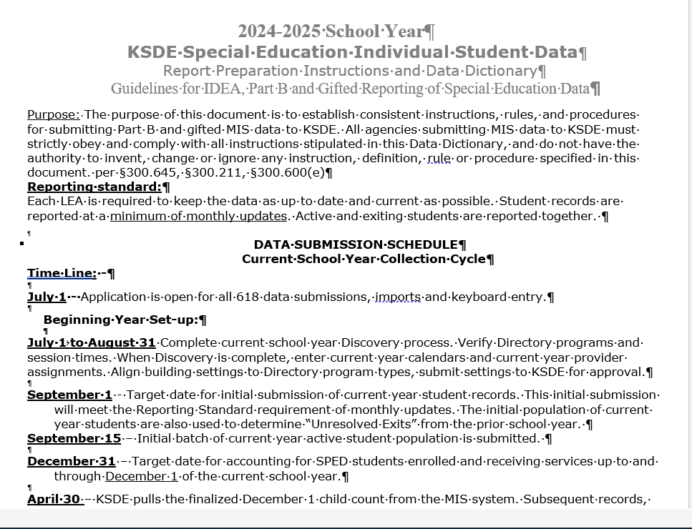
Business Rules, standards and Timelines
The MIS Data Dictionary

Slide 13
SPEDPro Application
SPEDPro is the current KSDE application used to collect and report student level special education data in the state of Kansas.
SPEDPro is a multi-user application. Accessed to SPEDPro is restricted to USD, Interlocal, Coop or State school organizations.

Slide 14
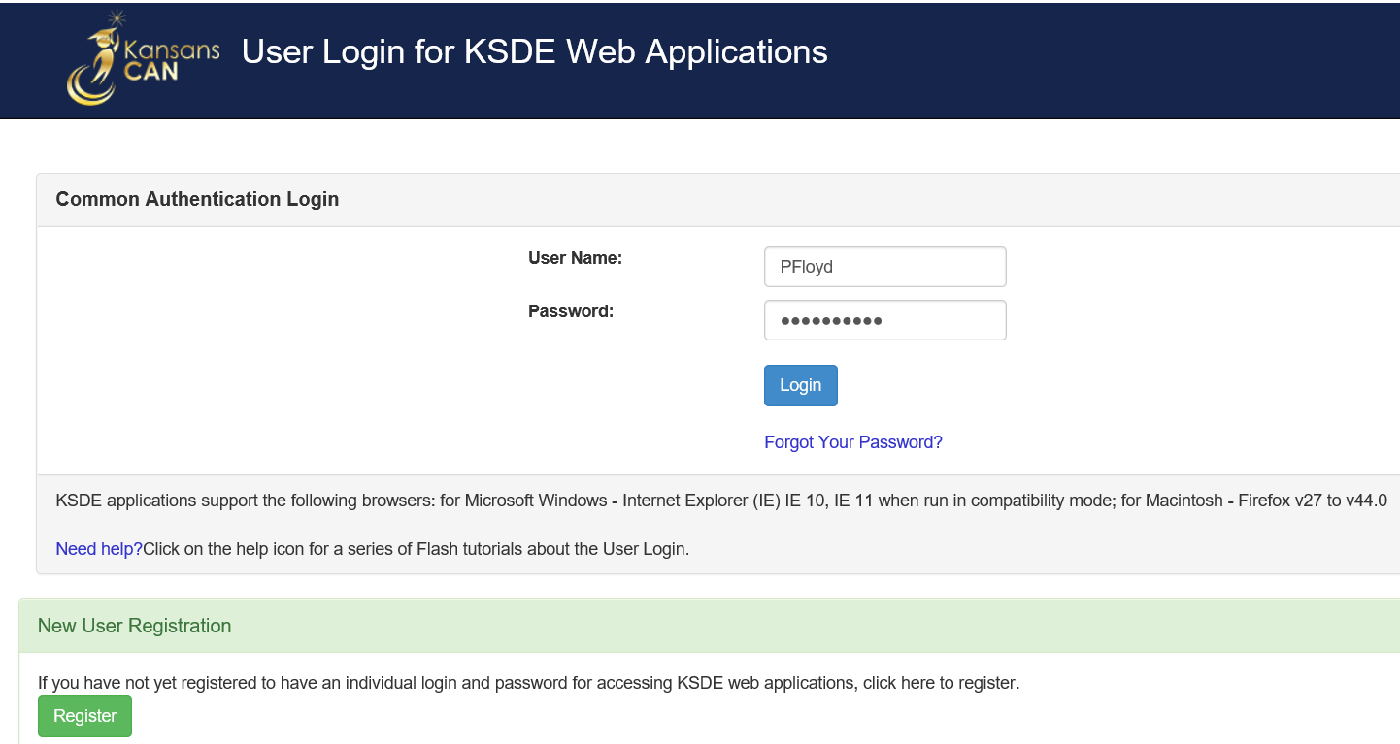
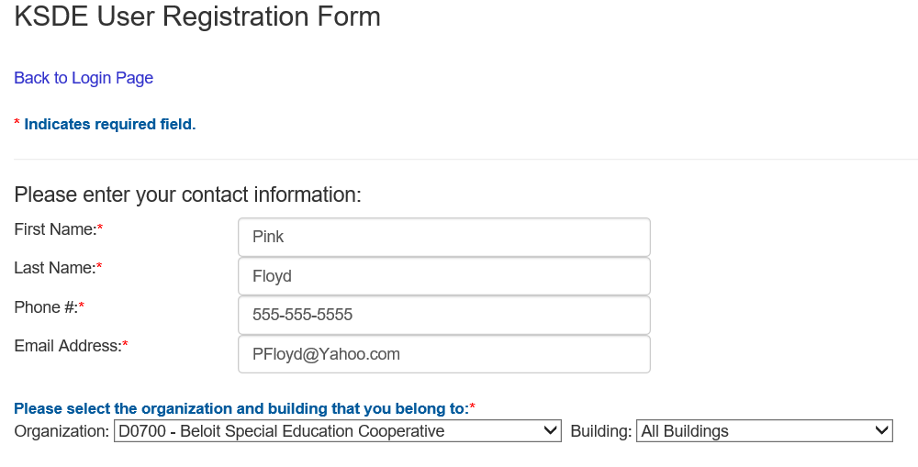
Common Authentication System
How to gain Access
Go to KSDE Web Applications
Enter Username
Enter Password
Log In
Usernames identify you by your agency and level of access.
If you have not registered, click the Register button to set up an account.
Complete the registration form. Select your organization and all buildings

Slide 15
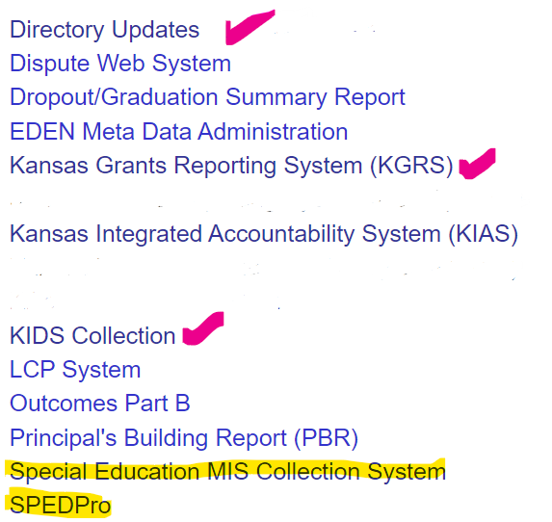
Common Authentication System
Once your account is established Log In, Select SPEDPro from the list of active applications. Manage My Account to request access to other Web applications
MIS clerks - Choose the District Update role and submit request

Slide 16
Common Authentication
RED Banner
The RED Banner is an alert that specific KSDE web applications will be unavailable for specific periods of time due to:
The application may be undergoing routine maintenance
Application upgrades
Bug fixes
Wait for the RED Banner to be removed before logging into SPEDPro. Note other web application not identified with a RED Banner are accessible.

Slide 17
SPEDPro User Guide
The functionality and data entry process for the SPEDPro application is documented in the SPEDPro User guide. The guide is posted on the MIS and Student data page at www.ksde.org. The User Guide is updated annual as functionality changes.
Additional support documents related to MIS reporting can also be found on the MIS and student data page. Including;
Monthly FAQ and reminders
Preparatory guidance for collection finalization
Index of support documents by subject
Directory guidance.

Slide 18
SPEDPro Functionality
The SPEDPro User Guide

