Slide 1
State Performance Plan and Annual Performance Report
(SPP/APR) FFY 2020-2025 Stakeholder Involvement
Resolution Sessions and Mediation

Slide 2
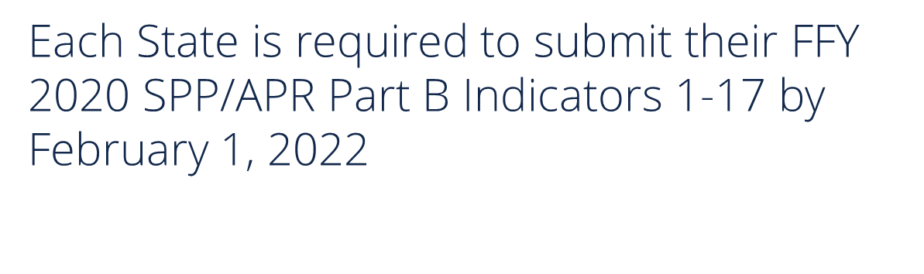
Resolution Sessions and Mediation SPP/APR Indicators
Indicator 15: Resolution Sessions – Percent of due process hearing requests that went to resolution sessions that were resolved through resolution session settlement agreements.
Indicator 16: Mediation – Percent of mediations held that resulted in mediation agreements.

Slide 3
Three Requirements For Target Setting
Must be rigorous yet achievable
Must show improvement over baseline*
Must be set with advice of stakeholders
*For Indicators 15 and 16, the U.S. Department of Education Office of Special Education Programs has provided guidance stating that in the case of resolution sessions and mediations, targets should not drive a specific outcome and should not influence agreements made within mediation and resolution sessions. Therefore, the 2025 target does not need to show improvement over baseline for indicators 15 and 16 and there is no specific threshold. See SPP/APR Universal Technical Assistance for FFY 2020-2025.

Slide 4
Last Thoughts Target Setting
Targets may remain the same several years in a row.
Targets must show improvement over baseline in the end.*
The state must clearly and completely explain the rationale and method used
*For Indicators 15 and 16, the U.S. Department of Education Office of Special Education Programs has provided guidance stating that in the case of resolution sessions and mediations, targets should not drive a specific outcome and should not influence agreements made within mediation and resolution sessions. Therefore, the 2025 target does not need to show improvement over baseline for indicators 15 and 16 and there is no specific threshold. See SPP/APR Universal Technical Assistance for FFY 2020-2025.

Slide 5
Resolution Sessions
Indicator 15
Resolution Sessions and Mediation

Slide 6
What is Indicator 15?
Data source for Indicator 15:
Resolution Sessions
Indicator 15 measures the percent of resolution sessions held in a school year that were resolved through written settlement agreements. For the purposes of reporting to the U.S. Department of Education, a resolution session is counted as resolved through written settlement agreement only if
a.) the agreement is reached through a resolution session and finalized within 30 days of the date the school district received the due process complaint, and
b.) the agreement fully resolves all issues of the due process complaint and negates the need for a due process hearing.
When a school district notifies the Kansas State Department of Education (KSDE) that a parent has filed a request for a special education due process hearing, the KSDE Dispute Resolution Coordinator provides the school district with a Resolution Session Tracking Form. A representative of the school district must complete the tracking form and send a copy of the completed form, along with a copy of any written waivers to both the KSDE Dispute Resolution Coordinator and the due process hearing officer appointed to the due process case.
States are not required to report Indicator 15 data at the school district level. Therefore, KSDE reports the percent of total resolution sessions held state-wide that were resolved through written settlement agreements. KSDE does not calculate or report this percent for individual school districts

Slide 7
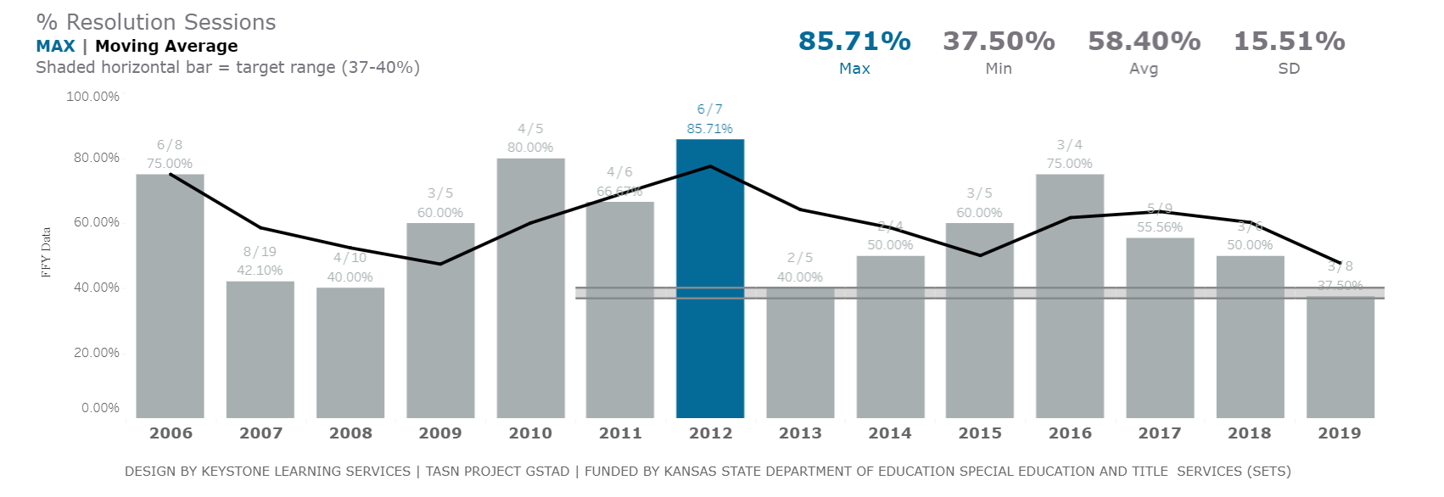
Indicator 15: Resolution Sessions Targets and Results Over Time
States are not required to establish baseline or targets if # of resolution sessions for the reporting year is less than 10.
Percent of resolution sessions held in a school year that were resolved through written settlement agreements.

Slide 8
COVID-19 Impacts
There has been no indication to date that COVID-19 has impacted the data for Indicator 15.

Slide 9

Targets for Indicator 15 for the 2020-2025 SPP/APR Reporting Period
KSDE will keep FFY 2005 data (35.00%) as the baseline. KSDE will keep the target ranges the same as previous years for FFY 2020 – FFY 2025:
2020: 37.00% - 40.00%
2021: 37.00% - 40.00%
2022: 37.00% - 40.00%
2023: 37.00% - 40.00%
2024: 37.00% - 40.00%
2025: 37.00% - 40.00%

Slide 10
How did we determine the changes?
KSDE is not making any changes to the Indicator 15 baseline or the targets for the FFY 2020 – 2025 reporting period. It is the longstanding position of the U.S. Department of Education Office of Special Education Programs that “in the case of resolution sessions, targets should not drive a specific outcome… [and] should not influence agreements made within resolution sessions.” See SPP/APR Universal Technical Assistance for FFY 2020-2025. KSDE’s approach is in line with this position.
Note that Kansas is not required to establish a baseline or targets for any reporting period in which the number of resolution sessions is less than 10. See SPP/APR Part B Indicator Measurement Table, page 24.

Slide 11
Mediation
Indicator 16
Resolution Sessions and Mediation

Slide 12
What is Indicator 16?
Data source for Indicator 16:
Mediation
Indicator 16 measures the percent of mediations held in a school year that result in mediation agreements.
  For the purposes of reporting to the U.S. Department of Education, a mediation is counted as resulting in agreement if the written mediation agreement fully or partially resolves issues in dispute
After the mediation process ends, the mediator appointed to conduct the mediation process submits a report to the Kansas State Department of Education (KSDE) Dispute Resolution Coordinator. The school district has no reporting responsibility for Indicator 16.
States are not required to report Indicator 16 data at the school district level. Therefore, KSDE reports the percent of total mediations held state-wide that result in mediation agreements. KSDE does not calculate or report this percent for individual school districts.

Slide 13
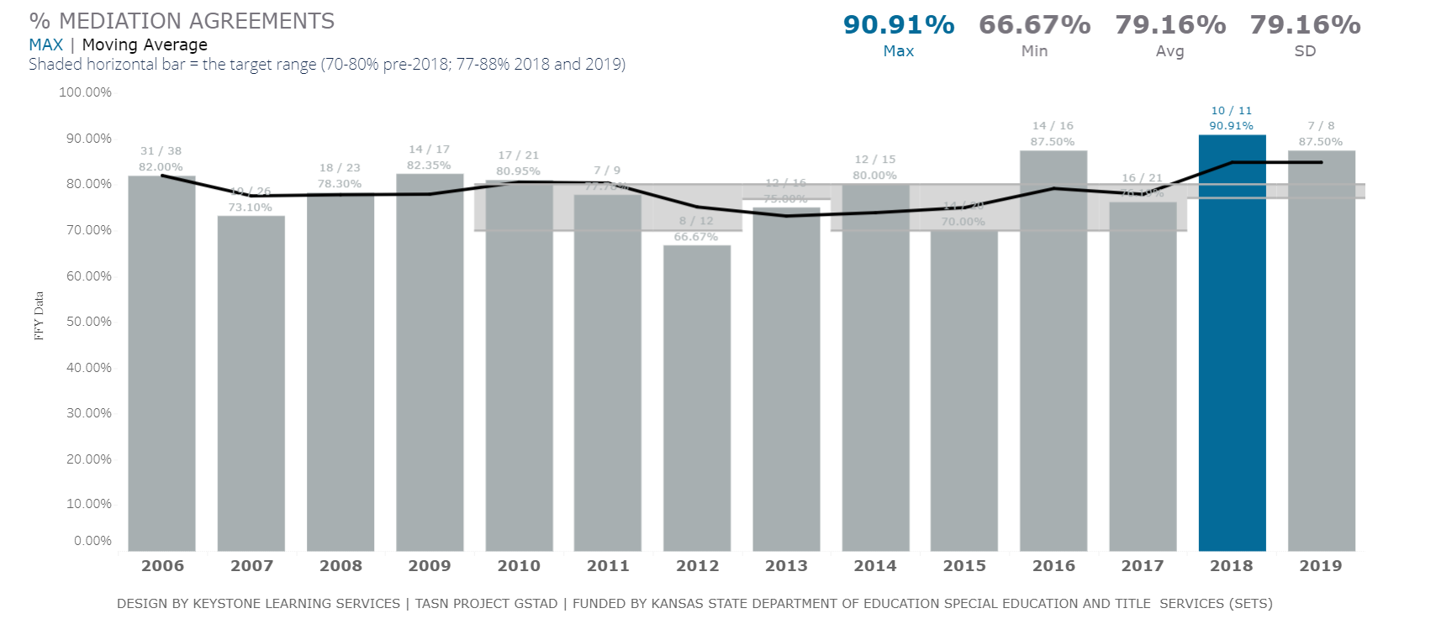
Indicator 16: Mediation Targets and Results Over Time
States are not required to establish baseline or targets if # of resolution sessions for the reporting year is less than 10.
Percent of resolution sessions held in a school year that were resolved through written settlement agreements.

Slide 14
COVID-19 Impacts
There has been no indication to date that COVID-19 has impacted the data for Indicator 16.

Slide 15
Targets for Indicator 16 for the 2020-2025 SPP/APR Reporting Period
KSDE will keep FFY 2013 data (75.00%) as the baseline. KSDE will keep the target ranges the same as previous years for FFY 2020 – FFY 2025:
2020: 77.00% - 80.00%
2021: 77.00% - 80.00%
2022: 77.00% - 80.00%
2023: 77.00% - 80.00%
2024: 77.00% - 80.00%
2025: 77.00% - 80.00%

Slide 16
How did we determine the changes?
KSDE is not making any changes to the Indicator 16 baseline or the targets for the FFY 2020 – 2025 reporting period. It is the longstanding position of the U.S. Department of Education Office of Special Education Programs that “in the case of mediations, targets should not drive a specific outcome… [and] should not influence agreements made within mediation.” See SPP/APR Universal Technical Assistance for FFY 2020-2025. KSDE’s approach is in line with this position.
Note that Kansas is not required to establish a baseline or targets for any reporting period in which the number of mediations is less than 10. See SPP/APR Part B Indicator Measurement Table, page 24.

Slide 17
Data Visualizations and Feedback
  KSDE has partnered with TASN GSTAD to create interactive visualizations of each indicator’s historical and projected data on a site called Tableau Public.
  These visualizations allow you to look at each indicator in depth, and break down indicator data by part, year, and percentages.
  They also allow you to see the KSDE targets, and you can change the projection step sizes to see how data from 2020-2025 could change. This tool will help you when leaving feedback about these targets.
  Finally, each visualization has the survey results embedded within it for you to review stakeholder feedback received on the targets.
  By clicking the link below, you will be routed to the Tableau Public webpage. Please be sure to look at the visualizations for each indicators.
  General Supervision Timely and Accurate Data - Profile | Tableau Public

