Slide 1
State Performance Plan and Annual Performance Report
(SPP/APR) FFY 2020-2025 Stakeholder Involvement
Early Childhood SPP/APR Indicators

Slide 2
Early Childhood SPP/APR Indicators
Indicator 6: Preschool Environments (Early Childhood Least Restrictive Environments-EC LRE)
Indicator 7: Preschool Outcomes (Early Childhood Outcomes- ECOs)
Indicator 12: Transitions from Part C to Part B

Slide 3
Three Requirements For Target Setting
Must be rigorous yet achievable
Must show improvement over baseline
Must be set with advice of stakeholders

Slide 4
Last Thoughts Target Setting
Targets may remain the same several years in a row.
Targets must show improvement over baseline in the end.
The state must clearly and completely explain the rationale and method used

Slide 5
Preschool Environments
Indicator 6
Early Childhood Least Restrictive Environments (EC LRE)

Slide 6
What is Indicator 6?
Preschool Environments
Indicator 6 is divided into two categories, Indicator 6A and Indicator 6B.
Indicator 6A measures the percent of children ages 3 through 5 with IEPs attending a regular early childhood program and receiving the majority of special education and related services in the regular early childhood program.
Indicator 6B measures the percent of children ages 3 through 5 with IEPs attending a separate special education class, separate school or residential facility.
Starting in FFY 2020 the new 6C:
Indicator 6C measures the percent of children ages 3 through 5 with IEPs receiving special education and related services in the home setting.
Data source for Indicator 6:
Data for Indicator 6 is collected from all districts in the state that is reported in the December 1 count of the 618 report.
Verification is conducted as part of Special Education 618 data collection (Sped Pro) collection procedures on the KSDE authenticated web application.

Slide 7
Percent of children aged 3 through 5 with IEPs attending a regular early childhood program and receiving the majority of special education and related services in the regular early childhood program.
Indicator 6A: EC LRE Target and Results Over Time

Slide 8
Percent of children aged 3 through 5 with IEPs attending a separate special education class, separate school or residential facility.
Indicator 6B: EC LRE Targets and Results Over Time

Slide 9
Changes to Indicator 6 for the 2020-2025 SPP/APR Reporting Period
States must report five-year-old children with disabilities who are enrolled in preschool programs in this indicator.
Five-year-old children with disabilities who are enrolled in kindergarten are included in Indicator 5.
Addition of 6C: Special education services in home setting

Slide 10
COVID-19 Impacts
Due to the COVID-19 pandemic, there has been a decrease in preschool students receiving special education and related services in a regular early childhood program (Indicator 6A)
Consequently, there has been an increase of preschool students receiving special education and related services in a separate class, school, or residential facility (Indicator 6B)
This impact could potentially last a couple of years. More parents chose to opt out of preschool services and special education services, or brought their children for services only, which impacted all of Indicator 6 data.
Indicator 6C has reported a significant drop in numbers as well, which may also have further implications to Indicator 6 data.

Slide 11
Targets for Indicator 6 for the 2020-2025 SPP/APR Reporting Period
States may choose to set one target that is inclusive of children ages 3, 4, and 5, or set individual targets for each age
We will use 3 inclusive targets rather than 9 total targets because:
Kansas Indicator 6 data has been stable over time even when separating data by age groups.
In Kansas, three year olds with disabilities are predominately served in early care and education settings, not at home, in Kansas
Efforts to decrease 6C will be more reasonable with inclusive targets, while still having a mechanism to serve preschoolers at home, as appropriate

Slide 12
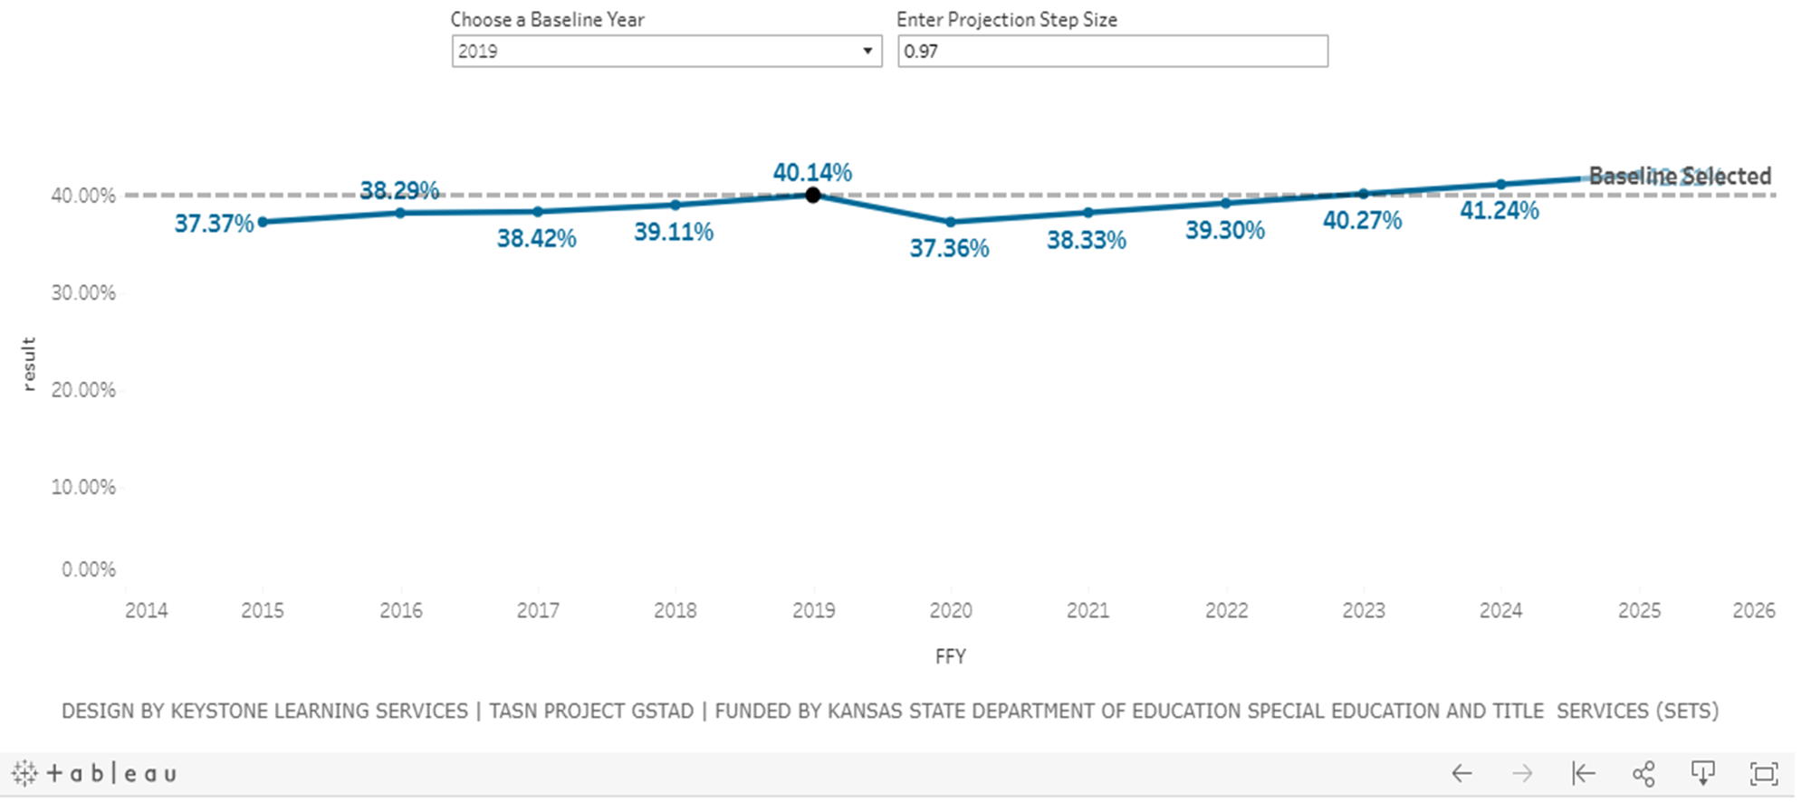
Percent of children aged 3 through 5 with IEPs attending a regular early childhood program and receiving the majority of special education and related services in the regular early childhood program.
Proposed Changes for SPP/APR FFY 2020-2025:
Indicator 6A: Changes for FFY 2020-2025:
42.21%

Slide 13
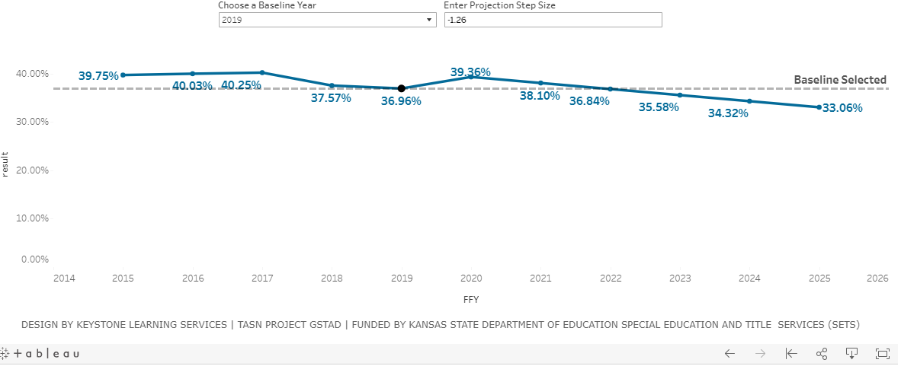
Percent of children aged 3 through 5 with IEPs attending a separate special education class, separate school or residential facility.
Indicator 6B: Changes for FFY 2020-2025:

Slide 14
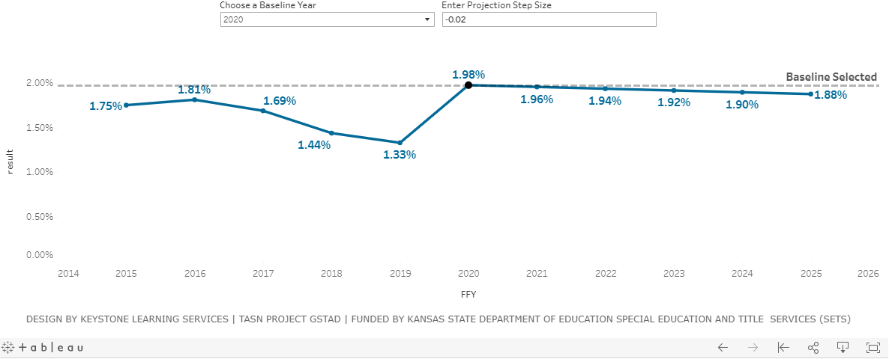
Percent of children aged 3 through 5 with IEPs receiving special education services in the home setting.
Indicator 6C: Targets for FFY 2020-2025:

Slide 15
How did we determine the changes?
6A
6B
6C
Used previous trend data from 2015 to present-removing 5 year old kindergarteners.
Baseline was changed to 2019 and established by KSDE with OSEP guidance.
Used standard deviation to determine projection step size of + 0.97%. We want to see an increase!
Ensured final 2025 target was higher than baseline year 2019.
Used previous trend data from 2015 to present-removing 5 year old kindergarteners.
Baseline was changed to 2019 and established by KSDE with OSEP guidance.
Used standard deviation to determine projection step size of -1.26%. We want to see a decrease!
Ensured final 2025 target was higher than baseline year 2019.
Used previous trend data from 2015 to present.
Baseline is automatically set as 2020.
OSEP clarified they want 6C targets to decrease.
Standard deviation of 1.26% did not apply. KS 6C numbers are low- 1.98%. We propose -0.02% to allow the continuous of the home setting for a child to receive services when appropriate.

Slide 16
Preschool Outcomes
Indicator 7
Early Childhood Outcomes (ECOs)

Slide 17
What is Indicator 7?
Data source for Indicator 7:
Preschool Outcomes
Indicator 7 measures the percent of preschool children aged 3 through 5 with an individualized education program (IEP) who demonstrate improved:
A. Positive social-emotional skills (including social relationships);
B. Acquisition and use of knowledge and skills (including early language/communication and early literacy); and
C. Use of appropriate behaviors to meet their needs.
Data for Indicator 7 information is collected at two points in time:
1) when a child first enters Part B Preschool Services and
2) when a child permanently exits Part B preschool services.
Districts will submit child outcome information into a state data collection system administered through the Kansas State Department of Education called the Outcomes Web Based System (OWS) located on the KSDE Web Application page.
Notes:
Indicator 7 measures the percent of preschool children aged 3 through 5 with an individualized education program (IEP) who demonstrate improved:
A. Positive social-emotional skills (including social relationships);
B. Acquisition and use of knowledge and skills (including early language/communication and early literacy); and
C. Use of appropriate behaviors to meet their needs.
Data for Indicator 7 information is collected at two points in time:
1) when a child first enters Part B Preschool Services and
2) when a child permanently exits Part B preschool services.
Districts will submit child outcome information into a state data collection system administered through the Kansas State Department of Education called the Outcomes Web Based System (OWS) located on the KSDE Web Application page: https://apps.ksde.org/authentication/login.aspx.

Slide 18
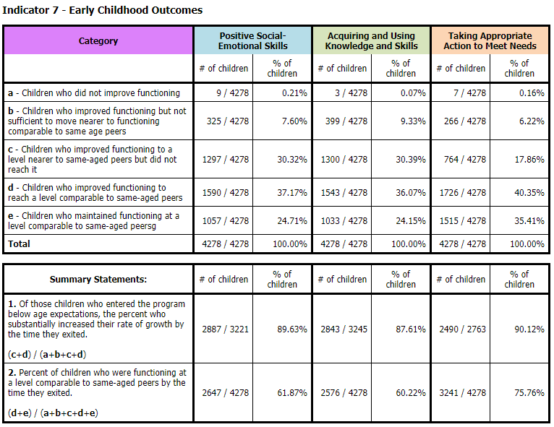
Notes:
You can access your district data under the EC Report. This report will break down Indicator 7 into the different categories of 7a, 7b, 7c, 7d, 7e and then the totals of 7A1, 7A2, 7B1, 7B2, 7C1 and finally 7C2.

Slide 19
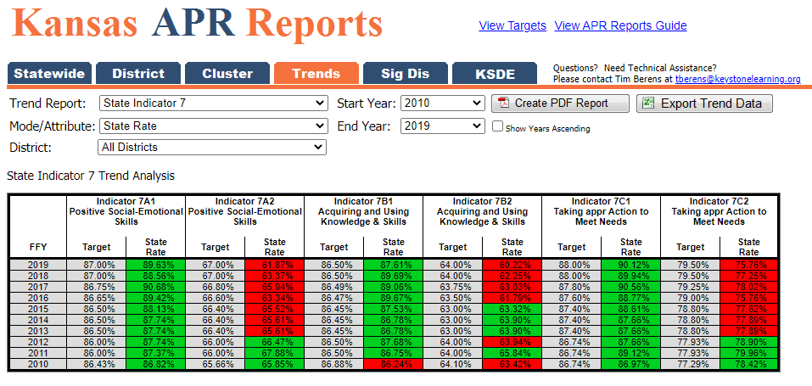
Indicator 7 Trend Data 2010-2019
Notes:
You can access your district’s Indicator 7 trend data as well from 2010 through the current year FY 2019.

Slide 20
Changes to Indicator 7 for the 2020-2025 SPP/APR Reporting Period
Set new targets and consider setting new baseline
Improve Data quality
Update Indicator 7 trainings and resources
Consider updating Curriculum Based Assessment (CBA) tools
Analyze CBA survey results

Slide 21
COVID-19 Impacts
COVID-19 impacted all parts of Indicator 7’s data because there were a high number of preschool students with no permanent or organizational exit.
Because of this, there will be a two-year “recovery window” for each target.

Slide 22
Targets for Indicator 7 for the 2020-2025 SPP/APR Reporting Period
7A1: 2-year “recovery window” then an increase of +0.27% in the years that follow
7A2: Two-year “recovery window” then an increase of +0.83% in the years that follow
7B1: Two-year recovery window” then an increase of 0.22% in the years that follow
7B2: Two-year “recovery window” then an increase of 0.34% in the years that follow
7C1: Two-year “recovery window” then an increase of 0.24% in the years that follow
7C2: Two-year “recovery window” then an increase of 0.27% in the years that follow

Slide 23
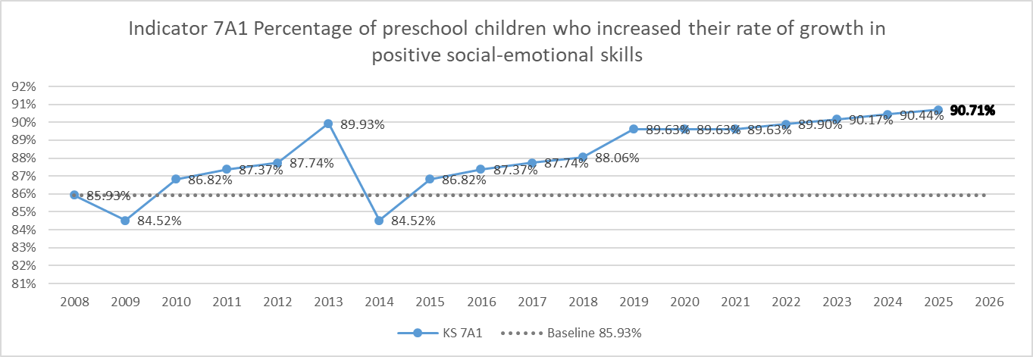
7A1: Projected targets (+0.27 for final 4 years)

Slide 24
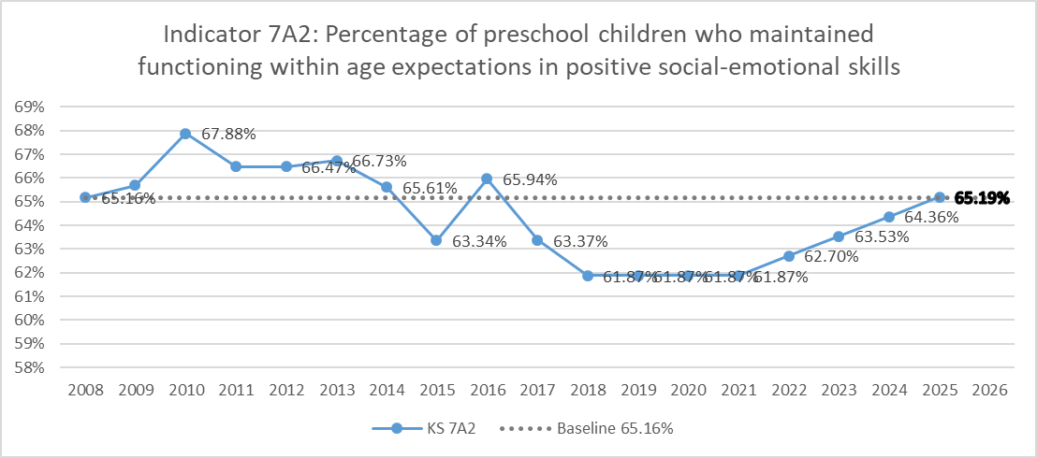
7A2: Projected targets (+0.83 for final 4 years)

Slide 25
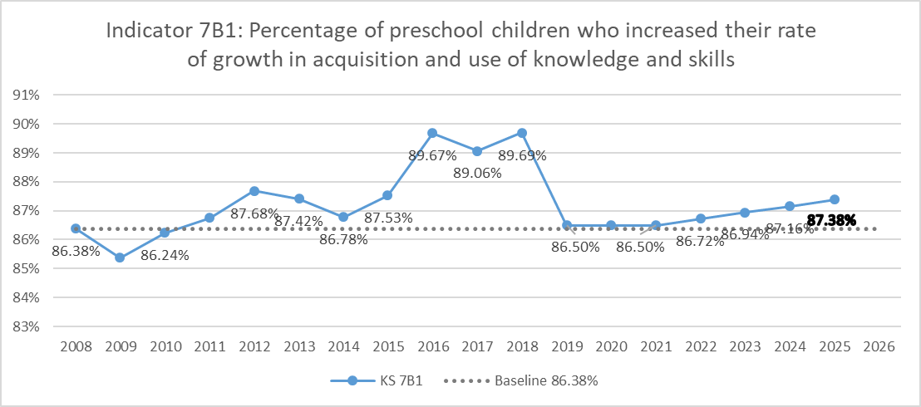
7B1: Projected targets (+0.22 for final 4 years)

Slide 26
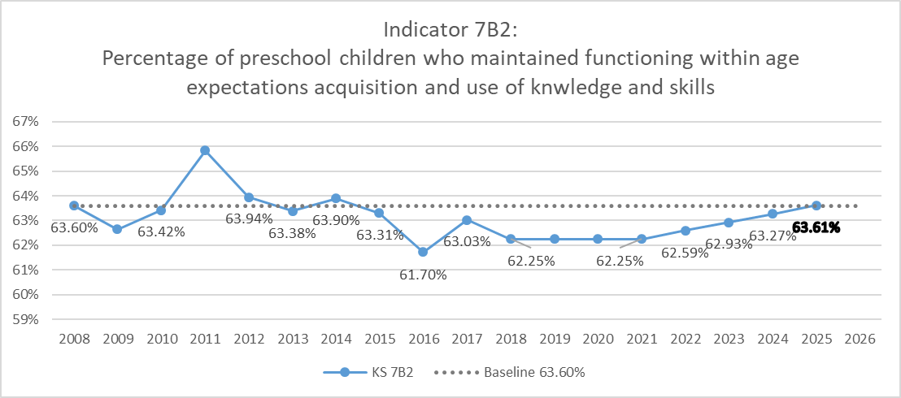
7B2: Projected targets (+0.34 for final 4 years)

Slide 27
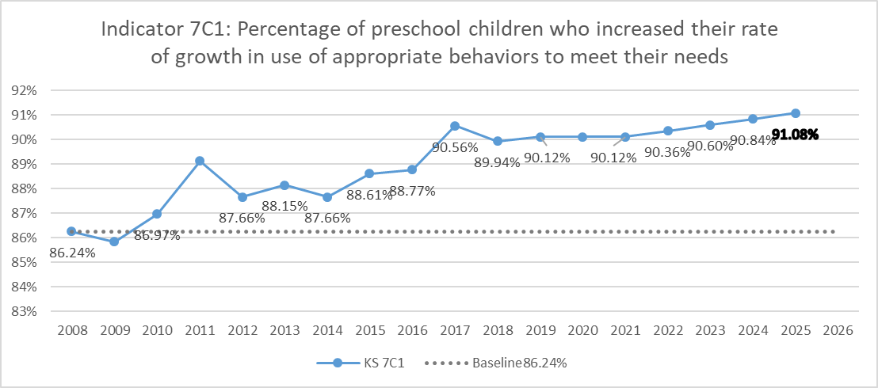
7C1: Projected targets (+0.24 for final 4 years)

Slide 28
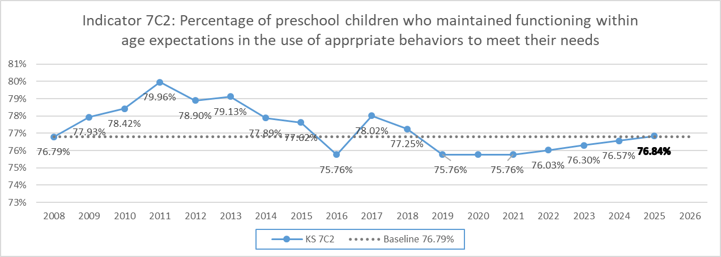
7C2: Projected targets (+0.27 for final 4 years)

Slide 29
How did we determine the changes?
Due to the COVID impact on Part B, we determined a two-year maintenance “recovery window” for targets
Baseline was not changed, as state did not meet the requirements needed. Started with the suggested standard deviation and adjusted to allow the final target be greater than the baseline as required by OSEP.
For 7A2, 7B2 and 7C2, Kansas has not been meeting targets consistently (in some cases since 2013)
Data appears to provide evidence that when consistent, ongoing training is not provided to districts, it impacts the state’s ability to meet the target

Slide 30
Transitions from Part C to Part B
Indicator 12

Slide 31
What is Indicator 12?
Data source for Indicator 12:
Early Childhood Transition from Part C to Part B
KDHE submits and uploads data fields from the Part C database into a secure site at KSDE annually. A file is generated by KSDE and is uploaded into KSDE authenticated website KIAS along with data submitted by districts. The KIAS runs verification checks specifically designed to find errors in the data and student data that needs follow-up. KIAS then calculates the measurement variables for Indicator 12.
Indicator 12 is a compliance indicator that measures the percent of children referred by Part C prior to age 3, who are found eligible for Part B, and who have an IEP developed and implemented by their third birthdays. 20 U.S.C. § 1416(a)(3)(B).
Notes:
Indicator 12 is a 100% compliance indicator that measures the percent of children referred by Part C prior to age 3, who are found eligible for Part B, and who have an IEP developed and implemented by their third birthdays. 20 U.S.C. § 1416(a)(3)(B).
KDHE submits and uploads data fields from the Part C database into a secure site at KSDE annually. A file is generated by KSDE and is uploaded into KSDE authenticated website KIAS along with data submitted by districts. The KIAS runs verification checks specifically designed to find errors in the data and student data that needs follow-up. KIAS then calculates the measurement variables for Indicator 12.

Slide 32
COVID-19 Impacts
There has been no indication to date that COVID-19 has impacted the data for Indicator 12.

Slide 33
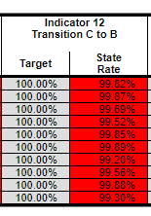
Indicator 12 Trend Data 2010-2019
Notes:
You can access your district’s Indicator 7 trend data as well from 2010 through the current year FY 2019.

Slide 34
Changes to Indicator 12 for the 2020-2025 SPP/APR Reporting Period
As this is a compliance indicator with goals set by the US Department of Education, no changes will be made to this indicator.
Target will remain 100%

Slide 35
Data Visualizations and Feedback
KSDE has partnered with TASN GSTAD to create interactive visualizations of each indicator’s historical and projected data on a site called Tableau Public.
These visualizations allow you to look at each indicator in depth, and break down indicator data by part, year, and percentages.
They also allow you to see the KSDE targets, and you can change the projection step sizes to see how data from 2020-2025 could change. This tool will help you when leaving feedback about these targets.
Finally, each visualization has the survey results embedded within it for you to review stakeholder feedback received on the targets.
By clicking the link below, you will be routed to the Tableau Public webpage. Please be sure to look at the visualizations for each indicators.
General Supervision Timely and Accurate Data - Profile | Tableau Public

Slide 36
Contact Information
Julie Rand
Education Program Consultant 619 Coordinator Early Childhood (785) 296-1944 jrand@ksde.org

