Slide 1
State Performance Plan and Annual Performance Report
(SPP/APR) FFY 2020-2025 Stakeholder Involvement
Education Environments (School Age)

Slide 2
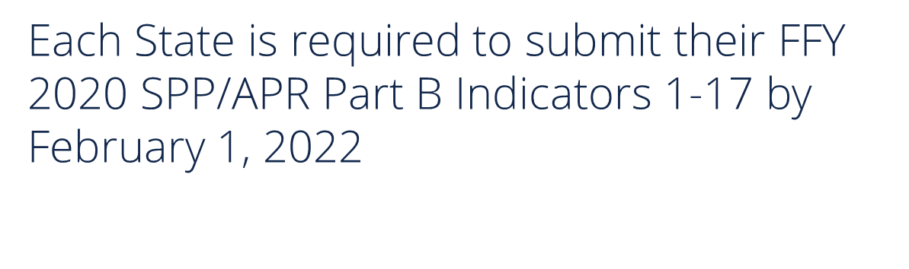
Education Environments SPP/APR Indicator
Indicator 5: Percent of children with IEP’s, age 5 and enrolled in kindergarten and ages 6-21 (least restrictive environment).

Slide 3
Three Requirements For Target Setting
Must be rigorous yet achievable
Must show improvement over baseline
Must be set with advice of stakeholders

Slide 4
Last Thoughts Target Setting
Targets may remain the same several years in a row.
Targets must show improvement over baseline in the end.
The state must clearly and completely explain the rationale and method used

Slide 5
Education Environments (School Age)
Indicator 5

Slide 6
What is Indicator 5?
Assessment
Data source for Indicator 5:
Indicator 5 looks at least restrictive environment (LRE) and measures the percent of children with IEPs aged 6 through 21 served:
  Indicator 5A: Inside the regular classroom 80% or more of the day
  Indicator 5B: Inside the regular classroom less than 40% of the day
  Indicator 5C: In separate schools, residential facilities, or homebound/hospital placements
Data for Indicator 5 is collected from all districts in the state that is reported in the December 1 count of the 618 report.
Verification is conducted as part of Special Education 618 data collection (Sped Pro) collection procedures on the KSDE authenticated web application.

Slide 7
Indicator 5A: Historical Data for Students with IEP’s inside a regular classroom for 80% or more of the day

Slide 8
Indicator 5B: Historical Data for Students with IEP’s inside a regular classroom for less than 40% of the day

Slide 9
Indicator 5C: Historical Data for Students with IEP’s in separate schools, residential facilities, or homebound/hospital placements

Slide 10
COVID-19 Impacts
KSDE projects that COVID-19 has had little to no effect on Indicator 5 due in part to the procedural guidance KSDE provided in response to COVID which included data reporting guidance.

Slide 11

Targets for Indicator 5 for the 2020-2025 SPP/APR Reporting Period
Indicator 5A – KSDE will use FFY 2019 data as a baseline, and to begin FFY 2020 with a target of 70.5%. This target will increase to 71.75% by FFY 2025.
Indicator 5B - KSDE will use FFY 2019 data as a baseline, and to begin FFY 2020 with a target of 7.02%. This target will decrease to 6.95% by FFY 2025.
Indicator 5C - KSDE will use FFY 2019 data as a baseline, and to begin FFY 2020 with a target of 2.20%. This target will decrease to 2.15% by FFY 2025.

Slide 12
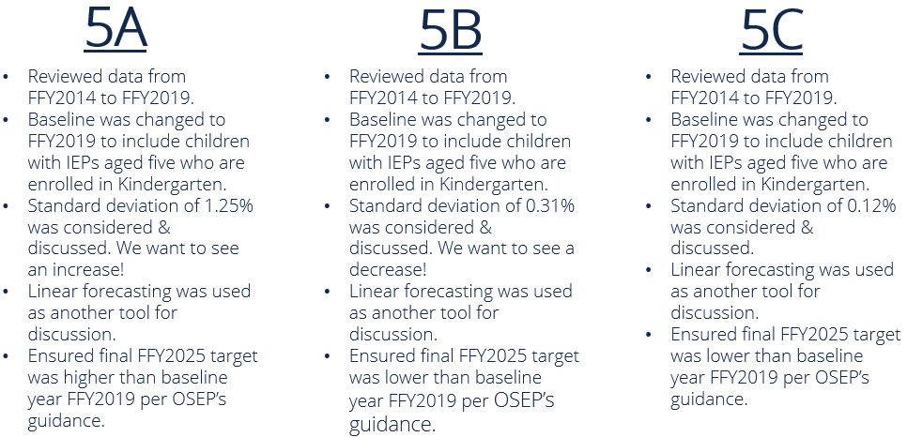
How did we determine the targets?

Slide 13
Data Visualizations and Feedback
  KSDE has partnered with TASN GSTAD to create interactive visualizations of each indicator’s historical and projected data on a site called Tableau Public.
  These visualizations allow you to look at each indicator in depth, and break down indicator data by part, year, and percentages.
  They also allow you to see the KSDE targets, and you can change the projection step sizes to see how data from 2020-2025 could change. This tool will help you when leaving feedback about these targets.
  Finally, each visualization has the survey results embedded within it for you to review stakeholder feedback received on the targets.
  By clicking the link below, you will be routed to the Tableau Public webpage. Please be sure to look at the visualizations for each indicators.
  General Supervision Timely and Accurate Data - Profile | Tableau Public

Slide 14
Contact Information
  Kelly Steele
  Education Program Consultant
  Assessment
  (785) 296-2050
  ksteele@ksde.org

