Slide 1
State Performance Plan and Annual Performance Report
(SPP/APR) FFY 2020-2025 Stakeholder Involvement
Secondary Transition and Post-Secondary SPP/ARP Indicators

Slide 2
Secondary Transition and Post-Secondary SPP/APR Indicators
Indicator 1: Graduation (percent of youth with IEP’s graduating with regular diploma)
Indicator 2: Drop Out (percent of youth with IEP’s dropping out)
Indicator 13: Secondary Transitions (percent of youth ages 16+ with measurable, annually updated IEP goals and appropriate transition assessment, services, and courses.)
Indicator 14: Percent of youth who are no longer in secondary school, had IEPs in effect at the time they left school, and were:
A. Enrolled in higher education within one year of leaving high school.
B. Enrolled in higher education or competitively employed within one year of leaving high school.
C. Enrolled in higher education or in some other postsecondary education or training program; or competitively employed or in some other employment within one year of leaving high school

Slide 3
Three Requirements For Target Setting
Must be rigorous yet achievable
Must show improvement over baseline
Must be set with advice of stakeholders

Slide 4
Last Thoughts Target Setting
Targets may remain the same several years in a row.
Targets must show improvement over baseline in the end.
The state must clearly and completely explain the rationale and method used.

Slide 5
Graduation
Indicator 1
Secondary Transition and Post-Secondary SPP/ARP Indicators

Slide 6
What is Indicator 1?
Graduation
Data source for Indicator 1:
The new data source for Indicator 1 are the Exit Records in the SPEDPro application. Districts can verify this data via the Projected and Final End of Year Report and OSEP Table 4 Exit Report in SPEDPro.
The Exit Status Report and Unknown Exit Report are data quality reports that alert the district that an inactive Status in SPEDPro may not be accurate based on other data reported in SPEDPro. The Unresolved Exit Report is a data quality report that alerts the district that an Exit may be unreported.
Indicator 1 measures the percent of youth with an individualized education program (IEP) graduating from high school with a regular diploma.

Slide 7
Percent of youth with IEP’s graduating with regular diplomas
Indicator 1: Graduation Target and Results Over Time

Slide 8
Changes to Indicator 1 for the 2020-2025 SPP/APR Reporting Period
The only change for Indicator 1 is the data source.
Instead of using Graduation data from local school district records entered into the KSDE Kansas Individual Data on Students (KIDS) system, Data for Indicator 1 will now be collected from the Exit Records in the SPEDPro application. Districts can verify this data via the Projected and Final End of Year Report and OSEP Table 4 Exit Report in SPEDPro.

Slide 9
COVID-19 Impacts
There is not enough information at this time to determine the effects of COVID-19 on this indicator.

Slide 10
Targets for Indicator 1 for the 2020-2025 SPP/APR Reporting Period
Indicator 1 - KSDE will begin FFY 2020 with a target at baseline, 80.5%. Then, KSDE will increase the target for FFY 2021 – 2025 0.5% per year.

Slide 11
How did we determine the targets?
Reviewed data from FFY 2011 to FFY 2021.
Baseline was changed to FFY 2020.
Increase of 0.5% was discussed. We want to see an increase!
Linear forecasting was used as a tool for discussion.
Ensured FFY 2025’s target was higher than baseline year FFY 2020 per OSEP’s guidance.

Slide 12
Drop Out
Indicator 2
Secondary Transition and Post-Secondary SPP/ARP Indicators

Slide 13
What is Indicator 2?
Drop Out
Data source for Indicator 2:
The new data source for Indicator 1 are the Exit Records in the SPEDPro application. Districts can verify this data via the Projected and Final End of Year Report and OSEP Table 4 Exit Report in SPEDPro.
The Exit Status Report and Unknown Exit Report are data quality reports that alert the district that an inactive Status in SPEDPro may not be accurate based on other data reported in SPEDPro. The Unresolved Exit Report is a data quality report that alerts the district that an Exit may be unreported.
Indicator 2 measures percent of youth with an individualized education program (IEP) dropping out of high school

Slide 14
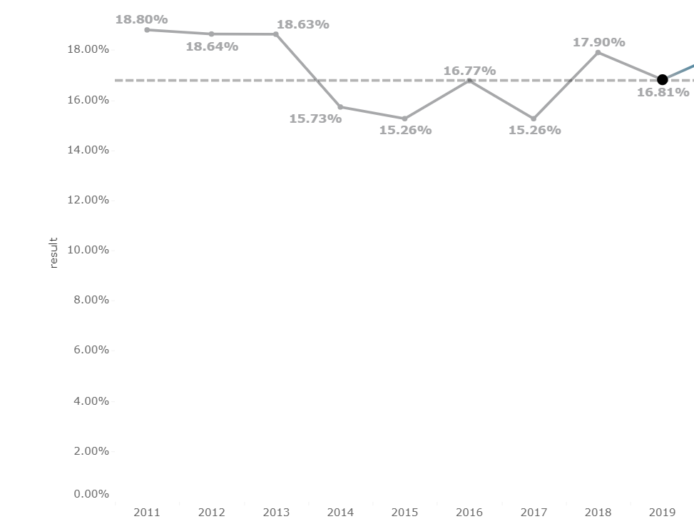
Percent of youth with IEP’s dropping out of school
Indicator 2: Drop Out Target and Results Over Time

Slide 15
Changes to Indicator 1 for the 2020-2025 SPP/APR Reporting Period
The changes for Indicator 2 are the data source and calculation.
Instead of using Graduation data from local school district records entered into the KSDE Kansas Individual Data on Students (KIDS) system, Data for Indicator 1 will now be collected from all districts in the state that is reported in the December 1 count of the 618 report.

Slide 16
COVID-19 Impacts
There is not enough information at this time to determine the effects of COVID-19 on this indicator.

Slide 17
Targets for Indicator 2 for the 2020-2025 SPP/APR Reporting Period
Indicator 2 - KSDE will begin FFY 2020 with a target at baseline, 17.95%. Then, KSDE will decrease the target for FFY 2021 – 2025 by 0.27% each year, resulting in a 1.35% decrease by FFY 2025.

Slide 18
How did we determine the changes?
Reviewed data from FFY 2011 to FFY 2021.
Baseline was changed to FFY 2020.
Decrease of 0.27% was discussed. We want to see an decrease!
Linear forecasting was used as a tool for discussion.
Ensured FFY 2025’s target was lower than baseline year FFY 2020 per OSEP’s guidance.

Slide 19
Secondary Transitions
Indicator 13
Secondary Transition and Post-Secondary SPP/ARP Indicators

Slide 20
What is Indicator 13?
Data source for Indicator 13:
Secondary Transitions
Indicator 13 is a compliance indicator that measures the percent of students who begin the process of discussing transition planning with their school/district no later than the student’s 14th birthday or younger when appropriate.
Every district completes the National Technical Assistance Center on Transition (NTACT) I-13 Checklist self-assessment Indicator 13 Checklist Form B on a yearly basis for a sampling of students age 16 and older. The results of the review are entered using the Indicator 13 module within the Kansas Integrated Accountability System (KIAS) web application.

Slide 21
COVID-19 Impacts
There has been no indication to date that COVID-19 has impacted the data for Indicator 13.

Slide 22
Changes to Indicator 13 for the 2020-2025 SPP/APR Reporting Period
As this is a compliance indicator with goals set by the US Department of Education, no changes will be made to this indicator.
Target will remain 100%

Slide 23
Post-School Outcomes
Indicator 14
Secondary Transition and Post-Secondary SPP/ARP Indicators

Slide 24
What is Indicator 14?
Post-School Outcomes
Indicator 14 requires states to report the “percent of youth who are no longer in secondary school, had IEPs in effect at the time they left school, and were:
Indicator 14A: Enrolled in higher education within one year of leaving high school.
Indicator 14B: Enrolled in higher education or competitively employed within one year of leaving high school.
Indicator 14C: Enrolled in higher education or in some other postsecondary education or training program; or competitively employed or in some other employment within one year of leaving high school”. (20 U.S.C. 1416(a)(3)(B)).
Data source for Indicator 14:
KSDE will be changing the sampling plan from a random stratified sample to a statewide census every year.

Slide 25
COVID-19 Impacts
The impact of COVID-19 on Indicator 14 is unknown at this time.

Slide 26
Percent of youth with IEP’s no longer in school and enrolled in higher education
Indicator 14A: Target and Results Over Time

Slide 27
Percent of youth with IEP’s no longer in school and enrolled in higher education or competitively employed.
Indicator 14B: Target and Results Over Time

Slide 28
Percent of youth with IEP’s no longer in school and enrolled in higher education, other postsecondary education, or training program or competitively employed in some other employment within one year of leaving high school.
Indicator 14C: Target and Results Over Time

Slide 29
Changes to Indicator 14 for the 2020-2025 SPP/APR Reporting Period
KSDE will be changing the sampling plan from a random stratified sample to a statewide census every year.
The baseline for this indicator would also change once KSDE has accurate data from the upcoming change in methodology.

Slide 30
Targets for Indicator 14 for the 2020-2025 SPP/APR Reporting Period
KSDE will use FFY 2009 data as a baseline, and begin FFY 2020 with targets reflecting the following:
Indicator 14A:
35.54%
Indicator 14B:
60.07%
Indicator 14C:
74.72%
KSDE will keep the targets the same for both FFY 2020 and 2021, then increase the targets for each sub-indicator by 0.5% each year.

Slide 31
How did we determine the targets?
Past performance shows multiple years of not meeting targets
Trend data from 2012 to present shows small growth across the three measures
Target has remained the same the past two years and targets were not met
New baseline would better reflect current performance
Targets show smaller increments of growth and still project improvement over time.

Slide 32
Data Visualizations and Feedback
KSDE has partnered with TASN GSTAD to create interactive visualizations of each indicator’s historical and projected data on a site called Tableau Public.
These visualizations allow you to look at each indicator in depth, and break down indicator data by part, year, and percentages.
They also allow you to see the KSDE targets, and you can change the projection step sizes to see how data from 2020-2025 could change. This tool will help you when leaving feedback about these targets.
Finally, each visualization has the survey results embedded within it for you to review stakeholder feedback received on the targets.
By clicking the link below, you will be routed to the Tableau Public webpage. Please be sure to look at the visualizations for each indicators.
General Supervision Timely and Accurate Data - Profile | Tableau Public

