Slide 1
Early Childhood Outcomes:
Improving the Quality of Data Through Training and Technical Assistance
Notes:
Amanda

Slide 2
Participant Outcomes
As a result of our time together participants will …
Understand the early childhood outcome purpose, data collection and reporting requirements.
Explore questions related to early childhood outcome reporting.
Know where to find resources for training and technical assistance related to early childhood outcomes.
Notes:
Amanda

Slide 3
Agenda
Participant
outcomes
Why and what of Indicator 7: Early Childhood Outcomes
National
data
Kansas
data
Improving
data quality
Resources for training and technical assistance
Contact
information
Notes:
Vera

Slide 4
What is Indicator 7?
Measured by Part C and Part B Preschool Special Education Programs.
Functional skills and behaviors that are meaningful for a child’s participation in everyday routines.
Cut across developmental domains
Meant to measure skills and behaviors across settings and situations.
Notes:
Vera
The three child outcomes, measured by early intervention and early childhood special education systems, encompass functional skills and behaviors that are meaningful for a child's participation in everyday routines. They cut across developmental domains to represent the integrated nature of how children develop, learn, and thrive. The breadth of these outcomes provides a framework for describing and consistently measuring children's functional skills and behaviors across settings and situations.
Reference:
Greenwood, C. R., Walker, D., Hornbeck, M., Hebbeler, K., & Spiker, D. (2007). Progress developing the Kansas early childhood special education accountability system: Initial findings using ECO and COSF. Topics in Early Childhood Special Education, 27(1), 2-18. https://journals.sagepub.com/doi/pdf/10.1177/02711214070270010101

Slide 5
Outcome A: Positive Social-Emotional Skills (including social relationships)
Relating with caregivers.
Attending to other people.
Interacting with peers.
Participating in social games and communicating with others.
Notes:
Vera
Relating With Caregivers
Demonstrate regulation and attachment, respond/initiate/sustain interactions, acknowledge comings and goings...
Attending to Other People in a Variety of Settings
Express awareness/caution, respond to/offer greetings, respond to own/others' names...
Interacting with Peers
Convey awareness, respond/initiate/sustain interactions, share/cope/resolve conflicts, play near and with peers...
Participating in Social Games and Communicating with Others
Respond to/initiate/sustain games and back-and-forth communication, demonstrate joint attention, engage in mutual activity, follow rules of games...
Following Social Norms and Adapting to Change in Routines
Transition between activities, respond to new/familiar settings/interactions, behave in ways that allow participation, follow routines and rules...
Expressing Own Emotions and Responding to Emotions of Others
Show pride/excitement/frustration, manage own emotions, display affection and comfort others...
Reference: ECTA https://ectacenter.org/eco/pages/childoutcomes.asp

Slide 6
Outcome A: Positive Social-Emotional Skills (including social relationships) Following social norms and adapting to change in routines.
Expressing own emotions and responding to the emotions of others.
Notes:
Vera
Relating With Caregivers
Demonstrate regulation and attachment, respond/initiate/sustain interactions, acknowledge comings and goings...
Attending to Other People in a Variety of Settings
Express awareness/caution, respond to/offer greetings, respond to own/others' names...
Interacting with Peers
Convey awareness, respond/initiate/sustain interactions, share/cope/resolve conflicts, play near and with peers...
Participating in Social Games and Communicating with Others
Respond to/initiate/sustain games and back-and-forth communication, demonstrate joint attention, engage in mutual activity, follow rules of games...
Following Social Norms and Adapting to Change in Routines
Transition between activities, respond to new/familiar settings/interactions, behave in ways that allow participation, follow routines and rules...
Expressing Own Emotions and Responding to Emotions of Others
Show pride/excitement/frustration, manage own emotions, display affection and comfort others...
Reference: ECTA https://ectacenter.org/eco/pages/childoutcomes.asp

Slide 7
Outcome B: Acquisition and Use of Knowledge and Skills
Showing interest in learning
Attending to other people in a variety of settings
Engaging in purposeful play
Understanding pre-academics and literacy
Acquiring language to communicate
Understanding questions asked and directions given
Notes:
Vera
Showing Interest in Learning
Persist, show eagerness and awareness, imitate/repeat actions, explore environment...
Attending to Other People in a Variety of Settings
Figure things out, use trial and error, remember steps/actions and execute them with intention, experiment with new/known actions...
Engaging in Purposeful Play
Show early awareness and exploration, use objects according to function, play by building, pretending, organizing and expanding play scenarios and roles...
Understanding Pre-Academics and Literacy
Notice differences or associations among things, demonstrate matching/sorting/labeling by size/color/shape/numbers/function, interact with books and pictures, practice early writing and reading...
Acquiring Language to Communicate
Learn and use sounds, words, and sentences with increasing complexity including sign language and augmentative and alternative communication (AAC)...
Understanding Questions Asked and Directions Given
Respond to gestures/verbal requests, understand meaning of increasingly complex words/questions/directions, know and state details about self (e.g., name, age)...
Reference: ECTA https://ectacenter.org/eco/pages/childoutcomes.asp

Slide 8
Outcome C: Use Appropriate Behaviors to Meet Needs
Moving around and manipulating things to meet needs
Eating and drinking with increasing independence
Dressing and undressing with increasing independence
Diapering/toileting and washing with increasing independence
Communicating needs
Showing safety awareness
Notes:
Vera
Moving Around and Manipulating Things to Meet Needs
Move with increasing control and purpose (e.g., reach, roll, crawl, walk, run, climb) to navigate the environment - with accommodations as needed, manipulate objects/tools (e.g., crayons, scissors, switches, fragile items) with increasing control...
Eating and Drinking with Increasing Independence
Suck/swallow, chew, bite, finger feed, use utensils, hold bottle, drink from cup, show growing independence with amount/type of food eaten, access food and feed self....
Dressing and Undressing with Increasing Independence
Assist with dressing, take off/put on shoes and clothes, undo/do fasteners...
Diapering/Toileting and Washing with Increasing Independence
Lift legs for diaper change, sit on potty, wash hands, brush teeth, help with bathing...
Communicating Needs
Indicate hunger/need for sleep/diaper change, express discomfort/hurt, request or reject food, express choice/preferences...
Showing Safety Awareness
Avoid dangers (e.g., putting things in mouth, touching hot stove), follow safety rules across settings and situations...
Reference: ECTA https://ectacenter.org/eco/pages/childoutcomes.asp

Slide 9
Why is Indicator 7 Important?
Focused on functional outcomes versus only academic achievement.
Emphasizes mastery and appropriate application of behaviors, knowledge and skills in a meaningful activities.
Emphasizes actions/knowledge that children need to be able to function successfully across a variety of settings.
Measures the benefit experienced as a result of services and supports received.
Notes:
Vera

Slide 10
Data Sources for Indicator 7
Collected for each child receiving Part B Preschool Services:
  When the child first enters Part B.
  When the child permanently exits Part B.
Child Outcome Summary (COS) Form completed by team and submitted into the Outcome Web Based System (OWS) located on the KSDE web application.
Notes:
Vera

Slide 11
Two Summary Statements for Each Outcomes
Summary Statement 1:
Summary Statement 2:
Of those children who entered or exited the program below age expectations in each outcome, the percent who substantially increased their rate of growth by the time they exited the program.
The percent of children who were functioning within age expectations in each outcome by the time they exited the program.
Notes:
Vera

Slide 12
Indicator 7: Early Childhood Outcomes Data
Notes:
Vera

Slide 13
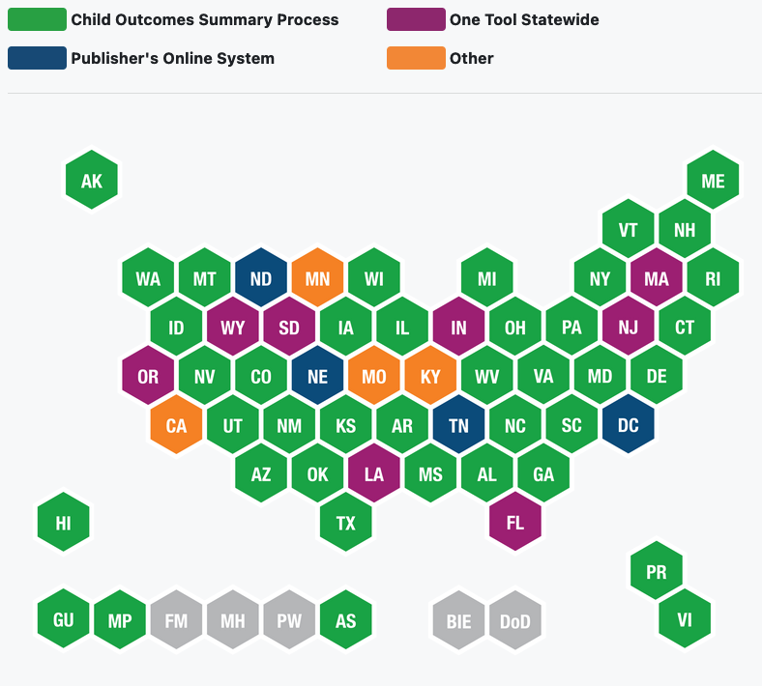
State Approaches to Measurement of Early Childhood Outcome
Notes:
Vera
FFY. 2019
COS process 40 68%
One tool statewide 9 15%
Publisher online system 5 8.5%
Other 5 8.5%
TOTAL 59 100%
Source: https://ectacenter.org/eco/pages/childoutcomes.asp

Slide 14
National Trends Indicator 7 Data
Indicator 7 A1, B1 and C1 Longitudinal Data: FFY 2014-FFY 2019
Notes:
Vera
2021 PART B FFY 2019 SPP/APR Indicator Analysis Booklet (PDF) (ed.gov)
Data Source
7A1 reads, of those preschool children who entered or exited the preschool program below age expectation in Positive social emotional skills, the percent who substantially increased their rate of growth by the time they turned 6 or exited the program.
7A2 reads, the percent of preschool children who were functioning within age expectations in positive social-emotional skills, by the time they turned 6 years of age or exited the program
7B1 reads, of those preschool children who entered or exited the preschool program below age expectations in Acquisition and
use of Knowledge and Skills, the percent who substantially increased their rate of growth by the time they turned 6 or exited the program.
7B2, the percent of preschool children who were functioning within age expectations in Acquisition and use of Knowledge and Skills by the time they turned 6 or exited the program.
7C1 reads, of those preschool children who entered or exited the preschool program below age expectations in Use of Appropriate Behaviors to meet their Needs, the percent who substantially increased their rate of growth by the time they turned 6 or exited the program.
7C2, the percent of preschool children who were functioning within age expectations in Use of Appropriate Behaviors to meet their Needs by the time they turned 6 or exited the program

Slide 15
Kansas Trends Indicator 7 Data
Indicator 7 A1, B1 and C1 Longitudinal Data: FFY 2016-FFY 2020
Notes:
Vera
Data Source : Kansas State_IND7_Trend Report
7A1 reads, of those preschool children who entered or exited the preschool program below age expectation in Positive social emotional skills, the percent who substantially increased their rate of growth by the time they turned 6 or exited the program.
7A2 reads, the percent of preschool children who were functioning within age expectations in positive social-emotional skills, by the time they turned 6 years of age or exited the program
7B1 reads, of those preschool children who entered or exited the preschool program below age expectations in Acquisition and
use of Knowledge and Skills, the percent who substantially increased their rate of growth by the time they turned 6 or exited the program.
7B2, the percent of preschool children who were functioning within age expectations in Acquisition and use of Knowledge and Skills by the time they turned 6 or exited the program.
7C1 reads, of those preschool children who entered or exited the preschool program below age expectations in Use of Appropriate Behaviors to meet their Needs, the percent who substantially increased their rate of growth by the time they turned 6 or exited the program.
7C2, the percent of preschool children who were functioning within age expectations in Use of Appropriate Behaviors to meet their Needs by the time they turned 6 or exited the program

Slide 16
Kansas Trends Indicator 7 Data
Indicator 7 A1, B1 and C1 Longitudinal Data: FFY 2016-FFY 2020
FFY | Indicator 7 A1 | Indicator 7 A1 | Indicator 7 B1 | Indicator 7 B1 | Indicator 7 C1 | Indicator 7 C1
FFY | Target | State Rate | Target | State Rate | Target | State Rate
2020 | 89.63% | 88.85% ⬇ | 86.50% | 88.87% ⬆ | 90.12% | 89.58% ⬇
2019 | 87.00% | 89.63% ⬆ | 86.50% | 87.61% ⬆ | 88.00% | 90.12% ⬆
2018 | 87.00% | 88.56% ⬆ | 86.50% | 89.69% ⬆ | 88.00% | 89.94% ⬆
2017 | 86.75% | 90.68% ⬆ | 86.49% | 89.06% ⬆ | 87.80% | 90.56% ⬆
2016 | 86.65% | 89.42% ⬆ | 86.47% | 89.67% ⬆ | 87.60% | 88.77% ⬆
Notes:
Vera
Data Source : Kansas State_IND7_Trend Report
7A1 reads, of those preschool children who entered or exited the preschool program below age expectation in Positive social emotional skills, the percent who substantially increased their rate of growth by the time they turned 6 or exited the program.
7A2 reads, the percent of preschool children who were functioning within age expectations in positive social-emotional skills, by the time they turned 6 years of age or exited the program
7B1 reads, of those preschool children who entered or exited the preschool program below age expectations in Acquisition and
use of Knowledge and Skills, the percent who substantially increased their rate of growth by the time they turned 6 or exited the program.
7B2, the percent of preschool children who were functioning within age expectations in Acquisition and use of Knowledge and Skills by the time they turned 6 or exited the program.
7C1 reads, of those preschool children who entered or exited the preschool program below age expectations in Use of Appropriate Behaviors to meet their Needs, the percent who substantially increased their rate of growth by the time they turned 6 or exited the program.
7C2, the percent of preschool children who were functioning within age expectations in Use of Appropriate Behaviors to meet their Needs by the time they turned 6 or exited the program

Slide 17
National Trends Indicator 7 Data
Indicator 7 A2, B2 and C2 Longitudinal Data: FFY 2014-FFY 2019
Notes:
Vera
2021 PART B FFY 2019 SPP/APR Indicator Analysis Booklet (PDF) (ed.gov)
Data Source
7A1 reads, of those preschool children who entered or exited the preschool program below age expectation in Positive social emotional skills, the percent who substantially increased their rate of growth by the time they turned 6 or exited the program.
7A2 reads, the percent of preschool children who were functioning within age expectations in positive social-emotional skills, by the time they turned 6 years of age or exited the program
7B1 reads, of those preschool children who entered or exited the preschool program below age expectations in Acquisition and
use of Knowledge and Skills, the percent who substantially increased their rate of growth by the time they turned 6 or exited the program.
7B2, the percent of preschool children who were functioning within age expectations in Acquisition and use of Knowledge and Skills by the time they turned 6 or exited the program.
7C1 reads, of those preschool children who entered or exited the preschool program below age expectations in Use of Appropriate Behaviors to meet their Needs, the percent who substantially increased their rate of growth by the time they turned 6 or exited the program.
7C2, the percent of preschool children who were functioning within age expectations in Use of Appropriate Behaviors to meet their Needs by the time they turned 6 or exited the program

Slide 18
Kansas Trends Indicator 7 Data
Indicator 7 A2, B2 and C2 Longitudinal Data: FFY 2016-FFY 2020
Notes:
Vera
Data Source : Kansas State_IND7_Trend Report
7A1 reads, of those preschool children who entered or exited the preschool program below age expectation in Positive social emotional skills, the percent who substantially increased their rate of growth by the time they turned 6 or exited the program.
7A2 reads, the percent of preschool children who were functioning within age expectations in positive social-emotional skills, by the time they turned 6 years of age or exited the program
7B1 reads, of those preschool children who entered or exited the preschool program below age expectations in Acquisition and
use of Knowledge and Skills, the percent who substantially increased their rate of growth by the time they turned 6 or exited the program.
7B2, the percent of preschool children who were functioning within age expectations in Acquisition and use of Knowledge and Skills by the time they turned 6 or exited the program.
7C1 reads, of those preschool children who entered or exited the preschool program below age expectations in Use of Appropriate Behaviors to meet their Needs, the percent who substantially increased their rate of growth by the time they turned 6 or exited the program.
7C2, the percent of preschool children who were functioning within age expectations in Use of Appropriate Behaviors to meet their Needs by the time they turned 6 or exited the program

Slide 19
Kansas Trends Indicator 7 Data
Indicator 7 A2, B2 and C2 Longitudinal Data: FFY 2016-FFY 2020
FFY | Indicator 7 A2 | Indicator 7 A2 | Indicator 7 B2 | Indicator 7 B2 | Indicator 7 C2 | Indicator 7 C2
FFY | Target | State Rate | Target | State Rate | Target | State Rate
2020 | 61.87% | 62.17% ⬆ | 62.25% | 61% ⬇ | 75.76% | 75.23% ⬇
2019 | 67% | 61.87% ⬇ | 64% | 60.22% ⬇ | 79.50% | 75.76% ⬇
2018 | 67% | 63.37% ⬇ | 64% | 62.25% ⬇ | 79.50% | 77.25% ⬇
2017 | 66.80% | 65.94% ⬇ | 63.75% | 63.03% ⬇ | 79.25% | 78.02% ⬇
2016 | 66.6% | 63.34% ⬇ | 63.5% | 61.79% ⬇ | 79% | 75.76% ⬇
Notes:
Vera
Data Source : Kansas State_IND7_Trend Report
7A1 reads, of those preschool children who entered or exited the preschool program below age expectation in Positive social emotional skills, the percent who substantially increased their rate of growth by the time they turned 6 or exited the program.
7A2 reads, the percent of preschool children who were functioning within age expectations in positive social-emotional skills, by the time they turned 6 years of age or exited the program
7B1 reads, of those preschool children who entered or exited the preschool program below age expectations in Acquisition and
use of Knowledge and Skills, the percent who substantially increased their rate of growth by the time they turned 6 or exited the program.
7B2, the percent of preschool children who were functioning within age expectations in Acquisition and use of Knowledge and Skills by the time they turned 6 or exited the program.
7C1 reads, of those preschool children who entered or exited the preschool program below age expectations in Use of Appropriate Behaviors to meet their Needs, the percent who substantially increased their rate of growth by the time they turned 6 or exited the program.
7C2, the percent of preschool children who were functioning within age expectations in Use of Appropriate Behaviors to meet their Needs by the time they turned 6 or exited the program

Slide 20
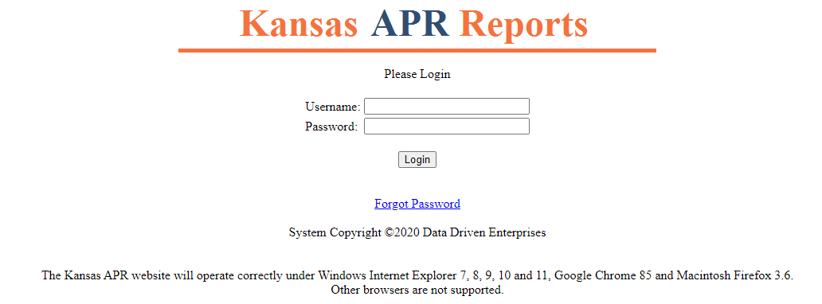
State Performance Plan/Annual Performance Report (SPP/APR) Data Site
Kansas APR Reports
Notes:
Chelie

Slide 21
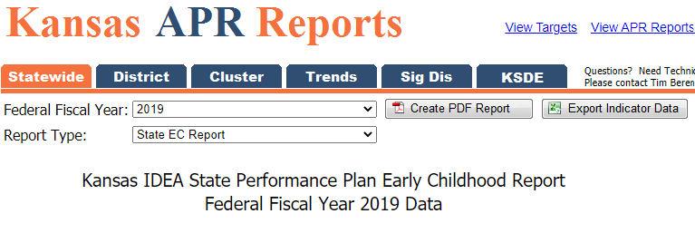
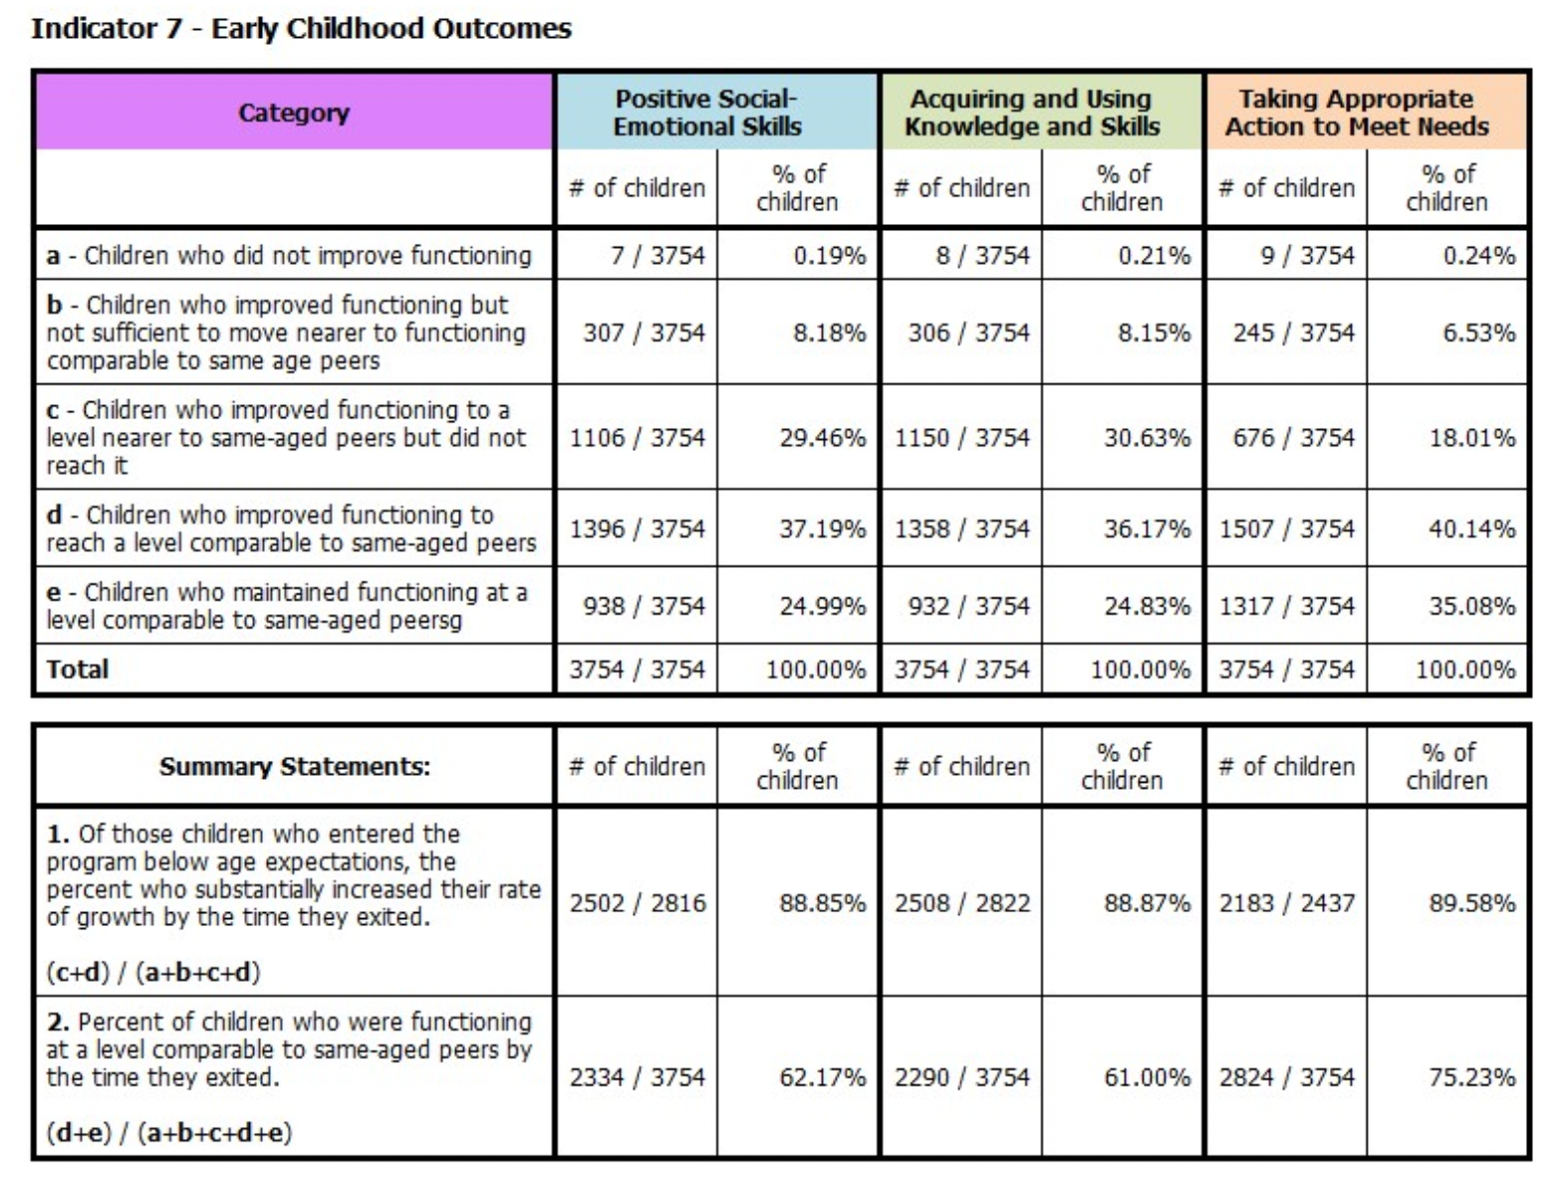
Kansas APR Reports
Notes:
Chelie

Slide 22
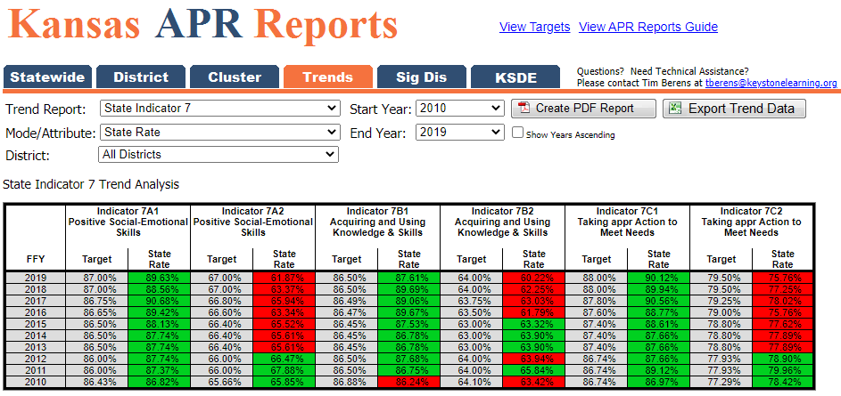
Kansas APR Reports
Notes:
Chelie

Slide 23
Early Childhood Outcome Reporting Requirements
Notes:
Chelie

Slide 24

Made by an Early Childhood Team
Early childhood outcome ratings are completed by a team that must include at least two professionals. Families can also be an important part of this team.
Notes:
Chelie

Slide 25
Kansas Curriculum-Based Measures
Assessment and Programming Evaluation System (AEPS)
Carolina Curriculum for Infants and Toddlers or Preschoolers with Special Needs
Child Observation Record (High Scope)
TS GOLD
Hawaii Early Learning Profile (HELP)
Transdisciplinary Play-Based Assessment (TPBA2)
Work Sampling System
Notes:
Chelie

Slide 26
Using A Curriculum-Based Measure Means ...
Focusing on what a child typically does.
Looking at actual performance across settings and situations.
Examining how a child uses skills to accomplish tasks.
Focusing on how a child functionally uses their skills and abilities rather than domain-specific tasks.
Identifying information that will inform instruction.
Notes:
Chelie

Slide 27
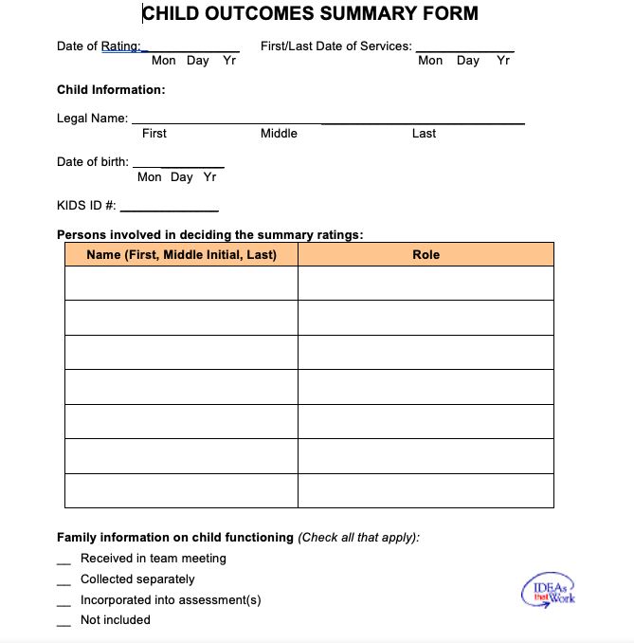
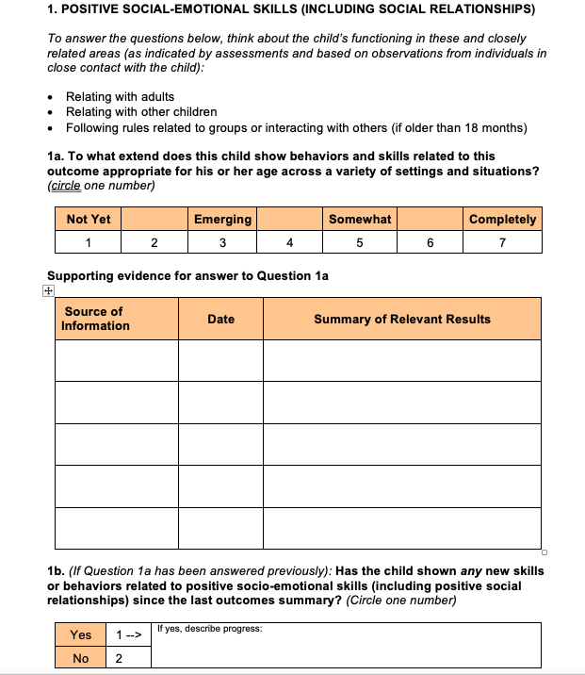
Child Outcome Summary Process
Notes:
Chelie
Source https://kskits.ku.edu/ta/ECOOutcomes/documents/BlankCOSFTemplate.doc

Slide 28
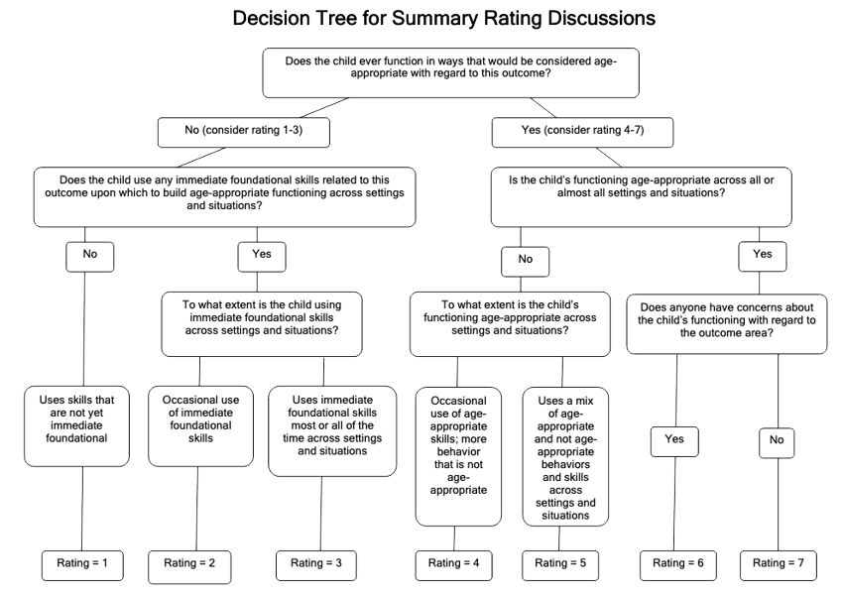
Decision Tree from Summary Ratings
Notes:
Chelie
Source https://kskits.ku.edu/ta/ECOOutcomes/documents/decision_tree_5_19_09.pdf

Slide 29
Outcome Web System (OWS)
Each child must have a Kansas Individual Data on Students (KIDS) State Student Identification (SSID) number before data can be entered into OWS.
The Child Outcomes Summary (COS) refers to the rating scale developed by the Early Childhood Outcomes Center.
All users must register with the KSDE Authenticated Web Applications and be approved by KSDE.
The OWS won’t allow child exit data on a child without entry data present in the system.
The data entry year is from July 1 through June 30 of each calendar year, but the OWS is open for data correction through Sept. 15 of that calendar year.
Notes:
Chelie
Source : https://www.ksde.org/Portals/0/SES/KIAS/indicators/Ind7-OWSguide.pdf

Slide 30
Data Entry Reminders
While children are sometimes served before their third birthday in IDEA Part B services, the OWS will only accept a first date of service on or after a child’s third birthday.
The OWS has a session setting of 30 minutes. The server will time out after 30 minutes of inactivity, and all data will be lost. Click on a button or link that causes server activity to reset the 30-minute window.
All children entering IDEA Part B services must have child outcome entry summary rating data entered in the OWS if they can be in the program for at least six months. Remember, the six months in a program is defined as the entire time a child is in Part B, not just the time a child is in a specific organization or district.
Notes:
Chelie

Slide 31
Data Entry Reminders
If a program knows the child will leave services within six months, do not enter a record for the child into the OWS. However, if there is any doubt that the child will leave within six months, it is highly recommended that an entry rating for that child be entered into OWS.
Child outcomes entry ratings must be determined within 30 days of the first service date per the IFSP/IEP.
Once a child has an entry COS completed, then exits IDEA Part B services permanently and has not been in the program for six months, the exit will be entered into the OWS, and no child outcomes summary rating data will be entered. The OWS system won’t allow the rating to be entered.
Notes:
Chelie

Slide 32
Data Quality Reminders
A permanent exit is considered when:
Transitioning from preschool services to kindergarten.
A child is in IDEA Part B preschool program and turns age 6.
Child has exited and no longer requires IDEA services.
Moved out of state.
Child is withdrawn by parent or guardian.
Child is deceased.
Notes:
Chelie

Slide 33
Timelines for Entering Child Outcome Data in OWS
June 30:
July 1–Sept. 15:
Last date for submitting child outcome entry summary rating data to KSDE for all newly identified children entering IDEA Part B services.
Last date for submitting child outcome exit summary rating data for children permanently exiting IDEA Part B services between July 1 and June 30 of the current year.
Data verification occurs during this period.
Notes:
Chelie
Here are the timelines for Indicator 7:
June 30:
Last date for submitting child outcome entry summary rating data to KSDE for all newly identified children entering IDEA Part B services.
Last date for submitting child outcome exit summary rating data for children permanently exiting IDEA Part B services between July 1 and June 30 of the current year.
July 1 – Sept. 15:
Data verification occurs during this period.

Slide 34
Kansas Early Childhood Outcome Resources and Supports
Notes:
Chelie

Slide 35

Indicator 7: Preschool Outcome Resources
Outcomes Web System (OWS) User Guide:
This guide provides you with all the steps and resources you need to complete the early childhood outcomes process.
Notes:
Chelie

Slide 36
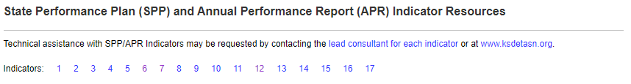
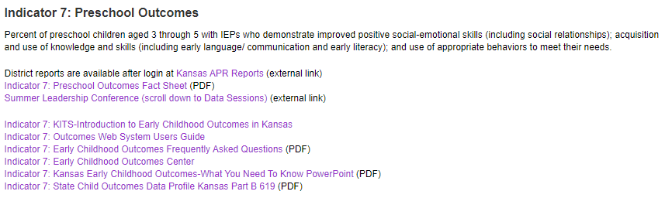
Indicator 7: Early Childhood Outcome Resources
KSDE website
Notes:
Chelie
Source: https://www.ksde.org/Agency/Division-of-Learning-Services/Special-Education-and-Title-Services/Special_Education/KIAS/SPP-and-APR#ind6
The second resource is where the early childhood outcomes information is shared on the KSDE website. You’ll find this information at the ksde.org website. You can go under the Teaching and Learning tab, click on Special Education- ECSE, scroll down and click on Indicator 7: Outcomes Web System.

Slide 37

Indicator 7: Preschool Outcomes Resources:
Kansas Technical Assistance System Network (TASN)
Indicator 7: Early Childhood Outcomes
Notes:
Chelie
Source: https://www.ksdetasn.org/ec/indicator-7-early-childhood-outcomes

Slide 38
Next Steps
Evaluate need for Indicator 7 training and technical assistance.
Create needed training and technical assistance materials.
Make connections to Indicator 6: Early Childhood Environments Data.
Notes:
Chelie

Slide 39
Discussion
In what ways have you examined the Early Childhood Outcome data in your district?
What have you learned from analyzing this data?
What does your state team need to know about your data and your efforts to improve this data?
Notes:
Chelie

Slide 40
Contact us:
Amanda Petersen
Director
Early Childhood, KSDE
(785) 296-7929
apetersen@ksde.org

