Slide 1
Indicator 14: Post School Outcomes
Getting to Better Outcomes for Students with
Disabilities

Slide 2
Indicator 14 Updates
Indicator 14 APR Report Changes
Coming:
No Significance Testing Going Forward
New Annual Targets

Slide 3
Indicator 14 Updates
New Annual Targets for Indicator 14 Measures A,B,C
FFY | 2022 | 2023 | 2024 | 2025
Target A >= | 22.71% | 23.21% | 23.71% | 24.21%
Target B >= | 56.20% | 56.70% | 57.20% | 57.70%
Target C >= | 67.75% | 68.25% | 68.75% | 69.25%

Slide 4
79 Opt-In Districts in 2024
USD 202 Turner USD 230 Spring Hill USD 234 Ft. Scott USD 260 Derby
USD 261 Haysville USD 308 Hutchinson USD 321 Kaw Valley USD 345 Seaman
USD 389 Eureka USD 450 Shawnee Heights USD 480 Liberal USD 501 Topeka
USD 101 Erie-Galesburg USD 256 Marmaton USD 257 Iola USD 258 Humboldt
USD 366 Woodson USD 387 Altoona-Midway USD 413 Chanute USD 479 Crest
USD 254 Barber County USD 255 South Barber USD 300 Comanche County USD 331 Kingman-Norwich
USD 335 Cunningham USD 349 Stafford USD 350 St. John-Hudson USD 351 Macksville
USD 361 Chaparral USD 382 Pratt USD 422 Kiowa County USD 438 Skyline
USD 474 Haviland USD 502 Lewis USD 511 Attica USD 309 Nickerson
USD 310 Fairfield USD 311 Pretty Prairie USD 312 Haven USD 313 Buhler
USD 200 Greeley County USD 209 Moscow USD 210 Hugoton USD 214 Ulysses
USD 215 Lakin USD 216 Deerfield USD 217 Rolla USD 218 Elkhart
USD 363 Holcomb USD 371 Montezuma USD 374 Sublette USD 452 Stanton County
USD 466 Scott County USD 457 Leoti USD 476 Copeland USD 494 Syracuse
USD 507 Satanta USD 289 Wellsville USD 348 Baldwin City USD 491 Eudora
USD 357 Belle Plain USD 358 Oxford USD 359 Argonia USD 360 Caldwell
USD 509 South Haven USD 251 North Lyon County USD 252 South Lyon County USD 253 Emploria
USD 284 Chase County USD 386 Madison-Virgil USD 390 Hamilton USD 417 Morris county
USD 347 Kinsley-Offerle USD 495 Ft. Larned USD 496 Pawnee Heights USD 458 Basehor-Linwood
USD 464 Tonganoxie USD 604 School for the Blind USD 610 School for the Deaf

Slide 5
SCKSEC Interlocal 605
Fifteen Districts Across Eight Counties
4A: Pratt
3A: Kingman/Norwich and Chaparral/Harper/Anthony
2A: Medicine Lodge
1A: Stafford, St. John, Macksville, Lewis, Haviland, Kiowa County, Coldwater/Protection, South Barber, Attica, Skyline, and Cunningham
2023-2024 Total FTE: 4,076.7
2023 December 1 Count: 1,522
2022-2023 Exiters: 51
Notes:
Mostly smaller, rural communities in our cooperative, but this is extremely beneficial and important in this process.

Slide 6
SCKSEC Interlocal 605
Conducting Interview/Tips for Success:
Relationships and Continued Postsecondary Conversations
Updated Demographics Page
Paying Close Attention to Students Who Turn 18 After the Annual IEP
Not using a USD Email
Ensuring the Student Has a Separate Phone Number
Letters Sent out to Previous Year and Current Year Exiters
Arranging Calls to be Made by a Teacher Within the District With a Local Number
Notes:
We used our 2023 exit data to implement the above changes, but have not gotten to the point of sharing data with staff. We would like to get to the point where we look at % of exiters who are employed and what steps led to that employment.

Slide 7
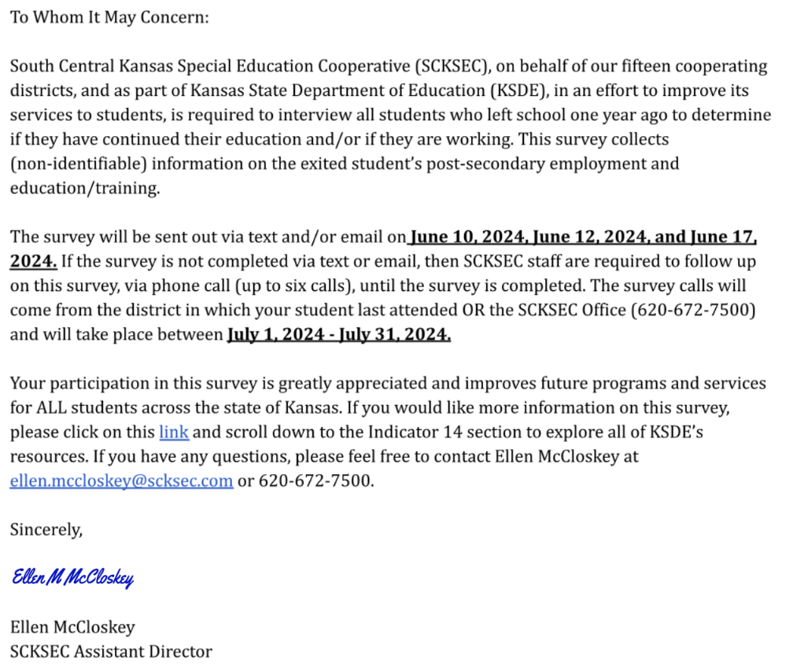
LETTER SENT TO 2022-2023 EXITERS

Slide 8
SCKSEC Interlocal 605
Programs/Practices that increase success after graduation…
Partnering with outside agency support services
Independent Living Centers
Community Development Disability Organizations
Vocational Rehabilitation/Pre-ETS
Collaboration Meeting/Individual review
Sharing information with staff/parents
Mental Health Organizations
Local Businesses
Steering Committee
Event Planning
Funding through community resources

Slide 9
SCKSEC Interlocal 605
Programs/Practices that increase success after graduation…
Events
Disability Mentoring Day
career shadow event
Advocacy Day
college/technical school event
Job-A-Thon
job skill focused event

Slide 10
Topeka USD 501
Topeka Public Schools
Overall enrollment of 11,623 students in the 2023-2024 School Year
Special Education count on December 1, 2023:
Total number of IEPs: 3075
Total number of students on a Gifted IEP: 294
Total number of students with a disability: 2781

Slide 11
Topeka USD 501
How Opting In Improved our Response Rate
2020-2021 Exiters
185 in Census
28 Interviews Completed
Response Rate: 15.14%
2021-2022 Exiters
224 in Census
89 Interviews Completed
Response Rate: 39.73%

Slide 12
Topeka USD 501
Conducting Interviews
Utilized District Staff to make calls
Included a Bi-lingual caller to reach all families
Attempted to contact Each Exiter at least three times

Slide 13
Topeka USD 501
Programs and Practices that assist with PSO
Transition Coordinators in Each High School-meet with families and students all four years
Partnership with Vocational Rehabilitation and Pre-ets
Youth Work Study Program-within district (Custodial, Food Service, Childcare, and Paraprofessionals) and out of district (job sites at: Stormont Vail Hospital, Walgreens, Stone House Animal Hospital, Discovery Center, Milk and Honey Coffee Shop, Let’s Help, Helping Hands Humane Society, Topeka Daycare, and the Topeka Zoo.

Slide 14
Contact Information
Ellen McCloskey, SCKSEC Asst. Director,
ellen.mccloskey@scksec.com , 620-672-7500
Tonya Applegarth, SCKSEC Transition Specialist,
tonya.applegarth@scksec.com, 620-672-7500

Slide 15
Contact Information
Jennifer S. Harrington, Ed.D
jharrington@tps501.org
Andy Ewing, KSDE aewing@ksde.org 785-296-3860

