Slide 1
EQUITY IN IDEA: Digging Into Significant Disproportionality
Steve Backman,
Rachel Wilkinson

Slide 2
Agenda
Defining significant disproportionality
Calculating significant disproportionality
Implications of significant disproportionality
Understanding and conducting root cause analysis
Key differences: significant disproportionality and IDEA equity indicators

Slide 3
What is “significant disproportionality?”
Per 34 C.F.R. § 300.646 of the regulations implementing the Individuals with Disabilities Education Act (IDEA), states must annually collect and examine data to determine whether significant disproportionality based on race or ethnicity is occurring in the state and each local education agency (LEA) with respect to:
the identification of children as children with disabilities, including the identification of children as children with a particular disability;
the placement of children with disabilities in particular educational settings; and
the incidence, duration, and type of disciplinary actions, including suspensions and expulsions.

Slide 4
METHODOLOGY
Calculating Significant Disproportionality

Slide 5
Unpacking Key Terms
Risk – likelihood of a particular outcome (identification, placement, discipline)
Example – LEA Utopia has 30 white students who are identified with an Intellectual Disability (ID). There are 1,000 white students in LEA.
30
1,000
Question: What is the likelihood, or risk, of a white student being identified as ID in LEA Utopia?
÷
=
3.00%
30
1,000
0.03

Slide 6
Unpacking Key Terms (cont.)
Risk Ratio – comparison of two risks
Example – In LEA Utopia, 3% of white students are identified as ID. There are 15 non-white students who are identified as ID. There are 1,500 non-white students in LEA Utopia.
15
1,500
Question: How does the risk of white students identified as ID compare to the risk of all non-white students identified as ID in LEA Utopia?
÷
÷
=
3.00%
15
=
1.00%
0.01
1,500
3.00
Risk – White and ID
White students are 3 times as likely as non-white students to be identified as ID
Risk – Non-white and ID

Slide 7
Unpacking Key Terms (cont.)
Minimum cell and N-sizes
Cell size – minimum number experiencing particular outcome (risk numerator)
Example = 30 white students identified as ID in LEA Utopia
In Kansas, the minimum cell size is 10 students
N-size – minimum number who could experience a particular outcome (risk denominator)
Example = 1,000 white students in LEA Utopia
In Kansas, the minimum n-size is 30 students

Slide 8
Unpacking Key Terms (cont.)
Alternate Risk Ratio – comparison of two risks used when comparison groups do not meet minimum cell and n-size requirements
Example – In LEA Utopia, 3% of white students are identified as ID.
There are 4 non-white students who are identified as ID. There are 1,500 non-white students in LEA.
Cell size = 4, which is less than the minimum cell size of 10
The comparison group becomes state data.
In the state, there are 500 non-white students who are identified as ID. There are 50,000 total non-white students in the state.
4
1,500
Question: How does the risk of white students identified as ID compare to the risk of all non-white students identified as ID in the state?
÷
÷
=
3.00%
500
=
1.00%
0.01
50,000
3.00
White students in LEA Utopia are 3 times as likely as non-white students in the state to be identified as ID
LEA Utopia Risk – White and ID
State Risk – Non-white and ID

Slide 9
At what point is there significant disproportionality?
Significant disproportionality is based on a risk ratio threshold that is set by states.
Identification Risk Ratio Thresholds
All Disabilities | ≥ 3.0
Autism | ≥ 3.0
Emotional Disturbance | ≥ 3.0
Intellectual Disability | ≥ 3.0
Other Health Impairment | ≥ 3.0
Specific Learning Disability | ≥ 3.0
Speech/Language Impairment | ≥ 4.5
Discipline Risk Ratio Thresholds
In-School Suspensions or Expulsions ≤ 10 days | ≥ 3.0
In-School Suspensions or Expulsions > 10 days | ≥ 3.0
Out-of-School Suspensions or Expulsions ≤ 10 days | ≥ 3.0
Out-of-School Suspensions or Expulsions > 10 days | ≥ 3.0
Disciplinary removals in total | ≥ 3.0
Placement Risk Ratio Thresholds
In Regular Education Setting < 40% of the Day | ≥ 3.0
In separate schools and residential facilities | ≥ 3.0

Slide 10
How many years of data are considered for significant disproportionality?
In Kansas, LEAs must exceed thresholds in the same categories and racial/ethnic groups for three consecutive years to be identified with significant disproportionality.
Example 1: LEA Utopia
Example 2: LEA Excel
School Year | Category | Racial/Ethnic Group | Risk Ratio
2020-21 | Identification of ID | White | 4.5
2021-22 | Identification of ID | White | 3.8
2022-23 | Identification of ID | White | 4.0
LEA Utopia meets criteria for significant disproportionality
School Year | Category | Racial/Ethnic Group | Risk Ratio
2020-21 | Identification of ID | White | 3.4
2021-22 | Identification of ID | White / Hispanic | 2.9 / 3.7
2022-23 | Identification of ID | White | 3.1
LEA Excel does not meet criteria for significant disproportionality

Slide 11
What if my data improves over time?
In Kansas, if an LEA shows reasonable progress ( >.50) per year in lowering the risk ratio, KSDE may not identify the LEA with significant disproportionality.
Example 1: LEA Utopia
Example 2: LEA Excel
School Year | Category | Racial/Ethnic Group | Risk Ratio
2020-21 | Identification of ID | White | 5.0
2021-22 | Identification of ID | White | 4.25
2022-23 | Identification of ID | White | 3.4
LEA Utopia shows reasonable progress, KSDE may not identify significant disproportionality
-0.75
-0.85
School Year | Category | Racial/Ethnic Group | Risk Ratio
2020-21 | Identification of ID | White | 4.2
2021-22 | Identification of ID | White | 3.9
2022-23 | Identification of ID | White | 3.3
LEA Excel does not show reasonable progress
-0.30
-0.60

Slide 12
Cooperatives and Interlocals
The regulations implementing IDEA provide the definition of local education agency:
"other public authority legally constituted within a State for either administrative control or direction of, or to perform a service function for, public elementary or secondary schools in a city, county, township, school district, or other political subdivision of a State, or for a combination of school districts or counties as are recognized in a State as an administrative agency for its public elementary schools or secondary schools."
Districts entered into interlocal cooperation agreements and cooperative agreements are local education agencies
KSDE calculates significant disproportionality, as required, at the local education agency level, adding together all member district data to conduct the analysis

Slide 13
Where can I find my LEA’s Significant Disproportionality reports?
LEA Significant Disproportionality data reports are available on the Kansas APR Reports under the Sig Dis tab. KSDE strongly encourages all LEAs to review this data whether the LEA has been identified for significant disproportionality or not.
The KS APR Report Sig Dis User Guide is located under the Sig Dis tab on the Kansas APR Reports website and was created to assist LEAs in accessing this data and utilizing specific report features and is available under the Sig Dis reports tab.

Slide 14
IMPLICATIONS
Implications of Significant Disproportionality

Slide 15
What happens if my LEA is identified as having significant disproportionality?
Review and, if appropriate, revise its policies, practices, and procedures used in identification or placement in particular education settings, and/or disciplinary removals, to ensure that the policies, practices, and procedures comply with the requirements of the IDEA;
Complete a root cause analysis to identify contributing factors to significant disproportionality;
Publicly report on the revision of those policies, practices, and procedures consistent with the requirements of the Family Educational Rights and Privacy Act, its implementing regulations in 34 C.F.R. part 99, and Section 618(b)(1) of IDEA; and
Reserve 15% of its IDEA Part B Section 611 and 619 allocations for comprehensive coordinated early intervening services (CCEIS) to address factors contributing to the significant disproportionality.

Slide 16
What is meant by policies, procedures, and practices?
Policies – Standard or mandate by governing body (e.g., local board)
Example – approved local board discipline policies
Non-example – Kansas Special Education Process Handbook
Procedures – Written documentation of how policies should be implemented
Example – written manifestation determination procedures
Non-example – Kansas Special Education Process Handbook
Practices – Evidence of implementation of policies and procedures
Example – review of documentation from a student’s manifestation determination meeting

Slide 17
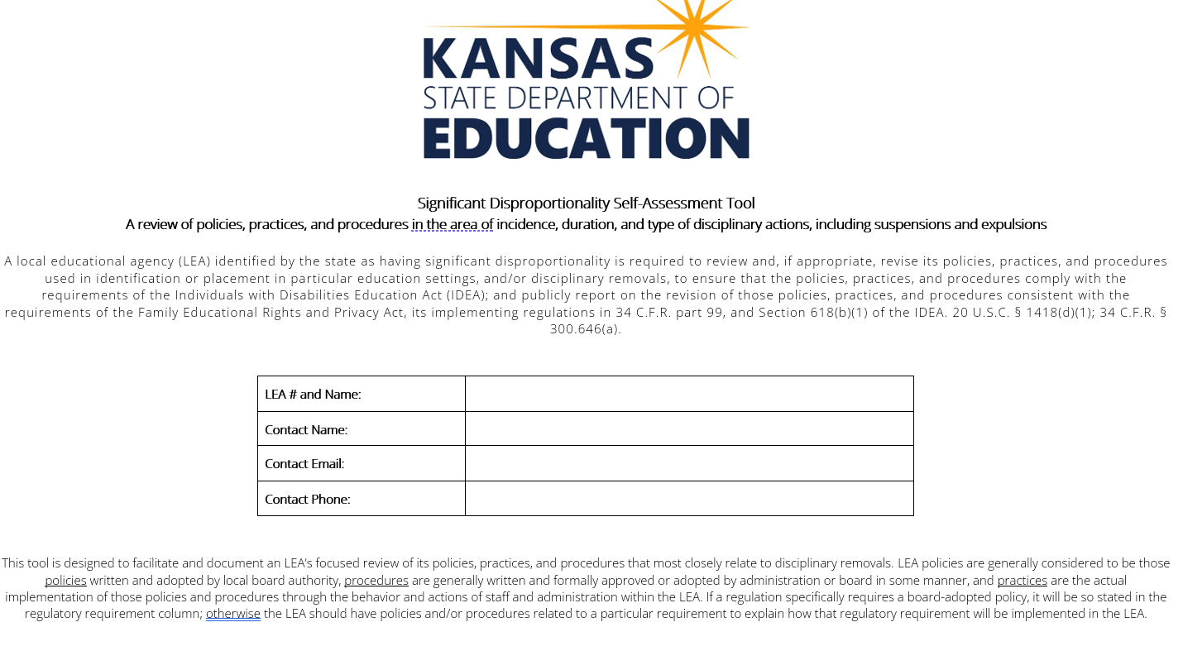
Significant Disproportionality Self-Assessment Tool
To review policies, procedures, and practices, KSDE requires LEAs to complete a significant disproportionality self-assessment tool

Slide 18
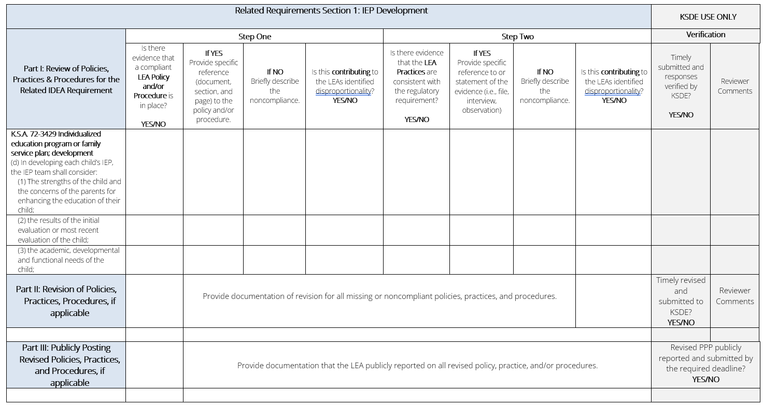
Related Requirements

Slide 19
Section 1: IEP Development

Slide 20
Determining Contributing Factors
The results from the self-assessment should be part of the data used in root cause analysis (more to come!)
The contributing factors identified through the self-assessment and root cause analysis are the areas the LEA should focus on and allocate CCEIS funds toward in order to address and resolve issues resulting in significant disproportionality.

Slide 21
ROOT CAUSE ANALYSIS
Understanding and Conducting Root Cause Analysis

Slide 22
What is root cause analysis?
There are many definitions and no “right” answer, but in short:
Root cause analysis is a problem-solving method for uncovering the root or “core” causes* of a problem in order to identify appropriate solutions.
*(within your ability to change)

Slide 23
Why do a root cause analysis?
Identifies a lever of change – “if I correct this thing/these things, I will address the contributing causes to the issue”
Supports systemic thinking rather than reactive behavior
Prevents wasted time and resource to address an issue or perceived contributing factor that may not actually be the root of the problem
Part of a continuous improvement process
Leads to a concrete, thoughtful, data-based rationale for selecting strategies that address and resolve contributing factors

Slide 24
Considerations for Root Cause Analysis
Ensure there is a diverse team at the table who can meaningfully contribute to the area of concern
Special education and regular education teachers
Support staff (e.g., school psychologists, speech-language pathologists, counselors)
Families and/or students of the impacted group(s)
Community members representing the impacted group(s)
Leaders with the ability to influence change

Slide 25
Considerations for Root Cause Analysis (cont.)
Prepare in advance for meetings and discussions to ensure data are readily available and accessible
Have data disaggregated in ways that will help further investigate areas of concern and unearth contributing factors (e.g., data at the school level, teacher level, grade level, for racial/ethnic groups, etc.)
Identify most effective ways to provide data (e.g., charts, graphs, other data visualizations)

Slide 26
What are some root cause analysis methods?
There is no “right” root cause analysis method
Methods can be modified, combined, or restructured in any way that is best for the team to truly dig into the root causes and factors contributing to issues
Some sample methods include
Fishbone Diagram
The Five Whys

Slide 27
Fishbone Diagram
This process allows you to identify areas of analysis and detail different factors under these areas to pinpoint what is causing the problem.
Cause
Effect
Ex.: Curriculum
Ex.: Instruction
Problem
Ex.: Teacher Prep
Ex.: Processes

Slide 28
The Five Whys
This is an iterative process of identifying a problem of practice and asking “why” five times to dig more deeply into why a problem exists.
Why
Why
Why
Why
Why
African American HS students are suspended for significant numbers of days due to “disrespectful behavior”
Example: LEA Utopia has significant disproportionality in the area of African American students with disabilities with OSS/Expulsions >10 days
Principal at HS issues mandatory 5-day suspension for “disrespectful behavior”
Principal is emphasizing the need for respectful behavior due to high number of office referrals from teachers
No clear definition of “disrespectful behavior” and individual bias is factoring into decision-making
Teachers interpret disrespect in a variety ways and are not trained to manage classroom behavior

Slide 29
Key Takeaways
Root cause analysis can be done any time, whether or not your LEA has significant disproportionality.
It can be great to conduct if your LEA is at risk of being identified to prevent identification.
You can determine the best way to conduct root cause analysis for you and the team you’re bringing together.
Root cause analysis is an effective way to find the solution(s) to systemic issues that will resolve the contributing causes to the issues or challenges identified.

Slide 30
IDEA EQUITY DATA
Significant Disproportionality and Other Equity Data

Slide 31
Beyond Significant Disproportionality: Other Equity Data
Indicator 4 – significant discrepancy in the long-term suspensions/expulsions of students with disabilities
4A – all students with disabilities
4B – students with disabilities by racial/ethnic group with policies, procedures, and practices that are noncompliant
Indicators 9 and 10 – disproportionate representation of students with disabilities in racial/ethnic groups that is the result of inappropriate identification
9 – all students with disabilities
10 – students with disabilities in particular disability categories

Slide 32
Comparisons of Significant Disproportionality and Other Equity Data
 | Significant Disproportionality | Indicator 4 | Indicators 9 and 10
Regulation | 20 U.S.C. 1418(d) and 34 CFR §300.646–647 | 20 U.S.C. 1416(a)(3)(A); 1412(a)(22) | 20 U.S.C. 1416(a)(3)(c)
Data | Identification of students with disabilities as a whole and in particular categories; placement; discipline (ISS, OSS, expulsions) 10 days or less more than 10 days, and total incidents | OSS and expulsions greater than 10 days | Identification of students with disabilities as a whole and in particular categories
Student Age | Identification = 3-21 years old Placement = 5 years old in KG through age 21 Discipline = 3-21 years old | 3-21 years old | 5 years old in KG through age 21
Comparison Group | Students with disabilities within the LEA | In Kansas: Students with disabilities among districts in the state | Students with disabilities within the district
Calculation Method | Risk ratio and alternate risk ratio | In Kansas: Rate of suspensions/expulsions in an LEA | In Kansas: Risk ratio and alternate risk ratio

Slide 33
Comparisons of Significant Disproportionality and Other Equity Data (cont.)
 | Significant Disproportionality | Indicator 4 | Indicators 9 and 10
Minimum cell and n-size | Based on stakeholder input, but presumptively reasonable minimums are 10 students for cell size and 30 students for n-size | In Kansas: at least one student with a long-term suspension/expulsion (cell) and 30 students with disabilities (n) | In Kansas: 10 students in category and racial/ethnic group (cell) and 30 students in the racial/ethnic group (n)
Reasonable progress | Can be used based on stakeholder input | Not used | Not used
Implications | Review of policies, practices, and procedures. Use 15% of IDEA funds for comprehensive coordinated early intervening services (CCEIS), which targets the root cause of the disproportionality | Review of policies, practices, and procedures. If they are determined as contributing to the disproportionate representation and do not comply with IDEA, engage in the correction of noncompliance | Review of whether disproportionate representation is the result of inappropriate identification practices. If noncompliance is determined engage in correction of noncompliance

Slide 34
RESOURCES

Slide 35
Significant Disproportionality Resources
Kansas Integrated Accountability System (KIAS)
Significant Disproportionality FAQ
Significant Disproportionality Police, Practice, and Procedures Self-Assessment (Identification, Placement, Discipline)
Kansas APR reports (information under Sig Dis tab)

Slide 36
Please contact us with any questions.
Steve Backman 785-296-2267 sbackman@ksde.org
Christy Weiler (CCEIS Funding) 785-296-1712
cweiler@ksde.org
Kelly Steele 785-296-2050 ksteele@ksde.org

