Slide 1
DLM training
Notes:
Districts may choose to use these PPT slides for trainings they do with staff. For districts identified for target TA or intensive TA, this training is one of the requirements.

Slide 2
Objectives:
To understand the concept of Least Dangerous Assumption and the role it plays in Assessment Decisions
To understand the regulations around Alternate Assessments based on Alternate Academic Achievement Standards (AA-AAAS) and the 1% Threshold placed on the State
To understand how Kansas monitors LEAs for the 1% threshold
To understand who takes the Dynamic Learning Maps (DLM) Alternate Assessment and the process for determining eligibility for the Alternate Assessment
.

Slide 3
Least Dangerous Assumption
Theory of Presuming Competence

Slide 4
Least Dangerous Assumption
Theory of Presuming Competence: Least Dangerous Assumption
“…in the absence of conclusive data, educational decisions ought to be based on assumptions which, if incorrect, will have the least dangerous effect on the likelihood that students will be able to function independently as adults. Furthermore, we should assume that poor performance is due to instructional inadequacy rather than to student deficits.”
– Anne Donnellan, 1984 as quoted by Cheryl Jorgensen, 2005
Notes:
If a student does not do well, the quality of the instruction should be questioned before the student’s ability to learn. When working with students with significant disabilities one should assume that they are competent and able to learn, because to do otherwise would result in harm (fewer educational opportunities, inferior literacy instruction, segregated education, and few choices as an adult)
Least Dangerous Assumption plays a role in least restrictive environment, assessment considerations, and assistive technology considerations
When we assume students with disabilities are not competent and able to learn from the general education curriculum, they often are not included in the general education classroom, people talk to them as if they are a much younger child, they are not supported to engage in social activities with same-age peers, and post-secondary education is geared toward lower-skilled jobs or workshops. Low expectations result in less focus on literacy or content learning. When we change our paradigm we promote student learning, inclusion, achievement, and quality of life now and in the future.

Slide 5
Least Dangerous Assumption
TIES Center: Tip #6 Using the Least Dangerous Assumption
in Educational Decisions
Notes:
Parent and educator interview on least dangerous assumption from the link (2 min total)

Slide 6
Kim
 | Scenario One | Scenario Two
Assumptions | She isn’t smart, sub-average intelligence and ability to learn | Treat her as smart, distrust validity of test results due to lack of communication and movement difficulties
Educational setting | Functional academics, speak in language more appropriate for younger child, functional skills, with other students with significant disabilities | Variety of methods to teach her to read, talk to her like any other teenager, enrolled in general academic classes, natural opportunities to teach functional skills
Communication support | Vocabulary and supports correspond to assessment of intellectual disabilities | Communication system includes words and concepts relating to current events, love, relationships, and her future
Friendships and dreams | Interactions with other students with disabilities, plan for moving into a group home and attend day program | Encourage friendships, participate in activities with classmates, postsecondary education addressed
Notes:
Think about the different approaches these 2 teams took. Next we will talk about the results of a brain scan that was performed on Kim.

Slide 7
Kim cont’d
 | Scenario One | Scenario Two
Brain scan results | IQ of 100 | IQ of 40
Has any harm been done? | Lost opportunity to teach her things she could have learned, missed social connections, missed high school experiences, low self-esteem, fewer possibilities for future career or post secondary education | Most say nothing has been lost, her education program offered her opportunities to develop life-long interest, to make friends, to be part of the social life of the school, to be part of the community after graduation, learned and generalized functional skills within the natural context of the day.
Modified from Cheryl Jorgensen article The Least Dangerous Assumption A Challenge to Create a New Paradigm
Notes:
This is an example of the effect of using the least dangerous assumption.

Slide 8
3 Principles of the least dangerous assumption
If you are going to fail, fail because you believed in the student not because you placed an artificial limit on the student.
https://www.youtube.com/watch?v=1rIwA7C-vc8
Notes:
https://www.youtube.com/watch?v=1rIwA7C-vc8
Points to Ponder
Do all people have different talents and skills?
Is intelligence measured accurately and reliably enough to base students’ educational programs and future goals on test results?
Do children learn best when they feel valued, when people hold high expectations for them, and when they are taught and supported well?
If you are going to fail, fail because you believed in the student not because you placed an artificial limit on the student.
As educators we need to promote: presumption of competence and potential, have a growth mindset, and believe in the power of “YET”

Slide 9
The least dangerous assumption is to have high expectations for all students.
What if we assume students CAN learn, so we give them every opportunity, and it turns out the CAN”T?
What if we assume students CAN”T learn, so we don’t give them every opportunity, and it turns out they CAN?
VS
Notes:
Think about the example I gave for Kim

Slide 10
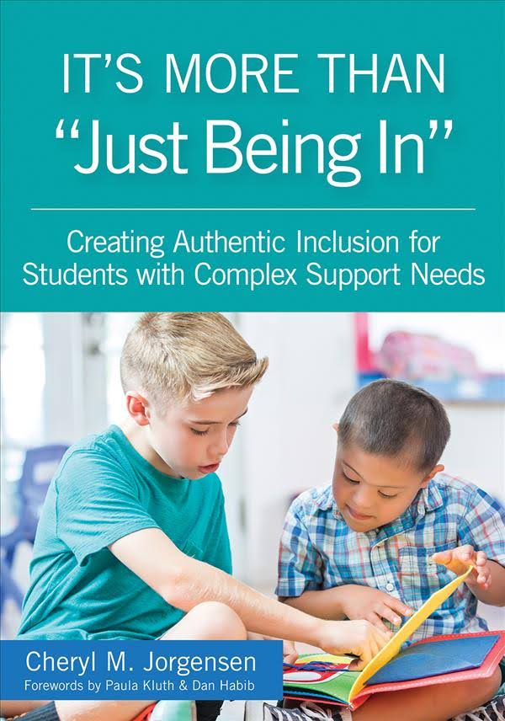
Flawed assumptions
Intelligence is something that can be reliably measured.
Students with intellectual disabilities cannot learn general education academic content……so there’s no benefit to being in general education classes.
The choice between a student being in general education or getting their needs met is an either/or situation.
Jorgenson, C.M.(2018). “It’s More Than ‘Just Being In’: Creating Authentic Inclusion for Students with Complex Support Needs.”
Notes:
In Cheryl Jorgenson’s book It’s more than “Just being In” she provides 3 flawed assumptions

Slide 11
Improving Student Outcomes
Presuming
Competence
Least
Dangerous
Assumption
High
Expectations
Notes:
“The Case for Presuming Competence in Students with Significant Disabilities” describes three elements that work together to improve outcomes for all students, especially those with more complex needs.
Presuming competence means we assume that students are capable, and that we need to work to find ways to allow their capabilities to emerge.
High expectations means we don’t settle for the status quo when it comes to our students’ learning; instead we are intentional about setting ambitious yet reasonable goals for our students to work toward
Least dangerous assumption means making decisions about student learning that will ultimately cause the least harm to their ability to function independently as an adult.
Presuming competence is nothing less than a Hippocratic oath for educators. “First, do no harm” Douglas Biklen

Slide 12
Questions to Ponder
Notes:
WHO: Students with significant intellectual disabilities
WHAT: Meaningful access to academics, high expectations
WHEN: Lesson planning, instruction, IEP goals, assessment
WHERE: Least restrictive environment*
WHY: Least dangerous assumption
HOW: Focus on balance, and share responsibility

Slide 13
Alternate Assessment based on Alternate Academic Achievement Standards
1% Threshold
Notes:
When we talk about the Alternate Assessment, we are referring to the Dynamic Learning Maps (DLM) The DLM is only intended for those students with a most significant cognitive disability. These are the students that are going to continue to need supports as adults. Many of these students are identified very young. Some are also untestable using standard IQ tests.

Slide 14
Every Student Succeeds Act (ESSA) - Enacted in 2016
Revision of the Elementary & Secondary Education Act of 1965
34 CFR 200.6 – Inclusion for all students
1.0 percent threshold is on the State
Not prohibit an LEA from assessing more than 1.0 percent of its assessed students in any subject for which assessments are administered under 34 CFR § 200.2(a)(1) with an alternate assessment aligned with alternate academic achievement standards.)
Require LEA must submit information justifying the need of the LEA to assess more than 1.0 percent of its assessed students in any such subject with an alternate assessment (Due to assessments being waived for the 2019-2020 school year, there will not be alternate assessment justifications this year)
Provide appropriate oversight , as determined by the State, of an LEA that is required to submit information to the State; and
Make the information submitted by an LEA publicly available, provided that such information does not reveal personally identifiable information about an individual student. http://www.ksde.org/Default.aspx?tabid=567
Notes:
34 CFR 200.6 Inclusion for all students indicates that a state must include students with disabilities in all assessments with appropriate accommodations. It permits students with the most significant cognitive disabilities to take an alternate assessment based on alternate academic achievement standards.
The 1.0 is a State threshold,
States can not prohibit an LEA from assessing more than 1.0% of its assessed students on the alternate assessment
Justifications and assurances are required by all districts that test over 1.0% of their students using an alternate assessment on the Dynamic Learning Maps.
KSDE must provide oversight of districts. Oversite will include sharing red flag data with districts, DLM test observations. and technical assistance provided to districts identified due to number or percentage of students taking the DLM, trends in the number and percentage of students taking the DLM over 3 years, and red flag data.

Slide 15
1.0% Threshold Waiver

Slide 16
Statewide 1%
All Students -100 students
Students with Disabilities – 15 Students
Students with Significant Cognitive Disabilities - 3
Students with the Most Sig Cog Dis
1 student
Notes:
STATEWIDE - 1% - This includes all students in the state including students in residential facilities.
blue oval represents eligibility categories ID, Autism, MD, perhaps OHI.
red oval represents only those students with a most significant cognitive disability.
As you can see from this graphic there will be students with significant cognitive disabilities in the blue, students with ID or Autism, who will NOT meet the criteria for the alternate assessment.
Some districts won’t have any students who have the most significant cognitive disabilities.

Slide 17
Requirements of the waiver extension
Have assessed at least 95 percent of all students enrolled and 95 percent of children with disabilities in the previous year in the grades assessed in that subject area.
Demonstrate that it sought and collected public comment on the State’s complete waiver extension request.
Provide updated information regarding each requirement in 34 CFR § 200.6(c)(4)(i)-(iv). Specifically, the State must provide the overall assessment participation rates for all students enrolled and for all students with disabilities in the grades assessed for each subject.
Assure that it verified that each LEA that the State anticipates will assess more than 1.0 percent of its assessed students in any subject for which assessments are administered in SY 2023-24 using an AA-AAAS followed each of the State’s guidelines and will address any disproportionality in the percentage of students in any subgroup taking an AA-AAAS.
Report on the progress of its plan and timeline submitted last year and additional actions the State plans for SY, including milestones previously achieved. The Department expects States to describe the plan for SY, and report on the work performed on the plan that was submitted for SY. This progress report should clearly demonstrate and explain how the State’s plan has evolved and been improved from the prior year’s waiver request. The Department strongly recommends that the plan and report of progress be posted on the State’s website.
Have reduced the percentage of students taking an AA-AAAS in a content area to be eligible to receive an extension of a waiver of the 1.0 percent cap for that content area.
Notes:
If a state anticipates testing over 1.0% of students in the State on the alternate assessment based on alternate academic achievement standards in any subject, they may submit a waiver to the Office of Elementary and Secondary Education.

Slide 18
History
Kansas had consistently tested just over 1.0 percent of our students on the Alternate Assessment based on Alternate Academic Achievement Standards (AA-AAAS) prior to 2020..
June 2019 – KSDE received an letter from the DOE requiring Kansas to submit a plan for coming into compliance with the 1.0 threshold. Plan was submitted July 24, 2019
KSDE submitted an AA-AAAS 1% threshold waiver request on August 22, 2019 – waiver was approved January 2, 2020
KSDE submitted an AA-AAAS 1% threshold waiver extension on June 2, 2020 – waiver extension was approved on August 7, 2020
KSDE submitted an AA-AAAS 1% threshold waiver extension on June 14, 2021- waiver was approved on January 27, 2022
KSDE has not submitted an 1% waiver extension since 2021 and has remained under the 1% threshold.

Slide 19
1% Monitoring

Slide 20
Oversight of LEAs that test more than 1.0 percent of students with AA-AAAS
DLM justifications and assurances– customized data display template
Three years of data on number and percentage of students taking the AA-AAAS per LEA
Red-Flag data based on DLM First Contact Survey
DLM test observations districts over 1%, high rates red flags, high number of short test duration testlets.
On-site TA – districts who request or have high rates of potential red flags

Slide 21
DLM Justifications
Notes:
DLM justifications and assurances are required by every district that tested over 1.0% of students in the district on the DLM in any subject.

Slide 22
DLM justifications
Data we provide
Number and percentage of students per subject
Disability Categories taking the DLM
Participation by Subject Subgroup – disproportionality using risk ratio
Percentage of students performing at target or advanced on the DLM by subject
Requirements of the district
Explain how they will address any disproportionality
Narrative that includes the data types and processes that the IEP teams utilize to qualify students for the AA
Districts next steps to ensure that annually the appropriate test is administered to each student
Whether the district needs additional training
Whether the district anticipates testing over 1% during the current school year
DLM Assurances

Slide 23
DLM Assurances

Slide 24
DLM Red Flags
DLM Red Flags Fact Sheet (PDF)

Slide 25
Red Flags
Based on the First Contact Survey
WHAT IS A RED FLAG?
KSDE analyzes variables from the DLM First Contact survey to assist districts in making sure only those students with the most significant cognitive disability are taking the alternate assessment. A red flag is a data point that stands out or looks questionable when thinking about the most significant cognitive disability. Some students identified with red flags from the first contact survey may be more appropriately challenged by taking the general assessment with accommodations. Other students may still be appropriate to take an alternate assessment. Only students with more than one red flag are used in the total red flag count for the district. IEP teams should review the red flags to ensure the first contact survey is accurate.
VARIABLES ANALYZED
1. Primary disability
2. Instructional reading level with comprehension
3. Computation skills
4. Writing skills

Slide 26
Probing Questions
Primary Disability
Is the primary disability marked on the First Contact Survey correct? •
Is this the most appropriate primary disability for the student? We know students with a most significant cognitive disability continue to need supports in adult life. Are we limiting the available supports for the student after graduation?
Instructional Reading Level with Comprehension
If a 3rd-grade student can read with comprehension at a primer level in the fall, is this a most significant cognitive disability?
If a 4th student can read with comprehension at a 1st-grade level in the fall, is this a most significant cognitive disability?
If a student can read with comprehension at a 2nd or 3rd-grade or above level, is this a most significant cognitive disability?

Slide 27
Probing Questions (continued)
Computation skills
If a 3rd – 4th-grade student can add and subtract consistently (at least 80% of the time) using numerals, is this a most significant cognitive disability?
If a student can consistently multiply and divide (at least 80% of the time) using numerals, is this a most significant cognitive disability?
Writing Skills
If a 3rd -4th-grade student can write words, phrases, or sentences using mostly correct spelling (with or without word prediction) without copying, is this a most significant cognitive disability?
If a student can write a paragraph-length text (or longer) using mostly correct spelling (with or without word prediction) without copying, is this a most significant cognitive disability?
Performance Level
Districts should look at this data even though KSDE is not including it in the red flags
Notes:
Performance

Slide 28
Tiered System of Technical Support

Slide 29
3 Levels of Technical Support
Universal
Online training and tools available for all districts; justifications and assurances required
Targeted Technical Assistance
Required DLM training, review of what the district’s data shows; student information sheets completed and submitted; development of a plan, possible DLM test observations; justifications and assurances required
Intensive Technical Assistance
Requirements of Targeted TA plus onsite folder review
Notes:
Initiated in 2020, due to COVID we were not able to complete DLM test observations. TA providers from the Technical Assistance Support Network were the leads for the targeted districts. KSDE Education Program Consultants working with the 1% were the leads for the intensive districts.
During the fall of 2020 10 districts were assigned targeted technical assistance and 9 districts were assigned intensive TA. We also had 5 districts that requested an extension to the requirements and continued into the next year.
During 2021-2022 KSDE identified 5 new districts for Targeted TA and 3 new districts for intensive TA while continue to work with the 5 districts that requested an extension.
During 2022-2023 KSDE identified 3 districts for intensive TA and 2 districts for targeted TA. DLM test observations were completed in all 5 districts. I also reached out by phone to directors of special education to discuss red flags identified for 14 students

Slide 30
DLM test observations - Purpose
Observations provide anonymous information about how DLM testlets are delivered to help the consortium evaluate the process of administering assessments and to inform improvements. Data from test administration observations also provide evidence of validity for the assessment system.
Intended to be non-judgmental – its not a gotcha
Provides opportunities to visit with the teachers administering the assessment and answer any questions they have. It also allows times for me to share information and resources they may not be familiar with.
Beginning in the fall 2023 – DLM test observations will include observing those teachers and students who had a high percentage of short duration testing
Purpose is to assist teachers in engaging the students in order to get more reliable and useful data on what the student knows and can do.
DLM research team has determined the amount of time that is not reasonable to complete a DLM testlet
ELA – 60 seconds or less
Math – 30 seconds or less
Science – 30 seconds or less
This is a testing irregularity that needs to be monitored and addressed by districts.
Notes:
Completed through Kite Collector
DLM researchers have determined the minimum amount of time that a testlet can be completed in each subject.

Slide 31
IEP File review: alternate assessment participation monitoring – Criteria 1 & 2
Notes:
This monitoring was developed before COVID, but due to not being able to be in the buildings we were not able to use it until this year.
Great opportunity to look through files with an administrator to help them understand what we are looking for. I was able to give suggestions and recommendations to the districts.

Slide 32
IEP File review: alternate assessment participation monitoring – Criteria 3-4

Slide 33
IEP File review: alternate assessment participation monitoring - Scoring

Slide 34
Dynamic Learning Maps (DLM)
Participation Guidelines
Notes:
Before a team decides to consider moving a student to the alternate assessment the IEP team should assume the student can learn grade level academic content and they should discuss what accommodations a student might need to assist them in learning grade level content.

Slide 35
Who are students with the most significant cognitive disability?
Notes:
Start at :42
6 minutes long

Slide 36
KSDE DLM Participation Guidelines- updated
Notes:
The DLM is intended for students with the most significant cognitive disability in the state.
Make sure staff are using the updated participation guidelines – these were updated in March 2021. The IEP Team need to also make sure they are not qualifying students based on one of the 14 not allowable considerations. The DLM participation guidelines should be completed yearly. I recommend that IEP teams begin looking at this at the beginning of the school year. If a student is no longer eligible for the DLM they need to be removed, preferably before the fall test window opens on Sept 12. If an IEP team feels a student will need to be taking the DLM for the first time, the IEP team needs to go through the participation guidelines in the fall prior to the test window opening on Sept 12 due to the DLM having a required fall and spring test window. It is very important that students participate in both the fall and spring test windows.

Slide 37
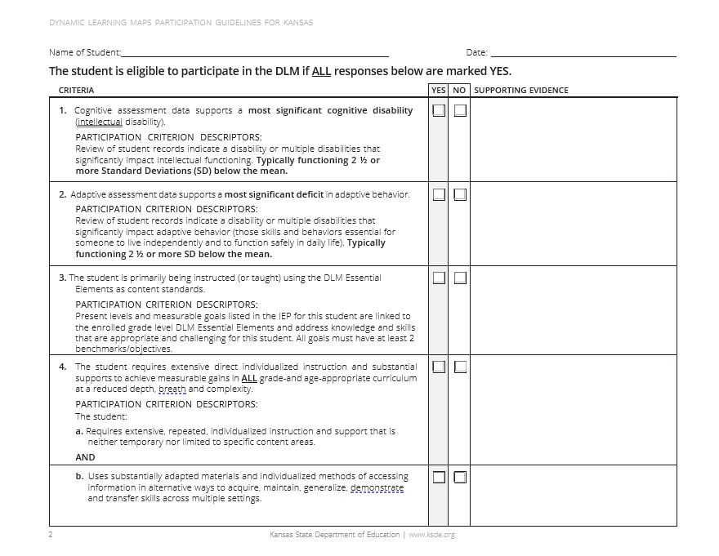
KSDE DLM Participation Guidelines- pg 2
Notes:
The response to all questions in the table on the participation guidelines must be yes, before the student takes the DLM. The participation guidelines should be discussed and included with the IEP. KSDE added a column for supporting evidence. This should assist IEP teams in making sure they have evidence to support the decision for taking the alternate assessment. The supporting evidence will also assist districts who are receiving 1% technical assistance in completing their data dive with KSDE.
Please note that on criteria 1 and 2, the criteria asks for assessment data that supports a most significant cognitive disability and a most significant deficit in adaptive behavior.

Slide 38
Review of the eligibility criteria #1
Cognitive assessment data supports a most significant cognitive disability (intellectual disability).
PARTICIPATION CRITERION DESCRIPTORS:
Review of student records indicate a disability or multiple disabilities that significantly
impact intellectual functioning. Typically functioning 2 ½ or more Standard
Deviations (SD) below the mean.
Student must have a deficit in the student’s ability to plan, comprehend, and reason
While a student with only a specific learning disability, speech impairment, or emotional disability may have significant academic challenges, he or she has the intellectual potential to reach grade-level expectations. The description of specific learning disability, speech impairment, and emotional disability and the definition of significant cognitive disability present conflicting information.
Notes:
Significantly below the mean – 2.5 or more SD below the mean. A large number of students with a most significant cognitive disability are not able to achieve an IQ score due to being untestable.

Slide 39
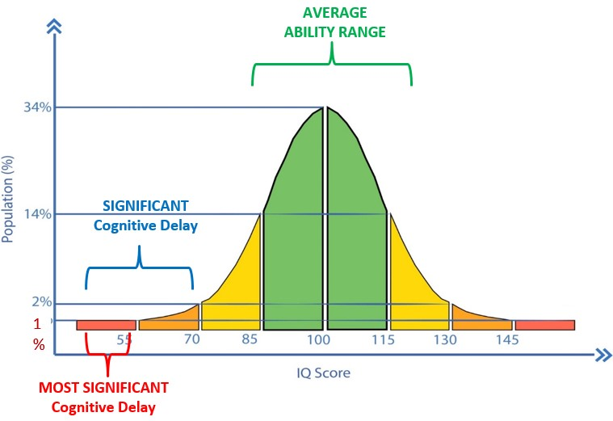
Student Eligibility
Most Significant Cognitive Disability = typically 2 ½ SD or more below the mean

Slide 40
Tool B: Intellectual Functioning Tool
The Kansas criteria to participate in the DLM is: the student has a most significant cognitive disability (defined as typically functioning 2 ½ or more standard deviations below the mean).
It may be more helpful for the IEP team to consider a continuum of intellectual functioning as shown in the tool.
No one characteristic should solely determine whether intellectual functioning is at a level that suggests the AA-AAAS is the appropriate assessment
Notes:
Tools B in the IEP Team Resource is the Intellectual Functioning Tool. The Kansas criteria to participate in the DLM is: the student has a most significant cognitive disability (defined as typically functioning 2 ½ or more SD below the mean). We encourage teams to consider a continuum of intellectual functioning, rather than looking at one characteristic to determine whether intellectual functioning is at a level to suggest participation in an alternate assessment. It was designed as a rubric to assist teams in identifying those students with the most significant limitations.
Each rubric has four levels, moving from ”Not Limited” on the left to “Most Significant” in the far right column. Teams should circle the cell in each row that most closely matches the student’s measured intellectual functioning. There may be variance as to which column is marked for each row. This is to be expected because students can vary in their skill levels, or exhibit splinter skills impacting their intellectual functioning. Teams should determine which column reflects the preponderance of the data, but only those students who have most of the ratings in the “most significant” column should be considered as appropriate for participation in the Alternate Assessment. We don’t want teams to feel that they must administer new testing to obtain an IQ score to determine eligibility for the alternate assessment. Intellectual or cognitive assessment results, because of their specific numeric link to the Kansas participation criteria, should be weighed most heavily if they are available. The last 3 rows of the intellectual functioning tool are useful when standardized assessments are not appropriate or results are not available.

Slide 41
Review of the eligibility criteria #2
Adaptive assessment data supports a most significant deficit in adaptive behavior.
PARTICIPATION CRITERION DESCRIPTORS:
Review of student records indicate a disability or multiple disabilities that significantly impact adaptive behavior (those skills and behaviors essential for someone to live independently and to function safely in daily life). Typically functioning 2 ½ or more SD below the mean.
Limit a student’s ability to apply social and practical skills such as personal care, social problem-solving skills, dressing and eating, using money, and other functional skills across life domains
It is unlikely to see these deficits in a student with a high incidence disability only, such as a specific learning disability, speech impairment, or emotional disability
Notes:
2.5 or more SD below the mean If a student does not have significant deficits in adaptive behavior, they are not eligible to take the DLM.

Slide 42
Behavior: What’s the difference?
Maladaptive Behaviors
Adaptive Behaviors
(Life Skills)
A collection of skills people use to function in everyday life.
Examples:
Ritualistic behaviors
Self-injurious behaviors
Aggressive behaviors
Non-Attentive behaviors
Attention-seeking behaviors
Addictive behaviors
Behaviors which inhibit a person’s ability to adjust to different situations.
Examples:
Personal care skills
Independent living skills
Social skills
Communication
Self-direction
Slide Borrowed with permission from Arkansas Division of Elementary and Secondary Education
Notes:
The factors for students to be eligible to participate in the Alternate Assessment are two pronged. They must have a disability that significantly impacts intellectual functioning and an adaptive behavior deficit. The question then becomes, what is an adaptive behavior.
Adaptive behaviors are skills required to function in life, while maladaptive behaviors are actions which inhibit a person’s ability to adjust to different situations. The behaviors we are concerned with when determining participation in the alternate assessment are the adaptive behaviors. Can the student cook, manage a budget, do laundry?

Slide 43
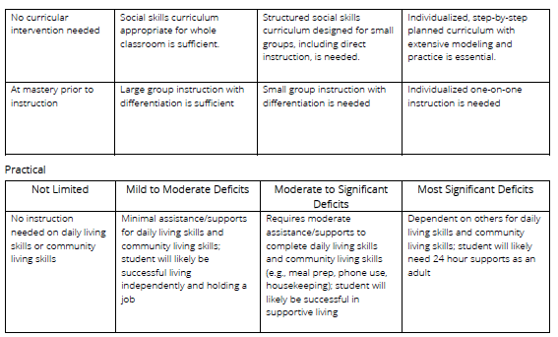
Tool C: Adaptive Functioning Tool
The Kansas criteria to participate in the DLM is: the student has significant deficits in adaptive behavior (defined as typically functioning 2 ½ or more standard deviations below the mean).
It may be more helpful for the IEP team to consider a continuum of adaptive functioning rather than a yes or no response.
No one characteristic or rating should solely determine whether adaptive functioning is at a level that suggests the AA-AAAS is the appropriate assessment.
Notes:
Tool C is the adaptive functioning tool. It was designed as a rubric to assist teams in identifying those students with the most significant limitations in adaptive behavior. The Kansas criteria to participate in an alternate assessment is: the student has significant deficits in adaptive behavior (defined as typically functioning 2 ½ or more standard deviations below the mean). It may be more helpful for the IEP team to consider a continuum of adaptive functioning rather than a yes or no response. No one characteristic or rating should solely determine whether adaptive functioning is at a level that suggests participation in the alternate assessment.
Each rubric has four levels, moving from ”Not Limited” on the left to “Most Significant” in the far right column. Teams should circle the cell in each row that most closely matches the student’s measured adaptive behavior information. There may be variance as to which column is marked for each row. This is to be expected because students can vary in their skill levels, or exhibit splinter skills impacting their adaptive behavior skills. Teams should determine which column reflects the preponderance of the data, but only those students who have most of the ratings in the “most significant” column should be considered as appropriate for participation in the Alternate Assessment.

Slide 44
Review of the eligibility criteria #3
The student is primarily being instructed or taught using the DLM Essential Elements as content.
PARTICIPATION CRITERION DESCRIPTORS:
Present levels and measurable goals listed in the IEP for this student are linked to the enrolled grade level DLM Essential Elements and address knowledge and skills that are appropriate and challenging for this student.
Teaching that includes hands-on materials, demonstrating concepts along with verbal directions, new tasks broken into small steps, prompting or shaping accurate performance, multiple opportunities and examples, and repeated student practice beyond disabled peers. Usually perform significantly below grade-level proficiency (an elementary student may perform 3 or more grade levels below age appropriate peers, while a high school student may perform 7-9 grade levels below age appropriate peers.
Notes:
Not all students with ID or autism will meet this criteria.
If a 3rd grader is a beginning reader, they probably do not have a most significant cognitive disability. When considering the least dangerous assumption, one could say the student is capable of reading and learning and the student should continue to be exposed to the general education classroom and curriculum because to do otherwise would result in harm. Middle school and high school age students who are able to read with comprehension above the 3rd grade level probably do not have a most significant cognitive disability.

Slide 45
Review of the eligibility criteria #4
The student requires extensive direct individualized instruction and substantial supports to achieve measurable gains in all grade-and age-appropriate curriculum.
a. Requires extensive, repeated, individualized instruction and support that is neither temporary nor limited to specific content areas.
b. Uses substantially adapted materials and individualized methods of accessing information in alternative ways to acquire, maintain, generalize, demonstrate and transfer skills across multiple settings.
IEP goals are both functional and academic in nature.
Instruction appears very different from the instruction of their age-appropriate peers.
Requires daily individualized instruction in every academic area that is on a substantially different level of rigor than peers with disabilities.
Often requires an alternate curriculum, modified tasks, modified requirements, and frequent prompting that differs from his or her peers receiving special education services.
Notes:
Students need to have a most significant cognitive disability that affects all aspects of there life. All content areas and adaptive behavior.
If a student has previously been on the general state assessment (KAP) and achieved a valid test score, they probably do not have a most significant cognitive disability. When reviewing state data we have found students who were previously taking the KAP and received a valid test score (some even scored at a level 2 or 3) but then were moved to the DLM. This is a red flag that the student may not be taking the most appropriate assessment.

Slide 46
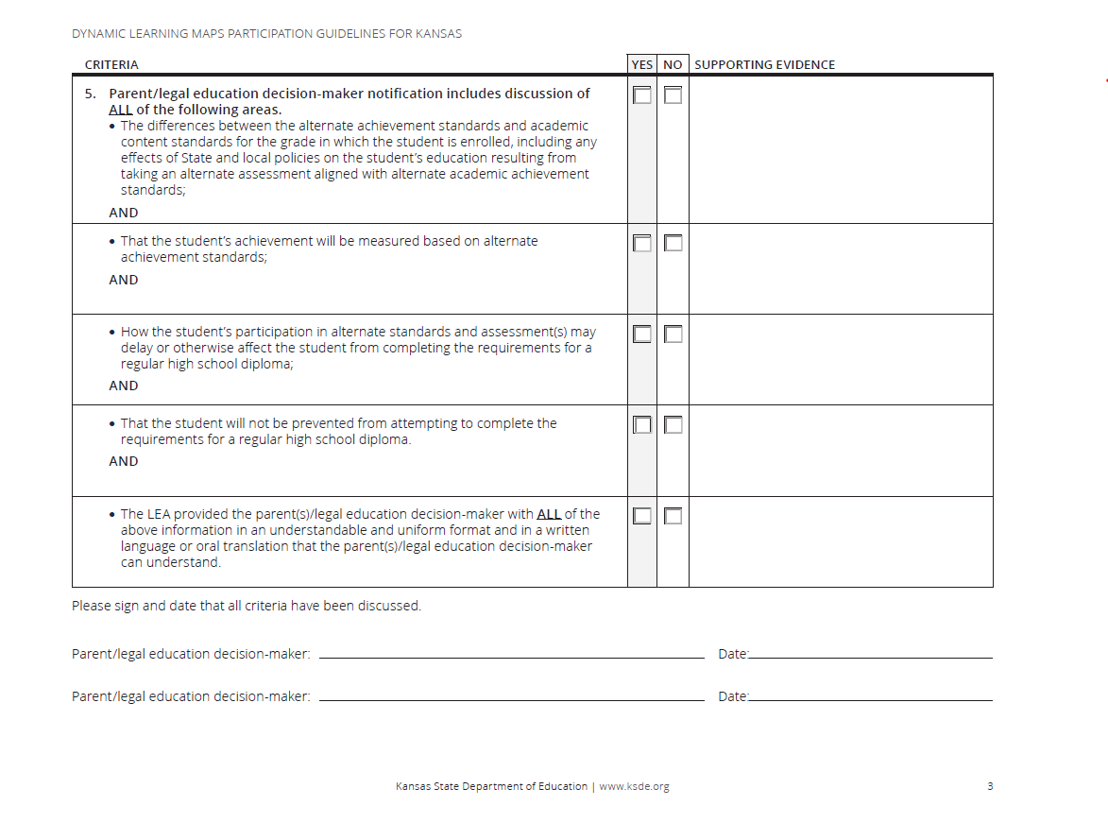
KSDE DLM Participation Guidelines- pg 3
Supporting evidence –
Shared/reviewed the
Alternate Assessment
Notification with
Parents/legal
Education
decision-maker
Notes:
Criteria 5 is new last year. ESSA (Every Student Succeeds Act) also emphasizes the importance of making implications of participation in the AA-AAAS clear to parents, as stated in Individuals with Disabilities Education Act. Two criteria are specifically stated in section 614 of the IDEA. 1. Parents of such students are clearly informed that their child’s academic achievement will be measured based on such alternate standards and 2. how participation in such assessments may delay or otherwise affect the student from completing the requirements for a regular high school diploma.
IEP teams can use the Alternate Assessment Notification (available in English and Spanish) to ensure that these components are met. The supporting evidence would be shared/reviewed the Alternate Assessment Notification with the parents.

Slide 47
KSDE DLM Participation Guidelines- pg 4
Notes:
The last page is an informational page that explains what a most significant cognitive disability is. Just because a student has an intellectual disability does NOT mean they automatically take the DLM.
Each goal must have at least 2 benchmarks/objectives

Slide 48
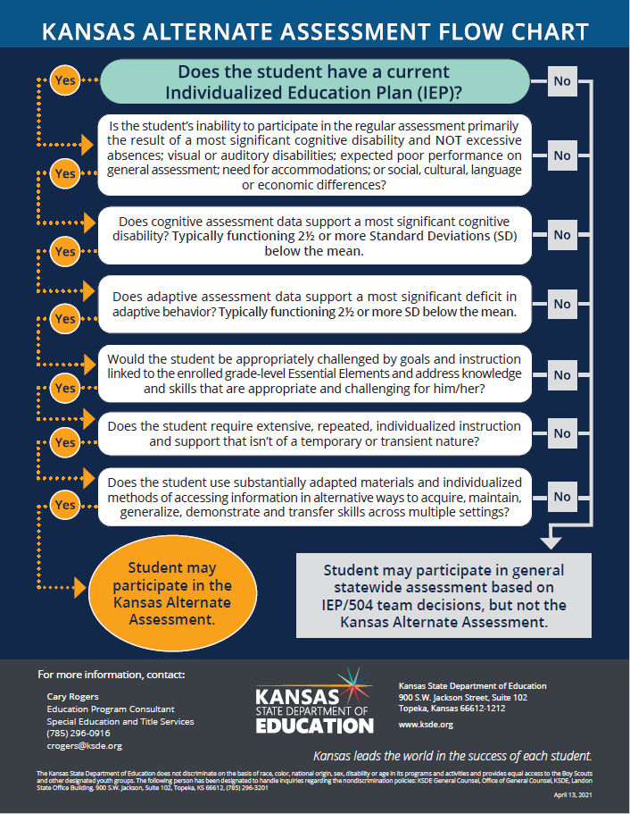
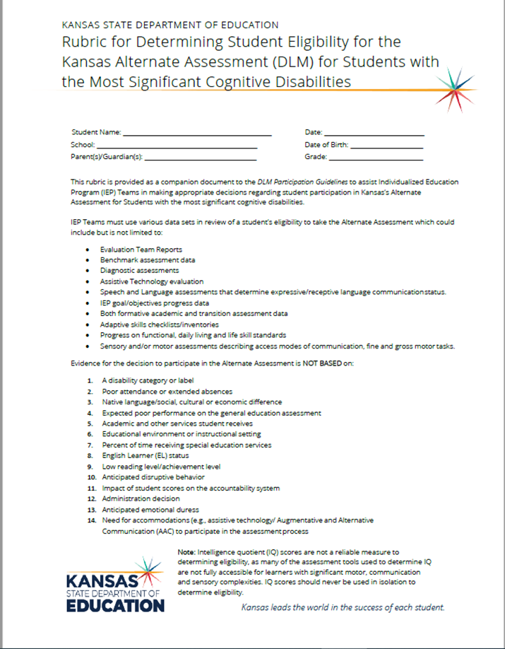
Kansas Alternate Assessment Flow Chart and Rubric for Determining Eligibility for the DLM
Notes:
The Rubric for Determining Eligibility for the Kansas Alternate Assessment is another tool teams can use. This tool is very helpful when considering eligibility on those students that the team is struggling with answering the 4 questions from the participation guidelines. It provides more in-depth probing and questions to consider when determining if a student is appropriate for the alternate assessment. The rubric was update last year to mirror the intellectual functioning tool and adaptive functioning tool from the IEP team resource.

Slide 49
Student Information Sheet
Notes:
The Student Information Sheet is a tool that will be required for districts identified for targeted and intensive TA that don’t have supporting evidence listed on the DLM participation guidelines or have a Rubric for determining eligibility in the alternate assessment. The form asks for the data that support the student having a most significant cognitive disability (defined as typically functioning 2 ½ or more SD below the mean), as well as the data supporting significant deficits in adaptive behavior (defined as typically functioning 2 ½ or more SD below the mean). This form will only be completed on students from targeted or intensive technical assistance districts that KSDE request additional information on. The purpose of the student information sheet is for KSDE to use the data in combination with the first contact survey data to complete a data dive for the district. The results from both sources are reviewed with the district to assist them in moving forward on their plan. Some districts identified additional areas of training that were needed based on the results. There is also the possibility of a file review based on the student information sheets for those districts in the intensive TA.
What we learned this past year:
School psychologists better understand what information we are requesting. Do teachers understand what 2 ½ or more SD represents?
Districts should review the students cumulative file and use the most recent evaluation data to support their decision.
If no adaptive behavior assessment has ever been given, this would be something the IEP team should consider. If forms are indicating none or NA for adaptive behavior, the team wouldn’t be able to mark yes for criteria 2 on the participation guidelines.

Slide 50
Examples of students with a most significant cognitive disability.
https://youtu.be/wIkxLDUnWRA
Notes:
https://youtu.be/wIkxLDUnWRA
This video provides some examples of students with a most significant cognitive disability

Slide 51
My student qualifies for the DLM
Find out who your district test coordinator is.
Provide your district test coordinator with the name(s) of students who qualify for the DLM, the student(s) grade level, primary exceptionality from the IEP, and the subjects your student will be taking in the DLM. (Note: students who take the DLM take it in all subject areas for that grade level. A student can not take a DLM in ELA and general assessment in math.
Let your district test coordinator know if you do not have an Kite Educator Portal account or if you are new to the DLM. You will not be able to complete the required training until this is done.
Your district test coordinator can get you access to Kite Educator Portal as a teacher for the DLM assessment. They will also be the individual to upload your students and roster files that link your students to you in each subject area.

Slide 52
My student no longer meets eligibility requirements for the DLM
IEP or IEP amendment must be done to remove the alternate assessment
Contact your district test coordinator to remove the student from the DLM and add the student to the KAP
We ask teams to take care of this in the fall before administering any DLM testlets if possible.
If a student has to be exited after beginning the DLM, that is fine. We want the right students taking the right test.
Discuss what accommodation the student needs in order to access grade level academic content.
Notes:
Requires prior written notice, does not require parent consent unless you are adding or removing a service or accommodation. If the student is going to need a new accommodation in order to take the general assessment it will require parental consent. Another thing to think about is if the IEP goals are aligned with the essential elements these should also be updated.

Slide 53
Resources

Slide 54
IEP Team Resource: Making Decisions about Participation in the Alternate Assessment
Section 1: Informing All IEP Team Members about the Kansas AA-AAAS
Tool A: Assessment Information for IEP Team Members
Section 2: Preparing for the Decision about Whether the Student Should Participate in the Kansas AA-AAAS
Tool B: Intellectual Functioning Tool
Tool C: Adaptive Functioning Tool
Tool D: Instruction and Supports Documentation
Tool E: Previous Test Participation and Performance Documentation
Tool F: Communication Skills Documentation
Section 3: Discussing Information Relevant to the Assessment Decision During the IEP Meeting
Tool G: Expectations for the Student’s Future
Tool H: Implications of Participation in General and Alternate Assessment
Tool I: Intellectual Functioning, Adaptive Functioning, and Previous Participation and Performance Summary
Tool J: Alternate Assessment Notification
Section 4: Reviewing Decisions about Instruction and Assessment
Tool K: Aggregation of Assessment Decisions by School and District
Tool L: Review of Aggregate Decisions by School and District
Appendix – 2 case studies (1 student who would be eligible for the DLM/ 1 student who would not be eligible for the DLM)
Notes:
The IEP team resource: making decisions about participation in the alternate assessment is a new resource This IEP team resource is designed to support IEP team members, including teachers, school psychologists, English language development specialists, speech language therapists, occupational therapists, paraprofessionals, parents, administrators, and others who may participate in the IEP team meeting. It provides supports for the decision about whether a student with a disability should participate in a general assessment or an AA-AAAS. It does not address the development of a complete IEP. There are a number of resources that focus on IEP development in general; these rarely provide support specifically about making the decision about in which state assessment a student should participate. The tool and other resources provided here are designed to encourage rich discussion about the assessment participation decision. The resource includes 12 different tools that districts can use. It also includes 2 case studies: 1 student who would be eligible for the DLM and 1 student who would not be eligible for the DLM.
This guide was customized for Kansas educators from one of three resources developed by states and technical assistance centers working together in NCEO’s 2019 1.0% Peer Learning Group which Kansas was a part of. (PLG 3).

Slide 55
Additional Guidance Documents
Participation Guidelines (PDF)
Kansas Alternate Assessment Flow Chart (PDF)
Rubric for Determining Student Eligibility for the Kansas Alternate Assessment (DLM) (PDF) (Companion document to the DLM Participation Guidelines)
IEP Team Resource Making Decisions about Participation in the Alternate Assessment (PDF)

Slide 56
Resource Links
KSDE DLM webpage
KSDE Assessment webpage (Assessment page)
DLM webpage
TASN website
Navigating Change 2020
Essential Elements Assessment Rubrics by grade band
Notes:
KSDE DLM page –links to the DLM webinars and the recordings

Slide 57
Subscribe to KAA listserv
To sign up for KAA listserv, send this information: Subject line: KAA Listserv Body of message: Email address, First Name, Last Name, USD Number, USD Name, Send to this address: crogers@ksde.org

Slide 58
Contact Information
Cary Rogers Education Program Consultant
Special Education and Title Services Team (785) 296-0916 crogers@ksde.org

