Slide 1
IDEA and Gifted Requirements File Review
Notes:
Melissa

Slide 2
Agenda
8:30-9:00 Registration​
9:00-9:05 Welcome and Review of the day
9:05-​9:15 DMS findings and potential changes
9:15-9:45 KIAS Overview ​
9:45-11:30 IDEA and Gifted Self-Assessment Requirements​
11:30-12:00 Lunch​
12:00-2:30 IDEA and Gifted Self-Assessment Requirements continued​
2:30-3:30 Fiscal File Review​
Breaks may be taken as often and as needed throughout the day​
Notes:
Introduce ourselves – Melissa, Cary, Crista, Josie, Brian (TAT providers); Dean and Helen
Melissa

Slide 3
Learning Objectives
Participants will understand that the IDEA and Gifted File Review is a part of General Supervision and integrated into the Kansas Integrated Accountability System.
Participants will understand the 24 IDEA and Gifted File Review Self-Assessment Questions and the criteria for demonstrating compliance on each question.
Participants will collaborate with LEA team(s) and use the new Reviewer Tool to identify compliance/noncompliance on provided examples for file review questions.
Collaborate with LEA teams to review examples and resources provided to write compliant IEPs and address identified issues of non-compliance in their LEA.
Notes:
Melissa

Slide 4
Education Benefit Review Opportunity
In an effort to provide results-based technical assistance, KSDE is offering Administrators an exciting opportunity to work with us through the Education Benefit Review Process.
If interested contact Ann Matthews amatthewstat@gmail.com
Notes:
Melissa

Slide 5
DMS
Notes:
Brian
What we are addressing for DMS
Currently working on changing general supervision which will affect what is currently cohort 3 – could affect number of files, who is monitored, how monitoring is done

Slide 6
KIAS
Notes:
Melissa

Slide 7
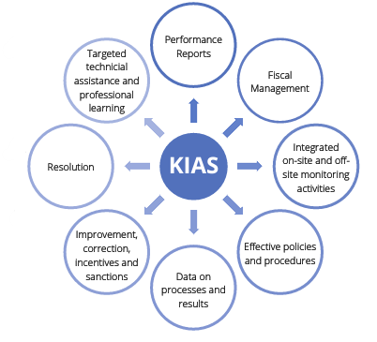
What is KIAS
Kansas Integrated Accountability System (KIAS) is the general supervision system for the Special Education and Title Services (SETS) Team in Kansas.
In Kansas, KIAS (general supervision) is integrated across federal programs, particularly ESEA and IDEA.
KIAS is an integrated, continuous process involving data collection; data verification; district corrective action; reporting; and incentives and sanctions.
KIAS is designed to ensure compliance with the State of Kansas, federal special education and Title programs and improved academic results for all children and youth.
KSDE KIAS Overview
Notes:
Melissa

Slide 8
Kansas Integrated Accountability System (KIAS)
KIAS is both a process for monitoring federal programs and state requirements, and an authenticated web application used as a tool to report data.
Some of the federal programs and state requirements monitored through KIAS (authenticated web application)
Federal title programs,
IDEA,
Kansas Special Education for Exceptional Children Act (which includes gifted),
Emergency Safety Intervention (ESI)
Alternate assessment justifications
Notes:
Melissa

Slide 9
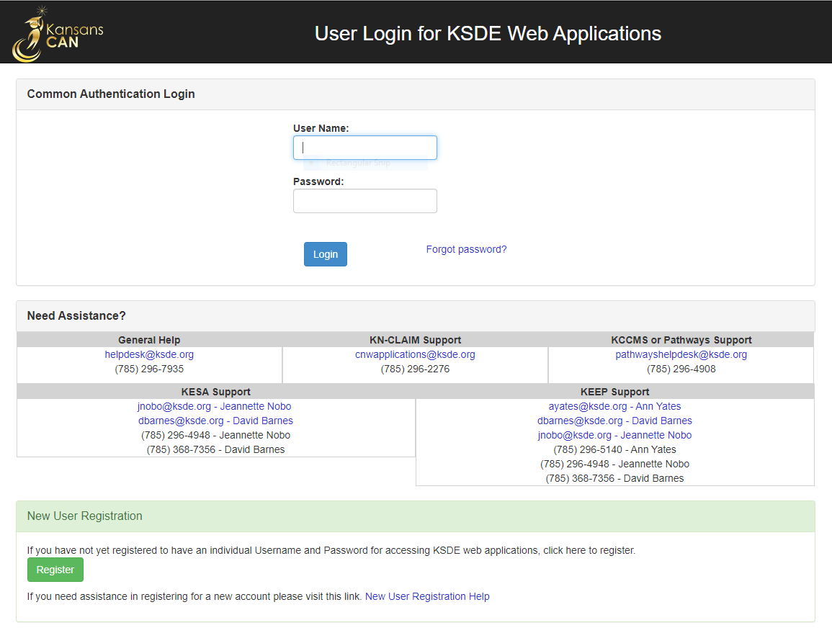

KIAS: The KSDE Web Application
New users must register for a new Common Authentication Login.
Users will be notified when access is approved.
Depending on the new user’s account type, after approval, they may need to be promoted (see Quick Start Guide).
Never share login information with anyone.
https://apps.ksde.gov/authentication/login.aspx
Registering and Making Account Changes for KIAS - Kansas Integrated Accountability System (PDF)
Notes:
Melissa
New user – you will need to register for a common authentication login. If you have changed districts you will also need to do this. You will be notified once your access is approved.
Depending on the role, you may need to be promoted so that you have the necessary access – district administrator. Anyone can have access, but the special education director decides what level of access. The quick start guide explains all of this.
Interlocal directors need approval from their superintendent and then will need to approve themselves.

Slide 10
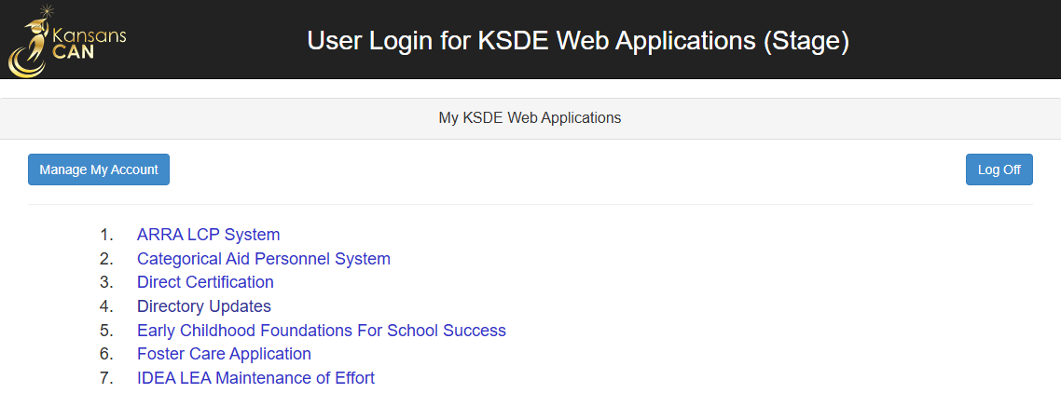
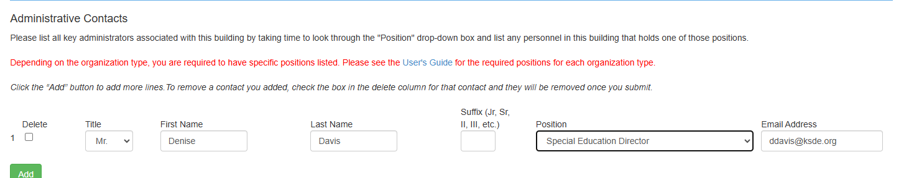
Directory Updates
KIAS pulls in contact information from KSDE’s Directory Updates web application.
If the Directory Updates web application is not updated appropriately, you will not receive KIAS notifications!
Only Special Education Director receives KIAS notifications about IDEA/Gifted File Review.
Notes:
Melissa
Directory updates- it is important that you update who is the director of special education so that you get notifications from KIAS for file review. IDEA and gifted file review only goes to the ‘special education director’. You must use this exact description. If you don’t know who does directory updates, please reach out to us.

Slide 11
Who Should Conduct Reviews?
Personnel who are familiar with the IEP process and how the files are organized
Personnel who could be included
Gifted facilitators or special education teachers
Special education/gifted coordinators
School psychologists
Administrators
Related services providers
MIS clerk
Principals
Notes:
Melissa

Slide 12
Types of Files Included in File Review
Early Childhood
Students attending a Virtual School
Kansas students placed out of state to receive FAPE
Out of state students the LEA voluntarily enrolls. If the LEA chooses to enroll the students to receive funding for the students, they are responsible for FAPE and the monitoring that comes with that responsibility.
Notes:
Melissa

Slide 13
Be Proactive!
Utilize an internal file reviewIDEA & GIFTED FILE REVIEW CONTINUOUS IMPROVEMENT MONITORING CONSIDERATION CHART
Kansas Integrated Accountability System (KIAS) Investigative Questions for State Performance Plan Compliance Indicators
Request assistance by contacting File.Review@ksde.gov or through TASN at www.ksdetasn.org
Notes:
Melissa

Slide 14
To Redact or Not to Redact? FERPA & IDEA exceptions
When uploading student records into the KIAS web application for Data Verification, it is not necessary to redact personally identifiable information.
FERPA regulations state: “An educational agency or institution may disclose personally identifiable information from an education record of a student without consent if the disclosure is to authorized representatives of state and local education authorities…. Authorized representatives of the officials or agencies may have access to education records in connection with an audit or evaluation of Federal or State supported education programs, or for the enforcement of or compliance with federal legal requirements that relate to those programs.” See 34 C.F.R. 99.31(a)(3)(iv); 99.35(a)(1)
IDEA regulations state: “Parental consent is not required before personally identifiable information is released to officials of participating agencies for purposes of meeting a requirement of this part.” See 34 C.F.R. 300.622(b)(1)
Notes:
Melissa
It is not necessary to redact personally identifiable information when uploading to KIAS web application. No PII can be sent in emails – please refer to the SSID when emailing.

Slide 15
Continuous Improvement Consideration Chart
Notes:
Melissa

Slide 16
IDEA & Gifted File Review Continuous Improvement Monitoring Consideration Chart: A Technical Assistance Tool for LEAs Conducting Internal System Reviews
File Review Question | Documentation Requirements | Acceptable Practices
Question #1: Was a copy of parent rights/procedural safeguards provided to both of the student’s parents (or legal education decision-maker) and the student (if the student is 18 or older) in all required instances and in the native language of the parents/adult student or other mode of communication used by the parents/adult student? | Documentation that copy of parent rights/procedural safeguards was provided to both of the student’s parents (or legal education decision-maker) when parents are living in separate households and student (if 18 or older) in ALL required instances, AND Evidence that parent rights/procedural safeguards provided were written in the native language or other mode of communication used by the parents/adult student. Gather documentation that one parent cannot be located. | Provide parent rights to both parents when parents are living in separate households; AND Provide parent rights in native language or other mode of communication used by parents/adult student; Offer to convene the team to reconsider the action taken by the LEA with the parent.
Question #2: Were evaluation materials selected and administered so as to not be discriminatory on a racial or cultural basis? | There must be documentation to show that elimination of racial and cultural discrimination was considered when selecting and administering evaluation materials for the particular student. NOTE: A checkbox or boiler plate language does not meet this requirement. | Document the assessment selection and administration thought process used, including how racial and cultural bias was considered for the particular student (e.g., review of relevant evidence from technical manuals and other demographic information considered by the team for this particular student). This could be reviewed during an IEP meeting, IEP amendment or provided to the parents in a letter. OR Provide PWN and obtain parent consent and conduct non-discriminatory evaluation.
Notes:
Melissa
The Continuous improvement monitoring consideration chart provides the file review question, the requirements for documentation, and acceptable practices for addressing any issues that are found.

Slide 17
FAQ for IDEA and Gifted Requirements Self-Assessment
Notes:
Melissa
FAQ has been updated. This document holds a wealth of information around specific questions. This is a great resource to become familiar with. Often times when directors email us, we respond to questions using the FAQ.
As you are working with your vendors and they are updating forms it might be a good idea to run those by KSDE

Slide 18
Questions
Notes:
Melissa
What questions do you have so far?

Slide 19
IDEA & Gifted File Review Self-Assessment: Parent Rights – Question 1
Notes:
Cary

Slide 20
KIAS flags/alerts
Looks at data with a School Year equal to the ‘End Year’ (e.g. if the current Monitoring dates are 2025 – 2026, then the ‘End Year’ used would be 2025).
RSL not English: Student’s First Language (KIDS record type ENRL, EOYA or TEST) is not English
RPL not English: In SpedPro system, on the Student Form page it uses the information in the “Language : Parent” field.
ELL: Information in the Record Common table of the Student ODS System (KIDS record types AGST, ENRL, TEST, EOYA, EXIT, SPED has a value is a 1, 2 or 3)
HI/DB: If the primary disability in SpedPro for this student’s Primary Exceptionality is either “Hearing Impaired” or “Deafblind”
Non-white race: Student is not white. It gets this information by locating the student in SpedPro and then matching up with the student’s record in KIDS by the KIDS ID.
Virtual, out of state, KS out of state, and Early Childhood
Notes:
Cary
KIAS uses Student Pull Logic data from KIDS or SPEDPro . Districts will notice that students in these categories will be pulled.

Slide 21
Question 1
Was a copy of parent rights/procedural safeguards provided to both student’s parents (or legal education decision-maker) and the student (if the student is 18 or older) in all required instances and in the native language of the parents/adult student or other mode of communication used by the parents/adult student? 34 C.F.R. 300.504(a), (d); 34 C.F.R. 300.520(a)(1)(i); K.S.A. 72-3430(e); K.S.A. 72-3431(a)
METHOD:
First, determine the native language or other mode of communication used by the parents (or legal education decision-maker) and student (if 18 years or older).
Next, check the student’s file to determine whether a copy of parent rights/procedural safeguards was provided to both parents (or legal education decision-maker) if they do not reside in the same household and the student (if 18 or older) in all required instances and in their native language or other mode of communication. To do this, determine all instances when the provision of parent rights/procedural safeguards was required. Parent rights/procedural safeguards must be provided one time each school year AND in EACH of the following instances:
*SPECIAL NOTE: If a copy of the parent rights/procedural safeguards was not sent to both student’s parents, then the student’s file should contain documentation indicating why (e.g., one parent’s rights have been terminated or despite documented reasonable efforts to locate a parent, school staff are unable to, etc.).
Notes:
Cary
KSDE has parent rights documents in 17 additional languages

Slide 22
Question 1 Continued
When Are Parent Rights Given?
Annually
Upon initial referral or parent request for evaluation
Upon receipt of the first state complaint in a school year
Upon receipt of the first due process complaint in a school year
On the date the decision is made to subject a student with a disability (not applicable to gifted) to a disciplinary change of placement because of a violation of a code of student conduct
Upon request by a parent
YES
Select YES if documentation shows ALL of the following:
• A copy of parent rights/procedural safeguards was provided to both of the student’s parents (or legal education decision-maker) and student (if 18 or older) in ALL required instances.
AND
• The parent rights/procedural safeguards provided were written in the native language or other mode of communication used by the parents/adult student.
NO
Select NO if documentation DOES NOT show ALL of the following:
A copy of parent rights/procedural safeguards was provided to both of the student’s parents (or legal education decision-maker) and student (if 18 or older) in ALL required instances.
AND
The parent rights/procedural safeguards provided were written in the native language or other mode of communication used by the parents/adult student.
Kansas Special Education Process Handbook, Chapter 1, Sections B., C., H., Questions and Answers – Q.3.United States, Office of Special Education and Rehabilitative Services. 71 Federal Register 46,568 (Aug. 14, 2006).
Notes:
Cary
Parent Rights must be given to both parents when they do not reside in the same household. If parents live in the same household, make sure both parents’ names are on the notice that is provided with parent rights. If a student is 18 years or older, the student needs to receive all of those notices. Their parents still need to receive all notices. Parent Rights must be provided in the parent’s native language or other mode of communication.
*SPECIAL NOTE: If a copy of the parent rights/procedural safeguards was not sent to both student’s parents, then the student’s file should contain documentation indicating why (e.g., one parent’s rights have been terminated or despite documented reasonable efforts to locate a parent, school staff are unable to, etc.).

Slide 23
Acceptable Documentation Q1
Documentation that the Parents (educational decision makers) live in the same household and at least one was provided Parent Rights OR
Evidence that the Parent Rights were presented to both parents (educational decision makers)
OR
Documentation indicating why the other parent did not receive them (parent rights terminated, parent is unknown, parent location unknown)
Additionally required:
Evidence that the Parent Rights were given in the native language of the parents (educational decision makers) AND
Evidence that the Parent Rights were delivered on all required occasions AND
If student 18 years old, evidence that the student also received rights in native language
Notes:
Cary
If you have a check box on the IEP indicating parents were provided a copy of their parent rights it should also indicate it was provided in the parent's native language. Could be documented in the meeting notes as well. Make sure all components are included.

Slide 24
IDEA & Gifted File Review Self-Assessment: Evaluation and Eligibility – Questions 2-9
Evaluation & Eligibility: Requirements and File Review
Evaluation Procedures Reflection
Reevaluation of decision tree final
Documenting Equity in Evaluation
Documenting Equity in Evaluation handout
Evaluation and Eligibility Gifted RTI
Considering, Addressing, and Documenting Racial, Cultural, and Language Characteristics with the Evaluation Process
Example- Team Evaluation Report and Eligibility Determination- Word
Example- Team Re-Evaluation Report and Eligibility Determination
Reevaluation Procedures
Notes:
Cary
If an evaluation was not completed last school year for a student selected for this file review, look at the last evaluation that was completed to answer Self-Assessment questions 2 through 9. Refer to the guidance in the FAQ.

Slide 25
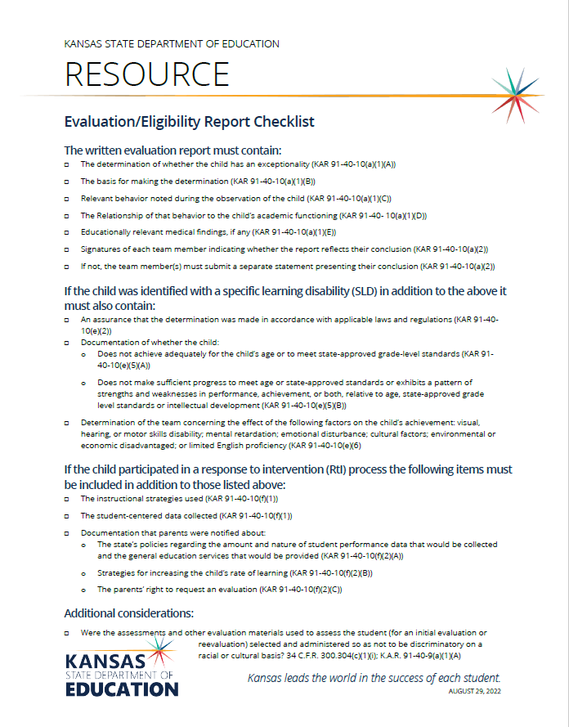
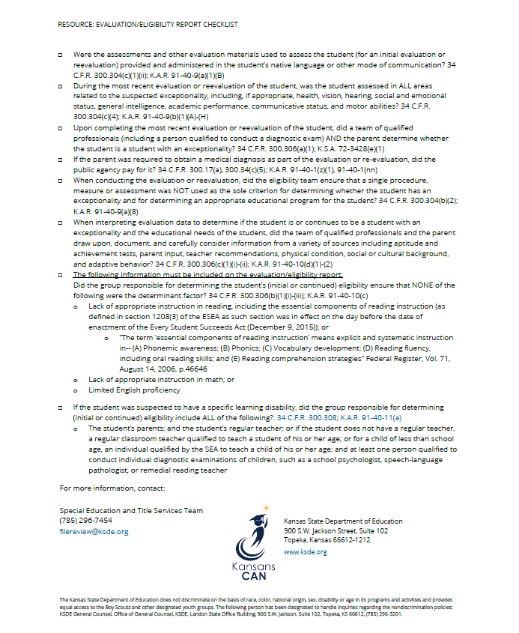
Evaluation/Eligibility Report Checklist
Notes:
Cary
This checklist can be used to assist teams in ensuring that all the required components are considered when completing an initial or re-evaluation. . The KSDE sample re-evaluation not needed agreement form is sufficient by itself and does not require any additional comments or justification when a school and a parent agree to waive the re-evaluation. KSDE does not recommend adding additional data or justification as it may bleed over into an actual re-evaluation process which has additional requirements. If the IEP team finds there was missing documentation for considerations and other elements on the last evaluation report, they should consider moving forward with a re-evaluation.
As a re-evaluation is coming due, a team could assign someone (school psych, SLP, etc) to look at the previous evaluation and ask 2 questions
Is the previous evaluation appropriate – could use the evaluation/re-evaluation report checklist
Are there any new concerns
If the previous evaluation is appropriate and there are no new concerns, the team could propose to the parent to waive the re-evaluation. The only documentation needed to waive is the re-evaluation not needed agreement form. No PWN or other documentation needs to be completed. Chapter 7 under section B ”need for re-evaluation” of the process handbook points out that when considering waiver, the school and parent should "consider the child's educational needs, which may include whether the child is participating in the general education curriculum and being assessed appropriately. The parent and the school will discuss the advantages and disadvantages of conducting a reevaluation, as well as what effect an evaluation may have on the child's educational program
Remember your policies, practices, and procedures should be followed.

Slide 26
Responding to Scenarios - FAQ
If a school district has not conducted any initial evaluation or reevaluation for a student selected for file review because the student transferred in after their initial evaluation or the most recent reevaluation was completed by a previous district and the student’s 3-year reevaluation has not yet come due, the school district will not be held responsible for an evaluation conducted in another district.
Answer “Yes” to each of the evaluation/eligibility Self-Assessment questions (2 through 9)
Explain in the LEA Comment Box that the school district has not had the opportunity to conduct an initial evaluation or reevaluation for the student.
Include the date of the students most recent evaluation conducted in the previous school district and the date of the student’s transfer to the current school district.
Notes:
Cary- I have taken the information on the next two slides from the FAQ document.
On move-in students, if your district has not had the opportunity to complete the initial evaluation or a reevaluation, you are not responsible. In this case answer, yes and in the comment box indicate you have never done an evaluation or re-evaluation and include the date of the most recent evaluation and the date the student transferred to the current school district.

Slide 27
Responding to Scenarios - continued
If the student’s initial evaluation or most recent reevaluation was conducted by a previous district and the current school district and parent agreed that the 3-year reevaluation was not necessary (waiver) for the student when it came due, the school district will use the most recent evaluation or reevaluation to answer the self-assessment questions. Further, the district may use any other data it relied on to determine that the reevaluation was unnecessary.
A district may consider conducting a reevaluation using currently available information. This approach may provide documentation for File Review Questions. If the team reviews the student’s file and other currently available information, and documents they considered the requirements of the File Review Questions when completing the review, then the documentation may meet File Review requirements. The reevaluation does not need to include assessments, unless otherwise indicated upon review of the student’s file and data.
Please note a review of existing evaluation data is not a waiver of a reevaluation. See 34 C.F.R. 300.305 and K.S.A. 72-3428(i) and (k). In addition, such review of existing evaluation data alone may constitute a complete reevaluation if the IEP Team and other appropriate, qualified professionals determine, on the basis of the review and input from the parents, that no additional data are needed to establish continuing eligibility and to determine the child’s current educational needs See OSEP Letter to Redacted, Question 3, Feb. 6 2007. If the IEP team makes this determination, the parents must be provided with notification of the determination, the reasons for the determination and the right of the parents to request an assessment See 34 C.F.R. 300.305(d)(1) and K.S.A. 72-3428(k).
Notes:
Cary - If the LEA chose to waive the re-evaluation on a move-in student, they will be required to complete the evaluation questions based on the evaluation completed by previous district.
Are there any questions with those two scenarios?

Slide 28
Question 2
2. Were the assessments and other evaluation materials used to assess the student (for an initial evaluation or reevaluation) selected and administered so as not to be discriminatory on a racial or cultural basis? 34 C.F.R. 300.304(c)(1)(i); K.A.R. 91-40-9(a)(1)(A) METHOD: Review the education record to determine whether there is evidence that the group of people responsible for conducting the student’s most recent evaluation/reevaluation selected and administered assessments and other evaluation materials so as not to be discriminatory on a racial or cultural basis. There must be documentation to show that elimination of racial and cultural discrimination was considered when selecting and administering evaluation materials. This information could be found in assessment technical manuals, a prior written notice form, an evaluation/eligibility report, teacher/provider notes, or other documentation in the education record. Staff who conduct assessments could cite relevant information from the assessment technical manual, or refer to that information in professional notes, or provide some other type of documentation about how those findings were taken into consideration.
YES
Select YES if documentation shows that the assessments and other evaluation materials used to assess the student, for the initial evaluation or most recent reevaluation, were selected and administered so as not to be discriminatory on a racial or cultural basis.
NO
Select NO if documentation DOES NOT show that the assessments and other evaluation materials used to assess the student, for the initial evaluation or most recent reevaluation, were selected and administered so as not to be discriminatory on a racial or cultural basis.
Kansas Special Education Process Handbook, Chapter 3, Section E.1. and Questions and Answers Section, Q&A 5.; Chapter 7, Section E.
Notes:
Cary
This question had the 2nd highest number of noncompliant files last year
Review the education record for documentation that the team selected evaluation material and administered the assessments so as not to be discriminatory on a racial or cultural basis.

Slide 29
Quality Indicators for Nondiscriminatory Assessment
Assess with authentic and alternative procedures.
Establish an appropriate basis for comparison.
Assess and evaluate the learning ecology/environment.
Assess and evaluate the student’s opportunity for learning.
Ensure the test norms are adequate.
What is the test supposed to measure?
What does the professional literature have to say about how diverse students perform on the test?
Consider how linguistic and/or cultural factors impacted the validity of the test/procedure.
Support conclusions through data convergence and multiple indicators. Ensure that you have multiple data sources.
Notes:
Deb/Cary
From Samuel Ortiz (2008, 2014) in Best Practices in School Psychology.
It is important that teams select assessments and other evaluation materials so as not to be discriminatory on a racial or cultural basis. It is critical that teams do not use a standard battery of tests with all students, and that they consider for each student what assessment instruments and practices will result in a non-biased assessment for that individual. Teams need to consider this information prior to assessment, and not wait until there are concerns with administration or the interpretation of test results. Documentation for this question would likely include a description of the team’s consideration of how the selected instruments will contribute to a nondiscriminatory evaluation for this individual student. For some students, this might include practices such as authentic assessment, or non-verbal assessment (or other alternatives to language-based assessment), or use of a response to intervention approach. This information could be included in a prior written notice form, or in an evaluation/eligibility report, or in notes made by a member of the evaluation team, or some other type of documentation. Districts should consider practices and procedures that are consistent in evaluation team's documentation.
The evaluation team needs to understand how to implement the quality indicators listed in the slide, and why they are important practices for nondiscriminatory assessment. Documentation for Q2 should include the consideration of and/or reporting the use of at least some of these quality indicators.

Slide 30
Example of documentation for Q2 –how we plan to approach the evaluation, given what we know
What we know: This third-grade black student is a recent move-in from rural Mississippi. His current elementary school is a school-wide Title project school. His teachers indicate that he is making typical progress with listening comprehension and written language, but his reading and math skills are lagging. Staff are concerned about his speech skills, and his peers report they have difficulty understanding him. However, a parent conference showed that he exhibits the same dialectical speech patterns as his mother. He had good attendance at his previous school and does now. His previous school reported concerns over lack of academic progress and retained him in first grade. He was not referred for a special education evaluation while in Mississippi, but he was going to be retained another year in second grade. Upon enrollment in Kansas this fall, his current school decided not to retain him again and enrolled him in third grade.
How we plan to approach the evaluation: The evaluation team decided to administer the Wechsler Intelligence Scales under standardized conditions to obtain more information about this student’s cognitive functioning and background knowledge. However, eligibility decision-making will utilize the non-verbal/performance components of the test to limit the possible negative impact of cultural and dialectical differences, as well as the potential negative impact on test validity due to the examiner’s difficulty in understanding his speech. Nationally normed achievement testing has already been conducted by the Title teachers and progress measures of Title interventions are available since the beginning of this school year. The speech and language clinician will conduct some modified speech and language assessment, The student’s fine and gross motor skills are excellent as are his social skills, so no assessment is needed in those areas.
Notes:
Deb/Cary
The information in the first bullet includes demographic and background information for the referred student. The second bullet contains an example of information that might be included in a PWN & Consent form for permission to evaluation. All of this information would be appropriate to include in an evaluation report.

Slide 31
Documentation for Q2
Documentation indicating how potential cultural and racial discrimination was addressed for a particular student when selecting and administering evaluation materials. This documentation could be found in PWN for evaluation consent, MDT report, case notes for planning the evaluation, PWN for placement, or other places in the educational records.
Evaluation teams need to consider potential racial or cultural bias in relation to the student’s similar peers, so that it is clear what the needs are due to the presence of the exceptionality and what are needs due to the student’s difference in racial or cultural circumstances….(IDEA & Gifted Requirements File Review: Frequently Asked Questions)
Notes:
Cary
Documentation indicating how potential cultural and racial discrimination was addressed for a particular student when selecting and administering evaluation materials. This documentation could be found in PWN for evaluation consent, MDT report, case notes for planning the evaluation, PWN for placement, or other places in the educational records.
Documentation of non-discriminatory assessment needs to be specific to the student’s characteristics. It should show How and What you did to individualize based on that student’s unique demographics. If what you say could apply to anyone, it’s not good enough.
At the bottom of the slide is a statement form the FAQ document. Evaluation teams need to consider potential racial or cultural bias in relation to the student’s similar peers, so that it is clear what the needs are due to the presence of the exceptionality and what are needs due to the student’s difference in racial or cultural circumstances

Slide 32
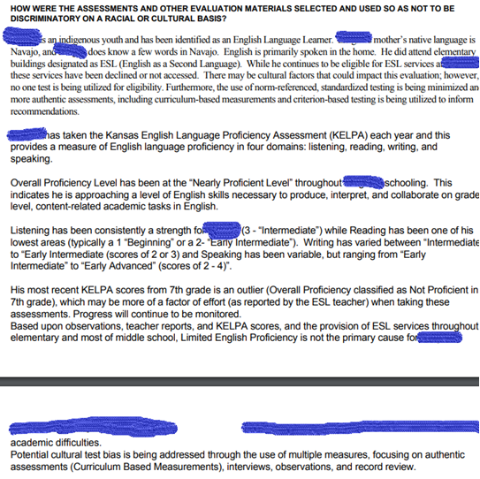
District Example
Notes:
Cary
This is an example from a district for a student who is an English Learner. The report address that this is an ELL student for whom English is primary language spoken in the home and family has declined ESOL services. They did address that their may be cultural factors that could impact the evaluation, however, no one test is being utilized for eligibility. They are also using curriculum-based measurements and criterion-based testing to inform recommendations. The student has been at the nearly proficient level throughout school on the KELPA. And they have provided details of those results.

Slide 33
Question 3
3. Were the assessments and other evaluation materials used to assess the student (for an initial evaluation or reevaluation) provided and administered in the student’s native language or other mode of communication? 34 C.F.R. 300.304(c)(1)(ii); K.A.R. 91-40-9(a)(1)(B) METHOD: First, review the education record to determine the student’s native language or other mode of communication. Next, review the education record to determine whether the assessments and other evaluation materials used for the student’s most recent evaluation or reevaluation were provided and administered in the student’s native language or other mode of communication. If the assessments and other evaluation materials were not provided and administered in the native language or other mode of communication, review the education record for information showing that it was clearly not feasible to do so. This information could be found in a prior written notice form, an evaluation/eligibility report, teacher/provider notes, or other documentation in the education record.
YES
Select YES if documentation shows that the assessments and other evaluation materials used to assess the student, for the initial evaluation or most recent reevaluation, were provided and administered in the student’s native language or other mode of communication.
OR
Select YES if documentation shows that it was clearly not feasible to provide or administer the assessments and other evaluation materials in the student’s native language or other mode of communication
NO
Select NO if documentation DOES NOT show that the assessments and other evaluation materials used to assess the student, for the initial evaluation or most recent reevaluation, were provided and administered in the student’s native language or other mode of communication.
KSDE Special Education Process Handbook, Chapter 3, Section and E.1, Chapter 7, Section E.
Notes:
Cary
Question number 3, which reads “Were the assessments and other evaluation materials used to assess the student (for an initial evaluation or reevaluation) provided and administered in the student’s native language or other mode of communication.” When you begin to review files for this question, the education record for the student should be examined to determine the student's native language or other form of communication. and then determine if the assessments and other evaluation materials that were used on the student's most recent evaluation or re-evaluation were provided and administered in the student's native language or other mode of communication. If the assessments and other evaluation materials were not given in the student's native language, there needs to be documentation showing why that was the case. For example, if a student who speaks Spanish at home has been in school for 7 years, evaluation may not be needed in Spanish if student is proficient in English, however, there needs to be documentation that the IEP team thought that through. As a reminder, this question refers to native language but also other modes of communication, which can include sign language and braille

Slide 34
KIAS flags/alerts Related to Q3
Looks at data with a School Year equal to the ‘End Year’ (e.g. if the current Monitoring dates are 2025 – 2026, then the ‘End Year’ used would be 2025).
RSL not English: Student’s First Language (KIDS record type ENRL, EOYA or TEST) is not English
RPL not English: In SpedPro system, on the Student Form page it uses the information in the “Language : Parent” field.
ELL: Information in the Record Common table of the Student ODS System (KIDS record types AGST, ENRL, TEST, EOYA, EXIT, SPED has a value is a 1, 2 or 3)
HI/DB: If the primary disability in SpedPro for this student’s Primary Exceptionality is either “Hearing Impaired” or “Deafblind”
Non-white race: Student is not white. It gets this information by locating the student in SpedPro and then matching up with the student’s record in KIDS by the KIDS ID.
Virtual, out of state, KS out of state, Early Childhood
Notes:
Cary
For Q 3 KSDE would expect to see language information for all students and considerations for all students flagged with RSL, RPL, ELL, HI/DB when it comes to Q3.
KIAS uses Student Pull Logic data from KIDS or SPEDPro . Districts will notice that students in these categories will be pulled.
RSL – reported student language
RPL – reported parent language

Slide 35
Quality Indicators for Assessing English Learners
Ensure parent involvement.
Conduct bilingual assessment.
Assess and evaluate the student’s developmental language proficiency in both L1 and L2. What are the family’s patterns of use of L1 and L2?
Ensure the evaluator has knowledge related to second language acquisition.
Use alternative assessment procedures. Use both formal and informal assessment.
Minimize the use of standardized tests. Assessments should be conducted in both the student’s L1 and L2.
Correlate standardized assessment results with informal assessment and intervention outcomes, referral reason, and student’s acculturation and bilingual development, as well as academic achievement history.
Notes:
Deb/Cary
From M. Villegas-Gutierrez (2015), Education Evaluation Center, Western Oregon University.
The evaluation team needs to understand how to implement the quality indicators listed in the slide, and why they are important. Documentation for Q3 should include the consideration of and/or reporting the use of at least some of these quality indicators.
Our goal should be to identify those students with disabilities who need special education but never to label a student because of a language difference.

Slide 36
Definitions
Native Language - In most cases, the term native language refers to the language that a person acquires in early childhood because it is spoken in the family and/or it is the language of the region where the child lives.
Preferred Language - The language most preferred for communication.
Primary Language- Primary language is the language that someone uses most frequently to communicate with. It is the language a person uses in most situations. For many people, their primary language is their first language, but for others their primary language might be their second language.
Home Language - A home language is a language (or the variety of a language) that is most commonly spoken by the members of a family for everyday interactions at home.
Notes:
Deb/Cary
If a student is an English Learner, the MDT should access information about a student's performance in each of these types of language from the student's ESOL instructor. In addition, the team should be aware of the most recent KELPA assessment results. In addition to these definitions, it is important to distinguish between a student's conversational skills in English and their competence in academic uses of English.

Slide 37
The English Learner Assessment Continuum
Most Desirable Approach
A bilingual special education assessment professional fluent in the student’s native language uses standardized and alternative assessment in the student’s L1 and L2 languages. School districts should conduct a dual language assessment conducted by a bilingual examiner fluent in English and the student’s native language. These resources are most likely available for Spanish-speaking English learners.
Least Desirable Approach
The least desirable approach is having an English-speaking assessment professional using only nonverbal or performance intelligence assessment measures and alternative assessment. This is considered an acceptable practice when testing in a low incidence language where resources (e.g., assessment materials in the L1 language) are unlikely to be available.
The reliability and validity of the Least Desirable Approach can be improved by combining it with progress monitoring data from GEI or RTI interventions and comparing results to other English Learners.
Notes:
Deb/Cary
Somewhere in-between these two options: If possible, an assessment professional conducts verbal testing in English with an Interpreter present when student requests assistance.
Most Desirable Approach
A bilingual special education assessment professional fluent in the student’s native language uses standardized and alternative assessment in the student’s L1 and L2 languages. School districts should conduct a dual language assessment conducted by a bilingual examiner fluent in English and the student’s native language.
Least Desirable Approach
The least desirable approach is having an English-speaking assessment professional using only nonverbal or performance intelligence assessment measures and alternative assessment. This is considered an acceptable practice only when testing in a low incidence language.

Slide 38
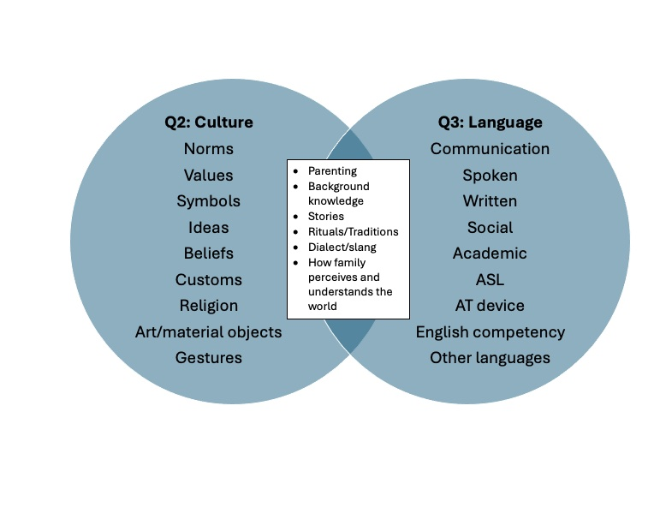
Venn diagram showing Q2 Culture characteristics and Q3 Language characteristics and overlap
Notes:
Deb/Cary
When assessing students who are English Learners (Q3), there will need to be consideration given to their cultural background as well (Q2). There is not a clear cut distinction between language and culture. This Venn Diagram tries to illustrate examples of what is distinct about Language compared to Culture, and what are examples of overlap/commonality of language and culture. One way this is important in assessment is that even when testing an English Learner seems to be fluent in English, that student's cultural background will still impact the student's background knowledge. Most verbal tests tap into background knowledge in some way and results need to be interpreted very carefully when assessing a student whose native language is other than English.

Slide 39
Examples of documentation for Q3 –how we plan to approach the evaluation, given what we know
If assessments are available in the student’s native language: The student’s primary language is Spanish and the student’s second language is English. The student’s competency in both languages will be assessed. Also, the student’s cognitive skills will be assessed in both Spanish and English (for example, using the WISC-V Spanish and the WISC-V in English). In addition, the student’s academic skills will be assessed in both languages (for example, using DIBELS and IDEL or the Woodcock-Johnson IV and the Bateria IV). Additional non-verbal measures will also be administered.
If assessments are not available in the student’s native language: The student’s primary language is Russian and the student’s second language is English. Evaluation of student's English skills show that he is fluent in English. His parents speak only Russian, and the student often translates for his parents when shopping or using professional services. He began learning English prior to starting kindergarten from an older brother and took English classes as soon as starting school in Russia, before the family’s move to the U.S. The evaluation of his high ability will be accomplished through a combination of formal and informal assessment in English. Test interpretation will emphasize the non-verbal components of cognitive tests to limit the possible negative impact of language acquisition. Similarly, academic test interpretation will emphasize the areas least impacted by language acquisition, which are also observed to be his areas of strength in the classroom setting.
Notes:
Deb/Cary
Here are two examples of documentation for File Review Question 3. The first bullet describes a situation where assessments are available in the student's native language. Most often this approach will be used with student's whose primary language is Spanish. Nationally, most students who are English Learners are Spanish speakers, so there are tests available in Spanish.
The second bullet describes a situation where assessments are not available in the student's native language. It describes how adaptations were made to traditional assessment practices for a student whose native language is Russian, but who is fluent in conversational English. Many times cultural issues (question 2) overlap with language issues (question 3) when making assessment decisions for English learners.

Slide 40
Q2 &Q3 Documentation Options-there are MANY
Most teams do consider racial, cultural and linguistic differences when planning and conducting their evaluations.
In some evaluations submitted for file review, it appeared we need to improve our documentation that we did in fact consider these factors, and how we chose to address them within the evaluation process.
Notes:
Deb/Cary – consider including this documentation consistently in one location – for example in the "Background Information" section of the MTR. There are many places it could be, but developing practices consistent among your teams would be helpful. It is suggested that you provide documentation of the source of your information regarding cultural characteristics of the student – was the parent interviewed, were records obtained from the previous school with information, was information provided by the ELL Teacher with knowledge of the home?, etc.
Documentation will likely begin with the MTSS or GEI teams and can easily be pulled into the MTR.

Slide 41
Considering, Selecting and Administering Assessments in light of student’s unique racial, cultural, and linguistic characteristics….What might this process look like in evaluation/reevaluation?
Step 1: MDT gathers and documents information regarding student's demographics and background as part of evaluation/reevaluation process.
Demographic information includes relevant information about the student's racial and cultural characteristics, native language, KELPA scores and language proficiency levels (if not a native English speaker), school attendance/moves, etc.
Step 2: MDT reviews the student's demographic information and background and considers how team will address potential cultural and racial bias in the evaluation/reevaluation process. (E.g., team considers specifically how they will select and administer assessments and evaluation materials for this student, in light of this student’s demographics.)
Step 3: MDT documents how the team will use/did use the student's demographic information to guide the selection and administration of assessments and tools to ensure non-biased evaluation. This documentation of approach should be included in the education record (e.g., Evaluation Report, PWN for evaluation consent, multidisciplinary evaluation/reevaluation team report, case notes for planning the evaluation, PWN for placement, or other places in the student's record).
Notes:
Deb/Cary
1. Team collects demographic information. Some of this information may be used by the MDT (multi-disciplinary team) with regard to exclusionary factors.
2. Team considers and documents how to address potential cultural/racial bias in the evaluation.
3. Team documents how student's demographic information was used in the selection and administration of evaluation instruments.
Example – a first grader whose records indicate no preschool, frequent moves and free/reduced meal status – choice of assessments would consider possible limitations in vocabulary and focus on nonverbal assessment tools to assess intellectual ability.

Slide 42
Background Information Example
Cultural Considerations:
Ethnicity: Black/African American
Native Language: English
Preferred mode of student communication: oral
English Language Learner (ELL): No
Has this student ever received ELL services: No
Parent/home language: English
The team has considered the student’s academic history, racial/cultural background, and notes the student is a native English speaker. Because this student’s racial/cultural and language background is the same as the majority of the population on which the chosen assessments were normed, the battery of tests selected to address the above areas should not result in a biased evaluation.
OR
The team has considered the student’s demographics, including native language, mode of communication, and cultural considerations and will select and administer assessments to mitigate potential for racial/cultural and language bias in the evaluation process in the following manner:
Because of concerns about the potential impact of racial/cultural background, and the availability of extensive General Education Intervention data, the decision was made to use a response-to-intervention approach for the evaluation.
Notes:
Cary

Slide 43
Elements for considering race/ethnicity, language and cultural characteristics (Initial Evaluations and Re-evaluations)
This type of information may be located in a variety of places within the student records. It makes sense for it to be summarized and discussed within the evaluation team report, as it guides decisions regarding the selection/administration of assessments in an evaluation/reevaluation which leads to making appropriate educational decisions for the student.
Race/Ethnicity:________
Native Language:_______
Preferred Language:________
English Language Learner (EL): Y/N _______________ (e.g., if yes, provide data, progress and history of services for students that qualify/or have qualified for ESOL in the past)
Cultural Considerations Reviewed: __________________________________
Educational History: (e.g., preschool participation, attendance over time, school moves, etc.)___________________
Verbal Communicator: Y/N
Deaf or Hard of Hearing: Y/N
Blind or Visually Impaired: Y/N
Notes:
Cary
Teams need to document the race/ethnicity, language, and cultural characteristics of each student. This is an example of what it might look like.

Slide 44
Multidisciplinary Team Report Example
Student Background/Demographics:
Race/Ethnicity: Hispanic
Native Language: Spanish
Preferred Language: English
English Language Learner (EL): (Y/N) Yes, Juan has participated in ESOL since Kindergarten, and has made “satisfactory” progress each year, at a rate comparable to his EL peers with similar backgrounds. His fall, 4th grade KELPA data for the four domains is as follows: Reading 2, Writing 3, Listening 3, Speaking 4. Overall, he is considered “nearly proficient” which is reflected in a score of 2 on a 3-point rubric. This suggests he is approaching a “level of English language necessary to produce, interpret and collaborate, on grade-level, content-related academic tasks in English.”
He remains eligible and in need of EL support.
Cultural Considerations Reviewed: Juan resides at home with his parents, maternal grandparents, and two younger siblings. Only Spanish is spoken in the home by the adults. As reported by mother, the children speak both English and Spanish. Parents are very involved in the student’s education and historically attend all student events and parent conferences at school. Both parents work outside the home and both parents graduated from High School prior to moving to the US from Mexico.
Notes:
Cary
The next two slide provide a fictional example using the sample multidisciplinary team report example

Slide 45
Multidisciplinary Team Report Example Continued
Educational History: Juan did not participate in preschool. He has attended Sheldon Elementary since kindergarten, with five or fewer missed school days per year.
Verbal Communicator: (Y/N) YES
Deaf or Hard of Hearing: (Y/N) No
Blind or Visually Impaired: (Y/N) No
The team has considered the student’s demographics as summarized above, and also notes the student is a native English speaker. Because this student’s racial/cultural background is the same as the majority of the population on which the chosen assessments were normed, the battery of tests selected to address the above areas should not result in a biased evaluation.
OR
The team has considered the student’s demographics as summarized above, including native language/mode of communication, and have selected and administered assessments and tools to mitigate potential for racial or cultural bias in the evaluation process in the following manner: Juan’s native language is Spanish, and his second language is English. He expresses a preference for English at this time. Juan’s competency in both languages was assessed as part of this evaluation. Additionally, Juan’s cognitive skills as well as his academic skills were assessed in both Spanish and English. Non-verbal measures were also administered as part of this evaluation. Assessment including criterion-referenced tests, curriculum-based measures, interviews, observation and record review were utilized. No single test or measure will be used to determine eligibility. Results of these assessments, along with any modifications made to standardized testing, will be described within the body of this report.
Notes:
Cary
On this example, we would mark box two, and fill in details of the consideration and how we will approach eval
Note, this sample assumes that the team documents the specific cultural and linguistic characteristics reviewed; it provides more than an assurance statement

Slide 46
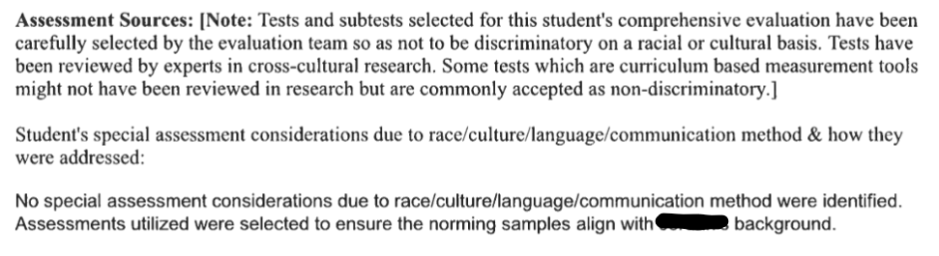
Compliant District Examples Q2 & Q3
Notes:
Cary

Slide 47
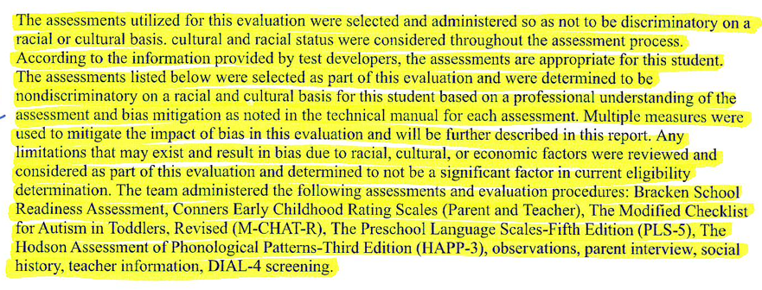

Compliant District Example Q2 & Q3
Notes:
Cary
this is another compliant example. The top part talks about the assessments used and the bottom provides the explanation.

Slide 48
Compliant Assurance Document
Yes Were the assessments and other evaluation materials used to assess the student selected and administered so as not to be discriminatory on a racial or cultural basis? Explain:
No formal, standardized assessments were administered at this time. XXXX is an English-speaking, white male living in the linguistic and cultural majority. Information gained from observations and interviews was juxtaposed with existing school records to mitigate any bias. Since XXXX is of the majority culture, it is assumed that no bias is found in these results.
Yes Were the assessments and other evaluation materials used to assess the student provided and administered in the student’s native language or other mode of communication? Explain:
XXXX was assessed in his native language, which is English
Notes:
Cary
This is an example that was submitted this past year for a student who is white and English-speaking

Slide 49
Documenting Q2 and Q3 in the IEP
In reviewing XXXX’s most recent reevaluation conducted on xxxx. It was determined that the reevaluation report contained a clerical error, as it did not include explicit documentation that cultural/racial/relevant factors specific to the child’s background were considered when selecting assessment procedures. This reevaluation process did indeed take into account relevant factors specific to the student’s background, and assessment procedures were selected and conducted appropriately. Specifically, there was a consideration that XXXX is a Hispanic female student whose primary language is English. The parents and school representatives also agreed that a review of existing data was sufficient for this evaluation and that the previous evaluation assessments and evaluation materials for XXXX were administered in such a way that they were valid, selected and administered so as not to be discriminatory on a racial or cultural basis and provided and administered in XXXX’s native language/mode of communication. To address the clerical error, this documentation is being added to the student’s special education record at this time.
Notes:
Cary
This is one way that a district has addressed Q2 and Q3 outside of the evaluation.

Slide 50
Approved District Examples Q3
XXXX is exposed to both English and Spanish. Both languages are used in the home. Previous report from the parent indicates that XXXX understands some Spanish but will rarely speak in Spanish. He primarily uses English at home. After consideration of multiple sources of data, all testing was completed in English.
Notes:
Cary

Slide 51
What about Gifted-Only for Questions 2 and 3?
Are the presence of racial, cultural, language factors preventing a student from being identified as a gifted student?
State Gifted Data – The data shows we need to do a better job of non-discriminatory referral and assessment and instruction for the various subgroups.
What does your district's disaggregated gifted placement data reveal about the process you use for identifying students of varied racial, cultural, and language backgrounds?
Investigate and discuss within your system:
What are our disaggregated rates of referral for gifted?
What are our disaggregated rates of placement for gifted?
How do we need to change our practices/procedures to address this within our system, if needed?
Notes:
Deb/Cary
File review: for gifted only...there is not an automatic yes....
But the team needs to consider for all gifted only,
Best practice rec-monitor/review the students (focus on diverse ) who do NOT qualify for gifted....what factors at play?

Slide 52
Expectations Moving Forward
Review documentation forms and templates; avoid boilerplate language and/or simple assurance statements without additional explanation. What specific factors did the team actually consider/discuss? Then document.
Provide professional development for staff in planning and completing evaluations to include documentation for addressing potential bias.
Review the assessment tools your district has access to at this time and consider purchase of additional assessments.
Request assistance (TASN)
Analyze your outcome (i.e., disaggregated placement) data.
Notes:
Cary

Slide 53
Be the reviewer Q1-3
Notes:
Cary
Q1-3
We are going to provide a few examples and ask you to discuss the documentation and whether your table feels it is compliant or what it is missing. We will then discuss as a group.

Slide 54
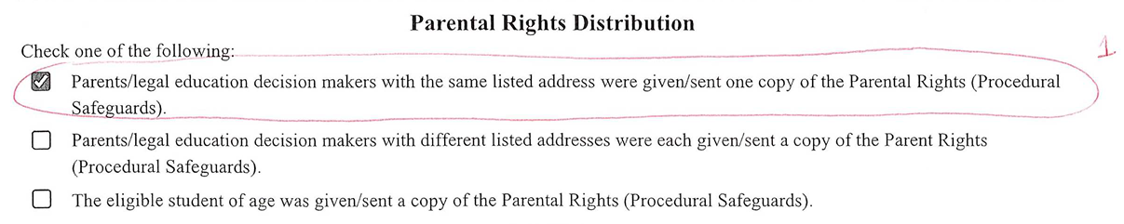
Q1 –
1.
2.
Notes:
Cary

Slide 55


Q1 – KSDE Response
1.
2.
Missing Primary language
Notes:
Cary (transitions)
The first example was accepted by the file review team.
The last example is missing the primary language. If the IEP indicates the primary language of the parent is English, this example would be accepted. If the primary language of the parent is not English, we have no idea if the Parental Rights were provided in the parent's primary language.

Slide 56
Q2 and Q3 – example 1
Relevant Background Information:
XXX received infant-toddler services prior to school-based services. He has received specialized instruction to meet his needs since he transitioned to school-based services at age 3 in the areas of social skills, speech, cognitive skills, and pre-academic skills. In 2021, xxx continued to demonstrate a need for services and at the time continued to qualify as a student with a developmental delay and received services in the area of cognitive and communication skills.
Other:
The assessments and other testing materials used to evaluate XXX were selected and administered so as not to be discriminatory on a racial and or cultural basis. The WISC-V and WIAT-IV were administered in English the student’s primary language. Based on observations the team believes these tests and scores are a valid reflection of XXX's abilities compared to his same-age peers.
Notes:
Cary

Slide 57

Q2 and Q3– KSDE Response
Relevant Background Information:
XXX received infant-toddler services prior to school-based services. He has received specialized instruction to meet his needs since he transitioned to school-based services at age 3 in the areas of social skills, speech, cognitive skills, and pre-academic skills. In 2021, xxx continued to demonstrate a need for services and at the time continued to qualify as a student with a developmental delay and received services in the area of cognitive and communication skills.
Other:
The assessments and other testing materials used to evaluate XXX were selected and administered so as not to be discriminatory on a racial and or cultural basis. The WISC-V and WIAT-IV were administered in English the student’s primary language. Based on observations the team believes these tests and scores are a valid reflection of XXX's abilities compared to his same-age peers.
Q2 – What is the student’s race/ethnicity? Are there cultural considerations that need to be address? KSDE does not have enough information to mark this compliant. Statement is boilerplate.
Q3 - Student was assessed in English which is the student's primary language. Compliant
Notes:
Cary

Slide 58
Q2 and Q3- example 2
Background information from evaluation:
XXX a white/non-Hispanic sixteen-year-old tenth grade student at XXXXX. His cognitive abilities are in the overall low average range when compared to his same age peers.
Interpretation of results:
The assessments utilized for this evaluation were selected and administered by the evaluation team so as not to be discriminatory on a racial or cultural basis. XXX’s cultural and racial status were considered throughout the assessment process. According to the information provided by test developers, the assessment are appropriate for xxx’s native language is English and therefore the tests were administered in English. Standardized test are normed across racial and cultural diverse groups, so as to minimize discriminatory effects in these groups.
Notes:
Cary

Slide 59

Q2 and Q3- example 2 – KSDE Response
Background information from evaluation:
XXX a white/non-Hispanic sixteen-year-old tenth grade student at XXXXX. His cognitive abilities are in the overall low average range when compared to his same age peers.
Interpretation of results:
The assessments utilized for this evaluation were selected and administered by the evaluation team so as not to be discriminatory on a racial or cultural basis. XXX’s cultural and racial status were considered throughout the assessment process. According to the information provided by test developers, the assessment are appropriate for xxx’s native language is English and therefore the tests were administered in English. Standardized test are normed across racial and cultural diverse groups, so as to minimize discriminatory effects in these groups.
Students race/ethnicity is indicated. Student’s cultural and racial status were considered throughout the assessment process
Student was tested in native language – English.
Notes:
Cary

Slide 60
Q2 and Q3 – example 3
Student was evaluated in his native language which is English. The following standardized assessments, rating scales, and screeners (WIDS-V, WIAT-4, BASC-3, ABAS-3, CASL-2, and Fast Bridge) were selected as part of this evaluation and were determined to be nondiscriminatory on a racial and cultural basis for this student, based on professional understanding of the assessment and bias mitigation as noted in the technical manuals of these assessments, ratings, and screeners. Multiple measures were used to mitigate the impact of bias in this evaluation and will be further described in this report. Any limitations that may exist and result in bias due to racial or cultural factors were reviewed and considered as part of this evaluation and determined to not be a significant factor in current eligibility determination.
Notes:
Cary

Slide 61
Q2 and Q3 – example 3 – KSDE Response
Q2 - What is the student's race/ethnicity? Are there cultural considerations that need to be addressed? KSDE does not have enough information to mark this compliant. Is it described further in the report?
Student was evaluated in his native language which is English. The following standardized assessments, rating scales, and screeners (WIDS-V, WIAT-4, BASC-3, ABAS-3, CASL-2, and Fast Bridge) were selected as part of this evaluation and were determined to be nondiscriminatory on a racial and cultural basis for this student, based on professional understanding of the assessment and bias mitigation as noted in the technical manuals of these assessments, ratings, and screeners. Multiple measures were used to mitigate the impact of bias in this evaluation and will be further described in this report. Any limitations that may exist and result in bias due to racial or cultural factors were reviewed and considered as part of this evaluation and determined to not be a significant factor in current eligibility determination.
Q3 - Student was assessed in English which is the student's primary language. Compliant
Notes:
Cary

Slide 62
Q2 and Q3 – example 4
The BASC-3 TRS and SRP were selected as part of this evaluation. These rating scales were determined to be nondiscriminatory on a cultural and ethnic basis when combined with follow-up interviews and further information. Bias mitigation techniques in the norming process are described in the BASC-3 technical manual and the BASC-3 was administered as described in order to mitigate the impact of bias.
XXXX is an English-speaking, African American female. While some research indicates that the BASC-3 overidentifies African American students for social emotional problems and ADHD. Information collected through culturally sensitive interviews, and clinical validation of the diagnosis mitigate the impact of bias on this evaluation.
Notes:
Cary

Slide 63
Q2 and Q3 – example 4 KSDE Response
The BASC-3 TRS and SRP were selected as part of this evaluation. These rating scales were determined to be nondiscriminatory on a cultural and ethnic basis when combined with follow-up interviews and further information. Bias mitigation techniques in the norming process are described in the BASC-3 technical manual and the BASC-3 was administered as described in order to mitigate the impact of bias.
XXXX is an English-speaking, African American female. While some research indicates that the BASC-3 overidentifies African American students for social emotional problems and ADHD. Information collected through culturally sensitive interviews, and clinical validation of the diagnosis mitigate the impact of bias on this evaluation.
Students race/ethnicity is indicated. Student’s cultural and racial status were considered throughout the assessment process
Student was tested in native language – English.
Notes:
Cary

Slide 64
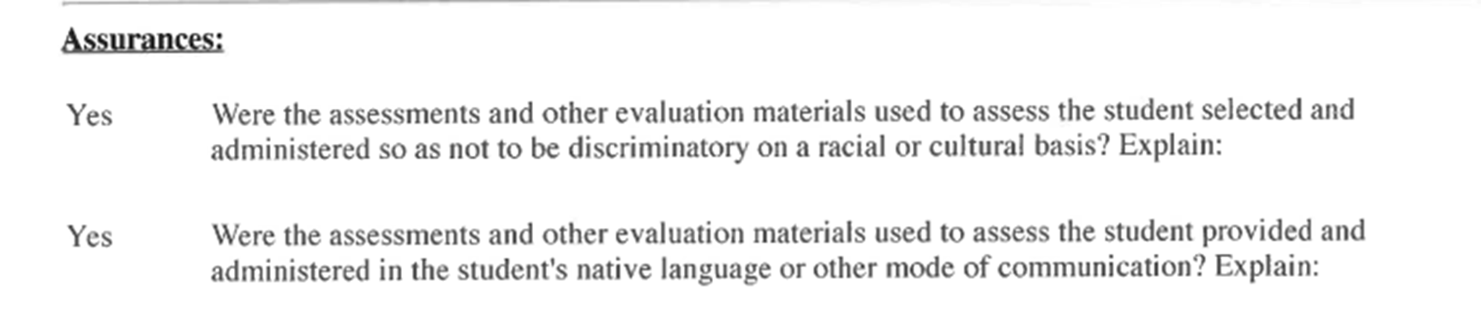
Q2 and Q3– example 5
Notes:
Cary

Slide 65
Q2 and Q3– example 5 KSDE Response
Q2 – What is the student’s race/ethnicity? Are there cultural considerations that need to be address? KSDE does not have enough information to mark this compliant.
Q3 - What language was the student assessed in? What is the native language of the student?
Notes:
Cary

Slide 66
Q2 and Q3 example – Dialect Differences
XXXX, an 8 yr old, male child of Asian, African American, and Caucasian descent is a 3rd grader at XXXX. English is the language in the home and of instruction, so a lack of English language proficiency is not considered a factor in XXX’s ability to access the general education curriculum. Assessments for this reevaluation were chosen to minimize bias based on racial/cultural background. No one assessment should be utilized to determine education placement. Because XXXX’s language skill levels are substantially different than his same-aged, typically developing peers, the team is using classroom performance, curriculum-based measurements, observations, and standardized assessments to better understand his abilities and needs. The results of the EOWPVT-4th Edition and the PPVT 5th Edition were interpreted with consideration of any dialectal or cultural differences, ensuring that differences related to the student’s background were not mistaken for errors.
Notes:
Cary

Slide 67
Q2 and Q3 example – Dialect Differences – KSDE Response
XXXX, an 8 yr old, male child of Asian, African American, and Caucasian descent is a 3rd grader at XXXX. English is the language in the home and of instruction, so a lack of English language proficiency is not considered a factor in XXX’s ability to access the general education curriculum. Assessments for this reevaluation were chosen to minimize bias based on racial/cultural background. No one assessment should be utilized to determine education placement. Because XXXX’s language skill levels are substantially different than his same-aged, typically developing peers, the team is using classroom performance, curriculum-based measurements, observations, and standardized assessments to better understand his abilities and needs. The results of the EOWPVT-4th Edition and the PPVT 5th Edition were interpreted with consideration of any dialectal or cultural differences, ensuring that differences related to the student’s background were not mistaken for errors.
Students race/ethnicity is indicated. Student’s cultural and racial status were considered throughout the assessment process
Student was tested in native language – English.
Notes:
Cary

Slide 68
Question 4
4. During the most recent evaluation or reevaluation of the student, was the student assessed in ALL areas related to the suspected exceptionality, including, if appropriate, health, vision, hearing, social and emotional status, general intelligence, academic performance, communicative status, and motor abilities? 34 C.F.R. 300.304(c)(4); K.A.R. 91-40-9(b)(1)(A)-(H) METHOD: First, review the education record to determine the student’s suspected needs and areas of concern that were observed or contemplated at the time of the referral for evaluation or reevaluation. This information could be found in communications or information provided by the parent, teacher notes and observations, Student Intervention Team (SIT) notes/documents, discipline records, emergency safety intervention (ESI) records, health and vision screenings, etc. Next, review the education record to determine whether the evaluation assessed the student in ALL suspected needs and areas of concern that were observed or contemplated at the time of the referral for evaluation or reevaluation, whether or not commonly linked to the disability category in which the child has been classified. If ALL areas were not assessed, review the education record for information showing which areas were selected and why those not selected were not assessed. This information could be found in a prior written notice form, an evaluation/eligibility report, teacher/provider notes, or other documentation in the education record.
YES
Select YES if documentation shows that during the most recent evaluation or reevaluation, the student was assessed in ALL areas related to the suspected exceptionality, including, if appropriate, health, vision, hearing, social and emotional status, general intelligence, academic performance, communicative status, and motor abilities.
NO
Select NO if documentation DOES NOT show that during the most recent evaluation or reevaluation, the student was assessed in ALL areas related to the suspected exceptionality, including, if appropriate, health, vision, hearing, social and emotional status, general intelligence, academic performance, communicative status, and motor abilities.
SPECIAL NOTE: The list of areas in the question (health, vision, hearing, social and emotional status, general intelligence, academic performance, communicative status, and motor abilities) is not an exhaustive list of areas that must be assessed. Decisions regarding the areas to be assessed are determined by the suspected needs of the child.
Kansas Special Education Process Handbook, Chapter 3, Section E.1.; Chapter 7, Section E.
Notes:
Josie
Were all areas related to suspected exceptionality assessed? If an area related to the suspected exceptionality was not assessed, then document why that area was not assessed and the bases of that decision.
Speak on special note at the bottom.

Slide 69
KPH Text Reflection Ch 3 Section E
“ The evaluation must be sufficiently comprehensive to identify all of the child’s special education and related service needs, whether or not commonly linked to the exceptionality category being considered for the child.”
“The data collected is critical not only for the purpose of determining whether the child is eligible, but also to assist with the development of PLAAFP and in the development of an instructional plan if not eligible.
If the child is found eligible, this information translates in the PLAAFP and forms the basis for making all the decisions in the IEP. If the child is not found eligible, the information assists the school in determining other appropriate instruction and supports for the child.”
“…at the close of the evaluation, the team should have enough information to support the child whether or not eligible.”
(Taken from Greenbush Comprehensive Evaluation workshop)
Notes:
Josie

Slide 70
Assessment Summary
✓A relevant, thorough, and complete assessment is the first step in program development.
✓A relevant assessment is the path to relevant present level statements, good goals and appropriate services.
✓Assessment depends on everyone’s input.
✓The assessment should serve as a baseline for measuring student progress.
Taken from Yell and Bateman CEC2025
Notes:
Josie

Slide 71
Question 5
5. IDEA only: If the school required the parent to obtain a medical diagnosis as part of the evaluation or re-evaluation, did the public agency pay for it? 34 C.F.R. 300.17(a), 300.34(c)(5); K.A.R. 91-40-1(z)(1), 91-40-1(nn) METHOD: First review the education record for documentation indicating whether the parent was required to obtain a medical diagnosis for the student as part of the evaluation or re-evaluation. If documentation shows that a medical diagnosis was required, review the education record for documentation that the public agency paid for the medical diagnosis or reimbursed the parent for the cost of obtaining the medical diagnosis.
YES
Select YES if documentation shows that the parent was required to obtain a medical diagnosis AND the public agency paid for it.
NO
Select NO if documentation shows that the parent was required to obtain a medical diagnosis and the public agency did NOT pay for it.
N/A
N/A Select N/A if documentation shows:
• This is a file for a gifted-only student.
OR
• The public agency did not require the parent to obtain a medical diagnosis for the student as part of the evaluation or re-evaluation.
SPECIAL NOTE: A medical diagnosis may be considered as supporting information. However, a diagnosis is not required by law, nor necessarily determinative, in eligibility decisions. If the parent elected to unilaterally obtain a medical diagnosis at any time, the public agency is not required to reimburse the parent.
Kansas Special Education Process Handbook, Chapter 3, Questions and Answers Section, Q. 13. Kansas State Department of Education Eligibility Indicators
.
Notes:
Josie
If the school required the parent to receive a medical diagnosis, did the school pay for it? Parents can elect to obtain a medical diagnosis on their own, which the school is not required to reimburse the parent.
We made a slight wording change on this question to make it clearer that this only applies to medical diagnosis that the school required the parent to obtain.

Slide 72
Question 6
6. Upon completing the most recent evaluation or reevaluation of the student, did a team of qualified professionals AND the parent determine whether the student is a student with an exceptionality? 34 C.F.R. 300.306(a)(1); K.S.A. 72-3428(e)(1) METHOD: Review the education record for documentation indicating who was included as part of the group responsible for determining the student’s initial or continued eligibility. This information could be found in the evaluation/eligibility report, a meeting attendance record, meeting notes, etc. Note that K.A.R. 91-40-10(a)(2) requires each member of the team of qualified professionals (but not the parent) to certify in writing whether the evaluation report reflects the team member’s conclusion; this certification document would serve as evidence of who was on the team. Documentation must show that all professionals on the team provided input and contributed to the decision. For evidence of the parent’s involvement in the eligibility determination, look for documentation that they had the opportunity to provide input in the preparation of the evaluation report and at the eligibility meeting.
YES
Select YES if documentation shows that the most recent (initial or continued) eligibility determination was made by ALL of the following:
• A team of qualified professionals
AND
• The parent
NO
Select NO if documentation DOES NOT show that the most recent (initial or continued) eligibility determination was made by ALL of the following:
• A team of qualified professionals
AND
• The parent
N/A
Select N/A if documentation shows:
File is for a student that is suspected to have a specific learning disability.
SPECIAL NOTE: A team of qualified professionals – refer to pg 40 of the Process Handbook for definition of “Evaluation Team” member
Kansas Special Education Process Handbook, Chapter 3, Sections C. and F.; Chapter 7, Sections D. and F.
.
Notes:
Josie
Questions 6 asks "…“ In order to document the team of qualified professionals that were part of the decision, the requirement of each member to certify in writing whether the evaluation report reflects their own conclusion is sufficient documentation to show who was part of the professional team. The team must be made up of qualified professionals, not just one professional like the school psychologist. For student with sensory loss, don't forget it will be vital to have professional who specialize in that field as part of the team. The parent also needs to be included in the decision to determine whether the student has an exceptionality. For evidence of the parent involvement, documentation that they had the opportunity to provide input in the preparation of the evaluation report and eligibility at the meeting. If both a team of qualified professional AND the parent made the eligibility determination select YES. If neither or only one of the two made the eligibility determination, mark NO. If the parent does not attend, documentation will need to show 2 attempts to contact using two different methods. The parent must be given the opportunity to provide input on the evaluation and eligibility report even if they do not attend, however if they do choose not to attend this opportunity can still be obtained and documented later.
For students who are suspected to have a specific learning disability select N/A and answer question 7 instead.
There is a list of potential members of the evaluation team in chapter 3, page 40 of the process handbook.

Slide 73
The Evaluation Team (KPH Ch 3 Section C)
Team members on each evaluation team may differ; however, there are specific members and skills that must be represented on the team. The makeup of this team would include:
The parents of the child;
Not less than one regular education teacher of the child (if the child is, or may be, participating in the regular education environment); If the child does not have a regular teacher, a regular classroom teacher qualified to teach a child of his or her age; or if the child is less than school age, an individual qualified to teach a child of his or her age;
Not less than one special education teacher of the child, or where appropriate, not less than one special education service provider of the child;
A representative of the local education agency who:
Is qualified to provide, or supervise the provision of, specially designed instruction to meet the unique needs of children with exceptionalities,
Is knowledgeable about the general education curriculum, and
Is knowledgeable about the availability of resources of the public agency;
An individual who can interpret the instructional implications of evaluation results;
At least one person qualified to conduct individual diagnostic examinations of children; and (Q7)
At the discretion of the parent or agency, other individuals who have knowledge or special expertise regarding the child, including related services personnel as appropriate. (K.S.A. 72-3404(u); K.A.R. 91-40-11(a); 34 C.F.R. 300.321; 34 C.F.R. 300.308)
Notes:
Josie

Slide 74
Question 7
7. IDEA only: If the student was suspected to have a specific learning disability, did the group responsible for determining (initial or continued) eligibility include ALL of the following?: 34 C.F.R. 300.308; K.A.R. 91-40-11(a) • The student’s parents; and • The student’s regular teacher; or if the student does not have a regular teacher, a regular classroom teacher qualified to teach a student of his or her age; or for a child of less than school age, an individual qualified by the SEA to teach a child of his or her age; and • At least one person qualified to conduct individual diagnostic examinations of children, such as school psychologist, speech-language pathologist, or reading specialist
METHOD: First, review the education record to determine if the student was suspected to have a specific learning disability when the evaluation or reevaluation was conducted. This information could be found in a parent’s or teacher’s/provider’s referral, Student Intervention Team (SIT) notes/documents, a prior written notice form, an evaluation/eligibility report, the IEP, etc. Next, review the education record for documentation indicating who was included as part of the group responsible for determining the student’s initial or continued eligibility. This information could be found in the evaluation/eligibility report, a meeting attendance record, meeting notes, etc. Note that K.A.R. 91-40-10(a)(2) requires each member of the team of qualified professionals (but not the parent) to certify in writing whether the evaluation report reflects the team member’s conclusion; this certification document would serve as evidence of who was on the team. For evidence of the parent’s involvement in the eligibility determination, look for documentation that they had the opportunity to provide input in the preparation of the evaluation report and at the eligibility meeting.
Notes:
Crista
SLD – Must include parents, regular education teacher, and at least one person qualified to conduct individual diagnostic examination of children.
Chapter 3 in the Process Handbook (pg 40-41) includes a description of the required Evaluation Team members.
Review the record to ensure that all 3 required participants were involved in determining the student’s initial or continued eligibility. This can be found in the evaluation/eligibility report, meeting attendance record, meeting notes, etc. Parents need to have had the opportunity to provide input in the preparation of the evaluation report and at the eligibility meeting

Slide 75
Question 7 Continued
YES
Select YES if documentation shows that the group responsible for determining initial or continued eligibility included ALL of the following:
• The student’s parents;
AND
• The student’s regular teacher, or if the student does not have a regular teacher, a regular classroom teacher qualified to teach a student of his or her age, or for a child of less than school age, an individual qualified by the SEA to teach a child of his or her age;
AND
• At least one person qualified to conduct individual diagnostic examinations of children, such as school psychologist, speech-language pathologist, or remedial reading teacher.
NO
Select NO if documentation DOES NOT show that the group responsible for determining initial or continued eligibility included ALL of the following:
• The student’s parents;
AND
• The student’s regular teacher, or if the student does not have a regular teacher, a regular classroom teacher qualified to teach a student of his or her age, or for a child of less than school age, an individual qualified by the SEA to teach a child of his or her age;
AND
• At least one person qualified to conduct individual diagnostic examinations of children, such as a school psychologist, speech-language pathologist, or remedial reading teacher.
N/A
Select N/A if documentation shows:
• This is a file for a gifted-only student.
OR
• This is a file for a student who was not suspected to have a specific learning disability.
Kansas Special Education Process Handbook, Chapter 3, Sections C. and F (pg 40-41)., Chapter 7, Sections D. and F..
Notes:
Crista
The FAQ document reminds reviewers that if the parent does NOT participate, despite opportunity, they should document attempts, same as question 6
They need to have the OPPORTUNITY to meaningfully participate in the eligibility decision. There is no excusal form for eligibility meetings, only IEP meetings.

Slide 76
Question 9
8. When interpreting evaluation data to determine if the student is or continues to be a student with an exceptionality and the educational needs of the student, did the team of qualified professionals and the parent draw upon, document, and carefully consider information from a variety of sources including aptitude and achievement tests, parent input, teacher recommendations, physical condition, social or cultural background, and adaptive behavior? 34 C.F.R. 300.306(c)(1)(i)-(ii); K.A.R. 91-40-10(d)(1)-(2) METHOD: Review the evaluation/eligibility report, team meeting notes, prior written notice forms, and other documentation in the education record to determine if the team and the parent drew upon, documented, and carefully considered information from a variety of sources when determining eligibility and the educational needs of the student. A checklist of these sources alone would not be sufficient to show that the information was carefully considered and documented.
YES
Select YES if documentation shows that when determining initial or continued eligibility and the educational needs of the student, the team of qualified professionals and the parent drew upon, documented, and carefully considered information from a variety of sources.
NO
Select NO if documentation DOES NOT show that when determining initial or continued eligibility and the educational needs of the student, the team of qualified professionals and the parent drew upon, documented, and carefully considered information from a variety of sources.
Kansas Special Education Process Handbook, Chapter 3, Section E.1.; Chapter 7, Section E.
.
SPECIAL NOTE: The list of sources in the question (aptitude and achievement tests, parent input, teacher recommendations, physical condition, social or cultural background, and adaptive behavior) is not an exhaustive list of sources that must be drawn upon, documented and carefully considered. The point of 34 C.F.R. 300.306(c)(1)(i)-(ii) and K.A.R. 91-40-10(d)(1)-(2) is to ensure that more than one source is used in interpreting evaluation data and making these determinations, and although these regulations include a list of examples of sources that may be used, the public agency would not have to use all the sources in every instance. 64 Federal Register 12,636 (Mar. 12, 1999).
Notes:
Josie
Question 8 pertains to continuation of exceptionality and continued educational needs of the student. In this question, the team of qualified professionals and the parent should be documenting and carefully considering information from a variety of sources when determining if the student is or continues to be a student with an exceptionality. The variety of information should come from aptitude and achievement tests, parent input, teacher recommendations, physical condition, social or culture background, and adaptive behavior. The file should have documentation that the team considered more than one assessment or record. If there are no concerns about adaptive behavior for the student, documentation should state that. A checklist alone is not acceptable documentation, instead the documentation should show that the information was carefully considered when making the eligibility decision. As a reminder, when considering a student for the alternate assessment, students must have significant deficits in cognitive AND in adaptive behavior. Select YES if documentation shows that multiple sources of information were carefully considered when determining initial or continued eligibility. Select NO if the documentation does not show this careful consideration, for example, a simple checklist of evaluation data does not show careful consideration and would be considered non-compliant.
Special note: This isn’t an exhaustive list nor is it required to have every single piece of data listed. The point is to ensure more than one source is used in interpreting evaluation data and making determinations.

Slide 77
RIOT
Record Review
Review of historical records and products
Interview
Interview with key stakeholders
Key Domains of Learning
+
Potential Sources of Information
Observation
Observation of student performance in natural environment
Test
Test student through careful use of appropriately matched measurement technologies
Taken from Greenbush Comprehensive Evaluation Workshop
Notes:
Josie
RIOT is a framework used in comprehensive special education evaluations to ensure that a wide range of data is collected from multiple sources. The acronym stands for Review, Interview, Observation, and Test. Each component of the RIOT process guides evaluators to collect data from diverse sources to create a holistic picture of a student's educational needs.

Slide 78
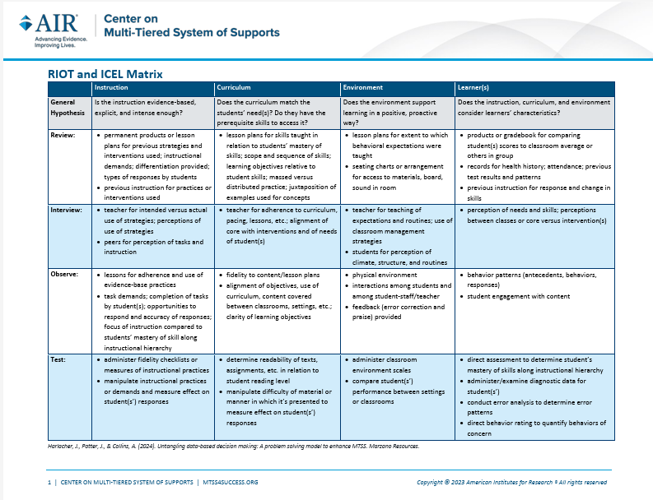
RIOT and ICEL Matrix
Notes:
Josie
RIOT is often combined with ICEL (Instruction, Curriculum, Environment, and Learner), which represents the domains to be assessed. Using the RIOT-ICEL matrix helps educational teams systematically gather information and avoid basing decisions on a single piece of data. This combined approach ensures that evaluators consider the potential influence of environmental and instructional factors before solely focusing on the student.
It isn’t LICE. Learner is only addressed when the curriculum and instruction are found to be appropriate and the environment accommodating.

Slide 79
Interpreting Data and Information
Ask questions when interpreting data to reduce bias.
Did we equally consider all the data? If not, what data did we not fully consider and why?
Did the data tell us what the student can do as well as student strengths? If not, go back and review the data or gather additional data.
Did the data converge to confirm the problem?
Did the data converge to confirm why the problem is occurring?
Did the data tell us what the student’s disability –related needs are so that we can develop IEP goals and align college and career ready IEP services?
Taken from Greenbush Comprehensive Evaluation Workshop
Notes:
Josie

Slide 80
Question 10
9. IDEA only: Did the group responsible for determining the student’s (initial or continued) eligibility ensure that NONE of the following were the determinant factor? 34 C.F.R. 300.306(b)(1)(i)-(iii); K.A.R. 91-40-10(c) • Lack of appropriate instruction in reading, including the essential components of reading instruction (as defined in section 1208(3) of the ESEA as such section was in effect on the day before the date of enactment of the Every Student Succeeds Act (December 9, 2015)); or o “The term ‘essential components of reading instruction’ means explicit and systematic instruction in-- (A) Phonemic awareness; (B) Phonics; (C) Vocabulary development; (D) Reading fluency, including oral reading skills; and (E) Reading comprehension strategies” Federal Register, Vol. 71, August 14, 2006, p.46646. • Lack of appropriate instruction in math; or • Limited English proficiency METHOD: Review the evaluation/eligibility report to determine whether the team and the parent examined ALL of these exclusionary factors before determining the student is or continues to be a student with an exceptionality.
YES
Select YES if documentation shows that NONE of the following were a determinant factor when determining the student’s initial or continued eligibility:
• Lack of appropriate instruction in reading including explicit and systematic instruction in phonemic awareness, phonics, vocabulary development, reading fluency, oral reading skills, and reading comprehension strategies.
OR
• Lack of appropriate instruction in math.
OR
• Limited English proficiency.
Select YES if student is gifted only.
NO
Select NO if documentation DOES NOT show that NONE of the following were a determinant factor when determining the student’s initial or continued eligibility:
• Lack of appropriate instruction in reading including explicit and systematic instruction in phonemic awareness, phonics, vocabulary development, reading fluency, oral reading skills, and reading comprehension strategies.
OR
• Lack of appropriate instruction in math.
OR
• Limited English proficiency.
Kansas Special Education Process Handbook, Chapter 3, Section F.1.(a)-(b); Chapter 7, Section F.
.
Notes:
Josie
This question had the 4th highest number of non-compliant files last year.
Common findings: Teams generally did a good job documenting for SLD in writing as required, but did not locate documentation demonstrating that exclusionary criteria were considered for initial or continued eligibility decisions for all other exceptionalities. Review the Evaluation/eligibility report for documentation that the team and the parent examined All of the exclusionary factors before determining the student is or continues to be a student with an exceptionality. Exclusionary factors for gifted come into play when a gifted student is not determined eligible for gifted services due to one of the exclusionary factors. Since file review is based on students who are eligible for services, it would be assumed that exclusionary factors did not play into eligibility determinations for a gifted student, therefore all gifted students should be marked yes. It is still best practice to include this documentation for gifted only students and should always be part of the eligibility conversations during determination meetings.
Did exclusionary factors prevent the student from being determined eligible. – add slide.

Slide 81
Q 9-did the group responsible for determining the student’s (initial or continued) eligibility ensure that NONE of the following were DETERMINANT factor?
These factors are sometimes referred to simply as “exclusionary factors”.
The multidisciplinary evaluation team, including the parent, must consider these factors for any area of exceptionality, including gifted.
This does not mean the team must conclude the absence of exclusionary factors. Rather, the team must determine the degree to which each factor affects the student’s performance. The fundamental question is whether the poor performance (or the need for advanced instruction through special education in the case of gifted service) is primarily the result of any of these factors.
There are additional factors that must be considered and documented for a specific learning disability as described in the Eligibility Indicator document found on the KSDE website
Notes:
Josie

Slide 82
Consideration of Exclusionary Factors
A child must not be determined to be a child with a disability if the determinant factor for the eligibility determination is the result of any of the following:
1. Has the child received appropriate instruction in reading including the essential components of reading instruction as defined in the Elementary and Secondary Education Act, which are phonemic awareness, phonics, vocabulary development, reading fluency including oral reading skills, & reading comprehension?
Yes No (If no, complete the following)
Lack of appropriate instruction in reading IS/IS NOT the determinant factor.
2. Has the child received appropriate instruction in math?
Yes No (If no, complete the following)
Lack of appropriate instruction in math IS/IS NOT the determinant factor.
3. Does the child have limited English proficiency?
Yes (If yes, complete the following) No
Limited English Proficiency IS/IS NOT the determinant factor.
Notes:
Josie

Slide 83
Q9 Strategies
Eligibility document includes the consideration of the exclusionary factors.
Re-evaluation on existing data report includes the consideration of the exclusionary factors.
Notes:
Josie

Slide 84
Be the reviewer Q6 & 9
Notes:
Josie
Q4-9
We are going to provide a few examples and ask you to discuss the documentation and whether your table feels it is compliant or what it is missing. We will then discuss as a group.

Slide 85
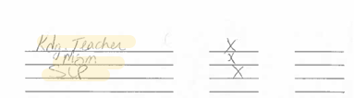
Q6 Example
Signature page from the MDT Report
Notes:
Josie

Slide 86

Q6 Example – KSDE Response
Who is knowledgeable about the availability of resources of the public agency?
Required Evaluation Team Members
The parents of the child;
Not less than one regular education teacher of the child;
Not less than one special education teacher of the child,
A representative of the local education agency
An individual who can interpret the instructional implications of evaluation results;
Signature page from the MDT Report
Notes:
Josie
(this slide has transitions)

Slide 87
The LEA Representative
Who may serve as the LEA representative (IDEA Regulations, 34 C.F.R. 300.321 § [a][4][i-iii]).
Must be qualified to provide, or supervise the provision of, specially designed instruction
Is knowledgeable about the general education curriculum
Is knowledgeable about the resources of the school district
The school district may designate the LEA representative as long as they meet the above criteria (IDEA Regulations, 34 C.F.R. 300.321 § [d]).
Notes:
Josie

Slide 88
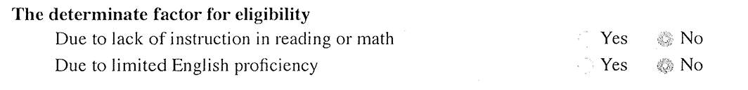
Q9 Example
Notes:
Josie
It would be preferred to have all three questions separate like the self-assessment shows, but these examples would still be considered compliant.

Slide 89
Q9 Example – KSDE Response
Notes:
Josie
It would be preferred to have all three questions separate like the self-assessment shows, but these examples would still be considered compliant.

Slide 90
IDEA & Gifted File Review Self-Assessment: IEP Development, Revision, & Review
Present Levels of Academic Achievement & Functional Performance (PLAAFPs) (PDF)
Questions 10-12
Notes:
Melissa
We have included a link to the PLAAFP document located on the KIAS page this is a great resource for IEP teams

Slide 91
Bateman & Linden, 2012
The IEP is like a house. The assessment is the foundation upon which the house is built. Neither a house nor a student’s IEP can stand on a faulty foundation. If a student’s assessment is incorrect or incomplete, the foundation of the IEP is faulty, and the IEP will not stand.
Notes:
Melissa

Slide 92
Build the structure of the IEP by Addressing the 4 primary FAPE Questions
What are a student’s individualized academic and/or functional needs to be addressed in the IEP? (PLAAFP)
What ambitious & measurable goals will enable a student to make academic and/or functional progress? (Annual Goals)
What special education services does a student require to make academic and/or functional progress (Sped services, related services, accommodations)
How will we determine if a student made progress toward his/her academic and/or functional goals?
Taken from Yell and Bateman CEC2025
Notes:
Melissa

Slide 93
The PLAAFP Statement is the Foundation for the IEP
PROGRESS Center at the American Institutes for Research® The PLAAFP Statement is the Foundation for the IEP National Center on Intensive Intervention at the American Institutes for Research CEC 2025
Notes:
Melissa

Slide 94
Key Questions for Designing the PLAAFP Statement
What do we want for our student? (described in the PLAAFP statement and measurable annual goals)
What is the student’s current reality and unique circumstances? (described in the PLAAFP statement)
What does the student need to be successful? (described in the PLAAFP statement and outlined in IEP aids/services)
How can we maximize our resources to support the student? (described in the placement and implementation of the IEP)
Essential for knowing the student and to collaboratively develop the PLAAFP statement with the family, student, related service providers, and educators.
PROGRESS Center at the American Institutes for Research® The PLAAFP Statement is the Foundation for the IEP National Center on Intensive Intervention at the American Institutes for Research CEC 2025
Notes:
Melissa

Slide 95


PLAAFPs Tip Sheet
What does IDEA say about the PLAAFP statement?
A statement of the child’s present levels of academic achievement and functional performance, including—
How the child’s disability affects the child’s involvement and progress in the general education curriculum (i.e., the same curriculum as for nondisabled children); or
(ii) For preschool children, as appropriate, how the disability affects the child’s participation in appropriate activities.
PROGRESS Center at the American Institutes for Research® The PLAAFP Statement is the Foundation for the IEP National Center on Intensive Intervention at the American Institutes for Research CEC 2025
Notes:
Melissa
PLAAFP statements prevent us from experiencing the dreaded and harmful “assumacide”. Assumacide is when we make decisions about programming or identify practices or supports based on our assumptions, rather than evidence. PLAAFPS are based on the individual needs that a child experiences because of the disability.
There are four essential elements of a high quality PLAAFP included on the tip sheet. All PLAAFPs need to include student needs, effect on progress in the general education, baseline information, and connection to goals and/or services.
Element 1 -Student needs addresses information on the student’s current academic and/or functional needs. – Question 10 and 11
Element 2 – Effect on progress in the general education classroom is an explanation of how the disability affects the student’s involvement and progress in the general education curriculum. – Question 12
Element 3 - Baseline information is the baseline data for monitoring student data. Baseline data needs to be specific, objective, and measurable.
Element 4 – connection to goals and/or services. This is the bridge between the PLAAFP statement and an annual goal, service, or supports listed in the IEP. – Question 13

Slide 96
Present Levels of Academic Achievement and Functional Performance
Accurate PLAAFP statements provide the
starting point or baseline for a student’s IEP
Identify Student Need
Effect on General Education
Serves as a baseline
Connected to a service, goal, or both
Taken from Yell and Bateman CEC2025
Notes:
Melissa

Slide 97
Question 11
10. Does the IEP include a description of the student’s present level of academic achievement as part of the Present Levels of Academic Achievement and Functional Performance (PLAAFPs)? 34 C.F.R. 300.320(a)(1); K.S.A. 72-3429(c)(1) METHOD: Review the IEP to determine if it includes information about the student’s current academic achievement.
Examples of What Current Performance Could Include:
Standardized Assessments | Instructional Preferences
Screening Data | Learning Rate & Strengths
Progress Monitoring Data | Diagnostic Assessments
Writing rubric | Results of recent re-evaluation
YES
Select YES if the IEP includes a description of the student’s current level of academic achievement.
NO
Select NO if the IEP DOES NOT include a description of the student’s current level of academic achievement.
Kansas Special Education Process Handbook, Chapter 4, Section E.2.a..
Notes:
Melissa
Academic achievement generally refers to a child’s performance in academic areas. It could vary depending on a child's circumstance or situation, therefore, a definition of academic achievement is not included in the IDEA regulations.
METHOD: Review the IEP to determine if it includes information about the student’s current academic achievement. In most cases we are talking about reading, writing, math, science , and history.
Yes or No: The IEP includes or does not include a description of the student’s current level of academic achievement.

Slide 98
PLAAFP Example
Student Needs
Effect on Progress in General Education
Baseline
Connection to Goals and Services
In January 2019, G.H. was identified as a student with a learning disability in the area of math calculation. Current data, indicate that G.H. continues to need specially designed instruction in the areas of math calculation to benefit from grade level math curriculum. On recent standardized math benchmark tests conducted in January 2022, G.H. scored at the 9th percentile, which is well below average. On three standardized measures of mixed-math fact fluency administered on 2/7 and 2/8, G.H. accurately recalled, on average, 18 facts compared with grade-level expectations of 75 facts in 2 minutes. Specifically, G.H. recalled about three multiplication mixed facts (0–9), 15 addition facts (0–9), and 0 division and subtraction facts (0–9) in the 2 minutes. This affects his ability to complete sixth-grade math assignments at the same rate as his peers and efficiently use mental math calculation skills to complete word problems. To complete grade-level math assignments, G.H. currently benefits from shortened assignments, peer support, and the use of a calculator. Increasing his math fact proficiency would increase his ability to independently access and benefit from grade-level math instruction. Review of current intervention implementation data suggests that G.H. benefits from daily direct one-on-one instruction distributed across the school day. G.H. would like to graduate with his peers and attend college.
example taken from the recent Prepping for Progress 2023 Conference on the ABC’s of IEPs
Notes:
Melissa
This was an example taken from the recent Prepping for Progress 2023 Conference on the ABC’s of IEPs We have color coded and highlighted to help show how some of this information may overlap between the 4 elements

Slide 99
Sample PLAAFP Statement Structure
Data from (sample source) indicates Student (performs in this way (objective data)) which affects (must include impact on involvement and progress in the general education curriculum). As a result, the student needs (justifies proposed services and supports).
example taken from the recent Prepping for Progress 2023 Conference on the ABC’s of IEPs
Notes:
Melissa
This sample was shared during the Prepping for Progress ABCs to IEPs

Slide 100
Example of Current Academic Achievement and Functional Performance
Jeremiah is a 9-year-old fourth grade student with average ability, whose achievement testing shows relative strength in reading and weakness in math. Jeremiah is reading at grade level and has good comprehension. He likes to read, and he also enjoys science activities. His most recent Curriculum Based Measurement (CBM) testing showed that he read 111 words per minute, which is at the 65th percentile on local norms. Math CBM testing showed that he scored 9 digits correct in a two-minute timing, which is at the 17 percentile on district fourth grade norms. Mom reports that he brings home assignments requiring reading, but he forgets his math homework.
In his general education 8th grade math classroom, Mike is currently turning in about half of his assignments, and only about a third of those assignments are completed. Accuracy of his turned-in work fluctuates markedly. Because of his poor assignment completion, Mike received a mid-quarter failing warning letter. Mike’s completion of assignments in other curricular areas is not a concern.
Notes:
Melissa
We have provided you with 2 examples that include a description of the student’s present level of academic achievement as part of the Present Levels of Academic Achievement and Functional Performance

Slide 101
Question 12
11. Does the IEP include a description of the student’s present level of functional performance as part of the PLAAFPs? 34 C.F.R. 300.320(a)(1); K.S.A. 72-3429(c)(1) METHOD: Review the IEP to determine if it includes information about the student’s current functional performance. If there are no current concerns about functional performance, the IEP must include a statement that functional performance was considered.
Examples of What Functional Performance Could Include:
Social/Emotional Skills | Motor Skills/Mobility
Communication | Memory
Perception or Attention Abilities | Vocational/Career Interests
Task Persistence/Completion | Independent Living Skills
YES
Select YES if the IEP includes a description of the student’s current level of functional performance or a statement that functional performance was considered and there are no current concerns.
NO
Select NO if the IEP DOES NOT include a description of the student’s current level of functional performance or a statement that functional performance was considered and there are no current concerns.
Kansas Special Education Process Handbook, Chapter 4, Section E.2.a.
Notes:
Melissa
Question number 11 is looking at whether or not the student's present level of functional performance is part of the IEP. There is no formal definition of functional performance in the law. Functional performance generally refers to activities that are not considered academic or related to a child's academic achievement. Functional often is used in the context of routine activities of daily living. Other examples of functional performance could be social/emotional skills, communication, attention, persistence, mobility and motor skills, memory, vocational or career interest, behavior, executive functioning, and independent living skills (dressing, eating, toileting). The PLAAFP must include a statement about the student’s current functional performance and its impact on progress in the general education curriculum. The purpose of including functional performance for all students that have exceptionalities is to prepare them for life after school. Functional performance applies to all exceptionalities, including gifted. However, the description of functional performance may look different for a gifted student, such as work completion, social skills, time management, and executive function. When you review this question, select YES if there is a description of the current level of functional performance in the student's IEP, and select NO if the IEP does not include this description.
If there are no functional needs and functional performance is age appropriate, document and state why you feel that is true. Functional needs may be addressed in other areas of the PLAAFPs and do not need to be addressed in every PLAAFP area.

Slide 102
Functional Performance
Jonah has difficulty paying attention during class time. His inability to stay on task and follow directions is negatively affecting his classroom performance. When asked to begin work, he often looks around as if he does not know what to do. Observations indicate he often looks to peers for directions, rather than attending to the teacher. This occurs in both classes that he likes and in those he does not like. When the teacher goes to him to provide individual help, he refuses help and insists he understands what to do, but then he often completes the assignment incorrectly.
Jonah also needs to work on staying in his personal space and not invading others’ personal space. This is exhibited when he swings a backpack or his arms around in a crowded room or while walking down the hall. Observations of Jonah show this is also an issue during games in PE class and in unstructured activities during recess, such as playing tag. He is unable to appropriately interact with others. He sometimes stands very close to other students, squaring up to them, in a posture that is intimidating to younger students, and challenging to those his own age. He has also been observed to inappropriately touch other students. These behaviors have been especially problematic during special out-of-school activities, and Jonah has not been allowed to attend the last two class field trips, because of the severity of problems on earlier field trips. Teachers estimate that he inappropriately invades other's space at least 50% of the time during unstructured activities. Observations using interval recording indicate that during recess he invaded others’ space during 70% of the observation intervals. During classroom time, he was out of his seat and inappropriately close to another student during 35% of the observation intervals. Total off-task behavior during classroom observation was 60% of observed intervals.
Notes:
Melissa
This example is from the PLAAFP guidance document on the KSDE website and IDEA and gifted file review toolkit

Slide 103
What might functional performance include for Gifted-Only IEP?
The handout for IEP Boot Camp for Gifted lists the following examples on page 4:
Examples of information related to Functional Performance
Observation reporting student’s task persistence across domains/environments
Observation of student’s interaction with peers during classroom group project
Teacher report regarding student’s time management (e.g., rate of turning in projects on time)
Observation shows ability to concentrate intensely
Reports of student’s ability or willingness to communicate with adults or peers
Emotional issues (e.g., perfectionism, frustration, feeling different, etc.)
Score on problem-solving rubric
Interview indicates interest in social/political issues
Participation in community activities
Results of Career Cruising (or other general education career inventory)
The IEP Boot Camp for Gifted (on the TASN website) provides these examples of functional performance in the slides:
Social/emotional Issues
Social skills with peers (e.g.: can the student work with a group in the classroom to complete a project?)
Career interests and skills related to those interests
Task persistence
Memory issues
Communication with adults and peers
Impact of perceptual or attention issues
Time management (e.g., turning projects in on time)
And parent concerns
Notes:
Josie
As I mentioned on the last slide, functional performance applies to all students with exceptionalities but may look very different for gifted-only students. Page 4 of the Gifted IEP boot-camp that is included on the TASN website provides many examples on functional performance for gifted-only students. You can search Gifted IEP boot camp on ksdetasn.org.

Slide 104
Question 13
12. Does the IEP describe how the student’s disability or giftedness affects the student’s involvement and progress in the general education curriculum as part of the PLAAFPs? For preschool children, as appropriate, does the IEP describe how the disability affects the child’s participation in appropriate activities as part of the PLAAFPs? 34 C.F.R. 300.320(a)(1)(i); K.S.A. 72-3429(c)(1)(A)-(B) METHOD: Review the IEP for a specific description of how the student’s disability or giftedness affects the student’s involvement and progress in the general curriculum. For preschool children, review the IEP for a description of how the disability affects the child’s participation in appropriate activities.
YES
Select YES if the IEP includes a specific description of how the student’s disability or giftedness affects the student's involvement and progress in the general curriculum.
For preschool children, select YES if the IEP describes how the disability affects the child’s participation in appropriate activities.
NO
Select NO if the IEP DOES NOT include a specific description of how the student’s disability or giftedness affects the student's involvement and progress in the general curriculum.
For preschool children, select NO if the IEP DOES NOT describe how the disability affects the child’s participation in appropriate activities.
Kansas Special Education Process Handbook, Chapter 4, Section E.2.a..
.
Notes:
Josie
Review the IEP for a specific description of how the student’s disability or giftedness affects the student’s involvement and progress in the general curriculum. We have a list of examples of what impact of exceptionality could look like on the next slide.

Slide 105
Examples of What Impact of Exceptionality Could Look Like:
Instructional Level | Reading Level
Effect of Processing Ability | Impact of Cognitive Ability
Rate of Progress with Supports | Birth-6 Curriculum Measures
Routines-Based Assessments | Supports Needed For Growth
Performance on Classroom Quizzes or Tests | Behavioral Impacts on Learning
Current Performance vs Past Performance | Match of Skills to Post-School Outcomes
Impact of Language for ESOL Students | Ability to Engage in Joint Attention
Notes:
Josie

Slide 106
Impact of Exceptionality
How is the student’s exceptionality & need(s) getting in the way of being involved in or having access and/or progress in the general curriculum?
Or, for gifted students, how is the exceptionality impacting the student’s ability to access a more advanced curriculum that is at their level of functioning/skills (including social/emotional/behavioral)?
Taken from Greenbush SDI workshop
Notes:
Josie

Slide 107
Impact of Exceptionality - IDEA
Ann’s disability in the area of auditory processing and auditory memory causes her to have difficulty processing problems and remembering information presented orally. This impacts her comprehension and her ability to follow multi-step directions and recall complex concepts. This also impacts her academic success in all instructional settings with oral presentations, including reading, written language, and math, and to a lesser degree, science and social studies.
Notes:
Josie
The first example is for an IDEA student.

Slide 108
Impact of Exceptionality - Gifted
As a result of her gifted ability, Sally has high level skills in the area of reading that limit her ability to progress in the general curriculum when provided with grade level instruction. Based on the building’s universal reading screening assessment, Sally (a 2nd grade student) is at mastery on reading recognition skills at the 4th grade level and at mastery on comprehension skills at a third-grade level. During core reading, she participates in a literature circle with other students reading books at a 3rd grade level, to help her work on improving skills with summarization and knowledge of plot structure. While this is meeting her needs for improving content skills related to reading comprehension, she also needs individualized instruction to continue to improve her reading recognition skills at her 5th grade instructional level.
Notes:
Josie
The second example is a gifted student. These examples came from the Present Levels of Academic Achievement and Functional Performance guidance document located on the KSDE website and IDEA and gifted file review toolkit.

Slide 109
Compliant District Example
XXXX’s challenges with math computation skills may impact her ability to fully access her general education curriculum. XXXX lacks the prerequisite skills needed in order to succeed in her general education math class. XXXX requires accommodations and modifications in order to access the general education curriculum.
XXXX’s limited English proficiency impacts her ability to fully access her general education curriculum. XXXX works with the ELL specialist in order to address spelling and writing needs.
Notes:
Josie

Slide 110
Goals
Question 13-14
Notes:
Melissa

Slide 111
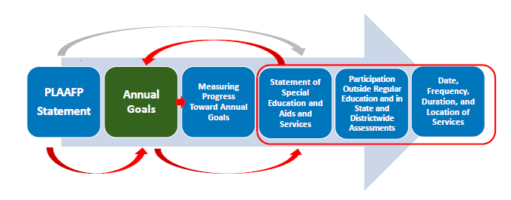
The Role of the Goal
PROGRESS Center at the American Institutes for Research® The PLAAFP Statement is the Foundation for the IEP National Center on Intensive Intervention at the American Institutes for Research CEC 2025
Notes:
Melissa

Slide 112
Why are measurable annual goals important?
Address academic and functional individual needs outlined in the PLAAFP statement.
Ensure high expectations and grade-level alignment, in light of the child’s circumstances.
Assess whether the special education program is promoting progress, in light of the child’s circumstances.
PROGRESS Center at the American Institutes for Research® The PLAAFP Statement is the Foundation for the IEP National Center on Intensive Intervention at the American Institutes for Research CEC 2025
Notes:
Melissa

Slide 113
Remember Endrew F.
Endrew F. v. Douglas County School District RE-1 (2017):
“To meet its substantive obligation under the IDEA, a school must offer an IEP that is reasonably calculated to enable a child to make progress appropriate in light of the child’s circumstances” (emphasis added, p. 16).
Source: Endrew F. v. Douglas County School District, 580 U.S. 16 (2017)
Notes:
Melissa

Slide 114
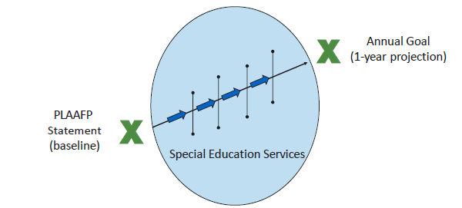
How do goals connect to the other components in the IEP?
PROGRESS Center at the American Institutes for Research® The PLAAFP Statement is the Foundation for the IEP National Center on Intensive Intervention at the American Institutes for Research CEC 2025
Notes:
Melissa
The PLAAFP is the baseline, where is the student at right now.
Measurable goals describe where we want the student to be in one year (projection)
We need to make sure the goals are challenging and ambitious enough
How are the special education services we are going to provide get us to the annual goal.

Slide 115
IEP goals should….
Focus on student behavior, not educator behavior.
Be monitored with enough frequency to determine progress and make timely instructional/intervention decisions.
Be measured using an objective, valid, and reliable measure (e.g., curriculum-based measure (CBM), Direct Behavior Rating (DBR), systematic direct observation) rather than a more subjective measure (e.g., teacher anecdotal notes).
Be realistic, yet “appropriately ambitious”.
PROGRESS Center at the American Institutes for Research® The PLAAFP Statement is the Foundation for the IEP National Center on Intensive Intervention at the American Institutes for Research CEC 2025
Notes:
Melissa

Slide 116
Question 14
13. Are all of the annual goals in the IEP designed to meet the student’s needs that result from the student’s disability or giftedness, to enable the student to be involved in and make progress in the general education or advanced curriculum? 34 C.F.R. 300.320(a)(2)(i)(A); K.S.A. 72-3429(c)(2)(A) METHOD: First review the PLAAFP section of the IEP for information about the student’s needs and how the student’s exceptionality affects involvement and progress in the general education curriculum. Then review all of the annual goals in the IEP. Determine if each of the annual goals is related to meeting the student’s needs that result from the student’s exceptionality, to enable the student to be involved and progress in the general or advanced curriculum. There should be a direct relationship between the annual goal and the needs identified in the PLAAFPs.
YES
Select YES if EVERY annual goal in the IEP is designed to meet the student’s needs that result from the student’s disability or giftedness, to enable the student to be involved in and make progress in the general education or advanced curriculum.
NO
Select NO if:
• The IEP DOES NOT contain at least one annual goal.
OR
• One or more of the annual goals in the IEP is/are NOT designed to meet the student’s needs that result from the student’s disability or giftedness, to enable the student to be involved in and make progress in the general education or advanced curriculum.
SPECIAL NOTE: Students who take the alternate assessment must have annual goals that enable them to be involved in and make appropriate progress in the general education curriculum. Any separate curriculum is supplementary, not an alternate to Tier 1 grade-aligned standards-based instruction. Alternate achievement standards are performance standards that align to the general education content standards at a reduced depth, breadth, and complexity.
Kansas Special Education Process Handbook, Chapter 4, Section E.2.b.
.
.
Notes:
Melissa
Goals should address the needs identified in the PLAAFPs. Students taking an alternate assessment also need to have goals that enable them to be involved in and make appropriate progress in the general education curriculum.

Slide 117
Student Example - IDEA
Present Levels: Ethan is a 10th-grade student identified with a Specific Learning Disability (SLD) in Reading Comprehension. Ethan decodes words with reasonable accuracy but struggles with understanding complex texts. On a recent reading comprehension assessment, he scored at the 7th percentile for his grade level, demonstrating difficulty identifying main ideas in expository text (scoring 40% accuracy) and answering inferential questions about fictional passages (scoring 30% accuracy).
Annual Goals:
Within 36 weeks, Ethan will accurately identify and summarize the main idea and key supporting details of a 10th-grade level expository text, when provided with a graphic organizer that prompts for main idea and key details, achieving an average of 80% accuracy on independent reading assignments.
Within 36 weeks, Ethan will draw inferences and make predictions based on textual evidence from a 10th-grade level fictional passage, when provided with guided questions that prompt him to connect textual evidence to background knowledge, achieving an average of 75% accuracy on reading comprehension tasks.
Notes:
Melissa

Slide 118
Student Example - Gifted
Present Levels: Sarah is a highly gifted and inquisitive 4th-grade student with a passion for science, particularly astronomy. Her verbal and quantitative reasoning scores are in the 99th percentile on the Cognitive Abilities Test (CogAT). Standardized academic assessments show Sarah performing at a 7th-grade level in science, demonstrating advanced vocabulary and comprehensive understanding of complex scientific concepts.
Sarah's learning style is characterized by a strong desire to explore topics in depth, independently research areas of interest, and develop advanced skills at a faster pace than her peers. She possesses excellent independent learning skills and often completes assignments and projects well ahead of schedule. She excels at complex, open-ended problems and thrives on intellectual challenges. Sarah is highly self-motivated and demonstrates strong organizational skills in managing her assignments and projects.
However, Sarah's advanced abilities and accelerated learning pace sometimes result in boredom and disengagement during whole-group instruction, particularly during activities that are repetitive or focus on concepts she has already mastered. This can lead to occasional off-task behavior and a need for consistent enrichment and extension activities to maintain her engagement.
Annual Goals:
By the end of the IEP, when given access to advanced learning materials and resources, Sarah will independently research and present on two self-selected advanced scientific topics, demonstrating in-depth knowledge and critical thinking beyond the standard 4th grade curriculum earning a score of 4 or higher on a 5-point rubric.
Notes:
Melissa

Slide 119
Measurable Annual Goals
What a Student is Expected to Accomplish in a 12-month period
Target Behavior
Condition or Given
Criterion for Mastery
Timeline
Taken from Yell and Bateman CEC2025
Notes:
Melissa

Slide 120
General goal reminders
Every IEP has to have at least 1 goal.
The goal is about what improvement you expect the student to make, even if the only service being provided is consultation.
All goals must be measurable (File Review Q14). If a measurable annual goal is written correctly with the 4 components (behavior, criteria, condition and timeframe), the requirement of how progress toward the goal is measured is contained within the goal and no additional information is required.
You must have a baseline for the goal to judge if the criteria is appropriate and if the student is making progress. Baseline data only has meaning if the data DIRECTLY relates to the target skill in the goal.
The goal, the baseline, and the progress reports must use the same method of measuring the student’s performance.
Make sure you are clear who is doing progress monitoring of the goal and reporting to parents as per frequency indicated within the IEP
Notes:
Melissa
These are some general reminder for IEP goals,
1. every IEP needs to have at least one goal. If there is not at least 1 measurable goal in the IEP, question 14 will need to be marked NO.
2. The goals that are in the IEP should outline what improvements the IEP team expects the student to make, even if the only service the student is receiving is consultation.
3. Again, all goals must be measurable, according to question 14. If a measurable annual goal is written correctly with the 4 required components, the requirement of how to progress toward completing the goal is measured is contained within the goal and no additional information is required
4. You must have a baseline for the goal in order to judge the criteria component as appropriate and evaluate if the student is making progress. Baseline data only has meaning if the data DIRECTLY relates to the target skill in the goal.
5. The goal, the baseline, and the progress reports must use the same method of measuring the student's performance. Don’t say in the goal that the student will read 100 words in a minute with 90% accuracy and then have the progress monitoring only say “student is doing great”
5. Lastly make sure you are clear about who is or will be doing the progress monitoring of the goal and reporting to the parents according to the frequency indicated in the IEP.

Slide 121
Question 15
14. Are all of the annual goals in the IEP measurable? 34 C.F.R. 300.320(a)(2)(i); K.S.A. 72-3429(c)(2) METHOD: Review all of the annual goals in the IEP. Determine if each of the annual goals is measurable. Read about the four critical components of a well-written goal in the Kansas Special Education Process Handbook, Chapter 4, Section E.2.b.
A Measurable Annual Goal Includes:
Behavior: Identify the performance to be measured.
Condition: Specify how progress will be measured.
Criteria: Determine to what level the behavior must occur.
Timeframe: Specify time required to attain the criterion.
YES
Select YES if EVERY annual goal in the IEP is measurable.
Timeline
Behavior
Criteria
Condition
NO
Select NO if:
• The IEP DOES NOT contain at least one annual goal.
OR
• One or more of the annual goals in the IEP is/are NOT measurable.
Kansas Special Education Process Handbook, Chapter 4, Section E.2.b..
Notes:
Melissa
Question 14 asks if all of the annual goals in the IEP are measurable. In order for a goal to be measurable it must contain behavior, condition, criteria and timeframe. If every goal in the IEP is measurable and contains these four components, select YES. If there is not at least 1 annual goal or if the annual goals in the IEP are NOT measurable, select NO.

Slide 122


Target Behavior – The academic or functional skills to be changed.
Observable & Measurable
To write
To read aloud
To point to
Invisible
To understand
To improve
To enjoy
Taken from Yell and Bateman CEC2025
Notes:
Melissa
Target behavior is the academic or functional skill to be changed. Here are 4 guiding questions
What do we want the student to be able to do?
Is the behavior observable and measurable?
Is it a functionally relevant replacement behavior?
Is this a measure of student behavior, not adult behavior

Slide 123


Condition – The context or environment in which the target behavior is to be exhibited and measured
Materials, Context
A third grade reading passage
100 randomly selected addition problems
A story starter
Unclear
A teacher made test
A worksheet to be developed
Teacher directions
Taken from Yell and Bateman CEC2025
Notes:
Melissa
Condition is the context or environment in which the target behavior is to be exhibited and measured.
Two guiding questions: Under what context will the behavior or skill be expected to occur? What level of independence is expected to complete the skill or demonstrate the behavior?

Slide 124
Criterion – the level of performance with which the IEP team can determine that a student has achieved the goal.
Observable & Measurable
Unclear
Accuracy
Speed
Fluency
Teacher Observation
Percentage with no starting point
Improve
Taken from Yell and Bateman CEC2025
Notes:
Melissa
Criterion is the level of performance with which the IEP team can determine that a student has achieved the goal. Here are 3 guiding questions: When will mastery of skills be expected to occur? What is the level of accuracy? How many trials does the student need to demonstrate mastery of the skills?

Slide 125
Kansas Special Education Process Handbook Guidance (Chapter 4)
Measurable Annual Goals Measurable annual goals are descriptions of what a child can reasonably be expected to accomplish within a 12- month period with the provision of special education (specially designed instruction) and related services.
Measurable annual goals must be related to meeting the child’s needs that result from the child’s exceptionality, to enable the child to be involved and progress in the general or advanced curriculum. In addition, they must meet each of the child’s other educational needs that result from the child’s exceptionality (K.S.A. 72-3429(c)(2))
There is a direct relationship between the measurable annual goal, baseline data, and the needs identified in the PLAAFPs. Because the PLAAFPs are baseline data for the development of measurable annual goals, the same criteria used in establishing the PLAAFPs must also be used in setting the annual goal.
Four critical components of a well-written goal are:
Timeframe is usually specified in the number of weeks or a certain date for completion. A year is the maximum allowed length for the timeframe. * In 36 instructional weeks… * By November 19, 2018… * By the end of the 2018–19 school year…
Conditions specify the manner in which progress toward the goal is measured. Conditions are dependent on the behavior being measured and involve the application of skills or knowledge. * When presented with 2nd-grade-level text… * Given a mixed, 4th-grade-level math calculation probe… * Given a story prompt and 30 minutes to write… * When given a directive…
Behavior clearly identifies the performance that is being monitored, usually reflects an action or can be directly observed, and is measurable. * Sarah will read… * Claude will correctly solve… * Mary will score… * Rex will follow a one-step direction
Criterion identifies how much, how often, or to what standards the behavior must occur in order to demonstrate that the goal has been reached. The goal criterion specifies the amount of growth the child is expected to make by the end of the annual goal period. * 96 words per minute with 5 or fewer errors. * 85% or more correct for all problems presented. * 4 or better when graded according to the 6-trait writing rubric. *Within one minute without help, 3 times a day, for 2 weeks
Notes:
Melissa
More information on annual measurable goals is found in chapter four of the special education process handbook. The handbook defines a measurable annual goal as a "description of what a child can reasonably be expected to accomplish within a 12-month period." This goal must be related to meeting the needs of the child that result from their exceptionality and there is a direct relationship between the measurable annual goal, baseline data, and the needs identified in the PLAAFPs. If we haven't stressed it enough, the four critical components of a measurable annual goal are timeframe - which is usually specified as number of weeks or a specific upcoming date, conditions - the manner by which progress towards the goal will be measured, behavior - which is the specific performance that is being monitored, and criterion - which identifies how much, how often, or to what standards the team will know that the goal has been reached. If you have eagle eyes, each of those critical components has an example of what that might look like in the individual goals of the children you will be reviewing files for.

Slide 126

A Goal is not Measurable if it Cannot be Graphed!!!
Taken from Yell and Bateman CEC2025
Notes:
Melissa

Slide 127
Goals and Objectives/Benchmarks
Need to be:
Measurable/Able to be Monitored
Meaningful
Standards-Aligned
“To help make certain that children with disabilities are held to high expectations and have meaningful access to a State’s academic content standards, we write to clarify that an individualized education program (IEP) for an eligible child with a disability under the Individuals with Disabilities Education Act (IDEA) must be aligned with the State’s academic content standards for the grade in which the child is enrolled.” (p.1)
U.S. Department of Education. (2015). OSEP DEAR COLLEAGUE LETTER on Free and Appropriate Public Education (FAPE) (November 16, 2015).
Derived from the needs resulting from the disability
Related directly to the present levels
Taken from Yell and Bateman CEC2025
Notes:
Melissa
Measurable goals should pass the stranger test (different evaluators can agree if the goal has been achieved).

Slide 128
Goal Examples
Letter Names: By the end of the IEP year, when given a page of 100 upper- and lower-case alphabet letters in mixed order, Alex will increase naming the correct letters in one minute from 28 to 68.
Math: Given a page of 28 addition and subtraction problems from one to three digits without regrouping, Emilia will increase the number of correct digits written in two minutes from 24 to 76 by May 24, 2026.
Taken from Yell and Bateman CEC2025
Notes:
Melissa
The easiest way to describe the timeframe is to use “by the end of the IEP year”. You could say something like “In 36 instructional weeks”, or whatever the number of instructional weeks is for your district. However, if the district changes the number of instructional weeks by lengthening the school day, as they often do to make up for snow vacations, you will need to amend the IEP to change the timeframe that uses instructional weeks. If you use the date of the next annual review, you must use the exact date.

Slide 129
Goal Examples Continued
Writing: Given a story starter and one minute to think, Nick will increase the number of correct writing sequences completed in three minutes from 14 to 37 by the annual review date of this IEP.
Reading: By the end of the IEP year, when given a 6th grade reading passage, Michael will increase the number of correct words read aloud in one minute from 120 to 157 in 4 consecutive trials.
Taken from Yell and Bateman CEC2025
Notes:
Melissa
The second goal on this slide has two criteria: 157 words read correctly in one minute and in 4 consecutive trials. The four consecutive trials is needed for students who are inconsistent in their performance. The goal then requires improvement in reading fluency and in the student’s consistency in reading fluency. Two criteria are not needed for all goals. If consistency is not an issue, then don’t add the second criterion. Remember, that if you write two criteria in the goal, you will need to do progress reporting on both criteria.

Slide 130
More Examples of Goals
By the end of the IEP year, given a reading passage at the 4th grade level, Samuel will be able to identify and describe the characters, setting, plot and theme, with 80% accuracy on a comprehension probe of 10 questions.
By the end of the IEP year, given a word list at the 2nd grade level, Amy will decode new words in isolation with 90% accuracy on a list of 30 words.
By January 17, 2026, given a word bank with key math vocabulary, Simon will answer questions related to content in tables, graphs and charts with 90% accuracy on a 20- question assessment.
Notes:
Melissa

Slide 131
Example Q14: Gifted Goals
In 18 instructional weeks, when assigned a research topic, Yolanda will conduct a research project and create a PowerPoint presentation of her research, scoring 20/20 points on a research rubric (see attached research rubric).
By November 22, 2025, given a 3rd grade level literary text, Sally will correctly summarize the plot, including the major conflict and 3 events related to the conflict scoring at least 90% correct on her summary.
Notes:
Melissa
For the first example, if you’re using a rubric, make sure it is included in the progress monitoring as well. Also, note that the timeframe for the first goal is given in instructional weeks (about one semester).

Slide 132
Set Measurable and Realistic Behavior or Functional Goals
Not realistic and ambitious
100% accuracy/frequency
Crossing the street with 80% accuracy.
50% accuracy/frequency
Realistic and ambitious
At or around 80-90% (for behaviors we want to increase)
10-20% (for behaviors we want to decrease)
Rate/level that exceeds peer expectations or could occur by chance
Rate/level that is commensurate with typical peers’ performance
Adapted from PROGRESS Center at the American Institutes for Research® National Center on Intensive Intervention at the American Institutes for Research
Notes:
Melissa

Slide 133
Academic Goal Example
Academic goals should focus on skills necessary for the student to access and benefit from general education instruction that is aligned with state standards.
Adapted from PROGRESS Center at the American Institutes for Research® National Center on Intensive Intervention at the American Institutes for Research
Revised Goal: In 36 instructional weeks, Given a second-grade reading probe, Jesse will read 65 words correctly in 1 minute with 95% accuracy on three consecutive probes.
Draft Goal: In 36 instructional weeks, Jesse will read 65 words per minute.
Essential Elements of Goals
☑ Timeframe
☒ Condition
☑ Target Behavior
☒ Criterion /Level of proficiency
Notes:
Melissa
(This slide has transitions)

Slide 134
Functional Goal Example
Functional goals should increase access, participation, and/or independence in the general education curriculum or setting.
Adapted from PROGRESS Center at the American Institutes for Research® National Center on Intensive Intervention at the American Institutes for Research
Revised Goal: By the end of the IEP year, John will remain academically engaged at least 70% of the class for five consecutive days as monitored by daily DBRs.
Draft Goal: By the end of the IEP year, John will pay attention and be engaged during a 40-minute class.
Essential Elements of Goals
☑ Timeframe
☑ Condition
� Target Behavior
� Criterion /Level of proficiency
Notes:
Melissa
(This slide has transitions)
the revised goal has dual criteria. Goals don't always need to have two criteria.

Slide 135
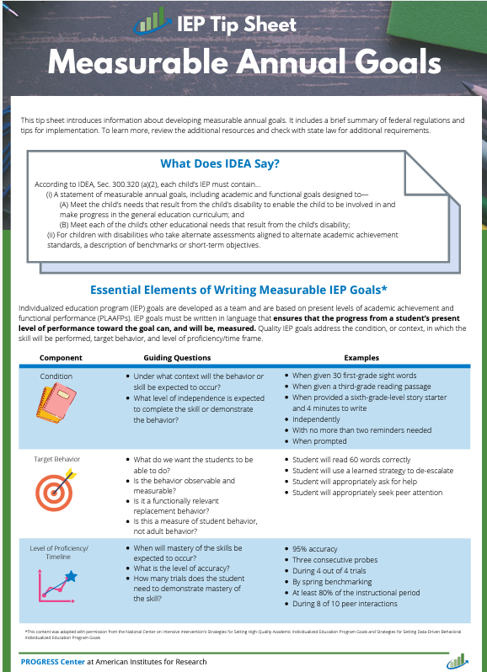
Measurable Annual Goals Tip Sheet
What does IDEA say about goals?
(i) A statement of measurable annual goals, including academic and functional goals designed to—
(A) Meet the child’s needs that result from the child’s disability to enable the child to be involved in and make progress in the general education curriculum; and
(B) Meet each of the child’s other educational needs that result from the child’s disability;
(ii) For children with disabilities who take alternate
assessments aligned to alternate academic
achievement standards, a description of benchmarks
or short-term objectives
Source: IDEA, Sec. 300.320(a)(2)(i-ii)
Notes:
Melissa
This is the progress centers tip sheet for measurable annual goals.
When writing a goal, start with the academic and functional needs identified in the PLAAFP statement. Then identify the needed skills to access and progress in grade level standards. Discuss what the student should be able to achieve during the next 12 months. Then develop an individualized, ambitious, but attainable goal. When reviewing your goals, it may help to think about “are the goals we write adequate and appropriate to determine effectiveness of our special education services?”

Slide 136
Be the reviewer Q12 & 14
Notes:
Melissa
Q4-9
Look over your files and discuss among your table. We will be walking around to answer any specific questions you may have.
What example from your files for Q4-9 would you like to share with the group? This could be a good example that you think could help others or an example you would like us to discuss or a trend you noticed. We will spend the last 10 minutes sharing out.

Slide 137
Q12 – Impact of Exceptionality
Susan’s reading and vocabulary level affect her ability to independently access the general education curriculum. The general education reading curriculum is two grades above her reading level, therefore it is difficult for Susan to stay on task because of the vocabulary and pace of the classroom. The IEP team suggests specialized instruction in phonics and vocabulary to address Susan’s reading delay.
Notes:
Melissa

Slide 138

Q12 – KSDE Response
Susan’s reading and vocabulary level affect her ability to independently access the general education curriculum. The general education reading curriculum is two grades above her reading level, therefore it is difficult for Susan to stay on task because of the vocabulary and pace of the classroom. The IEP team suggests specialized instruction in phonics and vocabulary to address Susan’s reading delay.
Notes:
Melissa

Slide 139
Q14 – Measurable Annual Goals IDEA
By February 14, 2024, xxxxx will be able to solve multi step math problems using appropriate procedures with 80% accuracy in the general education classroom with some support.
By February 6, 2025, given three written problems requiring xxxx to solve a two-step equation, she will write the solutions with no more than 3 errors with support.
By the end of the annual IEP (December 2024), when given math problems involving double digit subtraction with regrouping xxxxx will independently solve the problems with 95% accuracy.
Notes:
Melissa

Slide 140

Q14 – IDEA -KSDE Response
By February 14, 2024, xxxxx will be able to solve multi step math problems using appropriate procedures with 80% accuracy in the general education classroom with some support.
By February 6, 2025, given three written problems requiring xxxx to solve a two-step equation, she will write the solutions with no more than 3 errors with support.
By the end of the annual IEP (December 2024), when given math problems involving double digit subtraction with regrouping xxxxx will independently solve the problems with 95% accuracy.
What is some support? These goals don’t pass the stranger test.
Notes:
Melissa (transitions)

Slide 141
Q14 Measurable Annual Goals - Gifted
By the end of the IEP year, when presented with independent or small group activities or projects of interest to him, xxxx will further develop and consistently apply critical thinking skills and explore topics of study in greater depth on a minimum of four activities or projects. XXXX will give a written/oral report on each activity/project with 90% or higher on rubric.
By the end of the IEP year, utilizing the results of a provided career guide, XXXX will complete a research project analyzing three career paths, focusing on education, job responsibilities, salary, growth and work-life balance as measured by the submission and analysis of a collection of data that meets the 20-point rubric criteria.
Notes:
Melissa

Slide 142
Q14 Gifted – KSDE Response
By the end of the IEP year, when presented with independent or small group activities or projects of interest to him, xxxx will further develop and consistently apply critical thinking skills and explore topics of study in greater depth on a minimum of four activities or projects. XXXX will give a written/oral report on each activity/project with 90% or higher on a rubric.
By the end of the IEP year, utilizing the results of a provided career guide, XXXX will complete a research project analyzing three career paths, focusing on education, job responsibilities, salary, growth and work-life balance as measured by the submission and analysis of a collection of data that meets the 20-point rubric criteria.
What is the criterion?
Notes:
Melissa (transitions)

Slide 143
Progress Monitoring
Question 15
Notes:
Cary

Slide 144
Kansas Special Education Process Handbook Guidance
Measuring and Reporting Progress on Annual Goals (Chapter 4)
The team must include a description of how the child’s progress toward meeting the annual goals will be measured.
If a measurable annual goal is written correctly with the 4 components (behavior, criteria, condition and timeframe) the requirement of how progress toward the goal is measured is contained within the goal and no additional information is required.
The IEP must include a description of when parents will be provided periodic reports about their child’s progress toward meeting the annual goals.
Whatever the method chosen, progress toward the goals must be monitored in the method indicated on the IEP and progress reports should include a description of the child’s progress towards the child’s measurable annual goals.
Notes:
Cary
Chapter 4 of the Process Handbook reminds us of the requirements for Q 15.

Slide 145
Evaluation of Progress Decisions: Based Upon Data
Does the student need more than what they are getting?-
Does the student need something different than what they are getting?
Remember: Considering the Supreme Court’s Endrew F. ruling, not having progress or status data - and/or doing nothing in the presence of actionable data - is likely a denial of FAPE.
“The IEP must aim to enable the child to make progress. After all, the essential function of an IEP is to set out a plan for pursuing academic and functional advancement.” (Endrew F., 2017, p. 11.)
Taken from Yell and Bateman CEC2025
Notes:
Cary

Slide 146
Data Collection for Monitoring Progress
The method by which IEP teams can monitor student progress and make changes when needed.
Can be graphed (numbers not words)
Measured frequently & systematically
User friendly & time efficient
Analyze and use for decision-making
Taken from Yell and Bateman CEC2025
Notes:
Cary

Slide 147
Progress Monitoring
Systematic, frequent, & reported
Curriculum-Based Measurement
Curriculum-Based Assessment
Make changes when needed
Teacher Developed Assessments
Brief/in the moment student responding
Entrance/Exit Tickets
Haphazard
Teacher Observation
To be determined
Don’t analyze data & don’t make changes
Notes:
Cary

Slide 148
Why is Progress Monitoring Important?
It’s part of specially designed instruction.
It helps teachers know when to take action:
Change instructional practices
Adjust curriculum
Add services and supports
It results in improved outcomes for all students.
Promotes closing the achievement gap
Notes:
Cary
Progress monitoring is part of specially designed instruction and helps providers know when to change instructional practices, adjust curriculum and add services and supports. Progress monitoring improves outcomes for all students and promotes closing the achievement gap.

Slide 149
Progress Monitoring Process
Before
Benchmark assessment
During
Collect data on schedule
After
Evaluate progress
Determine intervention
Choose tool
Set goal
Decide on frequency of PM and schedule for decision making
Frequent, brief
Graph regularly
Share with team
Make decisions re: interventions
Continue Plan
Responsive
Non-Responsive
Make a Change
Practical Progress Monitoring (CEC 2023)
Notes:
Cary
This slide provides a timeline of what needs to be done before, during, and after progress monitoring. It shows how we make decisions base on whether the student was responsive or non-responsive to the instruction. It is important to make a change if the student is non-responsive.

Slide 150
Common Errors in Monitoring Progress Toward Annual Goals
Writing goals that are not measurable.
Goal, baseline, and progress monitoring data not using the same measurement.
Substituting subjective judgement for objective data.
Relying on “teacher observation” to measure progress
Using only commercially-developed summative achievement tests to monitor as student’s growth.
Taken from Yell and Bateman CEC2025
Notes:
Cary

Slide 151
What Does Progress Look Like?
Connection to PLAAFP is important
Criteria for Progress/
Performance
If multiple criteria are listed in the goal, all need to be addressed in progress report.
Rate/speed (15 times per hour)
Fluency (speed and accuracy) (60 words read correctly per minute)
Quality ratings/scores on scales/rubrics (a score of 4 for focus on the classroom assessment writing rubric)
Number of words/parts of a sentence/paragraph (6 sentence/paragraph elements, 80 correct words sequences)
Advancement on Learning Progressions/Task Analyses
# of attempts/trials (on 5 out of 5 attempts)
Time to respond/time limits (within 10 seconds of the question being presented
Minimum # of appropriate responses (a minimum of 3 times a day)
Change in level of prompting and /or supports needed (independence, 3 or few verbal prompts)
Change in generalization in use of content or skill
Taken from Yell and Bateman CEC2025
Notes:
Cary

Slide 152
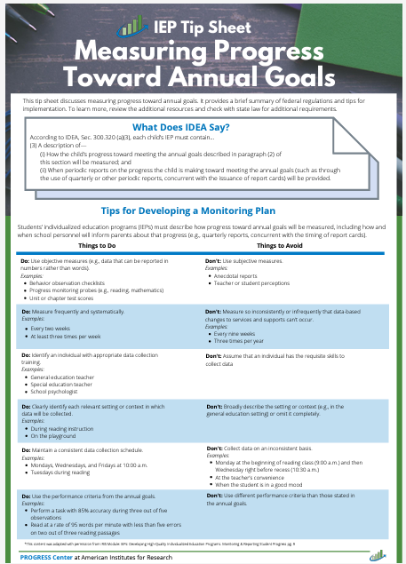
Progress Monitoring Tip Sheet
A description of—
How the child’s progress toward meeting the annual goals described in paragraph (2) of this section will be measured; and
(ii) When periodic reports on the progress the child is making toward meeting the annual goals (such as through the use of quarterly or other periodic reports, concurrent with the issuance of report cards) will be provided;
Notes:
Cary
The Progress Monitoring TIP sheet is a great resource for your IEP teams. This is one of the materials that we had printed for you.

Slide 153
Question 16
15. Was the student’s progress toward meeting each annual IEP goal measured and reported using the method and frequency described in the IEP? 34 C.F.R. 300.320(a)(3); K.S.A. 72-3429(c)(3) METHOD: First, review the IEP to determine if the IEP includes a description of how the student’s progress toward meeting each of the annual goals will be measured. This information could be contained within each goal or in a separate section of the IEP. Next, review the IEP to determine if the IEP includes a description of when periodic reports on the progress the student is making toward meeting each of the annual goals will be provided. Finally, compare these descriptions in the IEP to progress reports in the education record to determine if there is documentation to show a) the student’s progress toward meeting each annual IEP goal was measured as described in the IEP, and b) periodic reports on the progress were provided to the parents (or legal education decision-maker) at the times/intervals required by the IEP.
YES
Select YES if documentation shows ALL of the following:
The IEP includes a description of how the student’s progress toward meeting EACH annual IEP goal will be measured.
AND
The IEP includes a description of when periodic reports on the progress the student is making toward meeting each of the annual goals will be provided.
AND
The goal, the baseline, and the progress reports used the same method of measuring the student’s performance.
AND
Progress was reported to the parent (or education decision-maker) according to the frequency/intervals described in the IEP.
NO
Select NO if documentation DOES NOT show ALL of the following:
The IEP includes a description of how the student’s progress toward meeting EACH annual IEP goal will be measured.
OR
The IEP includes a description of when periodic reports on the progress the student is making toward meeting each of the annual goals will be provided.
OR
The goal, the baseline, and the progress reports didn’t used the same method of measuring the student’s performance.
OR
Progress wasn’t reported to the parent (or education decision-maker) according to the frequency/intervals described in the IEP.
Kansas Special Education Process Handbook, Chapter 4, Section E.2.d..
Notes:
Cary
This question had the highest number of non-compliant files last year.
METHOD:
First, review the IEP to determine if the IEP includes a description of how the student’s progress toward meeting each of the annual goals will be measured. This information could be contained within each goal or in a separate section of the IEP.
Next, review the IEP to determine if the IEP includes a description of when periodic reports on the progress the student is making toward meeting each of the annual goals will be provided.
Finally, compare these descriptions in the IEP to progress reports in the education record to determine if there is documentation to show a) the student’s progress toward meeting each annual IEP goal was measured as described in the IEP, and b) periodic reports on the progress were provided to the parents (or legal education decision-maker) at the times/intervals required by the IEP. We always want the goal, baseline, and progress report to use the same measurement.

Slide 154
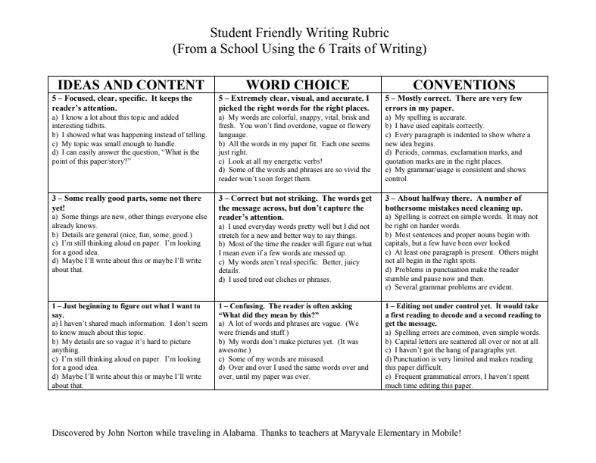
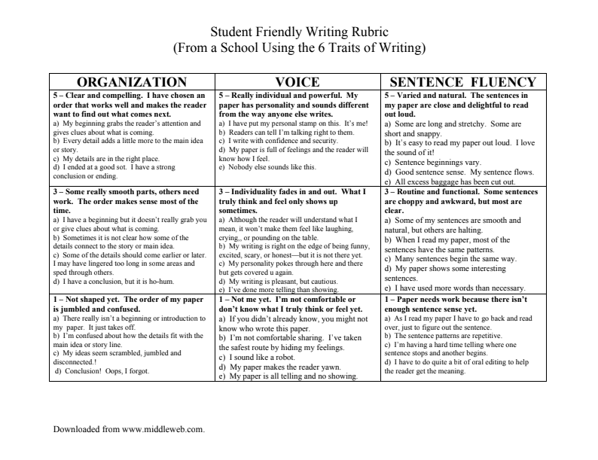
Writing Rubrics
Notes:
Cary
Resource shared on Stetson & Associates Progress Monitoring Webinar
Monitoring progress using rubrics
Rubrics can be an easy way to track specific student progress
Search for already published rubrics to simplify the task
Rubrics serve to task analyze some skill areas
A single rubric can be used to track student progress over time.
The images in the slide are of an Elementary writing rubric in student friendly terms
We have included the link which takes you to lots of rubrics

Slide 155
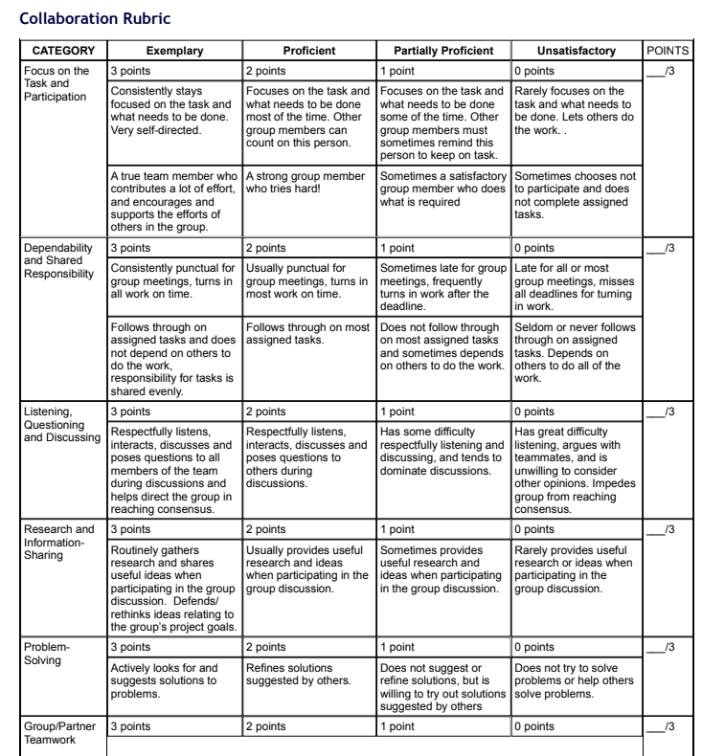
Middle School and High School Collaboration Rubric
Examples of Other Rubrics
Notes:
Cary
From University of Wisconsin – Stout
Resource shared on Stetson & Associates Progress Monitoring Webinar

Slide 156
Progress Statements
Policy requires that there be data to support the “checked box”.
Data should be chartable or graphable: Not a status alone, but a measure of progress over time.
Taken from Yell and Bateman CEC2025
Notes:
Cary

Slide 157
Graphing and Interpreting
There are multiple ways to score and analyze data
Hand scoring
Computerized scoring
Quick turn-around procedures are desired for feedback and instruction
Important to keep longitudinal data
Trend lines and aim lines
Notes:
Cary

Slide 158

Resources for Progress Monitoring
Resource
Easy CBM
IDEAs That Work (search for “progress monitoring”)
Intervention Central
National Center on Intensive Intervention
Research Institute on Progress Monitoring
RTI Action Network
IRIS Module: Intensive Intervention (Part 2): Collecting and Analyzing Data for Data-Based Individualization
Notes:
Cary

Slide 159
Most Common findings Q15
Progress reporting did not occur for every goal – will require DCAP and ICA.
Progress reporting did not match how the goal indicated it would be measured – will require DCAP and ICA.
Goal included multiple criterion and only one criterion was reported on.
Notes:
Cary

Slide 160
The Importance of Reacting to Data
When progress report and other data do not reflect that an annual goal will be met, reconvene the IEP team to determine why, make needed instructional changes, and continue to collect data
U.S. Department of Education, 2017
Questions & Answers on Endrew F. v. Douglas School District
DBI Process
National Center on Intensive Intervention (2013)
Notes:
Cary
Monitor students progress to the specially designed instruction. Does data indicate the SDI is working? If not, intensify and individualize the SDI by adapting as appropriate the content, methodology, or delivery of instruction. Monitor the student’s response to the adapted instruction. It is an ongoing process.

Slide 161
Be the Reviewer Q15
Notes:
Cary

Slide 162
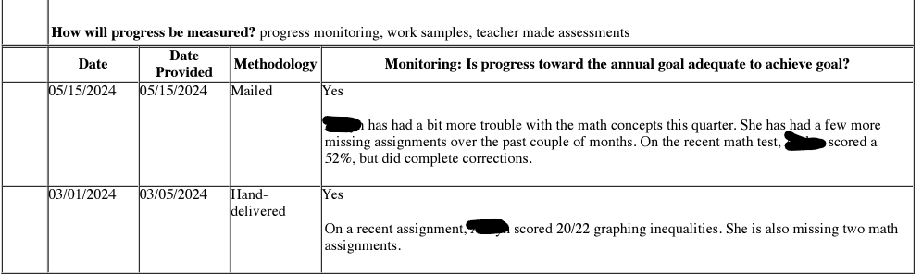
Q15 – Example 1
By February 6, 2025, given three written problems requiring xxxx to solve a two-step equation, she will write the solutions with no more than 3 errors.
Notes:
Cary

Slide 163
Q15 – Example 1 – KSDE Response
By February 6, 2025, given three written problems requiring xxxx to solve a two-step equation, she will write the solutions with no more than 3 errors.
The goal specifically calls out writing the solution for two-step equations with no more than 3 errors.
May PR – what was the content of the math test? How many errors?
March PR – did the graphing inequalities address two-step equations? One could infer that the student had only 2 errors but it is best to call it out so it is clear. How many errors?
Notes:
Cary

Slide 164
Q15 – Example 2
During one IEP school year, to help prepare him for post-secondary education/training and employment, when given a 3rd grade math probe including fractions xxxx will score 100%
Method of Measurement: CBM
Date | Progress adequate to achieve goal? | Notes
12/15/23 | Yes | Scored 69%
3/1/24 | Yes
5/16/24 | Yes
Notes:
Cary

Slide 165
Q15 – Example 2 – KSDE Response
During one IEP school year, to help prepare him for post-secondary education/training and employment, when given a 3rd grade math probe including fractions xxxx will score 100%
Method of Measurement: CBM
Date | Progress adequate to achieve goal? | Notes
12/15/23 | Yes | Scored 69%
3/1/24 | Yes
5/16/24 | Yes
March and May: Measurement is not included to match measurement identified in the goal. Data should be chartable or graphable: Not a status alone, but a measure of progress over time.
Notes:
Cary

Slide 166
Q15 – Example 3
To help with post-school education/training, employment, and independent living skills, in one IEP year, XXXX will apply and practice strategies regarding setting, monitoring and achieving goals at 90% according to goal setting checklist.
Date | Progress adequate to achieve goal? | Notes
3/1/24 | Not addressed this reporting period | XXXX has missed a lot of school this semester due to dysregulation and no medication. This will be tested more in depth as he attends more school.
5/16/24 | Not addressed this reporting period | XXXX continues to miss a lot of school this semester due to dysregulation and no medication. This will be tested more in depth as he attends more school.
Notes:
Cary

Slide 167
Q15 – Example 3 – KSDE Response
To help with post-school education/training, employment, and independent living skills, in one IEP year, XXXX will apply and practice strategies regarding setting, monitoring and achieving goals at 90% according to goal setting checklist.
Date | Progress adequate to achieve goal? | Notes
3/1/24 | Not addressed this reporting period | XXXX has missed a lot of school this semester due to dysregulation and no medication. This will be tested more in depth as he attends more school.
5/16/24 | Not addressed this reporting period | XXXX continues to miss a lot of school this semester due to dysregulation and no medication. This will be tested more in depth as he attends more school.
No progress reported. Substituting subjective judgement for objective data.
Notes:
Cary

Slide 168
Q15 – Example 4
During the IEP year, xxxx will complete at least one project per quarter or the benchmarks necessary to complete an on-going project in an area of interest to him with a score of 19/20 on a teacher-created rubric or teacher observed mastery of a concept. When addressing xxxx’s enrichment needs, projects such as: evaluation of and reflection on possible college choices, creation of organizational instrument for tracking college deadlines, analyzing and preparing applications to study abroad programs, and development of plan to effectively take college entrance exam of choice, will be successfully completed.
Date | Progress adequate to achieve goal? | Notes
10/11/24 | Yes | At the end of the 1st quarter of the 2024-2025 school year, xxxx is on track to meet his second quarter benchmark. He has begun the application process for a study abroad program. Progress has been determined by teacher observation.
1/3/25 | Yes | At the end of the 2nd quarter of the 2024-2025 school year, xxxx has successfully completed his second project of analyzing and preparing an application to a study abroad program, which he is now in the second tier of the process. Success was determined by teacher observation.
Notes:
Cary

Slide 169
Q15 – Example 4 – KSDE Response
During the IEP year, xxxx will complete at least one project per quarter or the benchmarks necessary to complete an on-going project in an area of interest to him with a score of 19/20 on a teacher-created rubric.
Date | Progress adequate to achieve goal? | Notes
10/11/24 | Yes | At the end of the 1st quarter of the 2024-2025 school year, xxxx is on track to meet his second quarter benchmark. He has begun the application process for a study abroad program. Progress has been determined by teacher observation.
1/3/25 | Yes | At the end of the 2nd quarter of the 2024-2025 school year, xxxx has successfully completed his second project of analyzing and preparing an application to a study abroad program, which he is now in the second tier of the process. Success was determined by teacher observation.
Progress Monitoring data does not match measurement in goal (19/20 on teacher-created rubric). Substituting subjective judgement for objective data is not compliant.
Notes:
Cary

Slide 170
Q15- Example 5
By September 10, 2025, when reading grade level text, xxxx will accurately comprehend the text at 90% accuracy as measured by reading comprehension questions.
Date | Progress | Score
10/9/24 | Yes | Currently, when reading grade level texts, xxxx will accurately comprehend the text at 74% accuracy as measured by reading comprehension questions.
Notes:
Cary

Slide 171

Q15- Example 5 – KSDE Response
By September 10, 2025, when reading grade level text, xxxx will accurately comprehend the text at 90% accuracy as measured by reading comprehension questions..
Date | Progress | Score
10/9/24 | Yes | Currently, when reading grade level texts, xxxx will accurately comprehend the text at 74% accuracy as measured by reading comprehension questions.
Notes:
Cary

Slide 172
Q15 – Example 6
By January 2025, xxxx will independently produce voiced and voiceless /th/ in all word positions, in structured sentences with 80% accuracy on 2/3 data days.
Date | Progress | Status
12/17/24 | XXXX is able to independently produce voiced and voiceless/th/ in all word positions, in structured sentences with 95% accuracy on 2/3 data days. | Mastered
10/18/24 | XXXX is able to independently produce voiced and voiceless /th/ in all word positions, in structured sentences with 90% accuracy on 2/3 data days | Mastered
Notes:
Cary

Slide 173

Q15 – Example 6 – KSDE Response
By January 2025, xxxx will independently produce voiced and voiceless /th/ in all word positions, in structured sentences with 80% accuracy on 2/3 data days.
Date | Progress | Status
12/17/24 | XXXX is able to independently produce voiced and voiceless/th/ in all word positions, in structured sentences with 95% accuracy on 2/3 data days. | Mastered
10/18/24 | XXXX is able to independently produce voiced and voiceless /th/ in all word positions, in structured sentences with 90% accuracy on 2/3 data days | Mastered
Notes:
Cary

Slide 174
Q15 - Example 7
Starting 12/5/23 and by the end of the IEP year, XXXX will demonstrate “reviewing and synthesizing” skills as measured by scoring at least “3” on that section of the Research Skills Rubric.
Date | Progress | Status
3/14/24 | XXXX regularly engages in college preparation activities. He scores “3” in “reviewing and synthesizing “ on the Research Skills Rubric | Moderate improvement
5/19/24 | XXXX continues to prepare for college by scoring “3” in “reviewing and synthesizing” on that section of the Research Skills Rubric | Mastered
11/22/24 | XXXX was able to demonstrate “reviewing and synthesizing” skills, as measured by scoring at least a “3” on the Research Skills Rubric | Mastered
Notes:
Cary

Slide 175

Q15 - Example 7
Starting 12/5/23 and by the end of the IEP year, XXXX will demonstrate “reviewing and synthesizing” skills as measured by scoring at least “3” on that section of the Research Skills Rubric.
Date | Progress | Status
3/14/24 | XXXX regularly engages in college preparation activities. He scores “3” in “reviewing and synthesizing “ on the Research Skills Rubric | Moderate improvement
5/19/24 | XXXX continues to prepare for college by scoring “3” in “reviewing and synthesizing” on that section of the Research Skills Rubric | Mastered
11/22/24 | XXXX was able to demonstrate “reviewing and synthesizing” skills, as measured by scoring at least a “3” on the Research Skills Rubric | Mastered
Notes:
Cary

Slide 176
Q15 - Example 8
By April 3, 2025, in order to achieve enhanced fluency, while fine tuning his articulation, xxx will be able to clearly state, with 80% or greater intelligibility, up to 4 strategies/tools that he utilizes for fluency, and 3 tips for correctly articulating the /r/ sound, in 5 consecutive sessions.
Date | Progress | Status
3/13/25 | XXX no longer demonstrates errors on his /r/ sounds. He does still have moments of hesitation and dysfluency in his speech. He states that he is comfortable with his speaking patterns but that he is interested in continuing with fluency help so that he could revisit the “Fluency Toolbag.” He is not able to remember all the strategies he has learned over the years, as most of that training was in his elementary years. xxx states a desire to review and practice those strategies. This will be discussed in his upcoming IEP meeting. | Moderate improvement
Notes:
Cary

Slide 177
Q15 - Example 8 – KSDE Response
By April 3, 2025, in order to achieve enhanced fluency, while fine tuning his articulation, xxx will be able to clearly state, with 80% or greater intelligibility, up to 4 strategies/tools that he utilizes for fluency, and 3 tips for correctly articulating the /r/ sound, in 5 consecutive sessions.
Date | Progress | Status
3/13/25 | XXX no longer demonstrates errors on his /r/ sounds. He does still have moments of hesitation and dysfluency in his speech. He states that he is comfortable with his speaking patterns but that he is interested in continuing with fluency help so that he could revisit the “Fluency Toolbag.” He is not able to remember all the strategies he has learned over the years, as most of that training was in his elementary years. xxx states a desire to review and practice those strategies. This will be discussed in his upcoming IEP meeting. | Moderate improvement
March PR does not use the same measurement as identified in the goal. The goal has 4 criteria, and not all criteria have been addressed. It appears that the criteria of 80% intelligibility might be met but the status still indicates moderate improvement indicating to us that some of the criteria have not been met. One criteria is that he can state up to 4 strategies/tools that he utilizes for fluency. The comment indicates that he struggles at remembering all the strategies. Another criteria is to clearly state 3 tips for correctly articulating the /r/ sound but there is nothing addressing tips in the comment. The final criteria is in 5 consecutive days which also wasn’t addressed.
Notes:
Cary

Slide 178
Q15 – Example 9 with Multiple Criterion
Goal: By the end of the IEP term, XXXX will complete a 10-problem set of single-digit addition and subtraction problems with 2 or fewer adult prompts to stay focused at 80% accuracy in 4 out of 5 trials.
PR 5/19/25 XXXX mastered this benchmark with averaging 88% accuracy with 2 prompts or less in 3 out of 5 trials. TXXXX has been utilizing a finger manipulative and has been able to independently complete the problems. Most prompting is to focus on the task, or where to write the answer. Great Job XXXX! Keeping working hard.
Notes:
Cary

Slide 179
Q15 – Example 9 – KSDE Response
Goal: By the end of the IEP term, XXXX will complete a 10-problem set of single-digit addition and subtraction problems with 2 or fewer adult prompts to stay focused at 80% accuracy in 4 out of 5 trials.
PR 5/19/25 XXXX mastered this benchmark with averaging 88% accuracy with 2 prompts or less in 3 out of 5 trials. XXXX has been utilizing a finger manipulative and has been able to independently complete the problems. Most prompting is to focus on the task, or where to write the answer. Great Job TXXXX! Keeping working hard.
Notes:
Cary

Slide 180
Q15 – Example 10 with Multiple Criterion
Goal: By April 2026, XXXX will demonstrate self-management tasks in the areas of self grooming and house-keeping skills by completing a list of 3 tasks independently with 90% accuracy with 1 adult prompt or less in 4 out of 5 trials.
PR – 5/19/25 XXXX has been working to complete a list of 3 tasks (folding t-shirts, folding socks and sorting by number) independently with 3 or less prompts or less. In 4 out of 5 trials she has completed this task with 3 prompts at 80% accuracy. During one trial she required 5 prompts, reminding her to continue working on the tasks and move on to the next and completed the tasks with 60% accuracy. Overall, XXXX has met this benchmark and will continue to work towards her independence during daily living tasks. Great Work XXXX!
Notes:
Cary

Slide 181
Q15 – Example 10 – KSDE Response
Goal: By April 2026, XXXX will demonstrate self-management tasks in the areas of self grooming and house-keeping skills by completing a list of 3 tasks independently with 90% accuracy with 1 adult prompt or less in 4 out of 5 trials.
PR – 5/19/25 XXXX has been working to complete a list of 3 tasks (folding t-shirts, folding socks and sorting by number) independently with 3 or less prompts or less. In 4 out of 5 trials she has completed this task with 3 prompts at 80% accuracy. During one trial she required 5 prompts, reminding her to continue working on the tasks and move on to the next and completed the tasks with 60% accuracy. Overall, XXXX has met this benchmark and will continue to work towards her independence during daily living tasks. Great Work XXXX!
Notes:
Cary

Slide 182
Statements of Services and Aids Connected to Other Parts of the IEP
Questions 16-21
Notes:
Cary

Slide 183
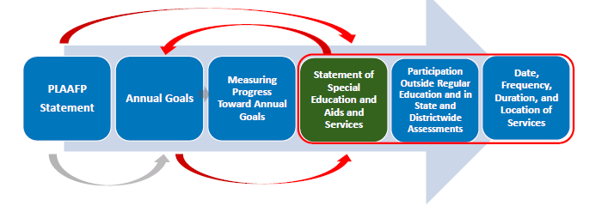
How does the statement of services and aids connect to the other parts of the IEP?
Taken from PROGRESS Center at the American Institutes for Research® The PLAAFP Statement is the Foundation for the IEP National Center on Intensive Intervention at the American Institutes for Research CEC 2025
Notes:
Cary

Slide 184
Question 17
16. IDEA only: If the IEP team has determined that the student with a disability must take an alternate assessment instead of a particular state or districtwide assessment, was that determination made in alignment with the KSDE Dynamic Learning Maps Participation Guidelines for Kansas and does the IEP include BOTH of the following?: (A) A statement of why the student cannot participate in the general state or district assessment; and (B) A statement of why the particular alternate assessment selected is appropriate for the student. 34 C.F.R. 300.320(a)(6)(ii), 300.160(c); K.S.A. 72-3429(c)(6)(B) METHOD: First, review the IEP to determine if the student must take an alternate assessment or regular state/districtwide assessment. Next, if the IEP states the student must take an alternative assessment, next review the education record for documentation that the student meets all of the criteria listed in the KSDE Dynamic Learning Maps Participation Guidelines for Kansas. This documentation could be in the IEP, evaluation/eligibility report, IEP Team meeting notes, a prior written notice, etc. Finally, review the IEP to determine if it includes a statement of why the student cannot participate in the general state or districtwide assessment, and a statement of why the particular alternate assessment selected is appropriate for the student. Every goal must have at least 2 benchmarks/objectives.
YES
Select YES if documentation shows ALL of the following:
• The student meets all of the criteria listed in the KSDE Dynamic Learning Maps Participation Guidelines for Kansas;
AND
• The IEP includes a statement of why the student cannot participate in the general state or district assessment;
AND
• The IEP includes a statement of why the particular alternate assessment selected is appropriate for the student.
NO
Select NO if documentation DOES NOT show ALL of the following:
• The student meets all of the criteria listed in the KSDE Dynamic Learning Maps Participation Guidelines for Kansas;
AND
• The IEP includes a statement of why the student cannot participate in the general state or district assessment;
AND
• The IEP includes a statement of why the particular alternate assessment selected is appropriate for the student.
N/A
Select N/A if:
• This is a file for a gifted-only student;
OR
• This is a file for a student who is convicted as an adult under State law and incarcerated in an adult prison (34 C.F.R. 300.324(d)(1)(i); K.A.R. 91-40-5(c)(2)(A));
OR
• The IEP Team determined that the student with a disability will take a regular State or districtwide assessment.
Kansas Special Education Process Handbook, Chapter 4, Section E.2.e.
KSDE Dynamic Learning Maps Participation Guidelines for Kansas
KSDE Rubric for Determining Student Eligibility for the Kansas Alternate Assessment (DLM) for Students with the Most Significant Cognitive Disabilities
Notes:
Cary
METHOD:
First, review the IEP to determine if the student must take an alternate assessment or regular state/districtwide assessment.
Next, if the IEP states the student must take an alternative assessment, review the education record for documentation that the student meets all of the criteria listed in the KSDE Dynamic Learning Maps Participation Guidelines for Kansas. This documentation could be in the IEP, evaluation/eligibility report, IEP Team meeting notes, a prior written notice, etc.
Finally, review the IEP to determine if it includes a statement of why the student cannot participate in the general state or districtwide assessment, and a statement of why the particular alternate assessment selected is appropriate for the student.
If a student is identified for an alternate assessment, there must be at least 2 short term objectives or benchmark for each goal.
Select YES if documentation shows ALL of the following:
• The student meets all of the criteria listed in the KSDE Dynamic Learning Maps Participation Guidelines for Kansas; or Rubric for determining eligibility for the alternate assessment;
AND
• The IEP includes a statement of why the student cannot participate in the general state or district assessment;
AND
• The IEP includes a statement of why the particular alternate assessment selected is appropriate for the student.
Select NO if documentation DOES NOT show ALL of those components
Select N/A if the student is gifted-only, student is convicted as an adult and incarcerated in an adult prison, or the IEP team determined the student would take the regular state and district assessment.

Slide 185
Q16 Requirements
Completed DLM Participation Guidelines with all criteria marked yes or completed Rubric for Determining Participation in the Alternate Assessment with the preponderance of answers in the most significant column for each question.
Why isn’t the student able to take the regular district/state assessment?
The student has a most significant cognitive disability and would not be able to complete or access the district/state assessment with accommodations. The student is currently untestable using standardized test. Currently the student is working from the grade-level Essential Elements which are at a reduced depth, breadth, and complexity.
Why is the alternate district assessment appropriate?
The student is working from the grade-level Essential Elements at the distal precursor level.
Each goal has at least 2 benchmarks/objectives.
Notes:
Cary

Slide 186
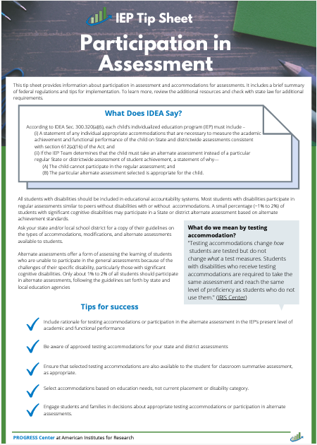
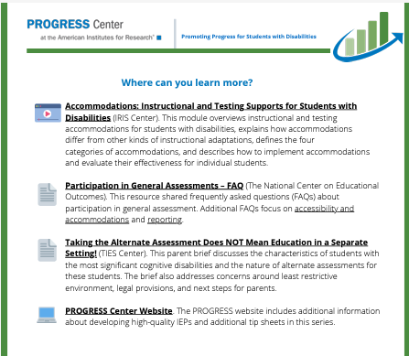
Participation in Assessment Tip Sheet
Notes:
Cary

Slide 187
Service Statements
The means by which schools can ensure that a student makes appropriate progress.
Addresses a Need in the PLAAFP
Based on Research to the Extent Practicable
Described with Specificity
Implemented as Agreed Upon
Taken from Yell and Bateman CEC2025
Notes:
Josie

Slide 188
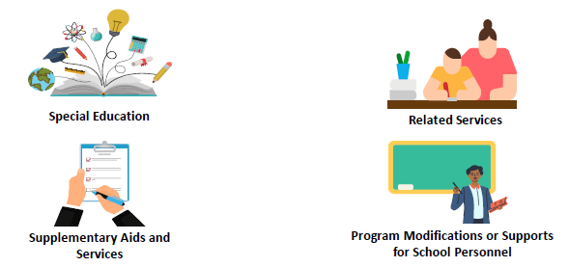
Five Parts of Service Statements
Taken from PROGRESS Center at the American Institutes for Research® The PLAAFP Statement is the Foundation for the IEP National Center on Intensive Intervention at the American Institutes for Research CEC 2025
Notes:
Josie
While there are only 4 images there are actually 5 parts of the service statements. Program modifications are for students, supports for school personnel are for teachers.

Slide 189
State Services with Sufficient Clarity
“Services and the amount of services offered should be set forth in the IEP in a fashion that is specific enough for parents to have a clear understanding of the level of commitment of services on the part of the school system. This will help to avoid misunderstandings or a finding that parents were not informed decision-makers.” (Julie Weatherly 90 Tips in 120 Minutes – CEC2025)
Notes:
Josie

Slide 190
Service Statements Need to be Specific
Specific
How often?
How long?
Where?
Not Specific
As needed
To be determined
Taken from Yell and Bateman CEC2025
Notes:
Josie

Slide 191
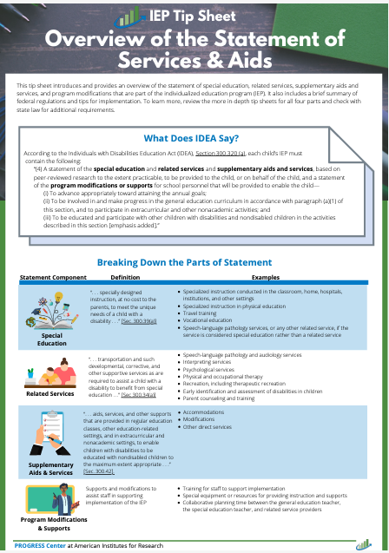
What does IDEA say about the statement of services and aids?
According to IDEA, Section 300.320 (a), each child’s IEP must contain the following:
“(4) A statement of the special education and related services and supplementary aids and services, based on peer-reviewed research to the extent practicable, to be provided to the child, or on behalf of the child, and a statement of the program modifications or supports for school personnel that will be provided to enable the child—… “
Source: IDEA, Sec. 300.320(a)(4), emphasis added
Services Tip Sheet
Notes:
Josie

Slide 192
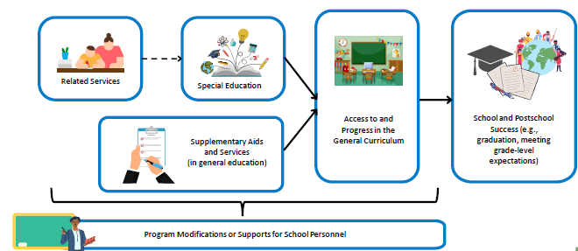
How do the parts of the statement of services and aids fit together?
Taken from PROGRESS Center at the American Institutes for Research® The PLAAFP Statement is the Foundation for the IEP National Center on Intensive Intervention at the American Institutes for Research CEC 2025
Notes:
Josie
Service Statements - What will we do in response to the student’s needs?
Special education services: Specially designed instruction to meet a student’s unique needs
Related services: Required to benefit from special education
Supplementary aids and services: Services to allow involvement in the general curriculum
Program modifications or supports for school personnel: Supports help school staff help students achieve their goals and participate in the general education classroom (e.g. training).
Special factors: The five areas (e.g., behavior, assistive technology)

Slide 193
Example: One Statement of Services and Aids
A sixth-grade student with a learning disability that impacts the student’s ability to decode and fluently read connected text.
Type of Service | Sample Proposed Services
Special Education (SDI) | Daily 30-minute direct instruction in phonics and reading fluency taught by the special education teacher.
Related Service | Pull out speech services 2 days a week for 20 min to address the disfluency/stutter impacting fluent reading of connected text.
Supplementary | Access to audio books or a peer reader when reading is above instructional reading level.
Program Modifications or Supports for School Personnel | Special education teacher and speech and language pathologist meet 30 minutes each monthly to ensure the speech services assist the student in benefiting from special education.
Taken from PROGRESS Center at the American Institutes for Research® The PLAAFP Statement is the Foundation for the IEP National Center on Intensive Intervention at the American Institutes for Research CEC 2025
Notes:
Josie

Slide 194
Question 18
17. Does the IEP include the projected date for the beginning of special education and related services, supplementary aids and services (including accommodations), program modifications and supports for school personnel? 34 C.F.R. 300.320(a)(7); K.S.A. 72-3429(c)(7) METHOD: Review the IEP to determine whether it contains a projected beginning date for EACH of the special education and related services, the supplementary aids and services (including accommodations), program modifications and supports for school personnel that will be provided.
For Each and Every Service
Describe the service (see above) | Provide the projected date for the beginning of each service (Note: the IEP start date does NOT serve the function of the start date for any service)
YES
Select YES if the IEP contains a projected beginning date for EACH of the special education and related services, supplementary aids and services (including accommodations, program modifications, and supports for school personnel that will be provided.
NO
Select NO if the IEP DOES NOT contain a projected beginning date for EACH of the special education and related services, supplementary aids and services (including accommodations, program modifications, and supports for school personnel that will be provided.
Kansas Special Education Process Handbook, Chapter 4, Section E.2.h..
Notes:
Josie
It is important to remember ALL students are general education students first. Some students will require special education aids and services to access and benefit from general education similar to their peers. The IEP needs to include the projected date for beginning of special education and related services, supplementary aid and services, program modifications and supports for school personnel. When you review the file, determine if there is a start date for EACH special education and related service, supplementary aids and services, program modifications and supports for school personnel. Select YES if the IEP includes documentation of the projected beginning date for EACH service, select NO if the IEP does not include documentation of the projected beginning date for ALL services.

Slide 195
Question 19
18. Does the IEP include anticipated frequency, location and duration of special education and related services, supplementary aids and services (including accommodations), program modifications and supports for school personnel? 34 C.F.R. 300.320(a)(7); K.S.A. 72-3429(c)(7) METHOD: Review the IEP to determine whether it contains the anticipated frequency, location, and duration for EACH of the special education and related services, supplementary aids and services (including accommodations), program modifications and supports for school personnel.
Examples of Frequency, Location, Durations for Related Services
Transportation | Counseling Services | Occupational Therapy
Frequency: Every day when school is in session | Frequency: Three Days per week | Frequency: Once per week
Location: In district special education vehicle | Location: Counselor’s Office | Location: Resource Room
Duration: Travel time from home to school/school to home via bus route | Duration: A total of 600 minutes per semester | Duration: Twenty minutes per week
YES
Select YES if the IEP contains the anticipated frequency, location, and duration for EACH of the special education and related services, supplementary aids and services (including accommodations), program modifications, and supports for school personnel.
NO
Select NO if the IEP DOES NOT contain the anticipated frequency, location, and duration for EACH of the special education and related services, supplementary aids and services (including accommodations), program modifications, and supports for school personnel.
Kansas Special Education Process Handbook, Chapter 4, Section E.2.h..
Notes:
Josie
This question had the 3rd highest number of non-compliant files last year
Review the IEP to ensure each special education and related service, supplementary aids and services including accommodations, program modification and supports for school personnel all contain frequency, location, and duration. KSDE does not allow using "as needed" as a frequency of accommodation. Using "as determined by the teacher" as a frequency of accommodation is not allowed.

Slide 196
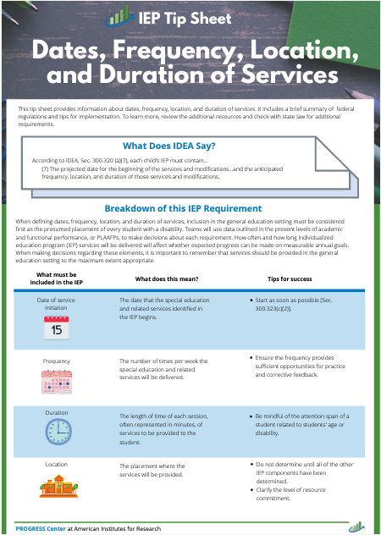
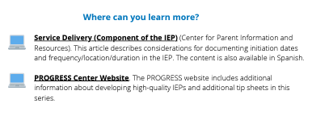
Frequency, Location, Duration Tip Sheet
Notes:
Josie

Slide 197
Documenting Accommodations
Assuring the Documentation of Frequency, Location, and Duration of Accommodations on the IEP (PDF)
Examples of Frequency, Location, and Duration for Accommodations & Modifications (PDF)
Documenting Frequency, Location, and Duration of Accommodations and Modifications on the IEP during the school year (PDF) (examples specific to Text-to-Speech)
Considerations for Accessible Educational Materials (PDF)
Kansas Assistive Technology Guide
Assistive Technology Dear Colleague Letter (PDF)
Myths and Facts Surrounding Assistive Technology Devices (PDF)
Notes:
Josie
This slide contains a variety of resources that have examples for how to document accommodations on the IEP

Slide 198
Examples: Accommodations and Modifications (Q17 & Q18)
ACCOMMODATION EXAMPLES:
Accommodation | Start Date | Location | Frequency | Duration
Extended time for assignments | 3/3/25 | In all core classes (social studies, science, math, and language arts) | Whenever written assignments are given | Todd will receive a time extension of 1 ½ of the required assignment time to complete the assignment
Text read aloud via human or electronic reader | 8/15/25 | In all settings, both general and special education | When given material above a second-grade level | Until reading of assigned text is completed
Use of calculator | 9/9/24 | In general education math class | Whenever assignment requires math calculation | For duration of math class
Provide copy of notes, study guide, or cloze activity to be used for review | 9/9/24 | Across all general education classrooms | For each chapter or unit of study | Notes, study guide, or cloze activity provided at least 4 days before any chapter or unit test
MODIFICATION EXAMPLES:
Modification | Start Date | Location | Frequency | Duration
Jolinda will be provided with fewer answer options for all classroom multiple choice tests (e.g., 3 answer options instead of 4). | 1/5/25 | In all core classes | Whenever multiple choice assessments are given | For the multiple-choice portion of all classroom assessments
During her general education math class, Linda will be asked to complete multiplication and division problems with no more than two digits. | 2/2/25 | In core math class | Whenever a math assignment or classroom math assessment is given that involves multiplication or division. | For the duration of all math assignments and classroom math assessments.
Notes:
Josie

Slide 199
Monitoring State Assessment Accommodations
Academic Assessment Peer Review
Critical Element 5.4 requires State to monitor test administration to ensure accommodations selected for State assessments are :
Consistent with accommodations provided to the students during instruction and/or practice
Consistent with the assessment accommodations identified by a student’s IEP under IDEA
LEA’s selected for random data verification will upload the accommodations section(s) of the students IEP for Q18. KSDE will cross reference with the students PNP to ensure consistency in accommodations.
Notes:
Cary

Slide 200
Be the Reviewer Q18
Notes:
Josie
Q16-21
Look over your files and discuss among your table. We will be walking around to answer any specific questions you may have.
What example from your files for Q16-21 would you like to share with the group? This could be a good example that you think could help others or an example you would like us to discuss or a trend you noticed We will spend the last 5 minutes sharing out.

Slide 201
Q18 – F,D,L Example 1
Accommodations/Modifications/Supplementary Support | Frequency | Location | Duration | Date
XXXX will be allowed extended time to complete assignments or assessments in math. | For each math assignment or assessment for which xxxx needs additional time to complete it | General education classroom; resource room | One extra day | Start date: 2/6/24 End date: 2/5/25
Notes:
Josie

Slide 202
Q18 – F,D,L Example 1- KSDE Response
Accommodations/Modifications/Supplementary Support | Frequency | Location | Duration | Date
XXXX will be allowed extended time to complete assignments or assessments in math. | For each math assignment or assessment for which xxxx needs additional time to complete it | General education classroom; resource room | One extra day | Start date: 2/6/24 End date: 2/5/25
“As needed” language is not specific, it doesn’t pass the stranger test. Non-compliant
Updated language: For each math assignment that is not completed within the timeframe given to the rest of the class.
Notes:
Josie

Slide 203
Q18 – F,D,L Example 2
Accommodations/Modifications/Supplementary Support | Frequency | Location | Duration | Date
XXXX will be allowed a break outside his regular education classroom | Anytime there is a school activity, assembly, or the classroom is too loud | General education classroom | For the duration of the IEP | Start date: 10/20/23 End date: 10/19/24
Notes:
Josie

Slide 204
Q18 – F,D,L Example 2 – KSDE Response
Accommodations/Modifications/Supplementary Support | Frequency | Location | Duration | Date
XXXX will be allowed a break outside his regular education classroom | Anytime there is a school activity, assembly, or the classroom is too loud | General education classroom | For the duration of the IEP | Start date: 10/20/23 End date: 10/19/24
What is too loud? How long will the break be? This is non-compliant
Updated language: XXX will be allowed a break outside his regular classroom when he shows signs that it is too loud (covering his ears) for 5-10 minutes until student is regulated.
Notes:
Josie

Slide 205
Q18 – F,D,L Example 3
Accommodations/Modifications/Supplementary Support | Frequency | Location | Duration | Date
XXXX will have assignments and tests read to him | Each time the regular classroom teacher believes it is necessary for XXX to fully understand the material presented on assignments and tests | Regular education classroom, resource room | Regular classroom period | Start date: 11/13/23 End date: 11/12/24
Notes:
Josie

Slide 206
Q18 – F,D,L Example 3 – KSDE Response
Accommodations/Modifications/Supplementary Support | Frequency | Location | Duration | Date
XXXX will have assignments and tests read to him | Each time the regular classroom teacher believes it is necessary for XXX to fully understand the material presented on assignments and tests | Regular education classroom, resource room | Regular classroom period | Start date: 11/13/23 End date: 11/12/24
Frequencies that include statements like “as needed” or “as determined by the teacher are non-compliant.
Updated language: XXX will have assignments and tests read to him when the reading level of the text is above the 3rd grade level in the regular education classroom and resource room until the assignment or test is completed.
Notes:
Josie

Slide 207
Q18 – F,D,L Example 4
Accommodations/Modifications/Supplementary Support | Frequency | Location | Duration | Date
XXXX will have assignments/assessments reduced by 50% (student responsible for 50% of assignment. | Each time assignment or assessment is given | Regular education classroom, | For the duration of the assignment/ assessment | Start date: 11/2/23 End date: 11/1/24
Notes:
Josie

Slide 208
Q18 – F,D,L Example 4 – KSDE Response
Accommodations/Modifications/Supplementary Support | Frequency | Location | Duration | Date
XXXX will have assignments/assessments reduced by 50% (student responsible for 50% of assignment. | Each time assignment or assessment is given | Regular education classroom, | For the duration of the assignment/ assessment | Start date: 11/2/23 End date: 11/1/24
Notes:
Josie

Slide 209
Q18 – F,D,L Example 5
Accommodations/Modifications/Supplementary Support | Frequency | Location | Duration | Date
XXXX will assignments and tests modified | XXXX assignments and tests may be modified more to his learning capacity. Ex: word banks, shorter questions, easier vocab. Words, shortened assignments and tests. After the classroom teacher determines that it is in the best interest of XXX feeling a sense of success in class | Regular education classroom, resource room | Regular classroom period | Start date: 11/13/23 End date: 11/12/24
Notes:
Josie

Slide 210
Q18 – F,D,L Example 5 – KSDE Response
Accommodations/Modifications/Supplementary Support | Frequency | Location | Duration | Date
XXXX will have assignments and tests modified | XXXX assignments and tests may be modified more to his learning capacity. After the classroom teacher determines that it is in the best interest of XXX feeling a sense of success in class | Regular education classroom, resource room | Regular classroom period | Start date: 11/13/23 End date: 11/12/24
Frequencies that include statements like “as needed” or “as determined by the teacher” are non-compliant. Does the student need questions to be multiple choice or matching? Does the student need simplified language? Does the student need shortened assignments. What specifically does the student need to make progress in the general curriculum?
Notes:
Josie

Slide 211
Q18 – F,D,L Example 6
Accommodations/Modifications/Supplementary Support | Frequency | Location | Duration | Date
XXXX will have Text-to-Speech or adult reader for all materials given above a 1st grade level | Each time reading is required to access curriculum/assignments/assessments | All settings | For the duration of the assignment/ assessment | Start date: 11/2/23 End date: 11/1/24
Notes:
Josie

Slide 212
Q18 – F,D,L Example 6 – KSDE Response
Accommodations/Modifications/Supplementary Support | Frequency | Location | Duration | Date
XXXX will have Text-to-Speech or adult reader for all materials given above a 1st grade level | Each time reading is required to access curriculum/assignments/assessments | All settings | For the duration of the assignment/ assessment | Start date: 11/2/23 End date: 11/1/24
Notes:
Josie

Slide 213
Q18 – F,D,L Example 7
Accommodations/Modifications/Supplementary Support | Frequency | Location | Duration | Date
XXXX will be provided frequent change and opportunity for movement (movement breaks) | daily | All settings | For the duration of the school day | Start date: 4/26/23 End date: 4/25/24
Notes:
Josie

Slide 214
Q18 – F,D,L Example 7 – KSDE Response
Accommodations/Modifications/Supplementary Support | Frequency | Location | Duration | Date
XXXX will be provided frequent change and opportunity for movement (movement breaks) | daily | All settings | For the duration of the school day | Start date: 4/26/23 End date: 4/25/24
This doesn’t pass the stranger test. How does staff know when XXXX needs a break and for how long.
Updated frequency: movement breaks will be provided approximately every 15-20 minutes based on XXXX sensory and behavioral cues.
Updated duration: each movement break will last 3-5 minutes with flexibility to extend or shorten duration depending on XXXX needs and the activity context
Rationale: Frequent movement breaks support sensory regulation and provide XXX opportunities to release physical energy, which helps reduce task avoidance behaviors such as climbing on furniture and running.
Notes:
Josie

Slide 215
Q18 – F,D,L Example 8
Accommodations/Modifications/Supplementary Support | Frequency | Location | Duration | Date
XXXX will be provided alternate ways to demonstrate learning | daily | All settings | For the duration of the school day | Start date: 4/6/23 End date: 4/5/24
Notes:
Josie

Slide 216
Q18 – F,D,L Example 8 – KSDE Response
Accommodations/Modifications/Supplementary Support | Frequency | Location | Duration | Date
XXXX will be provided alternate ways to demonstrate learning | daily | All settings | For the duration of the school day | Start date: 4/6/23 End date: 4/5/24
This doesn’t pass the stranger test.
Updated Language: alternate methods such as verbal responses, visuals, hands on demonstrations, or assistive technology.
Updated frequency: during all academic tasks, assessments and activities, as appropriate to the subject mater.
Updated duration: provided consistently throughout the school day and will remain in place until XXXX develops the skills needed to complete tasks in a more traditional format.
Notes:
Josie

Slide 217
34 C.F.R. 300.320(a)(7) requires every IEP to include the frequency, location, and duration of each service or modification in an IEP.
In their comments to the federal regulations in the Federal Register, Aug. 14, 2006, p. 46667, OSEP said:
What is required is that the IEP include information about the amount of services that will be provided to the child, so that the level of the agency's commitment of resources will be clear to parents and other IEP Team members. The amount of time to be committed to each of the various services to be provided must be appropriate to the specific service, and clearly stated in the IEP in a manner that can be understood by all involved in the development and implementation of the IEP (emphasis added).
In short, frequency and duration of any service must be stated in a way that passes the “stranger test.” That is, could a reasonable person (such as a parent, or a teacher, para, or other provider, or a due process hearing officer or judge if disputed) read the IEP and know the basis for each element: (1) what has to be provided; (2) when it has to be provided; and (3) how long it has to be provided? If reasonable minds can disagree about any of these three parts for a service, accommodation, or modification in an IEP, the description does not meet this requirement.
Central to this analysis is (1) what is to be provided. A statement that “supports” will be provided is insufficient because it omits a description of what supports need to be provided, and so the needed support is not clearly stated in the IEP in a manner that can be understood by all involved in the development and implementation of the IEP.

Slide 218
Question 20
19. Did the IEP team consider parent concerns for enhancing the education of their student in developing, reviewing and revising the IEP? 34 C.F.R. 300.324(a)(1)(ii); K.S.A. 72-3404(r); 72-3429(d)(1) METHOD: This information could be found in the Present Levels of Academic Achievement and Functional Performance (PLAAFP) statements or another IEP section or other documentation in the student’s file indicating the IEP team requested and considered the concerns the parent had for enhancing the education of their student in developing, reviewing and revising the IEP.
YES
Select YES if the IEP or the education record contains documentation that the IEP team considered the concerns of the parent for enhancing the education of their student in developing, reviewing and revising the IEP.
NO
Select NO if the IEP or the education record DOES NOT contain documentation that the IEP team considered the concerns of the parent for enhancing the education of their student in developing, reviewing and revising the IEP.
Kansas Special Education Process Handbook, Chapter 4, Section E.1.b. and Section F..
Notes:
Josie
could be found in meeting notes, PWN, or in IEP.

Slide 219
“Meaningful” Participation
Parent input is based on an understanding what will be discussed at the IEP meeting, what is going on during the meeting, and what is or will be proposed.
The opinions and suggestions made by a student’s parents must be given serious consideration by the IEP team
Taken from Yell and Bateman CEC2025
Notes:
Josie

Slide 220
The “Core of the Statute”
The “core of the statute” is "the cooperative process that it established between parents and schools.”
Shaffer v. Weast, 546 U.S. 49, (2005).
“Procedural violations that interfere with parental participation in the IEP formulation process undermine the very essence of the IDEA”
Amanda J. v. Clark County School District, 260 F.3d. 877 (9th Cir. 2001)
Taken from Yell and Bateman CEC2025
Notes:
Josie

Slide 221
Question 21
20. If the student’s behavior impedes the student’s learning or that of others, did the IEP Team consider the use of positive behavioral interventions and supports, and other strategies, to address that behavior when developing, reviewing or revising the IEP? 34 C.F.R. 300.324(a)(2)(i), (b)(2); K.S.A. 72-3429(d)(4) METHOD: First, review the education record for documentation indicating whether the student displays behavior that impedes the student’s or others’ learning. If the student’s behavior impedes learning (of self or others), then review the education record for documentation showing that the IEP Team considered the use of positive behavior interventions and supports and other strategies when developing the initial IEP, conducting the annual IEP review, or revising the IEP. This information can be found in the IEP, a prior written notice form, IEP Team meeting notes, and IEP amendment form, or other documentation in the education record.
YES
Select YES if documentation shows that when developing, reviewing or revising the IEP, the IEP Team considered the use of positive behavior interventions and supports and other strategies to address the student’s behavior that impedes the student’s or others’ learning.
NO
Select NO if documentation DOES NOT show that when developing, reviewing or revising the IEP, the IEP Team considered the use of positive behavior interventions and supports and other strategies to address the student’s behavior that impedes the student’s or others’ learning.
N/A
Select N/A if documentation shows that the student DOES NOT have behavior that impedes the student’s or others’ learning.
Kansas Special Education Process Handbook, Chapter 4, Section E.1.e.
Notes:
Josie
When you review the file for this question, first review the documentation that indicates whether the student displays behavior that impedes their own or other student's learning. If the documentation shows behavior that impedes learning is present, then review the record for documentation that shows that the IEP team CONSIDERED the use of positive behavior interventions and supports when developing the IEP, conducting the IEP review, or revising the IEP. Select YES if the documentation does have narrative that shows the teams consideration of positive behavior interventions and supports with other strategies to address the behavior that impedes on students learning. Select NO if the documentation does not show the teams consideration. This question also has the third option of N/A which should only be used if the documentation shows that the student does no have any behaviors that impede their own or other students learning. The FAQ document includes some helpful information related to question 20. This document is linked in an upcoming slide for your reference.

Slide 222
Behavior Intervention Plan Circumstances
IDEA identifies two circumstances in which a district should consider a student’s need for a BIP:
When the student’s behavior impedes his own learning or the learning of others (34 CFR § 300.324(a)(2)(i)); and
When a student has been removed from his current educational placement for a behavioral or disciplinary offense (34 CFR § 300.530(d)(1)(ii)).
IEP teams must include behavioral interventions in the IEP when a student requires them to receive FAPE. Dear Colleague Letter, 116 LRP 33108 (OSERS/OEP August 1, 2016)
Addressing Challenging Behavior of Students with Disabilities: Lessons Learned David Hodgins Tri-State Law conference 2024
Notes:
Josie

Slide 223
Address Behavior Strategies/Interventions
If a student has behavioral issues that impede the student’s learning or that of others, the IEP team is required to address positive behavioral strategies and interventions for that student. If it is determined that a functional behavior assessment should be done and/or the student needs a behavior management program or intervention plan, it should be discussed as a support service or intervention at the IEP meeting. (Julie Weatherly 90 Tips in 120 Minutes – CEC2025)
Notes:
Josie

Slide 224
Positive Behavior Supports
The IDEA does not require a school district to “eliminate interfering behaviors.”
The IDEA requires only that the school district “consider the use” of positive behavioral interventions and supports to address the behavior.
The school met this responsibility by including and implementing a behavioral component in the IEP.
J.W. v. Unified School. Dist. Of Johnson County, State of Kansas, 58 IDELR 124 (D. Kan. 2012)
Addressing Challenging Behavior of Students with Disabilities: Lessons Learned David Hodgins Tri-State Law conference 2024
Notes:
Josie

Slide 225
DID IT
D = Design
I = Implement
D = Documentation and data (drives good decision making)
I = Individualize
T = Training
Addressing Challenging Behavior of Students with Disabilities: Lessons Learned David Hodgins Tri-State Law conference 2024
Notes:
Josie

Slide 226
Student Example
Sarah, a 2nd-grade student, demonstrates age-appropriate academic skills in most areas. However, during whole-group instruction and independent work, she frequently calls out answers, makes distracting noises (e.g., humming, tapping), and leaves her seat without permission. These behaviors appear to be motivated by a desire to gain attention from the teacher or her peers. Her disruptive actions often interrupt the learning of other students and impede her ability to stay on task and complete assignments independently. A functional behavioral assessment (FBA) indicated that the primary function of these behaviors is attention seeking.
Positive behavior intervention plan (PBIP)
Proactive strategies to prevent attention-seeking behaviors
Clear Expectations and Rules: Mrs. Smith (teacher) will explicitly review classroom rules and expectations daily, focusing on positive statements (e.g., "Raise your hand to speak," "Stay in your seat during independent work").
Structured Routine: A visual schedule will be utilized to help Sarah understand the daily routine and upcoming transitions, reducing anxiety and uncertainty that may lead to disruptive behavior.
Minimized Distractions: Sarah will be seated in an area of the classroom with minimal distractions (e.g., near the front, away from windows and doors). Clutter will be minimized, and visual stimuli on the walls will be limited to necessary learning aids.
Frequent Positive Attention: Mrs. Smith will proactively engage with Sarah during instruction and independent work, providing positive attention and praise when she is following rules or demonstrating desired behaviors. This can include compliments, smiles, or short, positive interactions.
Teaching replacement behaviors
Teaching Hand-Raising: Direct instruction and practice will be provided to Sarah on how to appropriately raise her hand and wait to be called on before speaking or asking for help.
Verbal Cues: Sarah will be taught and prompted to use specific verbal phrases, such as "Excuse me" or "May I have your attention, please?" to gain adult attention when she has a question or needs assistance
Responsive Strategies
Planned Ignoring
Redirection and Prompting
Behavioral contract – “if… then…” statements
Notes:
Josie
This example provides 4 positive behavior strategies provided through proactive strategies to prevent attention seeking behaviors.

Slide 227
question 22
21. When developing, reviewing or revising the IEP, in the case of a student who has limited English proficiency, did the IEP Team consider the language needs of the student as those needs relate to the student’s IEP? 34 C.F.R. 300.324(a)(2)(ii), (b)(2); K.S.A. 72-3429(d)(5) METHOD: First, review the education record for documentation indicating whether the student has limited English proficiency. If the student has limited English proficiency, then review the education record for documentation showing that the IEP Team considered the student’s language needs as those needs relate to the IEP when developing, reviewing, or revising the IEP. This information can be found in the IEP, a prior written notice form, IEP Team meeting notes, and IEP amendment form, or other documentation in the education record.
YES
Select YES if documentation shows that when developing, reviewing or revising the IEP, the IEP Team considered the language needs of the student as those needs relate to the student’s IEP.
NO
Select NO if documentation DOES NOT show that when developing, reviewing or revising the IEP, the IEP Team considered the language needs of the student as those needs relate to the student’s IEP.
N/A
Select N/A if documentation shows that the student DOES NOT have limited English proficiency.
Kansas Special Education Process Handbook, Chapter 3, Sections C. and F., Chapter 7, Sections D. and F..
Notes:
Josie

Slide 228
Question 21: When developing, reviewing or revising the IEP, in the case of a student who has limited English proficiency, did the IEP team consider the language needs of the student as those needs relate to the IEP?
The education record for a student should indicate whether the student has limited English proficiency. If so, documentation should be found (in IEP, PWN, IEP team meeting notes, IEP amendment, or other location in the record) that shows when the IEP team develops, reviews and/or revises IEP, they considered language needs.
For example, a team might include something such as…
While the student needs direct special education services to address his learning disability, he is an English Learner and continues to need services from a language acquisition program to address those needs. His current language performance is described within the communication area of this IEP. It is critical that the EL teacher and the SPED teacher work closely to address all the student’s needs in a coordinated way. (This statement would need to be in the IEP somewhere, and the IEP would reflect both direct and consultative services from the SPED teacher. It needs to be clear in the IEP that the student will continue to receive EL).
Notes:
Josie

Slide 229
IDEA & Gifted File Review Self-Assessment: Placement – Questions 22-23
Notes:
Melissa

Slide 230
H.B. v. Las Virgenes (9th Cir. 2007)
”Predetermination occurs when an educational agency has made its determination prior to the IEP meeting, including when it presents one placement option at a meeting and is unwilling to consider other alternatives.”
Taken from Yell and Bateman CEC2025
Notes:
Melissa

Slide 231
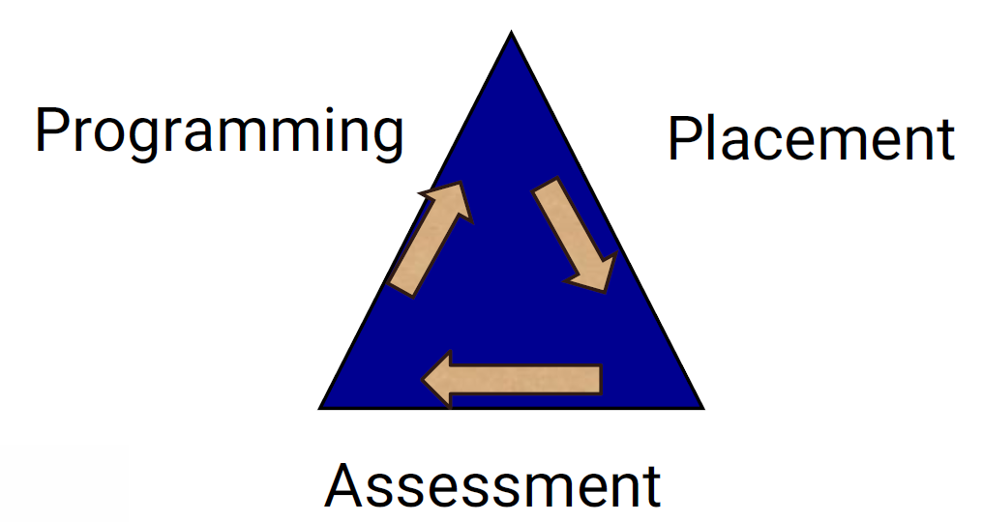
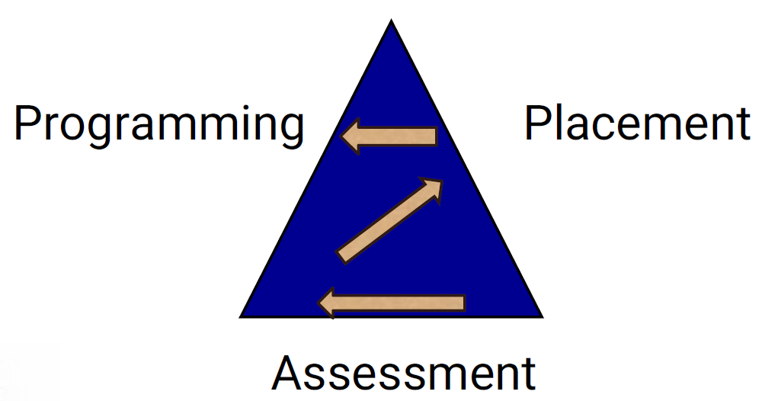
Special Education Process
The Right Way
Shoehorning
Taken from Yell and Bateman CEC2025
Notes:
Melissa

Slide 232
Question 23
22. Was the student’s educational placement determined at least annually? 34 C.F.R. 300.116(b)(1); K.A.R. 91-40-21(e)(1) METHOD: Review the education record for documentation that the exceptional student’s educational placement was determined at least annually. Compare dates of placement decisions documented in the student’s IEP or prior written notice documents. Review meeting records for evidence that the student’s placement was discussed and determined within one year of the previous placement determination.
YES
Select YES if the education record contains documentation that the student’s educational placement was determined at least annually.
NO
Select NO if the education record DOES NOT contain documentation that the student’s educational placement was determined at least annually.
Kansas Special Education Process Handbook, Chapter 6, Section B.
Notes:
Melissa

Slide 233
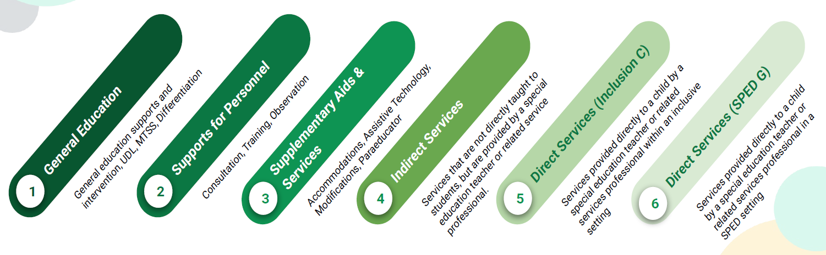
Continuum of Supports
Least Restrictive Environment (Everything) AND considerations for Harmful effects….
Taken from Greenbush SDI workshop
Notes:
Melissa

Slide 234
FAQ Guidance
QUESTION: Regarding Self-Assessment Question 22, if a school district always provides the parent with a PWN at the IEP annual review, does that documentation show that placement was determined annually?
ANSWER: Providing a PWN at the IEP meeting COULD show that placement was determined annually depending on the content of the PWN and whether it addresses the placement determination.
QUESTION: What are some examples of how to better document the LRE continuum when making changes?
ANSWER: See the Kansas Special Education Process Handbook, Chapter 6 Section C. Also see the LRE Decision Tree and accompanying chart at the end of the chapter.
Notes:
Melissa

Slide 235
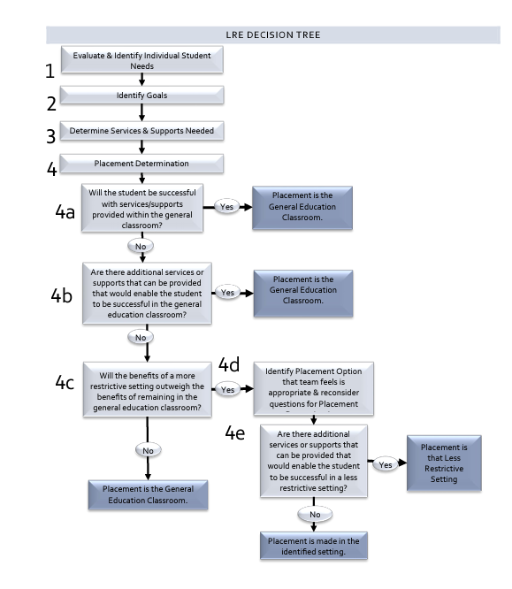
LRE Decision Tree
Notes:
Melissa

Slide 236
What is LRE?
Under the IDEA, each school district must ensure that:
To the maximum extent appropriate, children with disabilities are educated with children who are nondisabled; and
Special classes, special schooling, or other removal of children with disabilities from the regular education environment occurs only if the nature or severity of the disability is such that education in regular classes with the use of supplementary aids and services cannot be achieved satisfactorily. 34 CFR 300.114(a)(2)
LRE isn’t a place- it’s a process of decision making that guides a child’s education program. It looks different for each child because kids are unique (Greenbush SDI workshop)
Notes:
Melissa

Slide 237
Least Restrictive
Least Restrictive
Regular education with weekly monitoring from a special education teacher
Regular education with daily consultation from a special education teacher
Regular education with special education services and supports which are aligned with the general curriculum
Regular education with special education services provided for part of the day in a resource room or a special education classroom
Self-contained special education classroom
Special day school (outside the school campus)
Residential treatment facility
Hospital
Detention facility
Homebound
Most Restrictive
Addressing Challenging Behavior of Students with Disabilities: Lessons Learned David Hodgins Tri-State Law conference 2024
Notes:
Melissa

Slide 238
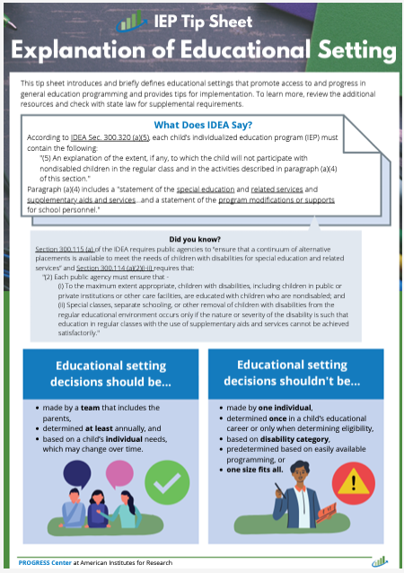
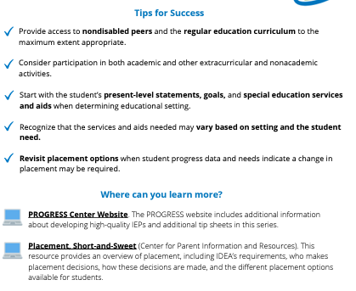
Educational Setting TIP Sheet
Notes:
Melissa

Slide 239
Question 24
23. IDEA only: If the student’s LRE (least restrictive environment) placement is outside of the regular education environment for any part of the school day (including nonacademic and extracurricular services and activities), did the team first determine that the nature or severity of the disability is such that placement in the regular education environment with the use of supplementary aids and services could not be achieved satisfactorily? 34 C.F.R. 300.114(a)(2)(ii), 300.117; K.S.A. 72-3420(a); K.A.R. 91-40-21(i) METHOD: First, review the education record to determine whether the student with a disability is placed in the regular education environment for the whole school day or in a more restrictive environment for any part of the school day. If the student is placed in a more restrictive environment for any part of the school day (including nonacademic and extracurricular services and activities – i.e. meals, recess, transportation, assemblies, clubs, athletics, etc.), next review the education record for documentation showing that the team first considered or implemented placement in the regular environment with the use of supplementary aids and services before considering more restrictive environments. Finally, review the education record for documentation showing that the nature or severity of the disability is such that education in regular classes with supplementary aids and services cannot be achieved satisfactorily.
YES
Select YES if:
• The education record contains documentation showing the student is placed in the regular education environment for the entire school day, including nonacademic and extracurricular services and activities.
OR
• The education record contains documentation showing a) the team first considered placement in the regular environment with supplementary aids and services, AND b) when placing the student outside of the regular environment the team determined that the nature or severity of the student’s disability is such that placement in the regular education environment with supplementary aids and services cannot be achieved satisfactorily.
NO
Select NO if the education record DOES NOT contain documentation showing a) the team first considered placement in the regular environment with supplementary aids and services, AND b) when placing the student outside of the regular environment the team determined that the nature or severity of the student’s disability is such that placement in the regular education environment with supplementary aids and services cannot be achieved satisfactorily.
N/A
Select N/A if:
• This is a file for a gifted-only student.
OR
• This is a file for a student who: (a) has been convicted as an adult under state law and is incarcerated in an adult prison; AND (b) the student’s IEP team has modified the student’s IEP or placement because the State has demonstrated a bona fide security or compelling penological interest that cannot otherwise be accommodated (34 C.F.R. 300.324(d)(2)).
Kansas Special Education Process Handbook, Chapter 3, Sections C. and F., Chapter 7, Sections D. and F..
Notes:
Melissa
Lastly, questions 23 reads"…". When you are answering this question, first you will determine the environment the student is placed in. If the student is placed in the regular education environment for the ENTIRE day then select YES. If the student is placed in a more restrictive environment for any part of the school day, which includes nonacademic and extracurricular services and activities like meals, recess, transportation, assemblies, clubs, and athletics, then documentation showing that the IEP team considered or implemented placement in the regular environment with the use of supplementary aids and services before considering more restrictive environments. There are two instances where N/A would need to be selected. First, if the file is a gifted-only student. The second instance where N/A would be selected is if the student has been convicted as an adult under state law and is incarcerated in an adult prison AND the student's IEP team has modified the IEP or placement because the incarceration does not allow for accommodation.

Slide 240
Common findings
Use of boiler plate statement as assurance that LRE was considered for a specific student, or simply restating the pullout services within the IEP
Lack of documentation that team first considered placement in general education with support before moving to more restrictive setting
“Courts and federal agencies are clear that IEPs and/or other relevant documentation and information should clearly and specifically document options considered on the continuum of alternative placements and why less restrictive options were rejected. This rationale must be clearly and appropriately stated.” (Julie Weatherly 90 Tips in 120 Minutes CEC2025)
Notes:
Melissa
Some common findings that we deemed as non-compliant for question 23 were the use of a boiler plate statements outlining that LRE was considered for a specific student or simply just restating the pullout services. The second common finding was a lack of documentation that the IEP team considered placement in general education first, before moving to a more restrictive environment.

Slide 241
LRE Sample Statements
Dan needs intensive social skills instruction and practice in a small group situation in order to improve his ability to resolve conflict and cooperate with peers. He will receive this instruction from the social worker during his study hall for 20 minutes per day, three times per week. Due to Dan's difficulty with sustaining focus and impulsivity in responding to peers and adults resulting from his disability, he needs direct and targeted opportunities to practice skills in a small group setting with verbal feedback first before transferring the practiced skill into the general education setting. This setting and level of support is considered to be the least restrictive environment at this time; data for previous attempts to provide support and instruction only within the general education setting in these areas suggested that Dan may gain skills faster and benefit from smaller groups with more structured opportunities with immediate adult feedback. As Dan gains skills in these two areas, the team will review progress at least annually, with goal to decrease his pullout time and increase his supports in general education to assist in successfully transferring these skills. Dan will receive his remaining instruction in the general education setting with his non-disabled peers.
Due to Sue’s significant information processing deficits in the areas of auditory acquisition and organization related to sequencing words resulting from her receptive language deficit, she needs small group reading instruction with repeated directions in multiple formats. Therefore, she will be removed from general education to receive this instruction daily for 25 minutes during intervention time. Sue will continue to participate in core reading instruction within the general classroom and will receive her remaining instruction in the general education setting with her general education peers. This level of support and location of service is considered to be the least restrictive environment at this time: special education services, service settings, and data collected will be reviewed at least annually to help inform placement decisions for the least restrictive placement to meet Sue's needs.
Notes:
Melissa
We have included 2 LRE Sample Statements as example for how districts could document LRE for Q 23.

Slide 242
Be the Reviewer Q23
Notes:
Melissa
Q22-23
Look over your files and discuss among your table. We will be walking around to answer any specific questions you may have.
What example from your files for Q22-23 would you like to share with the group? This could be a good example that you think could help others or an example you would like us to discuss. We will spend the last c5 minutes sharing out.

Slide 243
Q23 – Example 1
Due to XXXX’s significant speech errors and intelligibility, it is recommended that he receive speech services in a pull-out setting. XXXX will receive speech/language services outside of the general education classroom 2x a week for 20 minutes per session. Due to XXXX’s level of support and required to address his significant speech errors and current data, this level of support and location of services is the least restrictive environment for XXXX. Continued data collection and review will guide future conversations about services and placement for XXXX.
Notes:
Melissa

Slide 244
Q23 – Example 1- KSDE Response
Due to XXXX’s significant speech errors and intelligibility, it is recommended that he receive speech services in a pull-out setting. XXXX will receive speech/language services outside of the general education classroom 2x a week for 20 minutes per session. Due to XXXX’s level of support and required to address his significant speech errors and current data, this level of support and location of services is the least restrictive environment for XXXX. Continued data collection and review will guide future conversations about services and placement for XXXX.
Notes:
Melissa

Slide 245
Q23 – Example 2
It is anticipated that XXXX will receive approximately 150 minutes of support in the regular education classroom, 5 days per week for the duration of the IEP. It is anticipated that XXXX will receive approximately 20 minutes of support in the special education classroom, 5 days per week for the duration of the IEP. This action was proposed because it meets her educational needs.
Notes:
Melissa

Slide 246
Q23 – Example 2 – KSDE Response
It is anticipated that XXXX will receive approximately 150 minutes of support in the regular education classroom, 5 days per week for the duration of the IEP. It is anticipated that XXXX will receive approximately 20 minutes of support in the special education classroom, 5 days per week for the duration of the IEP. This action was proposed because it meets her educational needs.
There is lack of documentation showing the nature and severity of the disability is such that education in regular classes with supplementary aids and services cannot be achieved satisfactorily
Notes:
Melissa

Slide 247
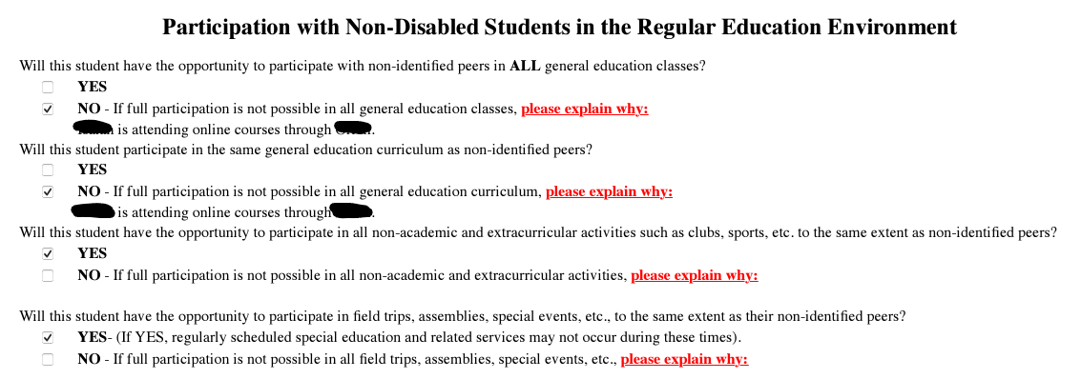
Q23- Example 3
Notes:
Melissa

Slide 248

Q23- Example 3 – KSDE Response
No information showing the nature or severity of the disability is such that education in regular classes with supplementary aids and services cannot be achieved satisfactorily.
Notes:
Melissa

Slide 249
Q23- Example 4
XXXX will participate with his/her peers in the general education classroom with support/services to help her access grade level content which includes core instruction in reading. Due to significant needs in reading resulting from her exceptionality, XXXX will receive specialized instruction away from her peers in an individual or small group that will be adapted to address skill deficits, pace of learning, provide practice/repetition with immediate feedback, and frequent progress monitoring. The team feels that this placement is appropriate for XXXX at this time. As new data is collected, it will be reviewed by the team with placement adjusted accordingly.
Notes:
Melissa

Slide 250

Q23- Example 4 – KSDE Response
XXXX will participate with his/her peers in the general education classroom with support/services to help her access grade level content which includes core instruction in reading. Due to significant needs in reading resulting from her exceptionality, XXXX will receive specialized instruction away from her peers in an individual or small group that will be adapted to address skill deficits, pace of learning, provide practice/repetition with immediate feedback, and frequent progress monitoring. The team feels that this placement is appropriate for XXXX at this time. As new data is collected, it will be reviewed by the team with placement adjusted accordingly.
Notes:
Melissa

Slide 251
619
Question 24
Notes:
Melissa

Slide 252
Question 24 – cohort 2
24. IDEA only: This question only applies to students in early childhood (3–5-year-olds). If this student is an early childhood student, did the student receive early intervention services under an individualized family service plan (IFSP)? 34 C.F.R. § 303.13 [34 CFR §300.124(c)]
K.A.R. 91-40-2 says “An IEP or IFSP shall be in effect by the child’s third birthday, but, if that birthday occurs during the summer when school is not in session, the child’s IEP team shall determine the date when services will begin.”
K.A.R. 91-40-16(c) says: “If an agency and a child’s parent agree, an IFSP that meets the requirements of the federal law and that is developed in accordance with this article may serve as the IEP of a child with a disability who is two years old but will reach three years of age during the next school year or who is three, four, or five years of age. (2) Before using an IFSP as an IEP, each agency shall meet the following requirements: (A) The agency shall provide to the child’s parent or parents a detailed explanation of the differences between an IFSP and an IEP. (B) If an IFSP is chosen, the agency shall obtain written consent from the parent for use of the IFSP as the child’s IEP.
Notes:
Melissa

Slide 253
Question 24 continued
METHOD: Review the education record for documentation that the student received early intervention services. If the student received early intervention services, select yes.
If yes continue. If no you’re finished.
*This is not a compliance question so selecting NO will result in 24a and 24b being skipped.
YES Select YES if the education record contains documentation showing the student received early intervention services. | NO Select NO if the education record DOES NOT contain documentation showing the student received early intervention service OR this isn’t an early childhood student.
Notes:
Melissa
We have been getting emails and phone calls with concerns about having to mark no if the student isn’t an early childhood student. When setting this question up in KIAS we assigned Q24 as not being a compliance questions. If a student is not an early childhood student marking no will not trigger non-compliance. This was done in order to apply skip logic so that only Q24 a and Q24b show up for those students where Q24 was mark as “yes”. Q24a and Q24b are compliance questions. So responding no to Q24a or b will trigger noncompliance.

Slide 254
Question 24a
24a. Was there LEA representation at the 90-day transition conference? [34 CFR §303.209 ] [34 CFR §300.124(c)]
K.A.R. 91-40-2(b)(3) says “If a child is transitioning from early intervention services provided under part C of the federal law, the agency responsible for providing FAPE to the child shall participate in transition planning conferences for the child.
34 CFR §300.124(c) says “Each affected LEA will participate in transition planning conferences arranged by the designated lead agency under section 635(a)(10) of the Act.
Notes:
Melissa

Slide 255
Question 24a - methodology
METHOD: Review the file to see if a LEA representative was at the 90-day conference? This could be located in:
Meeting Attendance Record: A document signed by all attendees at the IFSP meeting, which would include the name and signature of the LEA representative, indicating their presence.
Meeting Minutes or Notes: Detailed notes or minutes from the meeting that document the attendance of the LEA representative, as well as their involvement in the discussion and planning process.
Email or Written Confirmation: If the LEA representative cannot attend in person but attends virtually or provides input, an email or written confirmation from the LEA could serve as proof.
IFSP Document: The IFSP itself could include a section noting who was invited and attended, which would reflect the LEA representative’s participation.
If Part B is not being invited to transition meetings, they have a responsibility to reach out to Part C and work out a solution. Perhaps some of the documentation could include the efforts of the Part B program to ensure they are invited in the future, such as emails, meeting minutes, etc.
YES Select YES if the education record contains documentation that the LEA representative was present at the 90-day conference. | NO Select NO if the education record DOES NOT contain documentation that the LEA representative was present at the 90-day conference.
Notes:
Melissa

Slide 256
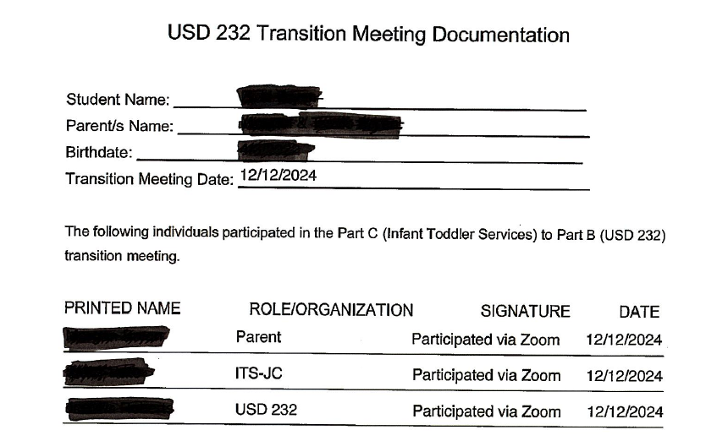
Q24a – Documentation
Notes:
Melissa
I want to thank Andrea West for reaching out and agreeing to share what their district has for documentation for the new Q24 on Part C to B.

Slide 257
Question 24b- methodology
24b. Did the IEP Team consider the child’s transition plan when developing the child’s initial Part B IEP? (K.S.A. 72-3428(b)(1))
METHOD: Review the file to see if there was a transition plan in place. This could be located in the evaluation report, meeting notes, PWN, or IEP. The team could document the IFSP information (Including goal progress) and relevant information from the transition conference in the evaluation report as well as note that both were data sources considered within the PWN.
YES Select YES if the education record contains documentation that the transition plan was considered when developing the child’s initial Part B IEP. | NO Select NO if the education record DOES NOT contain documentation that the transition plan was considered when developing the child’s initial Part B IEP.
Notes:
Melissa

Slide 258
Q24b - Documentation
Notes:
Melissa

Slide 259
Non-Compliance
Notes:
Cary
Districts that are notified of non-compliance on October 31 will need to correct the non-compliance through district corrective action plans, individual corrective action plans, and updated data.

Slide 260
OSEP QA 23-01
According to OSEP QA 23-01 all identified noncompliance must be corrected within one year of when noncompliance was identified. The district will be required to correct the noncompliance by completing the steps below to meet this one-year deadline.
District corrective action plan
Individual Corrective Action Plan
Updated data
Dear Colleague Letter on General Supervision Responsibilities
Guidance on State General Supervision Responsibilities
Notes:
Cary
The district must develop a district corrective action plan that outlines the root cause of the noncompliance and the actions the district will take to correct noncompliance within the timeframe specified by KSDE, but in no case more than one year from identification. Additionally, before concluding that noncompliance has been corrected, KSDE requires correction of all individual cases of noncompliance and collection of additional updated data to demonstrate that the district is correctly implementing the regulatory requirement that was originally identified with noncompliance. An ICA will not be required to correct individual noncompliance for a student who is no longer within the jurisdiction of the LEA.

Slide 261
Levels of Determination (LOD)
Change effective with the FFY 2021 district LOD, released in the spring of 2023
IDEA findings from IDEA & Gifted Requirements File Review
A district is Substantially Compliant when fewer than two children with a disability and an IEP had a finding on the same question
Cohort 1 (SY2024-2025) will be reported in FFY 2024 LOD report (April 2026)
Cohort 2 (SY2025-2026) will be reported in FFY 2025 LOD report (April 2027)
Notes:
Cary

Slide 262
District Corrective Action Plans (DCAPs)
A DCAP will need to be completed for each question that the district had non-compliance on.
DCAPs are completed in KIAS.
DCAPS must address:
Root Cause Analysis (RCA)
Strategy for correcting the problem identified by the RCA
Method of evaluation to assure this problem does not reoccur
Location of the documentation of actions taken
LEA Contact information
Notes:
Cary
There are some good resources to help the district identify the root cause, and the practice vs policy types of guidance for writing DCAPs. The IDEA and gifted file review toolbox houses the Investigative Questions document, Root Cause Analysis Form, DCAP Sample and ICA plan guidance documents. These documents can also be found within KIAS authenticated application under the help section after selecting IDEA and gifted file review

Slide 263
Root Cause Analysis
Identify and discuss data analyzed for determining root cause (i.e. data patterns including who, what and where) ​
What was the root cause of problem (i.e. why)?​
Was root cause at procedural, policy and/or practice level?
5 Why’s
Fishbone
Notes:
Cary
There are 3 parts to the root cause analysis section.

Slide 264
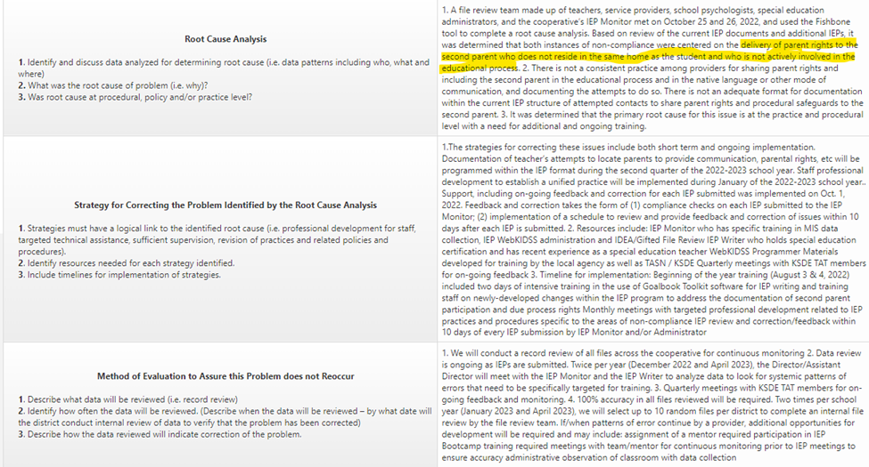
Question 1 DCAP Example
Notes:
Cary
On the next several slides we have exemplar DCAP example for you. It is important to note, we should not be seeing these exact DCAPs since each district will need to be doing their own root cause analysis and will base their strategies and methods on what they found to be the root cause.
In this DCAP the district identified the root cause being related to not delivering parent rights to the second parent who did not reside in the same home as the student.

Slide 265
Question 2 DCAP Example
Root Cause: When the most recent evaluation was reviewed for this student there was no evidence found that the assessments and other evaluation materials selected to assess the student were administered so as not to be discriminatory on a racial or cultural basis. In order to conduct a root cause analysis, a team consisting of 6 School Psychologists and 2 Special Education Administrators was formed. Utilizing the “5 Whys” strategy, the team was able to identify that the root cause of the problem was that this requirement is not currently outlined in the current Supplemental Manual which is found to be at the policy level. Through this process the team did identify that as a part of the last file review series that a change in practice was made to include this required information on the evaluation report. This change in practice, however, was not added to any written policies. When the time came to determine whether or not this student in particular needed to be reevaluated at the 3-year mark, the IEP team did not consider the lack of this information in the previous report when making the decision to not complete a reevaluation; therefore, the file was found to be non-compliant.
Strategies: In order to correct the problem the team has identified 3 steps to implement: This requirement will be added into the Supplemental Manual at the time of the annual review, which will occur during the summer of 2025. The revision will also include a statement to ensure that the most recent evaluation or incoming evaluation (if applicable) must include this language or the IEP team will need to complete a reevaluation. Information taken from the KSDE document entitled the “Evaluation/Eligibility Report Checklist” will be used as a resource when implementing this strategy. The School Psychologists will work to create an “Evaluation/Eligibility Report Checklist” to follow when conducting an initial evaluation, reevaluation, and/or working with an IEP team to determine if an evaluation should be accepted or if a reevaluation needs to occur. This checklist will not only reflect the requirements of the selected assessments to be administered as a part of the evaluation process so as not to be discriminatory on a racial or cultural basis but also all other requirements as outlined by KSDE. The checklist will be developed using the KSDE document entitled the “Evaluation/Eligibility Report Checklist” as a guide. The checklist will be completed by the start of the 2nd semester of the 2024-2025 school year. Following training on the checklist (see below) implementation of the checklist will begin. Training will be provided for all Case Coordinators that oversee the evaluation process on the updated guidance in the Supplemental Manual as well the checklist and expectations for use beginning in January of 2025. Information from the KSDE File Review Cohort #1 training will be used as a part of this training. Additionally, anytime a new Case Coordinator begins employment with they will receive this training. A Case Coordinator refers to the individual who oversees the evaluation and reevaluation process for a student. For most exceptionality categories (including gifted), this role is filled by the School Psychologist. If a student is identified with a Speech/Language Impairment and only receives speech & language services, the role of the Case Coordinator is assumed by the Speech-Language Pathologist.
Methods: Case Coordinators will be required to complete the checklist prior to submitting the initial or reevaluation paperwork OR along with the “Reevaluation Not Needed” form to ensure that compliance is met. Use of this checklist will be checked by the office staff upon submission for each individual file. Should a file be submitted without the checklist, the Case Coordinator will be contacted & expected to complete the checklist. If it is found through the use of the checklist that the most recent evaluation does not meet the criteria for compliance; the Case Coordinator will be expected to conduct a reevaluation to ensure the evaluation is compliant. Additionally, those that participate in the training will sign a document indicating they've completed the training and understand the evaluation requirements. A review of staff that needs to complete this training will be conducted on an annual basis and monitored throughout the school year should a new Case Coordinator begin employment.
Notes:
Cary

Slide 266
Question 9 DCAP Example
Root Cause: The root cause of the issue was that the re-evaluation form did not explicitly include questions addressing the consideration of exclusionary factors during the students' re-evaluations. While these questions were included in the district’s initial evaluation report, they were omitted from the re-evaluation form, leading to the problem. Furthermore, the retrieved student records, including reviewed IEPs and meeting notes, contained no evidence that these questions were addressed or considered. The student records in question, reflected comprehensive re-evaluations that occurred before the form was updated.
Strategies: To address the noncompliance identified in Question #9, the district adopted a new eligibility report in August 2022 that explicitly includes consideration of exclusionary factors. The outdated eligibility report was deactivated in the district’s IEP system, ensuring that all initial evaluations and reevaluations conducted from August 2022 onward address all exclusionary factors, regardless of the process used. To prevent recurrence of this issue, staff will undergo training to implement the following procedures: 1. During annual review meetings for students evaluated using the old form, teams will revisit the previous evaluation and explicitly discuss the exclusionary factor questions. 2. A special summary will be included in the meeting notes to document the team’s discussion and determination that eligibility decisions were not influenced by exclusionary factors. 3. If the team identifies that any exclusionary factor impacted the eligibility decision, a comprehensive re-evaluation will be conducted. No additional resources are required, as the updated form is the only active and accessible option for staff. The deactivated form has been removed from use. A professional development session, accompanied by guidance documents, will be developed to provide training on: - Reviewing exclusionary factors, - Documenting special summary statements, - Addressing scenarios where exclusionary factors are determined to be relevant, and - Implementing reevaluation waiver procedures. Implementation timeline: The professional development session and accompanying guidance documents will be provided by January 31, 2025.
Methods: The district will conduct a review of student records, including IEPs, meeting notes, and eligibility reports for all initial evaluations and reevaluations completed after August 2022 through an internal compliance review process. The focus will be on ensuring that exclusionary factors were explicitly considered and documented. Additionally, records of annual review meetings for students previously evaluated using the old form will be reviewed to confirm discussions of exclusionary factors and inclusion of the special summary in meeting notes. Internal data reviews will occur quarterly, beginning in January 2025. These reviews will assess evaluations conducted since the adoption of the new form and include checks for compliance with the documentation of exclusionary factors. The first comprehensive internal review will take place by April 30, 2025, to verify correction of the issue and will be followed by subsequent quarterly reviews through the 2025-2026 school year. Evidence of correction will include: - 100% of eligibility reports and re-evaluations after August 2022 containing documented consideration of exclusionary factors. - Documented discussions of exclusionary factors and inclusion of special summaries in meeting notes for all annual review meetings for students previously evaluated using the old form. - No instances of eligibility decisions being made based on exclusionary factors without appropriate re-evaluation.
Notes:
Cary

Slide 267
Question 14 DCAP Example
Root Cause: 1) As an agency, ambitious and measurable goal writing has been weak. During the 23-24 school term Administration reviewed through a file review process, consistency area wide on writing ambitious and measurable goals. A few staff were found to be struggling in writing ambitions and measurable goals. Guidance and monitoring were provided for writing appropriate goals. Improvement was shown with staff providing the required reporting. However, specific attention to ensuring that all goals are measurable and meet requirements was inconsistent. Further review in this area indicates that this is a systemic problem occurring periodically across disciplines and districts. 2) Attention to why these errors occur indicates both Highly Qualified and Apprentice staff are not writing ambitious and measurable goals ensuring all parts are included to formulate a SMART (specific, measurable, attainable, relevant and time based) goal. For some it is a lack of knowledge and for others an attempt to make goals easier to monitor. 3) Procedural and policy guidance is available for staff. Retraining and guided practice is needed to assist staff in complying with the requirements of goal measurement writing.
Strategies: 1) Administration has attended both the IEP Bootcamp in the past 2 years and Cohort 2 File Review TASN training this Fall to better address IEP development and reporting. Bi-Weekly Zoom training has been implemented each month with topics focused on ways to write better IEP's. Goals, Objectives and Progress Monitoring are a targeted section to be addressed. Additional attention is also being provided in the Special Education Google Classroom concerning the dos and don'ts of ambitious and measurable goal writing. Finally, XXXX is scheduling an agency wide random file review during the Spring of 2025 to determine additional targeted training that may be needed and to determine compliance to writing ambitious and measurable goals. 2) XXXX will use TIP funds to support the Bi-Weekly Zoom trainings. XXXX Sped. administration and a staff member who attended the IEP Cohort 2 File Review will conduct the trainings. The Wednesday trainings are provided on zoom and adding guidance concerning IEP needs is part of the process already established. The Spring file review will be formally addressed with guest reviewers to improve internal consistency in the process. Past reviews utilized all staff as a training event--but results indicate an inconsistent outcome when compliance was measured. TIP funds will be used for stipends for non-term work hours. 3) Activities addressing this area will occur over the next 3 months. A final report concerning compliance will be assessed after the random file review (February 18, 2025).
Methods: 1) File review data was measured during the Bi-Weekly Zoom trainings for baseline purposes 10/2/2024. On 2/17/25 a follow-up review will specifically look at question 14 compliance data to determine improvement. If problems are still occurring additional training will be scheduled on the Wednesday night Bi-weekly training session during the Fall 25. NKESC expects 100% compliance with this indicator by 2/18/2025.
Notes:
Cary
This DCAP addressed goals that were not measurable.

Slide 268
Question 15 DCAP Example
Root Cause Analysis: When the files were reviewed for this question, two different issues were found that caused the non-compliance. The first issue was that the goal, the baseline, and the progress reports did not all use the same method of measurement & frequency of the student’s performance. The second issue was that progress was not reported to the parent (or legal education decision maker) at the times/intervals as outlined in the IEP. There was no specific pattern that was able to be identified in regards to who, what, and where as these issues were found in files at different buildings with providers who had a wide range of experience in special education. In order to conduct a root cause analysis a team of 3 administrators, 1 special education teacher, and 1 gifted facilitator was formed. The team used the “5 Why’s” method to determine the root cause of both identified issues and found that both were found to be at the procedural level. It was determined that there is no procedure established at the building level to ensure compliance of these 2 issues. Additionally, it was determined that while there is a current procedure in place for providers to “check” their own IEP’s prior to submission and a current internal IEP review process, both of the procedures could use more clarity in regards to the expectation for compliance with these two areas. There were many reasons identified that fell at the practice level as well such as glitches in the system, provider forgetting, lack of organization in regards to when progress is due, etc.; however, the team ultimately agreed that without a procedure at the building level, there was no accountability. Furthermore, without providing more clarification to the current process in place for providers to check their own IEP’s prior to submission as well as more clarification to the current internal file review form regarding this file review question, we wouldn’t be able to fully correct the problem.
Strategy: In order to correct the problem the team has identified the following steps: A procedure will be implemented at the building level in which all special education primary providers will be required to submit a copy of their progress reports to the building LEA at the end of each reporting period (quarterly). These reports can be provided either electronically or as a hard copy as long as they are submitted all together. If there is a student who is not due for progress to be reported, the provider will still print the report so the LEA is aware that a progress report is not due at this time. Once the reports are received, the LEA will determine how those will be reviewed for accountability purposes within the building. The review can be done independently or with a team (group of admins in the building or SPED team). The review will consist of both a check to ensure progress was reported and that the progress was reported using the same method of measurement and frequency as the baseline and IEP goal. Final progress reports will be intentionally monitored as they are presented to parents during IEP meetings by the LEA. No additional resources are required to implement this procedure aside from the training that LEA’s will need (see #2). The timeline for this procedure is to have it be fully implemented by the end of the 3rd quarter of the ‘24-’25 school year. Professional development will be provided to the LEA’s at each building regarding the requirements for file review question #15. As a part of the training, LEA’s will be provided with clear examples of the following: -What to look for in an IEP to ensure that a description of how the student’s progress toward meeting each annual IEP goal will be measured -What the description of when periodic reports on the progress the student is making toward meeting each of the annual goals will be provided looks like -What it looks like when the goal, baseline, and progress report all use the same method of measurement and frequency when measuring the student’s performance -Where to look to ensure progress was reported to the parent (or legal education decision-maker) according to the frequency/intervals described in the IEP Resources from the Cohort #1 IDEA & Gifted File Review training, the Kansas Special Education Process Handbook, & TASN will be utilized as a resource to develop this training. The training will be held on March 6th, 2024 during a previously scheduled Administrator PLC. Professional development will be provided to all special education providers regarding the legal obligations of the following: -Ensuring that IEPs include a description of how the student’s progress toward meeting each annual IEP goal will be measured -Ensuring that a description of when periodic reports on the progress the student is making toward meeting each of the annual goals will be provided is included within the IEP -Ensuring that the goal, baseline, and progress report all use the same method of measurement and frequency when measuring the student’s performance -Ensuring that progress is reported to the parent (or legal education decision-maker) according to the frequency/intervals described in the IEP As a part of this training, providers will also be made aware of the updated procedure consisting of submitting progress reports at the building level at the end of each reporting period. This will be followed up with more specific guidance from building administrators. In addition, resources will be shared through this training to support furthering their understanding of each of these requirement components which will include a review of the current policies in place. Resources from the cohort #1 IDEA & Gifted File Review training, Kansas Special Education Process Handbook, Supplemental Manual, & TASN will be utilized as resources to develop this training. The training will be provided through a virtual pre-recorded video that providers will be expected to watch. This training will be provided to staff to complete during the last 2 weeks of February 2025 with the expectation that it is completed on or before Friday, February 28th, 2025.
Method: All LEA’s will be required to sign in for the professional development in order for us to document that they’ve received this training & understand the new procedure for ensuring that they’ve met compliance for the expectations regarding progress reports (file review question #15). All special education providers will be required to complete a short Google Form immediately following their professional development to ensure that they’ve completed the training. A line item will be added to the current IEP Submission Checklist asking providers to initial next to a line that will read as follows: Baselines for each IEP goal use the same method of measurement & frequency. The IEP Submission Checklist is a document that has previously been in place for primary providers to check their own IEP’s for a variety of components prior to submitting the final copy to the MIS Clerk; however, it has not specifically listed the above detail. These checklists are kept and filed along with each IEP packet as they are submitted. A line item will be clarified in the current internal IEP Review Form to ensure that the baseline, goal, and benchmarks that are set all contain the same method of measurement & frequency of the student’s progress.
Notes:
Cary

Slide 269
Question 18 DCAP Example
Root cause: Following an ongoing comprehensive review of 95% of IEPs starting in Fall of 2024 by the administrative team as part of KSDE's IDEA and Gifted File Review, it has been determined that non-compliance continues to occur in the area of documenting frequency, location, and duration of services—particularly within the sections addressing supplementary aids and services, program modifications, and supports for school personnel. The root cause is a continued need for targeted professional development, refined procedures, and monitoring protocols to ensure that all sections of the IEP include clearly defined, compliant information regarding frequency, location, and duration of services. The primary root cause remains at the practice and procedural level. Some staff are continuing to use vague or incomplete language when documenting these elements, particularly outside of the service delivery lines. This indicates a continued need for targeted professional development, refined procedures, and monitoring protocols to ensure that all sections of the IEP include clearly defined, compliant information regarding frequency, location, and duration of services.
Strategies: The creation of a new position and hiring of a Special Education Support Specialist whose primary duty is to review IEPs and Evaluations and provide professional development on special education processes is one strategy implemented to address compliance issues with respect to IEPs and Evaluations. The annual review and update of our Policies, Practices, and Procedures handbook which is Board approved each July is another strategy to address compliance issues with respect to IEPs and Evaluations. To directly address the procedural and practice-level root causes identified in Question #18 non-compliance, the Cooperative will implement a series of targeted, role-specific professional development sessions focused on improving the documentation of the frequency, location, and duration of special education and related services, supplementary aids and services, program modifications, and supports for school personnel. This will begin at the Beginning of the Year Inservice on 7/30/2025 ad continue throughout the year during district Professional Development days, at Special Education team meetings, and during our Quarterly’s held virtually throughout the year. These sessions will go beyond general compliance training to include hands-on, application-based learning. Staff will engage with real and anonymized IEP examples to analyze both compliant and non-compliant entries. They will participate in guided exercises to revise vague language and ensure descriptions meet IDEA requirements. The training will emphasize consistency in writing clear, specific, and individualized service descriptions across all relevant sections of the IEP, not just the service lines. All case managers and special education teachers will participate in the training by July 31, 2025, with follow-up sessions scheduled during the first semester of the 2025-2026 school year to reinforce expectations and address any ongoing gaps. The collection of data through review of IEPs and Progress Reports will assist in analyzing trends where there are specific providers continuing to show non-compliance in this area. Checklists will be optional for staff unless they have been identified as needing more targeted intervention through an improvement plan at which time individualized training and required checklists will be implemented. Continued non-compliance will be addressed by way of additional supervisory and disciplinary procedures. This strategy is directly linked to the identified root cause and is designed to build sustainable staff capacity for writing legally compliant IEPs that meet both KSDE and IDEA standards. These sessions will go beyond general compliance training to include hands-on, application-based learning. Staff will engage with real and anonymized IEP examples to analyze both compliant and non-compliant entries. They will participate in guided exercises to revise vague language and ensure descriptions meet IDEA requirements. The training will emphasize consistency in writing clear, specific, and individualized service descriptions across all relevant sections of the IEP, not just the service lines. Resources required for this strategy include time during scheduled professional development days or PLCs, support from internal or external compliance specialists, and the development of customized training materials. The materials and session structure will be finalized by July 20, 2025. All case managers and special education teachers will participate in the training by July 30, 2025, with a follow-up session scheduled during the first semester of the 2025-2026 school year to reinforce expectations and address any ongoing gaps. This strategy is directly linked to the identified root cause and is designed to build sustainable staff capacity for writing legally compliant IEPs that meet both KSDE and IDEA standards.
Methods: Describe what data will be reviewed (i.e., record review): The primary data to be reviewed will be IEP documents—specifically, the sections that address the anticipated frequency, location, and duration of special education and related services, supplementary aids and services (including accommodations), program modifications, and supports for school personnel. A focused record review will be conducted using a standardized checklist aligned with KSDE compliance indicators and internal expectations. Each reviewed IEP will be evaluated for specificity, clarity, and compliance in these targeted areas. Identify how often the data will be reviewed: From August 15, 2025 to May 15, 2026, all Special Education Teachers and Gifted Facilitators will submit draft IEPs 48 hours prior to the meeting to the Special Education Support Specialist. A pre-meeting review will be attempted and corrections returned to the provider with a 72 hour deadline to make all corrections. Due to the volume of submissions, reviews may occur after an IEP meeting has been completed, but a 72 hour deadline for completing corrections will be required. When the response rate for correction does not meet these expectations or continued non-compliance occurs for specific providers, supervision and disciplinary procedures will be put into place. In addition, monthly internal file reviews will be conducted by the Special Education Leadership Team starting in September 2025. These reviews will include a random sample of IEPs from each building to monitor broader compliance trends and ensure consistency across teams. Describe how the data reviewed will indicate correction of the problem: The correction of the problem will be indicated by a consistent pattern of compliant entries in the targeted IEP sections across all reviewed documents. Evidence of correction will include: Clear and specific language for frequency, location, and duration in all required sections—not just in service delivery lines but also in supplementary aids, accommodations, program modifications, and personnel supports. A decrease in the number of corrections required during the pre-meeting review process over time. 100% compliance of this area in all reviewed IEPs by the May 15, 2026. Documentation of all reviews, including the number and nature of corrections needed, will be logged through a standardized Google Form completed by the Special Education Support Specialist. This form will track trends and provide data for both internal use and submission to KSDE, if requested. Additionally, staff receiving repeated feedback will be provided targeted coaching or retraining as needed to ensure the correction is sustained. By implementing a combination of real-time review, structured feedback, and monthly monitoring, the district will verify correction of the problem and build in safeguards to prevent its recurrence in future IEP cycles.
Notes:
Cary
This DCAP is related to documenting frequency, location, and duration of accommodations on a move in student.

Slide 270
Individual Corrective Action (ICAs)
An ICA must be completed for every student on every question that was non-compliant
Exception – student has graduated or is no longer in the district
Click delete and select the reason
ICAs are completed in KIAS
ICAs must contain:
Statement of actions taken to correct the individual child specific noncompliance
Location of the documentation of actions taken to correct the child specific noncompliance
Date of correction by LEA
LEA contact information
Upload documentation showing file was corrected.
Notes:
Cary
You need to complete the ICA after the file has been corrected. Be specific in how the file was corrected. What actions did the district take to correct the non-compliance. Beginning with cohort 1 SY2024) the district will be required to upload documentation showing the file was corrected. This change is due to the updated general supervision guidance in 23-01

Slide 271
ICA Example Question 1
Q1 - Initial file review indicated that there was no documentation that parent rights/procedural safeguards were provided to both parents that do not live at the same address. The IEP team knows that an address for the student's second parent is unknown. However, this information was not documented anywhere. This error led to an overall change for the agency. A page was added to the IEP to prompt teachers to document this type of information in a more formal manner. Training was provided to this teacher. A new draft IEP was written by the teacher and submitted to the IEP monitor for compliance review. An IEP meeting was held on 10/03/2022 and the parent with whom the student resides signed the IEP. It was documented in the IEP that there were no additional contacts.
Notes:
Cary
We have also provided you with some ICA samples that you can refer to for guidance on what level of detail we are expecting on the ICAs. Again the ICAs you submit will need to be individualized based on the specific noncompliance.

Slide 272
ICA Example Question 2
Q2: In reviewing Xxxx’s most recent evaluation conducted on 12/10/2021, the IEP team found that the evaluation team at that time did not address potential bias that may occur when completing an evaluation. Upon a review of this evaluation, the team has determined that although statements were not included at that time, testing procedures were appropriate in light of Xxxx's race, cultural background, and language.
This information can be documented in team meeting summary or within the IEP.
Notes:
Cary

Slide 273
ICA Example Question 15
Q15- Initial file review indicated that progress reports did not contain specific and measurable data. This error is directly related to errors for Questions #11, #14, and #15. When training and resources were provided for writing complete PLAAFPs, connecting goals to area of need, and goal writing, reporting progress using the same method as goal measurement is an easier process. A new IEP was written on 09/07/2022 and progress reports for each nine weeks contain data that was established in the goal. IEP EXCERPT GOAL: Within 36 instructional weeks, xxxx will show mastery of a Kansas College and Career Ready Standard as demonstrated by the completion of a new problem/learning-based project and scoring at least 9/12 on each phase of the modified Renzulli, Type III Independent Investigation Rubric below. PROGRESS REPORT contains the rubric with highlighted rubric scores to show progress.
Notes:
Cary

Slide 274
ICA Example 2 and 3 for Question 15
When the IEP for this student was reviewed, it was determined that the same measurement used in the goal was not used to provide a progress update. Additionally, it was found the progress was not reported in March of the last IEP year. The primary provider that would have reported on this goal is no longer employed by xxxxx so the data was not able to be retrieved. The IEP team conducted an annual review of the IEP to correct this file in December of 2024. The updated IEP was reviewed internally and was checked for the following: 1. The goal, the baseline, and the progress report (there has NOT been a required reporting period thus far) use the same method of measuring the student's performance. 2. The IEP includes a description of how the student's progress toward meeting each annual IEP will be measured. 3. The IEP contains a description of when periodic reports on the progress the student is making toward meeting each of the annual goals will be provided. 4. Progress was reported to the parent (or LEDM) according to the frequency/intervals described in the IEP. Progress reports will continue to be monitored internally and training will be provided to staff on the requirements for question #15 as indicated in the DCAP. This will occur in February 2025.
When the IEP for this student was reviewed, it was determined that the same measurement used in the goal was not used to provide a progress update to the parent/LEDM. Upon conferring with the IEP team, data was available to support updating the progress report to reflect that same measurement; therefore, in order to correct the file, the team corrected the progress report and provided the parent with an updated copy.
Notes:
Cary

Slide 275
ICA Example Question 23
Q23- Initial file review indicated that the LRE determination lacked discussion regarding the consideration of less restrictive environments and reasons for rejecting these options. Training and resources were provided to the teacher to ensure understanding of the components of LRE consideration. A new draft IEP was written by the teacher and submitted for compliance review by the IEP monitor. An IEP meeting was held on 09/28/2022 and parents signed the IEP. PWN EXCERPT A DESCRIPTION OF THE ACTION PROPOSED OR REFUSED: During his 7th grade year, xxxx will receive specialized instruction for 30 minutes x 5 days a week of support in the interrelated classroom in the class of Study Hall for remediation/reteaching of concepts from the general education curriculum, direct instruction to work on his individual education goals outlined in his current individual education plan and work completion support from his general education English/Language Arts, Science, Social Studies, and Math classes during the current IEP year. xxxx will also receive special education inclusion support for 160 minutes x 5 days a week in the general education classrooms of English/Language Arts, Science, and Math. During his 8th grade year, xxxx will receive specialized instruction for 30 minutes x 5 days a week of support in the interrelated classroom in the class of Study Hall for remediation/reteaching of concepts from the general education curriculum, direct instruction to work on his individual education goals outlined in his current individual education plan and work completion support from his general education English/Language Arts, Science, Social Studies, and Math classes during the current IEP year. xxxx will also receive special education inclusion support for 115 minutes x 5 days a week in the general education classrooms of English/Language Arts, Science, and Math. EXPLANATION OF WHY THE ACTION IS PROPOSED OR REFUSED: xxxx meets the criteria for these actions, because, based on his most recent evaluation, as well as Aims Web, KAP, STAR Reading Assessment, and Goalbook assessments, xxxx meets the critieria of a student with a specific learning disability. These supports are proposed to provide xxxx support in the areas where he needs services to continue to advance in the general education curriculum. OPTIONS CONSIDERED AND WHY THE OPTIONS WERE REJECTED: The option to provide only support within the general education classroom. However, this was rejected as student currently requires additional opportunities to practice and reinforce skills with immediate teacher feedback in a smaller group setting. Additionally, this amount of pull-out support allows student to preview some skills that will be presented in the general education setting. DESCRIPTION OF THE DATA USED AS BASIS FOR THE PROPOSED OR REFUSED ACTION (including each evaluation procedure, assessment, record or report used as a basis for the proposed or refused action): Evaluation Data, Aims Web, STAR Reading Report, Goalbook Assessments, Parent/IEP team input, and observation.
Notes:
Cary

Slide 276
What is Updated Data?
As part of the correction of noncompliance process, KSDE must also collect Updated Data to verify that the district is correctly implementing the regulatory requirement(s) consistent with OSEP QA 23-01
The specific regulatory requirement(s) are identified on the District Corrective Action Plan (DCAP). Districts should only review updated data specific to the regulatory requirement(s) that were found noncompliant for the district.
NOTE: If there are NO FILES AVAILABLE, you must still click Submit. The root cause analysis and the DCAP will serve as the district’s assurance that the district is correctly implementing the regulatory requirement
Notes:
Cary

Slide 277
Updated Data
KIAS will pull files based on district size calculator (small 2+1; medium 4+1; larger 6+1).
District will answer yes/no for each student file pulled for each question that the district had non-compliance.
District will upload documentation to verify compliance.
If updated data results in continued non-compliance on any question for any student, the district will enter into continued non-compliance.
Notes:
Cary

Slide 278
Continued Non-Compliance on Updated Data
District will be required to update their DCAP(s)
District will be required to complete an ICA on each student for each question that was non-compliant
District will be required to complete another round of updated data
District will be assigned a TAT member to assist them
Notes:
Cary

Slide 279
Failure to Correct Non-Compliance within One Year
Notification sent to director, superintendent, and local school board president
Assigned Level of Determination of Needs Intervention
Put on intensive technical assistance (TA)- TASN
Update DCAP
Correction of all individual cases of non-compliance (ICAs)
Collect updated data as evidence the district correctly implemented the regulatory requirement(s)
Review of updated data during on on-site file review conducted by KSDE
Notes:
Cary

Slide 280
Resources
Notes:
Cary

Slide 281
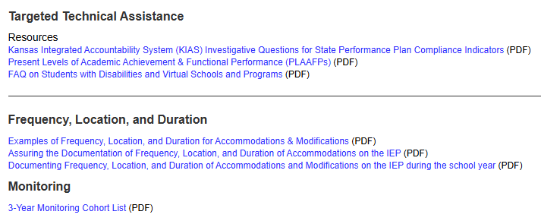
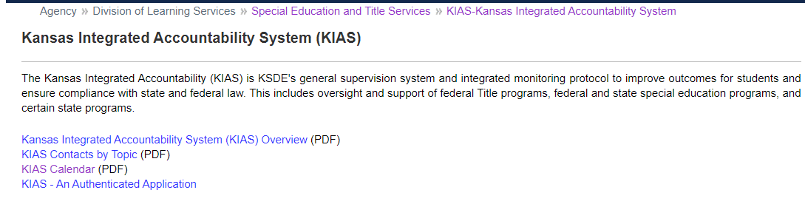
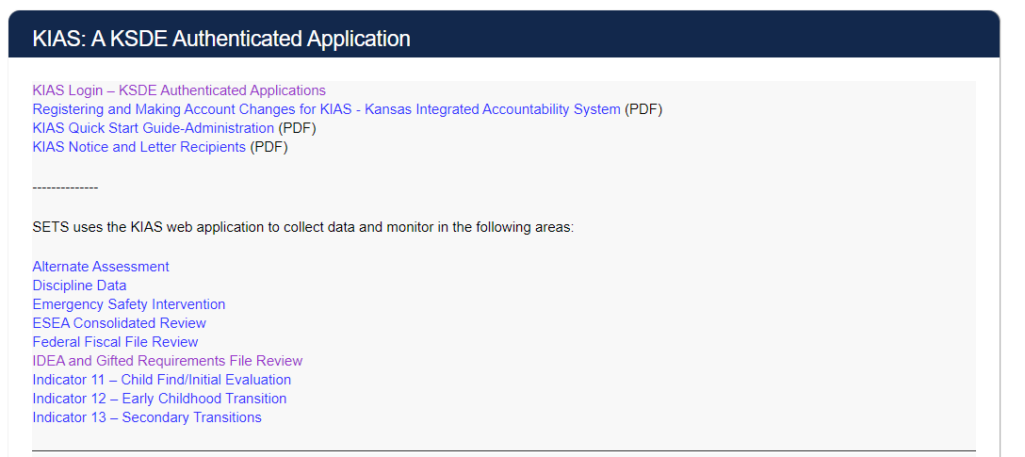
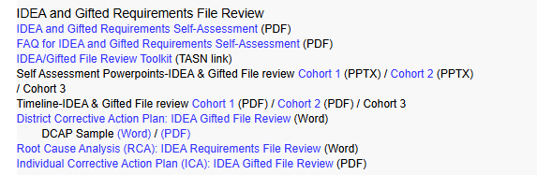
KSDE KIAS Webpage
Notes:
Cary
Top half of the web page includes information on KIAS as a monitoring system, including Targeted TA
Bottom half of the web page includes information on KIAS the authenticated application, including IDEA & Gifted File review

Slide 282
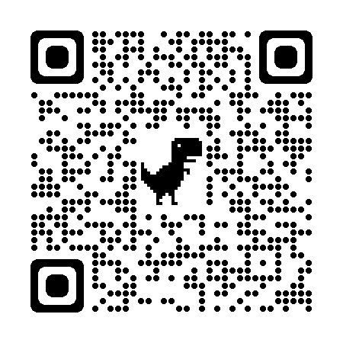
Additional Resources
IDEA & GIFTED FILE REVIEW TOOL KIT
Evaluation/Eligibility Report Checklist (PDF)
EVALUATION AND ELIGIBILITY FOR ENGLISH LEARNERS' HANDOUT
WHAT RESEARCH SAYS ABOUT IDENTIFICATION AND ASSESSMENT OF ENGLISH LEARNERS WITH DISABILITIES
EVALUATION AND ELIGIBILITY FOR ENGLISH LEARNERS’ PRESENTATION
IDEA & Gifted File Review Continuous Improvement Monitoring Consideration Chart
IDEA and Gifted Requirements Self-Assessment (PDF)
FAQ for IDEA and Gifted Requirements Self-Assessment (PDF)
Language USA (translating documents in other languages)
Notes:
Cary

Slide 283
Technical Assistance Team (TAT)
Resource for LEAs in areas such as early childhood, secondary transition, fiscal, file reviews, correction of noncompliance process, significant disproportionality
Team members are retired Kansas special education professionals.
Request assistance by contacting File.Review@ksde.gov or through TASN at www.ksdetasn.org
Notes:
Cary

Slide 284
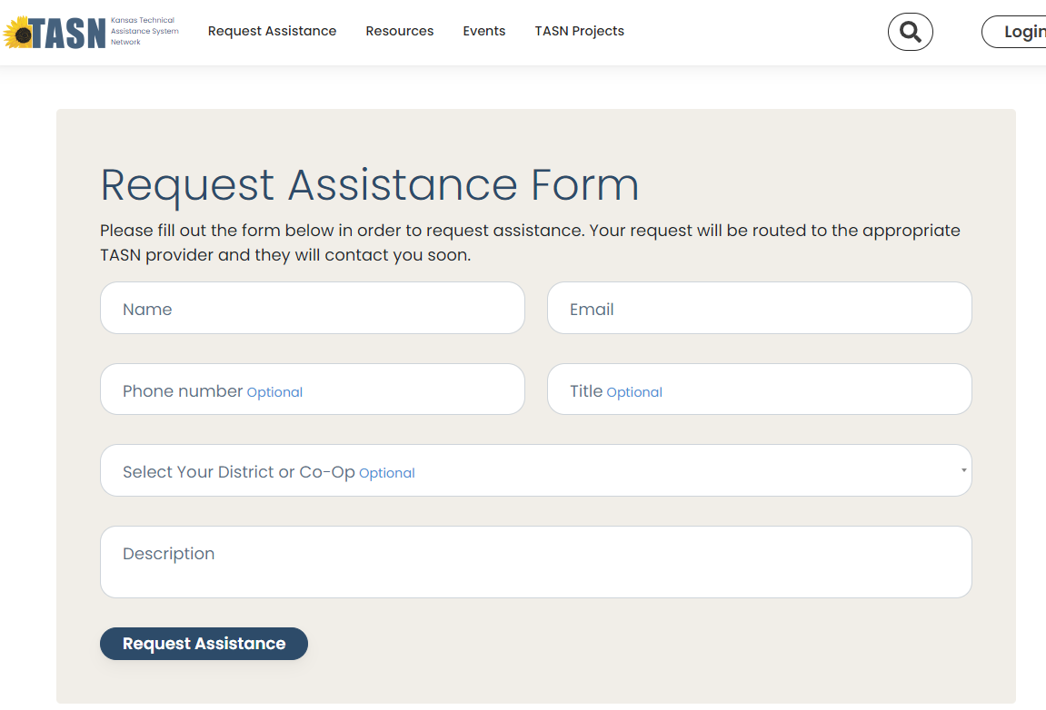
Technical Assistance System Network (TASN)
Notes:
Cary

Slide 285
Contact Information
Cary Rogers Education Program Consultant Special Education & Title Services (785) 296-0916 cary.rogers@ksde.gov
Melissa Valenza Coordinator Special Education & Title Services (785) 296-8092 melissa.valenza@ksde.gov
Josie McClendon Education Program Consultant Special Education & Title Services (785) 296-5608 josie.mcclendon@ksde.gov
File.Review@ksde.gov
Notes:
Cary

