Slide 1
IDEA and Gifted Requirements File Review Cohort 2 (SY2025-2026)

Slide 2
Agenda
8:30-9:00 Registration​
9:00-9:15 Welcome and Review of the day ​
9:15-9:45 KIAS Overview ​
9:45-11:30 IDEA and Gifted Self-Assessment Requirements​
11:30-12:30 Lunch​
12:30-2:45 IDEA and Gifted Self-Assessment Requirements continued​
2:45-3:00 Wrap up​
Breaks may be taken as often and as needed throughout the day​
Notes:
We will take a break from 11:30-12:30 for lunch, which will be provided. We have times built in to ask questions as well as times when we will ask you to look through your files and share any questions or ideas. Breaks may be taken as needed throughout the day. Coffee and water, restrooms
Introduce ourselves – Cary, Josie, Crista, Doug(TAT providers), Brian – Brian has a few comments he would like to share.
Cary

Slide 3
Learning Objectives
Participants will learn about the Kansas Integrated Accountability System that is used for IDEA and Gifted File Review and develop an understanding of the monitoring process.
Participants will learn about the 23 IDEA and Gifted File Review Self-Assessment Questions and the criteria for demonstrating compliance on each question.
Participants will have the opportunity to work with their teams and review files for each self-assessment question, asking for feedback if needed.
Participants will leave with a variety of examples and resources to assist their district in writing compliant IEPs and correcting any non-compliance that they may find.

Slide 4
Education Benefit Review Opportunity
In an effort to provide results-based technical assistance, KSDE is offering Administrators an exciting opportunity to work with us through the Education Benefit Review Process.
If interested contact Doug Tressler or Ann Matthews.
Notes:
Cary

Slide 5
Norms
General:
  Step up, step back
  Listen for understanding
  All questions are welcome
Notes:
Doug

Slide 6
KIAS
Notes:
Cary

Slide 7
Kansas Integrated Accountability System (KIAS)
KIAS is both a process for monitoring federal programs and state requirements, and an authenticated web application used as a tool to report data.
  The Kansas Integrated Accountability System (KIAS) is KSDE's general supervision system and integrated monitoring protocol to improve outcomes for students and ensure compliance with state and federal law. This includes oversight and support of federal Title programs, federal and state special education programs, and certain state programs.
  Some of the federal programs and state requirements monitored through KIAS include federal title programs, IDEA, Kansas Special Education for Exceptional Children Act (which includes gifted), and emergency safety intervention.
Notes:
Cary

Slide 8
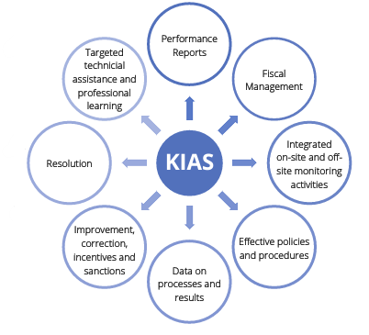
Definition and Purpose
KSDE implements and oversees an integrated monitoring protocol for programs.
In response to general supervision oversight expectations from DOE.
Integrated 3-year monitoring cycle
Aligns with Kansas Exceptional Childrens Act (2007), IDEA (2004), ESEA (2015) general supervision requirements for student outcomes and results
Notes:
KSDE implements and oversees integrated monitoring that includes ESEA and IDEA. This system is in response to general supervision oversight expectation from the US Department of Education. The diagram on the right show the different general supervision elements that connect with KIAS. It represents the integration of ESEA and IDEA programs

Slide 9
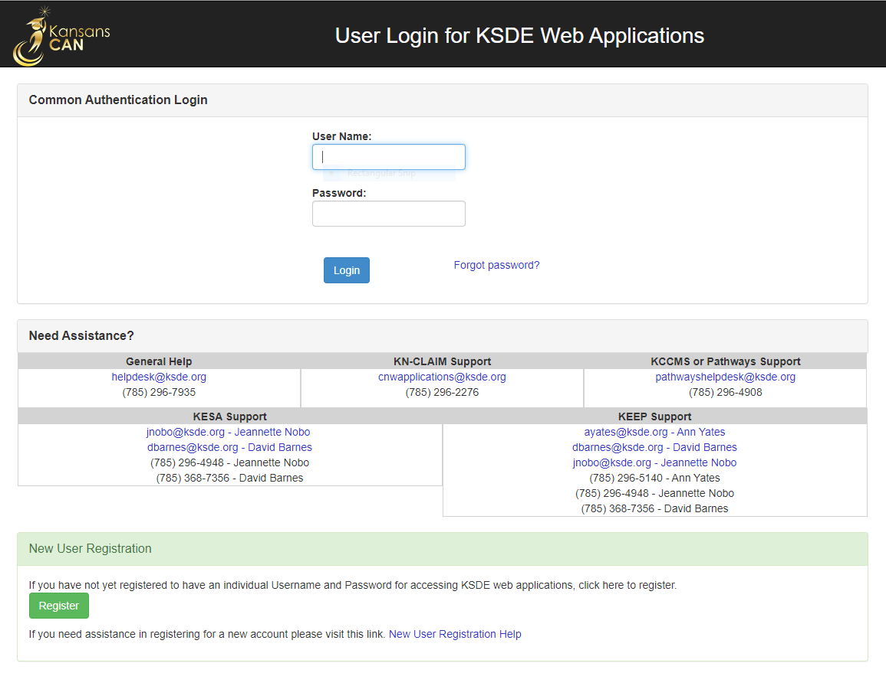

KIAS: The KSDE Web Application
New users must register for a new Common Authentication Login.
Users will be notified when access is approved.
Depending on the new user’s account type, after approval, they may need to be promoted (see Quick Start Guide).
Never share login information with anyone.
https://apps.ksde.org/authentication/login.aspx
Registering and Making Account Changes for KIAS - Kansas Integrated Accountability System (PDF)
Notes:
Cary
New user – you will need to register for a common authentication login. If you have changed districts you will also need to do this. You will be notified once your access is approved.
Depending on the role, you may need to be promoted so that you have the necessary access – district administrator. Anyone can have access, but the special education director decides what level of access. The quick start guide explains all of this.
Interlocal directors need approval from their superintendent and then will need to approve themselves.

Slide 10
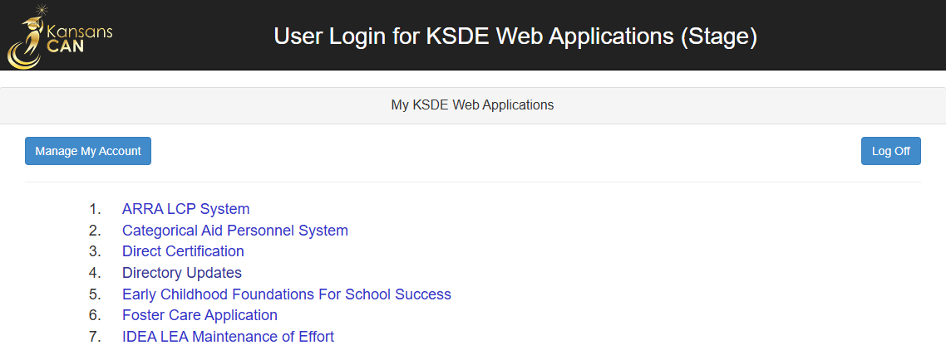
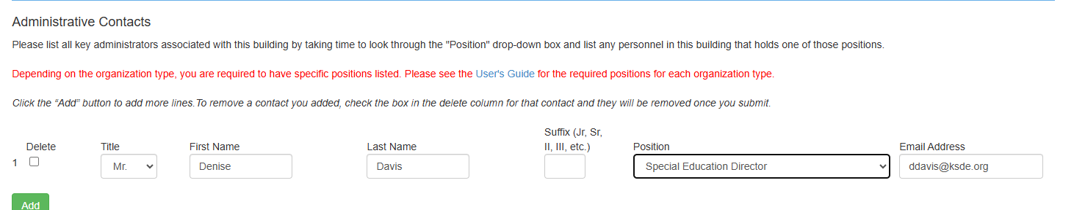
Directory Updates
KIAS pulls in contact information from KSDE’s Directory Updates web application.
If the Directory Updates web application is not updated appropriately, you will not receive KIAS notifications!
Only Special Education Director receive KIAS notifications about IDEA/Gifted File Review.
Notes:
Cary
Directory updates- it is important that you update who is the director of special education so that you get notifications from KIAS for file review. IDEA and gifted file review only goes to the ‘director, special education’. You must use this exact description. If you don’t know who does directory updates, please reach out to us.

Slide 11
Who Should Conduct the Review?
Personnel who are familiar with the IEP process and how the files are organized
Personnel who could be included
  Gifted facilitators or special education teachers
  Special education/gifted coordinators
  School psychologists
  Administrators
  Related services providers
  MIS clerk
  Principals
Notes:
Cary

Slide 12
KIAS: The IDEA and Gifted Requirements File Review Monitoring Process
Data Collection
Data & Compliance Verification
District & Individual Corrective Action
Updated Data
Incentives and Sanctions
Completed by all LEAs in the current Cohort (1, 2, or 3) Cohort 2 -Files completed between June 30, 2024, and July 1, 2025
Completed by only LEAs reporting noncompliance and random sample of LEAs reporting 100% compliance in Data Collection phase
Completed by only LEAs who have noncompliance in Data & Compliance Verification phase
Notes:
Cary – in your material there is a link to the cohort 2 timeline with additional explanation for each component of the monitoring process​
​
Data collection for cohort 2 – Files from June 30, 2024 to June 1, 2025. The number of files pulled depends on the LEA student size calculation (small districts – up to 5000 students 10 IDEA and 6 gifted files; medium districts 5001-24999 15 IDEA and 6 gifted files; large districts over 25000 20 IDEA and 6 gifted files​
​
​After Data verification those districts who self-reported non-compliance or were randomly selected will move into data and compliance verification. Non-compliant districts will be required to complete district corrective action plans, individual corrective action plans and updated data.
Incentives and Sanctions - this is one factor in Levels Of Determination.

Slide 13
Timeline
June 5: Notice of Initial Data Collection (SSID available in KIAS)
July 1- September 15: Initial Data Collection Window
September 20: Notice of Random District Selection
Sept. 20 - Oct. 2: Data Verification Window
Oct. 11: Notice of Potential Noncompliance
Oct. 10 - 24: Compliance Verification Window
Oct. 31: Compliance Status Letters sent
Nov. 3 - Dec. 2: DCAP Window
Nov. 3 – April 1: ICA Window
May 15-29: Updated Data Window
May 22: Correction of Noncompliance Letters sent
Notes:
Cary
Peach/Orange=District Action (note: not all peach colored dates will apply to EVERY district, for example, if the district is compliant they won’t do DCAP, ICA, or updated data
Light blueish=Notice from KSDE
I will be going into more detail on these events on upcoming slides.

Slide 14
Why does the LEA have more KIDS IDs than the maximum pulled?
KIAS pulls the KIDS ID for any student a Kansas LEA had placed outside the state (change for 2025 – 3 files will be pulled)
  If a Kansas LEA determined the best placement for a student was in another state, that should lead KSDE to monitor
  If OSEP asked how does KSDE ensure it is providing general supervision when a Kansas LEA places a child outside of Kansas, we can respond by saying this was our highest criteria when pulling KIDS IDs for monitoring
KIAS pulls the KIDS IDs for students placed in an Alternative School by a district outside of Kansas (change for 2025 – 3 files will be pulled)
  KSDE is monitoring out of state students the LEA voluntarily enrolls. If the LEA chooses to enroll the students to receive funding for the students, they are responsible for FAPE and the monitoring that comes with that responsibility.
Notes:
Cary

Slide 15
Virtual Schools
Beginning with cohort 2 (2025-2026 SY) KIAS will pull KIDS ID for students attending a virtual school.
KIAS will pull 3 additional SSIDs for students enrolled in a district virtual program. These students will not count towards the limits based on the District Size Calculator but in addition to.

Slide 16

Timeframe for Self-Assessment Stage- Cohort 2
Be proactive – utilize an internal file review/ TAT support
  IDEA & GIFTED FILE REVIEW CONTINUOUS IMPROVEMENT MONITORING CONSIDERATION CHART
  Kansas Integrated Accountability System (KIAS) Investigative Questions for State Performance Plan Compliance Indicators
June 5, 2025 – Notice of initial data collections –
  KIDS IDs available in KIAS
July 1– September 15, 2025: Data Collection Window - answering compliant or non-compliant
Deadline for all items is 11:59 p.m. Central Time.
Notes:
Cary​
Be proactive. Doug developed a self assessment survey that teams can use during compliance verification. Districts can utilize the Continuous Improvement Monitoring Consideration Chart ​ and the KIAS Investigative Questions document
​
Doug can you share what the TAT team has done in the past.​
​​​
Cary​
June 5 – notice of initial data collection will be sent to directors. KIDS IDs are available in KIAS. Prior to entering data for the initial data collection window - gather together the documentation for the selected files. Data may be found in more than one location. Correction can be made up until the time that data is entered into KIAS for the initial data collection window​
​
​

Slide 17
Data Verification (9/20/25-10/2/25) and Compliance Verification (10/10/25-10/24/25)
Any district that initially reports non-compliance can submit documentation that they have located showing they are compliant.
  This does not include documentation showing they have corrected the non-compliance after submitting initial data collection
20 districts that report 100% compliance will be randomly selected for data verification.
  These districts will be required to submit documentation on 5-7 questions that KSDE has chosen for random data verification.
  One IDEA and one gifted SSID will be pulled from the original SSID pull
A submit button will be added to both of these tabs.
Notes:
Cary

Slide 18
To Redact or Not to Redact? FERPA & IDEA exceptions
When uploading student records into the KIAS web application for Data Verification, it is not necessary to redact personally identifiable information.
FERPA regulations state: “An educational agency or institution may disclose personally identifiable information from an education record of a student without consent if the disclosure is to authorized representatives of state and local education authorities…. Authorized representatives of the officials or agencies may have access to education records in connection with an audit or evaluation of Federal or State supported education programs, or for the enforcement of or compliance with federal legal requirements that relate to those programs.” See 34 C.F.R. 99.31(a)(3)(iv); 99.35(a)(1)
IDEA regulations state: “Parental consent is not required before personally identifiable information is released to officials of participating agencies for purposes of meeting a requirement of this part.” See 34 C.F.R. 300.622(b)(1)
Notes:
Cary
It is not necessary to redact personally identifiable information when uploading to KIAS web application. No PII can be sent in emails – please refer to the SSID when emailing.

Slide 19
Continuous Improvement Consideration Chart
Notes:
Doug -

Slide 20
IDEA & Gifted File Review Continuous Improvement Monitoring Consideration Chart: A Technical Assistance Tool for LEAs Conducting KIAS IDEA & Gifted File Reviews and/or Internal System Reviews
File Review Question | Documentation Requirements | Acceptable Practices
Question #1: Was a copy of parent rights/procedural safeguards provided to both of the student’s parents (or legal education decision-maker) and the student (if the student is 18 or older) in all required instances and in the native language of the parents/adult student or other mode of communication used by the parents/adult student? | Documentation that copy of parent rights/procedural safeguards was provided to both of the student’s parents (or legal education decision-maker) when parents are living in separate households and student (if 18 or older) in ALL required instances, AND Evidence that parent rights/procedural safeguards provided were written in the native language or other mode of communication used by the parents/adult student. Gather documentation that one parent cannot be located. | Provide parent rights to both parents when parents are living in separate households; AND Provide parent rights in native language or other mode of communication used by parents/adult student; Offer to convene the team to reconsider the action taken by the LEA with the parent.
Question #2: Were evaluation materials selected and administered so as to not be discriminatory on a racial or cultural basis? | There must be documentation to show that elimination of racial and cultural discrimination was considered when selecting and administering evaluation materials for the particular student. NOTE: A checkbox or boiler plate language does not meet this requirement. | Document the assessment selection and administration thought process used, including how racial and cultural bias was considered for the particular student (e.g., review of relevant evidence from technical manuals and other demographic information considered by the team for this particular student) OR Provide PWN and obtain parent consent and conduct non-discriminatory evaluation.
Notes:
Doug

Slide 21
IDEA & Gifted File Review Continuous Improvement Monitoring Consideration Chart: Reviewing files of Students who graduated
Helpful documentation on Graduated students is often found on the Summary of Performance (SOP)
A Summary of Performance (SOP) is required for a child with a disability whose eligibility under special education terminates due to graduation with a regular diploma, or due to exceeding the age of eligibility. The local education agency must provide the child with a summary of the child’s academic achievement and functional performance, which must include recommendations on how to assist the child in meeting the child’s postsecondary goals (K.S.A. 72-3428(m); 34 C.F.R. 300.305(e)(3).
Notes:
Doug -The purpose of the SOP is to transfer critical information that leads to the student’s successful participation in postsecondary settings. It includes a summary of the achievements of the student with current academic, personal and career/vocational levels of performance. Information may be included as part of the summary based on assessment findings and team input. Assessment data and accommodations included in the summary should be written in functional terms easily understood by the student. Any supporting documents should be appropriately referenced and included with the summary. Signatures by the student and IEP team members are encouraged as verification that the contents of the summary has been explained but are not required. The SOP must, at a minimum, address the following:
• Academic achievement: Information on reading, math, and language grade levels, standardized scores, or strengths.
• Functional performance: Information on learning styles, social skills, independent living skills, self-determination, and career/vocational skills.
• Recommendations: Team suggestions for accommodations, assistive services, compensatory strategies for postsecondary education, employment, independent living, and community participation.

Slide 22
IDEA & Gifted File Review Continuous Improvement Monitoring Consideration Chart: Move-in Students and review of existing data
The first activity the reevaluation team is to conduct is a review of existing data. The reevaluation team needs to consider all data that is currently available including evaluations and information provided by the parents, current classroom-based, local, or State assessments, and classroom-based observations; and observations by teachers and related service providers; and the child’s response to scientifically, research-based interventions, if implemented. The review of existing data, as part of the evaluation, may be conducted without a meeting and without consent from the parents (K.A.R. 91-408(c)(d); K.A.R. 91-40-27(e); 34 C.F.R. 300.305(b); 34 C.F.R. 300.300(d)(1)).
Notes:
Doug - The purpose of reviewing existing data is to identify what additional data, if any, are needed to determine: • If the child continues to be a child with an exceptionality and needs special education; • whether the child continues to need special education and related services; • the educational needs of the child; • the present levels of academic achievement and functional performance (related developmental needs) of the child; and • whether any additions or modifications to the special education and related services are needed to enable the child to meet the measurable goals set out in the IEP and to participate, as appropriate, in the general education curriculum. (K.S.A. 72-3428(i)(2); 34 C.F.R. 300.305(a)(2)) After the team has reviewed the existing data, there must be a determination of what data, if any, will be collected during the reevaluation, with the Prior Written Notice completed to reflect that determination.

Slide 23
Questions
Notes:
Cary
What questions do you have so far?

Slide 24
Initial Data Collection
Notes:
Josie
This is the first stage of IDEA and Gifted requirements file review. Initial data collections consists of answering compliant or non-compliant for each of the 23 self assessment question.
KSDE did make some changes from the previous cohort cycle. We deleted Question 8 resulting in only 23 questions for this three-year cycle. Other changes will be shared on the specific questions.

Slide 25
IDEA & Gifted File Review Self-Assessment: Parent Rights
Notes:
Josie

Slide 26
Question 1
Was a copy of parent rights/procedural safeguards provided to both student’s parents (or legal education decision-maker) and the student (if the student is 18 or older) in all required instances and in the native language of the parents/adult student or other mode of communication used by the parents/adult student? 34 C.F.R. 300.504(a), (d); 34 C.F.R. 300.520(a)(1)(i); K.S.A. 72-3430(e); K.S.A. 72-3431(a)
METHOD:
First, determine the native language or other mode of communication used by the parents (or legal education decision-maker) and student (if 18 years or older).
Next, check the student’s file to determine whether a copy of parent rights/procedural safeguards was provided to both parents (or legal education decision-maker) if they do not reside in the same household and the student (if 18 or older) in all required instances and in their native language or other mode of communication. To do this, determine all instances when the provision of parent rights/procedural safeguards was required. Parent rights/procedural safeguards must be provided one time each school year AND in EACH of the following instances:
*SPECIAL NOTE: If a copy of the parent rights/procedural safeguards was not sent to both student’s parents, then the student’s file should contain documentation indicating why (e.g., one parent’s rights have been terminated or despite documented reasonable efforts to locate a parent, school staff are unable to, etc.).
Notes:
Josie
KSDE has parent rights documents in 17 additional languages

Slide 27
Question 1 Continued
When Are Parent Rights Given?
Annually
Upon initial referral or parent request for evaluation
Upon receipt of the first state complaint in a school year
Upon receipt of the first due process complaint in a school year
On the date the decision is made to subject a student with a disability (not applicable to gifted) to a disciplinary change of placement because of a violation of a code of student conduct
Upon request by a parent
YES
Select YES if documentation shows ALL of the following:
• A copy of parent rights/procedural safeguards was provided to both of the student’s parents (or legal education decision-maker) and student (if 18 or older) in ALL required instances.
AND
• The parent rights/procedural safeguards provided were written in the native language or other mode of communication used by the parents/adult student.
NO
Select NO if documentation DOES NOT show ALL of the following:
A copy of parent rights/procedural safeguards was provided to both of the student’s parents (or legal education decision-maker) and student (if 18 or older) in ALL required instances.
AND
The parent rights/procedural safeguards provided were written in the native language or other mode of communication used by the parents/adult student.
Kansas Special Education Process Handbook, Chapter 1, Sections B., C., H., Questions and Answers – Q.3.United States, Office of Special Education and Rehabilitative Services. 71 Federal Register 46,568 (Aug. 14, 2006).
Notes:
Josie
Parent Rights must be given to both parents when they do not reside in the same household. If parents live in the same household, make sure both parents’ names are on the notice that is provided with parent rights. If a student is 18 years or older, the student needs to receive all of those notices. Their parents still need to receive all notices. Parent Rights must be provided in the parent’s native language or other mode of communication.
*SPECIAL NOTE: If a copy of the parent rights/procedural safeguards was not sent to both student’s parents, then the student’s file should contain documentation indicating why (e.g., one parent’s rights have been terminated or despite documented reasonable efforts to locate a parent, school staff are unable to, etc.).

Slide 28
Process Pitfalls from Julie Weatherly (JW) Legally Defensible IEPs (CEC 2023)
Failure to properly notify parents of their rights/safeguards. Recommendations
  A copy of the IDEA procedural safeguards must be given to parents one time per school year, generally.
  Provide the rights at the beginning of the IEP meeting, be sure to document the date that they were provided and consider keeping a copy of the first page of the rights in the file (some districts even require parents to sign the copy indicating receipt).
  Check for understanding on the part of the parents that the document presented is a copy of the parent rights and ask whether they would like an explanation of those rights (Note: the explanation does not have to occur at the IEP meeting). Don’t just read them to parent during the meeting. Make an appointment with someone who can explain those rights.
  Consider the development and use of “parent friendly” versions of the rights to accompany the formal and somewhat non-user-friendly version.
  Even if posted on the website they still need to give a physical copy to the parent one time per year.
Notes:
Josie
Make sure everything is documented, potentially keeping a signed copy for your own records
Genuinely check for parent understanding and explain any legal or educational jargon

Slide 29
Acceptable Documentation Q1
Documentation that the Parents (educational decision makers) live in the same household and at least one was provided Parent Rights OR
Evidence that the Parent Rights were presented to both parents (educational decision makers)
OR
Documentation indicating why the other parent did not receive them (parent rights terminated, parent is unknown, parent location unknown)
Additionally required:
Evidence that the Parent Rights were given in the native language of the parents (educational decision makers) AND
Evidence that the Parent Rights were delivered on all required occasions AND
If student 18 years old, evidence that the student also received rights in native language
Notes:
Josie
If you have a check box on the IEP indicating parents were provided a copy of their parent rights it should also indicate it was provided in the parent's native language. Could be documented in the meeting notes as well. Make sure all components are included.

Slide 30
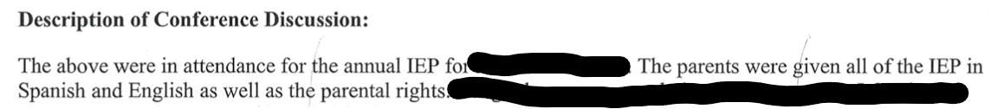
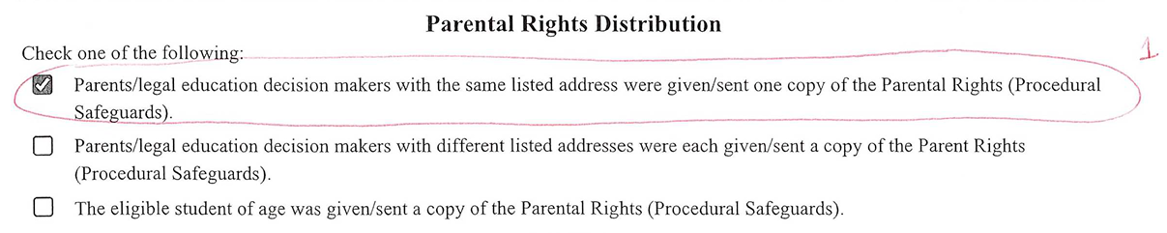
Q1 Examples
Missing Primary language
Notes:
Josie
The first two are examples that were accepted by the file review team.
The last example is missing the primary language. If the IEP indicates the primary language of the parent is English, this example would be accepted. If the primary language of the parent is not English, we have no idea if the Parental Rights were provided in the parent's primary language.

Slide 31
IDEA & Gifted File Review Self-Assessment:
Evaluation and Eligibility
Evaluation & Eligibility: Requirements and File Review
Evaluation Procedures Reflection
Reevaluation of decision tree final
Documenting Equity in Evaluation
Documenting Equity in Evaluation handout
Evaluation and Eligibility Gifted RTI
Notes:
Cary
If an evaluation was not completed last school year for a student selected for this file review, look at the last evaluation that was completed to answer Self-Assessment questions 2 through 9. Refer to the guidance in the FAQ.

Slide 32
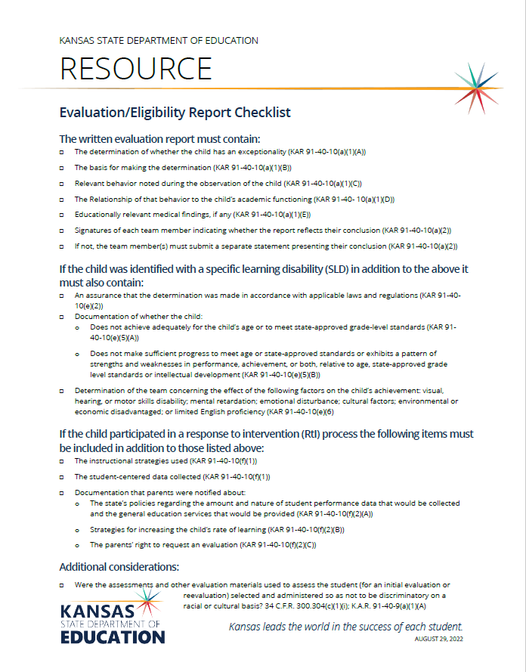
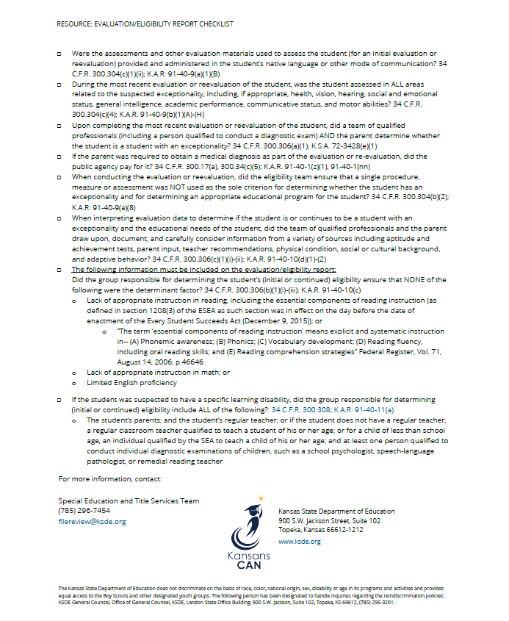
Evaluation/Eligibility Report Checklist
Notes:
Cary
This checklist can be used to assist teams in ensuring that all the required components are considered when completing an initial or re-evaluation. . The KSDE sample re-evaluation not needed agreement form is sufficient by itself and does not require any additional comments or justification when a school and a parent agree to waive the re-evaluation. KSDE does not recommend adding additional data or justification as it may bleed over into an actual re-evaluation process which has additional requirements. If the IEP team finds there was missing documentation for considerations and other elements on the last evaluation report, they should consider moving forward with a re-evaluation.
As a re-evaluation is coming due, a team could assign someone (school psych, SLP, etc) to look at the previous evaluation and ask 2 questions
Is the previous evaluation appropriate – could use the evaluation/re-evaluation report checklist
Are there any new concerns
If the previous evaluation is appropriate and there are no new concerns, the team could propose to the parent to waive the re-evaluation. The only documentation needed to waive is the re-evaluation not needed agreement form. No PWN or other documentation needs to be completed. Chapter 7 under section B ”need for re-evaluation” of the process handbook points out that when considering waiver, the school and parent should "consider the child's educational needs, which may include whether the child is participating in the general education curriculum and being assessed appropriately. The parent and the school will discuss the advantages and disadvantages of conducting a reevaluation, as well as what effect an evaluation may have on the child's educational program
Remember your policies, practices, and procedures should be followed.

Slide 33
Responding to Scenarios
If a school district has not conducted any initial evaluation or reevaluation for a student selected for file review because the student transferred in after their initial evaluation or the most recent reevaluation was completed by a previous district and the student’s 3-year reevaluation has not yet come due, the school district will not be held responsible for an evaluation conducted in another district.
  Answer “Yes” to each of the evaluation/eligibility Self-Assessment questions (2 through 9)
  Explain in the LEA Comment Box that the school district has not had the opportunity to conduct an initial evaluation or reevaluation for the student.
  Include the date of the students most recent evaluation conducted in the previous school district and the date of the student’s transfer to the current school district.
Notes:
Cary- I have taken the information on the next two slides from the FAQ document.
On move-in students, if your district has not had the opportunity to complete the initial evaluation or a reevaluation, you are not responsible. In this case answer, yes and in the comment box indicate you have never done an evaluation or re-evaluation and include the date of the most recent evaluation and the date the student transferred to the current school district.

Slide 34
Responding to Scenarios - continued
If the student’s initial evaluation or most recent reevaluation was conducted by a previous district and the current school district and parent agreed that the 3-year reevaluation was not necessary (waiver) for the student when it came due, the school district will use the most recent evaluation or reevaluation to answer the self-assessment questions. Further, the district may use any other data it relied on to determine that the reevaluation was unnecessary.
  A district may consider conducting a reevaluation using currently available information. This approach may provide documentation for File Review Questions. If the team reviews the student’s file and other currently available information, and documents they considered the requirements of the File Review Questions when completing the review, then the documentation may meet File Review requirements. The reevaluation does not need to include assessments, unless otherwise indicated upon review of the student’s file and data.
  Please note a review of existing evaluation data is not a waiver of a reevaluation. See 34 C.F.R. 300.305 and K.S.A. 72-3428(i) and (k). In addition, such review of existing evaluation data alone may constitute a complete reevaluation if the IEP Team and other appropriate, qualified professionals determine, on the basis of the review and input from the parents, that no additional data are needed to establish continuing eligibility and to determine the child’s current educational needs See OSEP Letter to Redacted, Question 3, Feb. 6 2007. If the IEP team makes this determination, the parents must be provided with notification of the determination, the reasons for the determination and the right of the parents to request an assessment See 34 C.F.R. 300.305(d)(1) and K.S.A. 72-3428(k).
Notes:
Cary - If the LEA chose to waive the re-evaluation on a move-in student, they will be required to complete the evaluation questions based on the evaluation completed by previous district.
Are there any questions with those two scenarios?

Slide 35
Question 2
2. Were the assessments and other evaluation materials used to assess the student (for an initial evaluation or reevaluation) selected and administered so as not to be discriminatory on a racial or cultural basis? 34 C.F.R. 300.304(c)(1)(i); K.A.R. 91-40-9(a)(1)(A)
METHOD: Review the education record to determine whether there is evidence that the group of people responsible for conducting the student’s most recent evaluation/reevaluation selected and administered assessments and other evaluation materials so as not to be discriminatory on a racial or cultural basis. There must be documentation to show that elimination of racial and cultural discrimination was considered when selecting and administering evaluation materials. This information could be found in assessment technical manuals, a prior written notice form, an evaluation/eligibility report, teacher/provider notes, or other documentation in the education record. Staff who conduct assessments could cite relevant information from the assessment technical manual, or refer to that information in professional notes, or provide some other type of documentation about how those findings were taken into consideration.
YES
Select YES if documentation shows that the assessments and other evaluation materials used to assess the student, for the initial evaluation or most recent reevaluation, were selected and administered so as not to be discriminatory on a racial or cultural basis.
NO
Select NO if documentation DOES NOT show that the assessments and other evaluation materials used to assess the student, for the initial evaluation or most recent reevaluation, were selected and administered so as not to be discriminatory on a racial or cultural basis.
Kansas Special Education Process Handbook, Chapter 3, Section E.1. and Questions and Answers Section, Q&A 5.; Chapter 7, Section E.
Notes:
Cary
Review the education record for documentation that the team selected evaluation material and administered the assessments so as not to be discriminatory on a racial or cultural basis.

Slide 36
Acceptable Documentation Q2
Documentation indicating how potential cultural and racial discrimination was addressed for a particular student when selecting and administering evaluation materials. This documentation could be found in PWN for evaluation consent, MDT report, case notes for planning the evaluation, PWN for placement, or other places in the educational records.
Evaluation teams need to consider potential racial or cultural bias in relation to the student’s similar peers, so that it is clear what the needs are due to the presence of the exceptionality and what are needs due to the student’s difference in racial or cultural circumstances….(IDEA & Gifted Requirements File Review: Frequently Asked Questions)
Notes:
Cary
If you recall from the last 3 years cycle of file review, we had extra allowances for documentation in order for districts to have sufficient time to ensure that all files had proper documentation for question 2. Those allowances are not being allowed during this 3-year cycle.
Documentation indicating how potential cultural and racial discrimination was addressed for a particular student when selecting and administering evaluation materials. This documentation could be found in PWN for evaluation consent, MDT report, case notes for planning the evaluation, PWN for placement, or other places in the educational records.
Documentation of non-discriminatory assessment needs to be specific to the student’s characteristics. It should show How and What you did to individualize based on that student’s unique demographics. If what you say could apply to anyone, it’s not good enough.
At the bottom of the slide is a statement form the FAQ document. Evaluation teams need to consider potential racial or cultural bias in relation to the student’s similar peers, so that it is clear what the needs are due to the presence of the exceptionality and what are needs due to the student’s difference in racial or cultural circumstances

Slide 37
Question prompt
How were the assessments and other evaluation materials used to assess the student (for an initial evaluation or reevaluation) selected and administered so as not to be discriminatory on a racial or cultural basis?
    ….XXX was assessed in her native language, which is YYY. The standardized assessment ZZZ was selected as part of this evaluation and was determined to be nondiscriminatory on a racial and cultural basis for this student based on professional understanding of the assessment and bias mitigation as noted in the ZZZ technical manual ...Multiple measures were used to mitigate the impact of bias in this evaluation and will be further described in this report. Any limitations that may exist and result in bias due to racial or cultural factors were reviewed and considered as part of this evaluation and determined to not be a significant factor in current eligibility determination.
Notes:
Cary
The FAQ indicates that check boxes and boiler plate language are not recommended. The last 3-years, KSDE has been recommending that districts consider adding a question prompt to their evaluation report to address this item.
This would allow the IEP team to individualize the response based on the student’s unique set of characteristics. The prompt we have used in this example is how were the assessments and other evaluation materials used to assess the student selected and administered so as not to be discriminatory on a racial or cultural basis.
In this example the student was assessed in her native language. The evaluation was determined to be nondiscriminatory on a racial and cultural basis based on professional understanding of the assessment and bias mitigation as noted in the technical manual. Multiple measures were used to mitigate the impact of bias and any limitations that may exist were reviewed and considered.
Fix this slide - TAT

Slide 38
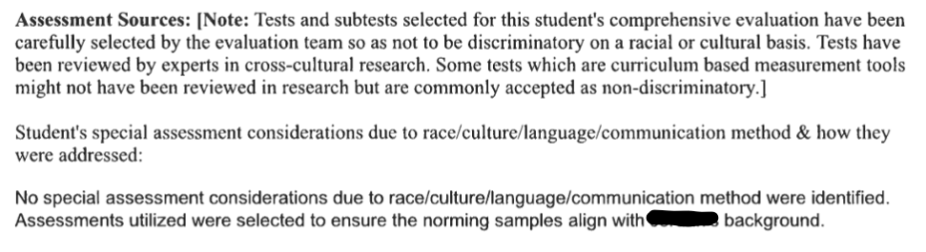
Compliant District Examples Q2

Slide 39
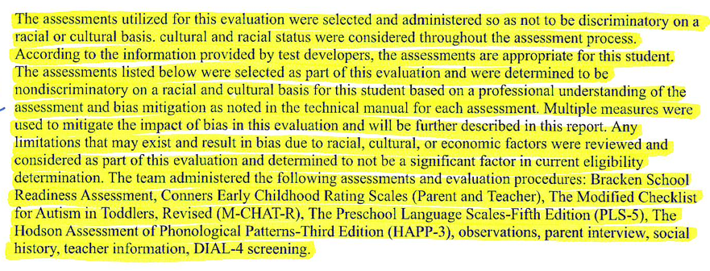

Compliant District Example Q2
Notes:
Cary – this is another compliant example. The top part talks about the assessments used and the bottom provides the explanation.

Slide 40
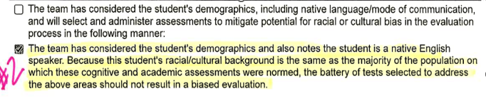
Minimally Approved District Example Cohort 2
Notes:
Cary
Although the examples on this slides is a check box examples the team feels it does meet minimal compliance. In this example the student was a native English speaker. On the first option it appears that the district has an area to enter information on what the district did to mitigate potential racial or culture bias. If the top box were marked we would expect to see some additional information.

Slide 41
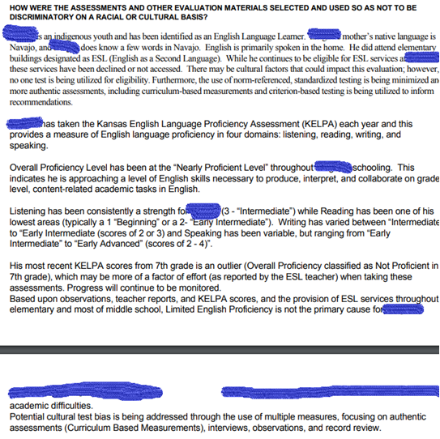
District Example
Notes:
Cary
This is an example from a district for a student who is an English Learner. The report address that English is primary language spoken in the home and family has declined ESOL services. They did address that their may be cultural factors that could impact the evaluation, however, no one test is being utilized for eligibility. They are also using curriculum-based measurements and criterion-based testing to inform recommendations. The student has been at the nearly proficient level throughout school on the KELPA. And they have provided details of those results.

Slide 42
Sample Process For Question 2:
What might this process look like in evaluation/reevaluation?
Step 1: MDT gathers and documents information regarding student's demographics and background as part of evaluation/reevaluation process.
Demographic information includes relevant information about the student's racial and cultural characteristics, native language, KELPA scores and language proficiency levels (if not a native English speaker), school attendance/moves, etc.
Step 2: MDT reviews the student's demographic information and background and considers how team will address potential cultural and racial bias in the evaluation/reevaluation process. (E.g., team considers specifically how they will select and administer assessments and evaluation materials for this student, in light of this student’s demographics.)
Step 3: MDT documents how the team will use/did use the student's demographic information to guide the selection and administration of assessments and tools to ensure non-biased evaluation. This documentation of approach should be included in the education record (e.g., PWN for evaluation consent, evaluation/reevaluation report, case notes for planning the evaluation, PWN for placement, or other places in the student's record).
Notes:
Deb
1. Team collects demographic information. Some of this information maybe used by the MDT (multi-disciplinary team) with regard to exclusionary factors.
2. Team considers how to address potential cultural/racial bias in the evaluation.
3. Team documents how student's demographic information was used in the selection and administration of evaluation instruments.

Slide 43
Examples for Question 2
Because the technical manuals for nationally normed tests showed group mean differences for this student’s racial/cultural group, it was decided to conduct the initial evaluation using non-verbal culture-free tests…
Because the professional literature regarding nationally normed tests (or because the district's placement data) show biased outcomes for this student’s racial/cultural group, it was decided to conduct the initial evaluation using authentic assessment practices…
Because of the impact of this student’s cultural background on opportunities for prior learning, it was decided to conduct the initial evaluation using a Response to Intervention (RTI) approach…
OR
The multidisciplinary team members considered the student's demographics in selecting and
administering the evaluation assessments and materials. Because this student’s racial/cultural background (as described previously in this report) is the same as the majority of the population on which these cognitive and academic assessments were normed, the battery of tests selected should not result in a biased evaluation.
Notes:
Deb
Here are example statements of documentation for question 2. The first 3 statements describe why and what assessment practices were used. The last statement (in italics) is one example of statement a team might use if no change in traditional practices are needed.

Slide 44
Question 3
3. Were the assessments and other evaluation materials used to assess the student (for an initial evaluation or reevaluation) provided and administered in the student’s native language or other mode of communication? 34 C.F.R. 300.304(c)(1)(ii); K.A.R. 91-40-9(a)(1)(B)
METHOD: First, review the education record to determine the student’s native language or other mode of communication. Next, review the education record to determine whether the assessments and other evaluation materials used for the student’s most recent evaluation or reevaluation were provided and administered in the student’s native language or other mode of communication. If the assessments and other evaluation materials were not provided and administered in the native language or other mode of communication, review the education record for information showing that it was clearly not feasible to do so. This information could be found in a prior written notice form, an evaluation/eligibility report, teacher/provider notes, or other documentation in the education record.
YES
Select YES if documentation shows that the assessments and other evaluation materials used to assess the student, for the initial evaluation or most recent reevaluation, were provided and administered in the student’s native language or other mode of communication.
OR
Select YES if documentation shows that it was clearly not feasible to provide or administer the assessments and other evaluation materials in the student’s native language or other mode of communication
NO
Select NO if documentation DOES NOT show that the assessments and other evaluation materials used to assess the student, for the initial evaluation or most recent reevaluation, were provided and administered in the student’s native language or other mode of communication.
KSDE Special Education Process Handbook, Chapter 3, Section and E.1, Chapter 7, Section E.
Notes:
Crista
Question 3 was a 3 way tie for the 3rd highest number of non-compliant files last year.
Question number 3, which reads “Were the assessments and other evaluation materials used to assess the student (for an initial evaluation or reevaluation) provided and administered in the student’s native language or other mode of communication.” When you begin to review files for this question, the education record for the student should be examined to determine the student's native language or other form of communication. and then determine if the assessments and other evaluation materials that were used on the student's most recent evaluation or re-evaluation were provided and administered in the student's native language or other mode of communication. If the assessments and other evaluation materials were not given in the student's native language, there needs to be documentation showing why that was the case. For example, if a student who speaks Spanish at home has been in school for 7 years, evaluation may not be needed in Spanish if student is proficient in English, however, there needs to be documentation that the IEP team thought that through. As a reminder, this question refers to native language but also other modes of communication, which can include sign language and braille
Other comments/notes:
https://sites.ed.gov/idea/regs/c/a/303.25/a Native language, when used with respect to an individual who is limited English proficient or LEP (as that term is defined in section 602(18) of the Act), means—
https://sites.ed.gov/idea/regs/c/a/303.25/a/1 The language normally used by that individual, or, in the case of a child, the language normally used by the parents of the child, except as provided in paragraph (a)(2) of this section; and
https://sites.ed.gov/idea/regs/c/a/303.25/a/2 For evaluations and assessments conducted pursuant to §303.321(a)(5) and (a)(6), the language normally used by the child, if determined developmentally appropriate for the child by qualified personnel conducting the evaluation or assessment. (If a student has been in school for 5 years we may not need to assess the student in Spanish, however we need to document that the team thought that through.)
Remember this refers to the student's native language or other mode of communication. Don't forget to think about sign language and braille.
https://sites.ed.gov/idea/regs/c/a/303.25/b Native language, when used with respect to an individual who is deaf or hard of hearing, blind or visually impaired, or for an individual with no written language, means the mode of communication that is normally used by the individual (such as sign language, braille, or oral communication).

Slide 45
Past findings
Evaluations conducted entirely in English for students whose primary mode of communication or preferred/native/home language is described in the MDT report or elsewhere as “non-English”
Lack of consistency between what is described in the MDT and what is listed in the IEP as student’s language
  Such as "parent reported student' language is X language on enrollment form and indicates that student speaks primarily Vietnamese in the home.
For students in ELL programs, scores/proficiency on KELPA and other measures of the student’s English proficiency not included as part of the MDT report
  Currently, student is proficient in English per KELPA score of X obtained on x date, and student was exited from ELL program due to proficiency on X date...Student interview indicates that student reports he is most comfortable speaking and reading English at school at this time. Teachers report that in class, student ..."
ELL teacher typically is NOT present at the IEP team meetings (KSDE recommends ELL teachers attend).
Notes:
Crista
Here on this slide we have listed out some of the common findings that were determined as non-compliant. This includes giving evaluations entirely in English when the MDT report or other documentation shows that the student's primary mode of communication or preferred/native language is not English. Another example of non-compliance would be if there is a lack of consistency between the MDT report and the IEP documentation of the student's native/preferred language. Lastly, when students were enrolled in ELL programs, there were instances where scores/proficiency on the KELPA or other measures of the student's English proficiency was not included in the MDT report to document why assessment was appropriate in English

Slide 46
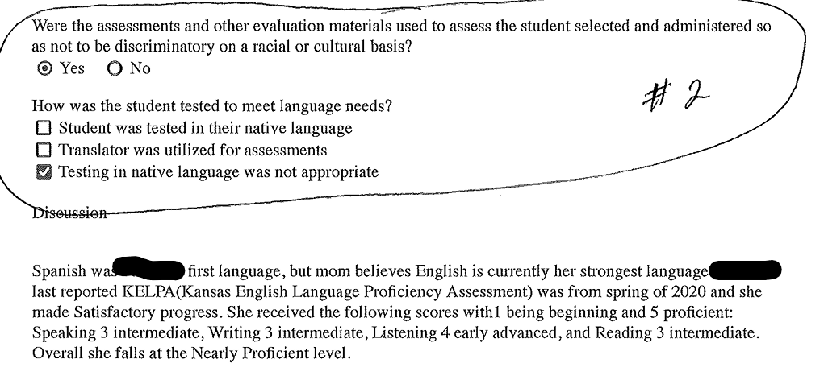
Approved District Example from Cohort 2
Notes:
Crista
Our team approved this example with check boxes due to the explanation under discussion.

Slide 47
Examples of documentation for Q3
If assessments are available in the student’s native language: The student’s primary language is Spanish and the student’s second language is English. The student’s competency in both languages will be assessed. Also, the student’s cognitive skills will be assessed in both Spanish and English (for example, using the WISC-V Spanish and the WISC-V in English). In addition, the student’s academic skills will be assessed in both languages (for example, using DIBELS and IDEL or the Woodcock-Johnson IV and the Bateria IV). Additional non-verbal measures will also be administered.
If assessments are not available in the student’s native language: The student’s primary language is Russian and the student’s second language is English. Evaluation of his English skills show that he is fluent in English. His parents speak only Russian, and the student often translates for his parents when shopping or using professional services. He began learning English prior to starting kindergarten from an older brother and took English classes as soon as starting school in Russia, before the family’s move to the U.S. The evaluation of his high ability will be accomplished through a combination of formal and informal assessment in English. Test interpretation will emphasize the non-verbal components of cognitive tests to limit the possible negative impact of language acquisition. Similarly, academic test interpretation will emphasize the areas least impacted by language acquisition, which are also observed to be his areas of strength in the classroom setting.
Notes:
Deb
Here are two examples of documentation for File Review Question 3. The first bullet describes a situation where assessments are available in the student's native language. Most often this approach will be used with student's whose primary language is Spanish. Nationally, most students who are English Learners are Spanish speakers, so there are tests available in Spanish.
The second bullet describes a situation where assessments are not available in the student's native language. It describes how adaptations were made to traditional assessment practices for a student whose native language is Russian, but who is fluent in conversational English. Many times cultural issues (question 2) overlap with language issues (question 3) when making assessment decisions for English learners.

Slide 48
Definitions
Native Language - In most cases, the term native language refers to the language that a person acquires in early childhood because it is spoken in the family and/or it is the language of the region where the child lives.
Preferred Language - The language most preferred for communication.
Primary Language- Primary language is the language that someone uses most frequently to communicate with. It is the language a person uses in most situations. For many people, their primary language is their first language, but for others their primary language might be their second language.
Home Language - A home language is a language (or the variety of a language) that is most commonly spoken by the members of a family for everyday interactions at home.
Notes:
Deb
If a student is an English Learner, the MDT should access information about a student's performance in each of these types of language from the student's ESOL instructor. In addition, the team should be aware of the most recent KELPA assessment results. In addition to these definitions, it is important to distinguish between a student's conversational skills in English and their competence in academic uses of English.

Slide 49
Breakout Discussion and Question
25 minutes
Notes:
Crista
Q1-3
Look over your files and discuss among your table. We will be walking around to answer any specific questions you may have.
What example from your files for Q1-3 would you like to share with the group? This could be a good example that you think could help others or an example you would like us to discuss or a trend you noticed. We will spend the last 10 minutes sharing out.

Slide 50
Question 4
4. During the most recent evaluation or reevaluation of the student, was the student assessed in ALL areas related to the suspected exceptionality, including, if appropriate, health, vision, hearing, social and emotional status, general intelligence, academic performance, communicative status, and motor abilities? 34 C.F.R. 300.304(c)(4); K.A.R. 91-40-9(b)(1)(A)-(H)
METHOD: First, review the education record to determine the student’s suspected needs and areas of concern that were observed or contemplated at the time of the referral for evaluation or reevaluation. This information could be found in communications or information provided by the parent, teacher notes and observations, Student Intervention Team (SIT) notes/documents, discipline records, emergency safety intervention (ESI) records, health and vision screenings, etc. Next, review the education record to determine whether the evaluation assessed the student in ALL suspected needs and areas of concern that were observed or contemplated at the time of the referral for evaluation or reevaluation, whether or not commonly linked to the disability category in which the child has been classified. If ALL areas were not assessed, review the education record for information showing which areas were selected and why those not selected were not assessed. This information could be found in a prior written notice form, an evaluation/eligibility report, teacher/provider notes, or other documentation in the education record.
YES
Select YES if documentation shows that during the most recent evaluation or reevaluation, the student was assessed in ALL areas related to the suspected exceptionality, including, if appropriate, health, vision, hearing, social and emotional status, general intelligence, academic performance, communicative status, and motor abilities.
NO
Select NO if documentation DOES NOT show that during the most recent evaluation or reevaluation, the student was assessed in ALL areas related to the suspected exceptionality, including, if appropriate, health, vision, hearing, social and emotional status, general intelligence, academic performance, communicative status, and motor abilities.
SPECIAL NOTE: The list of areas in the question (health, vision, hearing, social and emotional status, general intelligence, academic performance, communicative status, and motor abilities) is not an exhaustive list of areas that must be assessed. Decisions regarding the areas to be assessed are determined by the suspected needs of the child.
Kansas Special Education Process Handbook, Chapter 3, Section E.1.; Chapter 7, Section E.
Notes:
Josie
Were all areas related to suspected exceptionality assessed? If an area related to the suspected exceptionality was not assessed, then document why that area was not assessed and the bases of that decision.
Speak on special note at the bottom.

Slide 51
Question 5
5. If the school required the parent to obtain a medical diagnosis as part of the evaluation or re-evaluation, did the public agency pay for it? 34 C.F.R. 300.17(a), 300.34(c)(5); K.A.R. 91-40-1(z)(1), 91-40-1(nn)
METHOD: First review the education record for documentation indicating whether the parent was required to obtain a medical diagnosis for the student as part of the evaluation or re-evaluation. If documentation shows that a medical diagnosis was required, review the education record for documentation that the public agency paid for the medical diagnosis or reimbursed the parent for the cost of obtaining the medical diagnosis.
YES
Select YES if documentation shows that the parent was required to obtain a medical diagnosis AND the public agency paid for it.
NO
Select NO if documentation shows that the parent was required to obtain a medical diagnosis and the public agency did NOT pay for it.
N/A
N/A Select N/A if documentation shows:
• This is a file for a gifted-only student.
OR
• The public agency did not require the parent to obtain a medical diagnosis for the student as part of the evaluation or re-evaluation.
SPECIAL NOTE: A medical diagnosis may be considered as supporting information. However, a diagnosis is not required by law, nor necessarily determinative, in eligibility decisions. If the parent elected to unilaterally obtain a medical diagnosis at any time, the public agency is not required to reimburse the parent.
Kansas Special Education Process Handbook, Chapter 3, Questions and Answers Section, Q. 13. Kansas State Department of Education Eligibility Indicators
.
Notes:
Josie
If the school required the parent to receive a medical diagnosis, did the school pay for it? Parents can elect to obtain a medical diagnosis on their own, which the school is not required to reimburse the parent.
We made a slight wording change on this question to make it clearer that this only applies to medical diagnosis that the school required the parent to obtain.

Slide 52
Question 6
6. Upon completing the most recent evaluation or reevaluation of the student, did a team of qualified professionals AND the parent determine whether the student is a student with an exceptionality? 34 C.F.R. 300.306(a)(1); K.S.A. 72-3428(e)(1)
METHOD: Review the education record for documentation indicating who was included as part of the group responsible for determining the student’s initial or continued eligibility. This information could be found in the evaluation/eligibility report, a meeting attendance record, meeting notes, etc. Note that K.A.R. 91-40-10(a)(2) requires each member of the team of qualified professionals (but not the parent) to certify in writing whether the evaluation report reflects the team member’s conclusion; this certification document would serve as evidence of who was on the team. Documentation must show that all professionals on the team provided input and contributed to the decision. For evidence of the parent’s involvement in the eligibility determination, look for documentation that they had the opportunity to provide input in the preparation of the evaluation report and at the eligibility meeting.
YES
Select YES if documentation shows that the most recent (initial or continued) eligibility determination was made by ALL of the following:
• A team of qualified professionals
AND
• The parent
NO
Select NO if documentation DOES NOT show that the most recent (initial or continued) eligibility determination was made by ALL of the following:
• A team of qualified professionals
AND
• The parent
N/A
Select N/A if documentation shows:
File is for a student that is suspected to have a specific learning disability.
SPECIAL NOTE: A team of qualified professionals – refer to pg 40 of the Process Handbook for definition of “Evaluation Team” member
Kansas Special Education Process Handbook, Chapter 3, Sections C. and F.; Chapter 7, Sections D. and F.
.
Notes:
Josie
Questions 6 asks "…“ In order to document the team of qualified professionals that were part of the decision, the requirement of each member to certify in writing whether the evaluation report reflects their own conclusion is sufficient documentation to show who was part of the professional team. The team must be made up of qualified professionals, not just one professional like the school psychologist. For student with sensory loss, don't forget it will be vital to have professional who specialize in that field as part of the team. The parent also needs to be included in the decision to determine whether the student has an exceptionality. For evidence of the parent involvement, documentation that they had the opportunity to provide input in the preparation of the evaluation report and eligibility at the meeting. If both a team of qualified professional AND the parent made the eligibility determination select YES. If neither or only one of the two made the eligibility determination, mark NO. If the parent does not attend, documentation will need to show 2 attempts to contact using two different methods. The parent must be given the opportunity to provide input on the evaluation and eligibility report even if they do not attend, however if they do choose not to attend this opportunity can still be obtained and documented later.
For students who are suspected to have a specific learning disability select N/A and answer question 7 instead.
There is a list of potential members of the evaluation team in chapter 3, page 40 of the process handbook.

Slide 53
Question 7
7. If the student was suspected to have a specific learning disability, did the group responsible for determining (initial or continued) eligibility include ALL of the following?: 34 C.F.R. 300.308; K.A.R. 91-40-11(a)
• The student’s parents; and
• The student’s regular teacher; or if the student does not have a regular teacher, a regular classroom teacher qualified to teach a student of his or her age; or for a child of less than school age, an individual qualified by the SEA to teach a child of his or her age; and
• At least one person qualified to conduct individual diagnostic examinations of children, such as school psychologist, speech-language pathologist, or reading specialist
METHOD: First, review the education record to determine if the student was suspected to have a specific learning disability when the evaluation or reevaluation was conducted. This information could be found in a parent’s or teacher’s/provider’s referral, Student Intervention Team (SIT) notes/documents, a prior written notice form, an evaluation/eligibility report, the IEP, etc. Next, review the education record for documentation indicating who was included as part of the group responsible for determining the student’s initial or continued eligibility. This information could be found in the evaluation/eligibility report, a meeting attendance record, meeting notes, etc. Note that K.A.R. 91-40-10(a)(2) requires each member of the team of qualified professionals (but not the parent) to certify in writing whether the evaluation report reflects the team member’s conclusion; this certification document would serve as evidence of who was on the team. For evidence of the parent’s involvement in the eligibility determination, look for documentation that they had the opportunity to provide input in the preparation of the evaluation report and at the eligibility meeting.
Notes:
Josie
SLD – Must include parents, regular education teacher, and at least one person qualified to conduct individual diagnostic examination of children.
Chapter 3 in the Process Handbook (pg 40-41) includes a description of the required Evaluation Team members.
Review the record to ensure that all 3 required participants were involved in determining the student’s initial or continued eligibility. This can be found in the evaluation/eligibility report, meeting attendance record, meeting notes, etc. Parents need to have had the opportunity to provide input in the preparation of the evaluation report and at the eligibility meeting

Slide 54
Question 7 Continued
YES
Select YES if documentation shows that the group responsible for determining initial or continued eligibility included ALL of the following:
• The student’s parents;
AND
• The student’s regular teacher, or if the student does not have a regular teacher, a regular classroom teacher qualified to teach a student of his or her age, or for a child of less than school age, an individual qualified by the SEA to teach a child of his or her age;
AND
• At least one person qualified to conduct individual diagnostic examinations of children, such as school psychologist, speech-language pathologist, or remedial reading teacher.
NO
Select NO if documentation DOES NOT show that the group responsible for determining initial or continued eligibility included ALL of the following:
• The student’s parents;
AND
• The student’s regular teacher, or if the student does not have a regular teacher, a regular classroom teacher qualified to teach a student of his or her age, or for a child of less than school age, an individual qualified by the SEA to teach a child of his or her age;
AND
• At least one person qualified to conduct individual diagnostic examinations of children, such as a school psychologist, speech-language pathologist, or remedial reading teacher.
N/A
Select N/A if documentation shows:
• This is a file for a gifted-only student.
OR
• This is a file for a student who was not suspected to have a specific learning disability.
Kansas Special Education Process Handbook, Chapter 3, Sections C. and F (pg 40-41)., Chapter 7, Sections D. and F..
Notes:
Josie
The FAQ document reminds reviewers that if the parent does NOT participate, despite opportunity, they should document attempts, same as question 6
They need to have the OPPORTUNITY to meaningfully participate in the eligibility decision. There is no excusal form for eligibility meetings, only IEP meetings.

Slide 55
Question 9
8. When interpreting evaluation data to determine if the student is or continues to be a student with an exceptionality and the educational needs of the student, did the team of qualified professionals and the parent draw upon, document, and carefully consider information from a variety of sources including aptitude and achievement tests, parent input, teacher recommendations, physical condition, social or cultural background, and adaptive behavior? 34 C.F.R. 300.306(c)(1)(i)-(ii); K.A.R. 91-40-10(d)(1)-(2)
METHOD: Review the evaluation/eligibility report, team meeting notes, prior written notice forms, and other documentation in the education record to determine if the team and the parent drew upon, documented, and carefully considered information from a variety of sources when determining eligibility and the educational needs of the student. A checklist of these sources alone would not be sufficient to show that the information was carefully considered and documented.
YES
Select YES if documentation shows that when determining initial or continued eligibility and the educational needs of the student, the team of qualified professionals and the parent drew upon, documented, and carefully considered information from a variety of sources.
NO
Select NO if documentation DOES NOT show that when determining initial or continued eligibility and the educational needs of the student, the team of qualified professionals and the parent drew upon, documented, and carefully considered information from a variety of sources.
Kansas Special Education Process Handbook, Chapter 3, Section E.1.; Chapter 7, Section E.
.
SPECIAL NOTE: The list of sources in the question (aptitude and achievement tests, parent input, teacher recommendations, physical condition, social or cultural background, and adaptive behavior) is not an exhaustive list of sources that must be drawn upon, documented and carefully considered. The point of 34 C.F.R. 300.306(c)(1)(i)-(ii) and K.A.R. 91-40-10(d)(1)-(2) is to ensure that more than one source is used in interpreting evaluation data and making these determinations, and although these regulations include a list of examples of sources that may be used, the public agency would not have to use all the sources in every instance. 64 Federal Register 12,636 (Mar. 12, 1999).
Notes:
Josie
Question 8 pertains to continuation of exceptionality and continued educational needs of the student. In this question, the team of qualified professionals and the parent should be documenting and carefully considering information from a variety of sources when determining if the student is or continues to be a student with an exceptionality. The variety of information should come from aptitude and achievement tests, parent input, teacher recommendations, physical condition, social or culture background, and adaptive behavior. The file should have documentation that the team considered more than one assessment or record. If there are no concerns about adaptive behavior for the student, documentation should state that. A checklist alone is not acceptable documentation, instead the documentation should show that the information was carefully considered when making the eligibility decision. As a reminder, when considering a student for the alternate assessment, students must have significant deficits in cognitive AND in adaptive behavior. Select YES if documentation shows that multiple sources of information were carefully considered when determining initial or continued eligibility. Select NO if the documentation does not show this careful consideration, for example, a simple checklist of evaluation data does not show careful consideration and would be considered non-compliant.
Special note: This isn’t an exhaustive list nor is it required to have every single piece of data listed. The point is to ensure more than one source is used in interpreting evaluation data and making determinations.

Slide 56
Question 10
9. Did the group responsible for determining the student’s (initial or continued) eligibility ensure that NONE of the following were the determinant factor? 34 C.F.R. 300.306(b)(1)(i)-(iii); K.A.R. 91-40-10(c)
• Lack of appropriate instruction in reading, including the essential components of reading instruction (as defined in section 1208(3) of the ESEA as such section was in effect on the day before the date of enactment of the Every Student Succeeds Act (December 9, 2015)); or
o “The term ‘essential components of reading instruction’ means explicit and systematic instruction in-- (A) Phonemic awareness; (B) Phonics; (C) Vocabulary development; (D) Reading fluency, including oral reading skills; and (E) Reading comprehension strategies” Federal Register, Vol. 71, August 14, 2006, p.46646.
• Lack of appropriate instruction in math; or
• Limited English proficiency
METHOD: Review the evaluation/eligibility report to determine whether the team and the parent examined ALL of these exclusionary factors before determining the student is or continues to be a student with an exceptionality.
YES
Select YES if documentation shows that NONE of the following were a determinant factor when determining the student’s initial or continued eligibility:
• Lack of appropriate instruction in reading including explicit and systematic instruction in phonemic awareness, phonics, vocabulary development, reading fluency, oral reading skills, and reading comprehension strategies.
OR
• Lack of appropriate instruction in math.
OR
• Limited English proficiency.
Select YES if student is gifted only.
NO
Select NO if documentation DOES NOT show that NONE of the following were a determinant factor when determining the student’s initial or continued eligibility:
• Lack of appropriate instruction in reading including explicit and systematic instruction in phonemic awareness, phonics, vocabulary development, reading fluency, oral reading skills, and reading comprehension strategies.
OR
• Lack of appropriate instruction in math.
OR
• Limited English proficiency.
Kansas Special Education Process Handbook, Chapter 3, Section F.1.(a)-(b); Chapter 7, Section F.
.
Notes:
Josie
This question was a three way tie for the 3rd highest number of non-compliant files last year.
Common findings: Teams generally did a good job documenting for SLD in writing as required, but did not locate documentation demonstrating that exclusionary criteria were considered for initial or continued eligibility decisions for all other exceptionalities. Review the Evaluation/eligibility report for documentation that the team and the parent examined All of the exclusionary factors before determining the student is or continues to be a student with an exceptionality. Exclusionary factors for gifted come into play when a gifted student is not determined eligible for gifted services due to one of the exclusionary factors. Since file review is based on students who are eligible for services, it would be assumed that exclusionary factors did not play into eligibility determinations for a gifted student, therefore all gifted students should be marked yes. It is still best practice to include this documentation for gifted only students and should always be part of the eligibility conversations during determination meetings.
Did exclusionary factors prevent the student from being determined eligible. – add slide.

Slide 57
Q 9-did the group responsible for determining the student’s (initial or continued) eligibility ensure that NONE of the following were DETERMINANT factor?
These factors are sometimes referred to simply as “exclusionary factors”.
The multidisciplinary evaluation team, including the parent, must consider these factors for any area of exceptionality, including gifted.
This does not mean the team must conclude the absence of exclusionary factors. Rather, the team must determine the degree to which each factor affects the student’s performance. The fundamental question is whether the poor performance (or the need for advanced instruction through special education in the case of gifted service) is primarily the result of any of these factors.
There are additional factors that must be considered and documented for a specific learning disability as described in the Eligibility Indicator document found on the KSDE website
Notes:
Josie

Slide 58
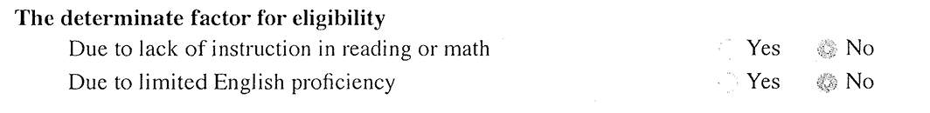
Q9 Examples
Notes:
Josie
It would be preferred to have all three questions separate like the self-assessment shows, but these examples would still be considered compliant.

Slide 59
Q9 Strategies
Eligibility document includes the consideration of the exclusionary factors.
Re-evaluation on existing data report includes the consideration of the exclusionary factors.
Notes:
Josie

Slide 60
Breakout Discussion and Question
25 minutes
Notes:
Josie
Q4-9
Look over your files and discuss among your table. We will be walking around to answer any specific questions you may have.
What example from your files for Q4-9 would you like to share with the group? This could be a good example that you think could help others or an example you would like us to discuss or a trend you noticed. We will spend the last 10 minutes sharing out.

Slide 61
Lunch
11:30-12:30
Notes:
Josie

Slide 62
IDEA & Gifted File Review Self-Assessment: IEP Development, Revision, & Review
Present Levels of Academic Achievement & Functional Performance (PLAAFPs) (PDF)
Notes:
Crista
We have included a link to the PLAAFP document located on the KIAS page this is a great resource for IEP teams

Slide 63
IEP content pitfalls- PLAAFPs (JW)
Failure to Ensure the Gathering of Sufficient and Current Evaluative Data
  Making IEP recommendations based upon inappropriate evaluative data can result in a finding of a denial of FAPE, in and of itself. When there’s debate, evaluate!
  Prior to an IEP meeting, be sure that staff has obtained all updated achievement and/or other evaluative data (formal and informal) necessary to define present levels of performance.
  Prepare for IEP meetings by asking all service providers (and parents) whether they believe that any evaluations might need to be suggested and considered at the upcoming IEP meeting, particularly if the student is not progressing as expected, needs have changed, etc. (they don’t have to be formal evaluations)
  If sufficient and current evaluative data are not available, ask for/insist upon the right to conduct evaluations/re-evaluations or to collect more data. If the parents refuse to allow an evaluation or re-evaluation, be sure to document that refusal. Kansas does not allow teams to move forward on an re-evaluation if parents fail to respond (refer to the Process Handbook)
Notes:
Crista

Slide 64
IEP content pitfalls - PLAAFPs(cont.)
Failure to include appropriate/meaningful student profile and present levels statements.
  The description of a student’s present levels of performance is a very important piece of the IEP and vital to measuring progress.
  Make sure that the IEP team uses up-to-date information, rather than old or “recycled” information. A new service provider should be able to review a student’s IEP and have a good overall feel for the student’s educational challenges, strengths, and current levels of academic and functional performance (i.e., stranger test).
  Remember that the student profile/Present levels statement is a link to the rest of the IEP content and that the strengths and challenges set forth are to be considered when determining and prioritizing goal areas and proposed services.
Notes:
Crista

Slide 65

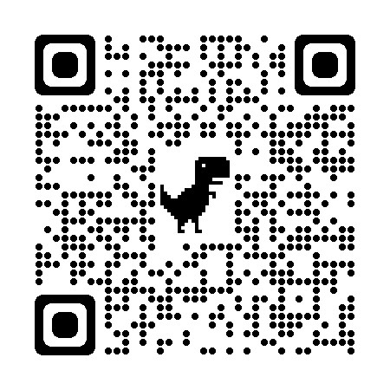
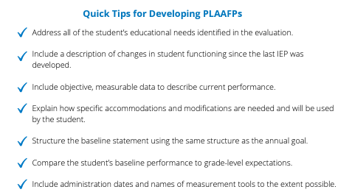
PLAAFPs Tip Sheet
Notes:
Crista
PLAAFP statements prevent us from experiencing the dreaded and harmful “assumacide”. Assumacide is when we make decisions about programming or identify practices or supports based on our assumptions, rather than evidence. PLAAFPS are based on the individual needs that a child experiences because of the disability.
There are four essential elements of a high quality PLAAFP included on the tip sheet. All PLAAFPs need to include student needs, effect on progress in the general education, baseline information, and connection to goals and/or services.
Element 1 -Student needs addresses information on the student’s current academic and/or functional needs. – Question 10 and 11
Element 2 – Effect on progress in the general education classroom is an explanation of how the disability affects the student’s involvement and progress in the general education curriculum. – Question 12
Element 3 - Baseline information is the baseline data for monitoring student data. Baseline data needs to be specific, objective, and measurable.
Element 4 – connection to goals and/or services. This is the bridge between the PLAAFP statement and an annual goal, service, or supports listed in the IEP. – Question 13

Slide 66
PLAAFP Example
Student Needs
Effect on Progress in General Education
Baseline
Connection to Goals and Services
In January 2019, G.H. was identified as a student with a learning disability in the area of math calculation. Current data, indicate that G.H. continues to need specially designed instruction in the areas of math calculation to benefit from grade level math curriculum. On recent standardized math benchmark tests conducted in January 2022, G.H. scored at the 9th percentile, which is well below average. On three standardized measures of mixed-math fact fluency administered on 2/7 and 2/8, G.H. accurately recalled, on average, 18 facts compared with grade-level expectations of 75 facts in 2 minutes. Specifically, G.H. recalled about three multiplication mixed facts (0–9), 15 addition facts (0–9), and 0 division and subtraction facts (0–9) in the 2 minutes. This affects his ability to complete sixth-grade math assignments at the same rate as his peers and efficiently use mental math calculation skills to complete word problems. To complete grade-level math assignments, G.H. currently benefits from shortened assignments, peer support, and the use of a calculator. Increasing his math fact proficiency would increase his ability to independently access and benefit from grade-level math instruction. Review of current intervention implementation data suggests that G.H. benefits from daily direct one-on-one instruction distributed across the school day. G.H. would like to graduate with his peers and attend college.
example taken from the recent Prepping for Progress 2023 Conference on the ABC’s of IEPs
Notes:
Crista
This was an example taken from the recent Prepping for Progress 2023 Conference on the ABC’s of IEPs We have color coded and highlighted to help show how some of this information may overlap between the 4 elements

Slide 67
Sample PLAAFP Statement Structure
Data from (sample source) indicates Student (performs in this way (objective data)) which affects (must include impact on involvement and progress in the general education curriculum). As a result, the student needs (justifies proposed services and supports).
example taken from the recent Prepping for Progress 2023 Conference on the ABC’s of IEPs
Notes:
Crista
This sample was shared during the Prepping for Progress ABCs to IEPs
This slide needs to be adjusted get help from TAT Remove last sentence

Slide 68
Connecting the PLAAFP to the Parts of the IEP
PLAAFP
Annual Goals
Measuring Progress Toward Annual Goals
Date, Frequency, Duration, and Location of Services
Participation Outside Regular Education and in State and Districtwide Assessments
Statement of Special Education and Aids and Services
“There should be a direct relationship between the present levels of performance and the other components of the IEP. Thus, if the statement describes a problem with the child’s reading level and points to a deficiency in reading skills, the problem should be addressed under both goals and specific special education and related services provided to the child.” [U.S. Department of Education, Code of Federal Regulations, 1999, Appendix C, Question 36. emphasis added]
Notes:
Crista
This is another slide from the Prepping for Progress 2023 conference ABC’s of the IEP presented by the Progress center

Slide 69
Question 11
10. Does the IEP include a description of the student’s present level of academic achievement as part of the Present Levels of Academic Achievement and Functional Performance (PLAAFPs)? 34 C.F.R. 300.320(a)(1); K.S.A. 72-3429(c)(1)
METHOD: Review the IEP to determine if it includes information about the student’s current academic achievement.
Examples of What Current Performance Could Include:
Standardized Assessments | Instructional Preferences
Screening Data | Learning Rate & Strengths
Progress Monitoring Data | Diagnostic Assessments
Writing rubric | Results of recent re-evaluation
YES
Select YES if the IEP includes a description of the student’s current level of academic achievement.
NO
Select NO if the IEP DOES NOT include a description of the student’s current level of academic achievement.
Kansas Special Education Process Handbook, Chapter 4, Section E.2.a..
Notes:
Crista
Academic achievement generally refers to a child’s performance in academic areas. It could vary depending on a child's circumstance or situation, therefore, a definition of academic achievement is not included in the IDEA regulations.
METHOD: Review the IEP to determine if it includes information about the student’s current academic achievement. In most cases we are talking about reading, writing, math, science , and history.
Yes or No: The IEP includes or does not include a description of the student’s current level of academic achievement.

Slide 70
Example of Current Academic Achievement and Functional Performance
Jeremiah is a 9-year-old fourth grade student with average ability, whose achievement testing shows relative strength in reading and weakness in math. Jeremiah is reading at grade level and has good comprehension. He likes to read, and he also enjoys science activities. His most recent Curriculum Based Measurement (CBM) testing showed that he read 111 words per minute, which is at the 65th percentile on local norms. Math CBM testing showed that he scored 9 digits correct in a two-minute timing, which is at the 17 percentile on district fourth grade norms. Mom reports that he brings home assignments requiring reading, but he forgets his math homework.
In his general education 8th grade math classroom, Mike is currently turning in about half of his assignments, and only about a third of those assignments are completed. Accuracy of his turned-in work fluctuates markedly. Because of his poor assignment completion, Mike received a mid-quarter failing warning letter. Mike’s completion of assignments in other curricular areas is not a concern.
Notes:
Crista
We have provided you with 2 examples that include a description of the student’s present level of academic achievement as part of the Present Levels of Academic Achievement and Functional Performance

Slide 71
Question 12
11. Does the IEP include a description of the student’s present level of functional performance as part of the PLAAFPs? 34 C.F.R. 300.320(a)(1); K.S.A. 72-3429(c)(1)
METHOD: Review the IEP to determine if it includes information about the student’s current functional performance. If there are no current concerns about functional performance, the IEP must include a statement that functional performance was considered.
Examples of What Functional Performance Could Include:
Social/Emotional Skills | Motor Skills/Mobility
Communication | Memory
Perception or Attention Abilities | Vocational/Career Interests
Task Persistence/Completion | Independent Living Skills
YES
Select YES if the IEP includes a description of the student’s current level of functional performance or a statement that functional performance was considered and there are no current concerns.
NO
Select NO if the IEP DOES NOT include a description of the student’s current level of functional performance or a statement that functional performance was considered and there are no current concerns.
Kansas Special Education Process Handbook, Chapter 4, Section E.2.a.
Notes:
Crista
Question number 11 is looking at whether or not the student's present level of functional performance is part of the IEP. There is no formal definition of functional performance in the law. Functional performance generally refers to activities that are not considered academic or related to a child's academic achievement. Functional often is used in the context of routine activities of daily living. Other examples of functional performance could be social/emotional skills, communication, attention, persistence, mobility and motor skills, memory, vocational or career interest, behavior, executive functioning, and independent living skills (dressing, eating, toileting). The PLAAFP must include a statement about the student’s current functional performance and its impact on progress in the general education curriculum. The purpose of including functional performance for all students that have exceptionalities is to prepare them for life after school. Functional performance applies to all exceptionalities, including gifted. However, the description of functional performance may look different for a gifted student, such as work completion, social skills, time management, and executive function. When you review this question, select YES if there is a description of the current level of functional performance in the student's IEP, and select NO if the IEP does not include this description.
If there are no functional needs and functional performance is age appropriate, document and state why you feel that is true. Functional needs may be addressed in other areas of the PLAAFPs and do not need to be addressed in every PLAAFP area.

Slide 72
What might functional performance include for Gifted-Only IEP?
The handout for IEP Boot Camp for Gifted lists the following examples on page 4:
Examples of information related to Functional Performance
Observation reporting student’s task persistence across domains/environments
Observation of student’s interaction with peers during classroom group project
Teacher report regarding student’s time management (e.g., rate of turning in projects on time)
Observation shows ability to concentrate intensely
Reports of student’s ability or willingness to communicate with adults or peers
Emotional issues (e.g., perfectionism, frustration, feeling different, etc.)
Score on problem-solving rubric
Interview indicates interest in social/political issues
Participation in community activities
Results of Career Cruising (or other general education career inventory)
The IEP Boot Camp for Gifted (on the TASN website) provides these examples of functional performance in the slides:
Social/emotional Issues
Social skills with peers (e.g.: can the student work with a group in the classroom to complete a project?)
Career interests and skills related to those interests
Task persistence
Memory issues
Communication with adults and peers
Impact of perceptual or attention issues
Time management (e.g., turning projects in on time)
And parent concerns
Notes:
Josie
As I mentioned on the last slide, functional performance applies to all students with exceptionalities but may look very different for gifted-only students. Page 4 of the Gifted IEP boot-camp that is included on the TASN website provides many examples on functional performance for gifted-only students. You can search Gifted IEP boot camp on ksdetasn.org.

Slide 73
Question 13
12. Does the IEP describe how the student’s disability or giftedness affects the student’s involvement and progress in the general education curriculum as part of the PLAAFPs? For preschool children, as appropriate, does the IEP describe how the disability affects the child’s participation in appropriate activities as part of the PLAAFPs? 34 C.F.R. 300.320(a)(1)(i); K.S.A. 72-3429(c)(1)(A)-(B)
METHOD: Review the IEP for a specific description of how the student’s disability or giftedness affects the student’s involvement and progress in the general curriculum. For preschool children, review the IEP for a description of how the disability affects the child’s participation in appropriate activities.
YES
Select YES if the IEP includes a specific description of how the student’s disability or giftedness affects the student's involvement and progress in the general curriculum.
For preschool children, select YES if the IEP describes how the disability affects the child’s participation in appropriate activities.
NO
Select NO if the IEP DOES NOT include a specific description of how the student’s disability or giftedness affects the student's involvement and progress in the general curriculum.
For preschool children, select NO if the IEP DOES NOT describe how the disability affects the child’s participation in appropriate activities.
Kansas Special Education Process Handbook, Chapter 4, Section E.2.a..
.
Notes:
Crista
Review the IEP for a specific description of how the student’s disability or giftedness affects the student’s involvement and progress in the general curriculum. We have a list of examples of what impact of exceptionality could look like on the next slide.

Slide 74
Examples of What Impact of Exceptionality Could Look Like:
Instructional Level | Reading Level
Effect of Processing Ability | Impact of Cognitive Ability
Rate of Progress with Supports | Birth-6 Curriculum Measures
Routines-Based Assessments | Supports Needed For Growth
Performance on Classroom Quizzes or Tests | Behavioral Impacts on Learning
Current Performance vs Past Performance | Match of Skills to Post-School Outcomes
Impact of Language for ESOL Students | Ability to Engage in Joint Attention
Notes:
Crista

Slide 75
Impact of Exceptionality
Stephanie, a third grader, when given a sixth grade-level mixed math operations probe that includes fractions, decimals, and percents, is able to correctly solve 87% of all problems presented. This means that Stephanie is approximately 3 years ahead of her typical third grade peers in math calculation. In areas of math other than calculation, Stephanie has mastered most of the fourth grade, but very few of the fifth-grade math standards. She is not yet able to solve one-step equations with one variable and she is not yet able to use function tables to model algebraic relationships. She has learned to make one, but not two transformations in the area of geometry. In probability, she has not yet learned how to use fractions to represent the probability of an event.
Jose’s current academic levels are at grade level in the language arts area, but he is extremely high in the area of math. Although he is in 6th grade, he has already mastered the 7th and 8th grade math outcomes. In order to progress in the math curriculum, he needs to enroll in the ninth-grade algebra class.
Notes:
Crista
Here are two examples of impact of exceptionality for gifted students

Slide 76
Question 14
13. Are all of the annual goals in the IEP designed to meet the student’s needs that result from the student’s disability or giftedness, to enable the student to be involved in and make progress in the general education or advanced curriculum? 34 C.F.R. 300.320(a)(2)(i)(A); K.S.A. 72-3429(c)(2)(A)
METHOD: First review the PLAAFP section of the IEP for information about the student’s needs and how the student’s exceptionality affects involvement and progress in the general education curriculum. Then review all of the annual goals in the IEP. Determine if each of the annual goals is related to meeting the student’s needs that result from the student’s exceptionality, to enable the student to be involved and progress in the general or advanced curriculum. There should be a direct relationship between the annual goal and the needs identified in the PLAAFPs.
YES
Select YES if EVERY annual goal in the IEP is designed to meet the student’s needs that result from the student’s disability or giftedness, to enable the student to be involved in and make progress in the general education or advanced curriculum.
NO
Select NO if:
• The IEP DOES NOT contain at least one annual goal.
OR
• One or more of the annual goals in the IEP is/are NOT designed to meet the student’s needs that result from the student’s disability or giftedness, to enable the student to be involved in and make progress in the general education or advanced curriculum.
SPECIAL NOTE: Students who take the alternate assessment must have annual goals that enable them to be involved in and make appropriate progress in the general education curriculum. Any separate curriculum is supplementary, not an alternate to Tier 1 grade-aligned standards-based instruction. Alternate achievement standards are performance standards that align to the general education content standards at a reduced depth, breadth, and complexity.
Kansas Special Education Process Handbook, Chapter 4, Section E.2.b.
.
.
Notes:
Crista
Goals should address the needs identified in the PLAAFPs. Students taking an alternate assessment also need to have goals that enable them to be involved in and make appropriate progress in the general education curriculum.

Slide 77
Questions
Notes:
Crista
What questions do you have over Q10-13? – we will have a breakout session coming up for you to look over those questions.

Slide 78
Question 15
14. Are all of the annual goals in the IEP measurable? 34 C.F.R. 300.320(a)(2)(i); K.S.A. 72-3429(c)(2)
METHOD: Review all of the annual goals in the IEP. Determine if each of the annual goals is measurable. Read about the four critical components of a well-written goal in the Kansas Special Education Process Handbook, Chapter 4, Section E.2.b.
A Measurable Annual Goal Includes:
Behavior: Identify the performance to be measured.
Condition: Specify how progress will be measured.
Criteria: Determine to what level the behavior must occur.
Timeframe: Specify time required to attain the criterion.
YES
Select YES if EVERY annual goal in the IEP is measurable.
Timeline
Behavior
Criteria
Condition
NO
Select NO if:
• The IEP DOES NOT contain at least one annual goal.
OR
• One or more of the annual goals in the IEP is/are NOT measurable.
Kansas Special Education Process Handbook, Chapter 4, Section E.2.b..
Notes:
Josie –
Question 14 asks if all of the annual goals in the IEP are measurable. In order for a goal to be measurable it must contain behavior, condition, criteria and timeframe. If every goal in the IEP is measurable and contains these four components, select YES. If there is not at least 1 annual goal or if the annual goals in the IEP are NOT measurable, select NO.

Slide 79
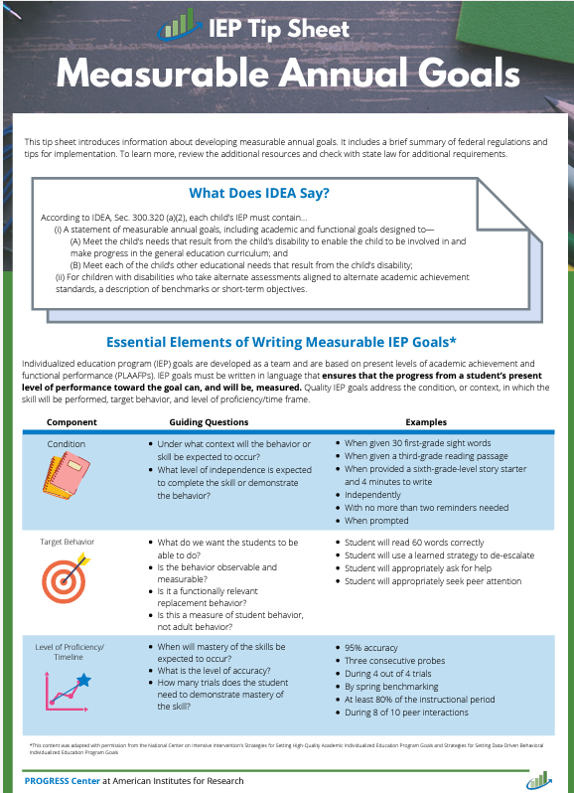
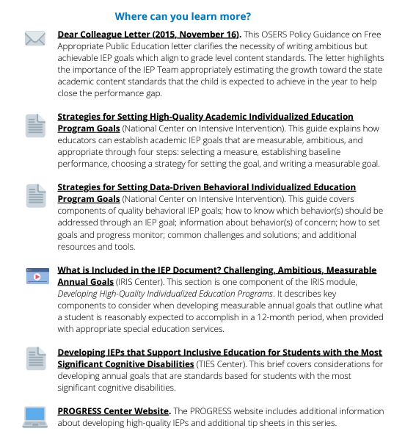
Measurable Annual Goals Tip Sheet
Notes:
Josie
This is the progress centers tip sheet for measurable annual goals.
When writing a goal, start with the academic and functional needs identified in the PLAAFP statement. Then identify the needed skills to access and progress in grade level standards. Discuss what the student should be able to achieve during the next 12 months. Then develop an individualized, ambitious, but attainable goal. When reviewing your goals, it may help to think about “are the goals we write adequate and appropriate to determine effectiveness of our special education services?”

Slide 80
General goal reminders
Every IEP has to have at least 1 goal.
The goal is about what improvement you expect the student to make, even if the only service being provided is consultation.
All goals must be measurable (File Review Q14). If a measurable annual goal is written correctly with the 4 components (behavior, criteria, condition and timeframe), the requirement of how progress toward the goal is measured is contained within the goal and no additional information is required.
You must have a baseline for the goal to judge if the criteria is appropriate and if the student is making progress.
The goal, the baseline, and the progress reports must use the same method of measuring the student’s performance.
Make sure you are clear who is doing progress monitoring of the goal and reporting to parents as per frequency indicated within the IEP
Notes:
Josie
These are some general reminder for IEP goals,
1. every IEP needs to have at least one goal. If there is not at least 1 measurable goal in the IEP, question 14 will need to be marked NO.
2. The goals that are in the IEP should outline what improvements the IEP team expects the student to make, even if the only service the student is receiving is consultation.
3. Again, all goals must be measurable, according to question 14. If a measurable annual goal is written correctly with the 4 required components, the requirement of how to progress toward completing the goal is measured is contained within the goal and no additional information is required
4. You must have a baseline for the goal in order to judge the criteria component as appropriate and evaluate if the student is making progress. 5. The goal, the baseline, and the progress reports must use the same method of measuring the student's performance. Don’t say in the goal that the student will read 100 words in a minute with 90% accuracy and then have the progress monitoring only say “student is doing great”
5. Lastly make sure you are clear about who is or will be doing the progress monitoring of the goal and reporting to the parents according to the frequency indicated in the IEP.

Slide 81
Kansas Special Education Process Handbook Guidance (Chapter 4)
Measurable Annual Goals Measurable annual goals are descriptions of what a child can reasonably be expected to accomplish within a 12- month period with the provision of special education (specially designed instruction) and related services.
Measurable annual goals must be related to meeting the child’s needs that result from the child’s exceptionality, to enable the child to be involved and progress in the general or advanced curriculum. In addition, they must meet each of the child’s other educational needs that result from the child’s exceptionality (K.S.A. 72-3429(c)(2))
There is a direct relationship between the measurable annual goal, baseline data, and the needs identified in the PLAAFPs. Because the PLAAFPs are baseline data for the development of measurable annual goals, the same criteria used in establishing the PLAAFPs must also be used in setting the annual goal.
Four critical components of a well-written goal are:
Timeframe is usually specified in the number of weeks or a certain date for completion. A year is the maximum allowed length for the timeframe. * In 36 instructional weeks… * By November 19, 2018… * By the end of the 2018–19 school year…
Conditions specify the manner in which progress toward the goal is measured. Conditions are dependent on the behavior being measured and involve the application of skills or knowledge. * When presented with 2nd-grade-level text… * Given a mixed, 4th-grade-level math calculation probe… * Given a story prompt and 30 minutes to write… * When given a directive…
Behavior clearly identifies the performance that is being monitored, usually reflects an action or can be directly observed, and is measurable. * Sarah will read… * Claude will correctly solve… * Mary will score… * Rex will follow a one-step direction
Criterion identifies how much, how often, or to what standards the behavior must occur in order to demonstrate that the goal has been reached. The goal criterion specifies the amount of growth the child is expected to make by the end of the annual goal period. * 96 words per minute with 5 or fewer errors. * 85% or more correct for all problems presented. * 4 or better when graded according to the 6-trait writing rubric. *Within one minute without help, 3 times a day, for 2 weeks
Notes:
Josie
More information on annual measurable goals is found in chapter four of the special education process handbook. The handbook defines a measurable annual goal as a "description of what a child can reasonably be expected to accomplish within a 12-month period." This goal must be related to meeting the needs of the child that result from their exceptionality and there is a direct relationship between the measurable annual goal, baseline data, and the needs identified in the PLAAFPs. If we haven't stressed it enough, the four critical components of a measurable annual goal are timeframe - which is usually specified as number of weeks or a specific upcoming date, conditions - the manner by which progress towards the goal will be measured, behavior - which is the specific performance that is being monitored, and criterion - which identifies how much, how often, or to what standards the team will know that the goal has been reached. If you have eagle eyes, each of those critical components has an example of what that might look like in the individual goals of the children you will be reviewing files for.

Slide 82

SMART
Practical Progress Monitoring Strategies for Efficient Data Collection and Reporting (CEC 2023)
Notes:
Josie
This is another example to assist IEP teams in writing measurable annual goals.

Slide 83
Example Q14
Behavior clearly identifies the performance that is being monitored, usually reflects an action or can be directly observed, and is measurable.
  Sarah will read…
  Claude will correctly solve…
  Mary will score…
  Rex will follow a one-step direction
Criterion identifies how much, how often, or to what standards the behavior must occur in order to demonstrate that the goal has been reached. The goal criterion specifies the amount of growth the child is expected to make by the end of the annual goal period.
  96 words per minute with 5 or fewer errors.
  85% or more correct for all problems presented.
  4 or better when graded according to the 6-trait writing rubric.
  Within one minute without help, 3 times a day, for 2 weeks.
Timeframe is usually specified in the number of weeks or a certain date for completion. A year is the maximum allowed length for the timeframe.
  In 36 instructional weeks…
  By November 19, 2018…
  By the end of the 2018–19 school year…
Conditions specify the manner in which progress toward the goal is measured. Conditions are dependent on the behavior being measured and involve the application of skills or knowledge.
  When presented with 2nd-grade-level text…
  Given a mixed, 4th-grade-level math calculation probe…
  Given a story prompt and 30 minutes to write…
  When given a directive…
Notes:
Josie
On this slide we have provided several examples for each required component of the measurable goal.

Slide 84
Example Q14: Gifted Goals
In 18 instructional weeks, when assigned a research topic, Yolanda will conduct a research project and create a Power point presentation of her research, scoring 20/20 points on a research rubric (see attached research rubric).
By November 22, 2022, given a 3rd grade level literary text, Sally will correctly summarize the plot, including the major conflict and 3 events related to the conflict.
Notes:
Josie
For the first example, if you’re using a rubric, make sure it is included in the progress monitoring as well.

Slide 85
Content Pitfall – Failure to Include Appropriate and Measurable Annual Goals (JW)- Recommendations
Where IEP goals area not measurable, the IEP is subject to substantive attack. In addition, it is difficult to demonstrate appropriate progress necessary to show the provision of FAPE.
Remember that when writing a goal, ask “what can she do now and what do we reasonably expect for her to be able to do a school year from now?”
When developing a goal, give considerable thought to how progress on the annual goal should and will be evaluated.
If data does not exist or cannot be generated to support stated progress on an Annual Goal and Progress Report, question whether the goal is measurable.
Do Not recycle IEP goals that have not proved successful for the student. In the Endrew F case many goals were repeated year to year showing that student wasn’t making progress in light of the student’s circumstances.
Ensure that there is a “rational” and “cogent” plan in place for accurately monitoring and measuring progress on the goals and for providing those Annual Goal Progress Reports!
Notes:
Josie

Slide 86
Question 16
15. Was the student’s progress toward meeting each annual IEP goal measured and reported using the method and frequency described in the IEP? 34 C.F.R. 300.320(a)(3); K.S.A. 72-3429(c)(3)
METHOD: First, review the IEP to determine if the IEP includes a description of how the student’s progress toward meeting each of the annual goals will be measured. This information could be contained within each goal or in a separate section of the IEP. Next, review the IEP to determine if the IEP includes a description of when periodic reports on the progress the student is making toward meeting each of the annual goals will be provided. Finally, compare these descriptions in the IEP to progress reports in the education record to determine if there is documentation to show a) the student’s progress toward meeting each annual IEP goal was measured as described in the IEP, and b) periodic reports on the progress were provided to the parents (or legal education decision-maker) at the times/intervals required by the IEP.
YES
Select YES if documentation shows ALL of the following:
The IEP includes a description of how the student’s progress toward meeting EACH annual IEP goal will be measured.
AND
The IEP includes a description of when periodic reports on the progress the student is making toward meeting each of the annual goals will be provided.
AND
The goal, the baseline, and the progress reports used the same method of measuring the student’s performance.
AND
Progress was reported to the parent (or education decision-maker) according to the frequency/intervals described in the IEP.
NO
Select NO if documentation DOES NOT show ALL of the following:
The IEP includes a description of how the student’s progress toward meeting EACH annual IEP goal will be measured.
OR
The IEP includes a description of when periodic reports on the progress the student is making toward meeting each of the annual goals will be provided.
OR
The goal, the baseline, and the progress reports didn’t used the same method of measuring the student’s performance.
OR
Progress wasn’t reported to the parent (or education decision-maker) according to the frequency/intervals described in the IEP.
Kansas Special Education Process Handbook, Chapter 4, Section E.2.d..
Notes:
Cary
This question had the highest number of non-compliant files last year.
METHOD:
First, review the IEP to determine if the IEP includes a description of how the student’s progress toward meeting each of the annual goals will be measured. This information could be contained within each goal or in a separate section of the IEP.
Next, review the IEP to determine if the IEP includes a description of when periodic reports on the progress the student is making toward meeting each of the annual goals will be provided.
Finally, compare these descriptions in the IEP to progress reports in the education record to determine if there is documentation to show a) the student’s progress toward meeting each annual IEP goal was measured as described in the IEP, and b) periodic reports on the progress were provided to the parents (or legal education decision-maker) at the times/intervals required by the IEP. We always want the goal, baseline, and progress report to use the same measurement.

Slide 87
Kansas Special Education Process Handbook Guidance
Measuring and Reporting Progress on Annual Goals (Chapter 4)
The team must include a description of how the child’s progress toward meeting the annual goals will be measured.
  If a measurable annual goal is written correctly with the 4 components (behavior, criteria, condition and timeframe) the requirement of how progress toward the goal is measured is contained within the goal and no additional information is required.
The IEP must include a description of when parents will be provided periodic reports about their child’s progress toward meeting the annual goals.
Whatever the method chosen, progress toward the goals must be monitored in the method indicated on the IEP and progress reports should include a description of the child’s progress towards the child’s measurable annual goals.
Notes:
Cary
Chapter 4 of the Process Handbook reminds us of the requirements for Q 15.

Slide 88
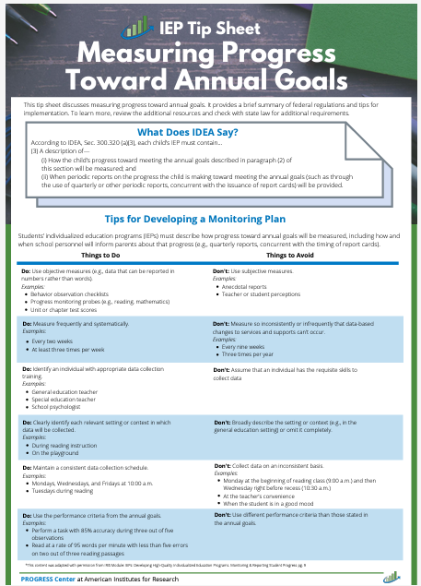
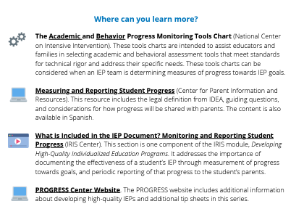
Progress Monitoring Tip Sheet
Notes:
Cary
The Progress Monitoring TIP sheet is a great resource for your IEP teams. This is one of the materials that we had printed for you.

Slide 89
What is progress monitoring
A set of techniques and methods for assessing student performance on a regular and frequent bases so that instructional decisions will be made that result in improved outcomes for students.
A scientifically based practice
  Assesses students’ progress toward a goal- ensure that what you are measuring aligns with the student’s goal
    Frequent
    Ongoing
    Quick
  Evaluates effectiveness of instruction
Notes:
Cary
When we talk about progress monitoring we are referring to methods for assessing a students progress on a regular and frequent bases so that we can evaluate the effectiveness of instruction. The measurement selected needs to align with the student’s goal.

Slide 90
Why is Progress Monitoring Important?
It’s part of specially designed instruction.
It helps teachers know when to take action:
  Change instructional practices
  Adjust curriculum
  Add services and supports
It results in improved outcomes for all students.
Promotes closing the achievement gap
Notes:
Cary
Progress monitoring is part of specially designed instruction and helps providers know when to change instructional practices, adjust curriculum and add services and supports. Progress monitoring improves outcomes for all students and promotes closing the achievement gap.

Slide 91
Progress Monitoring Process
Before
Benchmark assessment
During
Collect data on schedule
After
Evaluate progress
Determine intervention
Choose tool
Set goal
Decide on frequency of PM and schedule for decision making
Frequent, brief
Graph regularly
Share with team
Make decisions re: interventions
Continue Plan
Responsive
Non-Responsive
Make a Change
Practical Progress Monitoring (CEC 2023)
Notes:
Cary
This slide provides a timeline of what needs to be done before, during, and after progress monitoring. It shows how we make decisions base on whether the student was responsive or non-responsive to the instruction. It is important to make a change if the student is non-responsive.

Slide 92
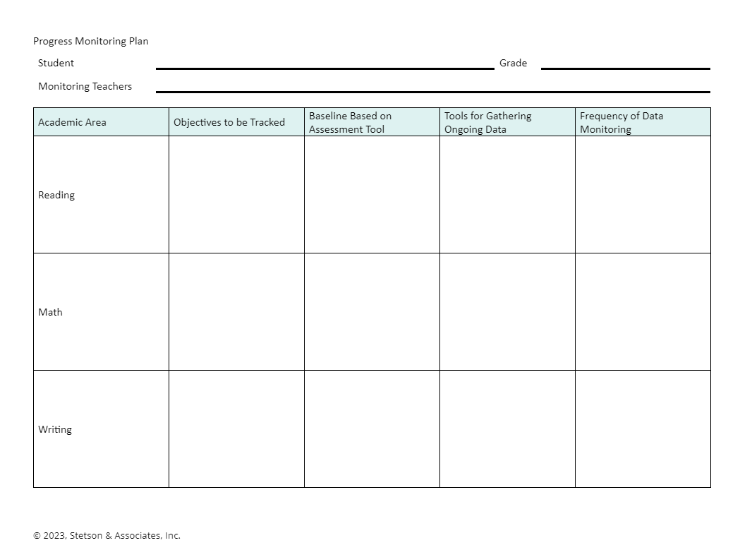
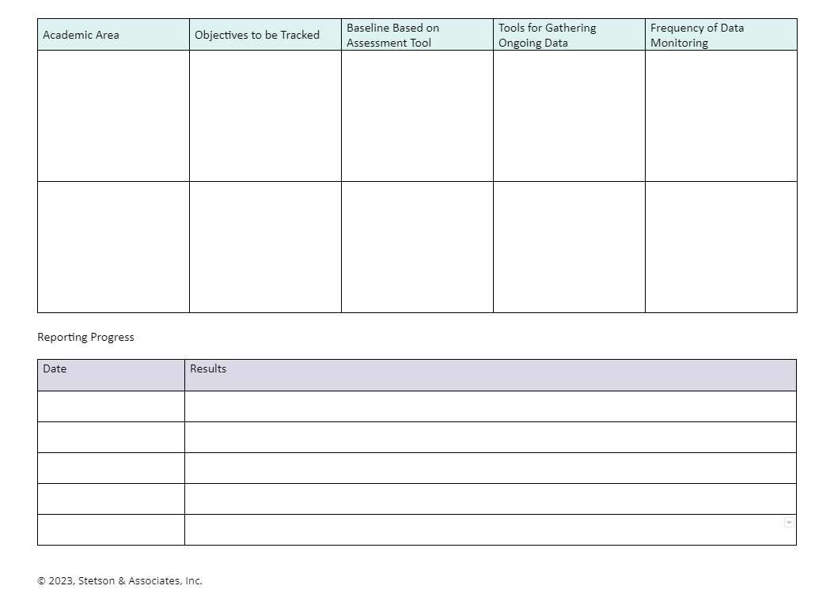
Progress Monitoring Plan
Notes:
Cary
This is a Resource shared on Stetson & Associates. Progress Monitoring All students need to be monitored against grade level standards.
Students that are expected to pass grade level assessments should be monitored along the same schedule as general education students
Some students are not anticipated to pass grade level assessments and should be monitored at least 2x per month
Students significantly below peers (1%) may need to be monitored weekly
General and special education should work together to create an individual progress monitoring plan for students with IEPs

Slide 93
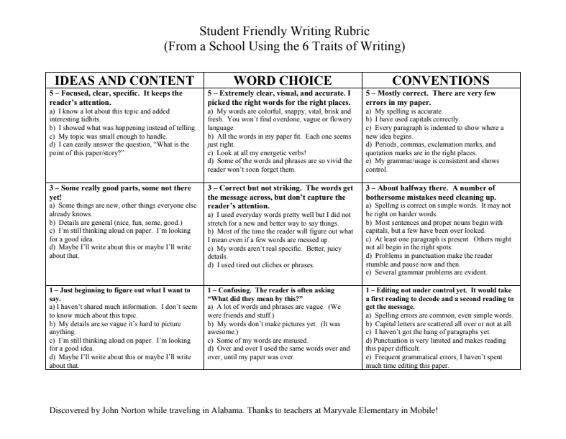
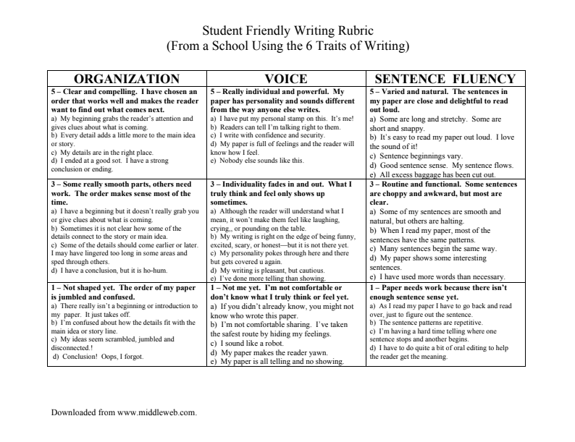
Writing Rubrics
Notes:
Cary
Resource shared on Stetson & Associates Progress Monitoring Webinar
Monitoring progress using rubrics
Rubrics can be an easy way to track specific student progress
Search for already published rubrics to simplify the task
Rubrics serve to task analyze some skill areas
A single rubric can be used to track student progress over time.
The images in the slide are of an Elementary writing rubric in student friendly terms
We have included the link which takes you to lots of rubrics

Slide 94
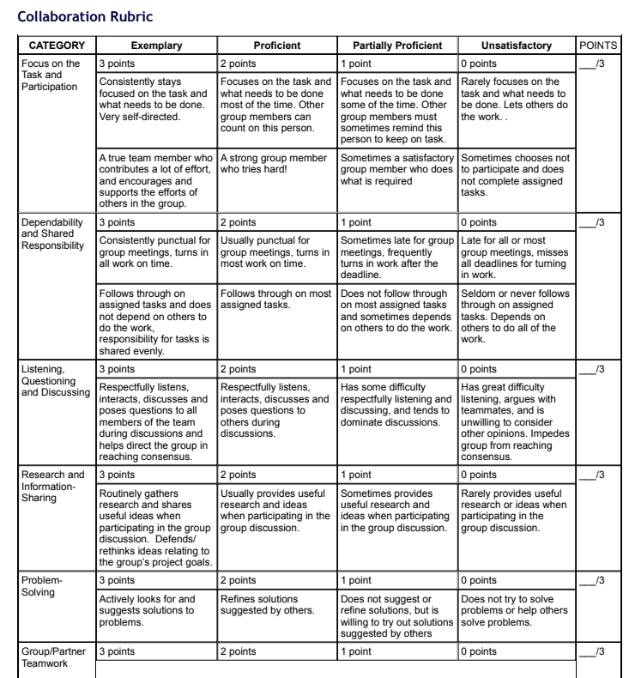
Middle School and High School Collaboration Rubric
Examples of Other Rubrics
Notes:
Cary
From University of Wisconsin – Stout
Resource shared on Stetson & Associates Progress Monitoring Webinar

Slide 95
Techniques for Progress Monitoring
Curriculum Based Measures (CBM)
Teacher Developed Assessments
Brief/in the moment student responding
Entrance/Exit Tickets
Observation
IRIS Module: Intensive Intervention (Part 2): Collecting and Analyzing Data for Data-Based Individualization
Notes:
Cary
This slide provides some techniques for progress monitoring. The IRIS Module: intensive intervention part 2 is on collecting and analyzing data for data-based individualization

Slide 96
Resources for Progress Monitoring
Resource
Easy CBM
IDEAs That Work (search for “progress monitoring”)
Intervention Central
National Center on Intensive Intervention
Research Institute on Progress Monitoring
RTI Action Network
Notes:
Cary

Slide 97
Graphing and Interpreting
There are multiple ways to score and analyze data
  Hand scoring
  Computerized scoring
Quick turn-around procedures are desired for feedback and instruction
Important to keep longitudinal data
Trend lines and aim lines
Notes:
Cary

Slide 98
Common findings Q15
Documentation lacked description of when periodic reports on progress would be provided to parent/legal education decision maker – please upload this portion of IEP
Progress report only showed most recent status – please upload all progress reports for the IEP under review
Progress reporting did not occur for every goal – will require DCAP and ICA
Progress reporting did not match how the goal indicated it would be measured – will require DCAP and ICA
Notes:
Cary

Slide 99
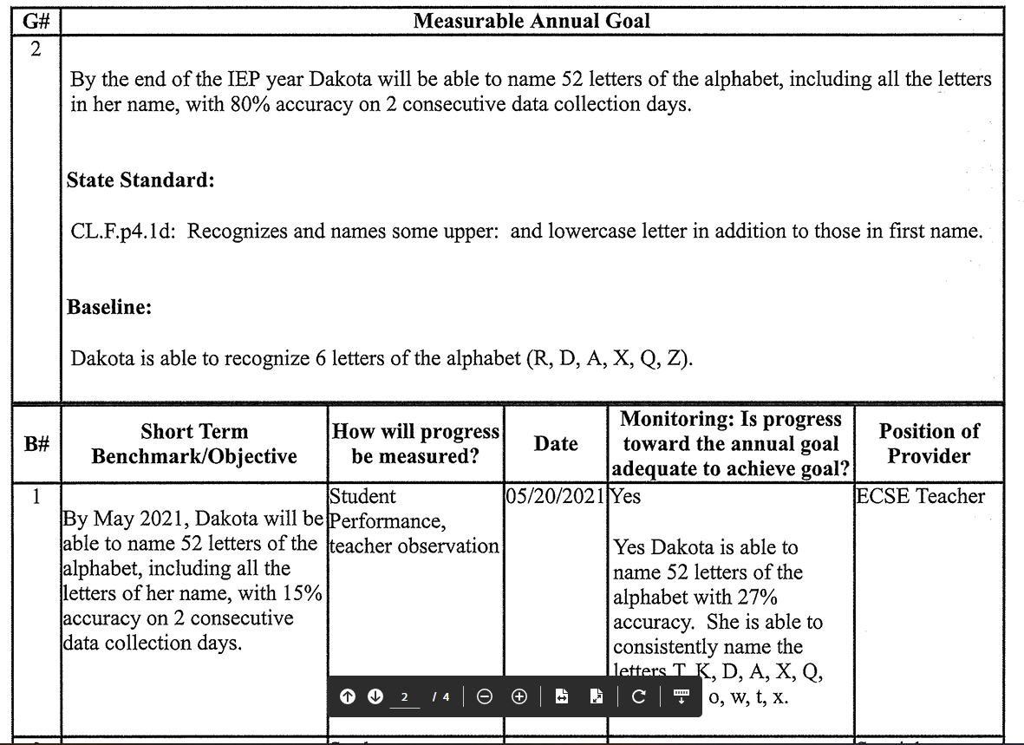
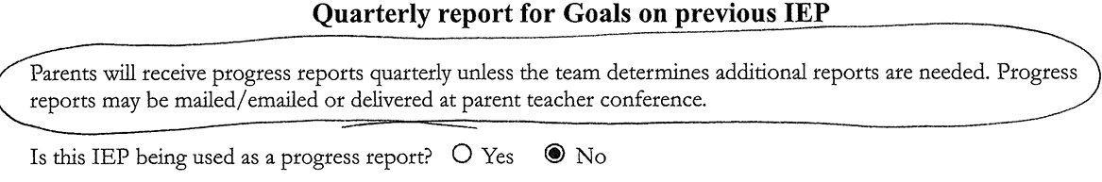
Compliant Example Q15
Notes:
Cary – Progress was also reported for all reporting periods.

Slide 100
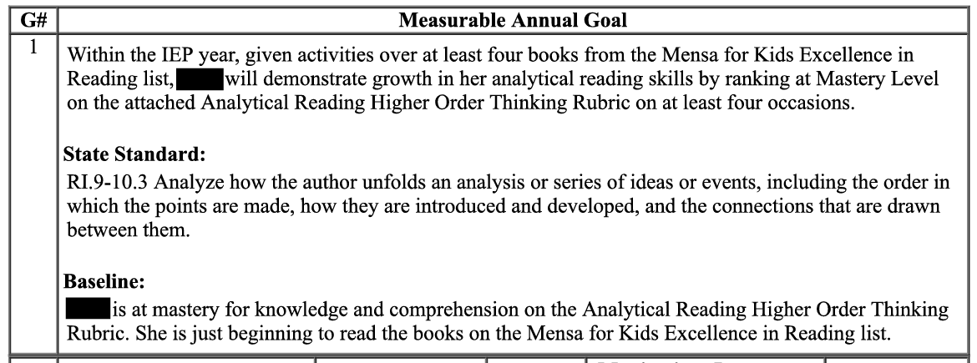
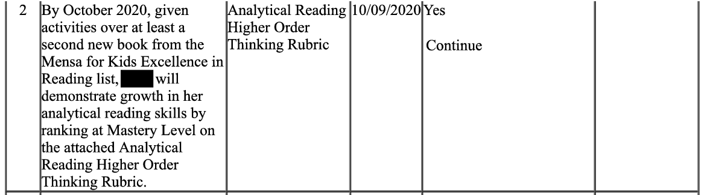
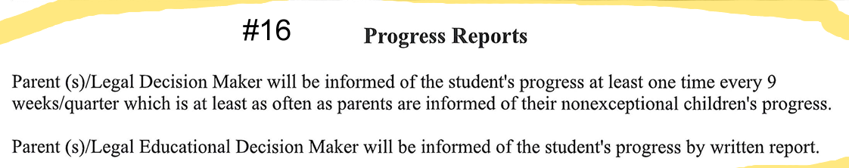
Noncompliant Example Q15
Notes:
Cary - The student’s progress toward meeting EACH annual IEP goal was NOT measured using the method described in the IEP. Goal states Analytical Reading Higher Order Thinking Rubric. Continue does not indicate how the student is performing on the rubric. To be compliant the rubric would need to be included or a summary of how the student is performing on the rubric.

Slide 101
Breakout Discussion and Question
20 minutes
Notes:
Cary
Q10-15
Look over your files and discuss among your table. We will be walking around to answer any specific questions you may have.
What example from your files for Q10-15 would you like to share with the group? This could be a good example that you think could help others or an example you would like us to discuss. Or a trend you noticed at your table. We will spend the last 5 minutes sharing out.

Slide 102
Question 17
16. If the IEP team has determined that the student with a disability must take an alternate assessment instead of a particular state or districtwide assessment, was that determination made in alignment with the KSDE Dynamic Learning Maps Participation Guidelines for Kansas and does the IEP include BOTH of the following?: (A) A statement of why the student cannot participate in the general state or district assessment; and (B) A statement of why the particular alternate assessment selected is appropriate for the student. 34 C.F.R. 300.320(a)(6)(ii), 300.160(c); K.S.A. 72-3429(c)(6)(B)
METHOD: First, review the IEP to determine if the student must take an alternate assessment or regular state/districtwide assessment. Next, if the IEP states the student must take an alternative assessment, next review the education record for documentation that the student meets all of the criteria listed in the KSDE Dynamic Learning Maps Participation Guidelines for Kansas. This documentation could be in the IEP, evaluation/eligibility report, IEP Team meeting notes, a prior written notice, etc. Finally, review the IEP to determine if it includes a statement of why the student cannot participate in the general state or districtwide assessment, and a statement of why the particular alternate assessment selected is appropriate for the student. Every goal must have at least 2 benchmarks/objectives.
YES
Select YES if documentation shows ALL of the following:
• The student meets all of the criteria listed in the KSDE Dynamic Learning Maps Participation Guidelines for Kansas;
AND
• The IEP includes a statement of why the student cannot participate in the general state or district assessment;
AND
• The IEP includes a statement of why the particular alternate assessment selected is appropriate for the student.
NO
Select NO if documentation DOES NOT show ALL of the following:
• The student meets all of the criteria listed in the KSDE Dynamic Learning Maps Participation Guidelines for Kansas;
AND
• The IEP includes a statement of why the student cannot participate in the general state or district assessment;
AND
• The IEP includes a statement of why the particular alternate assessment selected is appropriate for the student.
N/A
Select N/A if:
• This is a file for a gifted-only student;
OR
• This is a file for a student who is convicted as an adult under State law and incarcerated in an adult prison (34 C.F.R. 300.324(d)(1)(i); K.A.R. 91-40-5(c)(2)(A));
OR
• The IEP Team determined that the student with a disability will take a regular State or districtwide assessment.
Kansas Special Education Process Handbook, Chapter 4, Section E.2.e.
KSDE Dynamic Learning Maps Participation Guidelines for Kansas
KSDE Rubric for Determining Student Eligibility for the Kansas Alternate Assessment (DLM) for Students with the Most Significant Cognitive Disabilities
Notes:
Cary
METHOD:
First, review the IEP to determine if the student must take an alternate assessment or regular state/districtwide assessment.
Next, if the IEP states the student must take an alternative assessment, review the education record for documentation that the student meets all of the criteria listed in the KSDE Dynamic Learning Maps Participation Guidelines for Kansas. This documentation could be in the IEP, evaluation/eligibility report, IEP Team meeting notes, a prior written notice, etc.
Finally, review the IEP to determine if it includes a statement of why the student cannot participate in the general state or districtwide assessment, and a statement of why the particular alternate assessment selected is appropriate for the student.
If a student is identified for an alternate assessment, there must be at least 2 short term objectives or benchmark for each goal.
Select YES if documentation shows ALL of the following:
• The student meets all of the criteria listed in the KSDE Dynamic Learning Maps Participation Guidelines for Kansas; or Rubric for determining eligibility for the alternate assessment;
AND
• The IEP includes a statement of why the student cannot participate in the general state or district assessment;
AND
• The IEP includes a statement of why the particular alternate assessment selected is appropriate for the student.
Select NO if documentation DOES NOT show ALL of those components
Select N/A if the student is gifted-only, student is convicted as an adult and incarcerated in an adult prison, or the IEP team determined the student would take the regular state and district assessment.

Slide 103
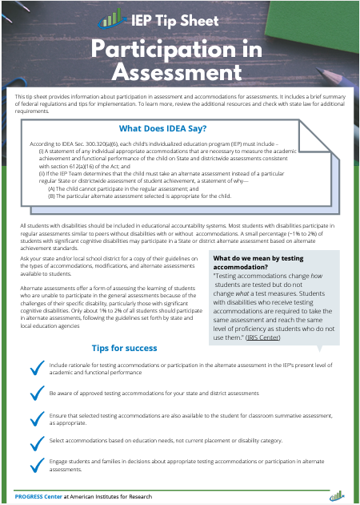
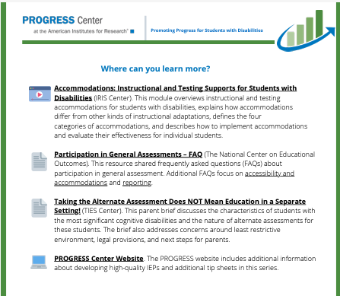
Participation in Assessment Tip Sheet
Notes:
Cary

Slide 104
Question 18
17. Does the IEP include the projected date for the beginning of special education and related services, supplementary aids and services (including accommodations), program modifications and supports for school personnel? 34 C.F.R. 300.320(a)(7); K.S.A. 72-3429(c)(7)
METHOD: Review the IEP to determine whether it contains a projected beginning date for EACH of the special education and related services, the supplementary aids and services (including accommodations), program modifications and supports for school personnel that will be provided.
For Each and Every Service
Describe the service (see above) | Provide the projected date for the beginning of each service (Note: the IEP start date does NOT serve the function of the start date for any service)
YES
Select YES if the IEP contains a projected beginning date for EACH of the special education and related services, supplementary aids and services (including accommodations, program modifications, and supports for school personnel that will be provided.
NO
Select NO if the IEP DOES NOT contain a projected beginning date for EACH of the special education and related services, supplementary aids and services (including accommodations, program modifications, and supports for school personnel that will be provided.
Kansas Special Education Process Handbook, Chapter 4, Section E.2.h..
Notes:
Crista
It is important to remember ALL students are general education students first. Some students will require special education aids and services to access and benefit from general education similar to their peers. The IEP needs to include the projected date for beginning of special education and related services, supplementary aid and services, program modifications and supports for school personnel. When you review the file, determine if there is a start date for EACH special education and related service, supplementary aids and services, program modifications and supports for school personnel. Select YES if the IEP includes documentation of the projected beginning date for EACH service, select NO if the IEP does not include documentation of the projected beginning date for ALL services.

Slide 105
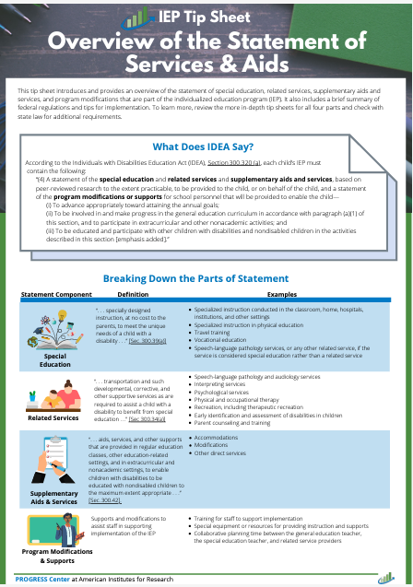
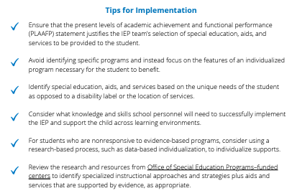
Services Tip Sheet
Notes:
Crista

Slide 106
Question 19
18. Does the IEP include anticipated frequency, location and duration of special education and related services, supplementary aids and services (including accommodations), program modifications and supports for school personnel? 34 C.F.R. 300.320(a)(7); K.S.A. 72-3429(c)(7)
METHOD: Review the IEP to determine whether it contains the anticipated frequency, location, and duration for EACH of the special education and related services, supplementary aids and services (including accommodations), program modifications and supports for school personnel.
Examples of Frequency, Location, Durations for Related Services
Transportation | Counseling Services | Occupational Therapy
Frequency: Every day when school is in session | Frequency: Three Days per week | Frequency: Once per week
Location: In district special education vehicle | Location: Counselor’s Office | Location: Resource Room
Duration: Travel time from home to school/school to home via bus route | Duration: A total of 600 minutes per semester | Duration: Twenty minutes per week
YES
Select YES if the IEP contains the anticipated frequency, location, and duration for EACH of the special education and related services, supplementary aids and services (including accommodations), program modifications, and supports for school personnel.
NO
Select NO if the IEP DOES NOT contain the anticipated frequency, location, and duration for EACH of the special education and related services, supplementary aids and services (including accommodations), program modifications, and supports for school personnel.
Kansas Special Education Process Handbook, Chapter 4, Section E.2.h..
Notes:
Cary
This question had the second highest number of non-compliant files last year
Review the IEP to ensure each special education and related service, supplementary aids and services including accommodations, program modification and supports for school personnel all contain frequency, location, and duration. KSDE does not allow using "as needed" as a frequency of accommodation. Using "as determined by the teacher" as a frequency of accommodation is not allowed.

Slide 107
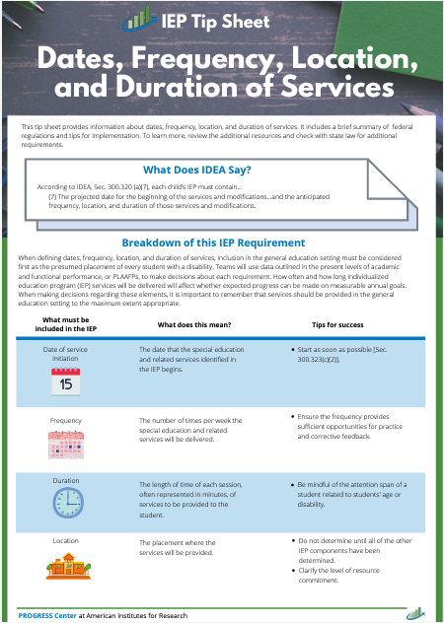
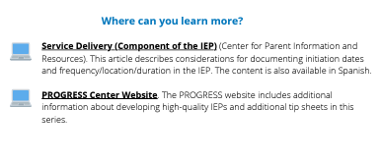
Frequency, Location, Duration Tip Sheet
Notes:
Cary

Slide 108
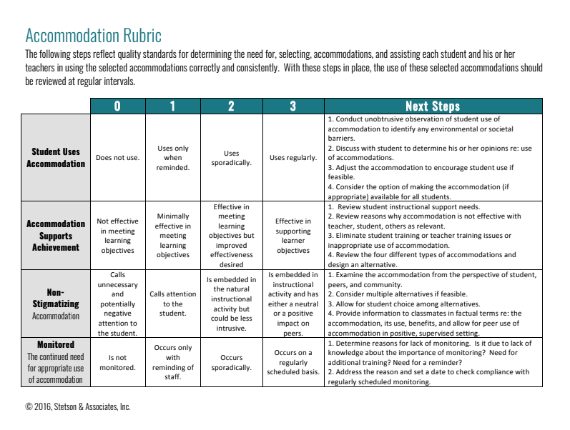
Accommodation Rubric
Notes:
Cary
Resource shared on Stetson & Associates Progress Monitoring Webinar in April.
This is a great tool to use prior to the student’s annual IEP mtg
How often is the student using the accommodation?
Does the accommodation support achievement? We tend to continue adding accommodations but don’t remove them. Teachers may not use the accommodations due to the number of accommodations.
Does the accommodation make the student look different than their peers?
Are we monitoring the use of the accommodation? – if its on the IEP it needs to be monitored on a regular basis

Slide 109
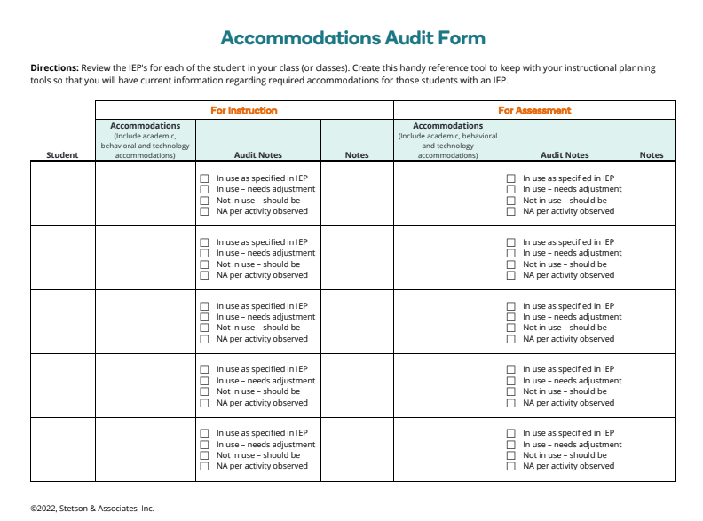
Accommodations Audit Form
Notes:
Cary
Resource shared on Stetson & Associates Progress Monitoring Webinar in April.
This form can be used when multiple students with accommodation are in a classroom. Use for instruction and assessment

Slide 110
Documenting Accommodations
Assuring the Documentation of Frequency, Location, and Duration of Accommodations on the IEP (PDF)
Examples of Frequency, Location, and Duration for Accommodations & Modifications (PDF)
Documenting Frequency, Location, and Duration of Accommodations and Modifications on the IEP during the school year (PDF) (examples specific to Text-to-Speech)
Considerations for Accessible Educational Materials (PDF)
Kansas Assistive Technology Guide
Assistive Technology Dear Colleague Letter (PDF)
Myths and Facts Surrounding Assistive Technology Devices (PDF)
Notes:
Cary
This slide contains a variety of resources that have examples for how to document accommodations on the IEP

Slide 111
Examples: Accommodations and Modifications (Q17 & Q18)
ACCOMMODATION EXAMPLES:
Accommodation | Start Date | Location | Frequency | Duration
Extended time for assignments | 3/3/22 | In all core classes (social studies, science, math, and language arts) | Whenever written assignments are given | Todd will receive a time extension of 1 ½ of the required assignment time to complete the assignment
Text read aloud via human or electronic reader | 8/15/22 | In all settings, both general and special education | When given material above a second-grade level | Until reading of assigned text is completed
Use of calculator | 9/9/22 | In general education math class | Whenever assignment requires math calculation | For duration of math class
Provide copy of notes, study guide, or cloze activity to be used for review | 9/9/22 | Across all general education classrooms | For each chapter or unit of study | Notes, study guide, or cloze activity provided at least 4 days before any chapter or unit test
MODIFICATION EXAMPLES:
Modification | Start Date | Location | Frequency | Duration
Jolinda will be provided with fewer answer options for all classroom multiple choice tests (e.g., 3 answer options instead of 4). | 1/5/22 | In all core classes | Whenever multiple choice assessments are given | For the multiple-choice portion of all classroom assessments
During her general education math class, Linda will be asked to complete multiplication and division problems with no more than two digits. | 2/2/22 | In core math class | Whenever a math assignment or classroom math assessment is given that involves multiplication or division. | For the duration of all math assignments and classroom math assessments.
Notes:
Cary

Slide 112
Monitoring State Assessment Accommodations
Academic Assessment Peer Review
  Critical Element 5.4 requires State to monitor test administration to ensure accommodations selected for State assessments are :
    Consistent with accommodations provided to the students during instruction and/or practice
    Consistent with the assessment accommodations identified by a student’s IEP under IDEA
  LEA’s selected for random data verification will upload the accommodations section(s) of the students IEP for Q18. KSDE will cross reference with the students PNP to ensure consistency in accommodations.
Notes:
Cary

Slide 113
Question 20
19. Did the IEP team consider parent concerns for enhancing the education of their student in developing, reviewing and revising the IEP? 34 C.F.R. 300.324(a)(1)(ii); K.S.A. 72-3404(r); 72-3429(d)(1)
METHOD: This information could be found in the Present Levels of Academic Achievement and Functional Performance (PLAAFP) statements or another IEP section or other documentation in the student’s file indicating the IEP team requested and considered the concerns the parent had for enhancing the education of their student in developing, reviewing and revising the IEP.
YES
Select YES if the IEP or the education record contains documentation that the IEP team considered the concerns of the parent for enhancing the education of their student in developing, reviewing and revising the IEP.
NO
Select NO if the IEP or the education record DOES NOT contain documentation that the IEP team considered the concerns of the parent for enhancing the education of their student in developing, reviewing and revising the IEP.
Kansas Special Education Process Handbook, Chapter 4, Section E.1.b. and Section F..
Notes:
Josie
could be found in meeting notes, PWN, or in IEP.

Slide 114
Parent Input Recommendations (JW)
Consider seeking parental input prior to an IEP meeting using a parental input or survey form for the parent to return prior to the meeting. Be sure to document consideration of parental concerns during the meeting.
Be sure to explain the meaning of any “coded” items on IEPs, such as codes with annual goals, internal school codes, etc.
Consider keeping drafts of IEPs or meeting notes that reflect changes that were made to the IEP based upon parental input.
Be careful not to be inappropriately bound or restricted by a computerized or web-based IEP program in the process of developing the IEP.
Notes:
Josie

Slide 115
Question 21
20. If the student’s behavior impedes the student’s learning or that of others, did the IEP Team consider the use of positive behavioral interventions and supports, and other strategies, to address that behavior when developing, reviewing or revising the IEP? 34 C.F.R. 300.324(a)(2)(i), (b)(2); K.S.A. 72-3429(d)(4)
METHOD: First, review the education record for documentation indicating whether the student displays behavior that impedes the student’s or others’ learning. If the student’s behavior impedes learning (of self or others), then review the education record for documentation showing that the IEP Team considered the use of positive behavior interventions and supports and other strategies when developing the initial IEP, conducting the annual IEP review, or revising the IEP. This information can be found in the IEP, a prior written notice form, IEP Team meeting notes, and IEP amendment form, or other documentation in the education record.
YES
Select YES if documentation shows that when developing, reviewing or revising the IEP, the IEP Team considered the use of positive behavior interventions and supports and other strategies to address the student’s behavior that impedes the student’s or others’ learning.
NO
Select NO if documentation DOES NOT show that when developing, reviewing or revising the IEP, the IEP Team considered the use of positive behavior interventions and supports and other strategies to address the student’s behavior that impedes the student’s or others’ learning.
N/A
Select N/A if documentation shows that the student DOES NOT have behavior that impedes the student’s or others’ learning.
Kansas Special Education Process Handbook, Chapter 4, Section E.1.e.
Notes:
Josie
When you review the file for this question, first review the documentation that indicates whether the student displays behavior that impedes their own or other student's learning. If the documentation shows behavior that impedes learning is present, then review the record for documentation that shows that the IEP team CONSIDERED the use of positive behavior interventions and supports when developing the IEP, conducting the IEP review, or revising the IEP. Select YES if the documentation does have narrative that shows the teams consideration of positive behavior interventions and supports with other strategies to address the behavior that impedes on students learning. Select NO if the documentation does not show the teams consideration. This question also has the third option of N/A which should only be used if the documentation shows that the student does no have any behaviors that impede their own or other students learning. The FAQ document includes some helpful information related to question 20. This document is linked in an upcoming slide for your reference.

Slide 116
IEP Content Pitfall - Failure to Appropriately Address the “Special Instructional Factor” of Behavior (JW)
For any student who has behavior that impedes his/her learning or that of others, the IEP team must consider positive behavioral interventions, supports and other strategies to address it. This must be done either through the inclusion of measurable annual goals, the provision of special education/related services and/or the performance of a functional behavior assessment (FBA) and development of a behavior intervention plan (BIP). May be addressed through goals, services or BIP or combination of the above.
Regardless of the recognized disability, if the student has any behavior that impedes his/her learning or that of others, the relevant box on the IEP needs to be checked “yes”.
Remember that behavior that impedes learning is not limited to outwardly disruptive behavior. It can include refusal to do work, truancy or skipping classes, lack of motivation, inattention, withdrawal, etc.
Be sure IEP contains either measurable behavioral goal, services to address concerns, or reference to the development of an appropriate BIP.
Notes:
Josie

Slide 117
question 22
21. When developing, reviewing or revising the IEP, in the case of a student who has limited English proficiency, did the IEP Team consider the language needs of the student as those needs relate to the student’s IEP? 34 C.F.R. 300.324(a)(2)(ii), (b)(2); K.S.A. 72-3429(d)(5)
METHOD: First, review the education record for documentation indicating whether the student has limited English proficiency. If the student has limited English proficiency, then review the education record for documentation showing that the IEP Team considered the student’s language needs as those needs relate to the IEP when developing, reviewing, or revising the IEP. This information can be found in the IEP, a prior written notice form, IEP Team meeting notes, and IEP amendment form, or other documentation in the education record.
YES
Select YES if documentation shows that when developing, reviewing or revising the IEP, the IEP Team considered the language needs of the student as those needs relate to the student’s IEP.
NO
Select NO if documentation DOES NOT show that when developing, reviewing or revising the IEP, the IEP Team considered the language needs of the student as those needs relate to the student’s IEP.
N/A
Select N/A if documentation shows that the student DOES NOT have limited English proficiency.
Kansas Special Education Process Handbook, Chapter 3, Sections C. and F., Chapter 7, Sections D. and F..
Notes:
Josie

Slide 118
Question 21: When developing, reviewing or revising the IEP, in the case of a student who has limited English proficiency, did the IEP team consider the language needs of the student as those needs relate to the IEP?
The education record for a student should indicate whether the student has limited English proficiency. If so, documentation should be found (in IEP, PWN, IEP team meeting notes, IEP amendment, or other location in the record) that shows when the IEP team develops, reviews and/or revises IEP, they considered language needs.
For example, a team might include something such as…
While the student needs direct special education services to address his learning disability, he is an English Learner and continues to need services from a language acquisition program to address those needs. His current language performance is described within the communication area of this IEP. It is critical that the EL teacher and the SPED teacher work closely to address all the student’s needs in a coordinated way. (This statement would need to be in the IEP somewhere, and the IEP would reflect both direct and consultative services from the SPED teacher. It needs to be clear in the IEP that the student will continue to receive EL).
Notes:
Josie

Slide 119
Breakout Discussion and Question
20 minutes
Notes:
Josie
Q16-21
Look over your files and discuss among your table. We will be walking around to answer any specific questions you may have.
What example from your files for Q16-21 would you like to share with the group? This could be a good example that you think could help others or an example you would like us to discuss or a trend you noticed We will spend the last 5 minutes sharing out.

Slide 120
IDEA & Gifted File Review Self-Assessment: Placement
Notes:
Crista

Slide 121
Question 23
22. Was the student’s educational placement determined at least annually? 34 C.F.R. 300.116(b)(1); K.A.R. 91-40-21(e)(1)
METHOD: Review the education record for documentation that the exceptional student’s educational placement was determined at least annually. Compare dates of placement decisions documented in the student’s IEP or prior written notice documents. Review meeting records for evidence that the student’s placement was discussed and determined within one year of the previous placement determination.
YES
Select YES if the education record contains documentation that the student’s educational placement was determined at least annually.
NO
Select NO if the education record DOES NOT contain documentation that the student’s educational placement was determined at least annually.
Kansas Special Education Process Handbook, Chapter 6, Section B.
Notes:
Crista
Question 22 was a three way tie for the 3rd highest number of non-compliant questions last year

Slide 122
FAQ Guidance
QUESTION: Regarding Self-Assessment Question 22, if a school district always provides the parent with a PWN at the IEP annual review, does that documentation show that placement was determined annually?
ANSWER: Providing a PWN at the IEP meeting COULD show that placement was determined annually depending on the content of the PWN and whether it addresses the placement determination.
QUESTION: What are some examples of how to better document the LRE continuum when making changes?
ANSWER: See the Kansas Special Education Process Handbook, Chapter 6 Section C. Also see the LRE Decision Tree and accompanying chart at the end of the chapter.
Notes:
Crista

Slide 123
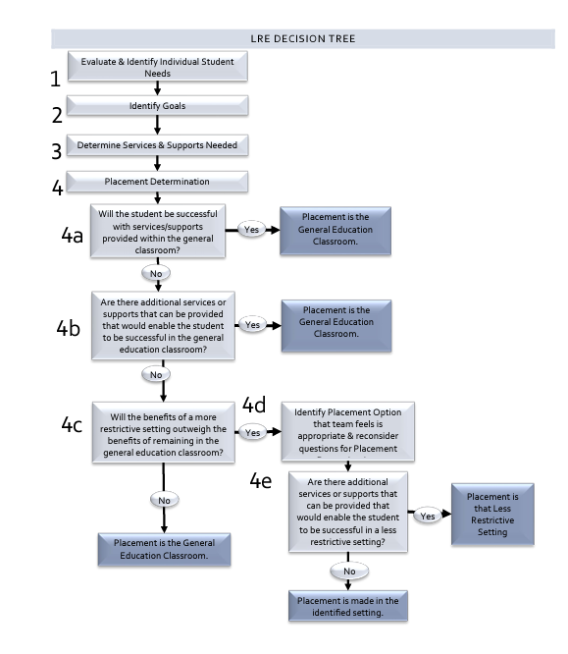
LRE Decision Tree
Notes:
Crista

Slide 124
Pre-determination of Placement is the “Big Kahuna” of Process Mistakes (JW)
Predetermination of placement is otherwise denying meaningful parental input into decision-making.
If draft IEP documents are prepared, seriously consider sharing them with the parent ahead of time and make it clear that they are drafts for discussion and preparatory purposes only. 99% of parents appreciate that school has drafted something for parents to review ahead of time. Cover memo indicating drafts for discussion purposes only. Train staff on how to handle the draft.
When preparing for IEP meetings and staff meetings are held, make sure that everyone who attends understands that no final placement determinations are to be made prior to the IEP meeting. These are “preparatory activities” only. Come to IEP with an open mind but not a blank mind.
Be careful not to be inappropriately bound or restricted by a computerized or web-based IEP program in the process of developing the IEP.
Thoroughly consider/discuss parental placement requests, even those that may seem “bizarre” or “ridiculous.” Document the discussions regarding that consideration.
Be careful not to open a meeting by overstating the purpose of the IEP meeting, in other words, be general. For example, “we are here today to review and possibly revise Susie’s IEP,” not “we are here today to develop an IEP for Susie to attend the self-contained class for LD students.”
Notes:
Crista

Slide 125
Failure to focus on the “I” in IEP and IDEA during decision-making (JW)
This could also be considered a form of “predetermination of placement.” Recommendations must be made based on every student’s individual education needs and nothing else (we would but we don’t have the staff to do that) (can’t just recommend what you can do rather than what the student needs)
Always respond to parental requests for services based upon what the student needs to make appropriate progress, rather than what the school district has or what it always does. For example, “it is our belief that this is what the student needs to make appropriate progress in her educational program,” not “I’m sorry, we just don’t have that here.”
Avoid statements that sound like a “one-size fits all” program is being recommended.
Avoid mentioning cost of services as a basis for denying services and redirect others when they do. The basis for any denial of requested services must always be that the school does not believe that the student needs those services in order to make educational progress – not the fact that they “cost too much”.
Some Office of Civil Rights (OCR) complaints on safety of having to carry student up and down stairs or onto the bus, lift bus, or elevator. If student needs a wheelchair at home, they probably need one at school.
Notes:
Crista

Slide 126
Question 24
23. If the student’s LRE (least restrictive environment) placement is outside of the regular education environment for any part of the school day (including nonacademic and extracurricular services and activities), did the team first determine that the nature or severity of the disability is such that placement in the regular education environment with the use of supplementary aids and services could not be achieved satisfactorily? 34 C.F.R. 300.114(a)(2)(ii), 300.117; K.S.A. 72-3420(a); K.A.R. 91-40-21(i)
METHOD: First, review the education record to determine whether the student with a disability is placed in the regular education environment for the whole school day or in a more restrictive environment for any part of the school day. If the student is placed in a more restrictive environment for any part of the school day (including nonacademic and extracurricular services and activities – i.e. meals, recess, transportation, assemblies, clubs, athletics, etc.), next review the education record for documentation showing that the team first considered or implemented placement in the regular environment with the use of supplementary aids and services before considering more restrictive environments. Finally, review the education record for documentation showing that the nature or severity of the disability is such that education in regular classes with supplementary aids and services cannot be achieved satisfactorily.
YES
Select YES if:
• The education record contains documentation showing the student is placed in the regular education environment for the entire school day, including nonacademic and extracurricular services and activities.
OR
• The education record contains documentation showing a) the team first considered placement in the regular environment with supplementary aids and services, AND b) when placing the student outside of the regular environment the team determined that the nature or severity of the student’s disability is such that placement in the regular education environment with supplementary aids and services cannot be achieved satisfactorily.
NO
Select NO if the education record DOES NOT contain documentation showing a) the team first considered placement in the regular environment with supplementary aids and services, AND b) when placing the student outside of the regular environment the team determined that the nature or severity of the student’s disability is such that placement in the regular education environment with supplementary aids and services cannot be achieved satisfactorily.
N/A
Select N/A if:
• This is a file for a gifted-only student.
OR
• This is a file for a student who: (a) has been convicted as an adult under state law and is incarcerated in an adult prison; AND (b) the student’s IEP team has modified the student’s IEP or placement because the State has demonstrated a bona fide security or compelling penological interest that cannot otherwise be accommodated (34 C.F.R. 300.324(d)(2)).
Kansas Special Education Process Handbook, Chapter 3, Sections C. and F., Chapter 7, Sections D. and F..
Notes:
Crista
Lastly, questions 23 reads"…". When you are answering this question, first you will determine the environment the student is placed in. If the student is placed in the regular education environment for the ENTIRE day then select YES. If the student is placed in a more restrictive environment for any part of the school day, which includes nonacademic and extracurricular services and activities like meals, recess, transportation, assemblies, clubs, and athletics, then documentation showing that the IEP team considered or implemented placement in the regular environment with the use of supplementary aids and services before considering more restrictive environments. There are two instances where N/A would need to be selected. First, if the file is a gifted-only student. The second instance where N/A would be selected is if the student has been convicted as an adult under state law and is incarcerated in an adult prison AND the student's IEP team has modified the IEP or placement because the incarceration does not allow for accommodation.

Slide 127
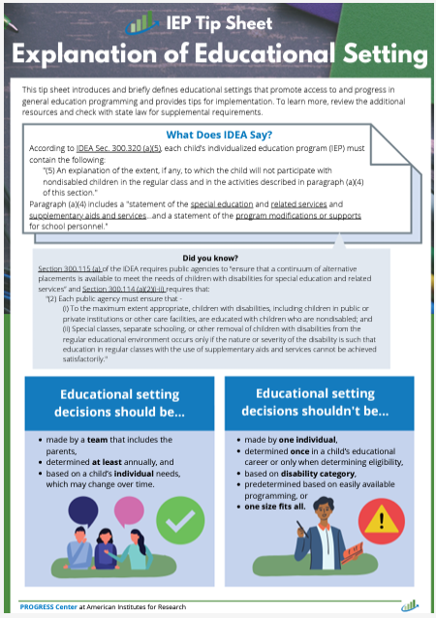
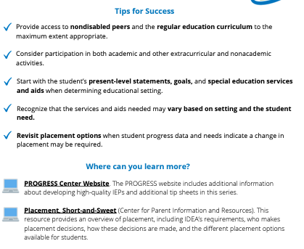
Educational Setting TIP Sheet
Notes:
Crista

Slide 128
Content Pitfalls – Making Inappropriate/Unsupported Recommendations Regarding LRE (JW)
Specific rationale for placing students outside of the regular education environment must be set forth by the team.
Not based solely on factors such as category of disability, severity of disability, availability of special education and related services, configuration of the service delivery system available, space or administrative convenience. Avoid pre-determination of LRE.
Remember to adequately train and involve regular ed teachers in the decision-making process.
Remember that the LRE mandate doesn’t trump the FAPE mandate. What is the least restrictive environment where this student can make progress appropriate in light of the individual student’s circumstances? (maximum extent appropriate not to be maximum extent possible).
Specifically identify the individual needs/target skills of the student and prioritize them taking into consideration the nature/severity of the student’s disability, the student’s age and other relevant circumstances.
Determine what level of services/supports is necessary to meet the defined needs and to support appropriate progress on goals/objectives.
Determine whether the student’s needs can be met satisfactorily in the regular education classroom with/without supplementary aids and services.
Identify what efforts the school has made to educate the student in the reg ed classroom and to try less restrictive options.
If needs cannot be or have not been satisfactorily met in the reg ed, move along the continuum to more restrictive.
When LRE is at issue, consider negotiating the “stay-put” in order to implement a “trial” placement for a stated period of time (in order to keep some data).
Notes:
Crista

Slide 129
Common findings
Use of boiler plate statement as assurance that LRE was considered for a specific student, or simply restating the pullout services within the IEP
Lack of documentation that team first considered placement in general education with support before moving to more restrictive setting
Notes:
Crista
Some common findings that we deemed as non-compliant for question 23 were the use of a boiler plate statements outlining that LRE was considered for a specific student or simply just restating the pullout services. The second common finding was a lack of documentation that the IEP team considered placement in general education first, before moving to a more restrictive environment.

Slide 130
LRE Sample Statements
Dan needs intensive social skills instruction and practice in a small group situation in order to improve his ability to resolve conflict and cooperate with peers. He will receive this instruction from the social worker during his study hall for 20 minutes per day, three times per week. Due to Dan's difficulty with sustaining focus and impulsivity in responding to peers and adults resulting from his disability, he needs direct and targeted opportunities to practice skills in a small group setting with verbal feedback first before transferring the practiced skill into the general education setting. This setting and level of support is considered to be the least restrictive environment at this time; data for previous attempts to provide support and instruction only within the general education setting in these areas suggested that Dan may gain skills faster and benefit from smaller groups with more structured opportunities with immediate adult feedback. As Dan gains skills in these two areas, the team will review progress at least annually, with goal to decrease his pullout time and increase his supports in general education to assist in successfully transferring these skills. Dan will receive his remaining instruction in the general education setting with his non-disabled peers.
Due to Sue’s significant information processing deficits in the areas of auditory acquisition and organization related to sequencing words resulting from her receptive language deficit, she needs small group reading instruction with repeated directions in multiple formats. Therefore, she will be removed from general education to receive this instruction daily for 25 minutes during intervention time. Sue will continue to participate in core reading instruction within the general classroom and will receive her remaining instruction in the general education setting with her general education peers. This level of support and location of service is considered to be the least restrictive environment at this time: special education services, service settings, and data collected will be reviewed at least annually to help inform placement decisions for the least restrictive placement to meet Sue's needs.
Notes:
Crista
We have included 2 LRE Sample Statements as example for how districts could document LRE for Q 23.

Slide 131
Breakout Discussion and Question
10 minutes
Notes:
Crista
Q22-23
Look over your files and discuss among your table. We will be walking around to answer any specific questions you may have.
What example from your files for Q22-23 would you like to share with the group? This could be a good example that you think could help others or an example you would like us to discuss. We will spend the last c5 minutes sharing out.

Slide 132
Non-Compliance
Notes:
Cary
Districts that are notified of non-compliance on October 31 will need to correct the non-compliance through district corrective action plans, individual corrective action plans, and updated data.

Slide 133
OSEP QA 23-01
According to OSEP QA 23-01 all identified noncompliance must be corrected within one year of when noncompliance was identified. The district will be required to correct the noncompliance by completing the steps below to meet this one-year deadline.
  District corrective action plan
  Individual Corrective Action Plan
  Updated data
Dear Colleague Letter on General Supervision Responsibilities
Guidance on State General Supervision Responsibilities
Notes:
Cary
The district must develop a district corrective action plan that outlines the root cause of the noncompliance and the actions the district will take to correct noncompliance within the timeframe specified by KSDE, but in no case more than one year from identification. Additionally, before concluding that noncompliance has been corrected, KSDE requires correction of all individual cases of noncompliance and collection of additional updated data to demonstrate that the district is correctly implementing the regulatory requirement that was originally identified with noncompliance. An ICA will not be required to correct individual noncompliance for a student who is no longer within the jurisdiction of the LEA.

Slide 134
Non-Compliance
Oct 31 – Letters of non-compliance go out
DCAP – District Corrective Action Plan (Nov. 3 – Dec. 2)
  For each question that was reported noncompliant.
ICA – Individual Corrective Action Plan (Nov. 3 – April 1)
  One individual corrective action plan for each student reported noncompliant.
  If a student is reported noncompliant for more than one question, the district will complete an individual corrective action plan on each noncompliant question for the student.​
  Districts will need to upload the documentation showing the file has been corrected.
Updated data (files completed between March 13 and May 14)
  Districts will need to upload the documentation showing the file is compliant on the question(s) the district had non-compliance on between May 15-May 29.
  ​
Notes:
Cary

Slide 135
Levels of Determination (LOD)
Change effective with the FFY 2021 district LOD, released in the spring of 2023
IDEA findings from IDEA & Gifted Requirements File Review
  A district is Substantially Compliant when fewer than two children with a disability and an IEP had a finding on the same question
  Cohort 1 (SY2024-2025) will be reported in FFY 2024 LOD report (April 2026)
  Cohort 2 (SY2025-2026) will be reported in FFY 2025 LOD report (April 2027)
Notes:
Cary

Slide 136
District Corrective Action Plans (DCAPs)
A DCAP will need to be completed for each question that the district had non-compliance on.
DCAPs are completed in KIAS.
DCAPs are due by December 2nd.
DCAPS must address:
  Root Cause Analysis (RCA)
  Strategy for correcting the problem identified by the RCA
  Method of evaluation to assure this problem does not reoccur
  Location of the documentation of actions taken
  LEA Contact information
Notes:
Cary
There are some good resources to help the district identify the root cause, and the practice vs policy types of guidance for writing DCAPs. The IDEA and gifted file review toolbox houses the Investigative Questions document, Root Cause Analysis Form, DCAP Sample and ICA plan guidance documents. These documents can also be found within KIAS authenticated application under the help section after selecting IDEA and gifted file review

Slide 137
Root Cause Analysis
Identify and discuss data analyzed for determining root cause (i.e. data patterns including who, what and where) ​
What was the root cause of problem (i.e. why)?​
Was root cause at procedural, policy and/or practice level?
  5 Why’s
  Fishbone
Notes:
Cary
There are 3 parts to the root cause analysis section.

Slide 138
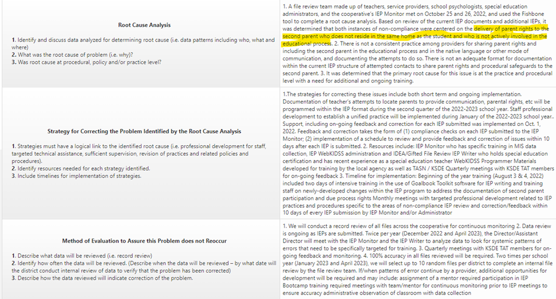
Question 1 DCAP Example
Notes:
Cary
On the next several slides we have exemplar DCAP example for you. It is important to note, we should not be seeing these exact DCAPs since each district will need to be doing their own root cause analysis and will base their strategies and methods on what they found to be the root cause.
In this DCAP the district identified the root cause being related to not delivering parent rights to the second parent who did not reside in the same home as the student.

Slide 139
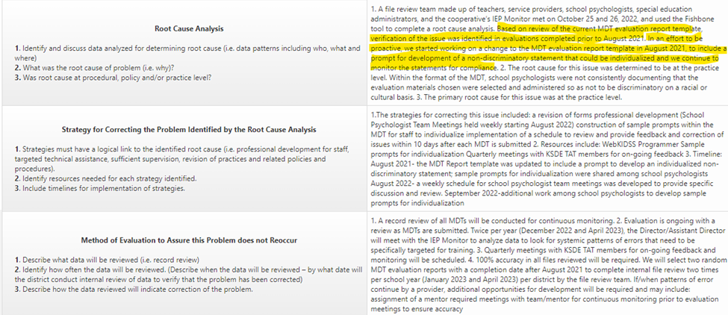
Question 2 DCAP Example
Notes:
Cary
This DCAP was based on review of the current MDT evaluation report template, verification of the issue was identified that evaluations completed prior to Aug 2021. In an effort to be proactive the district started working on a change to the MDT evaluation report template in Aug 21 to include a prompt for development of a non-discriminatory statement that could be individualized, and they continue to monitor statements for compliance.

Slide 140
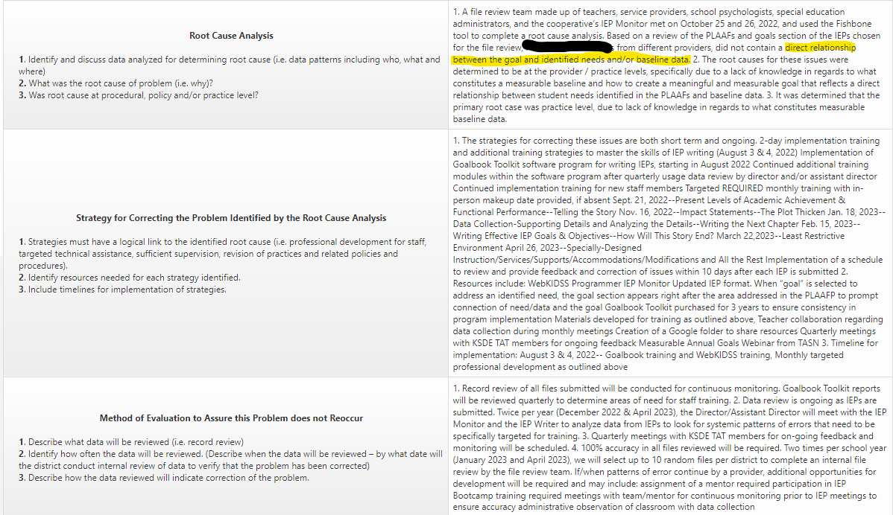
Question 13 DCAP Example
Notes:
Cary
This DCAP was related to their not being a direct relationship between the goal and identified needs and/or baseline data.

Slide 141
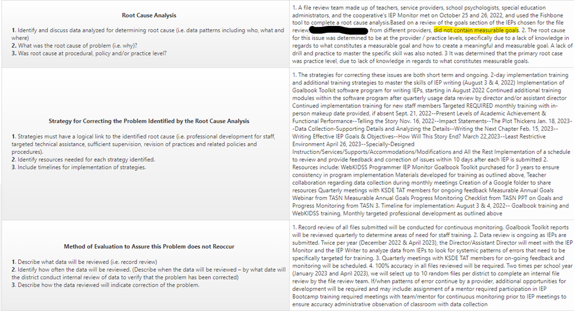
Question 14 DCAP Example
Notes:
Cary
This DCAP addressed goals that were not measurable.

Slide 142
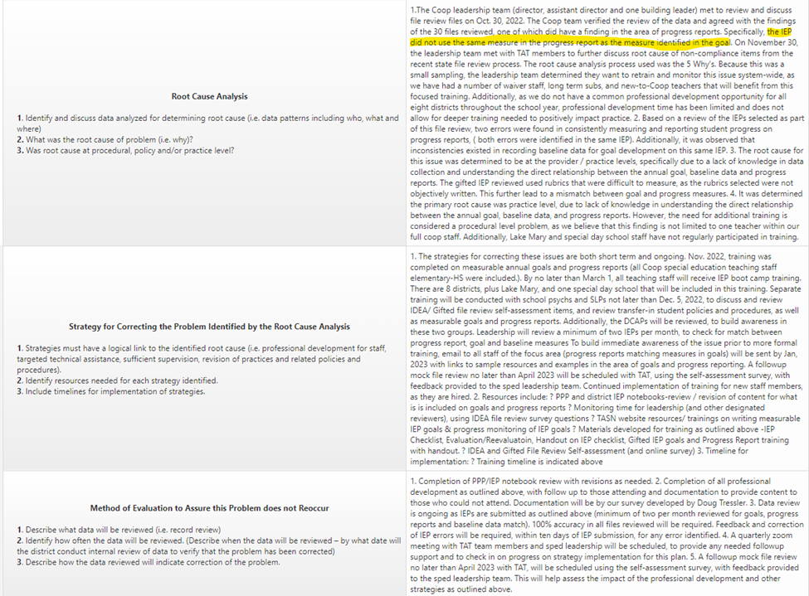
Question 15 DCAP Example
Notes:
Cary
This DCAP addressed IEPs that did not use the same measure in the progress report as the measure identified in the goal.

Slide 143
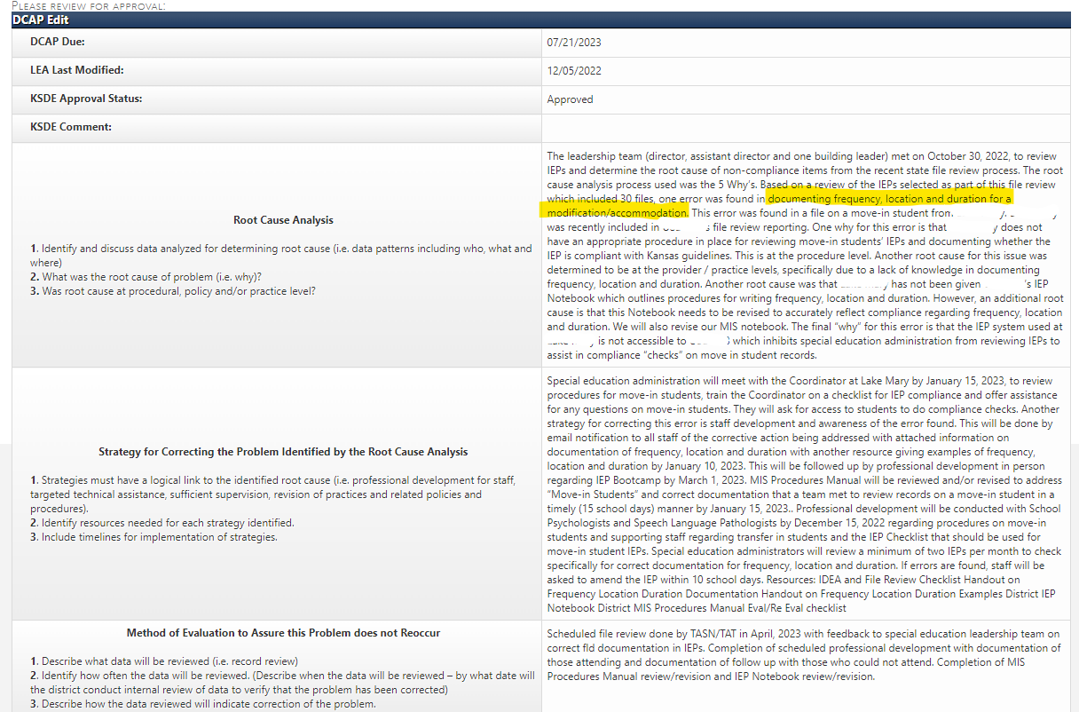
Question 18 DCAP Example
Notes:
Cary
This DCAP is related to documenting frequency, location, and duration of accommodations on a move in student.

Slide 144
Individual Corrective Action (ICAs)
An ICA must be completed for every student on every question that was non-compliant
  Exception – student has graduated or is no longer in the district
  Click delete and select the reason
ICAs are completed in KIAS
ICAs are due by April 1
ICAs must contain:
  Statement of actions taken to correct the individual child specific noncompliance
  Location of the documentation of actions taken to correct the child specific noncompliance
  Date of correction by LEA
  LEA contact information
  Upload documentation showing file was corrected.
Notes:
Cary
You need to complete the ICA after the file has been corrected. Be specific in how the file was corrected. What actions did the district take to correct the non-compliance. Beginning with cohort 1 SY2024) the district will be required to upload documentation showing the file was corrected. This change is due to the updated general supervision guidance in 23-01

Slide 145
ICA Example Question 1
Q1 - Initial file review indicated that there was no documentation that parent rights/procedural safeguards were provided to both parents that do not live at the same address. The IEP team knows that an address for the student's second parent is unknown. However, this information was not documented anywhere. This error led to an overall change for the agency. A page was added to the IEP to prompt teachers to document this type of information in a more formal manner. Training was provided to this teacher. A new draft IEP was written by the teacher and submitted to the IEP monitor for compliance review. An IEP meeting was held on 10/03/2022 and the parent with whom the student resides signed the IEP. It was documented in the IEP that there were no additional contacts.
Notes:
Cary
We have also provided you with some ICA samples that you can refer to for guidance on what level of detail we are expecting on the ICAs. Again the ICAs you submit will need to be individualized based on the specific noncompliance.

Slide 146
ICA Example Question 15
Q15- Initial file review indicated that progress reports did not contain specific and measurable data. This error is directly related to errors for Questions #11, #14, and #15. When training and resources were provided for writing complete PLAAFPs, connecting goals to area of need, and goal writing, reporting progress using the same method as goal measurement is an easier process. A new IEP was written on 09/07/2022 and progress reports for each nine weeks contain data that was established in the goal. IEP EXCERPT GOAL: Within 36 instructional weeks, xxxx will show mastery of a Kansas College and Career Ready Standard as demonstrated by the completion of a new problem/learning-based project and scoring at least 9/12 on each phase of the modified Renzulli, Type III Independent Investigation Rubric below. PROGRESS REPORT contains the rubric with highlighted rubric scores to show progress.
Notes:
Cary

Slide 147
ICA Example Question 23
Q23- Initial file review indicated that the LRE determination lacked discussion regarding the consideration of less restrictive environments and reasons for rejecting these options. Training and resources were provided to the teacher to ensure understanding of the components of LRE consideration. A new draft IEP was written by the teacher and submitted for compliance review by the IEP monitor. An IEP meeting was held on 09/28/2022 and parents signed the IEP. PWN EXCERPT A DESCRIPTION OF THE ACTION PROPOSED OR REFUSED: During his 7th grade year, xxxx will receive specialized instruction for 30 minutes x 5 days a week of support in the interrelated classroom in the class of Study Hall for remediation/reteaching of concepts from the general education curriculum, direct instruction to work on his individual education goals outlined in his current individual education plan and work completion support from his general education English/Language Arts, Science, Social Studies, and Math classes during the current IEP year. xxxx will also receive special education inclusion support for 160 minutes x 5 days a week in the general education classrooms of English/Language Arts, Science, and Math. During his 8th grade year, xxxx will receive specialized instruction for 30 minutes x 5 days a week of support in the interrelated classroom in the class of Study Hall for remediation/reteaching of concepts from the general education curriculum, direct instruction to work on his individual education goals outlined in his current individual education plan and work completion support from his general education English/Language Arts, Science, Social Studies, and Math classes during the current IEP year. xxxx will also receive special education inclusion support for 115 minutes x 5 days a week in the general education classrooms of English/Language Arts, Science, and Math. EXPLANATION OF WHY THE ACTION IS PROPOSED OR REFUSED: xxxx meets the criteria for these actions, because, based on his most recent evaluation, as well as Aims Web, KAP, STAR Reading Assessment, and Goalbook assessments, xxxx meets the critieria of a student with a specific learning disability. These supports are proposed to provide xxxx support in the areas where he needs services to continue to advance in the general education curriculum. OPTIONS CONSIDERED AND WHY THE OPTIONS WERE REJECTED: The option to provide only support within the general education classroom. However, this was rejected as student currently requires additional opportunities to practice and reinforce skills with immediate teacher feedback in a smaller group setting. Additionally, this amount of pull-out support allows student to preview some skills that will be presented in the general education setting. DESCRIPTION OF THE DATA USED AS BASIS FOR THE PROPOSED OR REFUSED ACTION (including each evaluation procedure, assessment, record or report used as a basis for the proposed or refused action): Evaluation Data, Aims Web, STAR Reading Report, Goalbook Assessments, Parent/IEP team input, and observation.
Notes:
Cary

Slide 148
What is Updated Data?
As part of the correction of noncompliance process, KSDE must also collect Updated Data to verify that the district is correctly implementing the regulatory requirement(s) consistent with OSEP QA 23-01
The specific regulatory requirement(s) are identified on the District Corrective Action Plan (DCAP). Districts should only review updated data specific to the regulatory requirement(s) that were found noncompliant for the district.
NOTE: If there are NO FILES AVAILABLE, you must still click Submit. The root cause analysis in the DCAP will serve as the district’s assurance that the district is correctly implementing the regulatory requirement
Notes:
Cary

Slide 149
Updated Data
KIAS will pull files completed between March 13 and May 14, 2026.
KIAS will pull files based on district size calculator (same as during initial data collection).
District will answer yes/no for each student file pulled for each question that the district had non-compliance.
District will upload documentation to verify compliance.
If updated data results in continued non-compliance on any question for any student, the district will enter into another round of correcting non-compliance (DCAP, ICA, updated data).
Notes:
Cary

Slide 150
Continued Non-Compliance on Updated Data
District will be required to update their DCAP(s)
District will be required to complete an ICA on each student for each question that was non-compliant
District will be required to complete another round of updated data
District will be assigned a TAT member to assist them
Notes:
Cary

Slide 151
Failure to Correct Non-Compliance within One Year
Assigned Level of Determination of Needs Intervention
Put on intensive technical assistance (TA)- TASN
Update DCAP
Correction of all individual cases of non-compliance (ICAs)
Collect updated data as evidence the district correctly implemented the regulatory requirement(s)
Review of updated data during on on-site file review conducted by KSDE
Notification sent to director, superintendent, and local school board president
Notes:
Cary

Slide 152
Resources
Notes:
Josie

Slide 153
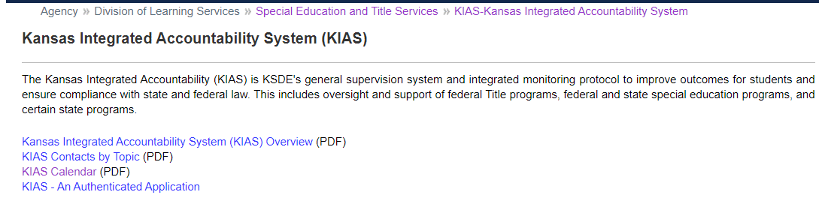
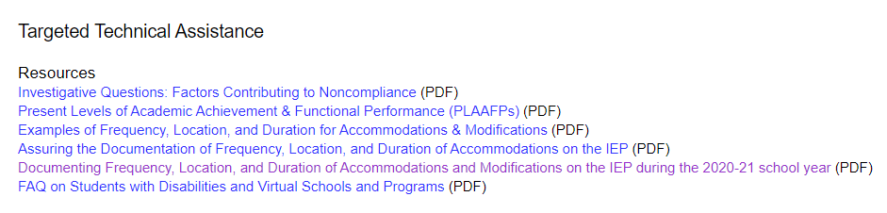
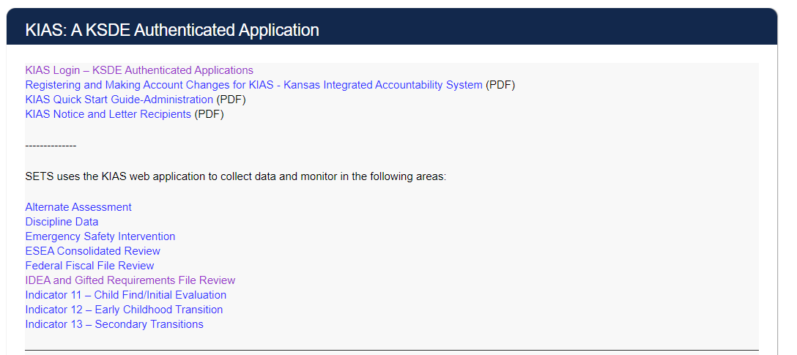

KSDE KIAS Webpage
Notes:
Josie
Top half of the web page includes information on KIAS as a monitoring system, including Targeted TA
Bottom half of the web page includes information on KIAS the authenticated application, including IDEA & Gifted File review

Slide 154
KIAS flags/alerts
Looks at data with a School Year equal to the ‘End Year’ (e.g. if the current Monitoring dates are 2023 – 2024, then the ‘End Year’ used would be 2023).
RSL not English: Student’s First Language (KIDS record type ENRL, EOYA or TEST) is not English
RPL not English: In SpedPro system, on the Student Form page it uses the information in the “Language : Parent” field.
ELL: Information in the Record Common table of the Student ODS System (KIDS record types AGST, ENRL, TEST, EOYA, EXIT, SPED has a value is a 1, 2 or 3)
HI/DB: If the primary disability in SpedPro for this student’s Primary Exceptionality is either “Hearing Impaired” or “Deafblind”
Non-white race: Student is not white. It gets this information by locating the student in SpedPro and then matching up with the student’s record in KIDS by the KIDS ID.
Notes:
Josie
KIAS uses Student Pull Logic data from KIDS or SPEDPro . Districts will notice that students in these categories will be pulled.
RSL – reported student language
RPL – reported parent language

Slide 155

Additional Resources
IDEA & GIFTED FILE REVIEW TOOL KIT
Evaluation/Eligibility Report Checklist (PDF)
EVALUATION AND ELIGIBILITY FOR ENGLISH LEARNERS' HANDOUT
WHAT RESEARCH SAYS ABOUT IDENTIFICATION AND ASSESSMENT OF ENGLISH LEARNERS WITH DISABILITIES
EVALUATION AND ELIGIBILITY FOR ENGLISH LEARNERS’ PRESENTATION
IDEA & Gifted File Review Continuous Improvement Monitoring Consideration Chart
IDEA and Gifted Requirements Self-Assessment (PDF)
FAQ for IDEA and Gifted Requirements Self-Assessment (PDF)
Language USA (translating documents in other languages)
Notes:
Josie

Slide 156
Technical Assistance Team (TAT)
Resource for LEAs in areas such as early childhood, secondary transition, fiscal, file reviews, correction of noncompliance process, significant disproportionality
Team members are retired Kansas special education professionals.
Request assistance by contacting Doug Tressler at dtressler@keystonelearning.org or through TASN at www.ksdetasn.org
Notes:
Josie

Slide 157

Technical Assistance System Network (TASN)
Notes:
Josie

Slide 158
Contact Information
  Cary Rogers
  Education Program Consultant
  Special Education & Title Services
  (785) 296-0916
  crogers@ksde.org
Josie McClendon
Education Program Consultant
Special Education & Title Services
(785) 296-5608
jmcclendon@ksde.org
Dr. Crista Grimwood
Education Program Consultant
Special Education & Title Services
(785) 296-7262
cgrimwood@ksde.org
filereview@ksde.org
Notes:
Josie
Individual contact information for co-leads, or contact us all at filereview@ksde.org

