Slide 1
Kansas Student Data Privacy
Current Privacy Legislation
KSDE Policy and Practice
April 17, 2015

Slide 2

Kansas Data Privacy Legislation
KS Student Data Privacy Act
  In effect as of July 1, 2014
SDPA Legislation Highlights:
  Provides restrictions for disclosing student data
    Applies to education entities (both school districts and KSDE)
    Applies to all student data collected by KSDE

Slide 3

Kansas Data Privacy Legislation
  Disclosure of student data is allowed
    to the student and the student’s parents.
    to anyone when an adult student / parent consents in writing.
    to authorized personnel of school districts, KSDE, and KBOR as required to perform assigned duties.
    to authorized personnel of any state agency or to service providers (contractors) working for state agencies or school districts (REQUIRES Data Sharing Agreements) specifically for instruction, assessment, or longitudinal reporting.
    Comply with subpoena or court order and to public health officials in compliance with health statutes.
    To enhancement vendors providing photography services, class ring services, yearbook publishing services, memorabilia services, or similar services.

Slide 4

Kansas Data Privacy Legislation
  Grants enforcement authority to the KS Attorney
  General or any District Attorney.
  Requires notification to affected party of unauthorized disclosure.
  Requires Kansas education boards to adopt a policy in accordance with SDPA in addition to applicable federal laws and regulations.
  Note: Disclosure and management of student data must follow both FERPA and SDPA guidelines.

Slide 5
Kansas Data Privacy Legislation
KSDE shall annually publish on its website the categories of student data that are submitted to and maintained in any statewide longitudinal student data system. Publications required by this section shall be published with an easily identifiable link located on the department's website homepage.
Annual report to governor and legislature. On or before May 15, 2015, and each year thereafter, the state board shall submit to the governor and the legislature a written report. The report shall include, but not be limited to the following information:
  (a) Any categories of student data collected for the statewide longitudinal student data system that are not otherwise described as student data under K.S.A. 2014 Supp. 72-6216, and amendments thereto;
  (b) any changes to existing data collections, which includes changes to federal reporting requirements by the secretary of the United States department of education;
  (c) an explanation of any exceptions provided by the state board in the preceding calendar year regarding the release or transfer of student data; and
  (d) the scope and nature of any privacy or security audits completed in the preceding calendar year.

Slide 6

KSDE Data Policy and Practice
KSDE Data Privacy Compliance
Transparency
Security Policies
Technical Architecture
Data Governance
Training
Resources

Slide 7
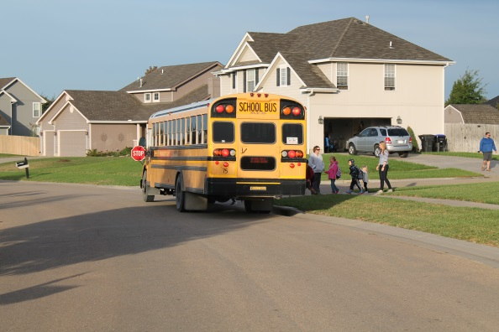
KSDE Data Policy and Practice
Transparency
KSDE publishes data collection information publicly
Reasons for collection include:
Public, State and federal reporting
Calculations for state funding
Administering state assessments
School accountability
Early childhood school readiness
To monitor and to improve programs and inform instruction
Program Participation
  Free/Reduced Lunch, Virtual Education, Child of Military Family
  Special Ed: Primary Disability / Gifted / accommodations
  English for Speakers of Other Languages (ESOL)
  Course Outcomes
  Course Identifier, Completion status /Educator ID
  Letter/Percent/Pass-Fail

Slide 8

KSDE Data Policy and Practice
2.) Security Policies
State of Kansas IT Security Policies
  Information Technology Executive Counsel 7230A
Family Educational Rights and Privacy Act (FERPA)
Data Sharing agreements
  Ex: KS Board of Regents, Department of Children and Families, Department of Health and Environment
  Department of Agriculture, National Student Clearinghouse
KSDE Security Policies
  Incorporates State and Federal requirements

Slide 9

KSDE Data Policy and Practice
3.) Technical Architecture
Security based network design
Enterprise Class Technologies
Industry Recognized Best Practices
Device and Student Data Encryption
AAA (Authentication, Authorization and Accounting)
(COOP) Continuity of Operations Planning
External Auditing

Slide 10
KSDE Data Policy and Practice
4.) Data Governance
KSDE has a mature Data Governance program, began in 2008
Model data governance program for the National Education Community
Data Governance Program Overview:
  Formal structure for decision making and authority for data related matters
  Establishes roles and responsibilities concerning data
  Ensures compliance, security and ethical standards for data use
Data Compliance Officer
  KSDE recently reallocated an existing FTE to create this position

Slide 11
KSDE Data Policy and Practice
5.) Training
KSDE Data Quality Certification Program
  School District focused instruction on general data quality practices, including an overview of the Student Data Privacy Act and FERPA, as well as intensive role-based training with the KSDE web-based applications, including the Kansas Individual Data on Students (KIDS) system.
KSDE Security Awareness Metric (SAM)
    KSDE employees and contractors are required to complete the Security Awareness Metric (SAM) within the first two days of employment.
    Results reviewed and tracked by agency IT Security staff.
Security Awareness and Data Security Training
  All KSDE staff are required to attend these updated sessions annually.
    These requirements are reported and tracked by agency IT Security staff.

Slide 12
KSDE Data Policy and Practice
6.) Resources and awareness
KSDE Public Website www.ksde.org
  Information on data collection and security
  Applicable laws and regulations
  State of Kansas Specific Policies
  Student Data Privacy Resources
  Training information

Slide 13
Questions?
Contact
Lane Wiley
KSDE Director of Information Technology
785-296-7931

