Slide 1
Kansas Leads the World in the Success of Each Student.

Slide 2

Creating a Vision for Kansas
“We choose to go to the moon in this decade and do the other things, not because they are easy, but because they are hard, because that goal will serve to organize and measure the best of our energies and skills, because that challenge is one that we are willing to accept, one we are unwilling to postpone, and one which we intend to win.”
- John F. Kennedy

Slide 3
Student Success
Kansas needs 71% of workers to have a post secondary certificate or degree.
Approximately 36% need to be bachelor degrees or higher
Approximately 35% need to have a certificate or associate degree

Slide 4
Postsecondary Evidence

Slide 5


















KANSAS CHILDREN KANSAS’ FUTURE Tour
Community Conversation
Business and Industry
Notes:
20 Community Conversation focus groups held throughout Kansas
7 Chambers of Commerce focus groups held
Total participation was nearly 2,000 Kansans

Slide 6
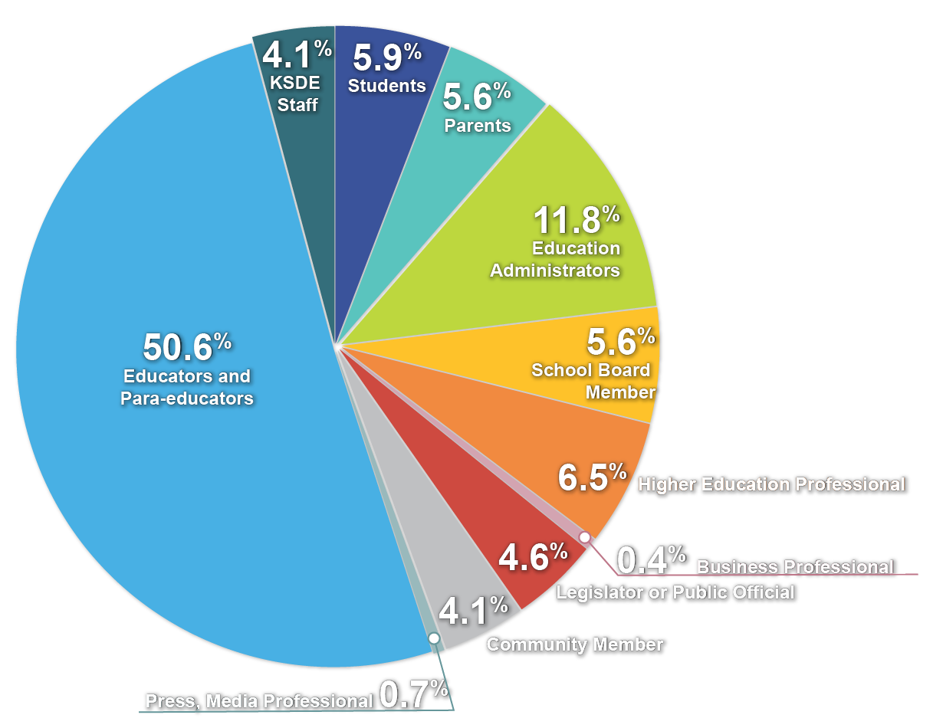
Respondents’ Occupational Roles
Role | #
● Students | 99
● Parents | 95
● Education Administrators | 199
● School Board Members | 95
● Higher Education Professional | 110
● Business Professional | 7
● Legislator or Public Official | 77
● Community Member | 69
● Press, Media Professional | 12
● Educators and Para-educators | 852
● KSDE Staff | 69
Notes:
This graph represents the individuals who attended the original 20 community conversation focus groups. You can see that we did not receive a strong representation from the business community, which prompted Commissioner Watson to go back out and host chamber of commerce focus groups in the seven areas.

Slide 7
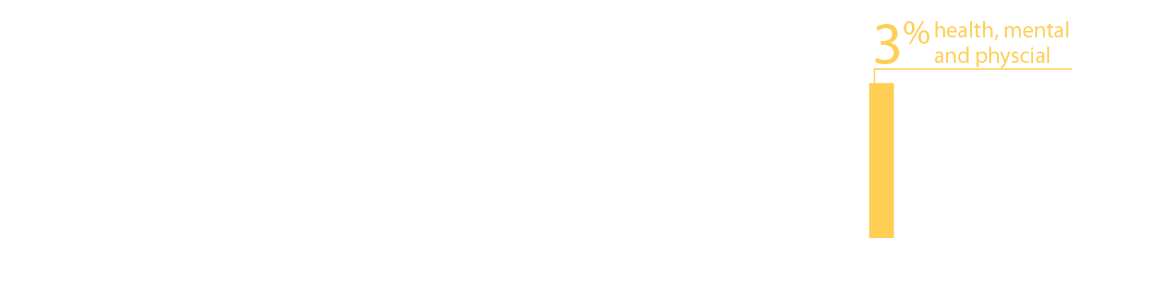
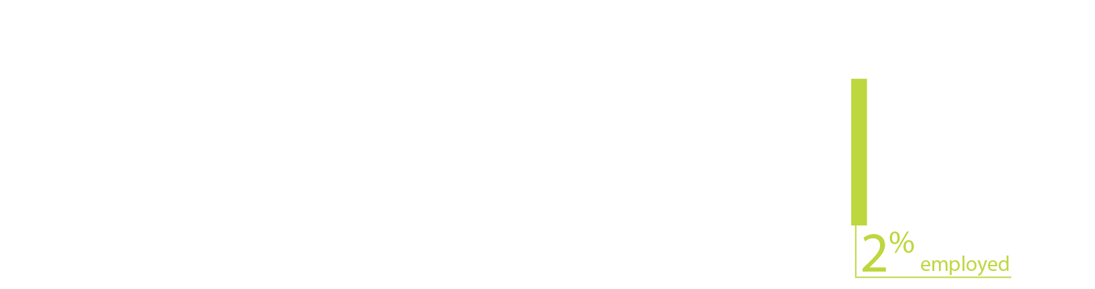
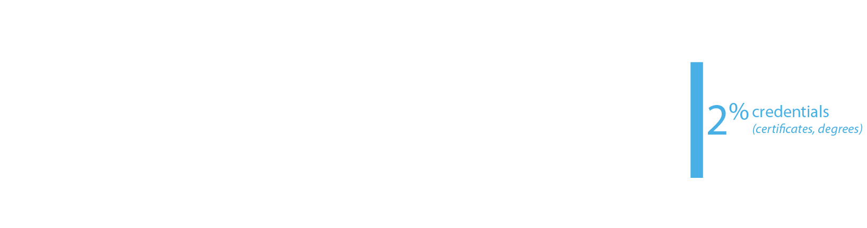
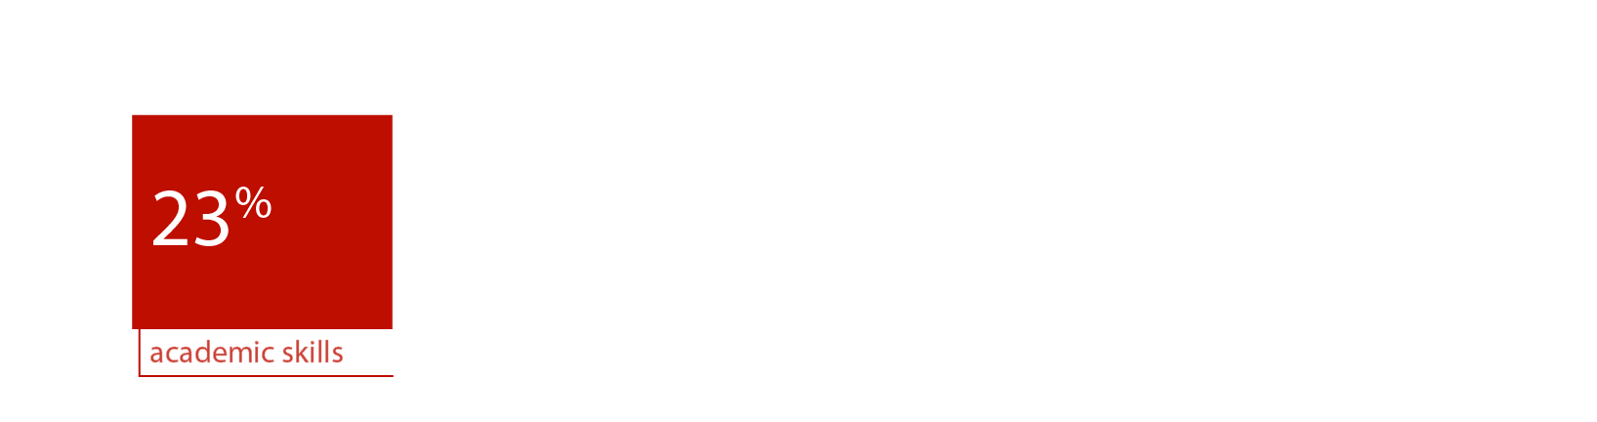

From the first set of focus group responses, what characteristics of success were most frequently cited?
Notes:
This result is a little surprising since about 66% of the respondents were educators, education administrators, or former educators—people who mostly teach, or used to teach, academic skills. Nevertheless, the soft skills—social-emotional, personality skills, or 21st century skills—they have lots of names—were cited 70% of the time.

Slide 8
BUSINESS AND INDUSTRY
Focus Groups by Organizational Size (number of employees)
# of employees | # of businesses at this level | %
0 | 2 | 1.8
1 - 10 | 28 | 25.2
11 - 50 | 28 | 25.2
51 - 100 | 8 | 7.2
101 - 150 | 6 | 5.4
151 - 200 | 6 | 5.4
201 - 500 | 14 | 12.6
> 500 | 19 | 17.1
Notes:
We had a fairly good representation from all sizes of business/industry attend the chamber sessions.

Slide 9
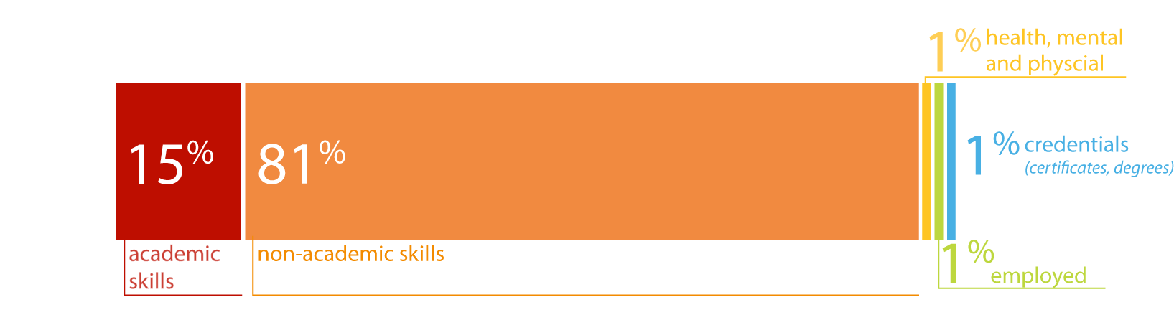
The business and industry focal groups cited non-academic skills with greater frequency than the community groups:
Notes:
Recall that the community groups cited non-academic skills 70% of the time and academic skills 23% of the time. These frequencies are remarkably similar to those expressed by the community groups. If volume can be equated with importance, the business and industry groups are saying that the non-academic characteristics are more important than academic skills, including applied skills, and that non-academic skills are at least as important to them as to the community groups, maybe more so.
One cited experience as a characteristic of the ideally prepared 24 year old (the tiny yellow line).

Slide 10
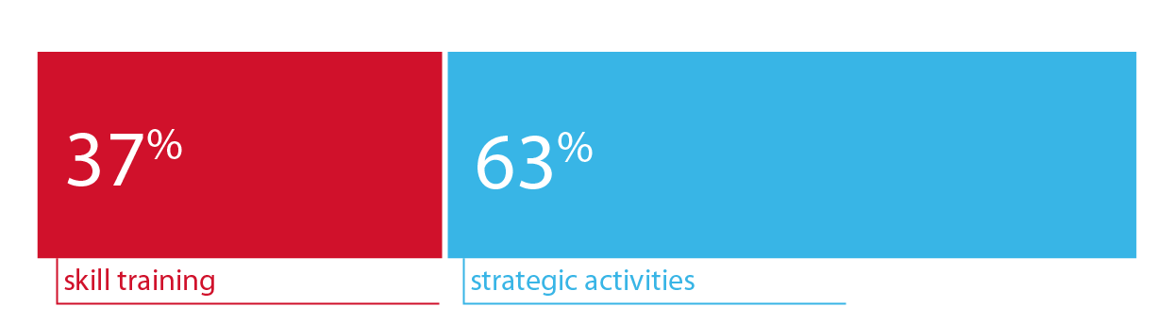
What is the role of K-12 education in achieving this future?
Notes:
The responses fit into two broad themes:
Skill training includes all skills – the direct training of skills --- academic, applied or job skills and non-academic, social-emotional skills -- that respondents say schools should be cultivating.
strategic activities: defined as “all the activities suggested as steps, building blocks or scaffolding to support the characteristics, abilities, and skills being cultivated in the students (family engagement, community collaboration, specialized staffing and training, particular curriculum design, etc.)”

Slide 11








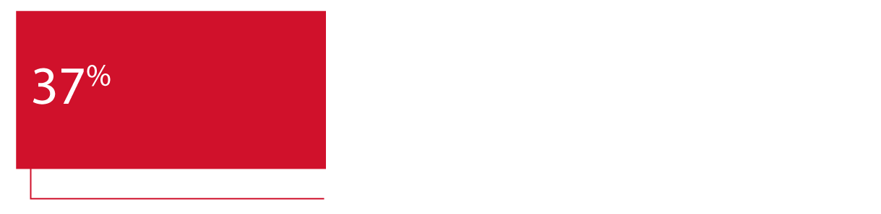



What themes made up the strategic activities?
human capital
Less frequently cited strategies:
Family engagement items complemented the career planning items, but the partnership between schools and families started early—birth through preK in some items. Some advocate joint planning for the child’s future, and others, opportunities for family participation and family education.
School climate activities were diverse and sometimes conflicting. Some advocate creating an environment of high expectations, while others recommend realistic expectations, or a positive supportive culture.
Career planning items called for individual goals and planning, of classes, pathways, further education, transitions, and careers. Some items included the family in the planning. When career planning should begin—middle school? 8th grade?--wasn’t clear.
teaching techniques
Project-based learning items emphasize the learning and demonstration of applied skills, sometimes in contrast to standardized curricula and assessments. Some suggest projects as part of community service, a qualification for graduation, or a better way to teach or measure personality skills.
Community collaboration items emphasized mutual obligations between students and the community and better social networking.
Some advocate student community service, sometimes as a requirement; others, partnerships with local businesses and social agencies, especially early childhood agencies.
Individualized instruction and experience varied in intensity, from career interest diagnostics to universally required individual plans that the student must personally defend. The timing varied from beginning in Kindergarten, to middle school, to 8th grade.
Real-world instruction items advocate for concrete, real-life, relevant problems to solve, sometimes including their social dimensions. Some suggest integrating academics with applied skills, to improve motivation. Timing? As early as preK.
Early childhood strategies include strengthening the foundations of language and social skills at this sensitive stage, and the early establishment of parental collaboration.
accountability
extracurricular activities
college collaboration
funding
prevention
Notes:
About the less frequently cited strategies:
Teaching techniques as strategies included integrated, collaborative teaching; teacher as facilitator; engaging students; teaching teachers how to teach soft skills, among others.
Investments in human capital suggested increasing the number of counselors (which fits with the suggestion for more individual career planning), and more professional development for elementary math teachers.
The more striking suggestions in the accountability recommendations included more autonomy for teachers, aiming to meet the Rose Standards, linking drivers’ licenses to graduation, and allowing for greater individual differences in student development.
College collaboration and extracurricular activities were relatively few, which is surprising with the larger initiatives to prepare students to be college and career ready, and the ideal of teaching more social-emotional skills.

Slide 12
Creating a Vision for Kansas
Student Achievement does not always equate to Student SUCCESS!
Notes:
Academics alone do not guarantee a student’s success after high school. Students who lack conscientiousness, perseverance, the ability to communicate effectively –these nonacademic skills we’ve been talking about – may find it more difficult to succeed in post-secondary education and the workforce.

Slide 13
A few take-home lessons
What is the role of K-12 education in achieving the future?
Re-designing the curriculum
New roles are suggested for school counselors
More integrated coordination with businesses and community organizations
Notes:
There is a suggestion of a structure of social opportunities—opportunities for experience, particularly real-world experiences—that students need to practice applied skills, both practical and social.
1. Re-designing the curriculum - around individualized goals, planning, instruction, and experience, around incorporating real-life problems and projects into the curriculum, and experiential learning is heavily suggested.
2. New roles are suggested for school counselors - in deeper individual career planning, and perhaps in coordinating internships and work experiences with business and community organizations.
3. The large proportion of instrumental skill training that included some experiential training, (e.g. internships; concrete, realistic practice, job shadowing, etc.) suggests much more integrated coordination with businesses and community organizations.

Slide 14
What are community focus groups saying about measures?
How should K-12 measure indicators towards success?
Non-cognitive, social-emotional measures, like conscientiousness and school climate, are important, but how they can be measured isn’t clear.
Project and task performance, individual planning, curriculum designed for realistic experiences, internships and work experiences are more important measures than traditional assessments.
Post high-school measures: Credentials, employment, well-being are also important measures of K-12 success.
Notes:
Feedback from the community focus groups suggest that schools will need to find ways to measure non-cognitive skills such as conscientiousness and school climate, but how we do this needs to be determined.
Focus groups also suggested that less emphasis should be placed on traditional assessment measures, focusing instead on project and task performance, designing curriculum to include providing realistic experiences, internships, etc.
Finally, community members said they want us to be able to develop post – high school measures such as how many students graduated with credentials, the number of graduates employed.

Slide 15
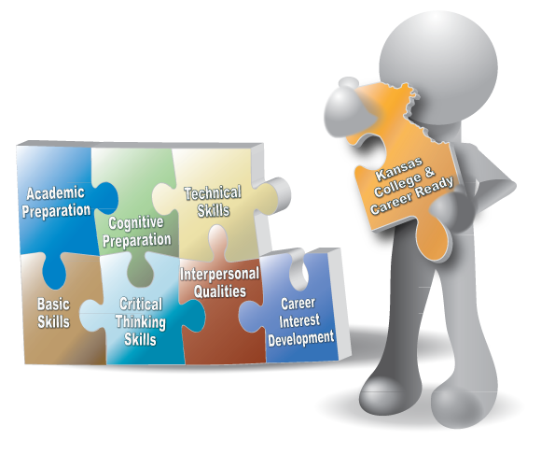

Kansas College and Career Ready
An individual has the
academic preparation,
cognitive preparation,
technical skills, and
employability skills
to be successful in postsecondary education, in the attainment of an industry recognized certification or in the workforce, without the need for remediation.
Notes:
The Kansas State Board of Education currently defines College and Career Ready to mean than an individual has the academic preparation, cognitive preparation, technical skills and employability skills to be successful in post-secondary education, in the attainment of an industry recognized certification or in the workforce, without the need for remediation.
Based on feedback from the Community Conversations, the board plans to revise the definition to include “Citizenship and Civic Readiness.”

Slide 16

A NEW Vision for Kansas….
Kansas leads the world in the success of each student..
Notes:
Based on the feedback received across the state, the board has adopted as its new vision for education “Kansas leads the world in the success of each student.”
We intend to challenge the status quo, move away from placing emphasis on a single test score and focus more on helping each student identify and achieve their career aspirations.
Teachers, administrators and support staff already are doing great work preparing Kansas’ students for success, and this new vision stands to unite our efforts across the state. You will hear us say we need to rethink how our schools are asked to operate. From a state perspective, we will look at every requirement to determine if and how we are supporting or impeding our schools’ abilities to address the needs of each child.

Slide 17
Creating a Vision for Kansas
State Level Outcomes will drive our Vision!
  High School Graduation Rates
  Post Secondary Completion/Attendance
  Remedial Rate of Students Attending Post-Secondary
  Kindergarten Readiness
  Individual Plan of Study Focused on Career Interest
  Social/Emotional Growth Measured Locally
Notes:
Among the outcomes being considered by the state board are:
High School Graduation Rates
Post Secondary Completion/Attendance
Remedial Rate of Students Attending Post-Secondary
Kindergarten Readiness
Individual Plan of Study Focused on Career Interest
Social/Emotional Growth Measured Locally
Education Commissioner Randy Watson and members of the State Board of Education will meet with business, education and state leaders to build agreement on how we will work together to achieve this vision for Kansas education.
Kansas schools are already doing tremendous work to address the needs of individual students, but in order to achieve this new vision we cannot expect schools to go it alone. This requires a unified effort with businesses, communities, parents, higher education, and elected officials working with educators to help provide the supports and experiences Kansas students need for their future success.

Slide 18


Slide 19

Notes:
Today’s students are the future workforce and future leaders of Kansas. Kansans Can achieve anything and, together, Kansans Can lead the world in the success of each student.

