Slide 1
Redesign Plan Year
Leadership & Culture Slides

Slide 2
Competency 6
A successful Redesign school can…
Develop and grow a collaborative learning culture through shared leadership

Slide 3
Mission Inception
Leadership Competencies

Slide 4
Conditions for a Learning Culture
Sh
Principals
Model Learning Leadership
Motivate Teachers
Support Inquiry, Innovation, and Exploration
Shared Leadership
Shared Leadership
-Shared Vision
-Psychological Safety
-Communication & Feedback
-Growth Mindset
Teachers
Collective Efficacy
Change Agents
Collegial Collaboration and Practices
Additional Stakeholders
Input in Goals and Strategies
Communicate about and Invest in the Work
Shared Leadership

Slide 5
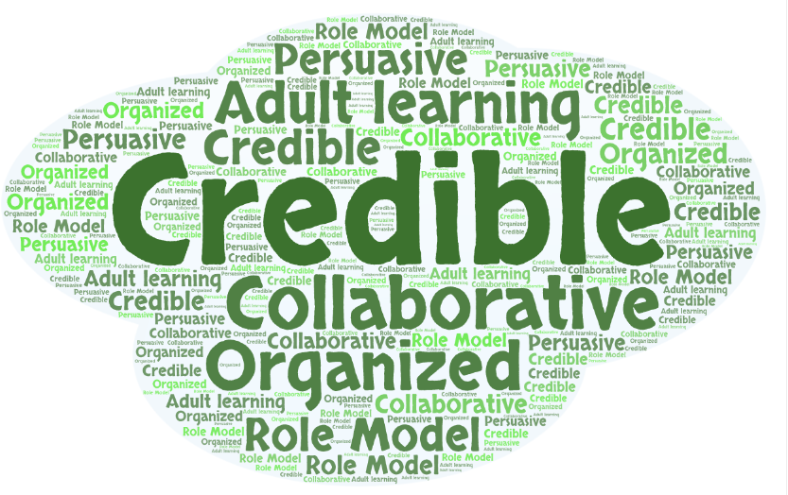
Qualities for Pilots/Co-Pilots
Notes:
● Have the capacity to persuade others
● Enjoy informal position and status
● Actively engage others in discussions
● Have credibility
● Earn and maintain status
● Are role models
● Are technical experts
● Are power people
● Can be cheerleaders
● Are the celebrities of the staff

Slide 6
The Role of the Principal
Participate in professional learning to grow your practice
Actively participate in regional training
Facilitate or create the conditions for group learning
Conditions to turnkey regional training content
Coach those you lead
Provide opportunities for staff to participate in decision making
Provide opportunities for students to participate in decision making
Give staff responsibility to lead activities projects
Ensure all actions are consistent with the school’s vision, mission, and values
Anticipate and address barriers and challenges
Notes:
Ideas came from the School Culture Survey, specifically, the ‘Modeling Learning Leadership’ construct

Slide 7
Leadership Competencies

Slide 8
Collective Efficacy- What & How?
→ Collective efficacy is the belief that you, and your team, have the ability and authority to make a difference and/or have an impact. Staff believe that they can produce meaningful learning experiences for students and that they can repair gaps in student learning. The belief in your own, or your groups’, potential.
Donahoo & Katz (2019)
Notes:
Donohoo, Jenni, and Steven Katz. “What Drives Collective Efficacy?” What Drives Collective Efficacy? - Educational Leadership, ASCD, July 2019, www.ascd.org/publications/educational-leadership/jul19/vol76/num09/What-Drives-Collective-Efficacy%C2%A2.aspx.
Elmore, D. R. F., Forman, M. L., & Stosich, E. L. (2010). Internal Coherence Survey. 7.
Kools, M., Stoll, L., George, B., Steijn, B., Bekkers, V., & Gouëdard, P. (2020). The school as a learning organisation: The concept and its measurement. European Journal of Education, 55(1), 24–42. https://doi.org/10.1111/ejed.12383

Slide 9
Evaluate Collective Efficacy
Are teachers…
Confident in their ability to motivate their students?
Skilled at producing meaningful student learning experiences?
Skilled in various methods of teaching?
Tenacious in that if a child doesn’t learn something new the first time, they will try another way?
Firm in the belief that every child can learn?
Confident to explore new instructional approaches to help underperforming students meet standards?

Slide 10
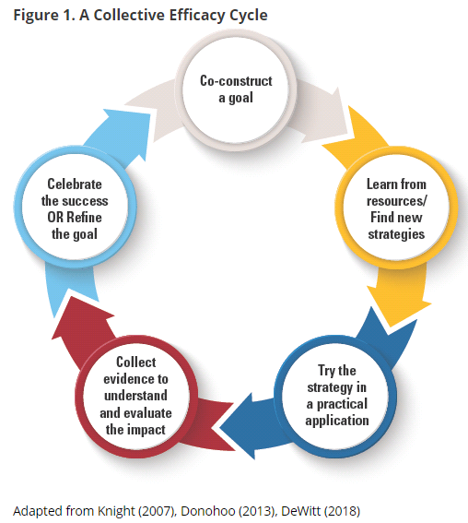
Grow Collective Efficacy
Notes:
The graphic on the left walks through the steps necessary for growing collective efficacy in your organization. In order to grow and build collective efficacy, you must allow all staff an opportunity to co-construct the goal; learn from resources and investigate strategies; staff must have a chance to ‘try a strategy on’ while collecting evidence to understand impact; and lastly, staff must have a collective opportunity to celebrate and reflect.
Donohoo, Jenni, and Steven Katz. “What Drives Collective Efficacy?” What Drives Collective Efficacy? - Educational Leadership, ASCD, July 2019, www.ascd.org/publications/educational-leadership/jul19/vol76/num09/What-Drives-Collective-Efficacy%C2%A2.aspx.

Slide 11
Grow Collective Efficacy
How are you intentionally developing the four ways teachers gain power and confidence to make a difference?
Learning together - Interdependence
Cause-and effect relationships - Deep reflection on what causes results and improving those causes (strategies)
Goal-directed behavior - Focus on mastery of teaching skills to improve their practice
Purposeful practice with feedback from a variety of sources (peer, credible expert, instructional coach - even students)
Donahoo and Katz July 2019
Notes:
http://www.ascd.org/publications/educational-leadership/jul19/vol76/num09/What-Drives-Collective-Efficacy%C2%A2.aspx

Slide 12
Building the Launchpad
Leadership & Culture

Slide 13
Shared Vision
→ A ‘Shared Vision’ is a student-focused statement that is crafted with stakeholder feedback and centers around the premise that all students are capable of learning and achieving success.
Notes:
How might a ‘Shared Vision’ improve a building’s culture?

Slide 14
Evaluate Your Vision:
Is your school’s vision…
Future-focused?
Centered on cognitive and social-emotional outcomes?
Inclusive of all students?
Was it created…
With student input?
With family input?
With school staff input?
With community/business input?
This can be used to shore up a vision you already have and want to keep using, or it can be used to make sure your new vision is strong.

Slide 15
Evaluate Your Vision:
Is your school vision…
Prominently displayed?
Communicated to all stakeholders?
Reviewed frequently and revisited annually?
Does your vision guide decisions on...
Learning activities?
Teaching practices?
Family/business/community engagement?
Professional learning?
This can be used to shore up a vision you already have and want to keep using, or it can be used to make sure your new vision is strong.

Slide 16
Grow Using Your Vision:
How might you...
Strengthen your school’s vision so that all stakeholders believe in it?
Ensure that your school’s vision is also the vision of administration and the local school board?

Slide 17
Additional Resources
See ‘Playbook for Redesigning Schools for the 21st Century’ (Cross & Martinez, 2016)
Chapter 2- Creating a Shared Vision (pgs 13-28)
See slides from Redesign Plan Year Regional Training over creating a ‘Collective Why’ and ‘Shared Vision’

Slide 18
Leadership Focus- Principal
Give staff responsibility to lead activities/projects
Facilitate or create the conditions for group learning
Co-create an agenda with the School Redesign Team and have members take the lead.
Coach teacher leaders through the challenges of leading their colleagues.
Plan, Review, and Reflect with teachers on their leadership within activities/projects.
Anticipate and address barriers to group learning.
Intervene skillfully when the conversation ‘heats up’.
Create time and space in the weekly schedule for teachers to learn together about Redesign.

Slide 19
Leadership Focus- Teachers
Understand adult learning
Create an environment of Inquiry, Innovation, and Exploration
Set clear goals
Revisit your ‘Why’
Review information regularly
Utilize training experiences to facilitate interactive learning
Encourage experimentation and innovation
Encourage staff to take initiative
Provide time for problem solving before taking action
Engage in inquiry
Be open to doing things differently
Openly discuss failures as an opportunity for growth
Notes:
Topics came from our Leadership Competencies- https://www.ksde.org/Portals/0/Communications/KC_School_Redesign/Fact%20Sheet%20KCSRP%20How%20do%20Leadership%20Roles%20of%20Redesign%20Fit%20Together.pdf?ver=2020-09-30-132651-717
https://www.wgu.edu/blog/adult-learning-theories-principles2004.html
http://www.ascd.org/publications/educational-leadership/apr15/vol72/num07/The-Juggler's-Guide-to-Collegiality.aspx

Slide 20
Designing the Rocket
Leadership, GAITs, and Culture

Slide 21
Leadership Focus- Principals
Ensure all actions are consistent with the school’s vision, mission, and values
Anticipate and address barriers and challenges
Begin using the Redesign Workbook to align your school’s vision, goals, and strategies with system expectations and State Board Outcomes.
Coach staff in prioritizing strategies that will leverage your goals and vision.
Serve as a conduit for communication between your teacher teams and your system leaders.
Evaluate resource implications for strategies so that implementation barriers can be addressed early.

Slide 22
Leadership Focus- Teachers
Psychological Safety- Relational Trust
Psychological Safety- Risk Taking
Benevolence- giving back to one another
Openness- sharing professional ideas
Honesty- telling the truth; refusing to spread untruths
Competence- collaborate to improve instructional practices
(Kaplan & Owings , 2013)
Utilize the mindset ‘safe enough to try’
Utilize the mindset of ‘failing forward’
Provide clarity around project ownership and responsibilities
Distribute authority to those closest to the decision
(Kim & Gonzalez-Black, 2016)

Slide 23
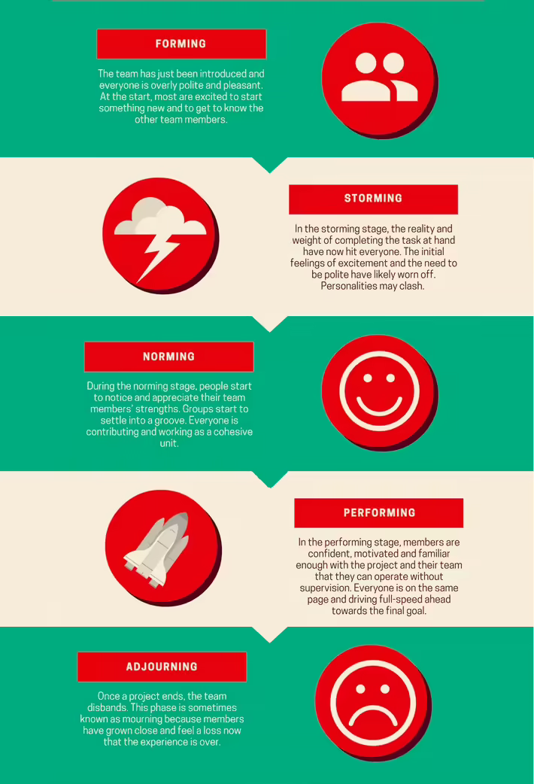
Team Development
As you form up your Goal Area Investigation Teams, be aware of the 5 phases every team works through:
Forming
Storming
Norming
Performing
Adjourning
Utilize Chapter 6 of ‘Playbook for Redesigning Schools for the 21st Century’ to learn how to evaluate your team and how to grow from a group to a team.
Notes:
Tuckman’s 5 stages of team development.
https://toggl.com/track/stages-of-team-development/#:~:text=In%201965%2C%20a%20psychologist%20named,have%20a%20knack%20for%20rhyming.

Slide 24
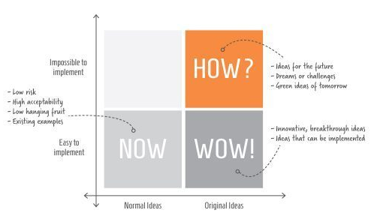
Grow Inquiry, Innovation and Exploration
Determine where your innovations fit on this matrix by completing this by Evaluating your current strategies using these slides from the Redesign Plan Year Regional Training materials (credit: ESSDACK).

Slide 25
Building the Rocket
Addressing Technical & Adaptive Challenges

Slide 26
Leadership Focus- Principals
Coach those you lead: Give Constructive Feedback
Maintain Accountability Meetings
Focus on the needs of the receiver
Be specific with descriptive facts
Tough on the performance (data)
Focus on the future and suggest positive alternatives
(McBride, 2019)
Ensure staff have time to hold weekly accountability meetings within their Goal Area Investigation Teams.
Provide technical support to teams when called upon.
Assist in facilitating tough conversations.
Notes:
KLC Guidebook, by Julia Fabris McBride, Kansas Leadership Center, 2020
Criticism:
A way of unloading anger or disappointment
Focused on the needs of the giver
Angry, dismissive, emotional
Ignore positive
Tough on the person
Vague, generalized, evaluative
Attributes opinions to others
Looks backward; laments missed opportunities
One-way pronouncements

Slide 27
Leadership Focus- Teachers
Giving and Receiving Constructive Feedback
Analyzing Data in Objective Conversations
Focus on the needs of the receiver
Be specific with descriptive facts
Tough on the performance (data)
Focus on the future and suggest positive alternatives
(McBride, 2019)
Focus on the facts and not the feelings
Establish and stick to conversation outcomes
Ex- Strategies are evaluated to determine if they should be continued, revised, or stopped.
Notes:
KLC Guidebook, by Julia Fabris McBride, Kansas Leadership Center, 2020
Criticism:
A way of unloading anger or disappointment
Focused on the needs of the giver
Angry, dismissive, emotional
Ignore positive
Tough on the person
Vague, generalized, evaluative
Attributes opinions to others
Looks backward; laments missed opportunities
One-way pronouncements

Slide 28
Grow Collective Efficacy
(Liang, Mitchell, & Scott, 2020)
Notes:
The graphic on the left walks through the steps necessary for growing collective efficacy in your organization. In order to grow and build collective efficacy, you must allow all staff an opportunity to co-construct the goal; learn from resources and investigate strategies; staff must have a chance to ‘try a strategy on’ while collecting evidence to understand impact; and lastly, staff must have a collective opportunity to celebrate and reflect.
If you compare that to the process used in Redesign of design thinking and the four disciplines of execution, you see that there is quite a significant alignment between them. In redesign, you use design thinking and 4dx to empathize with students and define your wildly important goals. You ideate and investigate strategies that become your lead measures. Your build prototypes the you test in small groups and while doing so, you create data scoreboards and you hold accountability meetings where ‘pivots’ or ‘adjustments’ are determined. And at the end of your test window, you reflect, celebrate and create a plan for scale or revise and begin again.
To put it simply, using the redesign process with fidelity and integrity will allow you to grow teacher collective efficacy. Let’s move on to learn a little bit more!
Donohoo, Jenni, and Steven Katz. “What Drives Collective Efficacy?” What Drives Collective Efficacy? - Educational Leadership, ASCD, July 2019, www.ascd.org/publications/educational-leadership/jul19/vol76/num09/What-Drives-Collective-Efficacy%C2%A2.aspx.
Liang, J. “Grace,” Mitchell, T., & Scott, J. (2020). Statewide School Redesign: Integrating Design Thinking and the Four Disciplines of Execution as a Continuous School Improvement Process. Journal of Case Studies in Educational Leadership, 1(13). Retrieved from https://journals.sagepub.com/doi/10.1177/1555458920975462

Slide 29
Show & Launch

Slide 30
Leadership Focus- Leaders
Evaluate Strategies for Technical & Adaptive Challenges
Provide Opportunities to Share Decision Making
As you prioritize strategies for scale, determine the technical and adaptive considerations and create an action plan for addressing these.
Work with your leadership to align future professional learning with strategies as a way of supporting the technical and adaptive challenges.
Provide teachers and students an opportunity to take part in deciding what’s next.
Provide external stakeholders an opportunity to take part in deciding what’s next.

Slide 31
Leadership Focus- Teachers
Evaluate Strategies for Technical & Adaptive Challenges
Telling Your Redesign Story
As you prioritize strategies for scale, determine the technical and adaptive considerations and create an action plan for addressing these.
Work with your leadership to align future professional learning with strategies as a way of supporting the technical and adaptive challenges.
Plan, write, and practice telling your Redesign story for multiple audiences.
Gather and share artifacts documenting your process and results.
Be able to share what Redesign means to you.

Slide 32
Prioritizing Strategies
When you complete your initial tests, you will need to prioritize strategies for scaling.
We recommend that you utilize this Strategy Report to assist you in evaluating each strategy to determine which should be prioritized for scale.

